Slide 1
PRESENTATION TO THE SELECT COMMITTEE ON TRADE AND INTERNATIONAL RELATIONS
ON THE ANNUAL REPORT 2016/17
Adv. Rory Voller
CIPC Commissioner
15 November 2017
1

Slide 2
Purpose
To present to the Select Committee on Trade and International Relations, the Companies and Intellectual Property Commission’s (CIPC) 2016 – 17 Annual Report
2

Slide 3
Vision and Mandate
Vision
The vision of CIPC is to be the gateway to sustainable formal economic participation and investment for all in South Africa.
Mandate
The CIPC is a Schedule 3A Public Entity under the PFMA and administers all or parts of pieces of legislation relating to corporate and intellectual property regulation. Its mandate encompasses companies, close corporations, co-operatives, trade marks, patents, designs, aspects of copyright legislation and enforcement of rules and regulations in most of these areas of law. The CIPC's primary institutional mandate is derived from the Companies Act, 2008, which establishes the CIPC as a juristic person.
3

Slide 4
Highlights of 2016/17
One-stop facility: InvestSA
First delinquency order against non-compliance
“Your Business, Our Focus” campaign
Pilot of eXtensible Business Language Reporting (XBRL)
Automation strategy paying off
Multichannel strategy – “Third Party Model”
Elected chair of the technical working committee on Starting a Business
Elected to the Corporate Register’s Forum
Over 370 000 new companies, most ever since establishment in 2011
Automation of name reservation function
4

Slide 5
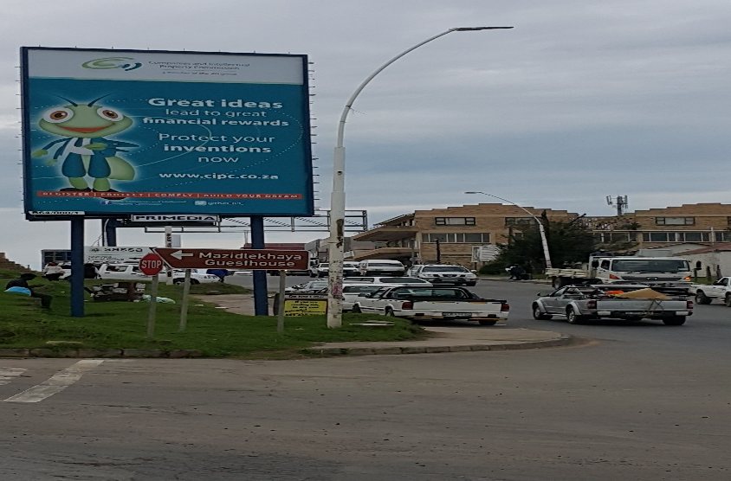
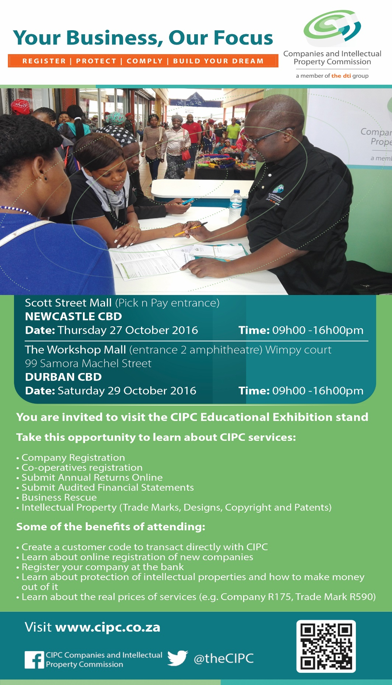
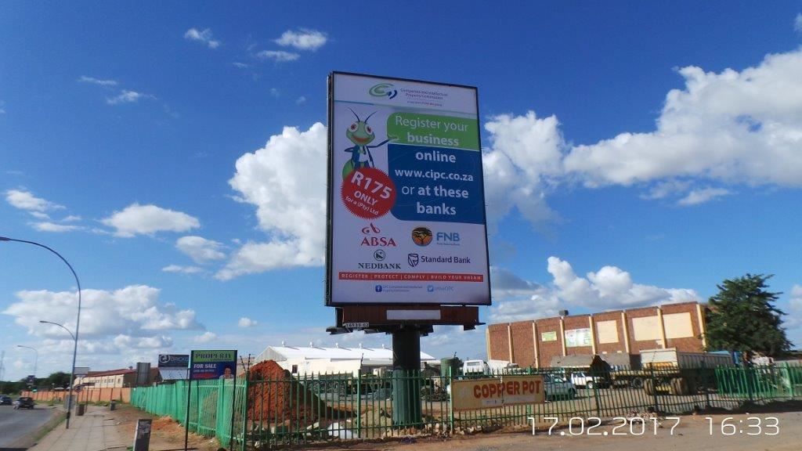
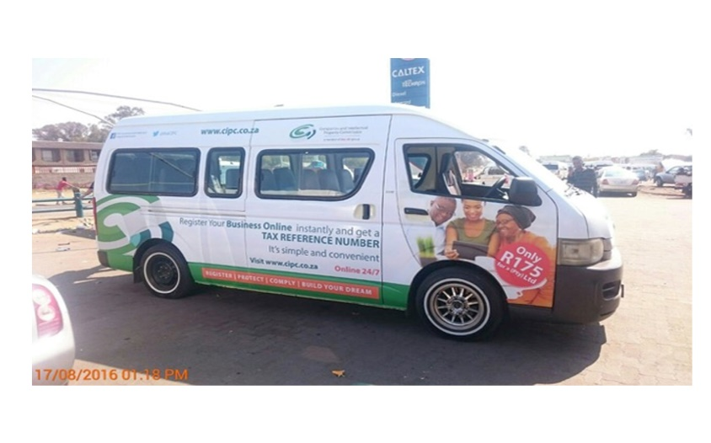
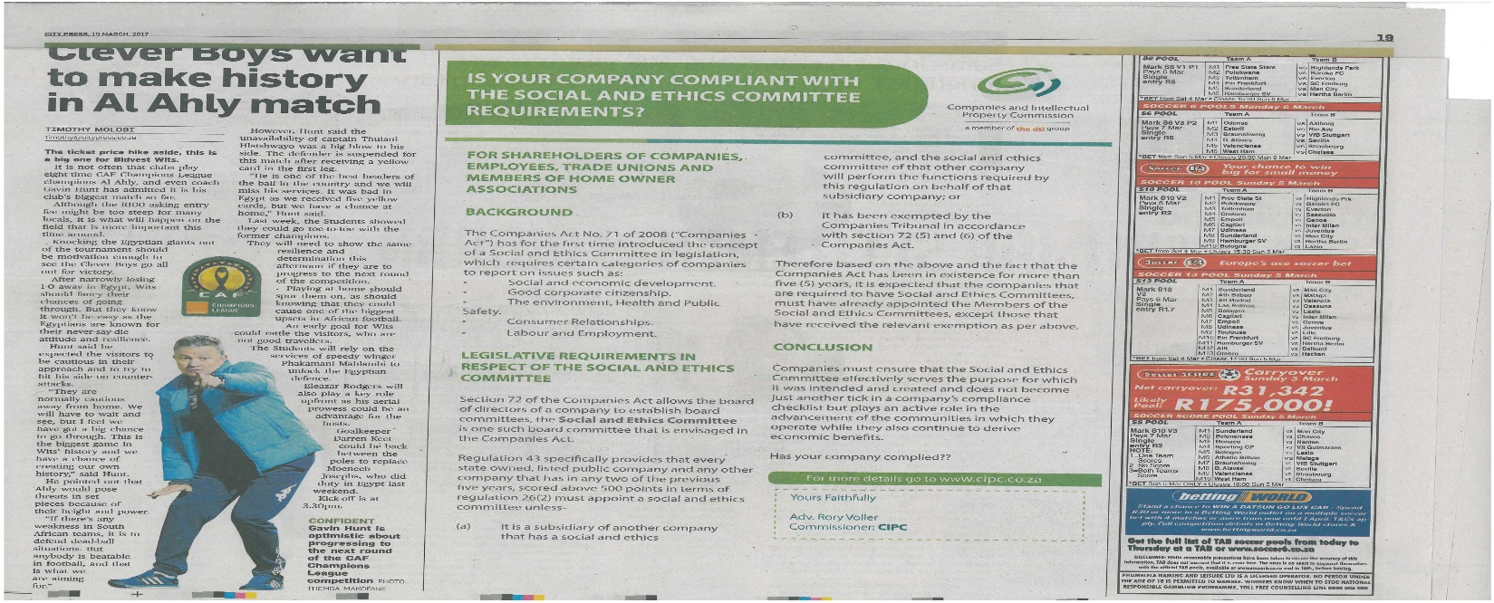
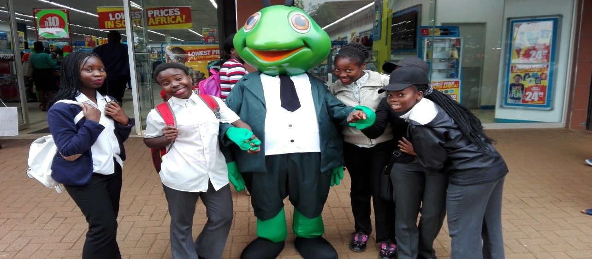
Your business, our focus campaign
5

Slide 6
Highlights of 2016/17
Stabilised labour environment
Improved service delivery standards – maintained or improved in most business areas
Increased uptake of online services both in the Companies and IP environments
Central Suppliers Database: integration with National Treasury
Collaboration with 4 major banks
Further automation of hybrid processes
Patent examiners appointed– substantive patent examination
MoU with the European Patent Organisation (EPO)
More collaborative partners in the EC, NW and FS
6

Slide 7
CIPC Distribution Channels and on-line transactions
Partnerships
CIPC National Footprint
Partnerships with public and private entities to enhancement service access for all customer segments
Gauteng
Mpumalanga
North West Province
FNB Branches
Self-Service Centres
Self-Service Terminals
Third Party Partners
FNB Branches
Self-Service Terminals
Third Party Partners
FNB Branches
Self-Service Terminals
Third Party Partners
Online
Limpopo
Online registration facility assists in improving the turnaround times for service units
Mpumalanga
Limpopo
Northern Cape
North West
Province
Gauteng
FNB Branches
Self-Service Terminals
Third Party Partners
Self-service Centres and Terminal (SST)
FNB Branches
Third Party Partners
Free State
Kwazulu- Natal
SST’s provides impetus on increasing accessibility the SMMEs and customers in general. Customer identification has been further enhanced by this initiative whilst the essence of partnerships in government was taken to a new level.
Northern Cape
Kwazulu Natal
Eastern Cape
FNB Branches
Self-Service Terminals
Third Party Partners
Western Cape
Western Cape
Eastern Cape
FNB Branches
Self-Service Centres
Self-Service Terminals
Third Party Partners
FNB Branches
Third Party Partners
Free State
Third Party Model
FNB Branches
Self-Service Terminals
Third Party Partners
Permits identified CIPC transactions using the DHA biometric authentication
Service | % of online transactions in 2013/2014 | % of online transactions in 2014/2015 | % of online transactions in 2015/2016 | % of online transactions in 2016/2017
Company registrations | 81% | 91% | 95% | 98%
Trade mark applications | 49% | 93% | 95% | 95%
Patent applications | 9% | 48% | 79% | 88%
Design applications | 8% | 28% | 31% | 51%
Copyright in film applications | 14% | 97% | 95% | 84%
7
Notes:
Should we keep LETSEMA on the slide?

Slide 8
Non-financial performance (Performance Information)
Output | Performance Measure or Indicator | Actual Achievement 2015/2016 | Annual Target 2016/2017 | Actual Achievement 2016/2017 | Deviation from planned target to Actual Achievement for 2016/2017 | Comment on deviations
GOAL 1: Improve the competitiveness of the South African business environment
Strategic Objective 1.1 Encourage the formalisation of South African businesses and their identity
Reduction in the average number of days to register a company from the date of receipt of a complete application | The average number of days to register a company from the date of receipt of a complete application | 4 | 3 | 3 | 0 | No deviation
Reduction in the average number of days to register a co-operative from the date of receipt of a complete application | The average of the number of days to register a co-operative from the date of receipt of a complete application | 2 | 2 | 2 | 0 | No deviation
Increased level of education and awareness around important changes in the Co-operative Act, 2013 and its regulations. | Number of workshops conducted by the CIPC on the new Co-operative Act, 2013 and its regulations, highlighting important changes | New indicator | 3 | 3 | 0 | No deviation
8

Slide 9
Non-financial performance (Performance Information)
Strategic Objective 1.2 Encourage the maintenance of high standards of corporate governance, transparency and brand protection
Output | Performance Measure or Indicator | Actual Achievement 2015/2016 | Annual Target 2016/2017 | Actual Achievement 2016/2017 | Deviation from planned target to Actual Achievement for 2016/2017 | Comment on deviations
Companies with an “active business” status that have filed annual returns by the reporting period (year to date) | % of companies (entities with an active business status) that have filed annual returns by the end reporting period (year to date) | 50% | 54% | 48% | 6% | 1. Some of the Companies are survivalist in nature and as such a large number of companies end up being de-registered. Possibly some business do not survive beyond their first year. 2. New registrations only file in the second year in terms of the Companies Act Some of the Challenges they face include: - Access to internet - Limited knowledge of requirements to file. - Electronic contact details incorrect (can’t send reminders)
Increased level of awareness of annual return compliance amongst State Owned Companies (SOCs) | Number of seminars with SOCs on annual return compliance (1 seminar in Cape Town, 1 in Durban and 1 in Gauteng) | New indicator | 3 | 3 | 1 in Cape Town and 2 in Gauteng | Although 3 workshops were held, no workshop was held in Durban. On 25 October 2016 in Cape Town, 23 February 2017 and 31 March 2017 in Gauteng. It was realised that the SOC were around Gauteng hence event held in Sandton attendance was great. It did not make business sense (introduction of Cost Containment measures) and the targeted SOC were in Gauteng to host the event outside Gauteng.
Reduction in the average number of days to issue an application number for a trade mark from the date of an application | The average number of days to issue an application number for a trade mark number from the date of application | 2 | 3 | 2 | 1 | Improved efficiency of processing.
9

Slide 10
Non-financial performance (Performance Information)
Output | Performance Measure or Indicator | Actual Achievement 2015/2016 | Annual Target 2016/2017 | Actual Achievement 2016/2017 | Deviation from planned target to Actual Achievement for 2016/2017 | Comment on deviations
GOAL 2: Promote innovation, creativity and indigenous cultural expression
Strategic Objective 2.1: Promote the protection and commercial exploitation of innovations in key sectors
Maintaining the average number of days to issue an application number for a patent from the date of receipt of a complete application. | The average number of days to issue an application number for a patent from the date of receipt of a complete application | 3 | 3 | 2 | 1 | Exceeded: Improved efficiency in processing, however additional uptake of electronic submissions will result in further improvement.
Maintaining the average number of days to issue an application number for a design from the date of receipt of a complete application | The average number of days to issue an application number for a design from the date of receipt of a complete application | 3 | 3 | 3 | 0 | No deviation
Increased knowledge and awareness on IP | Number of education and awareness workshops on IP conducted by CIPC | 21 | 20 | 25 | 5 | Received more requests for IP education and awareness workshops/information session
Strategic Objective 2.2 To protect our cultural heritage and support a strong competitive South African creative industry that provides benefits for local artists
Increased knowledge and awareness IKS | Number of education and awareness workshops in IKS creativity conducted by CIPC | New indicator | 3 | 14 | 11 | Exceeded: Received more requests for IP education and awareness workshops/information sessions
Increased knowledge and awareness on creativity and IP enforcement | Number of education and awareness events on creativity and visible IP Enforcement initiatives conducted by CIPC | New indicator | 4 | 6 | 2 | Exceeded: Better coordination by stakeholders.
10

Slide 11
Non-financial performance (Performance Information)
Output | Performance Measure or Indicator | Actual Achievement 2015/2016 | Annual Target 2016/2017 | Actual Achievement 2016/2017 | Deviation from planned target to Actual Achievement for 2016/2017 | Comment on deviations
Goal 3: To promote broader formal economic participation by enhancing service delivery and extending the reach of CIPC.
Strategic Objective 3.1: Provide easy access to credible, reliable and relevant information and advice and secure, value-added services
Increase in the % of CIPC services with an option to file electronically compared to services which can only be filed manually | % of CIPC services with an option to file electronically compared to services which can only be filed manually | 20% | 20% | 21% | 1% | Processes were automated, changed to hybrid processes
Increased of % in the website performance for e-services 24/7 | % website performance for 24/7 e-services | 96% | 95% | 96% | 1% | Infrastructure upgrades have resulted in improvements in website availability
Increase in the number of provinces where SSTs were installed and are operational | The number of provinces where SSTs were installed and are operational | 3 | 4 | 6 | 2 | The process of installing SSTs was faster than expected.
Strategic Objective 3.2: Build an enabling and intelligent work environment anchored in a governed and sustainable organisation
Increase the % of positions of the approved structure filled | % of positions of the approved structure filled | 74% | 75% | 75% | 0 | Critical posts filled.
11

Slide 12
The trend of corporate and IP registrations over the past five years
Number of registrations/applications over the past 5 years
#
Increase in company registrations:
Efficiency improvements by the CIPC
Formalisation of government procurement, requiring all companies that do business with the government to be fully compliant
High national unemployment which spurs entrepreneurship, leading to increasing company registration
Decrease in number of cooperative registrations
Withdrawal of the cooperative incentive scheme over a period of time
Reduced awareness campaigns conducted by municipal and provincial government
Improved simplicity and automation of registering a company leading to more people opting for companies’ registration
Increase in trademarks, designs and copyright application
International revival in Trademark applications
Education and awareness programmes implemented by the CIPC;
Key Insights:
374,844
317,498
222,146
240,781
236,673
+11.03%
Company Registration
21,515
21,330
20,396
Co-Op Registration
13,856
12.424
-10.4%
35,074
36,240
35,753
37,286
38,020
Trademark Application
+2%
Patents
Designs
10,676
+0.3%
Patent / Design
Application
8,906
9,421
9,314
9,017
-2.1%
2,345
1,859
1,987
1,915
2,109
Copyright in Film Application
+2.6%
2012/13
2013/14
2014/15
2015/16
2016/17
CAGR
12

Slide 13
Company Registrations
The number of companies registered has increased to record breaking levels for two years running. It is also the highest number of registrations ever achieved since the establishment of the Commission.
13

Slide 14
Co-operatives Registrations
The registration of co-operatives has continued its four year decline, registering a further decrease compared to the previous financial year. This may be influence by the various factors including the simplicity of registering a new standard MOI company and withdrawal of the cooperatives incentives, to mention but a few.
14

Slide 15
Trade Mark Applications
During the year under review, trade mark applications recorded a further increase compared to the previous period. This (38020) is the highest number of applications received in the last eight years. It must be noted that the Trade Mark Registrations (TMRs) do not correlate to the applications as the registration of trade mark is based o the merits of each case.
15

Slide 16
Patents and Designs
The filing of patents has decreased from last year by approximately 3% to 9017. Although the trend over the last 4 years is now downwards, the magnitude is negligible. The majority of these applications occur electronically (88%) with a turnaround time for these applications being 2 days. In contrast, the number of designs processed increased slightly over the last financial year. Electronic applications now amount to 51% of the filings. 49% of the filings still remain manual in nature. The high proportion of the electronic registration for patents compared to designs is linked to the fact that patents are (in general) filed through lawyers’ offices, with whom a high uptake of online filings has been achieved while designs are in general self-published and submitted manually. It is expected that the implementation of the SSE programme will result in an uptake of patent registrations as the total cost of registration will decrease while more easily attributing value to patents.
16

Slide 17
Copyright in Film Applications
57 copyright in film applications were done in the financial year. The decline in the number of registration is a direct result of the easy access to broadband and affordable data packages offered. The distribution channels have changed from physical products being offered to a digital trading environment. The CIPC will probably see continuous decline over the next few years in this area
17

Slide 18
Business Rescue
The below table reflects the status of commenced business rescue proceedings from inception of business rescue on 1 May 2011 to 31 March 2017
Operational BR Proceeding Applications | 2011 - 2012 | 2012 - 2013 | 2013 -2014 | 2014 -2015 | 2015 - 2016 | 2016 -2017 | Total
Business Rescue Proceedings Started | 382 | 440 | 410 | 413 | 481 | 373 | 2499
Invalid filings | 61 | 27 | 23 | 42 | 12 | 6 | 171
Business Rescue Proceedings Ended | 312 | 273 | 241 | 212 | 233 | 87 | 1358
Notice of Termination (CoR125.2) | 72 | 96 | 74 | 72 | 120 | 37 | 471
Notice of Substantial Implementation (CoR125.3) | 78 | 98 | 91 | 68 | 47 | 14 | 396
Liquidation | 54 | 46 | 53 | 44 | 42 | 20 | 259
CO_Set Aside BR | 2 | 6 | 3 | 3 | 0 | 0 | 14
Nullities (Proceedings started but was declared a nullity) | 106 | 27 | 20 | 25 | 24 | 16 | 218
Active as at 31 March 2017 | 70 | 167 | 169 | 201 | 248 | 286 | 1141
Active as at 31 December 2016 | 70 | 168 | 170 | 203 | 256 | 236 | 1103
Active as at 30 June 2016 | 83 | 179 | 184 | 236 | 336 | 101 | 1119
Active as at 31 March 2016 | 86 | 181 | 189 | 250 | 422 | 1129 | N/A
Active as at 31 December 2015 | 88 | 193 | 206 | 275 | 330 | 1092 | N/A
Active as at 30 June 2015 | 96 | 201 | 217 | 314 | 97 | 925 | N/A
18

Slide 19
Investigations
The turnaround for determination remained within the established standard for the reporting period. This is despite that the caseload per investigator has increased from 4 – 9 for the same period
Activity | Status of each activity | March 2016 | April 2016 | May 2016 | June 2016 | July 2016 | Aug 2016 | Sep 2016 | Oct 2016 | Nov 2016 | Dec 2016 | Jan 2017 | Feb 2017 | March 2017
Investigation | Cases brought forward | 54 | 49 | 51 | 54 | 49 | 56 | 62 | 60 | 57 | 61 | 72 | 85 | 100
 | Complaints Received | 8 | 15 | 24 | 10 | 23 | 10 | 20 | 12 | 10 | 13 | 34 | 26 | 30
 | Cases finalized and Referred | 13 | 13 | 21 | 16 | 16 | 4 | 22 | 15 | 6 | 2 | 21 | 11 | 23
 | Pending cases | 49 | 51 | 54 | 48 | 56 | 62 | 60 | 57 | 61 | 72 | 85 | 100 | 107
 | Average Turnaround time on determination of complaint / request for investigation / closed | 20 days | 28 days | 16 days | 22 days | 12 days | 20 days | 25 days | 19 days | 28 days | 17 days | 14 days | 15 days | 17 days
 | No of investigators | 9 | 9 | 8 | 7 | 7 | 7 | 7 | 7 | 7 | 7 | 7 | 7 | 7
 | Average case load per investigator | 7 | 7 | 9 | 9 | 10 | 11 | 11 | 10 | 9 | 10 | 15 | 15 | 18
19

Slide 20
Reportable irregularities 2016 - 2017
 | Q1 2016/17 | Q2 2016/17 | Q3 2016/17 | Q4 2016/17
Opening Balance | 189 | 177 | 201 | 237
Cases Received | 90 | 89 | 69 | 45
Closed Cases | 102 | 65 | 33 | 102
Closing Balance | 177 | 201 | 237 | 180
The above table depicts irregular matters received by the CIPC and matters closed for various reasons in the financial period in review. Reasons for closure vary from entities that complied with the CIPC’s notices of intention to investigate; entities being liquidated or deregistered; and or matters which will have been referred to other entities. With investigations being dependent on the response from the entity being investigated, the number of cases being closed varies from quarter to quarter.
20

Slide 21
Independent Review Regulation 29
 | Q1 2016/17 | Q2 2016/17 | Q3 2016/17 | Q4 2016/17
Opening Balance | 14 | 16 | 18 | 29
Allocated | 10 | 9 | 27 | 42
Liability Exceeds Assets | 4 | 1 | 12 | 8
Financial Assistance | 0 | 1 | 3 | 21
VAT Tax Return Not Declared To SARS | 1 |  | 1 | 2
Other | 3 | 5 |  | 1
Total Closed | 8 | 7 | 16 | 32
Closing Balance | 16 | 18 | 29 | 39
21

Slide 22
Call Centre % of calls offered, answered and abandoned
22

Slide 23
Call Centre Statistics 2016/2017
Quarterly Stats |  | Number of calls |  |  | % of calls
 | Received | Answered | Abandoned | Lost calls | Answered | Abandoned | Lost calls
Q1 | 60273 | 10771 | 49206 | 296 | 17.87 | 81.64 | 0.49
Q2 | 48805 | 24007 | 24753 | 41 | 49.19 | 50.72 | 0.08
Q3 | 39183 | 25953 | 11556 | 1674 | 66.24 | 29.49 | 4.27
Q4 | 49584 | 30243 | 19256 | 71 | 60.9 | 38.84 | 0.14
Number of call center positions – 32
Number of positions filled – 28
Number of vacant positions - 4
23

Slide 24
2016-17 Financial Performance: Income
For the period 01 April 2016 to 31 March 2017, revenue of R468 million was generated from business activities related to Annual Returns, Companies, Patents, Designs and Trade Marks. R6,1 million of other income was generated primarily from the recognition of deposits older than three years, as well as other sources such as recovery of staff bursary debt and the sale of tender documents. Interest of R121,8 million was earned on the CPD (Corporation for Public Deposits) investment at the Reserve Bank and other related accounts.
24

Slide 25
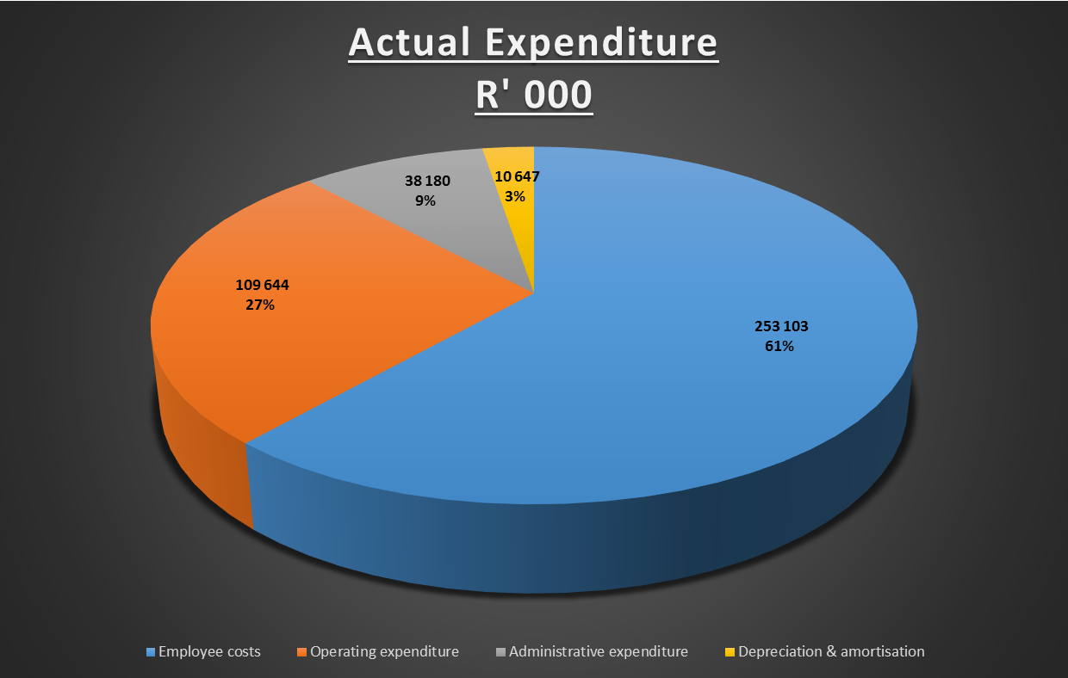
2016-17 Financial Performance: Expenditure
The main cost drivers for CIPC as a service organisation relate to employee remuneration, IT services, and accommodation and service delivery enhancement projects. Remuneration of staff remains the main cost driver, amounting to R253,1 million (61%) of total expenditure in the 2016/2017 financial year.
The organisation continues to invest in modernising its infrastructure. During the period under review, IT systems have been stabilised with improved infrastructure leading to improved functionality and greater security.
25

Slide 26
Annual Financial Statements:
Financial Position
26

Slide 27
Annual Financial Statements:
Financial Performance
27

Slide 28
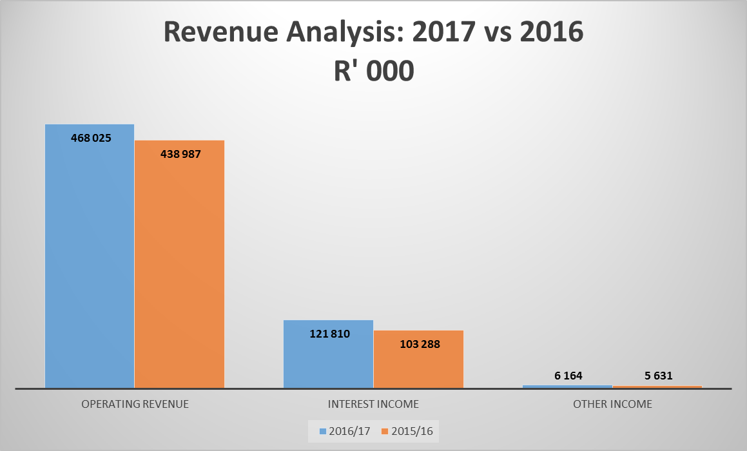
Revenue Analysis 2017 vs 2016
28

Slide 29
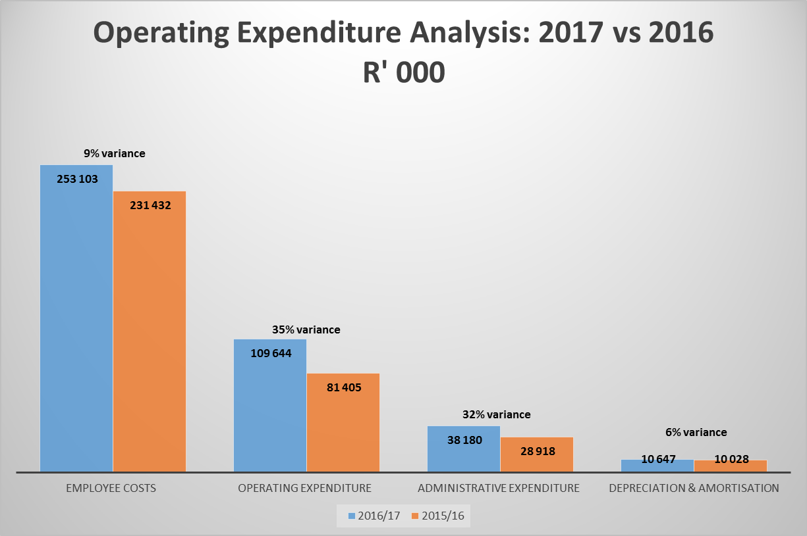
Expenditure Analysis 2017 vs 2016
29

Slide 30
Report of the Auditor-General
The Companies and Intellectual Property Commission obtained a clean audit opinion.
The following items were considered by the Auditor General in forming the opinion:
The Financial statements submitted for audit were fairly presented and were free of material misstatements;
There were no material findings on the usefulness and reliability of the reported performance information;
No instances of material non-compliance with selected specific requirements of applicable legislation were identified.
30

Slide 31
Thank you
31

