Slide 1
Regional Refugee Considerations
in the Move to Integration of
Migration Regimes
14 November 2017
Sergio Carciotto
Associate Director
director@sihma.org.za
www.sihma.org.za

Slide 2
Migration Dynamics
Agenda 2063 aims at promoting integration through migration as part of efforts to strengthen migration governance for regional economic integration and inclusive development
Migration streams within Africa are much larger than those out of Africa – more than 50% of those migrating internationally do so within Africa
Migration within the same sub region, predominates
65% of those migrating in Southern Africa migrate within their own sub region

Slide 3
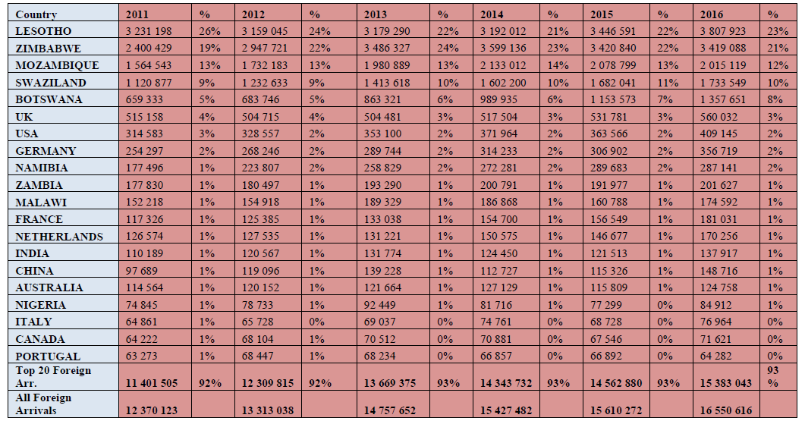
Trends in International Movements

Slide 4
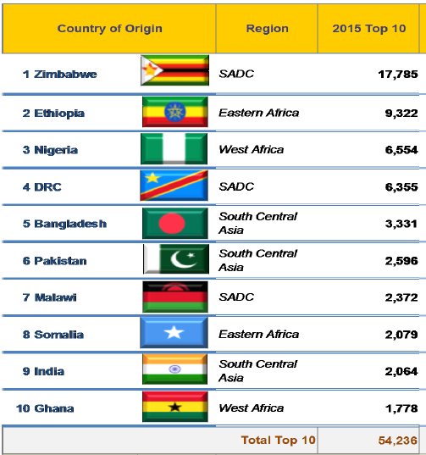
2015 Top ten Asylum seekers sending countries

Slide 5
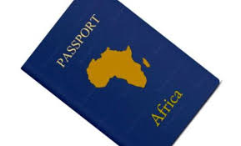
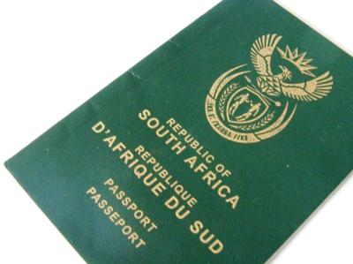
Some questions
What are the main concerns for refugees and asylum seekers in a continental free movement regime?
In which measure will a common African passport affect migration and refugee policies of national states?

Slide 6
AU Protocol on Free Movement of People in Africa
In 2015, the AU Assembly mandated the African Union Commission (AUC) to develop a Protocol on Free Movement by January 2018
The Protocol creates a system that guarantees access of all African citizens to all African countries (abolition of visa/visa at arrival/no visa fee)
It is bound to facilitate Entry, Residence and Establishment of all nationals of African Union Member States through a gradual approach
The Protocol will enable an African passport African passport, a visa-free Africa, free trade area, and other arrangements that will facilitate further integration

Slide 7
AU Protocol on Free Movement of People in Africa (cont.)
First Phase: Right of entry
Travel without Visa 90 for days
Entry restrictions for « inadmissible migrants »
Second Phase: Right of Residence
Income earning employment
Apply for jobs
Taking up a job according to national provisions
Remain in the country according to national provisions after ending the job
Third Phase: Right of Establishment
Creation and Management of enterprises

Slide 8
Some considerations
AU Protocol is not a refugee instrument
AU Protocol does not purport to limit the applicability of benefits conferred in other regional or universal instruments or agreements
Where provisions overlap on any given right or entitlement available to African citizens who are also refugees, the most favorable provision applies
Refugees may therefore enjoy rights under the AU Free Movement Protocol in addition to the rights to which they are entitled under international refugee law

Slide 9
First Phase: Rights of Entry
All citizens of a member state enjoy the right to enter into the territory of another member state without visa, provided they possess a valid travel document (African passport or a refugee travel document)
For up to 90 days, African citizens can stay in any member state without any prior administrative or police formality linked to the stay
Asylum seekers entering without authorization are not subjected to any penalties (entry from a POE; 5 days to report to RROs)
Entry for AS can be refused under the ‘first safe country’ principle -> not recognized under international law

Slide 10
Second & Third Phase: Right of Residence and Establishment
Initially this should remain under the national jurisdiction and not be part of the Continental Free Movement Protocol
Thus, the main scope of the Continental Free Movement Protocol would be only to put in place a system that guarantees access of all African citizens to all African countries (right of entry)
In October 2017 the Specialized Technical Committee (STC) on Migration, Refugees and Internally Displaced Persons considered the adoption of the Protocol to the Treaty Establishing the African Economic Community relating to Free Movement of Persons, Right of Residence and Right of Establishment

Slide 11
Final considerations
A continental integrated migration regime requires harmonized national migration policies and a common approach to respond to the protection needs of refugees and asylum seekers;
Importance of strengthening mechanism to differentiate between asylum seekers and other categories of migrants;
White Paper introduces an individual risk-based approach to manage efficiently cross-border movement of people, goods and conveyances; it also introduces limited provisions to a free movement regime for certain categories;
Encouraging efforts to ease the movements of Africans and reduce abuse of the asylum system (e.g. regularization programs and introduction of new visas);
Equality of treatment for refugees with other African citizens in the exercise of Free Movement, Right of Residence and Establishment;

Slide 12
Thank you Enkosi Ngiyabonga Dankie

