Slide 1
Operation Phakisa: Agriculture, Land Reform and Rural Development Presentation to the Portfolio Committee on Agriculture, Forestry and Fisheries
14 November 2017

Slide 2
Background of Operation Phakisa
In August 2013, President Jacob Zuma undertook a State Visit to Malaysia where he was introduced to the Big Fast Results Methodology.
Through this methodology the Malaysian government achieved significant government and economic transformation within a short period of time.
They addressed national key priority areas such as poverty, crime and unemployment.
With the support of the Malaysian government, the Big Fast Results approach was adapted to the South African context.
Operation Phakisa is a results-driven approach, involving setting clear plans and targets, on-going monitoring of progress, and making these results public.
To highlight the urgency of delivery the approach was renamed to Operation Phakisa (“phakisa” meaning “hurry up” in Sesotho).

Slide 3
What is the Operation Phakisa Methodology?
How far are we in implementing the methodology?
NDP and 9PP (RAAVC) compels us to review the development agenda for Agriculture & Land Reform
6
Monitoring
1
2
3
4
5
8
Strategic Direction
Lab
Launch
Open Day
Set-up institutional arrangements
External account-ability
7
Delivery
Processes of the lab phase
Proposal
Pre-lab
Scoping
Lab
Post lab

Slide 4
National Development Plan Vision 2030
The strategic intent of the Lab was to deliver according to the vision of the National Development Plan (NDP), which is to contribute towards an Inclusive Rural Economy, as well as the 9 Point Plan, of which the Revitalisation of the Agriculture and Agro-Processing Value Chain (RAAVC) is one.
1
Create 1 million jobs
600 000 potential jobs in communal areas and 300 000 jobs through commercial agriculture
2
Acquire 2 million hectares
Of strategically located land by 2019 for land reform
3
Develop 1 million hectares of under-utilised land
In communal areas and land reform projects for production.
ACTIONS:
4
Provide support to smallholder producers
In order to ensure production efficiencies – 80 000 new smallholders by 2019
5
Food security
By 2030, every household is able to say “WE HAVE food on the table”.
6
Developing and implementing spatial development plans
To guide how land is used while prioritising the 27 resource-poor district municipalities
7
Growing sustainable rural enterprises and industries characterised by strong rural-urban linkages, increasing investment in agro-processing, trade development and access to markets and financial services – resulting in rural job creation.

Slide 5
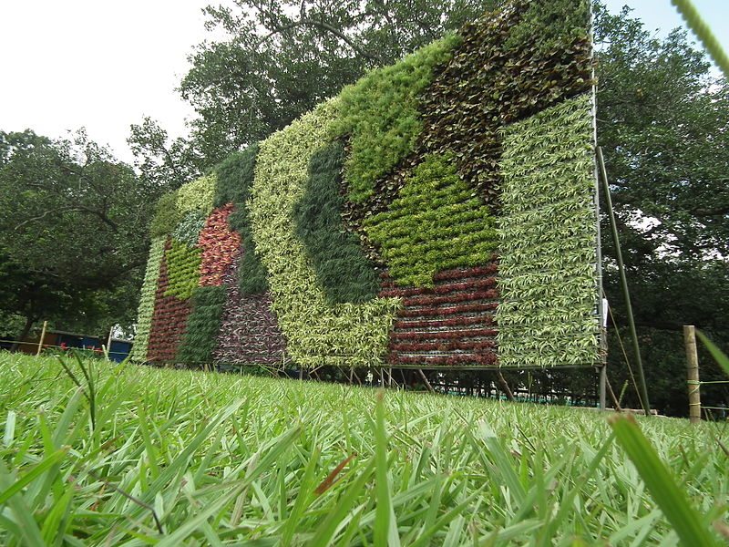
Aims of the Operation Phakisa: Agriculture, Land Reform and Rural Development Led by the Departments of Agriculture, Fisheries and Forestry (DAFF) and Rural Development and Land Reform (DRDLR), and supported by the DPME
2 Broad objectives
As enabling milestones, Specific Objectives have been identified
To stimulate growth, foster job creation and instil transformation along the agriculture and rural development value chain.
To contribute towards inclusive growth, as prescribed by the NDP and the Revitalization of the Agriculture and Agro-Processing Value Chain (RAAVC), amongst others.
Devise interventions for economic growth of priority commodities
1
Determine markets and improve access for commercial and emerging farmers infrastructure
2
Address fragmented and low impact of
financial and non-financial support provided
to producers
3
Improve productivity by balancing
mechanization and job creation
4
Stimulate development of rural economies
5
Reduce the environmental impact of
agricultural production;
6
Devise improvements in water management in agriculture and rural areas
7
SOURCE: National Development Plan 2030
Notes:
Background – Tanzania’s potential

Slide 6
Composition of the Participants
One hundred and sixty one registered participants, engaged in the five week lab
Business
Government
Civil Society
BAWSI
Agratech trade
Deciduous Fruit Industry Development Trust
Enterprise Evolution Technology Holdings
Makolobane Farmers Enterprise
AFRIWU
NAFUSA
The participants were allocated to various work streams namely: Grains, Horticulture, Livestock, Producer Support,
Land Reform, Rural Development and Labour; aligning their competencies and areas of expertise

Slide 7
What is Operation Phakisa Methodology?
How far are we in implementing the methodology?
6
Monitoring
Proposal used in a 6 month consultation process (7, 2-day workshops were held)
3
4
5
8
1
2
External account-ability
Strategic Direction
Lab
Launch
Open Day
Set-up institutional arrangements
7
Delivery
Processes of the lab phase
Proposal
Pre-lab
Scoping
Lab
Post lab

Slide 8
What is Operation Phakisa Methodology?
How far are we in implementing the methodology?
6
Monitoring
Inputs and comments received was used to develop the scoping document for the Lab
5
8
1
2
3
4
Strategic Direction
Lab
Launch
Open Day
Set-up institutional arrangements
External account-ability
7
Delivery
Processes of the lab phase
Proposal
Pre-lab
Scoping
Lab
Post lab

Slide 9
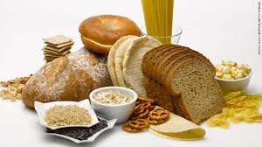
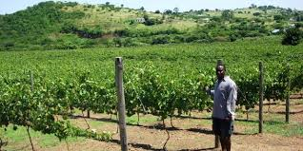
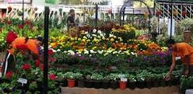
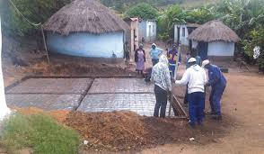
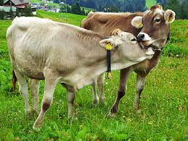
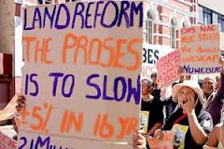
Operation Phakisa: Agriculture, Land Reform & Rural Development comprise of 3 commodity based workstreams, and 4 sectors enablers
5
1
Grains
Producer
Support
2
6
Horticulture
Labour
3
7
Livestock
Rural
Development
4
Land Reform
Notes:
Background – Tanzania’s potential

Slide 10
What is Operation Phakisa Methodology?
How far are we in implementing the methodology?
6
Monitoring
1
2
3
4
5
8
Strategic Direction
Lab
Launch
Open Day
Set-up institutional arrangements
External account-ability
7
Delivery
Processes of the lab phase
Proposal
Pre-lab
Scoping
Lab
Post lab
5- week Lab ran from 26 Sept – 28 Oct 2016. with 161 registered participants developing 27 initiatives

Slide 11
27 Operation Phakisa Initiatives
Optimising the Management of Natural Resources
Developing Skills and Capacity
Funding and Finance
Unlocking water to expand horticultural production (Horticulture)
Fortified veld management for sustainable livestock production (Livestock)
Demand led public/ private agri-skills unit (Labour)
Livestock skills and knowledge upgrading programme (Livestock)
Enhanced animal health through revolutionary veterinary services (Livestock)
Ndimo Desk (Producer Support)
Financial partnerships for accelerated and sustainable Land Reform (Land Reform)
Re-engineering agricultural development finance (Producer Support)
Unlocking finance for grains through PPP (Grains)
Dynamic Business Model for Producer Support (Producer) Support)
Value Chain Development and Market Access
Coordination and Knowledge Management
Reconfiguring Space & Promoting Functional Rural Settlement
Access to commercial and alternative livestock value chains (Livestock)
Integrated grain value chain (Grain)
Inclusive horticulture value chain participation model (Horticulture)
Rural enterprise development (Rural Development)
Trade Promotion, Retention and Optimisation (Horticulture)
Harmonization of legislation affecting the agricultural value chain (Producer Support)
Strategic leadership & coordination for structural transformation (Rural Development)
District Land Reform Delivery Centre (Land Reform)
National Agricultural Decent Work Programme (Labour)
Strengthening legal compliance mechanisms (Labour)
National livestock census, animal ID, & traceability (Livestock)
Grain Know How (Grains)
Fast tracking the settlement of outstanding restitution claims in a sustainable manner (Land Reform)
Accelerated Land Development and Redistribution Initiative (ALDRI) (Land Reform)
Promoting and protecting rights of persons living under insecure tenure (Land Reform)
Basic Services (Rural Development)
Farm worker house and land ownership programme (Labour)
10

Slide 12
What is Operation Phakisa Methodology?
The President launched Operation Phakisa for Agriculture, Land Reform and Rural Development on the 24 February, 2017.
How far are we in implementing the methodology?
6
Monitoring
1
2
3
4
5
8
Strategic Direction
Lab
Launch
Open Day
Set-up institutional arrangements
External account-ability
7
Delivery
Processes of the lab phase
Proposal
Pre-lab
Scoping
Lab
Post lab

Slide 13
How far are we in implementing the methodology?
6
Monitoring
1
2
3
4
5
8
Strategic Direction
Lab
Launch
Open Day
Set-up institutional arrangements
External account-ability
7
Delivery
Processes of the lab phase
Proposal
Pre-lab
Scoping
Lab
Post lab
Appointed Champions per initiative (finalised)
Cabinet submission of Lab report (Oct. - Nov)
Open Day (Presidency).

Slide 14
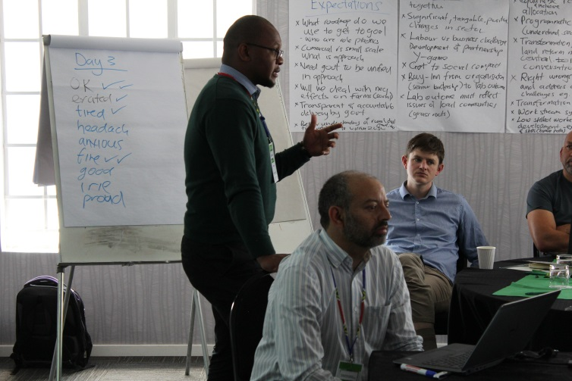
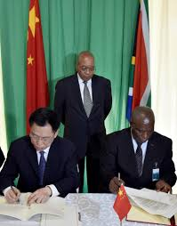
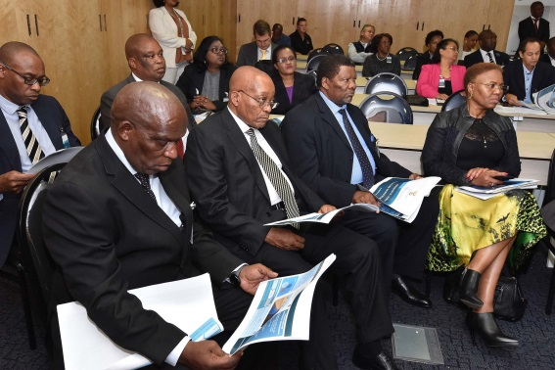
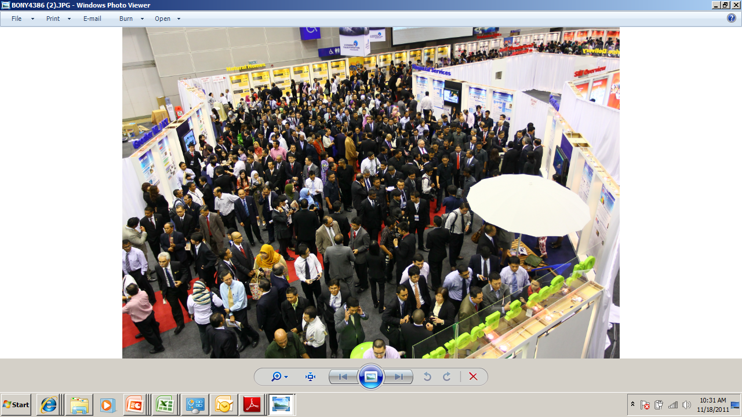
The Open Day is a vital step to achieving mass alignment and buy-in for lab outcomes
What is an Open Day?
Open Day concept for Operation Phakisa: Agriculture, Land Reform and Rural Development
An Open Day is typically 2-3 days of showing and sharing with the public the recommendations from the lab reports. However, due to financial constraints, Operation Phakisa for Agriculture, Land Reform and Rural Development will be a one-day event.
It is an interactive session where Lab participants can interact with the public sector and provide feedback.
It's also a proven methodology to secure mass alignment and buy-in. It is thus highly interactive and transparent.
One-day event with 2 sessions:
OPEN & CLOSED SESSION
It will be an interactive session where the public can interact with presenters at various stations (a minimum of 7) followed by a closed session.
The Closed Session will be by invitation only, and will target 200 guests along with a media contingency. The Open Day will remain the prerogative of the Presidency.

Slide 15
PHASE 1: securing buy-in and commitment from role players
1.2 Champions appointed per initiative to review the final draft report. This was done in collaboration with work stream reps and content leaders per work stream.
Progress: Completed June 2017
1.1 Internal and external syndication meetings with stakeholders; presenting the outcomes and initiatives of the Lab , their models/ frameworks and draft plans in full detail.
Progress: 19 April - Producer Support; 3 May – Livestock; 5 May – Rural Development ; 8 May - Horticulture; 9 May – Labour; 15 May – Grains; 04 Aug – Land Reform.
PHASE 1
Target timeframes: April – August 2017
1.3 Mini-Lab (series of workshops) to refine implementation plans of one of the Land Reform initiatives, namely Fast tracking the settlement of outstanding restitution claims in a sustainable manner. Completed in July 2017.
1.4 Champions to refine, align and translate 3-feet plans into a project implementation plans stipulating roles and responsibilities, clearly spelt out budgets, and schedule of activities etc.
Progress: 30 August, Special Cluster Syndication Workshops were held on 24-25 August and 20-21 September by DRDLR nad DAFF respectively
1.5 Report back sessions to Portfolio Committee, Study group, CEO Steering Committee, and others including industry organisations.
Progress: reporting dates May – October, 2017

Slide 16
PHASE 2: Signing of agreements (SLAs, MOUs, contracts)
2.2 Submit implementation project plans to DPME for quality assurance, prepare a cabinet memo for submission.
Progress: This milestone is based on 2.1 above . End November 2017
PHASE 2 (Confirming agreement towards Open Day)
2.3 Open Day – date determined by the Presidency. Submission made in October
2.1 All role players to come to some agreement on terms, budgets, funding arrangements, project schedule etc.
Project Implementation Plans must be captured in a preliminary signed agreement (format of agreement must be agreed upon).
Progress: Budgeted project implementation plans are being developed by both DRDLR and DAFF including Provincial Departments of Agriculture.

Slide 17
PHASE 3: Establishing institutional arrangements
PHASE 3 (Nov 2017)
3.1 Establishing the Directors General Steering Committee, by presenting the 1st draft of all Implementation Plans.
DUE: after Open Day
3.2 Establishing the Ministerial Steering Committee, by presenting the1st draft of all the Implementation Plans.
DUE: after Open Day
3.3 Establishing the National Premiers, MECs, and Mayors, District Managers Forum, through presenting relevant Implementation Plans and proposed way forward.
DUE: after Open Day

Slide 18
Progress on 27 Operation Phakisa Initiatives
Optimising the Management of Natural Resources
Unlocking water to expand horticultural production (Horticulture) The initiative seeks to establish a War Room within Presidency for improving the management and access to water through irrigation schemes. Areas where work is currently underway: A proposal was presented to the ESEID DG cluster, which requested that more detail be presented on the terms of reference for the War room. A meeting with role players were subsequently hosted through the DPME, and DAFF will return to ESEID, with Terms of Reference stipulating roles and responsibilities and proposed delegated authority. This will be done after the Operation Phakisa report is approved by cabinet. Budget Plan Pooling of all irrigation funds between DAFF, DRDLR, DEA and DWS, towards the integrated plan for irrigation, with 10% of the total allocation for the establishment of the “Presidential War Room”. Output for Open Day Signed MOU between DAFF, DRDLR, DEA and DWS on the T.O.R of “Water War Room”.

Slide 19
Progress on 27 Operation Phakisa Initiatives
Optimising the Management of Natural Resources
Fortified veld management for sustainable livestock production (Livestock) This initiative seeks to improve veld and pasture management for purposes of improving livestock production. The initiative requires coordination of all programmes and projects aimed at veld and pasture management. Areas where work is currently underway: Terms of Reference for the work and partnership between relevant departments and institutions were drafted to forge a joint plan between the ARC, DRDLR, DEA, and DWS; Legislative overlaps between DRDLR , DAFF and DEA concerning Natural Resource Management must be addressed; Institutional arrangements, such as the establishment of a soil conservation committee must be looked into. Budget Plan DAFF’s LandCare budget to be used for the implementation of the Fortified Veldt management initiative. Output for Open Day An MOU on a plan of action to be signed between DAFF, DRDLR,DEA, DWS and the ARC.

Slide 20
Progress on 27 Operation Phakisa Initiatives
Developing Skills and Capacity
Demand led public/ private agri-skills unit (Labour); merging with 4. Livestock skills and knowledge upgrading initiative The 2 merged initiatives are aimed at developing South Africa’s first comprehensive farm worker and producer development programme. Areas where work is currently underway: To look at the Farmer Production Support Units (FPSUs) of Agri-Parks as the delivery mechanism. AgriSETA agreed to be the national coordinating body. An MOU in this regard is still to be signed. The Provincial Department of Agriculture in Limpopo has agreed to pilot this initiative. MOUs still to be signed for other pilots, potentially in NW and KZN. Establish a national database of farm workers by integrating those of provincial and national role players. Develop a commodity based database incorporating provincial and national service providers of skills development and training for both farm worker and producers. Budget Plan Provincial Departments of Agriculture of Limpopo to fund pilot project. Output for Open Day An MOU between AgriSETA, and PDAs of Limpopo, KZN and NW.

Slide 21
Progress on 27 Operation Phakisa Initiatives
Developing Skills and Capacity
Enhanced animal health through revolutionary veterinary services (Livestock) Extend the capacity of veterinary services in a multi-level coordinated approach; utilise improvements in livestock identification, movement control and traceability for improved disease surveillance and control. Areas where work is currently underway: Proposed organisational change to vet governance was sent to the State Law advisers. The response was that there is no need for a change in the constitution; and that other legal mechanisms are possible. A submission requesting a work study and job evaluation for the National Veterinary Services was drafted. Finalised a draft guideline for the restructuring of the deployment and contracting of public and private practice veterinary professionals. Investigation of in-sourcing Vets and sending students abroad to study vet health i.e Cuba Model Quality Assurance (QA) system for veterinary services under development. The Minister gazetted the meat inspection scheme on the 07th of July 2017 for implementation. Liaise with SAVC to investigate relaxing of delegations rules to allow para vet to perform certain functions. Budget Plan Under discussion with National Treasury. Output for Open Day MOU between DAFF and the SA Veterinary Council.

Slide 22
Progress on 27 Operation Phakisa Initiatives
Developing Skills and Capacity
Ndimo Desk (Producer Support) Establishment of a centralised, virtual platform to link producers to services offered by participating public and private sector institutions through various communication channels Areas where work is currently underway: Role players engaged with platforms that partially address the needs of Ndimo. They are Vodacom, AgriPlace, ARC/DST, the Private Sector. Develop Terms of Reference for the finalisation of technical concept and prototype for Ndimo Desk/AIMS. Facilitate the establishment of partnerships: Vodacom, AgriPlace, ARC/DST, Private Sector. Budget Plan Monies from CASP were ring fenced to finance AIMS; this will now also be used for the NDIMO desk. Output for Open Day Signing of Memorandum of Understanding (or addendum to existing) with partner(s): Commodity Organisations (technical information) Service Provider (IT system management/maintenance). DAFF, DRDLR, PDAs, DWS, ESKOM, SOEs/Dtel/DoT/ Municipalities.

Slide 23
Progress on 27 Operation Phakisa Initiatives
Funding and Finance
Financial partnerships for accelerated and sustainable Land Reform (Land Reform) This initiative seeks to a) to mobilise private sector to complement public funding sources to finance the land reform programmes of restitution, redistribution and tenure; b) to develop public-private sector funding models and financial instruments to provide for the acquisition and development of land on a medium to long-term mortgage and CPI-indexed linked annuity basis, and; c) to foster a new and redefined win-win partnership between previous land owners and land reform beneficiaries that promotes continued production, increased employment, and social cohesion. Areas where work is currently underway: BASA has been engaged, and indicated willingness. Land Bank, NEF, IDC have MOU’s and SLA’s that are to be signed. Producer Support packages are to be developed to go hand in hand with the financial solutions. Budget Plan The Initiative will be financed through the existing DRDRL baseline budget. Output for Open Day Signed MOUs with Land Bank, NEF & IDC.

Slide 24
Progress on 27 Operation Phakisa Initiatives
Funding and Finance
Re-engineering agricultural development finance (Producer Support) The development of blended financial instruments from public and private funds, administered centrally, in order to improve access and affordability of finance and lessen the current reliance on grants. Areas where work is currently underway: Draft policy on Comprehensive Producer Development Support (CPDS) forms the policy framework for the initiative. A more comprehensive concept document was finalised and forms the basis of engagements with the key role players such as the LandBank. Discussion with the LandBank is almost complete, with an MOU to be signed. A pilot with a MOA between the Eastern Cape Department of Agriculture, the Land Bank and DAFF, is underway where the Land Bank provides the loan and bridging finance to the farming operation and the department provides additional financial support with the grants (Operation Phakisa initiative). Establish provincial delivery structures. Syndicate with DRDLR to assess possible areas of alignment with District AgriParks Management Council. Producer Support packages must go hand in hand with the financial model. Budget Plan The Re-engineering of Development Finance is fully financed through CASP. Output for Open Day Signed MOUs with Land Bank, and Provincial Departments of Agriculture – pilot with Eastern Cape.

Slide 25
Progress on 27 Operation Phakisa Initiatives
Funding and Finance
Unlocking finance for grains through PPP (Grains) Creating a structured financial solution for smallholder farmers by tapping into government security fund (to be created through redirected grant funds). Areas where work is currently underway: Engagement with GRAINSA, GFADA, AgBiz Grain, AFMA and SACOTA as role players to this initatives; Develop a suite of financial models (production, processing and R&D) with state guarantees/ incentives based on the existing models, namely: Jobs fund model; Agbiz / GFADA model; Afgri model; and Re-engineering of Development Finance. Develop a producer support package for Grain Producers. Budget Plan3 60% of the average CASP budget spent on Grains per province will be committed to finance this initiative. Output for Open Day3 Signed agreement with financial institutions and sector organisation of the Grain industry i.e GFADA, Afgri.

Slide 26
Progress on 27 Operation Phakisa Initiatives
Funding and Finance
Dynamic Business Model for Producer Support (Producer Support) The initiative is a partnership between the government, commodity organisations and other stakeholders to develop and provide a commodity-specific comprehensive producer support package for each black producer participating in the initiative. Areas where work is currently underway: Completed a review of producer support services which may be provided through the Dynamic Business model. Completed criteria for participants and service providers to be linked to the initiative. Engaged with commodity organisation and organised agriculture. Engaged with State owned enterprises (SOEs). Budget Plan The new model of Producer Support will be fully funded by CASP. Output for Open Day Signed Memorandum of Agreement with NERPO, GFADA, CGA, HORTGRO, DFDC, SAPPO, POTATOSA, SASA.

Slide 27
Progress on 27 Operation Phakisa Initiatives
Value Chain Development and Market Access
Access to commercial and alternative livestock value chains (Livestock) This initiative aims to organise local farmers into an aggregation entity e.g. cooperative to buy feed in bulk; transactions will be between feed suppliers and aggregation entity; feed supplier will deliver to central place; feed will be supplied in bags to facilitate distribution. Areas where work is currently underway: Met with several key organisations and companies with the following possible outputs: SACOTA - explore models to improve access and affordability of feed to smallholder farmers. AFMA - AFMA to provide and facilitate access for follow up deliberations with feed suppliers. Karan Beef - direct purchase of weaners/ cattle from smallholder farmers and custom feeding. Potential contracts must be consulted on with provinces and farmers (currently underway) Consult other commodity groups as per the 3 feet plan to develop pilot studies. NW has indicated interest to serve as the pilot. Budget Plan 60% of the average CASP budget spent on Livestock per province will be committed to finance this initiative. Output for Open Day Signed agreements with SACOTA, AFMA and Karan Beef & PDAs.

Slide 28
Progress on 27 Operation Phakisa Initiatives
Value Chain Development and Market Access
Integrated grain value chain (Grains) Formalise the integration of smallholder farmers in the grains value chain through SAFEX (South African Futures Exchange) 10 ton BEE White Maize contracts for smallholder farmers producing grain. Areas where work is currently underway: Met with key stakeholders, Agbiz, GrainSA, South African Futures Exchange (SAFEX) , South African Cereals and Oilseeds Traders Association (SACOTA), Animal Feed Manufactures Association (AFMA) and The Grain Farmer Development Association (GFADA) on linking training, market access through grain processors, and the 10 ton contract. Undertaking financial risk assessments (benefits and disadvantages) of the SAFEX 10 Ton contract, along with other models. Developing the model / packaging of the initiative i.e. How will government make it attractive for both farmers and buyers to participate in this programme. Testing buy-in of the model with role players. Develop a full support package for all farmers entering this programme. Assess current Infrastructure for Grain industry and determine additional needs. Budget Plan 60% of the average CASP budget spent on Grains per province will be committed to finance this initiative. Output for Open Day Signed agreement with role players of SAFEX, Afgri.etc.

Slide 29
Progress on 27 Operation Phakisa Initiatives
Value Chain Development and Market Access
Inclusive horticulture value chain participation model (Horticulture) An integration model that will accelerate the participation of black role players in the whole Horticulture value chain, resulting in optimum profitability and inclusive growth. Areas where work is currently underway: A joint task team between industry (CGA-GDC) and DAFF are finalising a situational analysis – DAFF committed HR capacity to complete the research to support the CGA-GDC commercialisation plan. An implementation plan will be based on this analysis, to be signed off between relevant role players. There is a need to broaden the analysis to other commodities, and other components of the value chain, such as: Agro-processing facilities Establish cold storage facilities Establishment of black logistics supply chain Budget Plan 60% of the average CASP budget spent on Horticulture per province will be committed to finance this initiative. Output for Open Day MOU with Citrus and Deciduous growers Association.

Slide 30
Progress on 27 Operation Phakisa Initiatives
Value Chain Development and Market Access
Rural Enterprise Development (Rural Development) Develop rural enterprises and create non-farm employment within identified economic clusters for job creation and increasing household income. Areas where work is currently underway: DSBD has been engaged, and indicated willingness to work with the DRDLR and DAFF on building Agricultural and Non-Agricultural Enterprises. The DRDLR is currently undertaking a re-engineering process where the focus of projects implemented will target value adding enterprise projects rather than primary production. Agri-Parks enterprises will form a corner stone for future project identification and funding. Budget Plan The Initiative will be funded form existing DRDRL baseline budget. Output for Open Day Still to be determined.

Slide 31
Progress on 27 Operation Phakisa Initiatives
Value Chain Development and Market Access
15. Trade Promotion, Retention and Optimisation (Horticulture) Increasing South Africa’s Horticultural trade potential from an estimated R54.4 billion in 2015 to R90 billion by 2030, through gaining, retaining and optimising local and export markets and trade facilitation to enable optimum participation by black commercial and smallholder farmers. Areas where work is currently underway: Priority export markets identified between the industry (Fruit Value Chain Round Table), the dti and DAFF. Research on market requirements was completed and workshopped with stakeholders. Human resource plan to fund the Market Research Unit and other trade related functions, such as the establishment of Sanitary and Phytosanitary measure remain unfunded. Capacity to support trade – Moratorium on filling vacant posts. Budget Plan Using DAFFs current allocation for Trade, certain elements of the initiative remain unfunded. Output for Open Day Still to be determined.

Slide 32
Progress on 27 Operation Phakisa Initiatives
Coordination and Knowledge Management
16. Harmonization of legislation affecting the agricultural value chain (Producer Support) This initiative seeks a comprehensive standardization and alignment of all agricultural and related legislation; Areas where work is currently underway: Meetings with relevant registrars are on going to reach an agreement on process flow of important pieces of legislation. Design of a process flow between relevant registrars. Budget Plan Certain elements of the initiative are unfunded (Legislative Review Study). Output for Open Day Signed agreement between DRDLR, DEA, DWS and DAFF.

Slide 33
Progress on 27 Operation Phakisa Initiatives
Coordination and Knowledge Management
17. Strategic leadership & coordination for structural transformation (Rural Development). Strategic leadership and coordination of Rural Development Plans aimed at rural development for structural transformation. This will be achieved through: vertical and horizontal strengthened coordination of planning, implementation, reporting, monitoring and evaluation of programmes across all spheres of government regular convening of all stakeholder representatives in structured information sharing, joint analysis and planning processes that ensures monitoring and accountability Areas where work is currently underway: The Draft RDA policy has been completed and will be submitted. The draft Bill on the National Rural Development Agency will be ready in December 2017. Draft Cabinet Memo for the establishment of the Presidential Rural Development Coordinating Council (PRDCC), this council will lead to the establishment of the Rural Development Agency and subsequenlty will take over the functions of the PRDCC. Budget Plan Funded from DRDLR budget; no additional funding required. Output for Open Day President to pronounce on progress on the Rural Development Bill and Rural Development Agency.

Slide 34
Progress on 27 Operation Phakisa Initiatives
Coordination and Knowledge Management
18. District Land Reform Delivery Centre (Land Reform) The District Land Reform Delivery Centre (DLRDC) is a local level implementing agent that seeks to ensure that land reform initiatives are designed and implemented in accordance with the specific needs of local beneficiaries as outlined by the land reform sector plan in a district. Areas where work is currently underway: District Joint Operational Centers (DJOCS) have been established in all 44 Districts. The membership of the committees are: District Municipalities; Local Municipalities; Councils of Stakeholders (COS); Land Rights Management Councils (LRMCs); District Land Reform Committees (DLRCs); District Agri-Parks Management Councils (DAMCs); Appointment of District Managers in 38 Districts. Institutionalisation of the DLRC, DAMCs and LRMCs. Budget Plan Funded from current DRDLR budget. Output for Open Day To be determined.

Slide 35
Progress on 27 Operation Phakisa Initiatives
Coordination and Knowledge Management
19. National Agricultural Decent Work Programme and 20. Strengthening legal compliance mechanisms (Labour) These initiatives aim to strengthen the compliance to Labour Laws (esp. LRA, BCEA, SDA13, OHS, the Agri-BEE charter and EEA) of commercial farmers, emerging farmers and agri-business owners. This is to eliminate human rights violations towards Agri-farm workers and farm dwellers. The initiative is to develop and implement a Decent Work Programme for the Agricultural Sector. Areas where work is currently underway: Key executive members of the Department of Labour met and agreed on the way forward on the 2 initiative. The initiatives were presented to the CCMA stakeholder/users forum A task team was established to develop an implementation plan and budget proposal. Budget Plan To be determined. Output for Open Day Agreement between Farm worker unions, DoL and CCMA.

Slide 36
Progress on 27 Operation Phakisa Initiatives
Coordination and Knowledge Management
21. National livestock census, animal ID, & traceability (Livestock) Conduct a formal complete livestock census to be repeated every 5 years. Develop an interactive animal identification system using the available legal instruments (Animal Identification Act, Animal Improvement Act, Animal Improvement Policy, etc.), to implement an integrated national livestock data base for performance recording and traceability in order to improve animal husbandry, enable proper planning and decision making and allow for competitive market access. Areas where work is currently underway: DAFF has drafted Livestock Identification and Traceability System policy document which is now gazetted and prepared for the SEIAS process. A policy consultation workshop took place with 110 attendees from the Red Meat Industry, Consumer groups, national and Provincial government officials and other stakeholders on 14 August 2017. A multidisciplinary LITS Committee was established to work on the establishment of the LITS in South Africa. Budget Plan Discussion with National Treasury underway - no current budget. Output for Open Day MOU between relevant role players on the implementation plan of Livestock Identification and Traceability System

Slide 37
Progress on 27 Operation Phakisa Initiatives
Coordination and Knowledge Management
22. Grain Know How Establishment of grains information centre that will provide farmers with relevant information in a format that is comprehensive considering literacy level and access to technology for improved yield and quality. Areas where work is currently underway: A database of all sources of grain information and relevant knowledge completed – but needs to be expanded on. Developing systems requirements to make this information accessible, currently underway – NDIMO desk will serve the purpose of providing that ICT platform. Integrate and Coordinate existing industry developed information sources (apps). Use existing service delivery (SASSA delivery points) points as satellite points. Budget Plan Research to be funded by DAFF’s National Research Fund, and the required information management system through the Ndimo desk. Output for Open Day MOU in place with role players such as DST, and industry.

Slide 38
Progress on 27 Operation Phakisa Initiatives
Reconfiguring Space & Promoting Functional Rural Settlement
23. Fast tracking the settlement of outstanding restitution claims in a sustainable manner (Land Reform) Conduct and finalise all outstanding research (916) by 31 December 2017 Conduct and finalise outstanding Verification in the next 48 months (since the lab) Settle and Finalise all outstanding claims (6558) in the next 48 months (since the lab) Re-designed restitution business process to support upfront project packaging to ensure sustainability. Areas where work is currently underway: As of 30 September 2017, 269 from 916 target research reports has been approved. Acceleration plan implemented by the Commission on Restitution of Land Rights is currently being implemented. Claimant Verification of community claimants for Limpopo, Mpumalanga and KZN outsourced. R100 million is required to execute this activity. As of 30 June 2017, 6558 claims were outstanding of which 1820 are in Phase two : screening phase, 115 Phase 3: determination of qualification and 4623 Phase 4: negotiations. 2152 claims will be settled and finalize in the next 24 months. The drafting of a Hybrid Settlement Options policy is at its advanced stage. This activity to finalize all claims (Transfer of land / Payment of financial Compensation) will require R30 Billion. This is ongoing. Commission’s business process reviewed as part of the Restitution mini Lab. A preferred Commission Operating model has been identified. Project Charter has been developed between CRLR and GTAC.

Slide 39
Progress on 27 Operation Phakisa Initiatives
Reconfiguring Space & Promoting Functional Rural Settlement
23. Fast tracking the settlement of outstanding restitution claims in a sustainable manner (Land Reform) Budget Plan Funded from existing budget but additional funding is required to speed up the delivery. Output for Open Day Presentation of Mini-Lab information.

Slide 40
Progress on 27 Operation Phakisa Initiatives
Reconfiguring Space & Promoting Functional Rural Settlement
24. Accelerated Land Development and Redistribution Initiative (ALDRI) (Land Reform) Entails government buying up agricultural zoned land in peri-urban areas around town. ALDRI proposes a target of 579 150 units to be developed over 5 years and allocated to Category 1 and 2 small holder farmers, as well as the urban landless and jobless people living in peri-urban areas and rural informal settlements. Areas where work is currently underway: Refinement of the model, and identification of a suitable pilot site that integrate resources of all three spheres of government. Obtaining buy-in from key stakeholders and the Private sector. Budget Plan DRDLR internal budget to be utilised to develop a integrated Land, Labour and Housing solution. Output for Open Day Showcase the ALDRI programme as an integrated housing, labour, tenure and farming solution in an peri-urban areas. MOU signed for the pilot with a Municipality, Salga, CoGTA, DRDLR andDAFF.

Slide 41
Progress on 27 Operation Phakisa Initiatives
Reconfiguring Space & Promoting Functional Rural Settlement
Note: The Initiatives 25 and 27 merged as these initiatives all support farm dweller support 25. Promoting and protecting rights of persons living under insecure tenure (Land Reform) Syndication done with other initiatives namely: ALDRI, Labour Farm worker house and land ownership programme, Basic Services and Funding and finance; this is currently done with various departments and private sector, a model of smart Agri villages is being finalised. 27. Farm worker house and land ownership programme (Labour) Syndication done with other initiatives namely: ALDRI, Basic Services and Funding and Finance; this is currently done with various departments and private sector, a model of smart Agri villages is being finalised. Areas where work is currently underway: DBSA’s cost estimate for the five years is R14 billion (DBSA was a participant at the Operation Phakisa lab on Agriculture, Land Reform and Rural Development). Refinement of the model, and identification of a suitable pilot site that integrate resources of all three spheres of government. Obtaining buy-in from key stakeholders and the Private sector.

Slide 42
Progress on 27 Operation Phakisa Initiatives
Reconfiguring Space & Promoting Functional Rural Settlement
Note: The Initiatives 25 and 27 merged as these initiatives all support farm dweller support Budget Plan DRDLR internal budgets to be utilised to develop an integrated Land, Labour and Housing solution. Output for Open Day Showcase the ALDRI programme as an integrated housing, labour, tenure and farming solution in an peri-urban areas. MOU signed for the pilot with a Municipality, Salga, CoGTA, DRDLR nad DAFF.

Slide 43
Progress on 27 Operation Phakisa Initiatives
Reconfiguring Space & Promoting Functional Rural Settlement
26. Basic Services (Rural Development) Massive augmentation of reliable well coordinated sustainable essential basic services. Of the estimated backlogs with the identified areas= 560 000 households (15% of the 17 Million Rural People) it is targeted that for 2018/19, 2000 households at the cost of R92 398 200 Million Rand excluding shelter) will be built. Areas where work is currently underway: Rural Infrastructure Observer has been developed by the DRDLR for Limpopo , North West and Mpumalanga. A detailed analysis per district has been completed, information has been collated under the project “’Turning South Africa into a construction Site’’. Social facilitation tool developed for use in determining the access standards of service provided. Rural Development Plans are being finalised for 44 districts and being adopted by the District Municipalities. The Rural Development Plans will guide the targeting of rural settlements with appropriate yet differentiated methods of services delivery i.e. off-grid solutions. Budget Plan Coordination of MIG and RWIG funds and ensuring alignment to Rural Development Plans. Output for Open Day To be determined.

Slide 44
SUMMARY OF RESOURCE PLAN
Ring-fencing funding for the three Value Chain initiatives for Grains, Livestock and Horticulture and finance model of grains, namely:
Access to commercial and alternative livestock value chains (Livestock)
Integrated grain value chain (Grain)
Inclusive horticulture value chain participation model (Horticulture), and
Unlocking finance for grains through PPP (Grains)
The four above will be financed through ring fenced monies of CASP, Ilima-Letsema and Mafisa, which will be used for infrastructure development, market access, and production support.
Sixty percent of the average spent of each province per commodity, will be dedicated to these initiatives.
The infrastructure development element of the 3 Value Chain initiatives will be synergised with SIP11.

Slide 45
SUMMARY OF RESOURCE PLAN
The training pillar of CASP and the Extension support will finance the skills development and support packages under the following:
5. Livestock skills and knowledge upgrading programme;
6. Dynamic business model; and
7. Re-engineering of Development Finance.

Slide 46
SUMMARY OF RESOURCE PLAN
The LandCare programme of DAFF will finance the implementation of the 8. Fortified Veld management initiative under Operation Phakisa.
The Agricultural Information Management System (AIMS) and the
9. Ndimo desk initiative will merge in both function and budget.
10. The Grain Know How will be financed through DAFF’s National
Research Fund and the system through the allocated funds of the
Ndimo desk initiative.
The Unlocking water to expand horticultural production initiative will be financed by pooling all irrigation funds of CASP, with 10% of the allocated budgets financing the establishment of the “Presidential Water War Room”.
All initiatives by DRDLR will be financed through their existing budget.

Slide 47
SUMMARY OF RESOURCE PLAN
UNFUNDED INITIATIVES
The research element of the 12. Harmonization of legislation affecting the agricultural value chain initiatives remains unfunded.
13. The Enhanced animal health through revolutionary veterinary services initiative and the 14. National livestock census, animal ID, & traceability initiative remains unfunded. However, discussions are underway with National Treasury to finance these two initiatives.
15. The Trade Promotion, Retention and Optimisation initiative also remains unfunded.

Slide 48
WAY FORWARD
Finalisation of the institutional arrangements for the implementation, coordination and oversight of this Operation Phakisa lab.
Finalisation of Implementation Plans for submission to DPME.

Slide 49
ABBREVIATIONS
9PP: Nine Point Plan;
ALDRI: Accelerated Land Development and Redistribution Initiative
AFMA: Animal Feed Manufacturers Association
Afgri:
AgBiz Grain: Agricultural Business Chamber
ARC: Agricultural Research Council
AIMS: Agricultural Information Management System
CEO Forum: Chief Executive Officer Forum of Agriculture
CASP: Comprehensive Agriculture Support Programme
CCMA: Commission for Conciliation, Mediation and Arbitration
CGA: Citrus Growers Association
CGA-GDC: CGA Grower Development Company
CoGTA: Cooperative Governance and Traditional Affairs
COS: Councils of Stakeholders
CPDS: Comprehensive Producer Development Support
DAFF: Departments of Agriculture, Fisheries and Forestry;
DAMCs: District Agri-Parks Management Councils
DEA: Department of Environmental Affairs
DFDC: Deciduous Fruit Development Chamber
DJOCS: District Joint Operational Centers
DLRDC: District Land Reform Delivery Centre
DLRCs: District Land Reform Committees
DoL: Department of Labour
DST: Department of Science and Technology
DPME: Department of Planning, Monitoring and Evaluation;
DRDLR: Rural Development and Land Reform
DSBD: Department of Small Business Development
DWS: Department of Water and Sanitation

Slide 50
ABBREVIATIONS
DTel: Department of Telecommunications
DoT : Department of Transport
ESEID: Economic Sector Employment and Infrastructure Development
FPSU: Farmer Production Support Units
GRAINSA: Grain South Africa
GFADA: Grain Farmer Development Association
HORTGRO: Horticultural Growers
IDC: Industrial Development Corporation
LRMS: Land Rights Management Councils
LITS: Livestock Identification and Traceability System
MOU: Memorandum of Understanding
NDP: National Development Plan
NEF: National Employment Fund
NERPO: National Emergent Red Meat Producers' Organisation
PDAs: Provincial Departments of Agriculture
PRDCC: Presidential Rural Development Coordinating Council
Potato SA: Potato South Africa
RAAVC: Revitalisation of the Agriculture and the Agro-Processing Value Chain
SACOTA: South African Cereals and Oil Seeds Traders Association
SALGA: South African Local Government Association
SAPPO: South African Pork Producers' Organisation
SAFEX: South African Futures Exchange
SASA: South African Sugar Association
SASSA: South Africa Social Security Agency
SOEs: State Owned Enterprises
T.O.R: Terms of reference

