Slide 1
BRIEFING TO THE SELECT COMMITTEE ON SOCIAL SERVICES
Annual Performance Report :
2016/17 Financial Year
14 November 2017

Slide 2
CONTENT
Vision, Mission and Value Statement.
Supporting Government Priorities.
DHA Outcomes and Strategic Objectives.
Overview of organisational performance of the Department.
Performance Per Programme.
Highlights: 2016 – 2017.
Strategic priorities linked to the MTEF (2015- 2019).
Tabular presentation of performance in key areas.
Reasons for non-achievement.
Financial Performance Information.
Way Forward.

Slide 3
VISION, MISSION AND VALUES
Value Statement
The Department of Home Affairs is committed to being:
People-centred and caring;
Patriotic;
Professional and having integrity;
Corruption free and ethical;
Efficient and innovative;
Disciplined and security conscious.
MISSION
The efficient determination and safeguarding of the identity and status of citizens and the management of immigration to ensure security, promote development and fulfill our international obligations.
VISION
A safe, secure South Africa where all of its people are proud of, and value, their identity and citizenship.

Slide 4
SUPPORTING GOVERNMENT PRIORITIES
The DHA contributes directly to four of the 14 Outcomes of Government:
Quality basic education.
A long and healthy life for all.
All people in South Africa are and feel safe.
Decent employment through inclusive economic growth.
Skilled and capable workforce to support an inclusive growth path.
An efficient competitive and responsive economic infrastructure network.
Vibrant equitable sustainable rural communities contributing to food security for all.
Sustainable human settlements and improved quality of household life.
Responsive accountable effective and efficient local government system.
Protect and enhance our environmental assets and natural resources.
Create a better South Africa a better Africa and a better world.
Social protection.
Nation building and social cohesion.
An efficient effective and development oriented public service.

Slide 5
DHA OUTCOMES AND STRATEGIC OBJECTIVES
^{Outcome 1:}
Secured South African citizenship and identity.
^{Strategic Objectives:}
All eligible citizens are issued with enabling documents relating to identity and status.
An integrated and digitised National Identity System (NIS) that is secure and contains biometric details of every person recorded on the system ..
^{Outcome 2:}
Secured and responsive immigration system.
^{Strategic Objectives:}
Refugees and asylum seekers are managed and documented efficiently.
Movement of persons in and out of the country managed according to a risk based approach.
Enabling documents issued to foreigners efficiently and securely.
^{Outcome 3:}
Services to citizens and other clients that are accessible and efficient.
^{Strategic Objectives:}
Secure, effective, efficient and accessible service delivery to citizens and immigrants.
Good governance and administration.
Ethical conduct and zero tolerance approach to crime, fraud and corruption.
^{Collaboration with relevent} stakeholders in support of enhanced service delivery and core business objectives.

Slide 6
STRATEGIC PRIORITIES LINKED TO MEDIUM TERM STRATEGIC FRAMEWORK (MTSF 2014 – 2019)
Establishing an integrated Border Management Authority (BMA);
Developing an over-arching strategy and sub-strategies to defend, protect, secure and ensure well-managed borders;
Ensuring that registration at birth is the only entry point for SA to the new national identity system (NIS);
National Identity System (NIS) designed and operational;
Ensuring that systems are in place to enable the capturing of biometric data of all travellers who enter or exit SA legally;
Immigration Policy developed and approved by Cabinet;
Reducing the time required for importing critical skills needed for the economy; and
Improving feedback opportunities for citizens and other service users through the establishing of a DHA contact centre.

Slide 7
OVERVIEW OF ORGANISATIONAL PERFORMANCE (2016–17)
The Department had a total of 32 targets planned for 2016/17 financial year. A total of 27 targets were achieved representing 84% achievement rate, which is a 3% improvement against the achievement of 81% of the previous year. 5 (16%) targets were not achieved.

Slide 8
PERFORMANCE PER PROGRAMME
Programme | No of Targets | Achieved | Not Achieved
Administration (1) | 19 | 17 (89%) | 2 (11%)
Civic Affairs (2) | 5 | 4 (80%) | 1 (20%)
Immigration Affairs (3) | 8 | 6 (75%) | 2 (25%)
TOTAL | 32 | 27 (84%) | 5 (16%)

Slide 9
HIGHLIGHTS: 2016 – 2017 (Civic Services)
)
The Department, together with the Department of Planning, Monitoring and Evaluation (DPME), commissioned a national evaluation study to scientifically determine the reasons for citizens not registering their children within 30 days.
2.6 million smart ID cards issued to citizens 16 years of age and older (the target of 2.2 million smart ID cards issued was exceeded by over 400 000 cards).
178 442 IDs (First Issue) were issued within 54 working days.
140 005 IDs (Re-Issue) were issued in 47 working days and 2 313 above.
Over 95% of the new passports issued by a fully digital process were delivered within 13 days, which exceeded the target by 5.4%.

Slide 10
HIGHLIGHTS: 2016 – 2017 (Immigration Services)
0
)
The draft White Paper on International Migration was finalised and subsequently approved by Cabinet.
During the year under review, the Department finalised the amendments to the Refugees Act, which are aimed at improving efficiencies in the management of the entire value chain of refugees as asylum seekers.
The department also approved a Lesotho Special Permit, which gave a waiver to certain requirements for the application of business, work and study visas. In this regard, a project was developed and implemented in consultation with the Lesotho government.
The Department has made significant progress for the approval of a public private partnership (PPP) to upgrade the six most-important land ports, which will have major positive economic benefits, as the request for Treasury Approval.
A major overhaul using new technology transformed the problematic Marabastad Refugee Reception Office currently known as Desmond Tutu .

Slide 11
PROGRAMME 1: ADMINISTRATION
Strategic objectives Supported by the targets | 1.2: An integrated and digitised National Identity System (NIS) that is secure and contains biometric details of every person recorded on the system.
 | 1.3:Ensure that systems are in place to enable the capturing of biometric data of all travellers who enter or exit SA legally.
 | 3.1: Secure, effective, efficient and accessible service delivery to citizens and immigrants.
 | 3.2 Good governance and administration.
 | 3.3 Ethical conduct and zero tolerance approach to crime, fraud and corruption.
 | 3.4 Collaboration with relevant stakeholders in support of enhanced service delivery and core business objectives.

Slide 12
PROGRAMME 1: ADMINISTRATION
Strategic Objective 1.2 An integrated and digitised National Identity System (NIS) that is secure and contains biometric details of every person recorded on the system.
PERFORMANCE INDICATOR | ANNUAL TARGET (2016/17) | ACTUAL (2016/17)
Automated processes for BMD (2016/17). | BMD processes developed onto Live Capture. | Achieved The modules have been developed and are currently under testing in the preproduction environment.
Live Capture functionality for refugees, smart ID cards and travel documents tested (2016/17). | Live Capture for refugees, smart ID cards and travel documents developed and tested. | Achieved The modules have been developed and are currently under testing in the preproduction environment.
E-permit prototype developed (2016/17). | End-to-end e-permit system developed (prototype). | Achieved The modules have been developed and are currently under testing in the preproduction environment.

Slide 13
PROGRAMME 1: ADMINISTRATION
Strategic Objective 1.3: Ensure that systems are in place to enable the capturing of biometric data of all travellers who enter or exit SA legally.
PERFORMANCE INDICATOR | ANNUAL TARGET (2016/17) | ACTUAL (2016/17)
Pilot of full biometric scope conducted at one port of entry as per signed business requirements (2016/17). | EMCS (full biometrics scope) developed and piloted at one port of entry. | Not Achieved The target was not achieved because of a lack of resources to develop the system in the previous financial year.

Slide 14
PROGRAMME 1: ADMINISTRATION
Strategic Objective 3.1: Secure, effective, efficient and accessible service delivery to citizens and immigrants
PERFORMANCE INDICATOR | ANNUAL TARGET (2016/17) | ACTUAL (2016/17)
Number of managers (junior, middle and senior managers) trained in leadership and management development programmes to improve performance and professionalization. | 300 of managers (junior, middle and senior managers) trained in leadership and Management development Programmes to improve performance and professionalization. | Achieved 490 managers (195 junior; 238 middle; 57 senior) were trained in leadership and management Development programmes to improve performance.
Phased implementation of business case for repositioning the DHA as a modern, secure department: Submission to Cabinet for approval (2016/17). | Second phase of repositioning completed (business case for modern, secure DHA submitted to Cabinet for approval. | Achieved Business case approved by Cabinet in March 2017.

Slide 15
PROGRAMME 1: ADMINISTRATION
Strategic Objective 3.2: Good governance and administration
PERFORMANCE INDICATOR | ANNUAL TARGET (2016/17) | ACTUAL (2016/17)
Compliance with set deadline for the submission of Annual Financial Statements to the AGSA by 31 May annually. | Annual Financial Statements submitted to the AGSA by 31 May Annually. | Achieved Annual Financial Statements was submitted to the AGSA by 31 May Annually.

Slide 16
PROGRAMME 1: ADMINISTRATION
Strategic Objective 3.2: Good governance and administration.
PERFORMANCE INDICATOR | ANNUAL TARGET (2016/17) | ACTUAL (2016/17)
Compliance with set deadline for submission of in-year monitoring reports to National Treasury in respect of required format and accurate. | In-year monitoring reports submitted to National Treasury by the 15th of each month. | Achieved The reports for all quarters were submitted to National Treasury by the 15th of each month.
Compliance with set deadline for tabling of Annual Report in Parliament as per PFMA. | Annual Report tabled in Parliament by 30 September annually. | Not Achieved Annual Report 2015/16 not submitted to Parliament by 30 September 2016.
Number of quarterly performance reports verified and approved by EXCO and signed by the Director-General within 60 days after each quarter. | Three DHA 2016/17 and one DHA 2015/16 quarterly performance reports verified and approved by EXCO and signed by the Director-General within 60 days after each quarter. | Achieved Three DHA 2016/17 and one DHA 2015/16 quarterly performance reports verified and approved by EXCO and signed by the Director-General within 60 days after each quarter.

Slide 17
PROGRAMME 1: ADMINISTRATION
Strategic Objective 3.2: Good governance and administration.
PERFORMANCE INDICATOR | ANNUAL TARGET (2016/17) | ACTUAL (2016/17)
Vacancy rate maintained at a set percentage or lower. | Vacancy rate maintained at 10% or below by 31 March 2017. | Achieved Vacancy rate maintained at 10% or below as at 31 March 2017 (0.6%).
Treasury Regulation 16.4 complied with (2016/17). | Feasibility study undertaken and Treasury Approval 1 request submitted to National Treasury. | Achieved The feasibility report was submitted to National Treasury on 14 March 2017 for consideration of Treasury Approval 1.

Slide 18
PROGRAMME 1: ADMINISTRATION
Strategic Objective 3.3: Ethical conduct and a zero-tolerance approach to crime, fraud and corruption.
PERFORMANCE INDICATOR | ANNUAL TARGET (2016/17) | ACTUAL (2016/17)
Number of awareness initiatives on ethics, fraud prevention and counter- corruption conducted. | 20 awareness initiatives on ethics, fraud prevention and counter- corruption conducted. | Achieved 41 awareness interventions conducted.
Percentage of reported cases for fraud and corruption finalised within 90 working days. | 64% reported cases for fraud and corruption finalised within 90 working days. | Achieved 65% reported cases for fraud and corruption finalised within 90 working days.
Number of detection reviews or security evaluations on processes conducted to identify possible vulnerabilities to fraud, corruption and security breaches in business processes (approved by Deputy Director- General: Counter Corruption and Security Services (DDG:CC&SS) and reports submitted to affected business units for implementation of recommendations). | 2 detection reviews or security evaluations on processes conducted to identify possible vulnerabilities to fraud, corruption and security breaches in business processes and reports submitted to affected business units for implementation of recommendations. | Achieved 2 detection reviews or security evaluations on processes conducted to identify possible vulnerabilities to fraud, corruption and security breaches in business processes and reports submitted to affected business units for implementation of recommendations.

Slide 19
PROGRAMME 1: ADMINISTRATION
Strategic Objective 3.3: Ethical conduct and a zero-tolerance approach to crime, fraud and corruption.
PERFORMANCE INDICATOR | ANNUAL TARGET (2016/17) | ACTUAL (2016/17)
Number of threats and risk assessments (TRAs) conducted in accordance with the requirements of Minimum Information Security Standards (MISS) and/or Minimum Physical Security Standards (MPSS). | 80 Threats and Risk Assessments (TRAs) conducted in accordance with the requirements of Minimum Information- (MISS) and / or Physical Security Standards (MPSS). | Achieved 96 offices assessed and re-assessed for Threats and risks.
Number of vetting files finalised and referred to the SSA for evaluation. | 620 vetting fieldwork investigations finalised and referred to State Security Agency (SSA). | Achieved 732 vetting fieldwork investigations finalised and referred to State Security Agency (SSA).

Slide 20
PROGRAMME 1: ADMINISTRATION
Strategic Objective 3.4: Collaboration with stakeholders in support of enhanced service delivery and core business objectives.
PERFORMANCE INDICATOR | ANNUAL TARGET (2016/17) | ACTUAL (2016/17)
Compliance with set number of interventions Implemented in support of communication strategy and action plan. | Communication strategy and action plan implemented with a focus on: • Corporate communication services • Media relations • Public awareness engagements Four publications of internal newsletter, Ikhaya.
 | 12 media briefings. | Achieved Target achieved 42 media briefings Conducted.
 | Six ministerial izimbizo and Budget Vote communication Events. | Achieved Nine ministerial izimbizo organised.

Slide 21
PROGRAMME 1: ADMINISTRATION
Strategic Objective 3.4: Collaboration with stakeholders in support of enhanced service delivery and core business objectives.
PERFORMANCE INDICATOR | ANNUAL TARGET (2016/17) | ACTUAL (2016/17)
Compliance with set number of interventions Implemented in support of communication strategy and action plan. | 11 publications of ministerial Home Affairs Today. Two campaigns conducted. | Achieved 19 Home Affairs Today publications produced. Two campaigns conducted.

Slide 22
PROGRAMME 1: ADMINISTRATION
Strategic Objective 2.1: Refugees and asylum seekers are managed and documented efficiently.
PERFORMANCE INDICATOR | ANNUAL TARGET (2016/17) | ACTUAL (2016/17)
Submission to Minister for approval of feasibility study, including financial model, for building asylum processing centres closer to the country’s borders. | Feasibility study, including financial model, for building asylum processing centres completed and submitted to Minister for approval. | Achieved The feasibility report was submitted to the Minister and approval was granted on 29 March 2017.

Slide 23
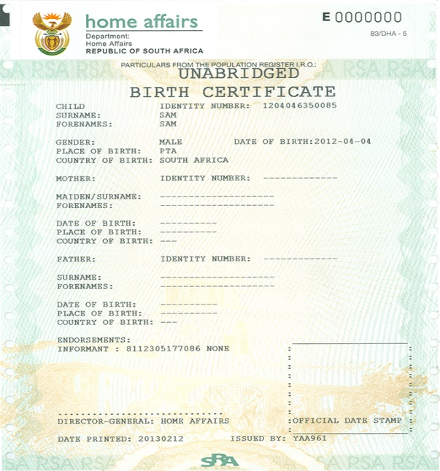
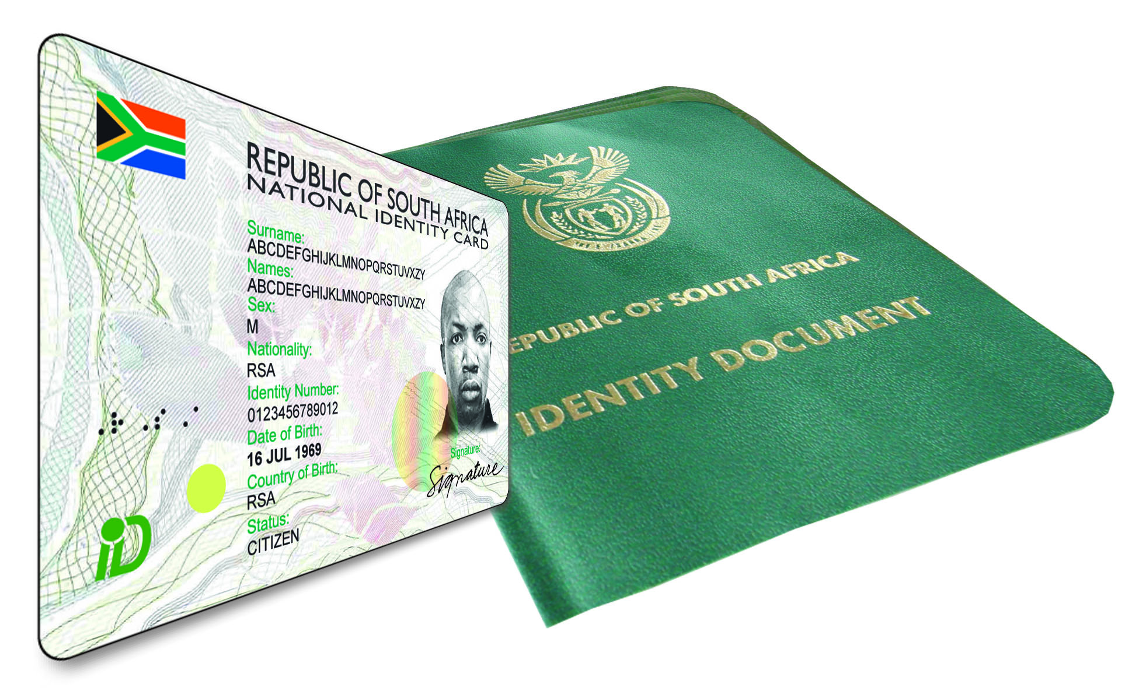
PROGRAMME 2: CITIZEN AFFAIRS
Strategic objectives Supported by the targets | Strategic Objective 1.1: All eligible citizens are issued with enabling documents relating to identity and status.

Slide 24
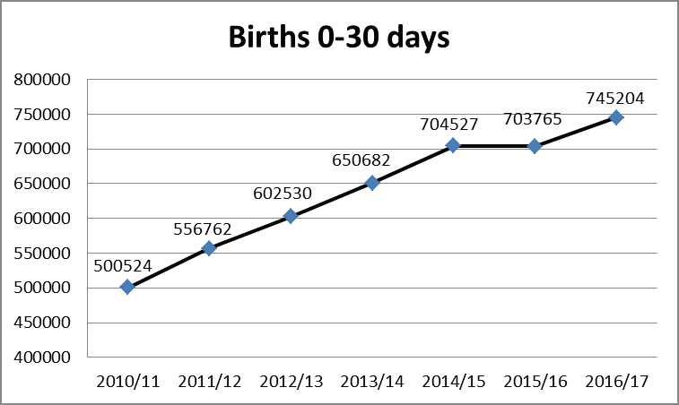
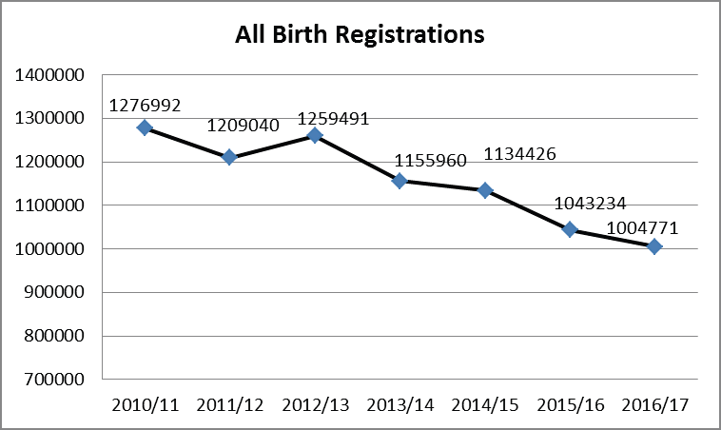
PROGRAMME 2: CITIZEN AFFAIRS
Strategic Objective 1.1: All eligible citizens are issued with enabling documents relating to identity and status.
PERFORMANCE INDICATOR | ANNUAL TARGET (2016/17) | ACTUAL (2016/17)
Number of births registered within 30 calendar days. | 750 000 Births registered within 30 calendar days. | Not Achieved 745 204 births were registered within 30 calendar days during the review period.

Slide 25
PROGRAMME 2: CITIZEN AFFAIRS (Births registered within 30 days)
Province | AT 2016/17 | T Q1 | AP Q1 | T Q2 | AP Q2 | T Q3 | AP Q3 | T Q4 | AP Q4 | Annual Performance | Variance | %
EC | 90,759 | 22,069 | 22,140 | 22,454 | 22,360 | 21,178 | 18,883 | 25058 | 22823 | 86206 | -4553 | 95%
FS | 45,388 | 11,104 | 10,365 | 11,528 | 10,807 | 10,546 | 9,843 | 12210 | 11327 | 42342 | -3046 | 93%
GP | 172,892 | 43,452 | 44,409 | 42,711 | 43,842 | 41,509 | 39,982 | 45218 | 45516 | 173750 | 858 | 100%
KZN | 128,756 | 32,037 | 33,588 | 31,974 | 32,786 | 30,275 | 28,408 | 34471 | 33576 | 128358 | -398 | 99%
LP | 99,828 | 24,129 | 25,549 | 24,301 | 25,359 | 22,893 | 22,207 | 28506 | 27872 | 100987 | 1159 | 101%
MP | 62,256 | 15,205 | 15,579 | 15,655 | 15,270 | 14,405 | 13,577 | 16991 | 15912 | 60338 | -1918 | 97%
NW | 46,653 | 11,791 | 12,614 | 11,667 | 12,728 | 11,117 | 11,672 | 12078 | 13090 | 50104 | 3451 | 107%
NC | 22,577 | 5,725 | 5,551 | 5,625 | 5,171 | 5,360 | 4,695 | 5867 | 5729 | 21146 | -1431 | 94%
WC | 80,891 | 20,133 | 20,645 | 19,958 | 19,915 | 20,405 | 18,698 | 20395 | 22715 | 81973 | 1082 | 101%
TOTAL | 750,000 | 185,645 | 190,440 | 185,873 | 188,238 | 177,688 | 167,965 | 200794 | 198560 | 745204 | -4796 | 99%

Slide 26
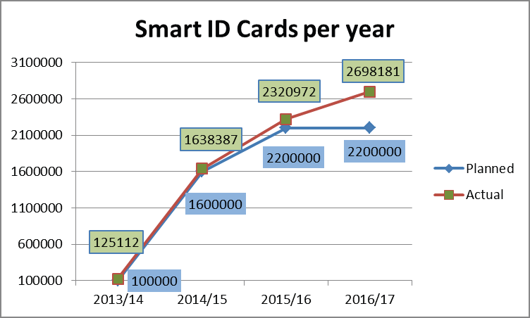
PROGRAMME 2: CITIZEN AFFAIRS
Strategic Objective 1.1: All eligible citizens are issued with enabling documents relating to identity and status.
PERFORMANCE INDICATOR | ANNUAL TARGET (2016/17) | ACTUAL (2016/17)
Number of smart ID cards issued to citizens 16 years of age and over. | 2.2 million smart ID cards issued to citizens 16 years of age and above. | Achieved 2 698 181 ID Smart cards were issued to citizens 16 years of age and above

Slide 27
PROGRAMME 2: CITIZEN AFFAIRS (2.2 million smart ID cards )
Province | Provincial contribution to the APP target | T Q1 | AP Q1 | T Q2 | AP Q2 | T Q3 | AP Q3 | T Q4 | AP Q4 | Annual Performance | Annual Variance | %
EC | 261,499 | 59,440 | 77,276 | 65,360 | 61,917 | 71,339 | 56,092 | 65360 | 70208 | 265493 | 3994 | 102%
FS | 113,695 | 25,865 | 35,972 | 28,375 | 30,861 | 31,080 | 27,019 | 28375 | 35967 | 129819 | 16124 | 114%
GP | 659,432 | 149,895 | 173,531 | 164,830 | 159,934 | 179,877 | 141,131 | 164830 | 186017 | 660613 | 1181 | 100%
KZN | 301,292 | 68,475 | 122,317 | 75,320 | 104,856 | 82,177 | 95,107 | 75320 | 126416 | 448696 | 147404 | 149%
LP | 204,651 | 46,525 | 82,947 | 51,150 | 67,722 | 55,826 | 61,389 | 51150 | 81034 | 293092 | 88441 | 143%
MP | 167,597 | 39,640 | 52,006 | 39,890 | 46,877 | 48,177 | 42,368 | 39890 | 54625 | 195876 | 28279 | 117%
NW | 176,227 | 40,040 | 51,622 | 44,080 | 45,978 | 48,027 | 51,838 | 44080 | 74573 | 224011 | 47784 | 127%
NC | 96,641 | 21,960 | 23,625 | 24,160 | 20,277 | 26,361 | 18,779 | 24160 | 24432 | 87113 | -9528 | 90%
WC | 218,966 | 48,160 | 93,089 | 56,835 | 82,340 | 57,136 | 75,367 | 56835 | 94441 | 345237 | 126271 | 158%
GP BANKS | 0 | 0 | 6,631 | 0 | 9949 | 0 | 13,182 | 0 | 16559 | 46321 | 0 | -
WC BANKS | 0 | 0 | 162 | 0 | 304 | 0 | 459 | 0 | 985 | 1910 | 0 | -
TOTAL | 2,200,000 | 500,000 | 719,178 | 550,000 | 631,015 | 600,000 | 582,731 | 550000 | 765257 | 2698181 | 498181 | 123%

Slide 28
PROGRAMME 2: CITIZEN AFFAIRS
Strategic Objective 1.1: All eligible citizens are issued with enabling documents relating to identity and status.
PERFORMANCE INDICATOR | ANNUAL TARGET (2016/17) | ACTUAL (2016/17)
Number of births registered within 30 calendar days. | 750 000 Births registered within 30 calendar days. | Not Achieved 745 204 births were registered within 30 calendar days during the review period.
Number of smart ID cards issued to citizens 16 years of age and over. | 2.2 million smart ID cards issued to citizens 16 years of age and above. | Achieved 2 698 181 ID Smart cards were issued to citizens 16 years of age and above.
Percentage of IDs (first issues) issued within 54 working days for applications collected and processed within the RSA (from date of receipt of application until ID is scanned at the office of application). | 90%IDs (First issues) issued within 54 working days for applications collected and processed within the RSA . | Achieved 96.65%of IDs (First Issues) were issued within 54 working days (RSA applications only) 164 606 IDs (First Issue) were issued within 54 working days and 7 474 above. The total number of IDs (First Issues) issued during the review period was 170 318.

Slide 29
PROGRAMME 2: CITIZEN AFFAIRS
Strategic Objective 1.1: All eligible citizens are issued with enabling documents relating to identity and status.
PERFORMANCE INDICATOR | ANNUAL TARGET (2016/17) | ACTUAL (2016/17)
Percentage of IDs (re-issues) issued within 47 working days for applications collected and processed within the RSA (from date of receipt of application until ID is scanned at office of application). | 95% of IDs (Re-issues) issued within 47 working days for applications collected and processed within the RSA (from date of receipt of application until ID is scanned at office of application. | Achieved 97.26% of IDs (reissues) were issued within 47 working days 153 586 IDs (reissues) were issued within 47 working days and 4 324 above 157 910 IDs (reissues) were issued during the period under review.
Percentage of machine-readable passports (new Live Capture system) issued within 13 working days for applications collected and processed within the RSA (from date of receipt of application until passport is scanned at office of application). | 90% of machine readable passports (new live capture system) issued within 13 working days for applications collected and processed within the RSA (from date of receipt of application until passport is scanned at office of application. | Achieved 95,42% of machine readable passports (MRP) (new live capture system) were issued within 13 working days. 740 259 MRPs (new live capture process) were issued within 13 working days and 35 547 above. The total number of MRPs issued during the review period was 775 806.

Slide 30
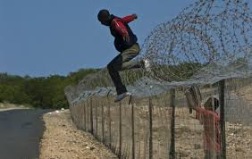
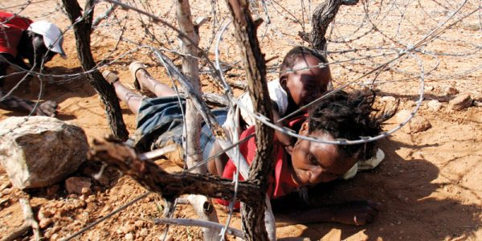
PROGRAMME 3: IMMIGRATION AFFAIRS
Strategic objectives supported by the targets | 2.1 Refugees and asylum seekers are managed and documented efficiently.
 | 2.2 Movement of persons in and out of the country managed according to a risk-based.
 | 2.3 Enabling documents issued to foreigners efficiently and securely.

Slide 31
PROGRAMME 3: IMMIGRATION AFFAIRS
Strategic Objective 2.2 Movement of persons in and out of the country managed according to a risk-based.
PERFORMANCE INDICATOR | ANNUAL TARGET (2016/17) | ACTUAL (2016/17)
Ministry- approved project plan for BMA launch implemented (2016/17). | BMA launched. | Not Achieved The BMA could not be launched as enabling legislation as the BMA is not in place .The NEDLAC consultative process on the BMA Bill took longer than expected Government spent six months in NEDLAC negotiations between November 2015 and May 2016 Since then, the Bill has been in Parliament. The Portfolio Committee on Home Affairs adopted the BMA Bill, 2016, in March 2017. The National Assembly debate on the Bill is planned for 11 May 2017. Should National Assembly adopt the Bill, it will be referred to the NCOP for consideration and then it will be returned to National Assembly for final adoption and enactment The BMA can only be launched after the BMA Bill, 2016,is enacted.

Slide 32
PROGRAMME 3: IMMIGRATION AFFAIRS
Strategic Objective 2.2 Movement of persons in and out of the country managed according to a risk-based.
PERFORMANCE INDICATOR | ANNUAL TARGET (2016/17) | ACTUAL (2016/17)
IBMS approved by Minister for implementation in outer years (2016/17). | IBMS (over-arching strategy) approved by Minister. | Achieved The IBMS was approved by the Minister in March 2017 .The IBMS will be incrementally implemented in the 2017/18 financial year.
Submission of White Paper to Cabinet for approval (2016/17). | White Paper on International Migration submitted to Cabinet for approval. | Achieved The White Paper was approved by Cabinet on 29 March 2017.
Number of selected ports of entry with either improved residential or improved office accommodation or both as per set standard. | 15 selected ports of entry with either improved residential or improved office accommodation or both as per set standard. | Not Achieved 12 out of 15 selected ports of entry have been improved with either residential or office accommodation or both as per set standards.

Slide 33
PROGRAMME 3: IMMIGRATION AFFAIRS
Strategic Objective 2.3: Enabling documents issued to foreigners efficiently and securely.
PERFORMANCE INDICATOR | ANNUAL TARGET (2016/17) | ACTUAL (2016/17)
Percentage of permanent residence applications adjudicated within eight months for applications collected within the RSA (from date of receipt of application until outcome is scanned at VFS centre – office of application) (Above applications refer to critical skills (section 27b), general work (section 26a) and business (section 27c) only). | 85% of permanent residence Applications adjudicated within eight months for applications collected within the RSA. | Achieved 98% (5 271 out of 5 374) of permanent residence applications were adjudicated within eight months for applications collected within the RSA.
Percentage of business and general work visas adjudicated within eight weeks for applications processed within the RSA (from date of receipt of application until outcome is scanned at VFS centre - office of application). | 80% of business and general work visas adjudicated within eight weeks for applications processed within the RSA. | Achieved 97% (2 007 out of 2 062) of business and general work visas were adjudicated within eight weeks for applications processed within the RSA.

Slide 34
PROGRAMME 3: IMMIGRATION AFFAIRS
Strategic Objective 2.3: Enabling documents issued to foreigners efficiently and securely.
PERFORMANCE INDICATOR | ANNUAL TARGET (2016/17) | ACTUAL (2016/17)
Percentage of critical skills visas adjudicated within four weeks for applications processed within the RSA (from date of receipt of application until outcome is scanned at VFS centre - office of application). | 75% of critical skills visas adjudicated within four weeks for applications processed within the RSA. | Achieved 94% (5 951 out of 6 314) of critical skills visas were adjudicated within four weeks for applications processed within the RSA.
Number of DHA premium visa and permit service centres opened for clients registered with the Corporate Accounts Unit (CAU). | 2 DHA premium visa and permit service centres opened for clients registered with the Corporate Accounts Unit (CAU). | Achieved 2 DHA premium visa and permit service centres opened for clients registered with the CAU (KwaZulu-Natal and Eastern Cape).

Slide 35
Provincial target : 100% of detected employers in contravention of the Immigration Act (Act 13 of 2002) charged
Province | AT 2016/17 | T Q1 | D & C Q1 | T Q2 | D & C Q2 | T Q3 | D & C Q3 | T Q4 | D & C Q4 | Annual Performance | Percentage
EC | 100% | 100% | 18 | 100% | 12 | 100% | 12 | 100% | 16 | 58 | 100%
FS | 100% | 100% | 10 | 100% | 18 | 100% | 10 | 100% | 24 | 62 | 100%
GP | 100% | 100% | 17 | 100% | 60 | 100% | 235 | 100% | 121 | 433 | 100%
KZN | 100% | 100% | 12 | 100% | 15 | 100% | 57 | 100% | 15 | 99 | 100%
LP | 100% | 100% | 24 | 100% | 33 | 100% | 28 | 100% | 20 | 105 | 100%
MP | 100% | 100% | 12 | 100% | 12 | 100% | 8 | 100% | 15 | 47 | 100%
NC | 100% | 100% | 21 | 100% | 5 | 100% | 12 | 100% | 10 | 48 | 100%
NW | 100% | 100% | 24 | 100% | 31 | 100% | 33 | 100% | 24 | 112 | 100%
WC | 100% | 100% | 13 | 100% | 8 | 100% | 11 | 100% | 6 | 40 | 100%
TOTAL | 100% | 100% | 151 | 100% | 194 | 100% | 406 | 100% | 251 | 1004 | 100%
AT – Annual Target
T – Target
D & C – Detected and Charged (actual number)
AP – Actual Performance

Slide 36
Provincial Target :100% of detected transgressors in contravention of the Immigration Act (Act 13 of 2002) charged
Province | AT 2016/17 | T Q1 | D & C Q1 | T Q2 | D & C Q2 | T Q3 | D & C Q3 | T Q4 | D & C Q4 | Annual Performance | Percentage
EC | 100% | 100% | 196 | 100% | 411 | 100% | 5 | 100% | 185 | 797 | 100%
FS | 100% | 100% | 270 | 100% | 962 | 100% | 145 | 100% | 183 | 1560 | 100%
GP | 100% | 100% | 2373 | 100% | 1959 | 100% | 1,519 | 100% | 2426 | 8277 | 100%
KZN | 100% | 100% | 248 | 100% | 317 | 100% | 414 | 100% | 181 | 1160 | 100%
LP | 100% | 100% | 1393 | 100% | 1921 | 100% | 1,858 | 100% | 1700 | 6872 | 100%
MP | 100% | 100% | 247 | 100% | 476 | 100% | 461 | 100% | 409 | 1593 | 100%
NC | 100% | 100% | 211 | 100% | 270 | 100% | 202 | 100% | 247 | 930 | 100%
NW | 100% | 100% | 700 | 100% | 605 | 100% | 383 | 100% | 398 | 2086 | 100%
WC | 100% | 100% | 135 | 100% | 156 | 100% | 225 | 100% | 294 | 810 | 100%
TOTAL | 100% | 100% | 5773 | 100% | 7077 | 100% | 5212 | 100% | 6023 | 24085 | 100%
AT – Annual Target
T – Target
D & C – Detected and Charged (actual number)
AP – Actual Performance

Slide 37
Provincial Target : 100% of undocumented foreigners deported within 30 calendar days (Direct Deportations)
Province | AT 2016/17 | T Q1 | D & C Q1 | T Q2 | D & C Q2 | T Q3 | D & C Q3 | T Q4 | D & C Q4 | Annual Performance | Percentage
EC | 100% | 100% | 7 | 100% | 4 | 100% | 15 | 100% | 2 | 28 | 100%
FS | 100% | 100% | 688 | 100% | 78 | 100% | 67 | 100% | 57 | 890 | 100%
GP | 100% | 100% | 218 | 100% | 99 | 100% | 73 | 100% | 201 | 591 | 100%
KZN | 100% | 100% | 30 | 100% | 161 | 100% | 137 | 100% | 124 | 452 | 100%
LP | 100% | 100% | 1,241 | 100% | 1,691 | 100% | 1,556 | 100% | 1433 | 5921 | 100%
MP | 100% | 100% | 661 | 100% | 706 | 100% | 879 | 100% | 666 | 2912 | 100%
NC | 100% | 100% | 12 | 100% | 20 | 100% | 7 | 100% | 15 | 54 | 100%
NW | 100% | 100% | 68 | 100% | 47 | 100% | 6 | 100% | 16 | 137 | 100%
WC | 100% | 100% | 2 | 100% | 13 | 100% | 0 | 100% | 1 | 16 | 100%
TOTAL | 100% | 100% | 2,927 | 100% | 2,819 | 100% | 2,740 | 100% | 2515 | 11001 | 100%
AT – Annual Target
T – Target
D & C – Detected and Charged (actual number)
AP – Actual Performance

Slide 38
Provincial Target : 100% Of Detected undocumented foreigners transferred to Lindela within 20 calendar days
Province | AT 2016/17 | T Q1 | D & C Q1 | T Q2 | D & C Q2 | T Q3 | D & C Q3 | T Q4 | D & C Q4 | Annual Performance | Percentage
EC | 100% | 100% | 30 | 100% | 25 | 100% | 26 | 100% | 27 | 108 | 100%
FS | 100% | 100% | 358 | 100% | 319 | 100% | 386 | 100% | 202 | 1265 | 100%
GP | 100% | 100% | 2,765 | 100% | 2,256 | 100% | 2,272 | 100% | 2160 | 9453 | 100%
KZN | 100% | 100% | 128 | 100% | 93 | 100% | 138 | 100% | 85 | 444 | 100%
LP | 100% | 100% | 92 | 100% | 68 | 100% | 58 | 100% | 42 | 260 | 100%
MP | 100% | 100% | 60 | 100% | 27 | 100% | 59 | 100% | 41 | 187 | 100%
NC | 100% | 100% | 256 | 100% | 73 | 100% | 123 | 100% | 42 | 494 | 100%
NW | 100% | 100% | 314 | 100% | 348 | 100% | 84 | 100% | 95 | 841 | 100%
WC | 100% | 100% | 0 | 100% | 6 | 100% | 5 | 100% | 11 | 22 | 100%
TOTAL | 100% | 100% | 4,003 | 100% | 3,215 | 100% | 3,151 | 100% | 2705 | 13074 | 100%
AT – Annual Target
T – Target
D & C – Detected and Charged (actual number)
AP – Actual Performance

Slide 39
Provincial Target : 80% of Detected fraudulent marriages & marriage of convenience cases finalised (investigation and recommendation submitted) within 60 days
Province | AT 2016/17 | T Q1 | D & C Q1 | T Q2 | D & C Q2 | T Q3 | D & C Q3 | T Q4 | D & C Q4 | Annual Performance | Percentage
EC | 80% | 80% | 0 | 80% | 1 | 80% | 0 | 80% | 0 | 1 | 80%
FS | 80% | 80% | 3 | 80% | 1 | 80% | 0 | 80% | 0 | 4 | 80%
GP | 80% | 80% | 35 | 80% | 38 | 80% | 18 | 80% | 143 | 234 | 80%
KZN | 80% | 80% | 27 | 80% | 74 | 80% | 85 | 80% | 41 | 227 | 80%
LP | 80% | 80% | 5 | 80% | 0 | 80% | 0 | 80% | 3 | 8 | 80%
MP | 80% | 80% | 2 | 80% | 25 | 80% | 16 | 80% | 38 | 79 | 80%
NC | 80% | 80% | 0 | 80% | 2 | 80% | 1 | 80% | 0 | 3 | 80%
NW | 80% | 80% | 0 | 80% | 0 | 80% | 1 | 80% | 3 | 4 | 80%
WC | 80% | 80% | 0 | 80% | 0 | 80% | 0 | 80% | 3 | 3 | 80%
TOTAL | 80% | 80% | 72 | 80% | 141 | 80% | 121 | 80% | 231 | 563 | 80%
Footnote: The figures mentioned are cases finalised within 60 days. More cases were detected in the period, but are still in process within the 60 day turn around time
AT – Annual Target
T – Target
D & C – Detected and Charged (actual number)
AP – Actual Performance

Slide 40
KEY REASONS THAT LED TO NON – ACHIEVEMENT (5 APP TARGETS
CHALLENGES: APRIL - JUNE 2017
EMCS (full biometrics scope) developed and piloted at one port of entry
Non availability of Business Analysts from SARS
Lack of resources to develop the system
Annual Report 2015/16 not submitted by 31 September
Annual report 2016/17 was not submitted by 31 September 2016; due to the delays on the accounting processes related mainly to foreign revenue
750 000 Births registered within 30 calendar days
Decrease in awareness and mobilisation due to capacity and resource constraints
Decrease in utilization of Mobile Offices and Campaigns
Less capacity (cannot fill posts). Moratorium was only lifted in February 2017
Total number of staff loss since April 2016: 202
Budget cuts (fleet management)
Birth registrations that are lost due to operational hours (DHA vs DoH) e.g. birth occurred on weekends

Slide 41
KEY REASONS THAT LED TO NON – ACHIEVEMENT (5 APP TARGETS
CHALLENGES: APRIL - JUNE 2017
BMA launched
The processing of the Bill in Parliament is taking much longer than had been anticipated due to unexpected contentions by the Finance Ministry in respect of the inclusion of customs functions in the BMA. This target could not be achieved as enabling legislation for the BMA is still under consideration in Parliament
15 selected ports of entry with either improved residential or improved office accommodation or both as per set standards
Lease agreements to acquire infrastructure at three (3) Maritime Ports of Entry could not be achieved due to the dependency on DPW for the Lease Agreement with TNPA

Slide 42
KEY REASONS THAT LED TO NON – ACHIEVEMENT (5 APP TARGETS
CHALLENGES: APRIL - JUNE 2017
COE - A diminishing capacity through attrition in management and operational positions
Resource constraints remain a serious challenge and hamper operations and service delivery
Unresolved labour dispute related to working hours
Other factors that led to non-achievement of the APP targets

Slide 43
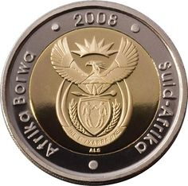
FINANCIAL PERFORMANCE INFORMATION
2016-17

Slide 44
CONTENT
)
Audited expenditure report :Actual vs Budget per programme.
Audited expenditure report :Actual vs Budget per Economic Classification.
Departmental Revenue.
2016/17 Audit Outcome.
Compliance with Legislation.
Steps to be taken to improve the audit outcome.

Slide 45
AUDITED EXPENDITURE REPORT: ACTUAL vs BUDGET PER PROGRAMME
PROGRAMME | FINAL BUDGET R’000 | FINAL EXPENDITURE R’000 | VARIANCE R’000 | %
1. Administration | 2,222,834 | 2,210,834 | 12,000 | 99.5%
2. Civics | 4,787,170 | 4,786,988 | 182 | 100%
3. IMS | 1,145,801 | 1,145,702 | 99 | 100%
TOTAL | 8,155,805 | 8,143,524 | 12,281 | 99.8%
During the 2016/17 financial year, the Department has underspent its allocation by 0.15 % (R12 million). The under spending is as a result of delays in the implementation of VOIP and video conferencing. NT has approved to roll-over funds to 2017/18.

Slide 46
AUDITED EXPENDITURE REPORT: ACTUAL vs BUDGET PER ECONOMIC CLASSIFICATION
Per economic classification | Final Budget R’000 | Actual Expenditure R’000 | Under(Over) spending R’000 | % Spend
CURRENT PAYMENT | 6,104,670 | 6,104,389 | 281 | 100%
Compensation of employees | 3,069,825 | 3,069,768 | 57 | 100%
Goods and Services | 3,034,845 | 3,034,621 | 224 | 100%
TRANSFERS & SUBSIDIES | 1,815,653 | 1,815,653 | - | 100%
Provinces & Municipalities | 918 | 918 | - | 100%
Departmental agencies & accounts | 1,792,405 | 1,792,405 | - | 100%
Households | 22,330 | 22,330 | - | 100%

Slide 47
AUDITED EXPENDITURE REPORT: ACTUAL vs BUDGET PER PROVINCE
PROVINCES | FINAL BUDGET | FINAL EXPENDITURE | UNDER/OVER SPENDING | % Spent
 | R’000 | R’000 | R’000
EASTERN CAPE | 241 571 | 241 500 | 71 | 100.0%
FREE STATE | 127 298 | 127 229 | 69 | 99.9%
GAUTENG | 400 151 | 400 171 | (20) | 100.0%
KWAZULUNATAL | 228 879 | 228 860 | 19 | 100.0%
LIMPOPO | 222 046 | 222 124 | (78) | 100.0%
MPUMALANGA | 151 763 | 151 783 | (20) | 100.0%
NORTH WEST | 156 555 | 156 508 | 47 | 100.0%
NORTHERN CAPE | 97 443 | 97 454 | (11) | 100.0%
WESTERN CAPE | 168 590 | 168 623 | (33) | 100.0%
TOTAL | 1 794 296 | 1 794 252 | 44 | 100.0%

Slide 48
DEPARTMENTAL REVENUE
Departmental Receipts | Estimate R’000 | Actual Amount Collected R’000 | Over(Under) collection R’000
Sale of goods & services other than capital assets | 935,912 | 1,074,164 | 138,252
Fines, penalties and forfeits | 16,070 | 10,271 | (5,799)
Interest, dividends and rent on land | 315 | 616 | 301
Transfer received(cash donations) | - | 1,162 | 1,162
Sale of capital assets | 2,264 | 3,058 | 794
Financial transactions in assets & liabilities | 7,764 | 10,265 | 2,501
Total | 962,325 | 1,099,536 | 137,211
The sale of goods & services includes foreign revenue of R 298 million collected by Dirco on behalf of the Department as compared to last financial year R 332 million

Slide 49
30 DAY PAYMENTS - PROVINCES
YTD & QTD STATS |  | YEAR -TO- DATE [FY2016/17]
 |  | 0-30 Performance |  |  |  | 31+ Performance
Province | Prov Code | TOTAL YTD Qnty | 0-30 Qnty | %Performance(YTD - 201617) PAID WITHIN 30 DAYS | PAID WITHIN 30 DAYS VALUE | % Under-Performance (YTD-201617) PAID AFTER 30 DAYS | PAID AFTER 30 DAYS VALUE
Head Office | HO | 18 669 | 14 808 | 79.32% | 1 563 122 421.07 | 20.68% | 419 896 803.02
Eastern Cape | EC | 1 119 | 1 108 | 99.02% | 9 238 329.23 | 0.98% | 44 736.77
Free State | FS | 993 | 987 | 99.40% | 3 420 480.44 | 0.60% | 401 240.79
Gauteng | GP | 1 104 | 1 075 | 97.37% | 4 685 209.31 | 2.63% | 144 290.20
Kwazulu Natal | KZN | 2 979 | 2 856 | 95.87% | 12 441 936.20 | 4.13% | 319 142.99
Limpopo | LP | 1 998 | 1 941 | 97.15% | 6 183 156.33 | 2.85% | 146 710.53
Mpumalanga | MP | 1 068 | 1 042 | 97.57% | 4 315 475.03 | 2.43% | 110 315.83
Northern Cape | NC | 1 838 | 1 831 | 99.62% | 13 038 693.17 | 0.38% | 9 603.13
North West | NW | 977 | 976 | 99.90% | 4 519 512.29 | 0.10% | 1 208.66
Western Cape | WC | 1 322 | 1 322 | 100.00% | 5 705 115.11 | 0.00% | 0.00
GRAND TOTALS |  | 32 067 | 27 946 | 87.15% | 1 626 670 328 | 12.85% | 421 074 052

Slide 50
30 DAY PAYMENTS - PROVINCES
 |  | HEAD OFFICE ONLY , MONTH - TO-DATE [MARCH - 2017]
 |  | 0-30 Performance |  |  |  | 31+ Performance
Head Office Branch | HO Code | TOTAL Monthly Qnty | 0-30 Qnty | % Performance (MARCH -2017) | PAID WITHIN 30 DAYS VALUE | % Under-Performance (March - 2017) PAID AFTER 30 DAYS | PAID AFTER 30 DAYS VALUE
Immigration Services | Immigration | 473 | 422 | 89.22% | 34 501 830.96 | 10.78% | 125 078.12
Civics Services | Civics | 259 | 244 | 94.21% | 9 458 000.42 | 5.79% | 289 681.89
Information Services | IT | 111 | 110 | 99.10% | 70 754 654.96 | 0.90% | 15 016.74
Finance & SCM | FSCM | 263 | 248 | 94.30% | 37 662 383.82 | 5.70% | 32 171 680.06
Human Resource | HR | 226 | 215 | 95.13% | 1 412 142.22 | 4.87% | 97 771.39
IPS | IPS | 152 | 138 | 90.79% | 1 250 645.06 | 9.21% | 3 577 330.84
Director-General | DG | 51 | 49 | 96.08% | 190 720.05 | 3.92% | 5 098.51
Ministry | Ministry | 207 | 97 | 46.86% | 1 096 600.01 | 53.14% | 1 727 878.89
Communications | Comms | 45 | 45 | 100.00% | 542 964.37 | 0.00% | 0.00
Counter Corruption | CC&SS | 106 | 106 | 100.00% | 10 069 894.78 | 0.00% | 0.00
Deputy Minister | Deputy Minister | 0 | 0 | 0.00% | 0.00 | 0.00% | 0.00
Border Management Agency | BMA | 11 | 10 | 90.91% | 151 406.72 | 9.09% | 1 069 484.55
Various - Branches | Various | 0 | 0 | 0.00% | 0.00 | 0.00% | 0.00
Provincial Offices | Provinces | 1 506 | 1 497 | 99.40% | 3 589 532.64 | 0.60% | 30 820.13
GRAND TOTALS |  | 3 410 | 3 181 | 93.28% | 170 680 776 | 6.72% | 39 109 841

Slide 51
2016/17 AUDIT OUTCOME
)
UNQUALIFIED WITH FINDINGS
MATTERS OF EMPHASIS
Restatement of corresponding figures as a result of an error in the financial statements of the Department at and for the year ended 31 March 2017.
Uncertainty relating to the future outcome of litigation: The Department is a defendant in various claims against the State. The ultimate outcome of these matters cannot presently be determined and no provision for any liability that may result has been made in the financial statements.
Irregular expenditure: the closing balance of R516 million includes an amount of R146 million incurred in the current and prior years that was still under investigation..

Slide 52
COMPLIANCE WITH LEGISLATION
)
Financial statements submitted for auditing were not prepared in accordance with the prescribed financial reporting framework and supported by full and proper records.
Material misstatements of current assets, current liabilities and cash flow identified by AGSA were corrected.
Not all contractual obligations and money owed by the Department were settled within 30 days.

Slide 53
STEPS TO BE TAKEN TO IMPROVE THE AUDIT OUTCOME
)
Audit action plan to address root causes with realistic target dates;
Greater reliance on Internal Audit;
Compliance checklist enforcement;
Focus areas: 30 day payment; irregular expenditure; monitoring of audit action plan;
Prompt and decisive consequence management required to address: awards made to close family members; officials doing business with the state; irregular expenditure and fruitless & wasteful expenditure.

Slide 54
WAY FORWARD
Review and conclude the dispute relating working hours; as this will affect some of the key DHA’s outputs
Strengthen lease agreements i.e. Transnet National Ports Authority; which prevented the completion of site visits to selected POE’s
Filling of critical posts in the Department i.e. DDG posts and specialist areas
Close and tight cooperation with governance structures i.e. Auditor General, risk management and audit committees to maintain improved audit outcomes (for both information and financials).

Slide 55
DHA would like to thank the Committee for their support and guidance.
Ke a leboha
Ndiyabulela
Thank you
Inkomu
Ngiyabonga
Dankie
Ke ya leboga
Ndo livhuwa

