Slide 1


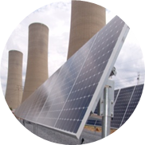
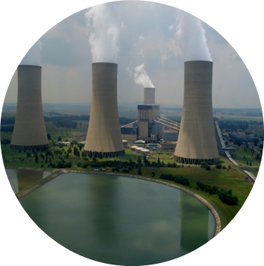
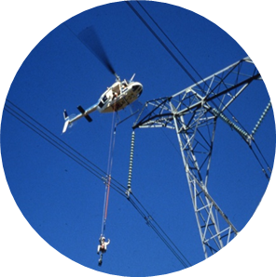
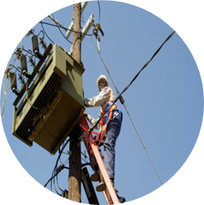
Eskom’s compliance with the Minimum Emission Standards
Presented at the Portfolio Committee on Environmental Affairs' Workshop on the Minimum Emission Standards
Date: 8 November 2017

Slide 2
Executive overview
Eskom supports the Minimum Emission Standards as they are needed to reduce harmful health effects of air pollution and provide certainty for planning
Power stations generally comply with the Minimum Emission Standards at the moment, but from 2020 will need to complete emission abatement retrofits and be granted postponements to remain in compliance
Particulate emissions from power stations have reduced by more than an order of magnitude in the last 30 years, but there has been no significant change to SO₂ or NOx emissions
Eskom has adopted a phased approach to compliance with the MES because there is insufficient funding, water and outages available in the short term
Eskom’s ambient air quality monitoring network shows that there is generally compliance with ambient SO₂ and NOx standards, but non-compliance with PM10 and PM2.5 standards on the Mpumalanga Highveld
Eskom’s air quality offset programme will address domestic burning which is the greatest source of PM2.5 in communities near power stations

Slide 3
Overview
Power station compliance with MES
Emission trends
Achieving full compliance with the MES
Eskom’s air quality offsets programme
Eskom’s ambient air quality monitoring network
Eskom’s emission reduction plan

Slide 4
Power station compliance with the MES: Compliance with current limits (2015-2020)
 | Power station | _{Sulphur} _{Dioxide} | Oxides of Nitrogen | Particulate Matter
New build coal-fired | Kusile
 | Medupi
Coal-fired | Majuba
 | Kendal
 | Matimba
 | Lethabo
 | Tutuka
 | Duvha (U1-3)
 | Duvha (U4-6)
 | Matla
 | Kriel
 | Arnot
 | Hendrina
Return-to-service coal-fired | Camden
 | Grootvlei
 | Komati
Liquid fuel-fired gas turbines | Ankerlig
 | Gourikwa
 | Acacia
 | Port Rex
Exceedances of SO₂ limits at Medupi and Matimba when high sulphur coal is burnt
 | Always comply
 | Postponement needed
 | Retrofit and postponement

Slide 5
Power station compliance with the MES: Compliance for 2020-2025
 | Power station | SO₂ | NOx | PM
New build coal-fired | Kusile
 | Medupi
Coal-fired | Majuba
 | Kendal
 | Matimba
 | Lethabo
 | Tutuka
 | Duvha (U1-3)
 | Duvha (U4-6)
 | Matla
 | Kriel
 | Arnot
 | Hendrina
Return-to-service coal-fired | Camden
 | Grootvlei
 | Komati
Liquid fuel-fired gas turbines | Ankerlig
 | Gourikwa
 | Acacia
 | Port Rex
Compliance will be achieved through emission reduction retrofits and hopefully approved postponements
 | Always comply
 | Postponement needed
 | Retrofit and postponement

Slide 6
Power station compliance with the MES: Compliance post-2025
 | Power station | _{Sulphur dioxide} | Oxide of Nitrogen | Particulate Matter
New build coal-fired | Kusile
 | Medupi
Coal-fired | Majuba
 | Kendal
 | Matimba
 | Lethabo
 | Tutuka
 | Duvha (U1-3)
 | Duvha (U4-6)
 | Matla
 | Kriel
 | Arnot
 | Hendrina
Return-to-service coal-fired | Camden
 | Grootvlei
 | Komati
Liquid fuel-fired gas turbines | Ankerlig
 | Gourikwa
 | Acacia
 | Port Rex
 | Always comply
 | Postponement needed
 | Retrofit and postponement

Slide 7
Emission trends: particulate matter
1982
2017

Slide 8
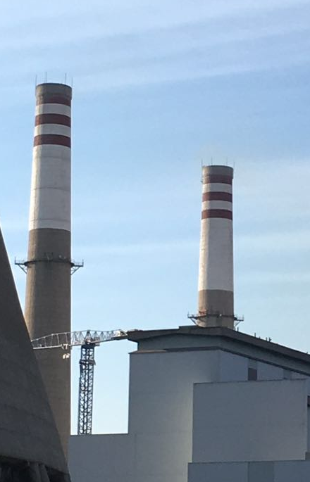
Emission trends: Grootvlei fabric filter plant retrofit
More than 10-fold reduction in particulate emissions from Grootvlei Power Station due to fabric filter plant retrofit
Clean stacks after Grootvlei fabric filter plant retrofit

Slide 9
Emission trends: SO₂ and NOx
NOx emissions
SO₂ emissions
Eskom’s NOx emissions have decreased by 9% since 2010/11 as a result of the decline in use of the coal-fired fleet
Eskom’s SO₂ emissions have not clearly decreased over the last 6 years despite the decrease in energy generated, due to the commissioning of Grootvlei and then Medupi Power Stations which both have high relative SO₂ emissions
GWh sent out from coal-fired fleet

Slide 10
Emission trends: Projected reductions due to Eskom’s current emission reduction plan
Particulates
SO₂
NOx

Slide 11
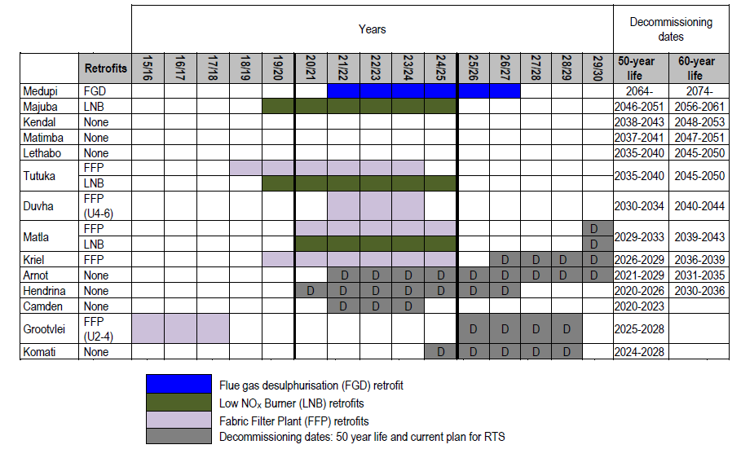
Eskom’s emission reduction plan
HFT
HFT
HFT
HFT
HFT
or high frequency transformer (HFT) installations

Slide 12
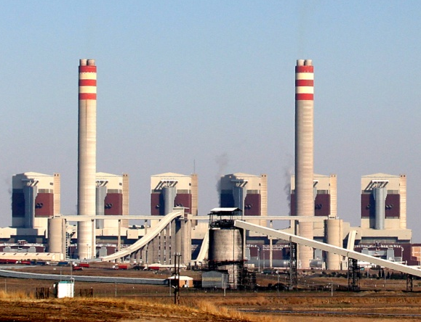
Achieving full compliance with the MES: Typical resource requirements and waste production for compliance for a 3600 MW power station
INPUTS
OUTPUTS
Capital costs:
R25-28.5 billion
Reduced SO₂, NOx & particulate emissions
Water:
3-6 million m³/annum
FGD waste/by product
Gypsum~675 000 tons/annum
Sorbent:
>400 000 tons/annum
Additional CO₂:
~165 000 tons/annum
Operating costs:
>R300 million/annum
Outage requirements:
Up to 150 days per unit

Slide 13
Achieving full compliance with the MES: Current plan vs full compliance cost
~3% higher electricity tariff
Cost (nominal)
Description
Current emission reduction plan to 2025 (57% compliance)
R63 billion*
FGD at Medupi
Low NOx burners at 3 stations
FFP at 2.5 stations
ESP upgrades at 4.5 stations
Requested by DEA in the postponement decision in addition to Eskom commitment
>R79 billion
FGD at Matimba and Kendal
~10% higher electricity tariff
Full compliance including retrofitting of stations close to end of technical life (risk cost)
>R300 billion (total)
FGD at 11 power stations
Low NOx burners 11 stations
FFP at 3.5 stations
ESP upgrades at 4.5 stations
*Subject to NERSA approval

Slide 14
Achieving full compliance with the MES: current plan vs full cost
Implications | Eskom’s emission reduction plan* | Full compliance with Emission Standards
Outages | 120-150 days/affected unit | 150 days per unit
Water consumption increase | 2-7% (8-24 million m³/annum) | 20% (67 million m³/annum)
CAPEX costs (nominal costs excl IDC) | R63 billion | >R300 billion
Annual OPEX costs | R1-2.5 billion | R6 billion
Tariff increase | 2-3% higher for 15 years | 8-10% higher for 10 years
Auxiliary power increase | 180-630 GWh/annum | 2 255 GWh/annum
CO₂ emission increase (FGD process only) | 400 000 tons/annum | 1-4 million tons/annum
Increase in coal consumption due to low NOx burners | 550 000 tons/annum | 970 000 tons/annum
FGD by-product production | 1.7 million tons/annum | 9.5 million tons/annum
*Excludes FGD at Kendal and Matimba but assumes NERSA approval of costs

Slide 15
Achieving full compliance with the MES: Assuming a ‘realistic’ retrofit timeline (scenario for Integrated Resource Plan)
It is assumed that:
Additional water for FGD is available
There is sufficient funding
FGD retrofits start at only one new station every year

Slide 16
Achieving full compliance with the MES: Assuming a ‘realistic’ retrofit timeline
Nominal CAPEX costs
Total days outage
Additional water use

Slide 17
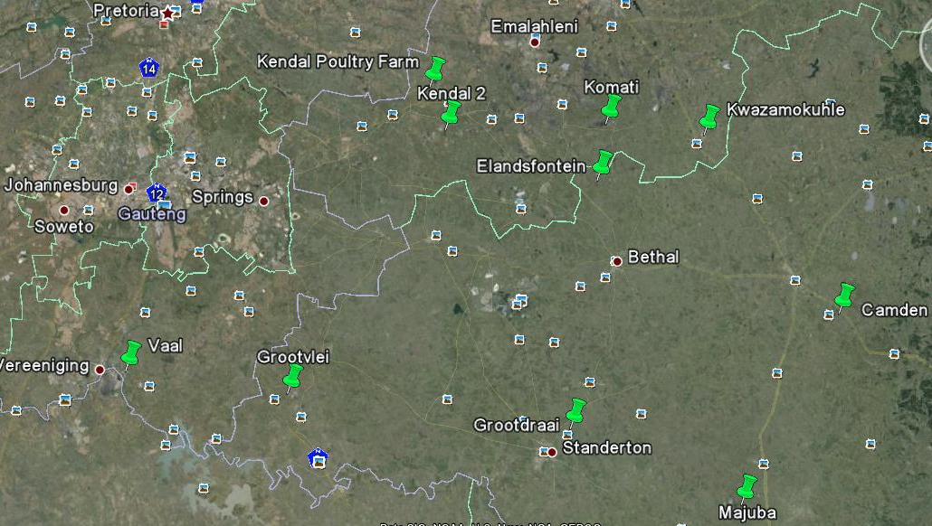
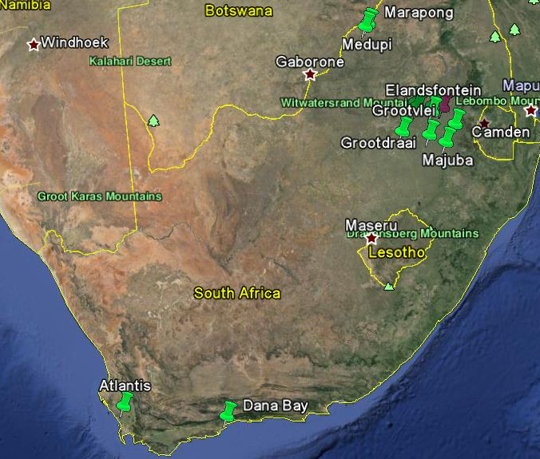
Eskom’s ambient air quality monitoring network
18 monitoring stations
Operated by Eskom’s ambient air quality monitoring team in RT&D (except for Edgemead and Mossel Bay)
Network is SANAS-accredited
Parameter | Compliance status
SO₂ | Compliance at all monitoring stations, except non-compliance with daily limit at Komati and KwaZamokuhle
NOx | Compliance at all monitoring stations
Particulate matter (PM10 & PM2.5) | Non-compliance at all monitoring stations except for Camden and Medupi
Edgemead
Mossel Bay
17

Slide 18
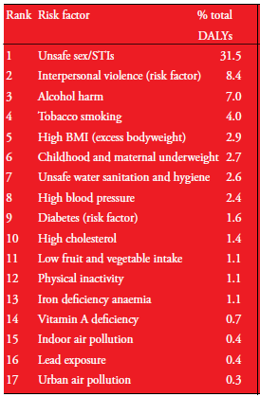
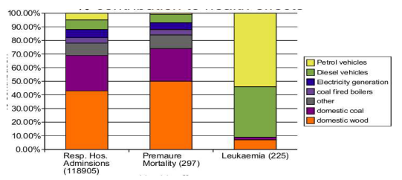
Why are air quality offsets a good idea?
Disability Adjusted Life Years attributed to selected risk factors
Causes of air quality related health effects
(FRIDGE, 2004)
(MRC, 2008)
A 10% increase in the electricity tariff will only solve 7% of the problem
18

Slide 19
Eskom’s air quality offsets programme
2011-2013
2014-2016
2017
2018-2020
2019-2025
Pilot project in KwaZamokuhle – 120 households
Lead implementation (KwaZamokuhle, Ezamokuhle Sharpeville) – 5000 households
Large-scale roll-out (at least one settlement per power station) – 40 000 households
Pre-feasibility study
Electricity pilot in KwaZamokuhle – 30 households
Insulation and electricity
Tested insulation, LPG, clean coal stoves, electricity subsidy; electricity starter pack

Slide 20

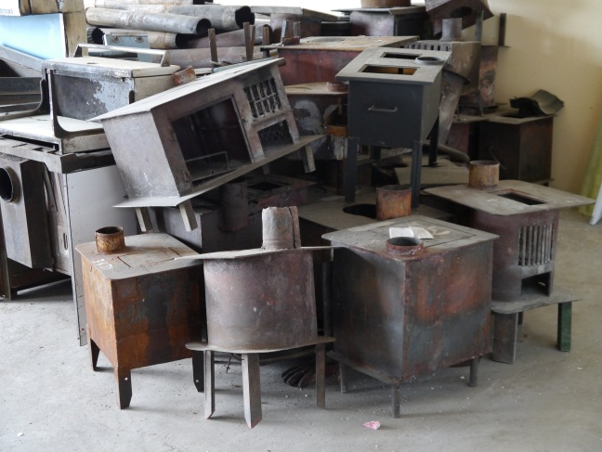
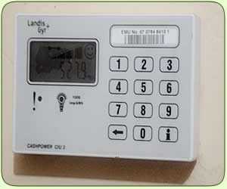
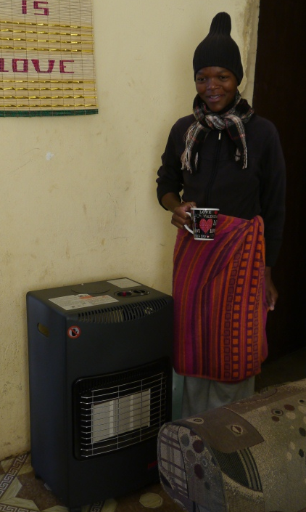
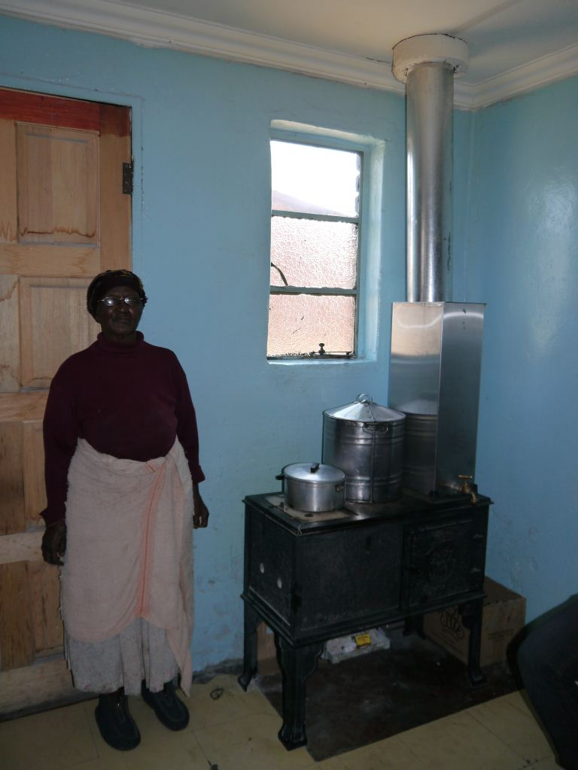
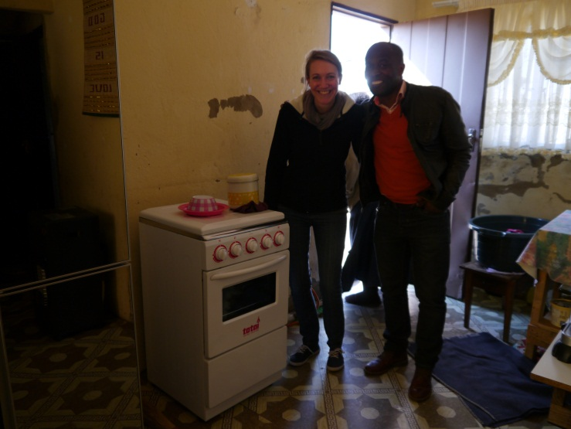

Interventions tested in 120-house pilot study (2015-16): fuel efficiency or switching
Electricity subsidy
LPG stove and heater
Efficient stove

Slide 21
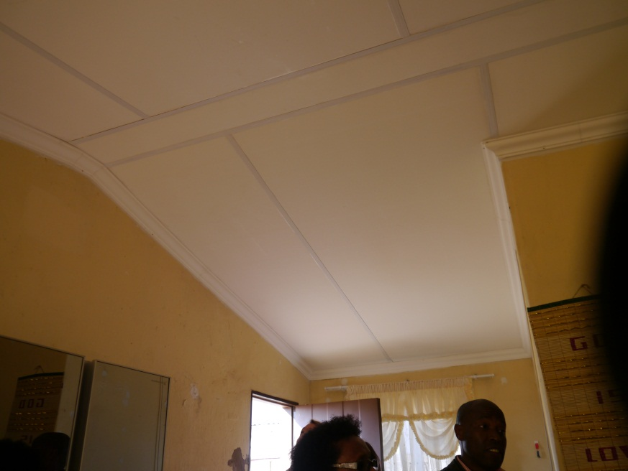
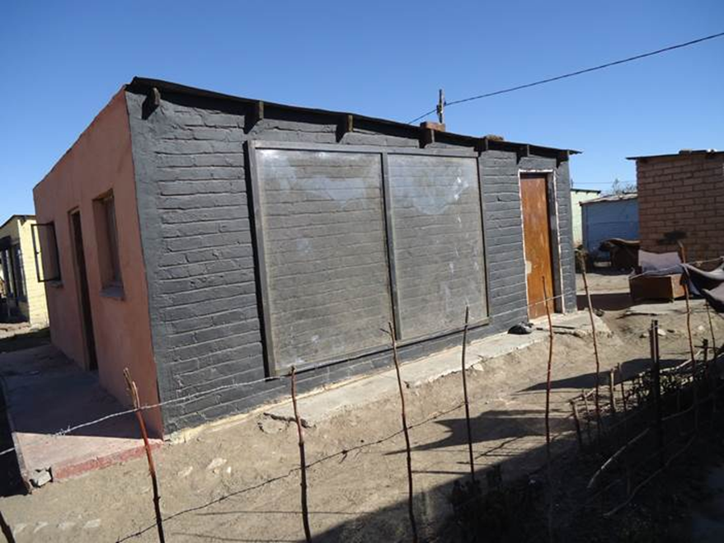
Interventions tested in 120-house pilot study (2015-16): housing insulation
Ceilings
Full thermal insulation: ceilings + three insulated walls + Trombe wall

Slide 22
Lessons learnt from the KwaZamokuhle pilot project
Domestic burning in KwaZamokuhle accounts for more than 50% of the ambient fine particulate matter
Indoor air quality is mainly determined by outdoor air quality, so interventions in a few houses have little impact on indoor air quality
Mean monthly income is less than R2000 per household. Households spend around R200-R300 per month on coal in winter. Affordability drives energy carrier selection.
Residents were very willing to participate in all interventions (>80%) and did not want their old coal stoves back at the end
Around 30% of households live in informal dwellings. A solution is still needed.

Slide 23
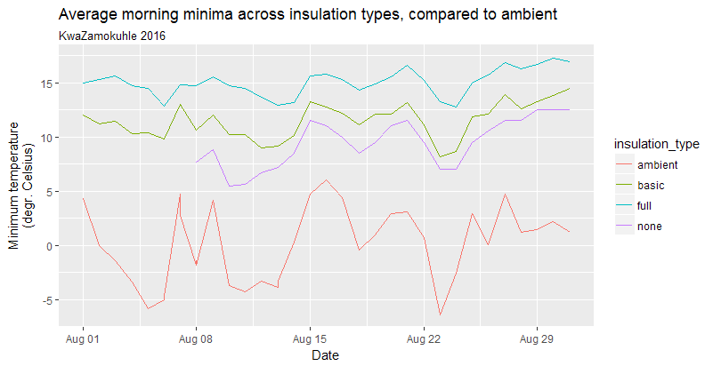
Lessons learnt from the KwaZamokuhle pilot project
Insulation raises minimum temperatures in houses by up to 9°C
LPG was well received
A stove swop AND housing insulation are needed to reduce domestic coal burning. Electricity subsidy without removing coal stove INCREASES coal use.
Poor construction of RDP houses poses challenges for installation of insulation. Proposed to use a spray on foam in future to reduce water leaks. Draft proofing also needed.
Difference in minimum temperature between insulated and uninsulated house
Coal use per year, per intervention type

Slide 24
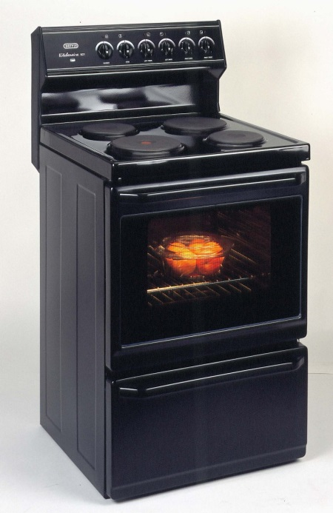
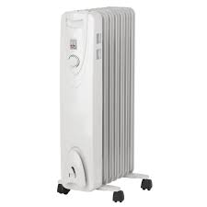
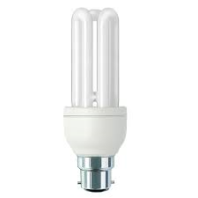
30-house electricity pilot in KwaZamokuhle (2017)
Switching households from coal to electricity is an untested intervention. A pilot on 30 houses in KwaZamokuhle is being completed to identify any fatal flaws or possible improvements.
Each house gets electricity starter pack and insulation on ceiling and three walls
CFL
Oil heater
4-plate stove and oven
  Coal stove exchanged for electricity starter pack: electric heater, electric stove and oven, energy efficient lighting, certificate of compliance

Slide 25
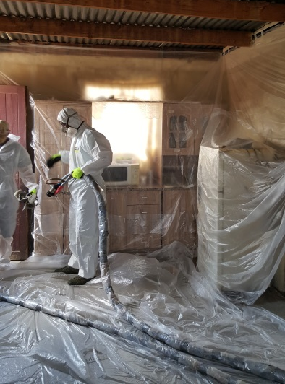
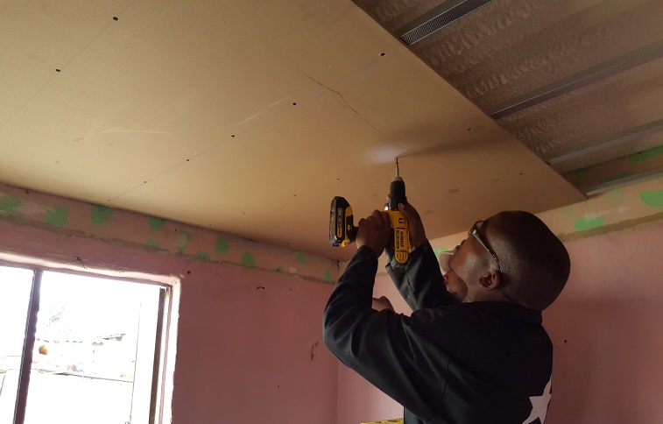
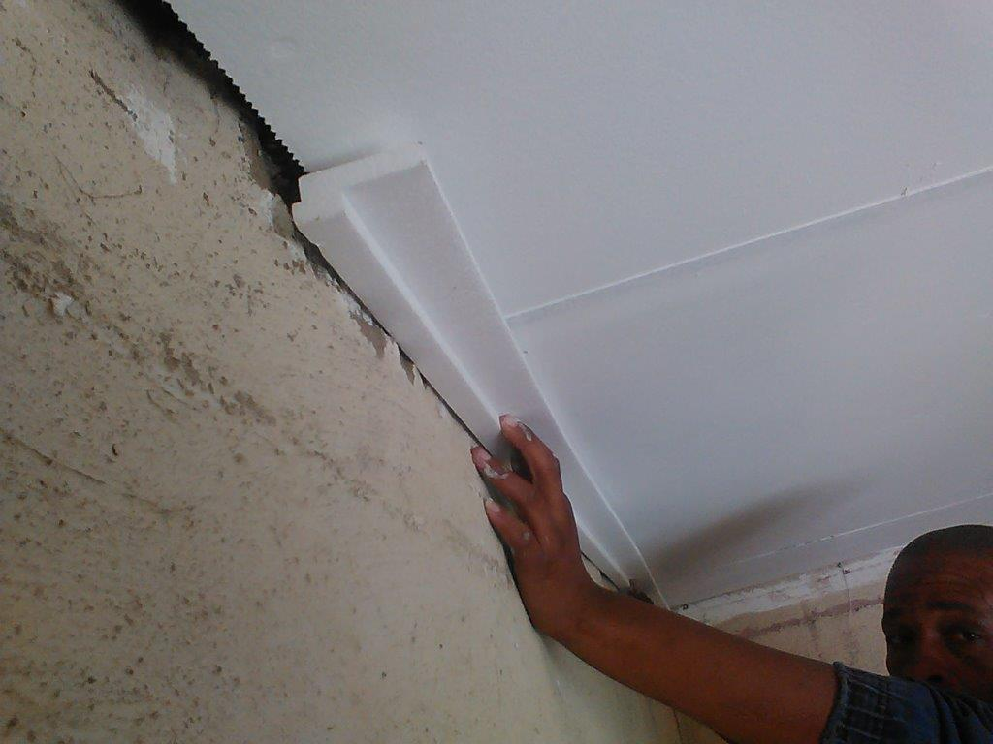
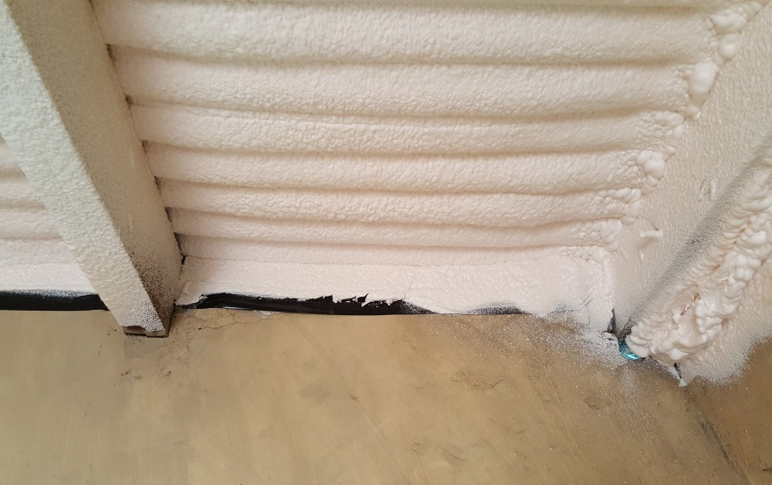
30-house electricity pilot in KwaZamokuhle (2017)
Installing the spray-on foam
Installing the ceiling
  Insulation on ceiling (spray-on foam and gypsum board) and three walls; draft-proofing

Slide 26
Concluding remarks
Eskom supports the Minimum Emission Standards because they are needed to reduce harmful health effects of air pollution, and they provide certainty for planning
Dialogue between government departments is needed to unlock conflicting mandates hampering full compliance with the MES (for example keeping electricity tariff low vs cost of reducing health burden; water for FGD)
A cost-benefit analysis is needed to prioritise retrofits and most efficiently channel scarce resources.
Eskom remains committed to reducing its environmental footprint

