Slide 1
PCEA WORKSHOP ON THE MINIMUM EMISSIONS STANDARDS (MES) IN SOUTH AFRICA
7- 8 November 2017, Cape Town

Slide 3
What you will hear today
Sasol is committed to compliance with all applicable laws including air quality laws. This supports sustainable air quality improvements as envisaged through the Air Quality Act and priority area air quality management plans
We are making good progress against our air quality roadmaps as committed in our postponement applications:
Continuous improvements and statutory maintenance have realised significant reductions in PM even prior to 2015
Our VOC roadmap in Secunda targets a mass-based reduction of 80% from a 2009 baseline, and we are likely to surpass this
Our NOx emissions have been consistently below the Atmospheric Emission License (“AEL”) level as informed by the postponement decisions
To support these roadmaps, we have a capital allocation framework to assist us in allocating capital, prioritising capital allocation towards the retention of Sasol’s license to operate
We already meet most of the Minimum Emissions Standards (MES) for existing plants, and will also be able to meet most of the new plant standards by latest 2025. This extended timeframe is required to safely implement the necessary abatement technologies in accordance with our roadmap schedules, taking into consideration shutdown and statutory maintenance obligations
In this regard, in the past we applied for, and going forward, we will be reliant on further applications for postponements, as the only legal mechanism currently provided for in law. Consequently, our licences, under which we are required to operate during the extended compliance period, contain appropriate limits informed by independent air quality specialist studies on the basis that these do not affect ambient air quality beyond National Ambient Air Quality Standards (NAAQS)
However, the new plant standards for boiler plant SO2 pose significant compliance challenges from a feasibility perspective for existing, maturing plants. The measured levels of SO2 in the airsheds where we operate are well below the internationally accepted health standard. Our appeal therefore is to consider alternative mechanisms to enable progressive air quality improvements for maturing facilities. To this extent, we continue to constructively engage in law reform processes and in this regard have recently submitted comments into the DEA’s framework review consultations
We believe it is appropriate for the applicable authorities to consider our postponement applications, since we meet the conditions of such applications and in particular demonstrate that our current and proposed contribution does not cause exceedance of the (NAAQS)
Regulation of industrial point sources alone, in our view, is insufficient to achieve the NAAQS. Offsets are therefore an important complementary mechanism in achieving the statutory objectives

Slide 4
We are making good progress against our air quality roadmaps

Slide 5
We are making good progress against our air quality roadmaps as committed in our postponement applications
Continuous improvements and statutory maintenance have realised significant reductions in particulate matter (PM) even prior to 2015
Our Boiler plant PM levels at Synfuels have been consistently below the existing AEL level as informed by the 2015 postponement decision
High-frequency transformer (HFT) (possible cost effective solution) trials to be executed during 2018
Our VOC roadmap in Secunda targets a mass-based reduction of 80% from a 2009 baseline, and significant reductions have already been realised
We are likely to surpass our voluntary VOC reduction target
Our NOx emissions have been consistently below the AEL level as informed by the 2015 postponement decisions
Low NOx burners installed on a boiler in Secunda, and further trials planned in both Secunda and Sasolburg for 2018
We have prioritised investigations for our incinerators in Sasolburg and Secunda in accordance with the waste hierarchy and have identified promising options that are overall more environmentally optimal as well as capital efficient, which require sufficient time to develop and test

Slide 6
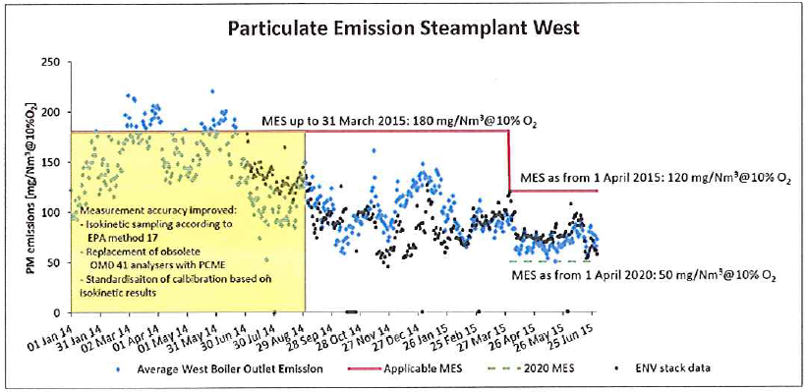
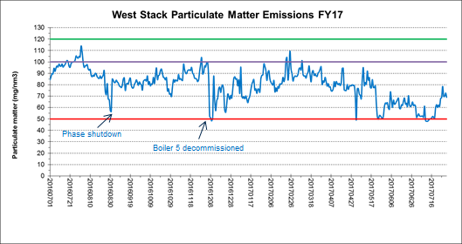
Continuous improvements and a rigorous maintenance program have realised significant reductions in PM even prior to 2015
Our boiler plant PM levels have been consistently below the existing AEL level as informed by the postponement decision
We continue to focus on 1) increasing boiler stability, 2) proactive maintenance, 3) reduction in mean time between breakdowns and 4) improvement in boiler reliability and availability
Whilst feedstock quality remains a challenge as we reach end of life on some of our mines, we continue to look for ways to stabilise coal quality
We plan to test alternative, more cost-effective solutions for our Electrostatic precipitator upgrades (e.g. high frequency transformers) within the next 12 months. If successful, this may enable quicker implementation and reductions in PM

Slide 7
Our VOC roadmap targets a mass-based reduction of 80% from a 2009 baseline, and significant reductions have been realised
We are likely to surpass our voluntary Group reduction target
Project in execution
Complete
FID taken
Complete
Pre-feasibility

Slide 8
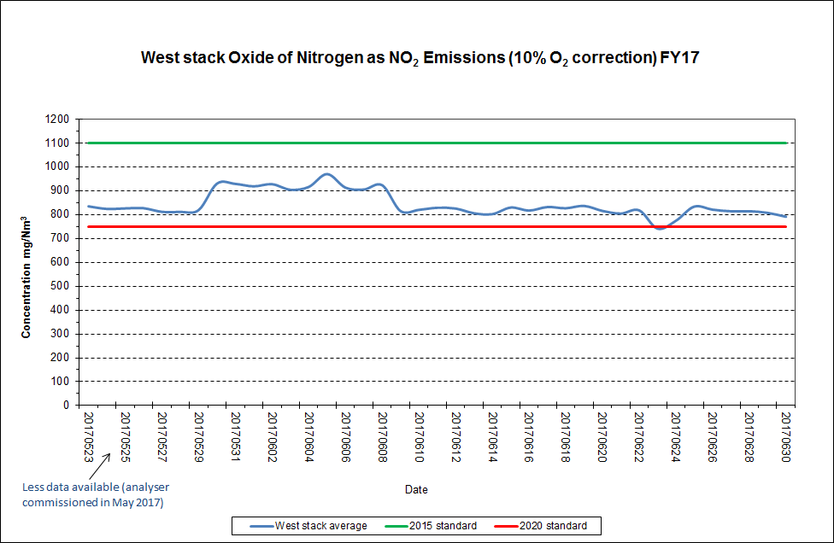
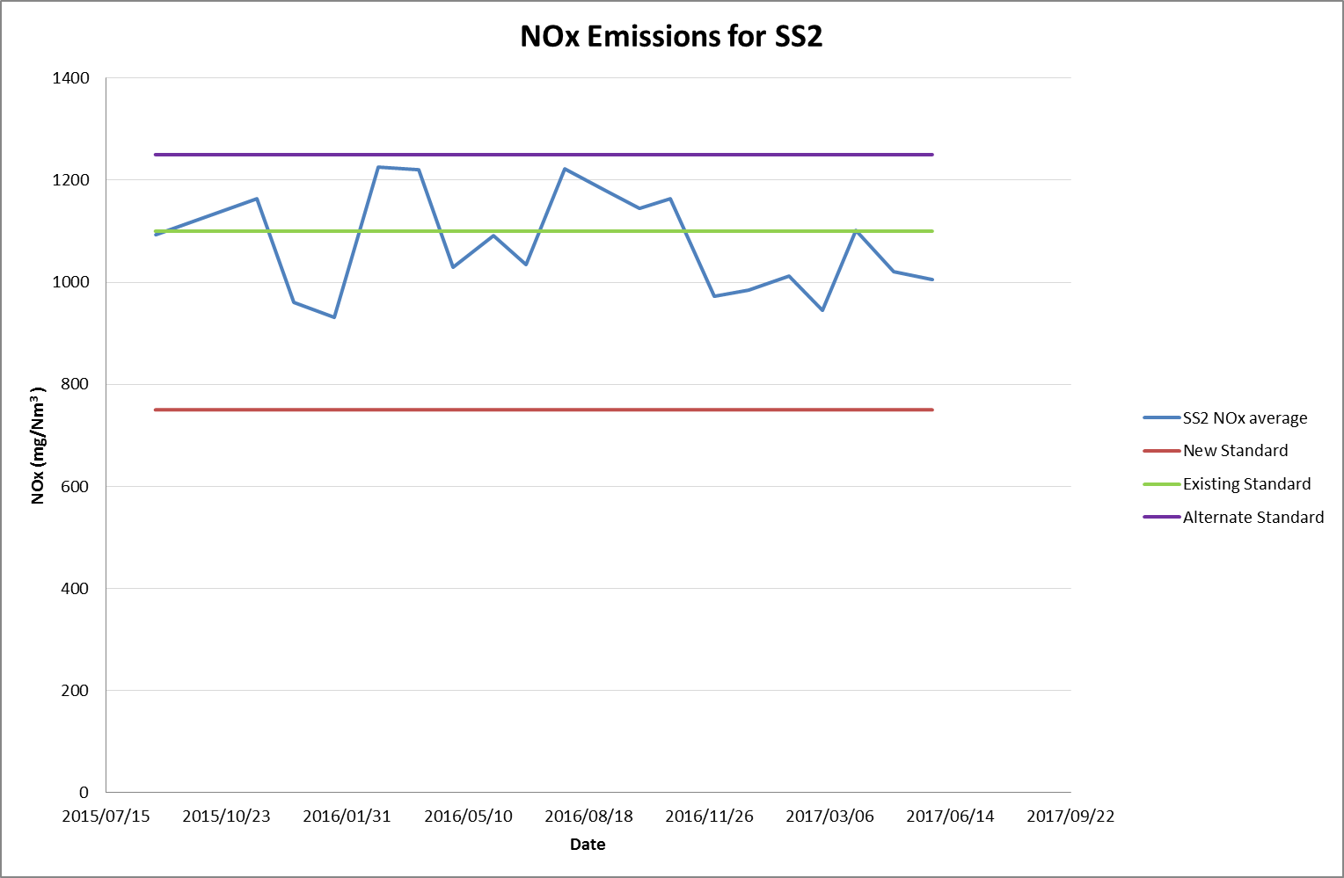
Our NOx emissions have been below the AEL level as informed by the 2015 postponement decisions
Secunda and Sasolburg operations piloting Low NOx Burners to assess technology performance
Secunda Synfuels Operations
Our Eastern and Western stack average emissions are 913 mg/Nm3 and 843 mg/Nm³ respectively which is below the 2015 existing plant standards
Sasol has one boiler retrofitted with LNB. Whilst initial indications yielded positive results in reducing NOx, associated operability challenges resulted in increased PM emissions
Our current NOx abatement project has progressed to feasibility. We are optimistic of the solution, however more test work needs to be done
Development funding has been approved and test will commence on one boiler early next year
Sasolburg Operations
Our Sasolburg Operations have realised NOx reductions below the AEL limit
Sustaining consistently low emissions below the standard is challenged by varying coal quality and other operational issues
Piloting of Low NOx burners on boiler 12 is progressing with an expected start-up date of May 2018
AAEL limit

Slide 9
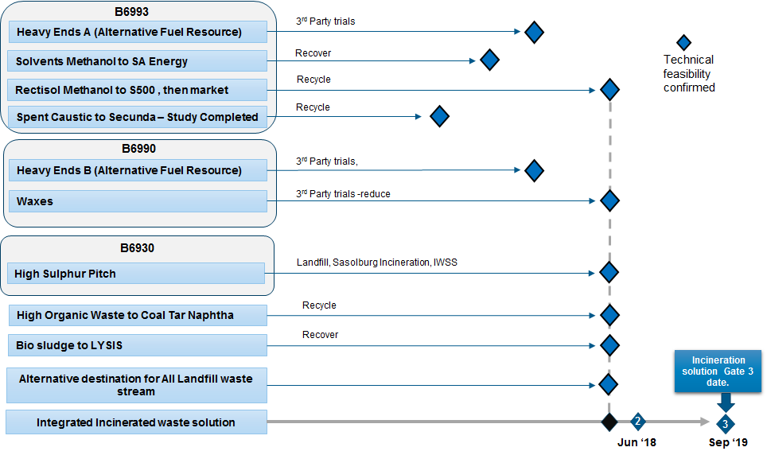
We have prioritised investigations for our incinerators in Sasolburg and Secunda in accordance with the waste hierarchy
In order to find the most environmentally sustainable solutions, reducing the need for incineration as far as possible, we are investigating promising options which require sufficient time to develop and test
~86% of total incinerated waste volume from Secunda.

Slide 10
We have a capital allocation framework to assist us in allocating capital and prioritising capital allocation towards the retention of Sasol’s license to operate
We have invested more than R25 billion on capital projects, over the past twelve years, to minimise our environmental footprint

Slide 11
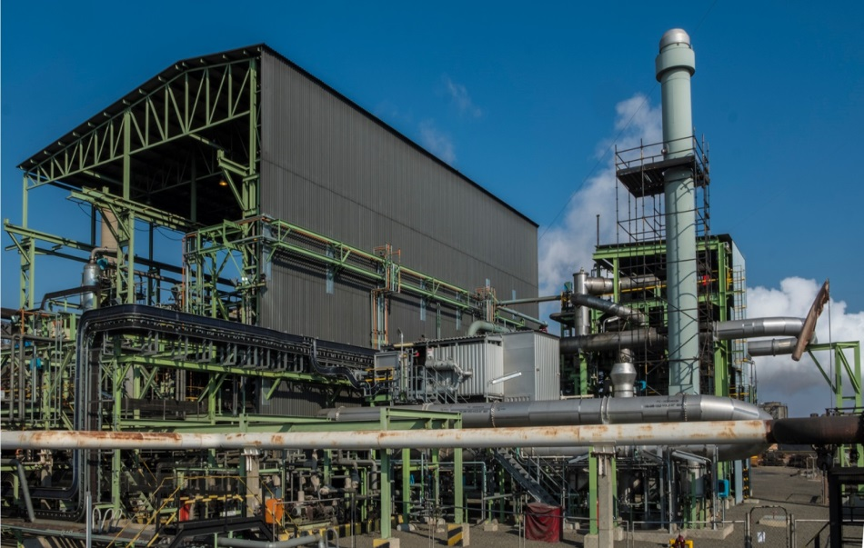
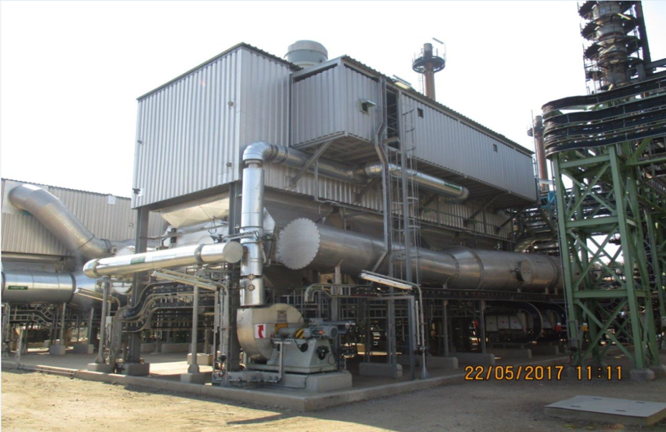
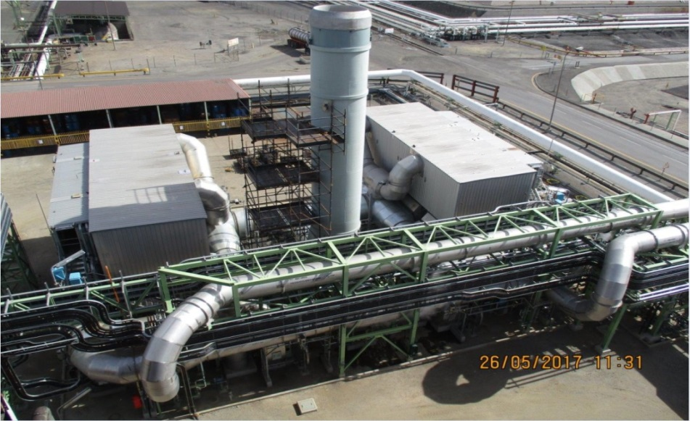
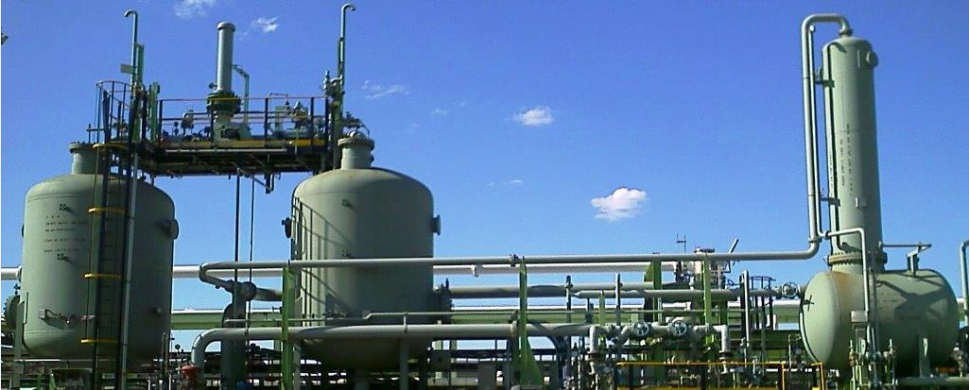
Volatile Organic Compound (VOC) abatement technologies installed on our Secunda Site
Regenerative Thermal Oxidisers (RTOs)
Regenerative Thermal Oxidisers (RTOs)
Regenerative Thermal Oxidisers (RTOs)
Vapour Recovery Unit (VRU)

Slide 12
Our AELs contain appropriate limits, informed by independent air quality specialist studies, under which we are required to operate in the extended compliance period

Slide 13
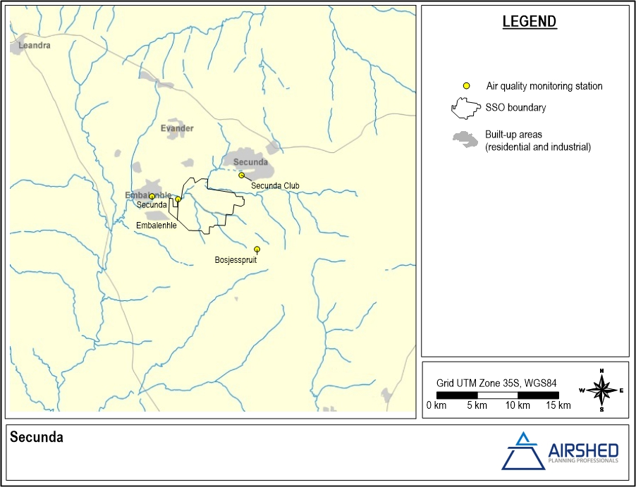
CURRENT STATE OF AMBIENT AIR QUALITY – SO₂ (2013-2015)
Ambient SO₂ levels in the Secunda region are within the National Ambient Air Quality Standards (NAAQS)
Within NAAQS
Exceed NAAQS
SO₂
SO₂
2013-2015
13

Slide 14
CURRENT STATE OF AMBIENT AIR QUALITY – NO₂ (2013-2015)
Ambient NO₂ levels in the Secunda region are within the NAAQS
Within NAAQS
Exceed NAAQS
NO₂
NO₂
2013-2015
14

Slide 15
CURRENT STATE OF AMBIENT AIR QUALITY – PM₁₀ (2013-2015)
Ambient PM10 levels in the Secunda region exceed the NAAQS
Within NAAQS
Exceed NAAQS
PM₁₀
PM₁₀
2013-2015

Slide 16
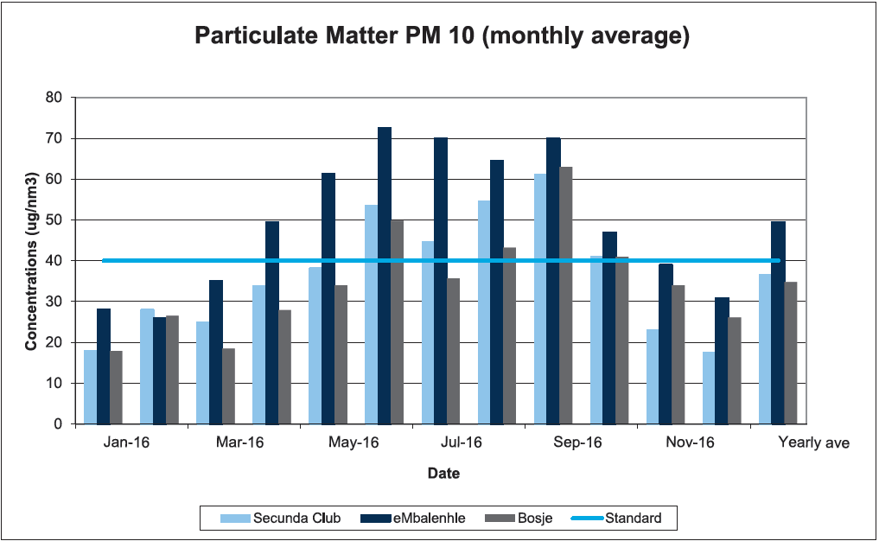
PM10 emissions for 2016 measured at the accredited Sasol Secunda ambient monitoring stations
Yearly average at eMbalenhle station exceeds NAAQS

Slide 17
CURRENT STATE OF AMBIENT AIR QUALITY – PM_{2.5} (2013-2015)
Ambient PM2.5 levels in the Secunda region exceed the NAAQS, except in the town of Secunda
Within NAAQS
Exceed NAAQS
PM_{2.5}
PM_{2.5}
2013-2015

Slide 18
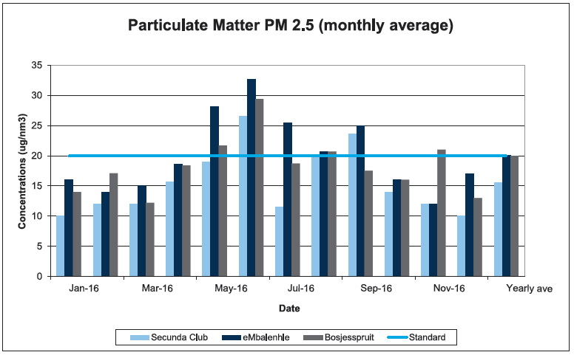
PM2.5 emissions for 2016 measured at the accredited Sasol Secunda ambient monitoring stations
Yearly average within the NAAQS

Slide 19
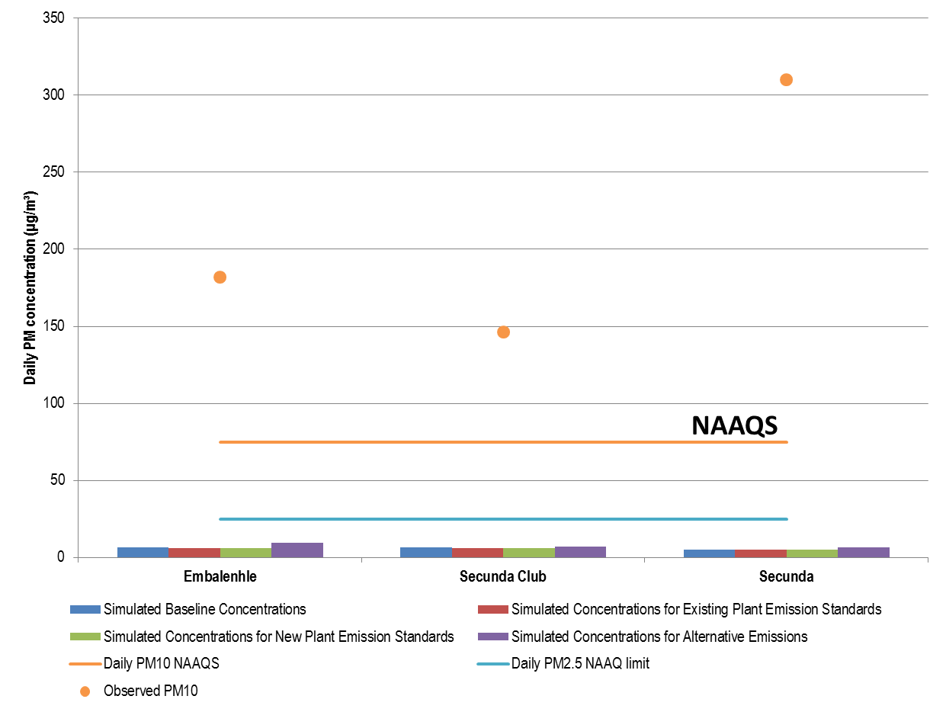
PM levels in the vicinity of our plant exceeds the NAAQS
Sasol’s simulated contribution between 2 - 3% of actual ambient concentrations
Even if the Sasol plant were to be decommissioned, ambient PM levels in the vicinity of our plant would still exceed the NAAQS, therefore offsets provide a complimentary lever to improve ambient air quality

Slide 20
New plant standards for boiler plant SO₂ pose significant compliance challenges from a feasibility perspective for existing, maturing plants

Slide 21
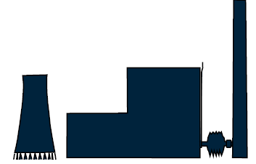
Flue gas desulphurisation technologies for boiler SO₂ abatement are complex with unintended consequences
Formally recognising air emission offsets may represent a sustainable mechanism to improve ambient air quality with the potential to deliver other concurrent environmental and socioeconomic benefits
Reduced SO₂ emissions
-
More Water
+
Reduced co-dispersion of other offgases
-
More Internal Power consumption
-
Increased CO₂ emissions
-
Additional Lime or Limestone
-
Net reduction in power output
-
Very high investment cost to retrofit complex abatement technology
$
Steam & Power Plant
New waste stream
-

Slide 22
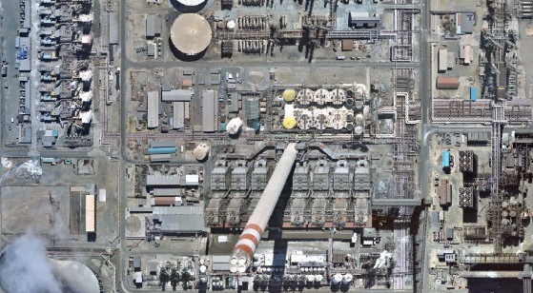
Implementing abatement technologies to meet SO₂ new plant standards challenging
Space restrictions, construction on a live brownfield site presents challenges

Slide 23
Sasol Secunda SO₂ sources do not cause exceedance of NAAQS
Boilers: 3,500 mg/Nm³
Boilers: 500 mg/Nm³
Boilers: 2,000 mg/Nm³

Slide 24
We continue to constructively engage in law reform processes and in this regard have recently submitted comments into the DEA’s framework review consultations

Slide 25
Our key comments made on the Framework review
Recognising that law reform can address existing challenges, we commented on the following, consistent with Section 5.4.3.3 of the National Air Quality Framework which provides for phase-in and transitional arrangements that distinguish between existing and new plants:
Reasonable accommodation of existing and maturing facilities that, for justifiable reasons, cannot meet the same standards as set for new plants, and are not causing significant detriment to ambient air quality.
This applies both to existing plants in meeting the current set of new plant standards, and also, looking forward, to current existing and new plants transitioning to any new requirements included in the standards, post 2020

Slide 26
Regulation of industrial point sources alone, in our view, is insufficient to achieve the NAAQS. Offsets are therefore an important complementary mechanism in achieving the statutory objectives

Slide 27
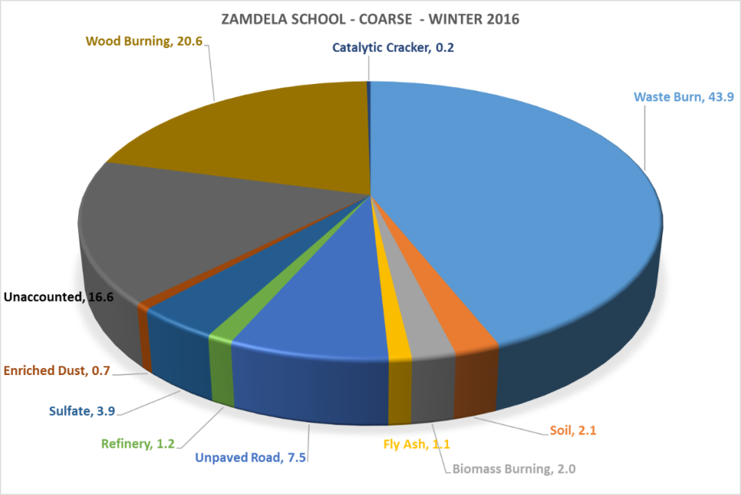
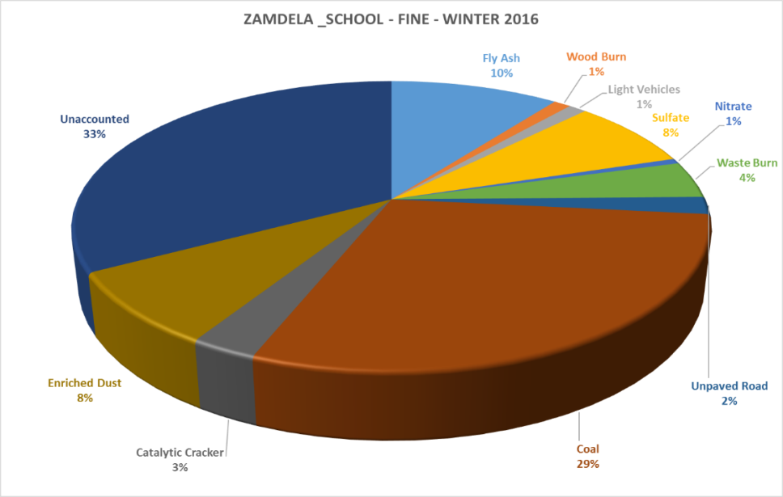
Preliminary source apportionment results indicate that non-industrial sources contribute significantly to ambient air quality
Our offset plan for Zamdela initially targets waste burning
Zamdela
Winter 2016 Coarse Fraction (PM10)
Winter 2016 Fine Fraction (PM2.5)

Slide 28
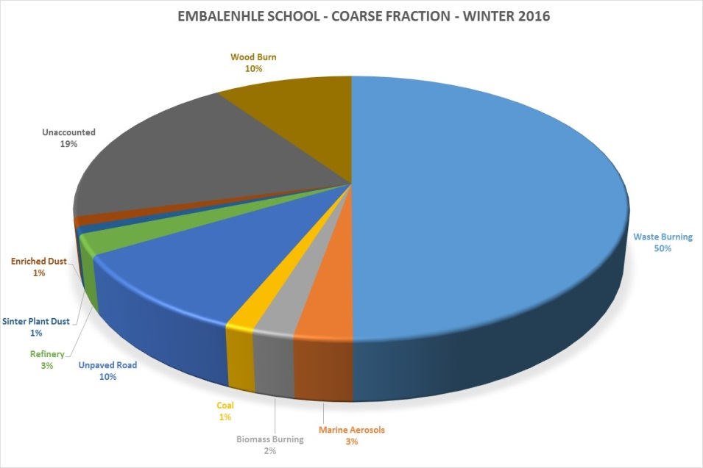
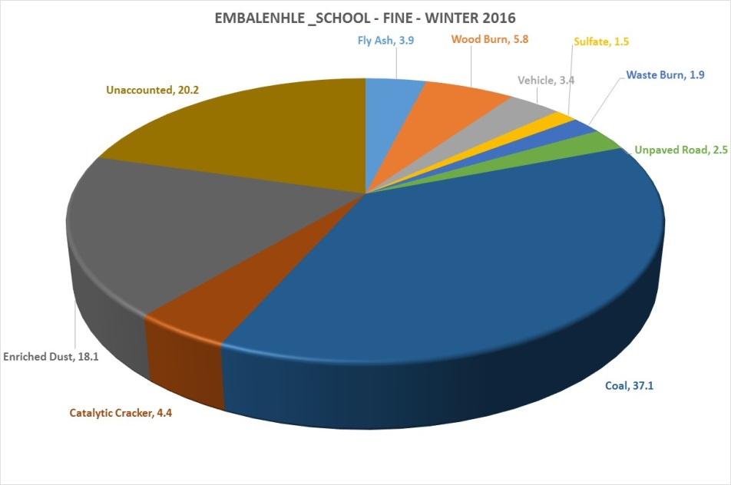
Preliminary source apportionment results indicate that non-industrial sources contribute significantly to ambient air quality
Our approved offset plan for eMbalenhle initially targets domestic solid fuel burning
eMbalenhle
Winter 2016 Coarse Fraction (PM10)
Winter 2016 Fine Fraction (PM2.5)

Slide 29
We are on track to delivering on our approved offset plans
Insulation of RDP homes
Testing of innovative solutions for the insulation of serviced informal dwellings
Veld fire management
Education and Awareness
Initiatives in Secunda focused on reducing domestic solid fuel burning
 |  | 2016 |  |  |  | 2017 |  |  |  | 2018 |  |  |  | 2019 |  |  |  | 2020
Baseline (eMbalenhle)
Baseline (Lebohang)
Lebohang , eMbalenhle (Feasibility for Roads) | PM
Lebohang , eMbalenhle (Informal housing insulation) | PM, SO_{x} NO_{x}
eMbalenhle (Veld fire management) | PM
Lebohang, eMbalenhle (Insulation of RDP) | PM, SO_{x} , NO_{x}, CO
Education and Awareness (Lebohang, eMbalenhle) | AQ PM NO_{x}
JAN
-
MAR
APR
-
JUN
JUL
-
SEP
OCT
-
DEC
JAN
-
MAR
APR
-
JUN
JUL
-
SEP
OCT
-
DEC
JAN
-
MAR
APR
-
JUN
JUL
-
SEP
OCT
-
DEC
JAN
-
MAR
APR
-
JUN
JUL
-
SEP
OCT
-
DEC
JAN
-
MAR
APR
-
JUN
JUL
-
SEP
OCT
-
DEC
⦿
Measurement Survey
⦿
Data Collection and Analyses
⦿
Preliminary Results
⦿
Integration of total results
⦿
Final Baseline reports
⦿
Ongoing monitoring
⦿
Ongoing monitoring
⦿
Ongoing monitoring
⦿
Household surveys
⦿
Detailed monitoring
⦿
Final baseline reports
⦿
Ongoing monitoring
⦿
Ongoing monitoring
⦿
literature reviews – kick off of prefeasibility work
⦿
Lab testing of material
⦿
Feasibility study of proposed road design
⦿
Feasibility study concluded not feasible.
Awaiting results of source apportionment study to facilitate decision to consider any further work on road surfacing
⦿
Literature reviews kick off of prefeasibility work
⦿
Lab fire testing (highlighted fire risks)
⦿
Testing new fire protection barriers (SNS accreditation) ⦿
Polycrete foam test
⦿
Insulation: pilot on 30 serviced shacks & stove swap test
Lebohang
⦿
Measure impact (assess effectiveness & durability of insulation. (Thermal and solid fuel monitoring)
⦿
Approx. 700 - 900 homes per year in total
(if pilot is successful)
⦿
Approx. 700 - 900 homes
ROLL-OUT
⦿
Veld fire management programme expanded and enhanced for air quality impacts
⦿
Cutting grass and fire breaks
⦿
Cutting grass and fire breaks
⦿
Cutting grass and fire breaks
⦿
Cutting grass and fire breaks
AD HOC SUPPORT IN VELD FIRE MANAGEMENT AT REQUEST OF GMM EMERGENCY RESPONSE
⦿
Establish Project Management unit for Procurement & community member training
⦿
Sasol Enterprise Development activities -SMMEs
⦿
Start Insulation of RDP houses in eMbalenhle (1st year: approx. 500 - 700 homes)
⦿
Insulation ramp-up (2nd year: approx. 1900 - 2100 homes)
⦿
Insulation ramp-up (3rd year: approx. 2600 - 2800 homes)
CONTINUE ROLL-OUT
⦿
Develop awareness programme for AQ campaign
⦿
Roll out awareness raising campaign
ON-GOING COMMUNITY EDUCATION AND AWARENESS
⦿
Measure Effectiveness

Slide 30
We are on track to delivering on our approved offset plans
Initiatives in Sasolburg and Natref focused on reducing waste burning
Veld fire management
Domestic waste management
Removal of recyclable waste
Education and Awareness
 |  | 2016 |  |  |  | 2017 |  |  |  | 2018 |  |  |  | 2019 |  |  |  | 2020
Baseline (eMbalenhle / Zamdela)
Education and Awareness (Lebohang, eMbalenhle ,Zamdela) | AQ PM NO_{x}
Zamdela I (Vehicle emissions) | PM NO_{x}
Zamdela II (Veld fire management) | PM + TOXINS
Zamdela III (Removal of recyclable waste) | PM + TOXINS
Zamdela IV Domestic Waste Management) | PM + TOXINS
JAN
-
MAR
APR
-
JUN
JUL
-
SEP
OCT
-
DEC
JAN
-
MAR
APR
-
JUN
JUL
-
SEP
OCT
-
DEC
JAN
-
MAR
APR
-
JUN
JUL
-
SEP
OCT
-
DEC
JAN
-
MAR
APR
-
JUN
JUL
-
SEP
OCT
-
DEC
JAN
-
MAR
APR
-
JUN
JUL
-
SEP
OCT
-
DEC
⦿
Measurement Survey
⦿
Data Collection and Analyses
⦿
Preliminary Results
⦿
Integration of total results
⦿
Final Baseline reports
⦿
Ongoing monitoring
⦿
Ongoing monitoring
⦿
Ongoing monitoring
⦿
Develop awareness programme for AQ campaign
⦿
Roll out awareness raising campaign
ON-GOING COMMUNITY EDUCATION AND AWARENESS
⦿
Measure Effectiveness
⦿
Aug 16 - Vehicle emission tests Natref
⦿
Oct 16 Identification & screening of Service providers
⦿
Mar 17
Training of Municipal staff establish testing facility
⦿
Apr 17
Roll out of emission testing
(municipality)
ON-GOING MONITORING & SUPPORT
⦿
Nov 16
Grass cutting
(Fire Prevention)
⦿
Mar 17
Finalisation of
business model
⦿
Implement business model & purchase equipment to cut grass before winter
ON-GOING MONITORING & SUPPORT
⦿
Mar 17
Rezoning of sites
8 locations
1 buy back center
⦿
May – July 16
Engagement with waste pickers
⦿
Mar – Oct 16
Satellite locations + buyback center (acquire and rezone)
⦿
Apr 17
Commence roll-out
ON-GOING MONITORING & SUPPORT
⦿
Feb – July 16
Consultation with local government + community behaviour assessment
⦿
Nov 16
Piloting of possible Solution (skips + topple trucks)
⦿
Jan 17
Procurement
&
Community education
⦿
May 17
Rollout Amelia + Iraq, municipal site unlawful, waste site / landfill site. Assist + arrange move to new site)
ON-GOING MONITORING & SUPPORT

Slide 31
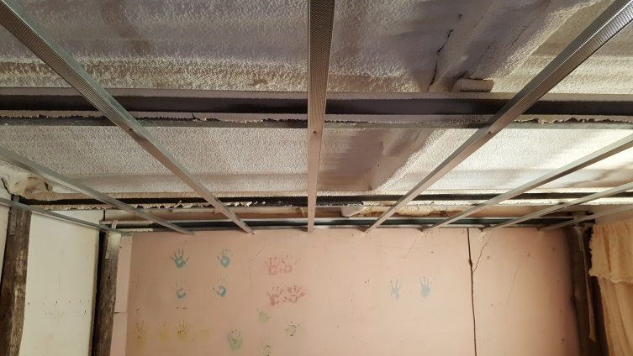
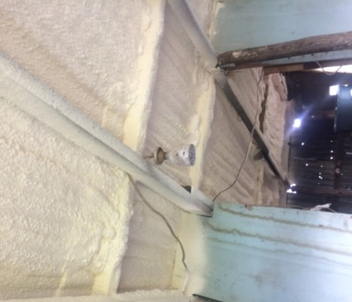
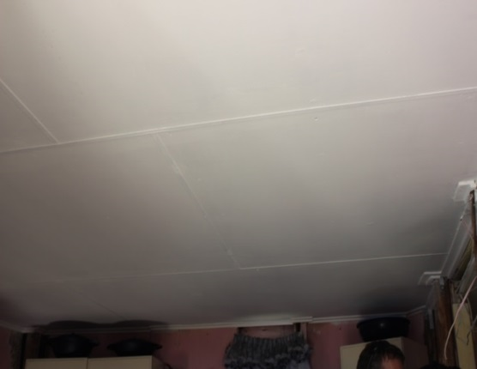
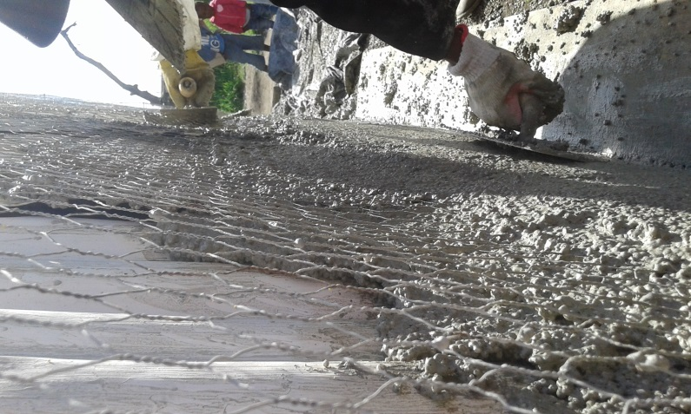
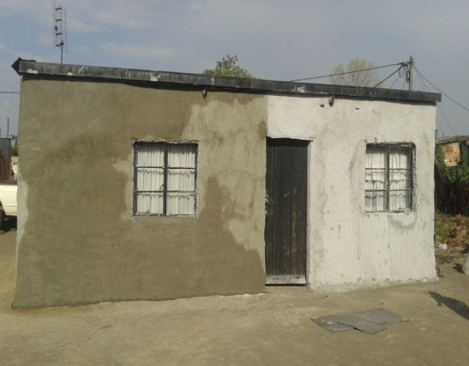
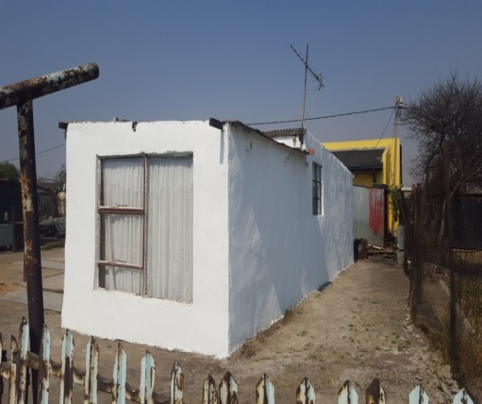
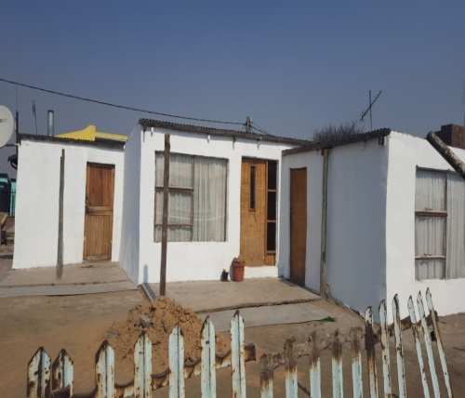
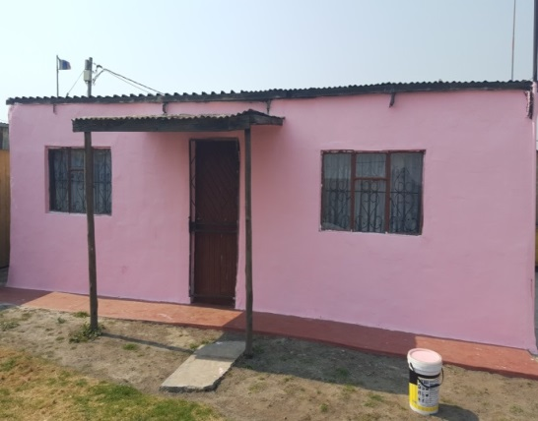
Insulation of serviced informal houses in Lebohang
Ceiling Installation
Preparation for Plastering
Painting

Slide 32
In conclusion
Sasol is committed to compliance with all applicable laws including air quality laws. This supports sustainable air quality improvements as envisaged through the Air Quality Act and priority area air quality management plans
We are making good progress against our air quality roadmaps as committed in our postponement applications
To support these roadmaps, we have a capital allocation framework to assist us in allocating capital, prioritising capital allocation towards the retention of Sasol’s license to operate
We already meet most of the Minimum Emissions Standards (MES) for existing plants, and will also be able to meet most of the new plant standards by latest 2025. This extended timeframe is required to safely implement the necessary abatement technologies in accordance with our roadmap schedules, taking into consideration shutdown and statutory maintenance obligations
In this regard, in the past we applied for, and going forward, we will be reliant on further applications for postponements, as the only legal mechanism currently provided for in law. Consequently, our licences, under which we are required to operate during the extended compliance period, contain appropriate limits informed by independent air quality specialist studies on the basis that these do not affect ambient air quality beyond National Ambient Air Quality Standards (NAAQS)
However, the new plant standards for boiler plant SO2 pose significant compliance challenges from a feasibility perspective for existing, maturing plants. The measured levels of SO2 in the airsheds where we operate are well below the internationally accepted health standard. Our appeal therefore is to consider alternative mechanisms to enable progressive air quality improvements for maturing facilities. To this extent, we continue to constructively engage in law reform processes and in this regard have recently submitted comments into the DEA’s framework review consultations\.
We believe it is appropriate for the applicable authorities to consider our postponement applications, since we meet the conditions of such applications and in particular demonstrate that our current and proposed contribution does not cause exceedance of the (NAAQS)
Regulation of industrial point sources alone, in our view, is insufficient to achieve the NAAQS. Offsets are therefore an important complementary mechanism in achieving the statutory objectives

