Slide 1
COMPLIANCE WITH MES

Slide 2
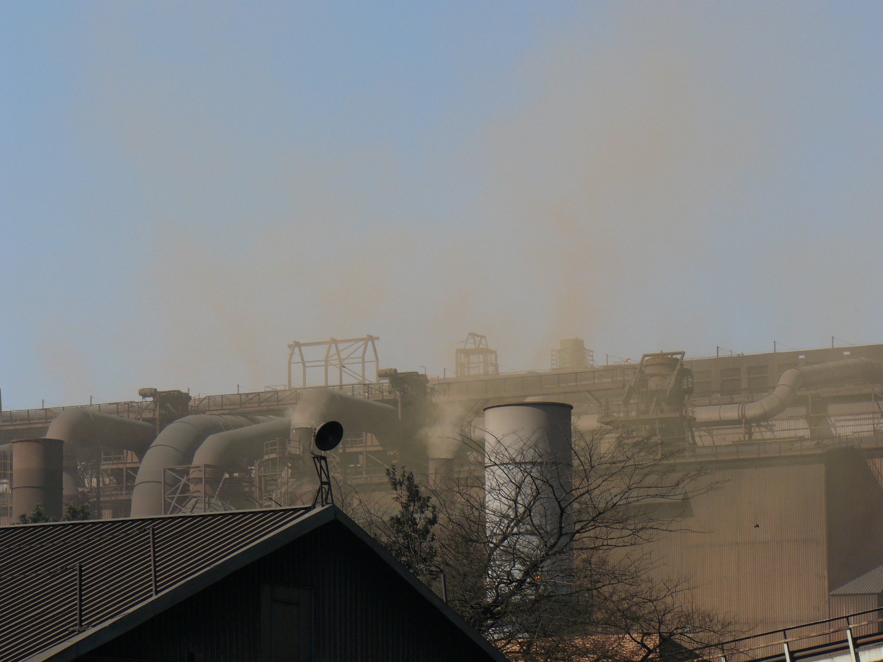
OBJECTIVES OF THE PRESENTATION
Approach to compliance and enforcement within the waste and pollution sector – compliance promotion/monitoring versus enforcement (used to bring facilities into compliance)
Understanding the role of DEA versus the local authorities
Current initiatives and status quo of Compliance and Enforcement activities in relation to air quality legislation (including MES) since coming into effect of the MES

Slide 3
FACILITATED APPROACH TO COMPLIANCE AND ENFORCEMENT
The focus is to bring facilities into the regulatory net rather than to shut them down and prosecute - process takes place over a number of years (actions since 2014) – coordinated and strategic (planning is essential)
Ensuring compliance without compromising integrity of the legislative framework, but at the same time recognising the importance of fiscal growth and other government priorities – job security
Compliance and Enforcement within the waste and pollution sector is very complex
Historical pollution requires time to remediate
Outdated technology – significant capital required to align to new requirements
Complex science involved requiring specialised equipment and tools

Slide 4
COMPLIANCE PROMOTION AND COMPLIANCE VERIFICATION
BASELINE INSPECTIONS
VOLUNTARY COMPLIANCE PROMOTED
Opportunities are given to make representations and to rectify
Compliance verification with line function (need for additional assistance assessed)
FOLLOW-UP INSPECTIONS
Continued non-compliance detected – referral for prosecution

Slide 5
BACKGROUND
On site compliance monitoring inspections by EMIs (DEA, Provincial Environmental Departments and Municipalities)
Facilities required to conduct emissions monitoring continuously and/or periodically and submit emissions monitoring reports to the Licensing Authorities (District Municipalities and Provinces) for review

Slide 6
Competence: National, Provincial, Local
Exclusive National | Exclusive Provincial | Concurrent National and Provincial | Local
National parks, Botanical gardens Marine resources | Abattoirs Provincial planning; Provincial recreation; Veterinary services, | Environment; Nature Conservation Pollution control Soil conservation | Air pollution; Beaches and amusement facilities; Cleansing; Control of public nuisances; Municipal parks and recreation; Noise pollution; Refuse removal, refuse dumps and solid waste disposal;

Slide 7
TOTAL NUMBER OF LOCAL AUTHORITY EMIS DESIGNATED
Province | 2014-15FY | 2015-16FY | 2016-17FY
Gauteng | 37 | 43 | 51
Limpopo | 10 | 22 | 29
North West | 9 | 13 | 24
Western Cape | 24 | 30 | 50
Free State | − | − | 22
Eastern Cape | 3 | 4 | 7
Mpumalanga | − | 18 | 14
KwaZulu-Natal | 102 | 102 | 102
Northern Cape | - | 4 | 4
Totals | 185 | 236 | 303

Slide 8
COMPLIANCE STATUS
On-site inspections conducted at 21 Facilities jointly by EMIs from 3 spheres since April 2015
Total of 16 not in full compliance to MES
5 are Eskom Power Stations
5 are HCRW facilities
6 are various facilities
Old technologies and poor quality of coal cited as reason for non-compliance
Reports of non-compliance shared with line functions
All the reports of non-compliance were referred either to Enforcement CD or C&WM (in line with Waste Protocol)

Slide 9
KEY: ACRONYMS
NEMA – National Environmental Management Act
APPA – Atmospheric Pollution Prevention Act
ECA – Environment Conservation Act
NEM:AQA – National Environmental Management Air Quality Act
AEL – Atmospheric Emission Licence
WML – Waste Management Licence
PM – Particulate Matter
C&WM – line function – Branch Chemicals and Waste Management
PCN – Section 31L NEMA Pre-Compliance Notice
CN – Compliance Notice in terms of NEMA
S31H Notice – Notice in terms of Section 31H of NEMA which requires certain information to be provided
PD – Pre-Directive

Slide 10
ENFORCEMENT STATUS
2016/17 FY
Facility | Date | Findings (Exceedances) | Action Taken / Status
PPC Dwaalboom | 1 September 2015 | PM | S31L NEMA PCN -18 May 2016 Representations received 30 June 2016 Meeting 23 Aug 2016 – additional information required Representations received on 02 September 2016 No further enforcement action – new AEL issued on 15 July 2016 (compliance inspection had been conducted against authorisation dated February 2015)
Eskom Tutuka Power Station | 17-18 November 2015 | PM, SO2, NOx | S31L NEMA PCN - 01 September 2016 S31H NEMA Notice - 06 July 2017 Representations received and under review
Eskom Kendal Power Station | 14 December 2015 | PM | S31L NEMA PCN - 24 October 2016 Representation submitted 15 December 2016 Timeframes provided to come into compliance within 3-4 years namely 2020

Slide 11
ENFORCEMENT STATUS
2015/16 FY
Facility | Date of inspection | Findings (Exceedances) | Action Taken / Status
Evraz Highveld Steel | 02-03 June 2015 | PM, SO2 | S12(3)(a) APPA and ECA and NEMA PDs - 2 February 2010 S31L NEMA PCN & S31A ECA PD -10 November 2010 S31H NEMA Notice -23 May 2012 2nd S31H NEMA Notice to Highveld Steel dated 3 August 2012 3rd S31H NEMA Notice - 25 January 2013 Follow-up inspection – June 2015 and PCN July 2015 Referred for criminal prosecution Shutdown Steel Plant – Business Rescue
Natref | 14 December 2015 | Monitoring not conducted as required | S31L NEMA PCN - 5 Aug 2016 Representations received and under review
Sasol Sasolburg | 19 April 2016 | CO, SO2, NOx, TOC | S31L NEMA PCN – 07 October 2016 S31H NEMA Notice – 02 May 2017 (Incinerators at Thermal Oxidation Plant currently shutdown) Referral of case to C&WM – Waste Protocol

Slide 12
ENFORCEMENT STATUS
2016/17 FY
Facility | Date | Findings (Exceedances) | Action Taken / Status
AMSA Vanderbijlpark | 6-7 June 2016 | PM | Referral of case to C&WM – Waste Protocol
DMS Powders | 30 August 2016 | PM | Referral of case to C&WM – Waste Protocol
Eskom Lethabo Power Station | 19-20 July 2016 | PM, SO2 | Air quality monitoring to be undertaken as part of the National Air Quality Blitz. Unfortunately, the air quality monitors could not be obtained in time. Subsequently a S31H NEMA Notice is in the process of being finalised and issued
Eskom Majuba Power Station | 5-6 September 2016 | Data presented not demonstrating compliance | Referral of case to C&WM – Waste Protocol
Eskom Medupi Power Station | 7-8 February 2017 | PM | Case referred to Branch: C&WM – Waste Protocol

Slide 13
ENFORCEMENT STATUS
2016/17 FY HCRW INCINERATORS
Facility | Date | Findings (Exceedances) | Action Taken / Status
Averda Klerksdorp | 15 Nov 2016 | HCl, CO, HF | PCN dated 9 April 2015 had been issued to Wasteman for WML and AEL non-compliances Follow-up inspection conducted on 7 April 2016 2nd PCN en route for signature
Biomed | 15 Nov 2016 | NO, NOx, Heavy Metals , Dioxins and furans | Case referred to C&WM – Waste Protocol
ClinX | 15 Nov 2016 | Monitoring not conducted | S31H NEMA PCN – 28 July 2017 S31L CN is currently being finalised for issuance to the facility
EnviroServ Eastern Cape (Roodepoort) | 15 Nov 2016 | PM, HCl, SO2, CO, Dioxins and Furans | S31L NEMA PCN – 26 Sept 2017 Awaiting representations
Optimum | 17 Nov 2016 | Monitoring no conducted as required | Site investigation in March 2017 Referred to C&WM - Waste Protocol Administrative enforcement action authorised - notice currently being drafted

Slide 14
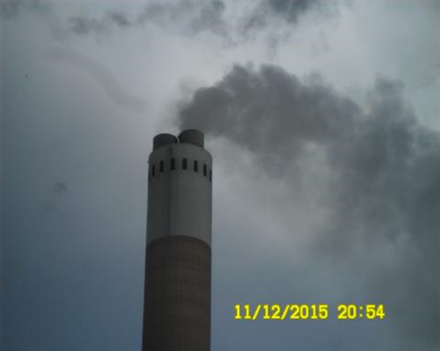
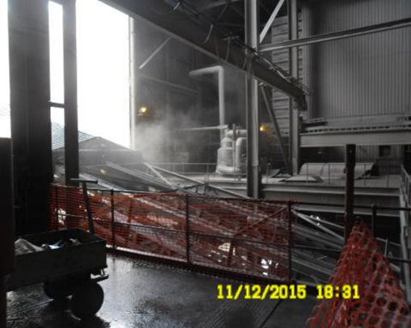
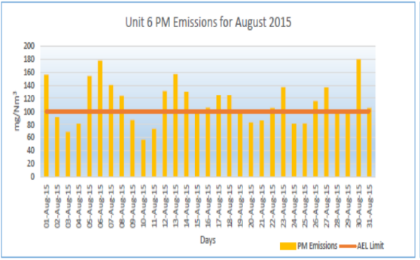
ESKOM KENDAL
Inspection on 14 December 2015:
Non-compliances with respect to AEL, emission limit exceedances
Enforcement Action:
S31L NEMA Pre-Compliance Notice issued on 24 October 2016
Outcomes/Initiatives/Action Plans as per representations:
Refurbishment and upgrades of abatement equipment;
Proposed plan for installation of high frequency transformers of ESPs
Refurbishment of the electrostatic precipitators during 2017-2020
Refurbishment of the S0₃ Plants during 2017-2020
Maintenance execution strategy for the Flue Gas Conditioning and Cleaning Plant
Submission of Quality Control Plans for various maintenance tasks that were undertaken at Unit 4
Repairs at various areas in the Ash Plant

Slide 15
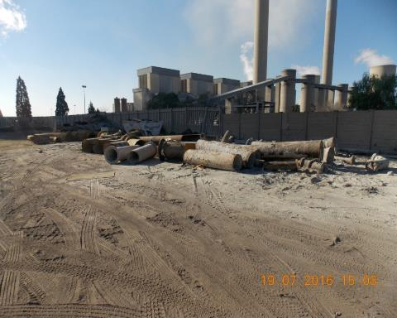
ESKOM LETHABO POWER STATION
Baseline Inspection: 03 November 2009
Failure to comply with conditions stipulated in APPA Registration Certificate (“R/C”), fugitive emission & exceedences of limits
2011:
Section 31(H) NEMA Notice to Lethabo Power Station dated 18 Oct 2011
S31A ECA PD and S31L NEMA PCN - 17 July 2012 due to non-compliance with the conditions of its APPA R/C
2013:
S31H NEMA Notice on 1 March 2013
2014:
Letter re: No further enforcement action on 3 February 2014 due to conversion of APPA R/C to AEL and exemption being granted by CAPCO
New Inspection: 19 & 20 July 2016
Failure to comply with conditions stipulated in the new Atmospheric Emissions Licence (“AEL”), fugitive emission & exceedences of limits.
The Department is in the process of taking enforcement action

Slide 16
NATREF
Inspection on 14 December 2015:
Non-compliance with conditions in AEL, elevated levels of PM, SO_{x} and NO_{x} emissions, failure to submit bi-annual emissions monitoring reports, ineffective abatement equipment, activities causing and have the potential to cause serious significant pollution or degradation of the environment
Enforcement Action:
S31L NEMA pre-compliance notice on 5 August 2016
Outcomes/Initiatives/Action Plans as per representations:
Vulnerability study on Sulphur Recovery Unit initiated to improve availability during shutdown
More frequent reporting and emission surveys, compliance with prescribed AEL Limits
Submission of sampling results biannually
Postponement application wrt SO₂ emission limits communicated to NAQO
Implementation of measures to reduce fuel oil firing – Reduction in SO₂ emissions
Changes to type of catalyst in Fluidised Catalytic Cracker to reduce PM emissions
R272 million FCC Cyclone replacement during shutdown in October 2016
Installation of electrostatic precipitator by 2022
Submission of off-set implementation plan to NAQO to reduce both SO₂ & PM in ambient environment.

Slide 17
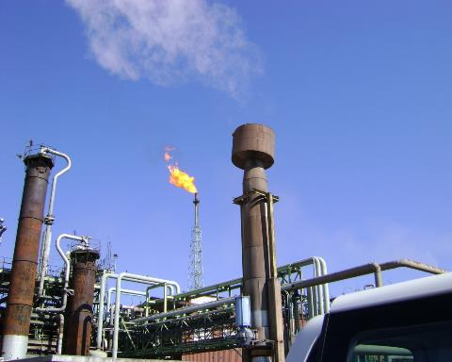
SASOL SASOLBURG
Baseline inspection: Between 29 and 31 October 2012 –
No enforcement action taken (2014 & 2017 postponement applications)
Follow-Up Inspection: Between 18 and 20 April 2016:
Lack of information regarding the “feed stream analysis” for the B6990 incinerator
Exceedences from the Heavy End B, Spent Caustic and High Sulphur Pitch Incinerators at the Thermal Oxidation Unit; and No continuous emissions monitoring (“CEM”) at the Thermal Oxidation Unit
Non-compliances with the conditions stipulated in the AEL
Enforcement Action: 2016 & 2017
S31L NEMA pre-compliance notice on 7 October 2016
S31H NEMA notice on 02 May 2017
Outcomes/Initiatives/Action Plans as per representations:
Analysis for Mercury, Fluoride and Chloride.
Feed stream analysis for B6990 Incinerator.
SO-env-212 Project plan for recommissioning of Incinerator S6900.
The Department is currently considering the request for “recommissioning”
Case referred to C&WM – Waste Protocol

Slide 18
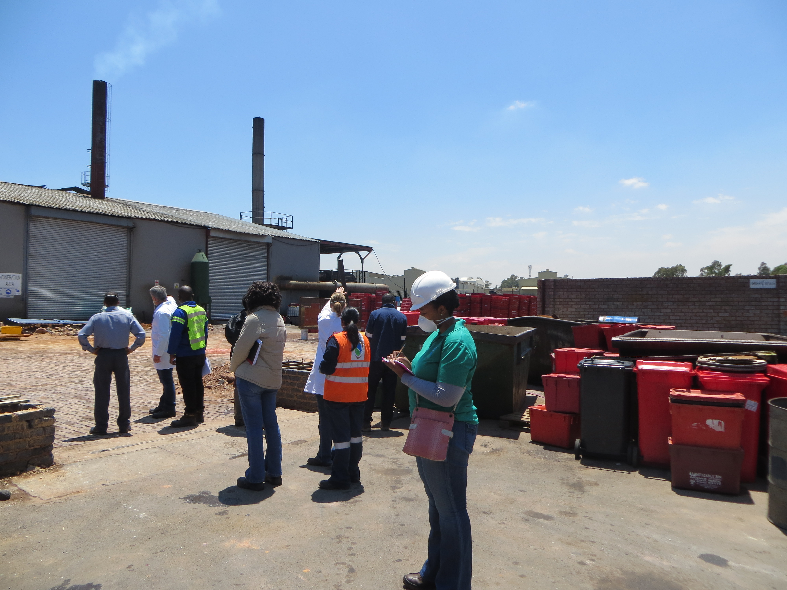
CLINX
Inspection: 15 October 2014
Failure to comply with conditions stipulated in the WML and PAEL, as well section 49A(1)(e) and (f) of the NEMA
Enforcement Action:
S31H NEMA notice issued on 29 February 2016. Representations to S31H NEMA Notice received on 14 March 2016
Facility was still in non-compliance with AEL conditions and NEMA
S31L NEMA PCN issued on 15 July 2016. Representations received on 29 August 2016
Follow-up Inspection: 15 November 2016
Subsequently, the Department embarked on a national HCRW blitz which included this facility
Continued failure to comply with conditions stipulated in the WML and PAEL, as well section 49A(1)(e) and (f) of the NEMA
Follow-up administrative enforcement action will be taken against the facility

Slide 19
CRIMINAL INVESTIGATIONSMES
AEL MINING
Part of the Highveld & Vaal Air Quality Priority area blitz
Search warrant executed on Monday 14 December 2015
Criminal case docket registered with Sebenza under Cas 113/01/2017
Contraventions
Section 51(1)(e) of NEM:AQA – non-compliance with conditions and requirements of AEL: emissions above of what was allowed in the AEL
Criminal case docket submitted to DPP on 23 June 2016 for decision
ADR agreed upon on 24 August 2017 & finalised

Slide 20
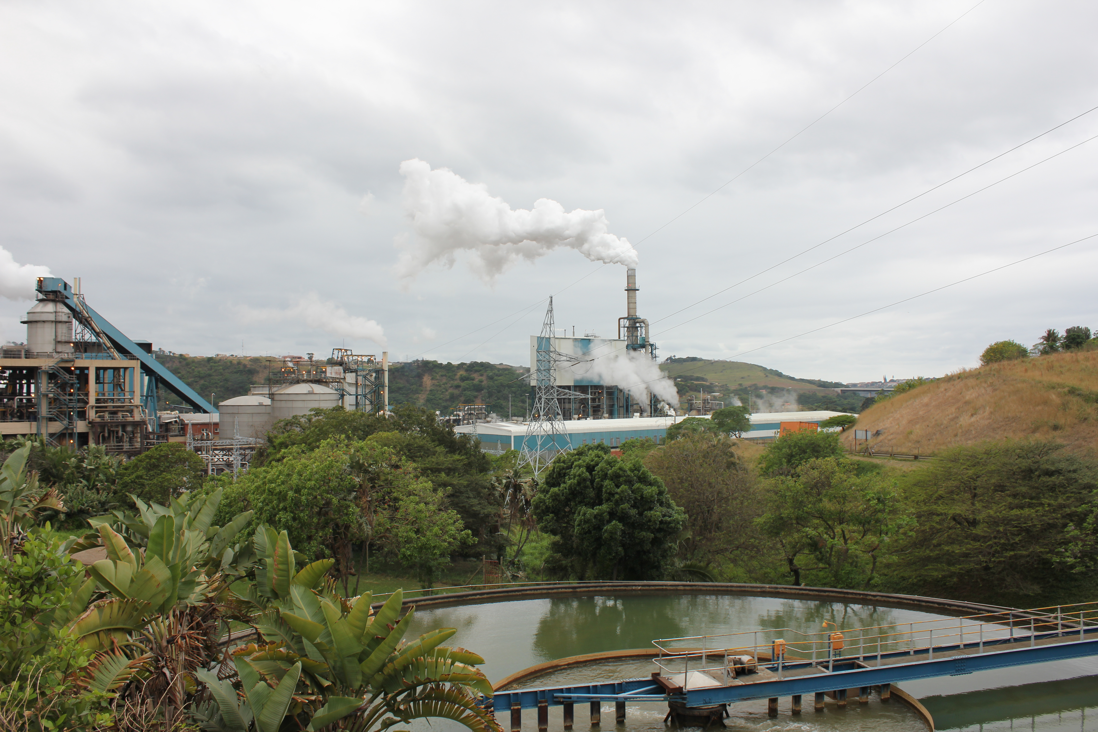
CRIMINAL INVESTIGATIONS
SAPPI SAAICOR
July 2015 received complaint from Compliance and Monitoring and Ethekwini Municipality regarding non-compliance of SAPPI-Saiccor with their AEL
Search and seizure operation conducted on the 7th September 2015
Criminal Case registered with SAPS under Umkomaas CAS 241/03/2017 and referred to DPP on 24 March 2017
Section 51(1)(e) of NEM:AQA – failed to comply with conditions of AEL
Section 49A(1)(f) – Act or omission which detrimentally affects or is likely to detrimentally affect the environment

Slide 21
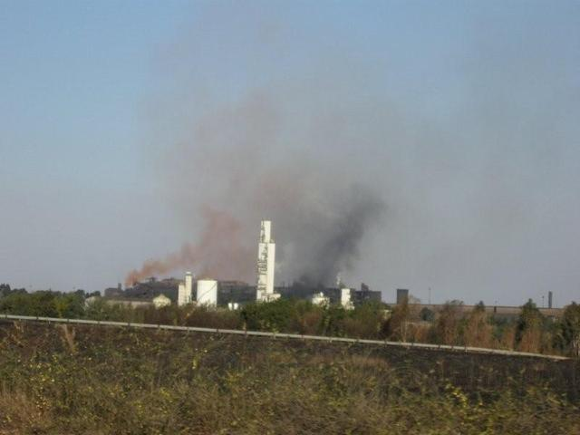
EVRAZ HIGHVELD STEEL

Slide 22
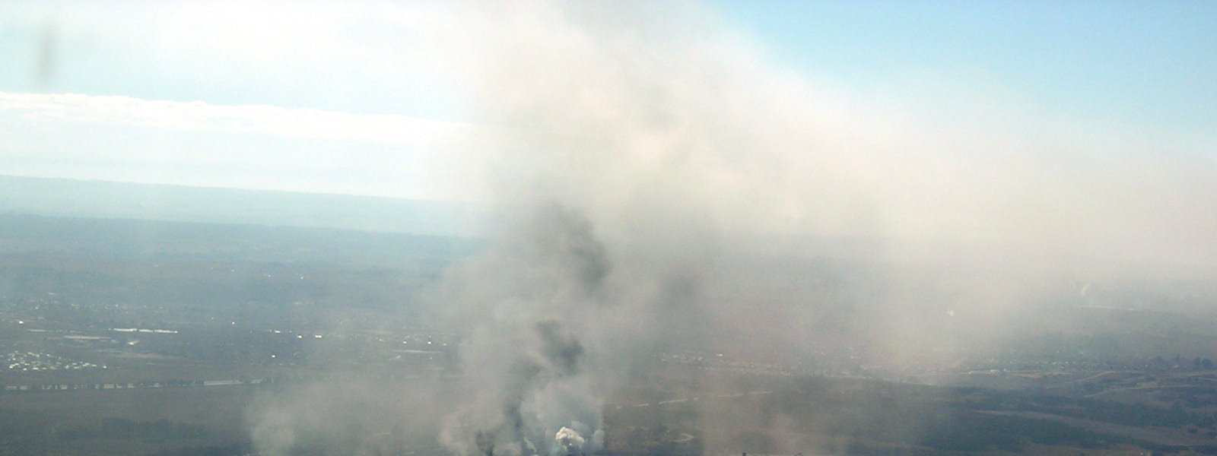
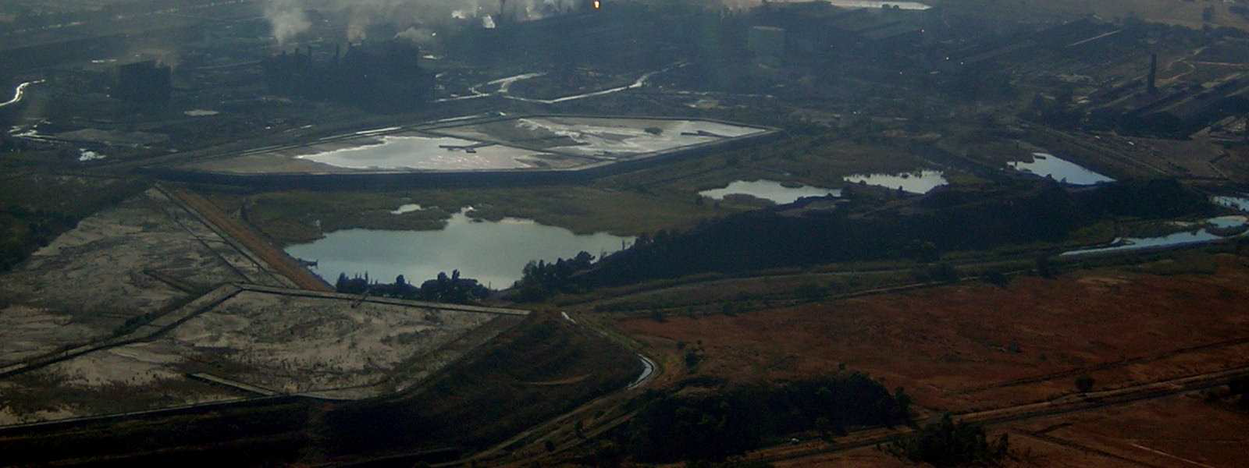
Highveld Steel:
Total of 54 non-compliances:
Lack of adequate monitoring
Exceedences of the emission limits (SO_{x}, PM_{10,} No_{x})
Exceedences in production and use of raw materials
Unauthorised scheduled processes
NEMA duty of care
Both administrative and criminal enforcement initiated
Facility shut down in 2016 – Business Rescue
Criminal case finalised and awaiting decision from the DPP

Slide 23
CHALLENGES IN RELATION TO COMPLIANCE AND ENFORCEMENT
Number of Business Rescue processes
Building and retaining compliance and enforcement specialised experience within government (technical and legal)
Enabling growth and development while enforcing environmental compliance
Overlapping mandates / legislation – better co-ordination / information collection and sharing
Transitional period from APPA registration certificates to AELs – more stringent permits – able to monitor compliance and enforce
Staggered time periods for compliance with standards
Lengthy process when non-compliance detected – old, dirty technologies and significant monetary resources to correct
Capacity to monitor compliance and enforce – local authorities responsible for issuing AEL’ s

Slide 24
PLANS IN 2017/2018
Additional work required in respect of postponement decisions – checking of road maps
Support apportionment study in the Vaal and Highveld priority areas – justification for taking compliance and enforcement action
Assist and capacitate Local Authorities as and when required

