Slide 1
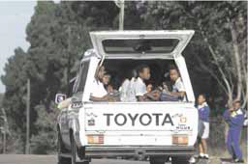
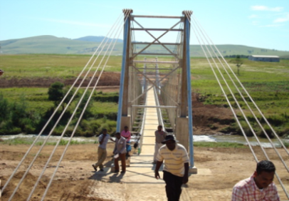
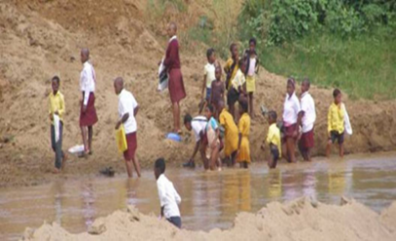
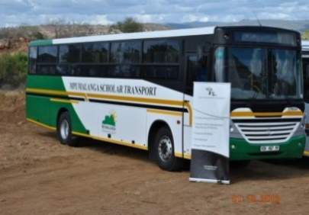
SCHOLAR TRANSPORT PRESENTATION PORTFOLIO COMMITTEE ON BASIC EDUCATION
7 NOVEMBER 2017

Slide 2
Presentation Outline
Purpose
Background
Key elements and objectives
Institutional framework
Progress on Learner Transport programme
Evaluation of the programme
Challenges and interventions
Recommendation

Slide 3
Purpose
To present to the Portfolio Committee on Basic Education, progress with the provision of learner transport.

Slide 4
Background
The learner transport policy development started a few years ago after the realisation of a policy gap.
As such the environment within and the manner in which learners accessed centres of learning experienced serious challenges, among others, no services at all, unsafe and unsecure methods that were used, uncoordinated services, unscrupulous operations, non-standardised methods, to mention but a few.
The following process (with Department of Basic Education as a key partner-approved by both Minmecs) was adopted:
Needs analysis
Stakeholder engagement
Draft Policy
Gazette for final comments
Final Policy
Cabinet
Cabinet
FOSAD
Implementation, M& E
We are here

Slide 5
Key Elements of the Policy
Institutional Framework for the implementation of learner transport;
Learner transport planning;
Learner transport safety and security;
Criteria for learner Transport Beneficiaries;
Service Design for learner transport;
Procurement of learner transport services;
Remuneration of learner transport operators;
Funding;
Modal Integration;
Universal Design;
Law Enforcement; and
Monitoring and evaluation.

Slide 6
Objectives
To improve access to quality education by providing safe, decent, effective, and integrated sustainable learner transport;
To improve access to quality education through a coordinated and aligned transport system;
To improve planning and implementation of an integrated learner transport service;
To manage and oversee the implementation of an integrated learner transport service;
To ensure an effective management of learner transport system; and
To provide for a safe and secure transport environment for learners through co-operation and collaboration with law enforcement authorities.

Slide 7
Desired Outcomes
Timeous delivery of service;
Rate of road accidents reduced;
A coordinated approach in relation to planning and implementation;
Learner transport operators that adhere to road traffic regulations;
Vehicle maintenance plan and technical support for emergencies;
Viable and sustainable operations;
Uniformity of services and tariff structure; and
A coherent performance monitoring system.

Slide 8
Institutional Framework
PROVINCE | IMPLEMENTING DEPARTMENT
Eastern Cape | Transport
Free State | Transport
Gauteng | Education
KwaZulu-Natal | Education
Limpopo | Education
Mpumalanga | Transport
Northern Cape | Transport
North West | Transport
Western Cape | Education

Slide 9
Institutional Framework…
The policy provides for the establishment of the National Inter-Departmental Committee (NIDC) to oversee the implementation of the learner transport programme.
The committee is comprised of national and Provincial Departments of Transport and education.
The Committee meets on quarterly basis to receive progress on the implementation of the learner transport programme.
The committee reports to the Ministers of Basic Education and Transport.
To this end, the NIDC has been established.
Four (4) meetings were held for the 2016/17 financial year.
The 1st Quarter meeting for the 2017/18 financial year took place in July 2017.
Reports from the NIDC have been submitted to the Ministers .

Slide 10
Institutional Framework…
The following are standard matters addressed:
Progress on implementation of the policy ;
Plans for learner transport per province;
Learners transported quarterly per province;
Budget/financial performance per province;
Accident information per quarter;
Transportation of learners with disabilities; and
Challenges and mitigation.

Slide 11
Progress on National Learner Transport Programme
2017/18

Slide 12
Policy Implementation Progress
Action | Responsibility | Timelines
Finalise Norms/Standards and Operational Guidelines for Learner Transport | Department of Transport | Completed
Assessment of costing and funding for policy implementation | Department of Transport | Ongoing. Part of the evaluation of the programme
Development of Standardised Model Contract to guide contracting authorities | Department of Transport | Completed

Slide 13
Policy Implementation Progress
Action | Responsibility | Timelines
Institute National Inter-Departmental Committee (NIDC) and facilitate the provincial interdepartmental Committees | Department of Transport Provinces | Completed
Develop and implement a targeted a National Learner Transport Road Safety Programme | Department of Transport Provinces RTMC | Ongoing
Monitoring of the Learner Transport Programmes Implementation | DOT, DBE and provinces | Ongoing

Slide 14
Learners transported in quarters 1 and 2
 |  |  | Q1 progress | Q2 progress
Province | No of learners identified 2017/18 | Target to be transported 2017/18 | No transported Q1 | No transported Q2
EC | 111406 | 80288 | 80427 | 80288
FS | 12399 | 12245 | 9449 | 11186
GP | 110509 | 110515 | 110509 | 110515
KZN | 90000 | 47747 | 47747 | 47747
LP | 40268 | 37171 | 35859 | 37171
MP | 60256 | 60231 | 60256 | 60231
NC | 26477 | 23896 | 23896 | 23896
NW | 54059 | 42421 | 37371 | 42421
WC | 58739 | 58000 | 58739 | 59371
TOTAL | 562328 | 472514 | 464253 | 472826

Slide 15
FINANCIAL PERFORMANCE Q1 and Q2
FINANCIAL PERFORMANCE Q1 |  |  |  | FINANCIAL PERFORMANCE Q2
PROVINCE | BUDGET 2017/18 | EXPENDITURE Q 1 | % EXPENDITURE | EXPENDITURE Q 2 | % EXPENDITURE | EXPENDITURE TO DATE | % OF EXPENDITURE TO DATE
EC | R 462 000 000.00 | R 116 844 537.00 | 25.29% | R 129 456 919.90 | 28.02% | R 246 301 456.90 | 53.31%
FS | R 40 000 000.00 | R 16 316 886.72 | 40.79% | R 20 311 953.81 | 50.78% | R 36 628 840.53 | 91.57%
GP | R 779 184 000.00 | R 303 631 791.16 | 38.97% | R 166 555 159.54 | 21.38% | R 470 186 950.70 | 60.34%
KZN | R 195 000 000.00 | R 52 483 535.39 | 26.91% | R 73 599 489.87 | 37.74% | R 126 083 025.26 | 64.66%
LP | R 274 223 000.00 | R 39 823 020.26 | 14.52% | R 107 106 556.72 | 39.06% | R 146 929 576.98 | 53.58%
MP | R 476 914 000.00 | R 103 684 729.75 | 21.74% | R 220 069 129.74 | 46.14% | R 323 753 859.49 | 67.89%
NC | R 125 310 000.00 | R 27 082 114.97 | 21.61% | - | - | R 27 082 114.97 | 21.61%
NW | R 287 100 000.00 | R 36 218 955.52 | 12.62% | R 73 134 418.47 | 25.47% | R 109 353 373.99 | 38.09%
WC | R 380 047 000.00 | R 86 570 955.00 | 22.78% | R 86 570 955.00 | 22.78% | R 168 753 296.00 | 44.40%
Total | R 3 019 778 000.00 | R 782 656 525.77 | 25.92% | R 876 804 583.05 | 29.04% | R 1 655 072 494.82 | 54.81%

Slide 16
Incidents Reported Q2
PROVINCE NAME | NO Of DISTRICT | NO OF SCHOOL | NO OF OPERATOR | NO OF INCIDENT / ACCIDENT | NUMBER OF:
 |  |  |  |  | INJURIES | DEATHS
Eastern Cape | 2 | 2 | 2 | 2 | 3 | 1
Free State | 1 | 1 | 1 | 1 | 1 | 0
Gauteng | 5 | 5 | 5 | 5 | 30 | 3
Kwazulu Natal | 0 | 0 | 0 | 0 | 0 | 0
Limpopo | 2 | 2 | 2 | 2 | 48 learners were taken to hospital for screening and 26 learners were treated for trauma | 0
Mpumalanga | 0 | 0 | 0 | 0 | 0 | 0
Northern Cape | 0 | 0 | 0 | 0 | 0 | 0
North West | 0 | 0 | 0 | 0 | 0 | 0
Western Cape | 0 | 0 | 0 | 0 | 0 | 0
TOTAL | 10 | 10 | 10 | 10 | 34 | 4

Slide 17
Evaluation of National Learner Transport

Slide 18
Evaluation of the Scholar Transport Programme
The Standing Committee on Appropriations made the recommendations that the National Treasury in partnership with the Department of Basic Education, Department of Performance, Monitoring and Evaluation, Civil Society an assessment of the efficacy of funding and a comprehensive evaluation of spending and implementation of the scholar transport programme be undertaken.
The purpose of this evaluation is to assess the implementation of the scholar transport programme, the efficacy of the funding model and whether learners are transported safely and on time. Additionally, this evaluation should show how funding and expenditure impacts on the programme.
The evaluation will encompass the mandate and reach of the Scholar Transport Implementation Programme. The data will be reviewed from 2011/12 to 2016/17 financial years.
.

Slide 19
Key Questions to be Addressed
(Relevance and Appropriateness): To what extent is the design of the STP appropriate, and to what is extent is the intervention design consistent with education & transport sectors’ priorities and policies, and partnerships with all key stakeholders.
(Effectiveness): To what extent has the implementation of the Scholar Transport Program been effective in achieving its goal(s), objectives and intended outcomes?
Is the programme being implemented as planned during the period of review?
(Efficiency) To what extent has the implementation of the Scholar Transport Programme been efficient?
(Impact) What is the impact of the Scholar Transport Program in facilitating access to education in the country.

Slide 20
Stakeholders Identified
National and Provincial Transport Departments;
National and Provincial Education Department;
National Treasury (NT);
Department of Performance Monitoring and Evaluation (DPME);
Statistics South Africa (STATSA);
Schools and other educational institutions; and
Other bodies such as teacher unions, Santaco, SABOA, SACO, EE, and other NGOs.

Slide 21
Progress
The Learner Transport Evaluation Technical Working group was established in January 2017;
The Terms of Reference were developed and approved by the Steering committee in May 2017;
Quest Research Services was appointed in October 2017 as the service provider for the Evaluation of the Learner Transport Programme; and
An inception meeting with the appointed service provider was held on 30 October 2017 to approve the project plan.

Slide 22
Key Challenges

Slide 23
Key challenges
Insufficient Funding of learner transport
Based on the current spending and costing, there will be a need for additional funding in some provinces.
Provinces to prioritize learner transport in their budgets.
However, there is an need to comprehensively evaluate the programme performance in terms of its efficacy/ efficiency and to determine funding requirements and mechanisms. The evaluation of the programme will assist in determining this.

Slide 24
Key challenges cont…
Road safety: This is particularly so in privately arranged learner transport where there is a contract between parents and operators. Use of old un-roadworthy vehicles, un-authorised services and unqualified drivers.
Road safety must be implemented within the context of the national road safety strategy.
Need for implementation of the National Road Safety Strategy;
Pillar 3: Safer Vehicles: strengthening roadworthiness mechanisms to ensure safety of vehicles;
Pillar4: Safer Road Users: strengthen law enforcement efforts; increase public engagement around road safety; involve citizens in debates around road safety and leading road safety campaigns (parents, learners, schools and operators).
Implementation of Focused National Learner Transport Road Safety Programme its imperative i.t.o awareness campaigns and enforcement

Slide 25
Key challenges cont…
Rationalization of schools
Rationalisation/ closure of schools have an impact on the increasing demand for learner transport.
A national task team to assist provinces address rationalization challenges has been set up. Infrastructure is an integral member of the committee to ensure that infrastructure matters are addressed timeously.
Lack of uniformity in contracting and remuneration
Provinces use various methods to contracting and remunerate operators;
Implementation of the model contract documents and guidelines; and
The evaluation of the programme will provide solutions in terms of the appropriate remuneration model based on the performance reviews of the programme.

Slide 26
Interventions
Department of Transport engages with different law enforcement agencies to address issues of overcrowding and un-roadworthy vehicles;
Joint intervention and monitoring teams at national, provincial and local level constituted;
Road safety programmes in conjunction with the Road Traffic Management Corporation (RTMC); including law enforcement and road safety awareness targeting operators, learners and parents; and
Develop and enforce driver and learner code of conduct.

Slide 27
Recommendation
It is recommended that the Portfolio Committee considers and discusses the report.

Slide 28
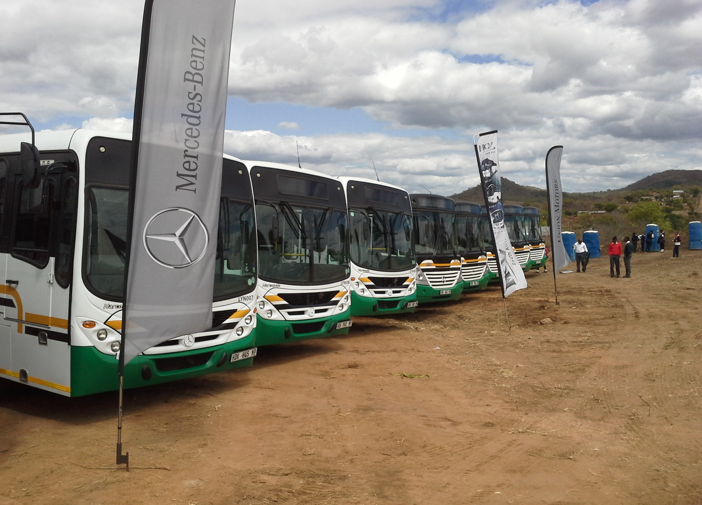
Thank You

