Slide 1
SMALL-SCALE FISHERIES: FROM POLICY TO IMPLEMENTATION

Slide 2
Presentation Outline
Introduction
Small-Scale Fisheries sector objectives
Progress on Implementation Process
Future work

Slide 3
Introduction
The Small Scale Fisheries Policy (SSFP) was developed as a response to an Equality Court order in 2007.
The court order compelled government to redress the inequalities suffered by traditional fishers who conducted fishing and fishing related activities for many years as part of a customary practice, but were generally not given fishing rights.
The SSFP went through an extensive process of consultation with all relevant stakeholders under the oversight of National Economic Development and Labour Council (NEDLAC).
The primary aim of the SSFP is to provide redress and recognition of the rights of traditional fishers.

Slide 4
Introduction (cont…)
Some important features of the SSFP, include;
Sustainable utilization of resources
Sustaining livelihoods
Poverty alleviation through economic development and job creation, and
Food security
Some key principles of the SSFP include community-orientated management, co-management of resources and an allocation of the basket of species.
The SSFP was adopted in 2012 and set guidelines for formally establishing Small Scale Fisheries sector.

Slide 5
Introduction (cont…)
In 2013 the SSFP Implementation Plan (IP) was finalised. The IP estimated a five (5) year process and a total budget of R424 million.
Accordingly, the MLRA had to be amended to accommodate the small-scale fishing sector.
The MLRA Amendment Bill was extensively consulted on and was signed into law by the President in May 2014.
Extensive consultation was done on the draft SSF Regulations, which was based on the SSFP. Feedback was also provided to NEDLAC on the SSF Regulations.
The SSF Regulations were approved by Minister and President promulgated the Amended MLRA in March 2016, which allowed the Department to proceed with the SSFP implementation process.

Slide 6
Small-Scale Fisheries Sector objectives
Create a sustainable, equitable, small-scale fishing sector
Secure the well-being and livelihood of small-scale fishing communities
Maintain the health of marine ecosystems
Uplift fishing communities by providing appropriate support mechanisms, education and training, infrastructure and participatory management practices.
Communities and Government co-manages near-shore marine living resources
Takes fundamental human rights, MLRA principles and international obligations into account
Give due regard to promoting interests of women, disabled and child-headed households

Slide 7
Progress on Implementation Process
2016
Amended MLRA promulgated - Mar
SSF regulations approved - Mar
Expression of Interest closed – Apr (316 communities registered)
Registration conducted (NC, WC, EC, KZN) – Mar-Aug
Socio-economic baseline survey conducted for all communities – Mar -Aug
Verification and assessments conducted (NC, WC, EC, KZN) – Mar -Aug
Announcement of provisional lists of successful fishers (NC, WC- Oct16, (EC- Nov16,
Appeals process (NC, WC, EC) – Sep, Nov, Dec
Appeals assessed (NC) - Oct

Slide 8
Progress on Implementation Process cont…

Slide 9
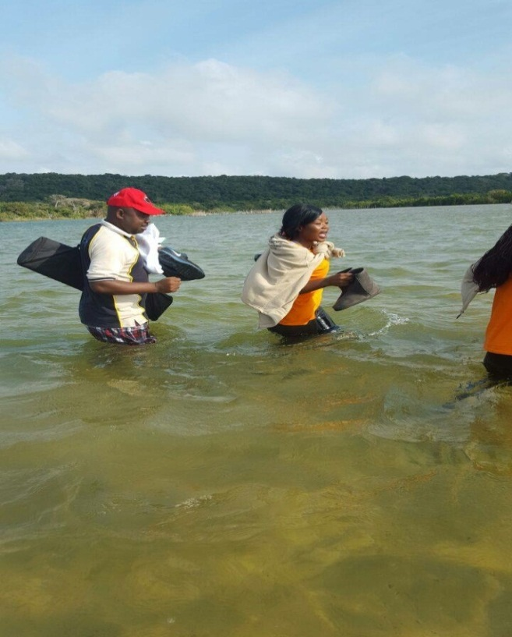
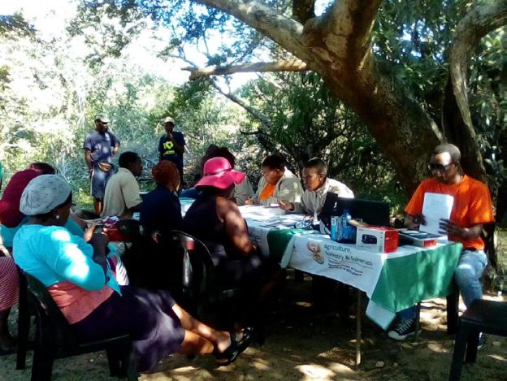
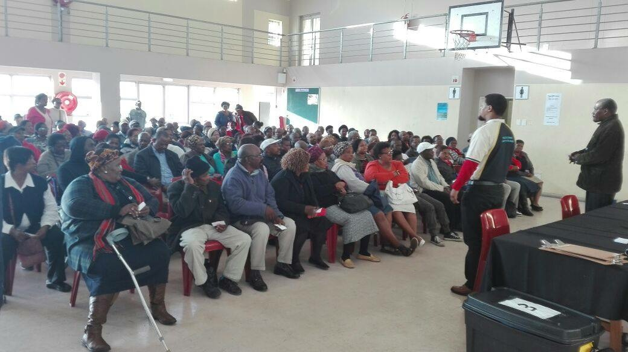
Progress on Implementation Process cont…
Registration and verification by numbers:
4 coastal provinces
5 months community work
55 DAFF officials & 60 service provider staff
316 communities
22 601 people registered

Slide 10
Progress on Implementation Process cont…
2017
Concluded appeals process for NC and provided recommendation en route to Hon. Minister
Announced provisional lists for KZN in May17
Consulted on proposed fee structure for small-scale fisheries sector in June17
Finalized socio-economic baseline for NC, WC, EC, KZN in July17
Conducted appeals process for KZN in May-August17
Assessed WC and EC appeal applications in August17

Slide 11
Future work
Activity | Date
Announce final successful list for NC communities | October/November 17
Register NC co-ops | November 17
Rights allocation for NC co-ops | December 17
Conclude appeals for WC & EC communities | November 17
Announce final list for WC & EC | December 17 - Jan 18
Establish and register WC & EC co-operatives | February 18
Assess appeal applications for KZN communities | November 17
Commence rights allocation for WC & EC co-ops | March18
Announce final list for KZN | December 17
Register and commence rights allocation for KZN co-ops | March 18
Finalize all rights allocation appeals | June 18

Slide 12
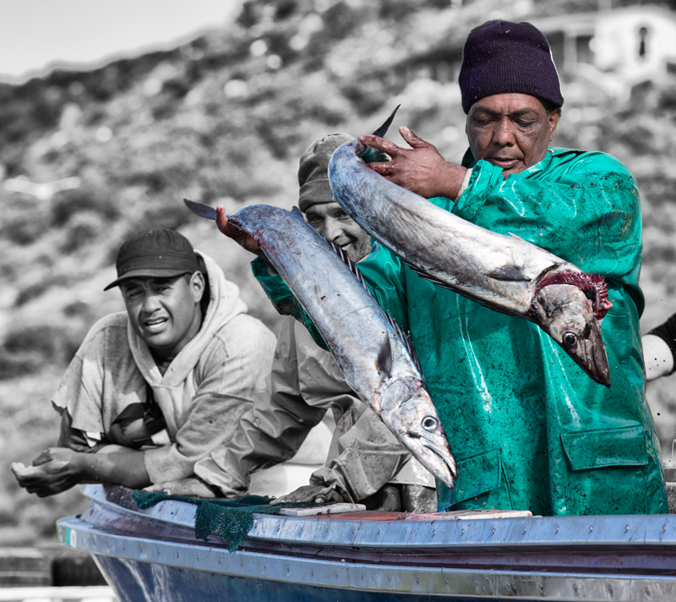
Be Part Of The BIG CHANGE
Follow us on:
www.daff.gov.za
www.small-scalefisheries.co.za
@DAFF.small.scale.fisheries

