Slide 1
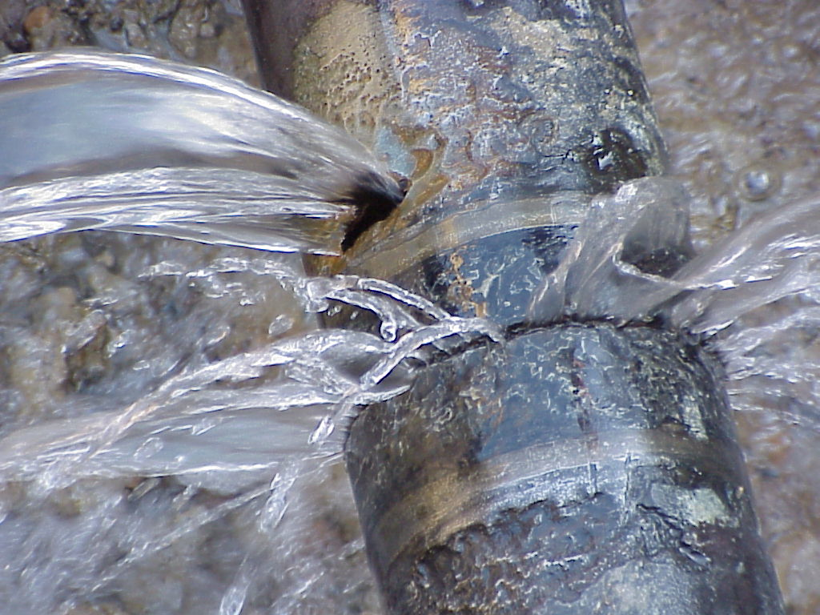
Water and the medium term budget policy statement
Dr Rolfe Eberhard
Presentation to the Portfolio Committee on Water and Sanitation, National Assembly, Parliament of the Republic of South Africa

Slide 2
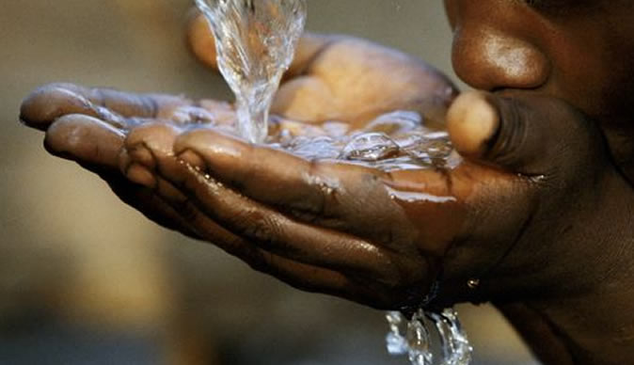
Outline
Why is water important?
Who is responsible for what?
What are the risks?
What needs to be done?
Budget implications

Slide 3
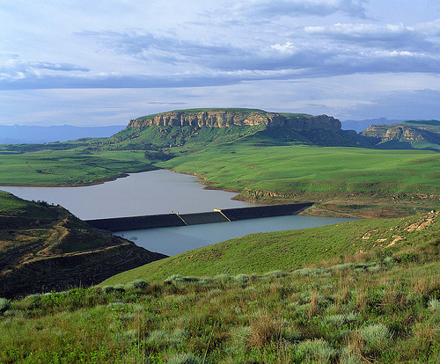
Why is water important?

Slide 4
Water is a small but essential part of the national budget
R4900 billion
R16 billion
Water is 1% of national budget

Slide 5
Food
rivers and groundwater
Business
Dams, pipes, pumps
treatment works
People
Wastewater treatment

Slide 6
Water is a top global risk
Extreme weather events
Water crises
Impact
Likelihood

Slide 7
South Africa already experiences severe water scarcity, & this will get worse
Water scarcity is not economic destiny,
but there is no room for error
South Africa already experiences severe water scarcity and this will get worse

Slide 8
Getting it wrong has serious economic & social consequences

Slide 9
Who is responsible for what?

Slide 10
The SA Constitution creates separate responsibilities
for water resources management and water services
National government
dams
WATER RESOURCES
Surface and ground water
Abstraction Licence
WATER SERVICES
Local government
Discharge Licence
Water Treatment
Distribution
Consumer
Collection
Wastewater Treatment
Re-use

Slide 11
Legal mandates and primary roles related to water infrastructure
National Water Act
Water Services Act
Municipal legislation
Department
Water & Sanitation
infrastructure
branch
national
R15 billion
TCTA
R2 billion
Water Boards
regional
R15 billion
Municipalities providing water services
local
R66 billion
Approximate water budgets (2017/18) – capital and operating

Slide 12
Funding principles
Economic use
Social use
10 000
Irrigation
Volume
3 000
7%
Municipal
(excluding basic use)
2 000
Industrial
1000
Basic
Approximate volumes -- million m3 per year

Slide 13
Funding models for water infrastructure
(policy design)
National Government (National Treasury)
guarantee
capital budget
implicit guarantee
budget
TCTA
Water Trading
Entity
Equitable share
and capital grants
100%
x%
Water Boards
33%
100%
Municipalities providing water services
66%

Slide 14
Funding models for water infrastructure
(practice)
National Government (National Treasury)
guarantee
budget
budget
Capital and operating subsidies
DWS
TCTA
Water Trading
Entity
Equitable share
and capital grants
100%
x%
Water Boards
33%
100%
Municipalities providing water services
66%

Slide 15
What are the risks?
and how should Parliament be holding the executive accountable for managing these risks?

Slide 16
Three key risks (infrastructure focus)
Planning and decision making
Effectiveness of spend
Level of spend

Slide 17
Planning & decision making
Questions for the executive
Timeliness and quality of water resources plans
The quality of underlying data informing planning
Soundness of decisions: examples Mangaung, Mzimvubu.
Timeliness of decision making and execution of decisions: examples Lesotho Highlands Water Project, Clanwilliam Dam, Voelvlei Augmentation
Transparency of processes

Slide 18
Effectiveness of spend and financial controls
Questions for the executive
The status of DWS finances and financial controls
Control on project expenditure
Competitiveness of tenders & use of panels
Revenue collection on trading account & impacts on government guarantees
Impacts on priority projects for water security

Slide 19
Level of spend
Available resources are insufficient to meet the required investments. Water infrastructure throughout the water value chain – dams, pipelines, pumps, treatment works, water distribution network, meters, sewers and wastewater treatment – is aging and its overall performance is deteriorating.
Three imperatives
Spend existing money more effectively
Limit grant spending to the social component of water
Make greater use of commercial finance

Slide 20
What needs to be done?

Slide 21
Priority actions
Re-establish financial discipline within DWS
Establish clear definition of social component of water
Scrap the initiative to create a single act (this is a distraction)
Take a decision on creating a national infrastructure agency
Prioritise water security for major cities (safe-guard the economy)
Make more and better use of commercial financing
Create an independent regulator for greater transparency on performance

Slide 22
Other aspects not addressed
Water quality
Mining licences
Acid mine drainage
Wastewater treatment
Sanitation in informal settlements
Municipal governance affecting performance
Irrigation and emerging farmers

Slide 23
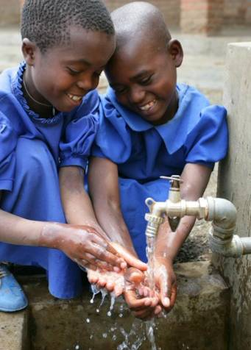
Implications for national budget
A fundamental dilemma: more money is needed but existing resources are being wasted.
Solution: make allocation of additional resources contingent on fundamental reforms to improve governance and effectiveness of spend.

