Slide 1
PRESENTATION TO THE WATER AND SANITATION PORTFOLIO COMMITTEE
By
Black Business Council & Black Business Council in the Built Environment (BBCBE)
07 November 2017

Slide 2

Institutional Alignment
The BBC is the overarching confederation representing professional and business associations and chambers, with the main purpose to lobby government on policy related matters in order to accelerate the participation of black South Africans in the mainstream economy.
The affiliates of the BBC cut across the various sectors of the economy and
the black business council in the built environment (bbcbe) concerned with the construction and built environment sector.
Notes:
The proportion of households whose main source of water for drinking is piped water inside the yard has almost doubled from 16,6% in 1996 to 30% in 2016. There is a slight decline of 0,2% from 2011 to 2016 of households whose main source of water for drinking is piped water inside the dwellings. Just less than three-quarters of households use piped water inside the dwellings/yards as their main source of water.
Access to safe drinking water is fundamental right that also links to the health, well-being and safety of the population of the country. The quality and availability of the water services are of extreme importance for the quality of human life and living standards. The CS 2016 asked questions related to the households’ main source of water, as well as the safety of drinking water that households had access to.
Source: Statistics South Africa, Census 1996; Census 2001; Census 2011; CS 2016 Note:
Piped water from access point outside the yard includes Piped water on community stand, Neighbour’s tap and Public/communal tap No access to piped water includes Borehole in the yard, Rain-water tank in the yard, water-carrier/tanker, Borehole outside the yard, Flowing water/stream/river, Well, Spring, Other CS 2016 asked households about their main source of water for drinking, whilst the Censuses asked whether the household had access to piped water.

Slide 3
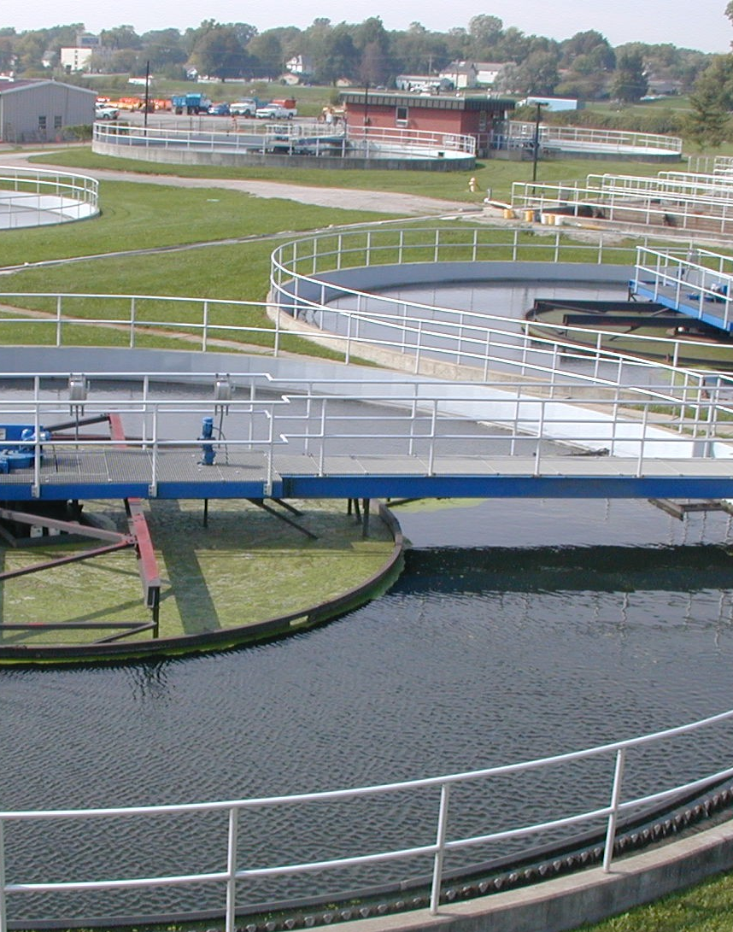
STATUS QUO
WATER & SANITATION
WATER IS LIFE, SANITATION IS DIGNITY
Notes:
The proportion of households whose main source of water for drinking is piped water inside the yard has almost doubled from 16,6% in 1996 to 30% in 2016. There is a slight decline of 0,2% from 2011 to 2016 of households whose main source of water for drinking is piped water inside the dwellings. Just less than three-quarters of households use piped water inside the dwellings/yards as their main source of water.
Access to safe drinking water is fundamental right that also links to the health, well-being and safety of the population of the country. The quality and availability of the water services are of extreme importance for the quality of human life and living standards. The CS 2016 asked questions related to the households’ main source of water, as well as the safety of drinking water that households had access to.
Source: Statistics South Africa, Census 1996; Census 2001; Census 2011; CS 2016 Note:
Piped water from access point outside the yard includes Piped water on community stand, Neighbour’s tap and Public/communal tap No access to piped water includes Borehole in the yard, Rain-water tank in the yard, water-carrier/tanker, Borehole outside the yard, Flowing water/stream/river, Well, Spring, Other CS 2016 asked households about their main source of water for drinking, whilst the Censuses asked whether the household had access to piped water.

Slide 4
PREMISE
    BBC Infrastructure assumes that the National
    Development Plan (NDP) 2030 Vision complemented by the Industrial Policy Action Plan (IPAP) 2017/2018 to 2019/2020 provides us with a menu of options to ensure active participation of black-owned companies in the water industry. The BBC Infrastructure: Water and Sanitation relates to the prioritization of options through some tough trade-offs with the private sector and government to invest on water as a constraining resource for growth and development!

Slide 5
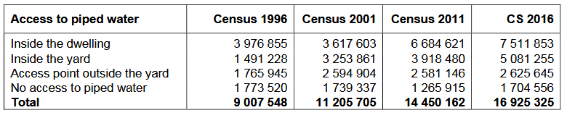
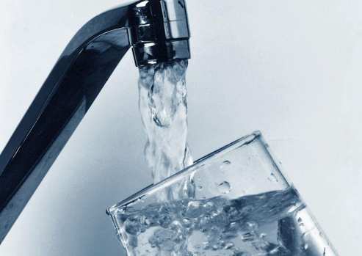
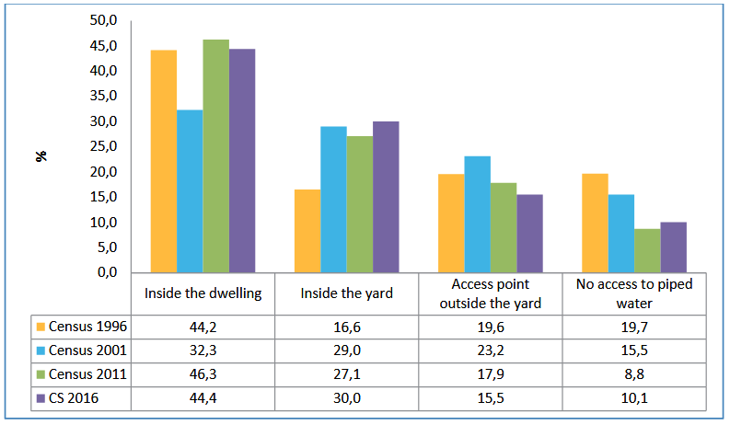
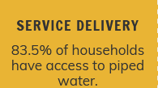
ACCESS TO WATER – NATIONAL:
Distribution of households by access to piped water: Census 1996 - CS 2016
Percentage of households by access to piped water: Census 1996–CS 2016
Notes:
The proportion of households whose main source of water for drinking is piped water inside the yard has almost doubled from 16,6% in 1996 to 30% in 2016. There is a slight decline of 0,2% from 2011 to 2016 of households whose main source of water for drinking is piped water inside the dwellings. Just less than three-quarters of households use piped water inside the dwellings/yards as their main source of water.
Access to safe drinking water is fundamental right that also links to the health, well-being and safety of the population of the country. The quality and availability of the water services are of extreme importance for the quality of human life and living standards. The CS 2016 asked questions related to the households’ main source of water, as well as the safety of drinking water that households had access to.
Source: Statistics South Africa, Census 1996; Census 2001; Census 2011; CS 2016 Note:
Piped water from access point outside the yard includes Piped water on community stand, Neighbour’s tap and Public/communal tap No access to piped water includes Borehole in the yard, Rain-water tank in the yard, water-carrier/tanker, Borehole outside the yard, Flowing water/stream/river, Well, Spring, Other CS 2016 asked households about their main source of water for drinking, whilst the Censuses asked whether the household had access to piped water.

Slide 6
ACCESS TO WATER BY PROVINCE:
2011
2016

Slide 7
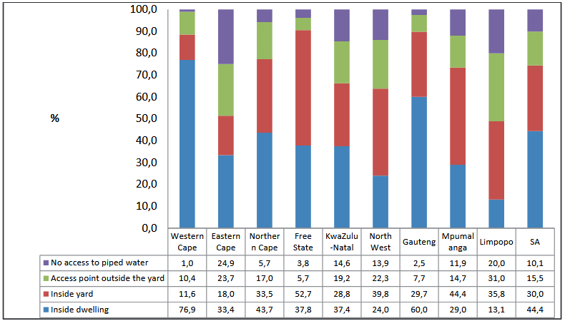
STRATIFICATION OF ACCESS TO WATER BY PROVINCE:
NATIONALY
MORE THAN 55% OF HOUSEHOLDS ACCES WATER OUTSIDE DWELLING
NATIONALY
BELOW 50% OF HOUSEHOLDS ACCES WATER INSIDE DWELLING
Notes:
The highest proportion of households whose main source of water for drinking is piped water inside the dwelling is in the Western Cape (76,9%) followed by Gauteng, (60%) respectively. Households that reported to have no access to piped water are highest in the Eastern Cape (24,9%) and Limpopo (20.0%).

Slide 8
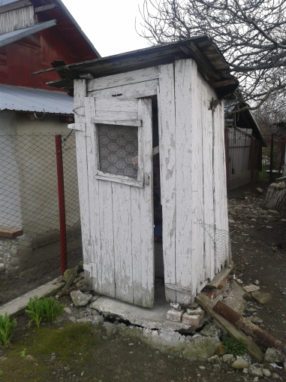
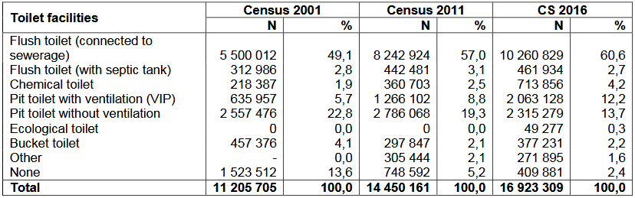
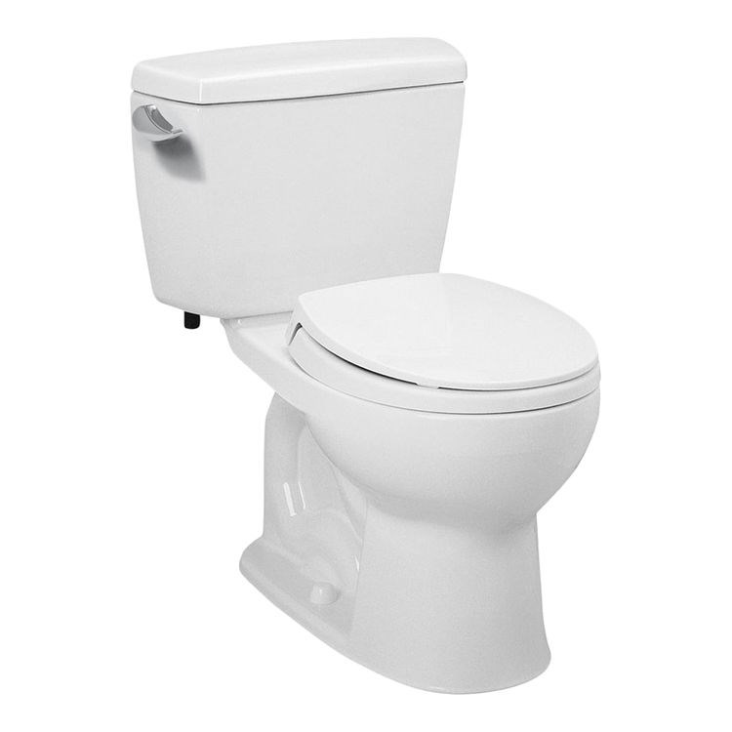
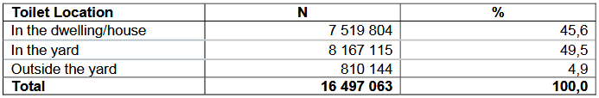
ACCESS TO SANITATION:
Distribution of households by toilet facilities
Distribution of households by location of toilet facilities – CS 2016

Slide 9
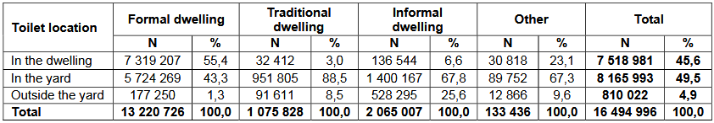
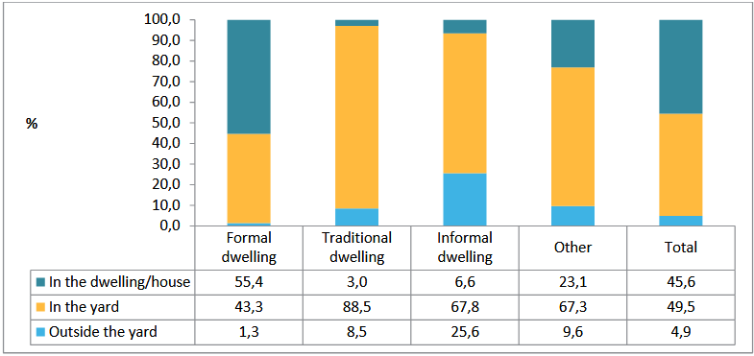
ACCESS TO SANITATION BY FACILITY:
Distribution of households by location of toilet facilities and type of main dwelling – CS 2016
The distribution of households by location of toilet facilities and type of main dwelling
Notes:
location of toilet facilities by type of main dwelling. In total, about 49,5% of toilet facilities are located in the yard as compared to 45,6% of those in the dwelling/house. Comparison by type of main dwelling shows that 55,4% are in the formal dwelling – highest as compared to those in traditional, informal and other dwellings. Households living in traditional dwellings have higher proportions of toilet facilities being located in the yard (i.e. 88,5%) followed by those in the informal and other dwellings respectively with just over 67%. Toilets that are located outside the yard are highest among households living in informal dwellings (i.e. 25,6%) as compared to only 1,3% of those in formal dwellings.

Slide 10
WATER KNOWLEDGE SYSTEM:
CONSIDERS THE FUNCTIONALITY/RELIABILITY OF THE INFRASTRUCTURE.
Access to Basic Services focuses on the status of people/households with access to RDP level and above Water Supply infrastructure and Sanitation.
Notes:
The total number of households without access to water supply infrastructure at or above RDP level such as further than 200m from dwelling, less than 25 litres per capita per day, no access etc. This is commonly known as the water supply backlog. Three figures are presented of which the first one focusses on access to infrastructure, the second one presents the result of Census 2011 access below RDP level water supply and the third one includes the impact of dysfunctional schemes.

Slide 11
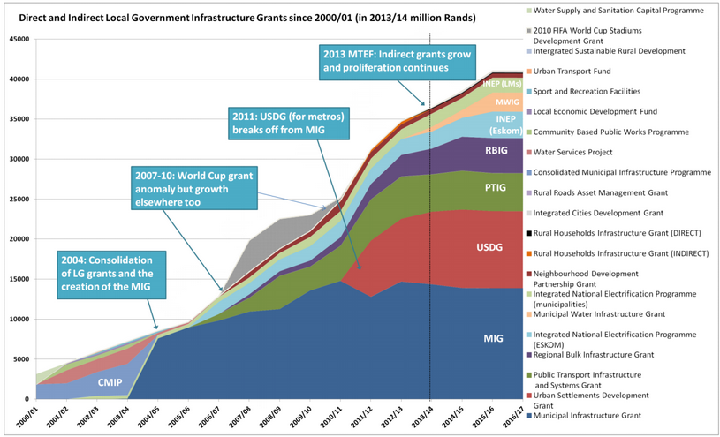
FUNDING STREAMS :
Direct and Indirect Local Government Infrastructure Grants since 2001

Slide 12
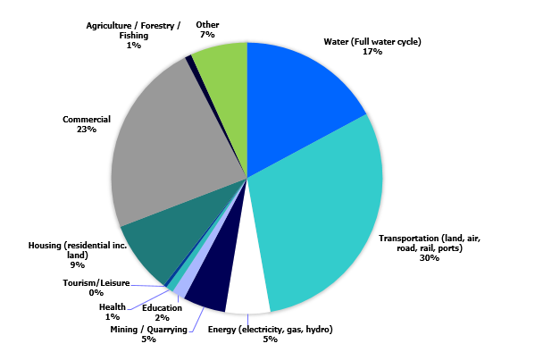
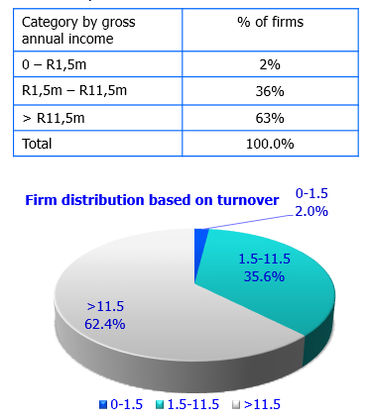
MONEY FLOW –CONSULTING:
R1,860 billion
R1,344 billion
R10,335 billion
R3,411 billion
Profile of Earnings by Sector (Source: CESA, 2016)
Economic Sector Rm, Real 2000 prices, Annualized
Notes:
According to CESA (Consulting Engineers South Africa) earning by sector as shown below indicate water (i.e. the full water cycle business) is a significant component of the earnings at 17%.
The engineering space where water and sanitation largely falls is dominated by companies with over R11.5 million gross annual income, accounting for over 60%. It is a known fact the companies that would be categorized in the high turnover bracket comprise of the historically white companies and that is where the skill and expertise resides as well, hence the need for “WEALTH TRANSFER” in its various forms

Slide 13
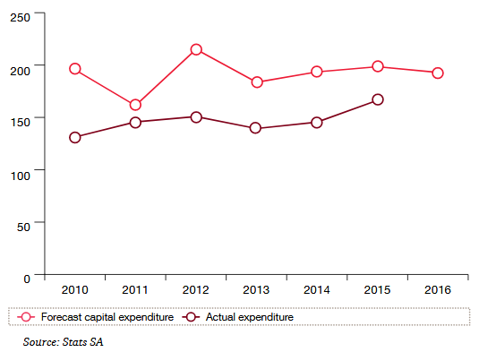
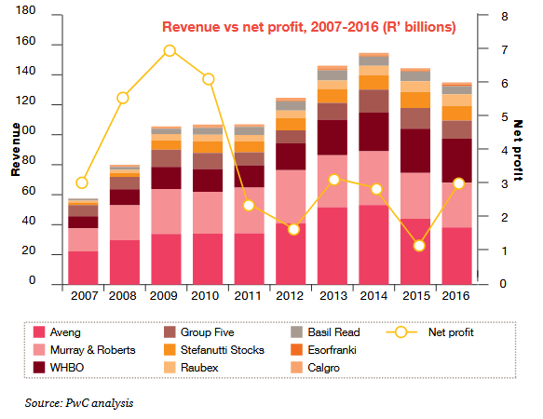

MONEY FLOW – CONSTRUCTION:
A LION’S SHARE GOES TO THE BIG COMPANIES
Notes:
First Figure
compares the actual capital expenditure relating to new construction,
development of properties and major rejuvenation projects incurred by the
public sector, alongside the forecasted expenditure as forecast in the year
before the actual expenditure.
Construction Revenue
The revenues are a mix of public and private sector work, that being said A good indicator of industry performance is public sector infrastructure expenditure.
Other revenue, consisting mainly of the sale of construction and related materials (value chain)
The revenues to black business still requires further research

Slide 14
CONTEXT OF WATER INFRASTRUCTURE BUSINESS
CUSTOMERS
LEGISLATION
INVESTORS
COMMERCIAL ENVIRONMENT
ORGANIZATIONAL STRATEGIC PLAN
OPERATE
MAINTAIN
DISPOSE
ACQUIRE
PLAN
ORGANIZATION & PEOPLE ENABLERS
ASSET MANAGEMENT STRATEGY & PLANNING
RISK & REVIEW
DELIVERY
LIFE CYCLE
ASSET MANAGEMENT DECISION MAKING
ORGANIZATION & PEOPLE ENABLERS

Slide 15
Preferential Payment Systems for BIP:
Delayed/Non-payment of service providers by the public sector has resulted in the reversal of the economic empowerment and inclusivity gains since the dawn of democracy.
The Department of Water & Sanitation is guilty of not paying contractors on time and the imposition of unfair and non-contractual payment practices e.g. deduction of retention whilst the department/water board holds a retention guarantee.
Payment of service providers/contractors is absolutely essential for the success of the BIP. We are currently lobbying National Treasury to include payment guarantees as a provision in the Public Procurement Bill. Most significantly there has to be consequences management on state personnel who disregards government’s commitment to pay service providers within 30 days.

Slide 16
Bulk Water Infrastructure Development:
In recognition of the tough fiscal constraints that will be facing government within the MTEF, specifically the enormous challenge regarding government’s ability to invest significantly in the Water & Sanitation Infrastructure in order to meet the NDP’s targets, the BBC (through its work in the Presidential Business Working Group) is partnering with the Department of Water & Sanitation on the 30th of November 2017 to host a Water Infrastructure Investment Summit.
The objective of the Summit is to crowd-in private sector investment in amongst others government’s Bulk Water Infrastructure Programme.

Slide 17

NDP 2030 –BLACK Industrialization PROGRAMME
The NDP has a vision to create 11 million jobs by 2030 by,
inter alia, raising exports and competitiveness.
Its proposals include:
Water security –infrastructure using Private Services Provider (PSP) funding model – global funding model
Energy solutions – alternative energy
Agricultural development in terms of ocean economic and /or circular economy
Land –optimal land use and water allocation for growth and development – 1884/1885 Berlin Demarcation of Africa and CMAs – water licences and ownership – new water policy
Technology- water quality and reporting on water security and availability
Health- income and growth leading reduction of malnutrition

Slide 18
An important step in a longer journey
MDGs
SDGs
AU 2063 Agenda
2015-2030
2003-2015

Slide 19
Socio-Economic Development : Water and Sanitation Governance and Investment Models
MDGs
2003-2014
SDGs
AfSD 2030
NDP 2030
AU Agenda 2063

Slide 20

The NDP 2030 vision can lead to more Water Industrialisation Programme and IPAP by bbc , wrc, dti and dws
Green Path
-Black Industrial Programme
Manufacturing using PSP
On-the-job training – SETA system
Bulk Infrastructure Investment
Competent officials in waterworks
Water and Sanitation Policy Governance Loop- bridging the gap
Red Path
- Ageing infrastructure (DWS, 2011)
- inability to create jobs
-ageing infrastructure
-vandalism of infrastructure & waterworks
-poor O&M
-lack of dedicated O&M budget
- Non Revneue Water increased

Slide 21
Water for Growth and Development through W.E.A.L.T.H. creation in partnership with private sector
Poverty
Knowledge
Solutions
Enterprise &
Business
Development
Research
Social barriers
Unemployment
Inequality

Slide 22
New Water and Sanitation under the NDP 2030
Growth & Development
Knowledge
Solutions- WELATH Water and Sanitation Seminars
Enterprise
Development
Economic Analysis of the water industry
Competitiveness
A more equal society
Prosperity

Slide 23
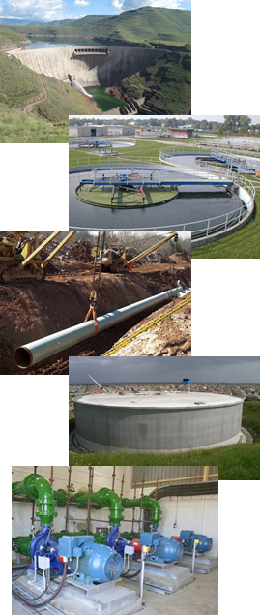
WATER & SANITATION INFRASTRUCTURE:
Water & Sanitation Components | Major Inputs
Water Resource Development | Steel, Concrete, materials, etc
Water Treatment | Steel, Concrete, Pumps, Chemicals, Instrumentation
Pipelines & Conveyance | Steel Pipes, PVC Pipes, HDPE, Pipes, Valves
Reservoirs | Steel, Concrete, etc
Pump Stations | Pumps, Steel, Concrete
RAW MATERIAL
MANUFATURING
SPECIALIZED BENEFICIATION
DISTRIBUTION & LOGISTICS
CONSTRUCTION
FULL VALUE
CHAIN
INVOLVEMENT MUST BE ACROSS THE ENTIRE VALUE CHAIN
Notes:
Opportunities for Black business must be seen in the context of the entire value chain of the water business
E.g. supply of concrete and material begins at the mining operation to the processing plant and concrete mixing plants, distribution logistics (which involves plant and equipment) right to the construction site.

Slide 24
Economic Opportunities for Black Industrialists:
The BBC & BBCBE have successfully lobbied the Department of Trade & Industry and the Presidential BBBEE Advisory Council for the inclusion of the Construction Industry in the BIP.
The programme is aimed at transforming the entire construction industry value chain.
In the Water & Sanitation Sector the BIP will be targeted at the following value chain players:
  Built Environment Professionals (Architects, Engineers, QS, etc.) ;
  Contractors; and
  Suppliers & Manufacturers (Steel, Concrete, Materials, Pumps, Chemicals, Instrumentation, Valves, Steel & PVC Pipes, etc.)

Slide 25
WAY FORWARD
Private Sector Provider support 86 financial distress and 34 financially distressed municipalities ( B2B, 2014)
Private Sector Provider provide a funding mechanism using existing grants to enhance infrastructure development and maintenance, Water and Sanitation Governance and maintenance , Local Economic Development using standardised designs and criteria for local economic development ( scale in the value chain)
Through this Private Sector Provider approach, water prices, inflation and future water tariffs are determined
Existing RSA companies have the capacity to mentor, coach and provide skills transfer of young professionals , process controllers, and operation and maintenance of waterworks in a private sector environment
Standardisation of criteria and designs increase volume for bulk infrastructure investment to support BIP and job creation

Slide 26
WAY FORWARD
BIP encourages Private Sector Provider (PSP) in the water industry as a means of raising additional financing for regional bulk infrastructure grants (RBIG)
Allow new water industrialists and new business models to stimulate competition for reliability of infrastructure and new operational models spearheaded by new black industrialists;
Water Sector to optically use BBC & BBCBE Water and Sanitation Seminars to strengthen water governance and strategic planning (launched at the JSE on the 4-5 October 2017)

Slide 27
WAY FORWARD
Adopt incubator projects for black industrialists, entrepreneurs, and ideapreneuers by using 21st century technology solutions
Investment Planning in partnership with the African Development Bank (ADB) Development Bank of Southern Africa (DBSA), new BRICS Bank, Trans-Caledon Tunnel Authority (TCTA) and Lesotho Water Highlands Project under the custodianship, and stewardship of the RSA Ministry of Water and Sanitation.
As part of an inclusive circular economy, the SADC Integrated Infrastructure Investment Model using PSP and Transnational Infrastructure Investment Planning in terms of Agenda for Sustainable Development (AfSD) 2030 by African Union (AU) countries is highly recommended

Slide 28
WAY FORWARD
Implement skill transfer projects informed by circular economy in the Built Environment and advance socio-economic impact assessment of water and sanitation infrastructure;
In the context of resource depletion, climate change, and biodiversity degradation, it is vital more youth programmes will be dedicated to champion modern technology and innovation solutions in the water industry;
BBC is working with WRC , DWS, and DTI on Water Industrialisation Programme ( IPAP 2017/2018-2019/2020) for accelerating job opportunities and skills transfer.

Slide 29


Slide 30
THANK YOU

