Slide 1

Response to presentations made during the Parliamentary hearings on the 2017 MTBPS
Michael Sachs | DDG: Budget Office

Slide 2
Fiscal consolidation and economic growth
Response to PBO presentation
Government has repeatedly raised the dilemma of economic growth and fiscal consolidation.
Fiscal consolidation has been a “headwind” in respect of economic growth in recent years. However:
  Other factors (domestic and international, structural and cyclical) have played a far stronger role in the secular deceleration of growth in the last decade.
  It is highly doubtful that fiscal demand stimulus would have changed to direction of the growth trajectory.
  Failure to consolidate could have worsened growth outcomes as a result of adverse market reactions, higher interest rates and capital outflows.
Going forward, it is unlikely that South Africa can consolidate itself into fiscal sustainability, without measures to enhance growth. As pointed out in the MTBPS, “unless decisive action is taken to chart a new course, the country could remain caught in a cycle of weak growth, mounting government debt, shrinking budgets and rising unemployment.”
The only sure way forward is to grow ourselves out of the debt trap – to consolidate the fiscus through economic growth.
National Treasury modelling indicates that achieving and sustaining 3 percent growth would stabilise the debt-to-GDP ratio below 60 per cent.
But it is impossible to achieve this by borrowing more to stimulate demand – even if the multiplier is assumed to be very high, and monetary policy is accommodative.
The Presidential Fiscal Committee is consideration proposals to stabilise the debt-to-GDP ratio over the medium term, through measures that narrow the deficit, stimulate economic growth and build investor confidence.

Slide 3
UPDATE: Actions to boost confidence
Restore the sustainability of fiscal policy
  Budget Facility on Infrastructure - 59 submissions received, project appraisals under way
  Negotiations on the next public-service wage agreement have commenced
Promote transformation and competitive outcomes by implementing sector reforms
  Preferential Procurement Policy Framework Act Regulations took effect on 1 April 2017
  Financial Sector Regulation Act signed into law on 21 August 2017
  Small business fund for ideation and start-up being set up
Manage fiscal and economic risks associated with state-owned companies
  SAA recapitalised, with new board and permanent CEO
  Frameworks for private sector participation and costed SOC mandates approved by Cabinet
  Eskom governance interventions in motion. IPP agreements to be signed at 77c/kWh or below
Create policy certainty by finalising key legislative and policy processes
  CSIR study on spectrum availability and open access
  Market inquiry launched into broadband data prices
  Licensing of Postbank under way
  Mining Charter engagements following postponed implementation
  Stakeholder consultation on the Regulation of Agricultural Land Holdings Bill

Slide 4
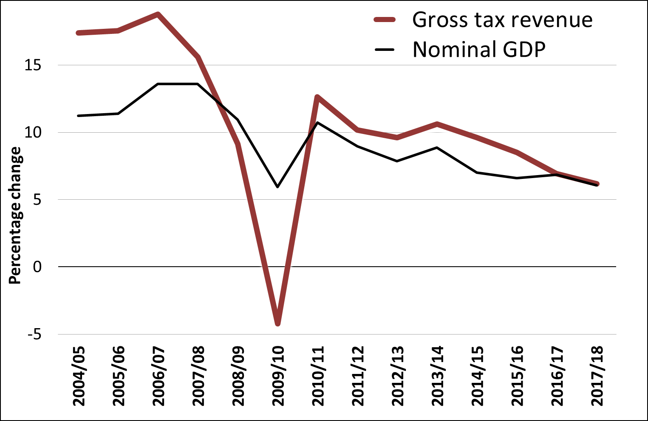
Factors behind revenue under-collection
This period of revenue buoyancy appears to have run its course.
Revenue growth outpaced GDP between 2011 and 2015 - partly the result of tax policy,
partly the result of underlying economic trends.
Revenue weakness reflects a number of economic factors:
  Growth in key sectors has slowed – finance, retail and telecoms
  Low bonus payments, moderate wage settlements, job losses and a slower employment growth
  Persistently weak growth and commodity price volatility in mining sector
  Sharp contraction in imports
  Stabilisation of the rand
Other factors could include:
  Behavioural responses to tax increases
  Compliance concerns and weakening tax morality
  Administrative challenges in SARS
Growth in gross tax revenue and nominal GDP
Revenue under-collection reflects slowing economic growth, but may also suggest a profound shift in the relationship between economic growth and tax collection in the years ahead.

Slide 5
Corporate tax collection as a share of GDP
[OECD countries; data from 2015 or 2014]

Slide 6
Illicit capital flows
Estimates of illegal capital flows are generally unreliable.
Tax and financial crimes are complex and sophisticated crimes, committed by highly skilled and well-connected people with extensive resources.
Capacity to investigate and prosecute people who are engaged in illicit financial activities is critical.
Dedicated and highly trained personnel are needed to focus on these complex and sophisticated crimes.
To increase tax yield from capital flows, we need to strengthen the transfer pricing audit capacity within SARS, as well as its capacity to implement the transfer pricing country-by-country reporting and audit reportable arrangements.
Other law enforcement and regulatory agencies have a critical role to play: anti-money laundering agencies, the Reserve Bank , policing and prosecution authorities.
No matter how well drafted our laws may be, without stronger capacity to enforce such laws, we will not win the battle against illicit financial flows.

Slide 7
Public sector employment and remuneration
Responding to COSATU: “… the state is actively reducing the number of jobs available in the public sector.”
Since 2011 government has been forced to restrict employee headcount growth to accommodate rising salaries
Yet spending on compensation continues to grow more quickly than nominal GDP
The MTEF provides for an overall increase of 7.3 per cent a year to accommodate improvements in conditions of service
Many departments are already at risk of exceeding this limit, even assuming that personnel numbers do not increase.
A fair and reasonable compromise between government and state employees is in the public interest
Total employment (full time equivalents)

Slide 8
Equity in government salaries
Response to COSATU presentation:
“[Government] must reduce the out of control salaries of SOE CEOs and executives, Political Office Bearers including DGs.”
High salaries and bonuses in publicly funded entities is of great concern and are being reviewed.
Nevertheless, within the public-service there is a growing challenge of salary compression
The highest-paid 1 per cent of public servants receive 23 times the income of the lowest paid 1 per cent. In the private sector the same ratio is 633
Average cost of living adjustments and consumer inflation
Average remuneration by salary level (real 2016 prices)
Distribution of income: Public servants compared to all taxpayers

Slide 9
Various issues
Responding to Fiscal Cliff Study Group
It is true, as argued by the FCSG that the combination of mandated expenditures on debt service costs and compensation of employees is crowding out other expenditures, and eroding the effectiveness of the public finance.
“Purchase only vehicles manufactured in South Africa for the government’s vehicle fleet.” (Fiscal cliff study group)
  An excellent idea, which needs to be addressed in the Ministerial Handbook.
SACU revenue sharing arrangement (Fiscal cliff study group)
  In general, government agrees that the current SACU revenue sharing arrangement needs to be reformed. It is detrimental to regional economic development, exacerbates fiscal pro-cyclicality and creates dependence on declining revenue sources.
  Compared with 2017 Budget estimates, South Africa’s payments to SACU have been revised down by about R34 billion over the next two years.
  This revision is favourable to South Africa since they off-set the downward revision to main budget revenue
  But they will certainly place our SACU partners under fiscal stress in the years ahead.
  These revisions are driven by a formula defined in the multi-lateral agreement based on estimates of GDP, intra-SACU trade and error-corrections with two-year lag.

Slide 10
Programmes that benefit children
Responding to UNICEF
The recommendations regarding the preservation of budgets that impact on children's rights are well-taken and helpful.
Government remains committed to protecting core social expenditures from the impact of fiscal consolidation measures.
Proposals to expand primary health care are at the heart of government’s programme to implement National Health Insurance.
Funding for the NPO service sector is of great concern.
A review of the equitable share formula is currently underway, and UNICEF is welcome to engage National Treasury if they have specific proposals in this regard.

Slide 11
Presidential Fiscal Committee
The President of the Republic of South Africa: His Excellency President Jacob G Zuma
The Deputy President of the Republic of South Africa: Mr MC Ramaphosa
The Minister in The Presidency: Planning, Monitoring and Evaluation: Mr JT Radebe
The Minister of Economic Development: Mr E Patel
The Minister of Energy: Mr MD Mahlobo
The Minister of Finance: Mr MKN Gigaba
The Minister of Science and Technology: Ms GNM Pandor
The Deputy Minister of Finance: Mr SN Buthelezi

Slide 12
Website
Further information including documents and data, graphs and tables in excel format are available at:
www.treasury.gov.za/documents/MTBPS/

