Slide 1


2017 Medium Term Budget Policy Statement
Standing Committee on Appropriations
3 November 2017

Slide 2

“We are giving an honest view of the challenges facing our country.
It is not in the public interest, nor is it in the interest of government, to sugar-coat the state of our economy and the challenges we are facing.
It is only when we understand these challenges fully and candidly that we will know what to do and can decide what course we must take in addressing them, as well as what trade-offs we must make in the national interest.”
Minister of Finance, Malusi Gigaba, 25 October 2017

Slide 3
Overview
Accelerating economic growth
Infrastructure investment
Education
Health
Towards a Responsive and Developmental Local Government
Social Cohesion and Higher Education
Major Risk Areas Facing South Africa’s Fiscal Trajectory

Slide 4
Accelerating Economic Growth

Slide 5
Steep Economic Downturn & Sluggish Recovery
Downward revision of 2017 growth forecasts (from 1.3% to 0.7%)
  Recession began in 4th Quarter of 2016
  Economic growth below 2% since 2014
  Pegged below NDP target (5.4% GDP growth p.a.)
Sharp contraction in fiscal revenue as a result of economic downturn
  Slow growth undermines the fiscal framework
  Reduced spending and selective tax increases to stabilise debt-to-GDP ratio
Sectoral drivers of ‘weak recovery’ – precarious primary sectors (Agriculture = 21,2%; Mining = 4,3%)
Unemployment at 27,7%; 30.4 million living below the poverty line; extreme ‘wealth inequality’

Slide 6
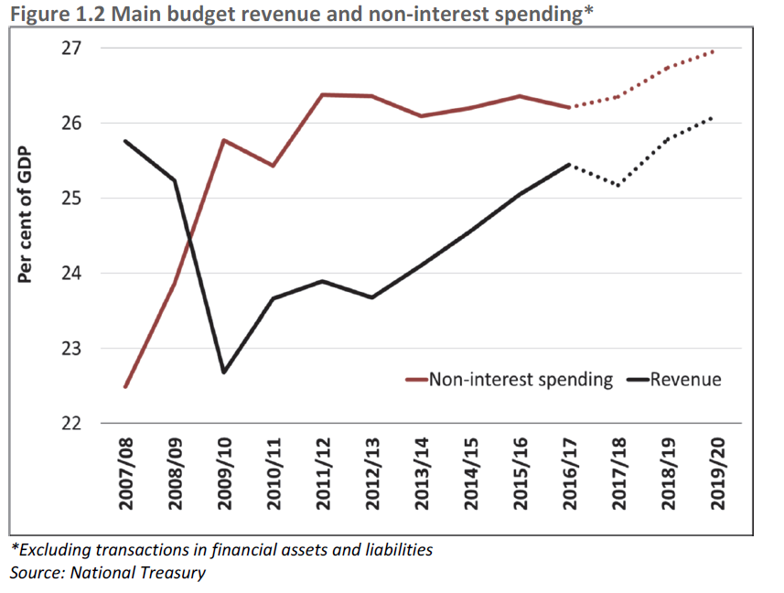

Slide 7
Debt Share of GDP Rising
From fiscal consolidation to rise in deficit spending
Fiscal deficit overshoots the target – at 4.3% instead of 3.1% of GDP
“Debt-service costs are the fastest-growing category of expenditure, crowding out social and economic spending.”
  Debt-to-GDP ratio = 61%
  Debt-service costs/GDP share = 15%

Slide 8
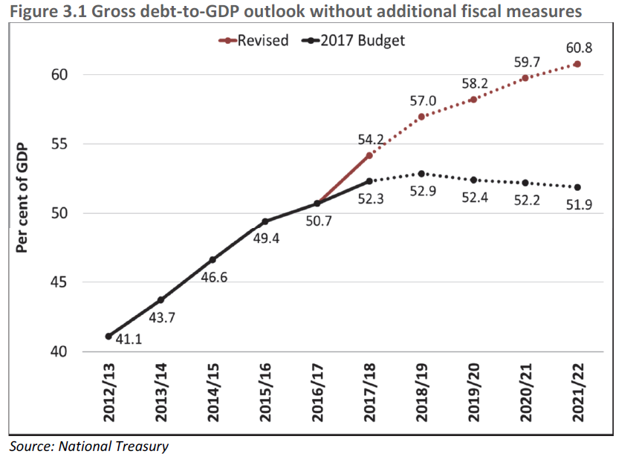

Slide 10
Spending Priorities & 14-Point Plan
Protect spending on core social programmes that benefit poor South Africans (7 Spending priorities aligned with the NDP)
  What is the fiscal space for ‘inclusive economic transformation’?
July Cabinet adopted 14 point plan – confidence boosting measures & micro-economic reforms
Logistics sector reforms to reduce port and rail prices
  Reduce the cost of electricity
  Consider a stimulus package – details to be announced in February 2018 budget

Slide 11
Promoting counter-cyclical R&D and innovation to stimulate inclusive economic growth
With the retraction of the economy and increasing unemployment, R&D expenditure by the business sector is declining, in real terms
Business expenditure on R&D (BERD) in a given year tends to follow a cyclical pattern, declining in countries faced with recession
It is influenced by a myriad of activities, including fluctuations of GDP, government funding, and industry structures
Governments usually follow a counter-cyclical pattern in a recession, by increasing funding of R&D, mostly to the public sector
In South Africa, government expenditure on R&D has increased steadily, but to science councils and higher education
Government funding of business R&D declined from 23% in 2005/6 to 5.4% in 2014/15

Slide 12
Moreover, there has been a decline in expenditure on experimental development by firms, from 62% in 2005/6 to 36.9% in 2014/15. Experimental R&D typically leads to the improved production of goods and services
On a positive note, there is more R&D expenditure on applied research, an indication of potential innovation and contribution to knowledge in future.
Together, these trends have implications for policy attempts to stimulate and support business innovation
A critical policy question is: how can government promote counter-cyclical funding for private sector R&D?
The typical mechanisms are tax incentives but the trends suggest the need to review existing, and identify new, funding instruments

Slide 13
Infrastructure investment

Slide 14
Public Investment in Infrastructure Networks & Coordination
Infrastructure investment will amount to R948 billion over the next three years (5.9% of GDP)
Improve the quality of government’s infrastructure spending
  PICC & Budget Facility for Infrastructure (better plan and execute large infrastructure initiatives)
  59 projects worth R135 bn in detailed appraisal phase
Economic Infrastructure Spending via SOCs – but fix patterns of poor governance, fiscal and economic risks connected with SOCs
Fiscal planning for rapid urbanisation
  Cities and towns as engines of economic growth
  Integrated Urban Development Framework
  Cities Support Programme

Slide 15
Education

Slide 16
Education: Vote 14 & 15
Vote 14: Basic Education
Two stories:
Policy success with workbooks & Textbooks
Implementation concern wrt infrastructure development
Vote 15: Post school education
Funding distribution
Trends in HE and TVET enrolments
Broad trends in NSFAS funding and recipients

Slide 17
Resources: Textbooks and Workbooks
TIMSS results show that policy investment in workbooks (now grades 1-9 for math, 1-6 for home language and grade R) makes a difference.
Gr 9 maths learners have their own textbook (2015)
69%
Gr 9 science learners have their own textbook (2015)
87%
Gr 5 learners have their own maths workbook (2014)
82%
Grade 9 learners scored 24 points higher for maths and 31 points higher for science than those who did not have a textbook.
Grade 5 learners who had workbooks scored 63 points higher that those who did not.
Continued investment in structured learning materials
Need to know how teachers and learners USE textbooks and workbooks
Notes:
In KwaZulu-Natal, only 42% of learners reported having a science textbook
teachers reported improved availability of resources for the teaching of mathematics.

Slide 18
Home & School infrastructure
ALL schools do not have full infrastructure.
Learners from poor homes go to poorly resourced schools. Home and School resources influence achievement

Slide 19
Higher Education: Vote 15

Slide 20
Post School Education Expenditure, 2017 (million)

Slide 21
Skills Supply: Enrolments at Public Universities and TVET colleges: 2010-2016
 | UNIVERSITY | TVET COLLEGES
2010 | 892 936 | 358 393
2011 | 938 201 | 400 273
2012 | 953 373 | 657 690
2013 | 983 698 | 639 618
2014 | 969 154 | 702 383
2015 | 985 212 | 737 880
2017 | 975 836 | 540 075
60% of the TVET qualifications are at NQF level 4 i.e. matric equivalent

Slide 22
University & TVET Completers, 2014
 | TOTAL | Business, Economic & Management Science | Science, Engineering Technology | Humanities | Services
Universities Diplomas and Degrees | 185394 | 50380 27% | 55574 30% | 79749 43%
TVET Colleges NCV 4 | 7405 | 3824 52% | 1628 22% |  | 1953 26%
TVET Colleges NATED 6 | 24178 | 13886 57% | 7925 33% |  | 2367 10%
Completers from University and more especially TVET colleges is low and a concern.

Slide 23
Trends in NSFAS funding
 | TOTAL BUDGET ® | TOTAL STUDENTS | UNIVERSITY | TVET
2013/14 | 8.5 billion | 416 174 | 194 923 | 220 978
2014/15 | 9 billion | 414 802 | 186 150 | 228 642
2015/16 | 9.2billion | 414 949 | 205 000 | 200 000
2016/17 | 2.4 + 2.1 additional | 451 507 | 225 950 (R10.3billion) | 225 557 (R2.1 billion)
2017/18 | 15.2 | 291 747 (Feb 2017) | 180 944 71 098 first year 109 846 returning students | 110 803

Slide 24
Health

Slide 25
  Spending on the social sector will not be adjusted over the MTEF and is expected to grow by 7% annually.
  With 2/3 of spending on socio-economic rights
  Allocations of R948 billion for infrastructure – to include health infrastructure as more hospitals are needed particularly teaching hospitals and rehabilitation of existing infrastructure
  BUT – it is very limited on specific details on structural and specific social sector reforms.
  For instance, in the last budget statement-reference was made to the establishment of NHI Fund – this statement was very silent on NHI. This is a critical transformative program –and should not dropped from the priority programme list.
  It is important to look after both the “health” of the economy and that of the people particularly the workforce” – as TB/HIV/NCD pose a real threat to loss of productive skills to drive the economy
  This might be time to enhance implementation of innovative ways of funding health using innovative taxes – sugar tax, sin tax , and other forms of earmarked health taxes , etc

Slide 26
Risks
Significant investments in all sectors subject to improvements in economic growth (0.7 - 1.9% is very low vs NDP’s 5%).
The competing demands for fees-must fall versus National Health Insurance
It is particularly hard to see how all these competing needs will be achieved with a (0.7 in 2017 to 1.9% in 2020)
It calls for “SMART” spending to ensure that the limited funds are allocated and used efficiently and effectively – this needs improved governance structures
Wasteful expenditure at all levels of government!!
The burden of disease particularly NCDs is on the rise, in addition to already co-epidemic of HIV-TB which threatens the lives of many people with potential devastating effects on the workforce

Slide 27

Towards A Responsive & Developmental Local Government

Slide 28
Towards A Responsive & Developmental Local Government
Post-1994 government characterised by policy and service delivery shifts.
278 municipalities’ population increased from 40.5 million to 51.8 million people (StatsSA 2011).
Average annual increase of 2.26 million people.
Growth impacts on service delivery - more challenges for urban metros and rural municipalities.
Imperative to reposition local government sector for efficient and inclusive response.

Slide 29
Repositioning Local Government
Project Consolidate, the Local Government Turn Around Strategy (LGTAS) and Back to Basics (B2B) aimed to improve all aspects of local government.
Auditor General South Africa (AGSA): most municipalities are not meeting audit requirements and are not responsive.
Need for ecosystem of local government to be analysed and repositioned on:
    Political interference
    Capability deficits
    Weak financial management
    Lack of accountability
    Inadequate revenue base

Slide 30
Repositioning Local Government
Local government sector repositioning project should be initiated to ensure sector-wide and in-depth analysis of institutions and their contexts.
Proposed Repositioning project outcomes:
  Dynamic strategy to enhance capacity of responsive developmental local government.
  Blueprint for best practice, implementation guidelines and roadmap that responds to NDP Vision 2030 and the domestication of the SDGs.
  Effective delivery on Integrated Development Plans and inclusive sustainable development.
  Report to Cabinet to guide implementation towards responsive developmental local government in phased roll-out

Slide 31
HSRC Research on Local Government
Verification Study on the informal settlements and backyard shacks backlogs/demand and supply within Eastern Cape; 2009-10. ECD of Housing.
Relationship between traditional and modern institutions of local governance; 2009-11; IDRC.
Developing a Comprehensive Indigent Exit Strategy; 2010. City of Tshwane.
N2 Wildcoast Highway: Survey of Communities along Port Edward & Port St Johns; 2010-11. SANRAL.
Relationship between traditional and modern institutions of governance; 2009-11. IDRC
Safe and Inclusive Cities, 2013-5. IDRC funded Cost Benefit + Quantitative Analysis of Community Advice Offices in S.A.; 2104. NADCAO.
Cities Support Programme, 2013-15. DBSA/National Treasury

Slide 32
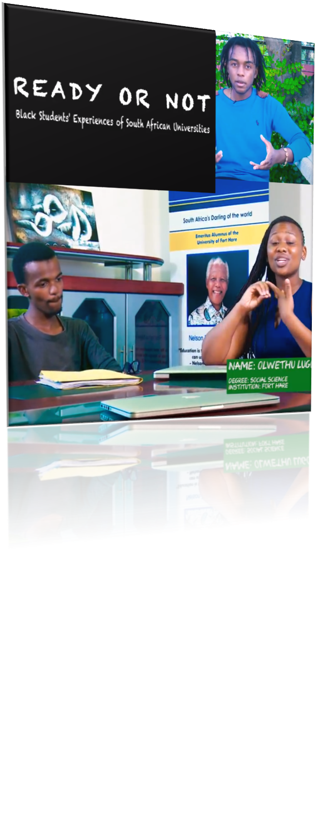

Social cohesion & Higher education

Slide 33
Racism and attitudes towards redress
A country that is committed to justice for current and past inequalities, and is making progress in redress, has nothing to fear from populist leaders or populist movements.
South Africa’s current inequalities contribute to the culture of protest and racism
  Life expectancy 20 year; - Unemployment 4 fold
  Household income 6 fold; - University enrolment 7 fold
  Human Development Index 116th v. 15th
What are our attitudes towards redress?
  White South Africans know that wealth is highly unequally distributed in South Africa, and say they are opposed to such inequalities.
  But most reluctant to do anything about redress (e.g. land reform, affirmative action, sports quotas and apartheid compensation)

Slide 34
Racism and attitudes towards redress
What about specific restitutive actions: (HSRC SASAS 2016)
In agreement with the following statements: | Black | White
We should forget the past and just move on | 51% | 76%
White South Africans must act to repair the past | 60% | 20%
Black South Africans should demand restitution | 54% | 13%
Apartheid corruption should be investigated | 56% | 16%
A voluntary restitution fund should be set up | 54% | 14%
A compulsory restitution tax should be implemented | 43% | 8%
We should have small group discussions about restitution | 56% | 22%

Slide 35
Racism and attitudes towards redress
Also there are worrying trends - the ‘ostrich’ syndrome
  66% want to ‘forget the past’ and ‘move on’
  Changes in 2016 - Whites now 76%, Black people now 51%
‘Hate speech’ - What should happen to people who say “F*&%$ White people” as seen in recent student protests
  81% “people who do these things should stop it, should be punished for it and should be told they are destroying our vision for a united future”
  2% “they should be praised for it”
  13% “nothing should happen to them”
  4% had no opinion
Tipping points come at around 20-30%.
We need to redouble efforts at social cohesion, and including White South Africans (and business) in programmes of redress

Slide 36
Higher education and a framework for student support
A 5-year qualitative study of agency and impasses to success amongst higher education students – 8 universities
Reason for study:
  55% failure rates among students
  Low completion rates on time (only 1 in 4)
  Inequity in enrolment rates (15% Black versus 54% White in 2014).
  White completion rates 50% higher than Black students (CHE, 2013).
Financial recommendations will be addressed by the Heher report

Slide 37
Higher education and a framework for student support
Key recommendations (in the area of social cohesion)
  The need for a national student support framework
  Investment in high schools, preparing students for university
  Co-agency at university – mentoring, self care, accountability
  Services available but seldom used
  Urgent need for mental health services
  Better and ongoing orientation for students
  Required evaluations of lecturers and support staff
  Rethink pedagogy - especially translanguaging
  Introduce a core course on equality/justice and African content

Slide 38
Major Risk Areas Facing South Africa’s Fiscal Trajectory

Slide 39
The Approach
Q1: Are public resources being allocated in an optimal way to foster growth economically and socially?
  What is the balance between investment in economic infrastructure; spending on social services/consumption; and spending on public administration (government employees)?
  Is there an appropriate balance between spending on the maintenance and repair of existing infrastructure and investment in new infrastructure?
  Do economic considerations influence the detailed pattern of spending?
  Which areas offer potential savings?

Slide 40
The Approach
Q2: Are public resources being used properly?
  Does public spending comply with the formal rules and procedures?
  Is public spending worthwhile?

Slide 41
Key Risk Areas
State Owned Enterprises
  Demand maximum information from SOEs to justify bailouts
  Insist on conditions being attached to any approvals, including regular report backs on progress
Higher Education and Vocational Education
  Consider the implications of raising higher education expenditure for other items of public spending
  Be particularly careful about funds being diverted from vocational training and community education towards higher education

Slide 42
Key Risk Areas
Public Sector Salaries
  Composition of expenditure across functions, composition of expenditure within functions
  Composition of the wage bill in a context where many basic services remain understaffed
  Request detailed information on the impact of recent efforts to curb the wage bill by freezing vacant posts and encouraging voluntary retirement and departure
National Health Insurance
  Does the NHI require substantial spending above the funds available from a reduction in medical tax credits?

Slide 43
Key Risk Areas
Ratings downgrades
  Increased debt service costs as well as the cost of new borrowing
  Reduced resources available for allocation, thereby requiring even more difficult decisions about cutbacks
  Danger of targeting priority areas for cutbacks
Special Zones and Strategic Projects
  Major risks for public spending
  How can government spending prioritize selective projects to stimulate economic growth and development in lagging regions?
  Emerging lessons from these projects?

