Slide 1
CoGTA Plans to Improve the Financial Status of Municipalities
PRESENTATION TO PORTFOLIO COMMITTEE
01 NOVEMBER 2017

Slide 2
PRESENTATION OVERVIEW
Purpose and Background
The Ideal Municipality
Progress with B2B
Financial Status of Municipalities (NT, AG and CoGTA)
Conclusion
Resolutions taken at the LG Summit
What needs to be done
Recommendations

Slide 3
Purpose and Background
Purpose:
To inform the Portfolio Committee about CoGTA’s plans to improve the financial status in municipalities
Background
Since establishment of Developmental Local Government System in year 2000 there have been various support initiatives:
Project Consolidate; (2003/05)
Five-Year Strategic Agenda; (2005/08)
LG Turn Around Strategy; (2008/13); and
Back to Basic’s Approach; (2014/16)
Support and interventions measures must practically respond to addressing existing weaknesses, and improve, strengthen oversight and accountability mechanisms (Holistic approach). The Back to Basics programme (B2B), was launched in September 2014, based on a foundation of doing the basics right: putting people first by engaging with communities; effective delivery of services; good governance; sound financial management; and building institutional capabilities to ensure the living conditions of communities are improved.

Slide 4
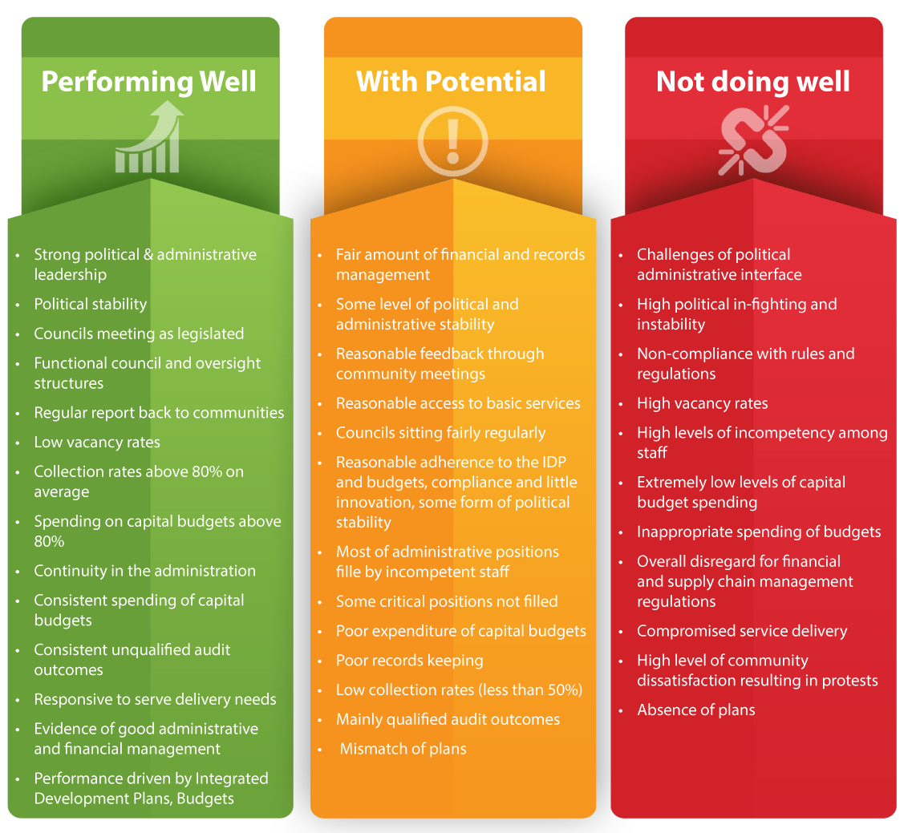
THE IDEAL MUNICIPALITY

Slide 5
Progress with B2B
There is an extraordinary variety of characteristics across South Africa’s municipalities, spreading from their population size (ranging from 4.4 million residents in the City of Johannesburg to just 8 895 residents in Laingsburg – figures from Community Survey 2016), to their different geographical sizes.
Hantam Municipality in the Northern Cape, for example, covers 39 085 km² and has a population density of 0.6 people per km2, versus Mandeni in KZN that covers 545 km2 and has a population density of 271 people per km².
Household growth drives the demand for service delivery in municipalities. The province with the highest household growth in local municipalities between 2011 and 2016 was Gauteng (20.9%), followed by Western Cape (18.3%). Particularly metropolitan municipalities experienced high levels of growth.

Slide 6
Progress with B2B
In the 2015/16 period, 2135 protests were recorded by municipalities in the B2B monthly questionnaire, of which 945 protests were violent. Gauteng and the Western Cape had the largest number of violent protests. Service delivery protests were more prevalent in metropolitan areas, with 76% of the total protests for 2015/16 recorded in metropolitan municipalities.
The increase in service delivery protests occurred irrespective of the public participatory type meetings (such as ward committee meetings) held in general as prescribed or expected. One must be however be cautious to assume that it is merely as a result of the public participation mechanisms not being effective or functional enough, that service delivery protests have been increasing. The phenomenon of protests is complex, with many causes, of which the effectiveness of public participation mechanisms is but one.

Slide 7
Progress with B2B
Well-maintained water and electricity distribution infrastructure is central to economic production and attracting businesses to particular localities, with the spin-offs of more jobs and a larger municipal tax base.
Challenges are mainly still experienced across the infrastructure development life cycle in municipalities, namely from project identification, infrastructure planning, financing, construction to operations and maintenance.
Some of the root causes remain weak institutional capacity and the shortage of skills, that all impact on the ability to plan for operation and maintenance of infrastructure.

Slide 8
Progress with B2B
The two sides of the budget – revenue and expenditure – play equally important roles in municipal sustainability. On average the revenue bases of metros, secondary cities, larger towns and medium to smaller towns are dominated by own revenue (derived mainly from property rates and user charges), whereas rural municipalities and districts tend to rely heavily on intergovernmental transfers.
National Treasury identified the following common challenges in financially distressed municipalities:
An increase in the number of acting Municipal Managers and Chief Financial Officers;
An increase in poor cash flow management;
An increase in reliance on conditional grants;
Low capital spending on infrastructure;
Increases in debtors and creditors;
Inadequate provision for repairs and maintenance;
Lack of credible budgeting; and
Ineffective governance structures which undermines the administration of municipalities.

Slide 9
Progress with B2B
The on-going instability in senior municipal management positions has a negative impact on service delivery to communities. This manifests in a number of ways, including the inability to make basic managerial decisions such as the appointment of service providers. This often delays project implementation and affects the municipality’s ability to spend its capital budget.
As was observed with the previous five local government elections, this point in the electoral cycle is inherently one of strategic and administrative change.
New administrations under new political leadership usually introduce revised five year strategies that are, in all probability, driven by new administrative leadership including new MMs and new CFOs.
A total of ninety (90) appointments were made during the first quarter of 2017/18 (April - June 2017). The total number of competent and suitably qualified municipal managers and managers directly accountable to municipal managers increased from eighteen (18) as at June 2016 to seventy-two (72) as at 30 June 2017 representing 80% compliance rate.

Slide 10
FINANCIAL STATUS OF MUNICIPALITIES: VIABILITY AND FINANCIAL MANAGEMENT
MUNICIPALITIES IN FINANCIAL DISTRESS (NT) 2016/17 FY BASED ON THE SECTION 71 MFMA REPORTS | MUNICIPALITIES WITH FINDINGS IN 7 OR MORE OF THE FINANCIAL HEALTH INDICATORS ASSESSED BY THE AG (2015/16 FY) | DCoG LIST OF PRIORITY MUNICIPALITIES IDENTIFIED BY PROVINCIAL COORDINAOTRS IN SEPTEMBER 2017
EASTERN CAPE:
Gariep | Gariep
 | Nxuba
 | Inxuba Yethemba
 |  | Makana
 |  | Buffalo City
 |  | Mnquma

Slide 11
FINANCIAL STATUS OF MUNICIPALITIES: VIABILITY AND FINANCIAL MANAGEMENT
MUNICIPALITIES IN FINANCIAL DISTRESS (NT) 2016/17 FY | MUNICIPALITIES WITH FINDINGS IN 7 OR MORE OF THE FINANCIAL HEALTH INDICATORS ASSESSED BY THE AG (2015/16 FY) | DCoG LIST OF PRIORITY MUNICIPALITIES IDENTIFIED BY PROVINCIAL COORDINAOTRS IN SEPTEMBER 2017
NORTH WEST:
City of Matlosana
Ditsobotla
Naledi | Naledi
 | Ventersdorp
 | Tswaing
 | Lekwa Teemane
 | Madibeng
 |  | Mamusa LM
 |  | Ngaka Modiri Molema
 |  | Kagisano-Molopo

Slide 12
FINANCIAL STATUS OF MUNICIPALITIES: VIABILITY AND FINANCIAL MANAGEMENT
MUNICIPALITIES IN FINANCIAL DISTRESS (NT) 2016/17 FY | MUNICIPALITIES WITH FINDINGS IN 7 OR MORE OF THE FINANCIAL HEALTH INDICATORS ASSESSED BY THE AG (2015/16 FY) | DCoG LIST OF PRIORITY MUNICIPALITIES IDENTIFIED BY PROVINCIAL COORDINAOTRS IN SEPTEMBER 2017
GAUTENG
Emfuleni |  |  | Emfuleni
Randfontein |  |  | Rand West
Mogale City
WESTERN CAPE
 | Kannaland |  | Kannaland
 |  |  | Beaufort West

Slide 13
FINANCIAL STATUS OF MUNICIPALITIES: VIABILITY AND FINANCIAL MANAGEMENT
MUNICIPALITIES IN FINANCIAL DISTRESS (NT) 2016/17 FY | MUNICIPALITIES WITH FINDINGS IN 7 OR MORE OF THE FINANCIAL HEALTH INDICATORS ASSESSED BY THE AG (2015/16 FY) | DCoG LIST OF PRIORITY MUNICIPALITIES IDENTIFIED BY PROVINCIAL COORDINAOTRS IN SEPTEMBER 2017
NORTHERN CAPE
 | Siyathemba | Siyathemba
 |  | Ubuntu LM
 |  | Renosterberg
 |  | Magareng
 |  | Tsantsabane LM
 |  | Ga-Segonyana
 |  | Kgatelopele LM
 |  | Dikgatlong
 |  | Phokwane

Slide 14
FINANCIAL STATUS OF MUNICIPALITIES: VIABILITY AND FINANCIAL MANAGEMENT
MUNICIPALITIES IN FINANCIAL DISTRESS (NT) 2016/17 FY | MUNICIPALITIES WITH FINDINGS IN 7 OR MORE OF THE FINANCIAL HEALTH INDICATORS ASSESSED BY THE AG (2015/16 FY) | DCoG LIST OF PRIORITY MUNICIPALITIES IDENTIFIED BY PROVINCIAL COORDINAOTRS IN SEPTEMBER 2017
KZN
 | uMkhanyakude District | uMkhanyakude District
 |  | eMadlangeni
EASTERN CAPE
Gariep | Gariep
 | Nxuba
 | Inxuba YeThemba
 |  | Makana
 |  | Buffalo City
 |  | Mnquma

Slide 15
FINANCIAL STATUS OF MUNICIPALITIES: VIABILITY AND FINANCIAL MANAGEMENT
MUNICIPALITIES IN FINANCIAL DISTRESS (NT) 2016/17 FY | MUNICIPALITIES WITH FINDINGS IN 7 OR MORE OF THE FINANCIAL HEALTH INDICATORS ASSESSED BY THE AG (2015/16 FY) | DCoG LIST OF PRIORITY MUNICIPALITIES IDENTIFIED BY PROVINCIAL COORDINAOTRS IN SEPTEMBER 2017
FREE STATE
Matjhabeng |  | Matjhabeng
Maluti-a-Phofung |  | Maluti-a-Phofung
Nketoana
Ngwathe | Ngwathe
Dihlabeng | Dihlabeng
Moqhaka | Moqhaka
Nala | Nala
 | Masilonyana | Masilonyana
 | Mafube | Mafube

Slide 16
FINANCIAL STATUS OF MUNICIPALITIES: VIABILITY AND FINANCIAL MANAGEMENT
MUNICIPALITIES IN FINANCIAL DISTRESS (NT) 2016/17 FY | MUNICIPALITIES WITH FINDINGS IN 7 OR MORE OF THE FINANCIAL HEALTH INDICATORS ASSESSED BY THE AG (2015/16 FY) | DCoG LIST OF PRIORITY MUNICIPALITIES IDENTIFIED BY PROVINCIAL COORDINAOTRS IN SEPTEMBER 2017
LIMPOPO
Thabazimbi |  | Thabazimbi
Musina
Ba Phalaborwa
 | Mookgophong/Modimolle | Mookgophong/Modimolle
 | Mopani District | Mopani District
 |  | LIM345 (Collins Chabane)
 |  | Vhembe DM
 |  | Sekhukhune DM
 |  | Mogalakwena LM

Slide 17
CONCLUSION
Uneven performance continue to characterize the state of municipalities;
There are municipalities that continue to remain in a dire state, despite support and intervention measures, e.g. (Makana, Ngaka Modiri Molema, Thabazimbi, Ubuntu, Emalahleni, Emfuleni, Mafube and Masilonyana, Kannaland, etc)
Perennial fundamental deficiencies:
Leadership
Management
Accountability
Oversight
The perennial deficiencies remain the inability to comply with constitutional and legislative requirements governing local government system, and enforcement and regulation thereof
Across the Intergovernmental Sphere System

Slide 18
CONCLUSION
Root causes:
Weak oversight mechanism – systems and processes at National and Provincial Level;
Uneven capacity of Provincial Cogta departments;
Political and administrative instability at municipal level;
Poor oversight structures at municipal level (MPACs, Council Committees, Audit Committee);
Inadequate consequence for poor performance and transgressions;
Instability on vacancies on key senior management positions;
“Doing the same thing over and over again and expecting different results”
&
“We cannot solve today’s problems with the same level of thinking that created the problems in the first place”
(Albert Einstein)

Slide 19
RESOLUTION OF THE PRESIDENTIAL LG SUMMIT – 2016
SUMMIT DELEGATES COMMITTED TO:
1. Provide ethical and committed leadership;
2. Implement the National Development Plan (NDP)
3. Continue with the implementation of the Back to Basics Programme;
4. Put people and their concerns first and ensure constant contact with
communities through effective public participation platforms;
5. Improve the political management of municipalities and be responsive
to the needs and aspirations of local communities;
6. Create conditions for decent living by consistently, equitably and
efficiently delivering municipal services to the right quality an
standard;
7. Act collaboratively with sectors to address spatial imbalances in
economic opportunities and prioritise alignment of spatial
development frameworks with integrated development plans

Slide 20
RESOLUTION OF THE PRESIDENTIAL LG SUMMIT – 2016, cont.
SUMMIT DELEGATES COMMITTED TO:
8. Expand economic opportunities near where people live and work;
9. Coordinate infrastructure investments in targeted spaces across
spheres, sectors and with stakeholders;
10. Overcome persistent backlogs and/or inequities in service delivery
through improved intergovernmental planning and budgeting
processes;
11. Overcome the widespread under-maintenance and renewal of
infrastructure;
12. Recognise rural-urban interdependency and the need for a more
comprehensive, integrated approach to urban and rural
development;
13. Reap the ‘urban dividend’ through well-managed, well governed
urbanisation;

Slide 21
RESOLUTION OF THE PRESIDENTIAL LG SUMMIT – 2016, cont.
SUMMIT DELEGATES COMMITTED TO:
14. Implement the Integrated Urban Development Framework (IUDF);
Ensure good governance and effective administration - cut wastage,
spend public funds prudently, hire competent staff, ensure
transparency and accountability;
16. Further ensure that corruption is prevented and rooted out at all
levels;
17. Ensure sound financial management and accounting by prudently
managing resources so as to sustainably deliver services and bring
development to communities;
18. Build and maintain sound institutional and administrative capabilities
managed by dedicated and skilled personnel at all levels;
19. Eliminate unnecessary regulatory burdens; and
20. Ensure continued performance monitoring and reporting
on the work of municipalities as directed by the Back to Basics approach.

Slide 22
WHAT NEEDS TO BE DONE
We need to do things differently if we want different solutions.
National Cogta to lead Provincial Engagements Sessions;
Joint National and Provincial Session to undertake following:
identify critical municipalities;
Agree on root causes and extent of challenges;
Develop joint B2B action plans;
Convene Sectoral engagement with critical sector departments to develop and confirm sector support plans aligned to the B2B action plans;

Slide 23
WHAT NEEDS TO BE DONE
National & Provincial Cogta, National & Provincial Treasuries, SALGA and Sector Departments review existing legislative levers/regulatory regime and other instruments to address the perennial deficiencies;
Submit concluded Provincial Reports to MinMec, PCC and Cabinet for endorsement and support;
Critical assessment of Provincial capacity, functions and resources to support municipalities;

Slide 24
MUNICIPAL DEVELOPMENTAL TRAJECTORY ALIGNED TO 2030 - NDP VISION
3RD Presidential LG Summit Resolution provide following:
Confirms sound focus of Back to Basics priorities;
Defines a LG developmental agenda aligned to the 2030 National Development Plan Vision;(social & economic transformation)
Articulate a need for an intergovernmental paradigm shift in planning within and across spheres;
Improvement of the alignment of spatial plans and budgets based on medium and long terms developmental plans at municipal level;
Mobilise Intergovernmental efforts towards alignment of spatial plans of National and Provincial Spheres with IDP’s of municipalities
Encourage forward planning and sticking to the plan (remove short - termism in planning)
Implementation of the IUDF (spatial transformation of spaces)

Slide 25
MUNICIPAL DEVELOPMENTAL TRAJECTORY ALIGNED TO 2030 - NDP VISION
WHAT NEEDS TO BE DONE:
Improve the planning capability and paradigm:
improve intergovernmental planning, budgeting and integrated implementation;
Address spatial misalignment across sectors and spheres and foster integration with municipal IDP’s;
Target spatial transformation outcomes in identified municipal spaces;
Creative use of fiscal instruments, levers and grant conditions to achieve developmental outcomes;
Undertake evidence based socio-economic analysis of opportunities and potential of municipal spaces;
Develop medium to long-term feasible, viable and achievable plans and stick to the plan;
IDP’s to be the integrating point for intergovernmental plans and investments

Slide 26
RECOMMENDATIONS
The Portfolio Committee to:
Endorse the proposed approach to implementing the 2nd phase of Back to Basics to holistically address the financial status of municipalities;
Support the Provincial Engagements Sessions and prepare accordingly for the tasks to be undertaken thereof;

