Slide 1
UPDATE ON SHORT AND LONG TERM DROUGHT INTERVENTIONS AND STRATEGIES IN THE WESTERN CAPE PROVINCE
PORTFOLIO COMMITTEE ON WATER AND SANITATION
25 OCTOBER 2017

Slide 2
Purpose
Overview of the drought situation
Seasonal Weather Forecast
Status of water resources and dam levels
The drought situation in the Western Cape Province
Progress on short term drought intervention measures implemented
The 2016/17 Disaster Grant funding to augment the shortfall
Long term drought intervention measures being considered for implementation
Strategies being implemented to address the Western Cape drought situation
Progress on disbursement of the allocated emergency Disaster Relief Grant totaling R74.8 million
Communication and Information Management
Conclusion
Recommendations

Slide 3
1. Purpose of the presentation
Provide an update on:
the short and long-term drought interventions and strategies put in place in the Western Cape Province
The dispersal of the allocated Disaster Relief Grant

Slide 4
2. Overview of the drought situation
Even though the country has received summer rainfalls in different parts of the country, the drought conditions are still persisting.
The recent rainfall, in certain parts of the country have relieved some of our major dams which recorded 100% full during February – March 2017.
During the month of May and recently in Sept/Oct, the majority of the rain was experienced over the northern and eastern parts of the country, however, there is very little rain in the western parts of the country.
Recently, the western parts of the country experienced some decent amount of rainfalls due to a cold frontal systems which passed the southern extremities of the country, but the province is still reeling from severe drought.
The Northern and Eastern Cape provinces are closely monitored since they are also facing drought in certain areas.

Slide 5
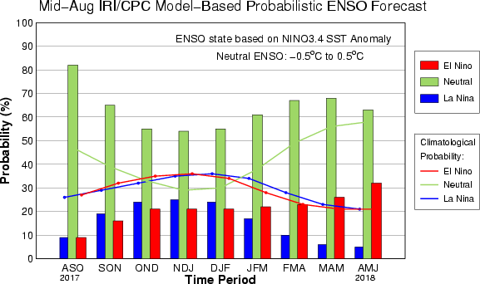
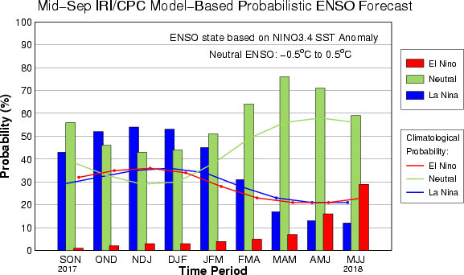
3. Seasonal Weather Forecast
There has been a drastic change in the expected El Niño Southern Oscillation (ENSO) phase.
The current predictions now indicate a high likelihood for a weak La Niña to develop during the early and mid-summer months (Nov-Dec-Jan and Dec-Jan-Feb).
This, supported by the regional forecasts, indicates that the summer rainfall areas (north-eastern parts of South Africa) can expect above-normal rainfall during these periods.
Source: SAWS Weather Outlook Report, 16/10/17

Slide 6
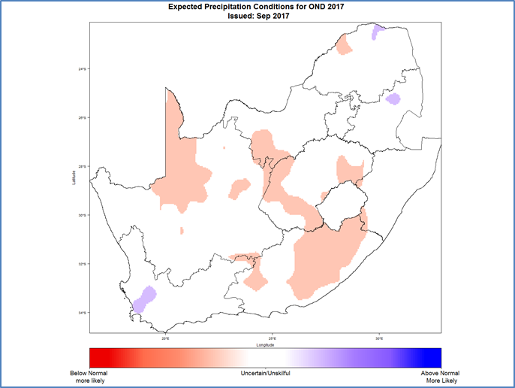
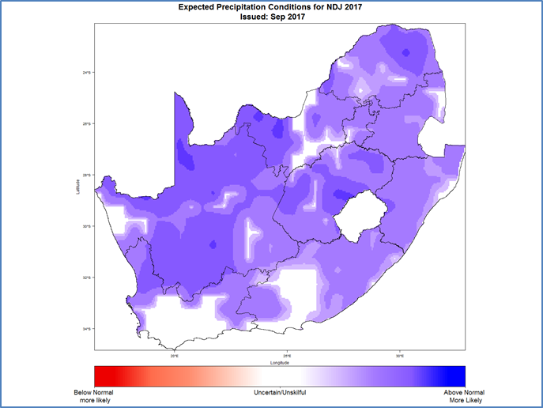
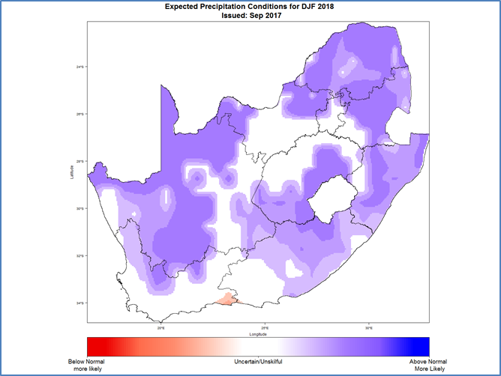
3. Seasonal Weather Forecast. Cont…
Source: SAWS Weather Outlook Report, 16/10/17

Slide 7
3. Seasonal Weather Forecast. Cont…
In this particular map, focusing on a more stringent threshold (namely POP 50mm or more), the KZN region, NE Free State, Gauteng and Mpumalanga are identified as being well-favoured for falls exceeding 50mm in the period ending 30 October.
While daily rainfall conditions remain fairly favourable for KZN during the week of 23-30 October, at this stage, ensemble NWP suggests there may be a peak of (heavy?)rainfall over KZN in the period 27, 28, 29 October, coinciding with a surface ridging event.
Source: SAWS Weather Outlook Report, 16/10/17

Slide 8
3. Seasonal Weather Forecast. Cont…
In the short term, there appears to be an enhanced chance of relatively significant rainfall in the week ending 30 October, particularly for KwaZulu-Natal as well as the bulk of the summer rainfall region. Deterministic NWP currently hints at the period 27, 28, 29 October (see slide 7) as being especially well-favoured. Please bear in mind that this is merely an early “heads up” (low to medium confidence outlook) and that much could change in the interim.
The current predictions now indicate a high likelihood for a weak La Niña to develop during the early and mid-summer months (Nov-Dec-Jan and Dec-Jan-Feb).
Forecasts indicate enhanced likelihood for wetter conditions during early summer over central and eastern parts, in agreement with earlier forecasts.
It is very important to keep monitoring any developments that may provide more clarity on the current expectations for the coming seasons.
Drought conditions are still persisting in the Western Cape, notably hydrological and agricultural. The situation is compounded by the fact that the winter rainfall season has drawn to an end.
Source: SAWS Weather Outlook Report, 16/10/17

Slide 9
3. Seasonal Weather Forecast. Cont…
It is then recommended that the current drought risk reduction measures in place should continue in an intensified manner.
Precautionary measures are therefore advised for the summer rainfall areas, in the event El Nino event does manifest.
Cognisant of the South African Weather Services' Weather Report, organs of state are required to prepare multi-hazard seasonal contingency plans to ensure emergency preparedness and timely response to disasters.

Slide 10
4. Status of Water Resources for Week 17/10/2017 (Source: Department of Water and Sanitation Status of Water Resources for 17 October 2017) )
Province | FSC in 10⁶ m^3 | Number of Dams per Province |  |  |  | % of full capacity
 |  | Total | ≤10% | 10% to 40% | ≥100% | 17/10/16 Last Year | 09/10/17 | 16/10/17
Eastern Cape | 1 832 | 43 | 2 | 9 | 7 | 63.0 | 55,4 | 60.2
Free State | 15 971 | 19 | 1 | 4 | 1 | 51.2 | 74,7 | 74.1
Gauteng | 115 | 4 | 0 | 0 | 1 | 78.3 | 88,6 | 87.2
Kwazulu-Natal | 4 669 | 18 | 0 | 3 | 1 | 40.9 | 49,3 | 49.6
Lesotho* | 2 376 | 2 | 0 | 1 | 0 | 37.6 | 36,1 | 36.1
Limpopo | 1 522 | 28 | 0 | 1 | 3 | 45.9 | 70,8 | 70.3
Mpumalanga | 2 539 | 22 | 0 | 1 | 1 | 48.0 | 70,5 | 71.1
Northern Cape | 146 | 5 | 1 | 0 | 2 | 55.3 | 92,9 | 87.2
North West | 887 | 30 | 0 | 0 | 4 | 55.7 | 78,9 | 78.4
Swaziland* | 334 | 1 | 0 | 0 | 0 | 16.7 | 61,8 | 61.1
Western Cape O | 270 | 21 | 9 | 4 | 2 | 39.3 | 20,3 | 20.6
Western Cape W | 1 598 | 22 | 0 | 9 | 2 | 65.6 | 38,7 | 38.4
Western Cape | 1 867 | 43 | 9 | 13 | 4 | 61.8 | 36,1 | 35.9
Total | 32 272 | 215 | 13 | 32 | 24 | 49.4 | 64,2 | 64.4

Slide 11
4. The storage levels within the Country
Source: Department of Water and Sanitation Status of Water Resources for 17 October 2017

Slide 12
4. The storage levels within the Western Cape Province
The Department of Water and Sanitation monitors 43 dams in the Western Cape on a weekly basis in two distinct areas, a winter rainfall area and a transitional area.
By 16th October 2017 the following status of water in storage for these areas was recorded:
Overall for 43 dams: 35,9% (compared with 36,1% last week and 61,8% last year)
Transitional (or ‘other rainfall’ ) for 21 dams: 20,6% (compared with 20,3% last week and 39,3% last year)
Winter rainfall area for 22 dams: 38,4% (compared with 36,1% last week and 61,8% last year)
Western Cape System consisting of 6 dams serving the City of Cape Town and surrounding towns is stable at 35.9%, compared to 36.1% last week and 61,8% this time last year.
Source: Department of Water and Sanitation Status of Water Resources for 17 October 2017

Slide 13
4. The storage levels within the Western Cape Province
The situation has improved very slightly from a low average of 17,7% in early June this year just before the local storms brought some relief and the following light rains in places over the next three months.
The end of the rainy season for the winter rainfall areas has arrived and it is unlikely that there will be significant inflows to the dams. A slight downward trend in the water levels of some dams is already noticeable.
Water use for the Cape Town Water Supply system is still relatively high at an average daily use recorded last week of 600 Mega litres per day and above, not showing any progress towards their stated goal of no more than 500Ml.
Source: Department of Water and Sanitation Status of Water Resources for 17 October 2017

Slide 14
5. The Western Cape Province drought situation
The dam levels are still low in the province compounded by the fact that the the province has drawn to the end of their rainy season.
Due to the prevailing situation, the DWS in collaboration with the Western Cape Government held a Water Indaba during May 2017 to explore ways of addressing the dire drought situation in the province.
Subsequently, the NDMC conducted a drought assessment within Cape Winelands and Eden District Municipalities and classified the occurrence a Provincial state of Disaster.
In June 2017, the Premier, Provincial Ministers and Mayors signed a Municipal Declaration with regards to long term water security for the province.

Slide 15
5. The Western Cape Province drought situation. Cont…
The signed declaration propagates seven key points for enhanced water demand management and conservation that include:
Enhancing Water Conservation efforts including adopting Water Sensitive Urban Design planning principles to permanently reduce the per capita demand on the water resources;
Reducing water leakages;
Recognising the need to manage groundwater wisely;
Diversifying water supply;
Protecting the quality and integrity of water resources;
Legislative overhaul in areas where needed, and;
Driving water innovation.

Slide 16
5. The Western Cape Province drought situation. Cont…
Additional local authorities declared the states of local disaster after a state of provincial disaster was declared (Drakenstein, Stellenbosch, Langeberg, Beaufort West, Saldanha, Swartland, Cederberg and Matzikama).
As a result the National Disaster Management Centre, in collaboration with the Western Cape Provincial Disaster Management Centre, conducted the drought assessment from 18-20 October 2017 in the affected local authorities.
The due process of ensuring that the municipalities which have declared a state of local disaster are supported will follow immediately after the impact assessment.

Slide 17
6. Progress on short- term drought intervention measures implemented
The NDMC, through the National Joint Drought Coordination Committee (NJDCC), facilitated the reprioritisation process to address the effects of drought.
Significant contributions were made by relevant organisations including civil society and the private sector to respond to the immediate needs of the communities.
The Department of Cooperative Governance, through Municipal Infrastructure Grant and Municipal Infrastructure Support Agent, provided technical support and monitored the projects to be implemented in the municipalities.
Accordingly drought is treated as an emergency due to its far reaching socio-economic impact to the lives of the people and the environment.

Slide 18
6. Progress on short- term drought intervention measures implemented
During 2016/17, the NJDCC facilitated and coordinated implementation of the following short term intervention measures during drought:
Drilling and equipping of boreholes;
Re-equipping and refurbishing of boreholes;
Implementation of water restriction systems for domestic, agricultural (irrigation) and Industrial use;
Issuing of directives to Water Services Authorities and water users not in compliance to restrictions published (Gazetted), and;
Continuous awareness campaigns on water conservation.

Slide 19
7. The 2016/17 Disaster Grant funding to augment the shortfall
The Department of Cooperative Governance, through the NDMC, facilitated disaster funding through the National Treasury to augment the depleted resources after the reprioritisation process by line function organs of state.
An amount of R553 million was allocated by the National Treasury during October 2016 for the provision and transportation of livestock feed within the agriculture sector and for procurement of the mobile desalination plant, water tankering and storage within the water sector.
The DWS was allocated R341.3 million to address drought and water scarcity situation, whereas the Department of Agriculture, Forestry and Fisheries was allocated an amount of R212 million for the provision and transportation of livestock feed within farming communities.

Slide 20
7. 2016/17 Disaster Grant funding to augment the shortfall. Cont…
The Funds were expended as follows:
The details for the allocation of R341 million to DWS for drought. intervention measures (October 2016).
NO | PROVINCES | PROJECTS IMPLEMENTED | AMOUNT SPEND
 | KwaZulu-Natal | Mobile Desalination Package Plant | R290.7 million
2. | Eastern Cape, Kwazulu-Natal, Free State, North West | Water tankering and storage | R50.6 million
Total amount |  |  | R341.3 million
It should be noted that the reports from DWS indicate that the department further made available own funding to augment the allocation regarding water tankering and storage. It is important to note the following:
The provincial allocations were done by DWS.
The expenditure on water tankering and storage exceeded the allocation of R50.6 million which was augmented by DWS.

Slide 21
7. 2016/17 Disaster Grant funding to augment the shortfall. Cont…
The details for the spending of the R212 million by the Department of Agriculture, Forestry and Fisheries for drought intervention measures (October 2016).
NO | PROVINCE | PROJECTS IMPLEMENTED | AMOUNT SPEND (October 2016)
 | Eastern Cape | Provision and transportation of livestock feed | R29 million
2 | Free State | Provision and transportation of livestock feed | R31 million
3 | KwaZulu-Natal | Provision and transportation of livestock feed | R23 million
4 | Limpopo | Provision and transportation of livestock feed | R28 million
5 | Northern Cape | Provision and transportation of livestock feed | R25 million
6 | Mpumalanga | Provision and transportation of livestock feed | R26 million
7 | North West | Provision and transportation of livestock feed | R38 million
8 | Western Cape | Provision and transportation of livestock feed | R12 million
Total amount |  |  | R212 million

Slide 22
8. Long-Term drought intervention measures to be considered for implementation
Note should be taken that the long term drought interventions and strategies are to be led by each organ of state with the support of amongst others, Department of Cooperative Governance Municipal Infrastructure Grant; Municipal Infrastructure Support Agency; National Disaster Management Centre and Back to Basics programme including other organs of state.
The following long-term intervention measures are being implemented during drought:
Implementation of water harvesting within urban and rural areas, i.e. building packages that includes static tanks to harvest water. The project is implemented in some provinces such as the Eastern Cape and KwaZulu-Natal.
Preservation, rehabilitation and protection of ecological infrastructure such as wetlands, estuaries, etc. for water harvesting.
Eradication of illegal water use, e.g. enforcement in the river systems.
Desilting of dams and canals, where feasible.

Slide 23
8. Long-Term drought intervention measures to be considered for implementation. Cont…
Building of dams to avoid water losses.
Encouragement of water ‘buffering’ through improved land management practices.
Review of requirements for non-consumptive water uses, considering re-use of grey water, etc.
Investment in new technologies, improving water utilisation and productivity.
Intensive promotion of, and support to all projects under the Water Conservation and Water Demand Management programmes like the Drop-a-Block campaign and the War on Leaks projects as managed by Water Services Authorities.

Slide 24
8. Long-Term drought intervention measures to be considered for implementation. Cont…
Repair of water infrastructure within the Water Service Authority areas.
Support and coordinate protective works to safeguard springs and open water resources.
Eradication of alien plants that consume more water through the Working for Water (WfW) programme.
Improved monitoring and new monitoring systems for resource status, quality and use.
Review of water management practices and institutional arrangements.

Slide 25
9. Strategies implemented to address the Western Cape Province drought situation
The following strategies are being put in place to address the water scarcity and drought situation in the province:
Implementation of by-laws to enforce water restrictions. Currently the City of Cape Town has instituted Level 5 water restrictions to all users whereby the failure to comply constitutes an offence in terms of the City of Cape Town’s By Laws:
Repairs of infrastructure to prevent water leakages.
Awareness campaigns in the municipalities through different platforms within communities and communication mechanisms.

Slide 26
10. Progress on disbursement of the allocated emergency disaster grant totaling R74.8 million
The Department of Cooperative Governance facilitated immediate relief funding through the National Treasury to address the immediate needs for both hydrological and agricultural drought.
An amount of R74 866 263 (R74.8 million) was approved by the National Treasury in August 2017 to provide assistance within the affected sectors.
A total of R40 million was allocated to the Western Cape Department of Agriculture for the provision and transportation of livestock feed to assist farming communities affected by drought and fires.
The Department of Agriculture has as of 15 August 2017 also spent R59m from its own budget on provision of animal feed, assisting 4156 farmers, whereby 1684 were commercial farmers and 2472 were smallholder farmers.

Slide 27
10. Progress on disbursement of the allocated emergency disaster grant totaling R74.8 million. Cont…
The funding was accessed from the Municipal Disaster Grant to address the below attached short term drought intervention (water projects).
NO | MUNICIPALITIES | PROJECTS | AMOUNT (September 2017)
 | City of Cape Town | Drilling of boreholes and installation of water pumps and pipelines | R20.8 million
2. | Bitou Local Municipality | Drilling of boreholes and installation of water pumps and pipelines | R10.9 million
3. | Theewaterskloof Local Municipality | Drilling of boreholes and installation of water pumps and pipelines | R3.1 million
Total: |  |  | R34.8 million

Slide 28
10. Progress on disbursement of the allocated emergency disaster grant totaling R74 million. Cont…
Of the R74.8 million, the Department of Agriculture was allocated an amount of R40 million from the Provincial Disaster Grant to address the short-term needs within the sector.
NO | PROVINCE | PROJECTS | AMOUNT (October 2016)
 | Western Cape | Provision and transportation of livestock feed | R40 million
NB: Disaster Grants are conditional grants, which do not cater for long-term projects, which fall within other water services development programmes such as Regional Bulk Infrastructure Grant, Municipal Infrastructure Grant and Water Services Infrastructure Grant.

Slide 29
10. Progress on disbursement of the allocated emergency disaster grant totaling R74.8 million. Cont…
An amount of R34 866 263 (R34.8 million) is for the implementation of water provision projects in Bitou, Theewaterskloof and City of Cape Town municipalities (see slide 27).
Theewaterskloof: All projects have commenced and no invoice paid thus far hence no expenditure recorded;
Bitou: An amount of R1 174m has been spent thus far out of R10 920m to procure control panels, drilling of a borehole in Kurland, pumps and surveying of areas for borehole drilling.
No report yet from the City of Cape Town
No report on the R40 million expenditure for agriculture has been received as yet.

Slide 30
11. Communication and information management
Communicators continues to coordinate key messages from all sectors and ensure that they are communicated through one platform.
The NDMC through the NJDCC continues monitoring the drought and water scarcity situation within the country with specific emphasis to the Western Cape Province, Eastern Cape and Northern Cape Provinces that are the most affected.
The Western Cape will be monitored since the SAWS weather report painted a bleak picture for the province with regard to rainfall forecast.
The NJDCC continues encouraging an integrated approach whereby all relevant affected organs of state provide support to the province to ensure maximization of resources and avoid duplication of efforts.

Slide 31
12. Conclusion
The Inter-Ministerial Task Team (IMTT) on Drought and Water Scarcity meets regularly to monitor trends with disaster risk reduction and management and also pay special attention to the management of the drought response and recovery.
An Integrated Communication Strategy has been approved and is being rolled out under the aegis of the IMTT.
The NDMC, through the NJDCC, continues to monitor the drought and water scarcity situation across the country with specific emphasis to the Western Cape Province, Eastern Cape and Northern Cape Provinces that are the most affected.
The NJDCC continues to encourage integrated and multi-disciplinary approaches and support to the province to ensure maximization of resources and avoidance of duplications for realization of the developmental impact.

Slide 32
13. Conclusion
Additionally, the NDMC encourages and provide support to organs of state to develop and strengthen their multi-hazard contingency plans to ensure emergency preparedness
Water Conservation and Water Demand Management strategies are being put in place and monitored by the authorities.
Rainwater harvesting must be encouraged and ensure provision of tanks in both affected and non affected areas.

Slide 33
13. Conclusion
Currently public advocacy and awareness campaigns are being conducted nationally to raise awareness among communities in an effort to build resilience.
Impact is being made with the political leadership support to ensure mitigation and emergency response to the situation.
Multi-sectoral cooperation and support demonstrated during the Western Cape and Eastern Cape Provinces disasters are commendable and encouraged through-out the country.

Slide 34
14. Recommendation
It is recommended that the Portfolio Committee:
Notes the report on the short and long-term drought intervention measures and strategies in the Western cape Province including status on the dispersal of relief funding allocated to the Western Cape Province.
Provides support in upscaling risk reduction measures to enhance water conservation within the water sector.
Provides political support in ensuring prioritisation of resources for the refurbishment and replacement of aged infrastructure and proper operations as well as the maintenance of existing infrastructure to prevent infrastructure decay.

Slide 35
14. Recommendation
It is recommended that the Portfolio Committee:
Encourage integration and coordination by relevant sectors in provinces to ensure alignment and maximization of resources e.g. Municipal Infrastructure Grant, Water Services Infrastructure Grant, Regional Bulk Infrastructure Grant in dealing with drought as a hazard
Encourage Water Services Authorities to implement bulk water supply projects in accordance to their project plans to avoid delays that may trigger water shortages during drought situations.
Assist in sustaining momentum on stringent measures and restrictions on water use, conservation, awareness and public advocacy and building resilience among our infrastructure and communities.
Encourage municipalities to enforce their by-laws.

