Slide 1

ANNUAL REPORT
24 October 2017

Slide 2
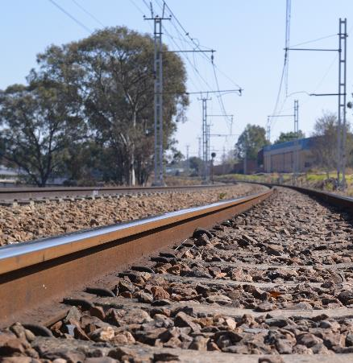
TABLE OF CONTENTS
AUDITOR GENERAL OPINION
AUDIT OUTCOMES – 4 YEAR PERSPECTIVE
2016/17 FINDINGS
PERFORMANCE TREND
KEY ACHIEVEMENTS
NON ACHIEVEMENTS
FLAGSHIP PROJECTS
SOCIAL RESPONSIBILITY
HR OVERVIEW
FINANCIAL OVERVIEW
HIGH STRATEGIC AND EMERGING RISKS
PLANNED INITIATIVES

Slide 3

AUDITOR GENERAL OPINION
UNQUALIFIED with
Non Compliance: Expenditure Management

Slide 4
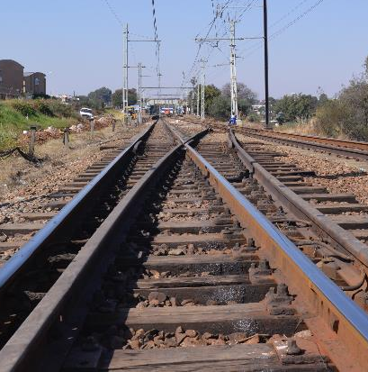
AUDIT OUTCOMES - 4 YEAR PERSPECTIVE
FINANCIAL STATEMENTS
FINANCIAL YEAR | OUTCOME
2013/14 | Unqualified
2014/15 | Unqualified
2015/16 | Unqualified
2016/17 | Unqualified

Slide 5
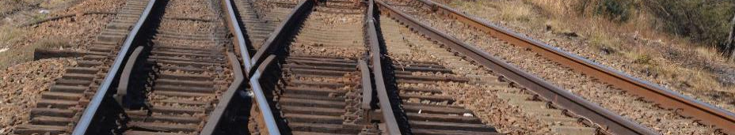
AUDIT OUTCOMES - 4 YEAR PERSPECTIVE
AREAS | FINANCIAL YEAR
 | 2013/14 | 2014/15 | 2015/16 | 2016/17
Number of Findings | 10 | 8 | 20 | 11
Number of recurring findings | 0 | 0 | 0 | 1

Slide 6
2016/17 FINDINGS
AREA | NO. OF FINDINGS
Procurement and Contract Management | Four (4) new findings
Audit of predetermined objectives | Two (2) new findings
Expenditure | One (1) new finding
Property, Plant and Equipment | Three (3) new findings
 | One (1) repeat finding
The RSR was able to reduce the number of findings, year on year, from twenty to eleven due to various corrective action plans implemented during as explained below
The RSR has seen a significant reduction of findings in procurement and contract management compared to the previous financial year, reducing from eight to four after implementing various corrective action plans, such as implementing compliance check lists and quarterly internal audit reviews
No corrections or audit adjustments were required on the financial statements after investing in financial statement software as well as implementing additional levels of financial statement reviews

Slide 7
PERFORMANCE TREND

Slide 8
ACHIEVEMENTS

Slide 9
ACHIEVEMENTS

Slide 10
ACHIEVEMENTS

Slide 11
FLAGSHIP PROJECTS
Projects | Achievements
The Ergonomics Society of South Africa (ESSA) Conference | Showcased the role of human factors in rail and road transport; and Promoted awareness of the RSR’s training courses and technical awareness programmes aimed at promoting human performance, safety and the wellbeing of the general user population.
Certification of Train Drivers | MOU with PRASA; Licensing of 130 train drivers; 18 of whom are drivers of the new PRASA Electric Multiple Units (EMU) Trains; and Recommendations for licensing requirements in the RSR’s approval conditions to PRASA for the trial run of the new trains issued in early 2017.
Accreditation of Suppliers | Support localisation from Concept Phase. Play a leading role in technology advancement in rail Industry Partnering with other Government and Higher Education Institutions

Slide 12
FLAGSHIP PROJECTS
Projects | Achievements
4. Technology Reviews | PRASA EMU trains Transnet MDS projects (23E locomotives); 45D locomotives and new Trans Africa Locomotives
5. Technical Training – Railway Safety Inspector Qualification | Developed a Railway Safety Inspector curriculum in collaboration with the Community of Expert Practitioners. This qualification has been approved by Transport Education Training Authority (TETA) and submitted to the Quality Council for Trade and Occupations.

Slide 13
NON-ACHIEVEMENTS
APP Target | Reason for non-Achievement | Action Plan
Railway Reserve Regulation implemented | DoT requested that a Socioeconomic Impact Assessment System be conducted prior to Gazetting of the Regulation. | The impact assessment will be conducted during 2017/18.
Human Factor Regulation Implemented | DoT requested that a Socioeconomic Impact Assessment System be conducted prior to Gazetting of the Regulation. | The impact assessment will be conducted during 2017/18.
100 % Compliance to 50 % (10) of all PTI Improvement Directives issued during 2016/17 | 70 % of PTI Improvement Directives issued during 2016/17 were closed due to Operators being unable to implement the targeted improvement directives issued during 2016/17. | The outstanding directives will be followed up for implementation in 2017/18.

Slide 14
HUMAN RESOURCES

Slide 15
HR OVERVIEW
No of current employees
163
Head Office and Gauteng Region
No of projected employees
218
7
8
12
23
15
25
4
9
NB: The projected staff (green) relates to the approved staffing plan

Slide 16
VACANCY RATE

Slide 17
EMPLOYMENT EQUITY
ETHNICITY | MALE | FEMALE
AFRICAN | 88 | 90
COLOURED | 2 | 7
INDIAN | 1 | 0
WHITE | 9 | 4
TOTALS | 100 | 101
1. Turnover: 5%

Slide 18

WOMAN EMPOWERMENT

Slide 19
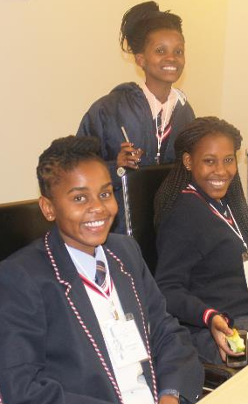
YOUTH DEVELOPMENT
18 interns participated in the RSR’s internal training programme;
Two interns progressed to the Trainee Inspector programme;
15 were absorbed into the RSR structure; and
1 Resigned;
Provided financial support to youth pursuing academic excellence in various academic institutions around the country
52 youth have been provided with the financial support as part of the RSR’s Youth Development initiative.

Slide 20
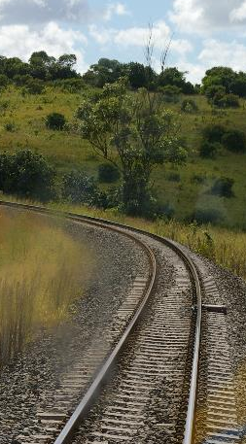

SDIX PERFORMANCE TREND
2014/15
SDIX Score 38
2016/17
SDIX Score 51
2015/16
SDIX Score 37.7
2016/17
SDIX Target 46

Slide 21
SDIX PERFORMANCE TREND
* This figure shows the RSR SDIX for 2014 (Blue); 2015 Index (Orange); 2016 Index (Purple), and 2016 RSA Global Innovation (GII) Index (Red).

Slide 22
FINANCE

Slide 23
YEAR-ON-YEAR REVENUE (R’000)

Slide 24
REVENUE VS EXPENDITURE (R’000)

Slide 25
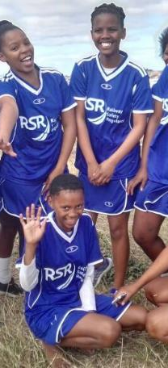
BBBEE SPEND

Slide 26
RISK

Slide 27
HIGH STRATEGIC RISKS
RISK | INHERENT RATING | RESIDUAL RATING | MITIGATIONS | RISK OUTLOOK
Insufficient cash flow | Very High | High | Budget committee focussing on cost minimisation and savings
 |  |  | Virtual office model to realise savings of head office rental and maintenance costs
 |  |  | 2017/18 Accruals to be factored into factored into 2018/19 budget
Improving
Regulatory Capture | Very High | High | RSR consolidated database for audit and inspection findings, occurrence findings and directives.
 |  |  | Increased monitoring of the closure of directives
 |  |  | Issuing of penalties, suspend and re-work licences
Improving

Slide 28
ECONOMIC DEVELOPMENT INTERVENTION
RSR CAN PLAY A MORE EFFECTIVE ROLE IN INDUSTRIAL DEVELOPMENT BY CREATING CONDUSIVE ENVIRONMENT FOR PARTICIPATION IN THE ROLE SECTOR WITHOUT COMPROMISING SAFETY. TO ACHIEVE THIS, RSR WILL
Playing Leading Role in Technology Advancement in Rail Industry
Support Localisation Program from Concept Phase
Comparative Expenditure in Rail Industry between Local Manufactured Components and Imported Components
Raising Funds to enable Local Industrialist in Rail Supply
Partnering with other Government and Higher Education Institutions
Providing National Vision of the Rail Industry for SA and the SADC Region

Slide 29


THANK YOU
THANK YOU
THANK YOU

