Slide 1
NEMISA (changing to iNeSI)
Contribution to the Broadcasting Industry
Annual Performance Plan 2017/18

Slide 2
outline
Contribution to the Broadcasting Industry
strategic positioning
multi-stakeholder collaboration
Impact to-date
digital opportunities
envisaged impact
Targeted intervention
e-Skills
core programmes
structure
Approved APP 2017/8
Budget

Slide 3
strategic position
1998 Inception: NEMISA positioned and established as the Institute offering Broadcast Programmes across Radio; Film and Television; Broadcast Engineering and Animation.
Reflected in its programme expansion and accreditation with MICT SETA towards 2021. Current accreditation programmes:
Radio Production;
Film and Television Production;
Broadcast Engineering;
2 D & 3 D Animation

Slide 4
strategic position
vision: An e-skilled society by 2030

Slide 5
strategic position
mission:
To provide a national integrated e-skills development framework towards sustainable socio-economic development in South Africa.
national
e-skills development framework
integrated

Slide 6
collaboration
Formalised Agreements: leverage partnership to develop competencies and certification for broadcast incumbents’ :
1. | South Africa Broadcast Corporation (SABC)
2. | Kwa Zulu Natal Film Commission (KZN FC)
3. | National Community Radio Forum (NCRF)
4. | Moses Kotane Institute (MKI)
5. | MICT SETA
6. | National Association Of Broadcasters (NABSA)
7. | ECITI

Slide 7
Impact to-date
The number of students trained since inception in Broadcasting (TV & Radio) is reflected in the table below:
Year | * Radio Production | * Film and Television | * Broadcast Engineering | Short Courses | Animation Multi Media | Other | TOTAL
1999 | 14 | 17 |  |  |  |  | 31
2007 | 23 | 43 |  |  | 12 | master class 75 | 153
2008 | 24 | 51 | 17 | 15 (Nodal Areas) | 16 | Telecoms 17 SABC 133 Workplace 19 | 292
2009 | 25 | 50 | 27 Neotel 31 Siemens | 155 | 18 130 | Desktop photography 225 | 661
2010 | 28 | 35 |  | 171 | 19 | Multi Media 252 | 505
2011 | 26 | 23 |  | 268 | 41 |  | 358
2012 | 25 | 37 |  |  | 20 | 57 | 136
2013 | 17 | 25 |  | 123 (DOC) |  |  | 165
2014 |  | 20 RPL | 17 H&P | 77 |  |  | 114
2015 | 30 KZN | 20 GP |  | 33 KZN |  |  | 83
2016 | 30 MP | 19 EC 16 RPL 08 |  | 15 (H&P) 99 SABC |  |  | 179
2016/17 | 14 NC 16 KZN (MKI) | 95 SABC (NW; EC; GP; KZN; FS) 20 Film Commission (KZN) |  |  |  |  | 145
 |  |  |  |  |  |  | 2822
* Full Qualification

Slide 8
Digital opportunity
National impact of the partnership and training initiative results in:
Content Producers: Learners have opportunity in digital migration.
Technical Skills Deficit Management: Draft Community Broadcast Scheme document of 1 July 2015 (Government Gazette 676 of 2015) calls for more training of technical skills in broadcast sector.
Building an Informed Citizenry: National Development Plan (NPD) identified that access to information via print, broadcasting and the internet are vital for building an informed citizenry.
Two fold intervention: NEMISA’s platform in various provinces enables learners to be certified as future sector users.
SMME development: Increase of entrepreneurs, support to small business to training that have a commercial product as an end result.

Slide 9
envisaged impact
Expanded market: Since 2015 NEMISA expanded its methodology by using blended learning and learnership programme with community media and production houses. The decentralised model have expanded its reach and enabled SMME development.
New Student Markets: NEMISA recognises millennials are a mobile generation; strong in networking and strong in new and emerging talents – hence the need to target new markets
Innovative Training: NEMISA doing away with chalk and talk and fostering an integrative blended learning model.
Blended Learning and Online Learning results in: round the clock access to learning materials; cross media consumption and social media interaction.

Slide 10
targeted intervention
learning pathway|e-astuteness
Further Education & Training Certificate: Film & Television Production Operations (SAQA ID 61450 NQF Level 4 157 Minimum Credits)
learner obtains the necessary competence to enter the film and television industry
learner understand the context and is able to function within the context of film and television productions.
Job Pathway - Producer Assistant; Camera Operator; Digital Editor; Script and Research Assistant
National Certificate: Broadcast Engineering (SAQA ID48792 NQF Level 5 120 Minimum Credits)
learner obtains the competencies required in broadcast engineering
learner able to use methods in Broadcast Engineering to install, set-up, operate, fault find, maintain and repair broadcasting equipment in one of the above mentioned disciplines.
Job Pathway - Transmitter Operators; Transmitter Distribution; Studio Repairs

Slide 11
targeted intervention
learning pathway | e-astuteness
National Certificate: Radio Production (SAQA ID 62069 NQF Level5 159 Minimum Credits)
learners are equipped for production of radio programmes across commercial, public and community service fields.
learners not required to make products and develop content for radio broadcasts
Job Pathway - Content Producers; Technical and Sound Management; Research and Script Writers; Audio Production; On Air Presenters
National Certificate: Film and Television Production (SAQA ID 58394 NQF Level5 122 Minimum Credits)
learners receive specialist competence in all the disciplines related to film and television production, including camera, lighting, vision control, vision mixing, editing, recording, sound and captioning competence.
Job Pathway - Content Producers; Camera Specialists; Digital Editor; Sound and Lighting Specialist; Vision and Control Room Operator

Slide 12
targeted intervention
learning pathway | e-astuteness
National Certificate: 2D Animation (SAQA ID 57611 NQF Level5 136 Minimum Credits)
Learners develop local 2D animation competence: a local form of expression is developed, with a local graphic style, as a local art form.
Job Pathway - Traditional 2D Animation, Digital 2D Animation, Animator, Background Design, Animation Producer, Animation Director, Scriptwriter, Illustrator, Storyboard Artist, Digital Painter,
National Certificate: 3D Animation & Visual Effects (SAQA ID 57607 NQF Level 5 149 Minimum Credits)
learners attain knowledge about the history of animation, forms, styles and technology, characterisation and story boarding, the production process, procedures for storyboarding, conceptualising, copyright, intellectual property, editing principles, film/video/camera language and cinematography.
Job Pathway - 3D Animation, Animator, Background Design, Animation Producer, Animation Director, Scriptwriter, Illustrator, Storyboard Artist, Digital Painter, Lighting, Modelling, Rigging, Social Media Marketing

Slide 13
e-skills
e-literacy or digital literacy
user digital skills (sector)
ICT practitioner
e-leader or digital leader

Slide 14
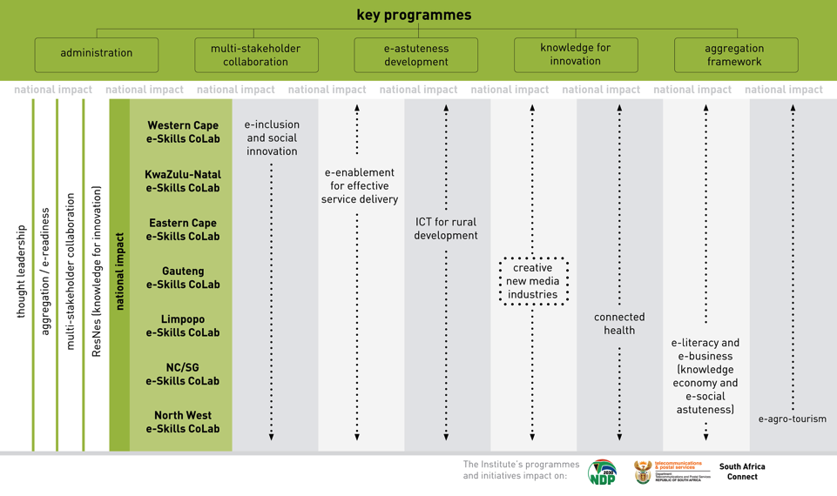
core programmes

Slide 15
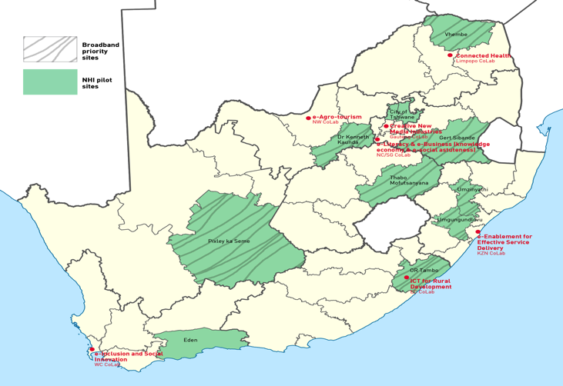
collaboration for acceleration

Slide 16
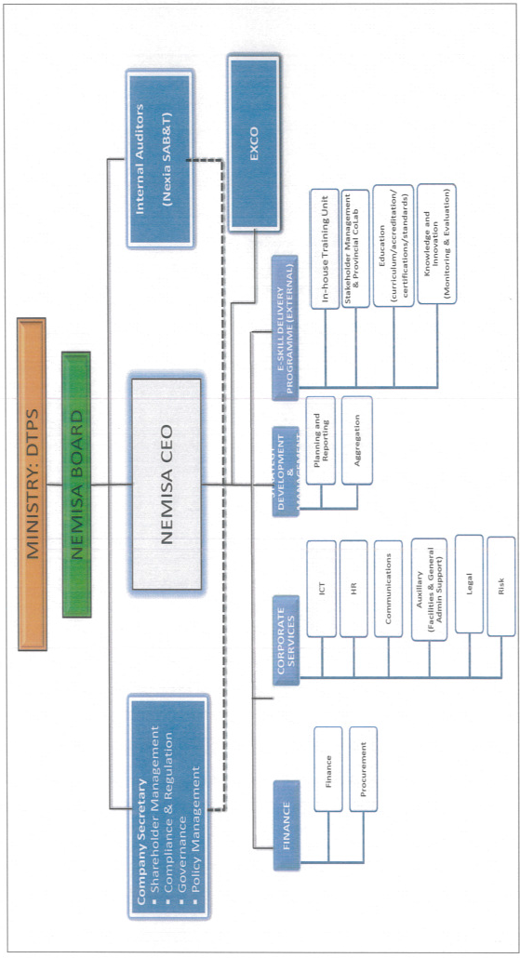
organisational functional
structure

Slide 17
app
ANNUAL PERFORMANCE PLAN FOR 2017/18

Slide 18
programme 1: institutional development (administration)
No | Performance Indicator | Reporting Period | Annual Target 2017/18 | Quarterly Targets
 |  |  |  | 1st | 2nd | 3rd | 4th
1.1 | Corporate governance
1.1.1 | Number of Quarterly Performance Reporting | Quarterly | 4 | 4th Quarter performance Report developed and submitted | 1st Quarter Performance Report developed and submitted | 2nd Quarter Performance Report developed and submitted | 3rd Quarter Performance Report developed and submitted
1.2 | Business process support
1.2.1 | Organisational structure, processes and systems redesign (incl. Change Management) | Annually | Revised organizational structure, processes and systems finalised | Consultation with DTPS on iNeSI Business model undertaken | Consultation with internal structures on iNeSI Business model concluded | Implementation of the structure | Migration of staff

Slide 19
programme 2: multi-stakeholder collaboration
No | Performance Indicator | Reporting Period | Annual Target 2017/18 | Quarterly Targets
 |  |  |  | 1st | 2nd | 3rd | 4th
2.1 | Advocacy and awareness (campaigns = all media e.g. broadcasts, social media, web sites, seminars, publications etc.)
2.1.1 | Number of Campaigns | Annually | 12 | 2 | 3 | 3 | 4
2.1.2 | Institute brand visibility platforms leveraged | Quarterly | 20 | 5 | 5 | 5 | 5
2.1.3 | Number of public awareness survey report provided | Annually | 1 | - | Distribution of survey questionnaires to the public | Consolidation of received survey forms from the public | Produce a public awareness report
2.1.4 | Consolidated campaign report | Annually | 1 | - | - | - | 1
2.2 | Partnership development (International, national, provincial, local across all sectors)
2.2.1 | Number of new partnerships formalised | Annually | 4 MOA signed with identified partners | MOA signed with identified partner | MOA signed with additional identified partner | MOA signed with additional identified partner | MOA signed with additional identified partner
2.2.2 | Number of Formal Partnerships renewed | Annually | 4 |  |  |  | 4 Formal Partnerships renewed
2.2.3 | Partnership performance report against MoU/MoA agreements | Annually | 1 |  |  |  | 1 Partnership performance report

Slide 20
programme 3: e-astuteness development
NO | Performance Indicator | Reporting Period | Annual Target 2017/18 | Quarterly Targets
 |  |  |  | 1st | 2nd | 3rd | 4th
3.1 | Curriculum development
3.1.1 | Number of new targeted courses available (developed / acquired / customised) | Annually | 8 | Engage with CoLabs on a number of courses to be developed/acquired/ customised | Monitor implementation of the development, acquisition and customization of the new courses | - | Report on new targeted courses available/developed/ acquired/customized.
3.1.2 | National e-skills curriculum competency framework reviewed (n) | Annually | 1 | Engage with CoLabs on the curriculum on the competency framework review process | Monitor the curriculum competency framework review process | - | Report on curriculum competency framework review
3.1.3 | Courses revision report (n) | Annually | 1 | Identify courses that need to be revised | Implementation of the revision of the courses | - | Courses Revision Report

Slide 21
programme 3: e-astuteness development (2)
NO | Performance Indicator | Reporting Period |  | Annual Target 2017/18 | Quarterly Targets
 |  |  |  |  | 1st | 2nd | 3rd | 4th
3.2 | e-competence development / learning (e.g. formal education, internships, learnerships)
3.2.1 | Number of e-literacy learners trained (n) |  | Annually | 3000 | - | 1500 | - | 1500
3.2.2 | Number of sector users trained (n) |  | Annually | 1300 | - | 650 | - | 650
3.2.3 | Number of ICT practitioners trained (n) |  | Annually | 600 | - | 300 | - | 300
3.2.4 | Number of e-leaders trained (n) |  | Annually | 140 | - | 70 | - | 70
3.3 | Access to learning
3.3.1 | Number of smart community centers |  | Annually | 10 | - | - | - | 10
3.3.2 | Number of online courses available |  | Annually | 10 | - | - | - | 10

Slide 22
programme 4: knowledge for innovation
No | Performance Indicator | Reporting Period | Annual Target 2017/18 | Quarterly Targets
 |  |  |  | 1st | 2nd | 3rd | 4th
4.1 | Research programmes
4.1.1 | Number of research chairs allocated | Annually | 1 | 1
4.1.2 | Number of non-degree research and postgraduate research funded | Annually | 8 | Initiate consultation with CoLabs on research areas to be conducted | Agreement with the CoLabs on research areas to be conducted | - | Report on 8 Non-degree and Post-graduate Research conducted
4.1.3 | Number of national e-Skills/ ICT environmental scans conducted | Annually | 1 | - | Appointment of a service provider to do the an environmental scan | - | Environmental scan conducted

Slide 23
programme 4: knowledge for innovation (2)
No | Performance Indicator | Reporting Period | Annual Target 2017/18 | Quarterly Targets
 |  |  |  | 1st | 2nd | 3rd | 4th
4.2 | Knowledge assimilation / production (e-products, e.g. mobile applications, documentaries)
4.2.1 | Number of Scholar/Researcher exchanged (n) | Annually | 1 | - | Research Publication | - | Completion of Masters thesis
.2.2 | New products developed (n) | Annually | 6 | - | Identify ICT products to be developed | Provide report on ICT identified products developed | 6 ICT identified products developed
4.3 | Knowledge transfer
4.3.1 | Number of research colloquium hosted in eSkills/ ICT | Annually | 4 | Identify CoLab to convene an ICT colloquium | - | Convene an ICT research colloquium | -
4.3.2 | Number of research papers in eSkills/ ICT delivered / presented | Annually | 5 | Identify research papers to be delivered | Report on research papers to be delivered | - | Final report on 5 research papers delivered
4.3.3 | Number of eSkills/ ICT thought leaders engagements | Annually | 6 | - | - | - | Final Report on thought leader engagements
4.3.4 | Number of e-Skills/ ICT thought leaders engagements | Annually | 6 | - | - | - | 6

Slide 24
programme 5: aggregation framework
No | Performance Indicator | Reporting Period | Annual Target 2017/18 | Quarterly Targets
 |  |  |  | 1st | 2nd | 3rd | 4th
5.1 | Strategic guiding documents (frameworks, models, policies, scenarios, strategies, plans)
5.1.1 | Number of new strategic guiding development reports provided (e.g. e-competency framework, aggregation framework, etc) | Annually | 1 | Develop the new strategic guiding document | Develop Strategic guiding document | - | Strategic guiding document completed
5.2 | Impact Measurement
5.2.1 | E-competence development impact indices report provided (n) | Annually | 1 | - | - | - | 1
5.2.2 | National e-skills summit hosted (n) | Annually | 1 | Appointment service provider | Embark on preparations to convene summit | - | Host e-Skills Summit

Slide 25
2017/18 allocations
NEMISA’s budget for 2017/18 is made up of the following:
Budget | Amount
1. NEMISA (operations) | R43,785,000
2. e-Skills Roll-Out | R42,000,000
3. e-SI Programmatic | R7,205,000
Total | R92,990,000

Slide 26
budget overview
The Institute has an allocation of R43,785 million. The budget 2017/2018 was based on 2015/2016 expenditure and was increased by CPI as per MTEF Guidelines.
58% of the budget allocation is allocated towards compensation of employees – this includes the increase of 7.3% mandated by DPSA.
ICT costs have increased due to urgent and critical hardware and software upgrades.
196% increase in Board travel due to the new Board
16% of the budget allocation is towards rental of premises, this includes an estimated rental increase of 8%
Staff Incentives provision has been excluded and marketing ad ICT budget has been reduced to accommodate budgetary constraints.
R42,000 million for the e-skills roll-out across the country.
R32,000 million has been directed to implementation of e-Astuteness Development this includes that of NEMISA targeted in-house training, Knowledge for Innovation and Aggregation especially in the provinces such as Eastern Cape, North West, Limpopo, Northern Cape and KwaZulu Natal directed towards the BB and NHI sites and the growth of the ICT Sector. The remainder will be spent on the national coordination for the e-skills programme e.g. expansion into the Free State and Mpumalanga, national environmental scan and the National e-Skills Summit.
The R7,205 million will be spent on maintaining and strengthening the existing five (5) CoLabs.

Slide 27
envisaged impact
Recognised as a leader in developing economic appropriation of modern ICT devices and applications to address inequity
addressing inequity
developing economic appropriation of modern ICT devices and applications
addressing inequity

Slide 28
envisaged impact
Direct contribution to the NDP, SA Connect, Digital SA (100% digital literacy by 2030):
workforce to skills of the future
building smart communities (metros and towns)
NEMISA (changing to INeSI)
Globally
NDP
SA Connect
Digital SA
Local Evidence – CoLabs
e-literacy or digital literacy
user digital skills (sector)
ICT practitioner
e-leader or digital leader

Slide 29
Thank you

