Slide 1
Briefing to the PORTFOLIO COMMITTEE ON AGRICULTURE, FORESTRY AND FISHERIES
STATE OF READINESS FOR 2017 PLANTING SEASON
Cape Tow,
Ms. Joyene Isaacs

Slide 2
When the well is dry, we learn the worth of water.
Benjamin Franklin

Slide 3
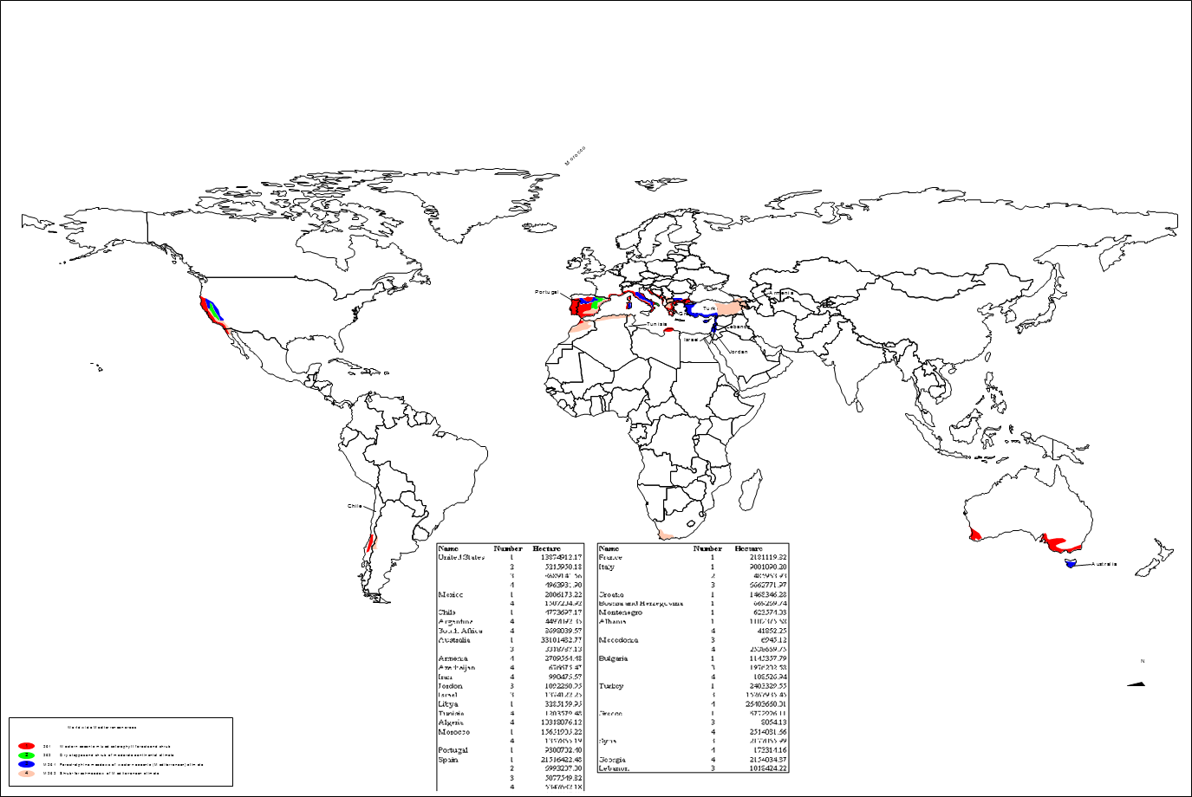
Mediterranean regions of the World

Slide 4
Western Cape drought
The Western Cape Province has experienced sustained agricultural disasters which have led to both environmental as well as biological impacts.
The disasters has affected most of the Province, significantly altering the sector’s agricultural production
Disaster fires in Southern Cape – close to 25 000 hectares affected, damage currently estimated at R40m.
Nineteen (19) municipalities have implemented water restrictions, ranging from levels 1 – 5, with five (5) municipalities, including the City of Cape Town graded as high risk.
High risk municipalities are those with less than ninety days of water supply, while medium risk towns have less than 180 days of water supply.
The Premier declared a provincial state of disaster in terms of Section 41(1) of the Disaster Management Act (Act 57 of 2002).
Curtailment of agricultural water use – up to 50% by the Department Water and Sanitation – September 2017

Slide 5
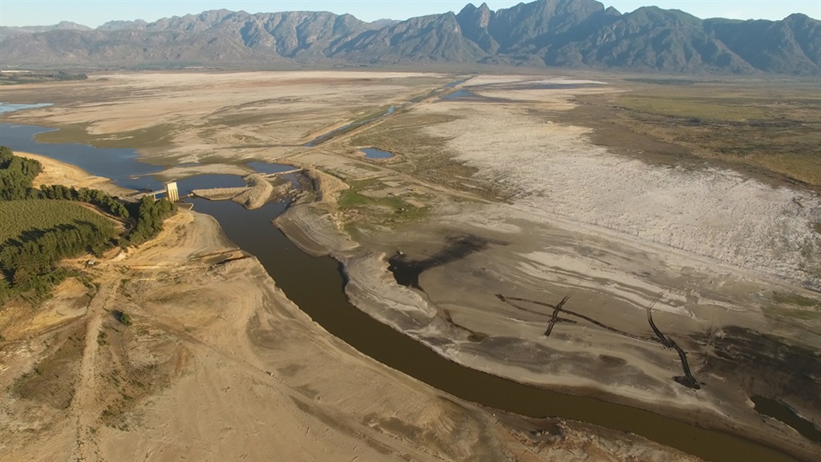
Theewaterskloof Dam Inlet to tunnel at Charmaine April ‘17

Slide 6
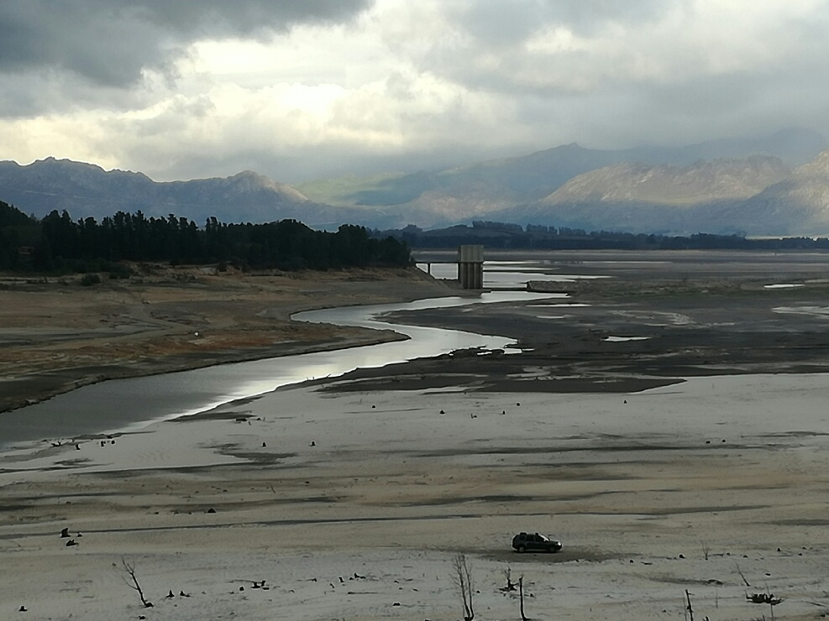
Theewaterskloof Dam Inlet to tunnel at Charmaine May ‘17

Slide 7
Hectares Planted
Project name | District | Commodity | Ha Planted
Leeuwendrift Boerdery | West Coast | Grain | 164
Drommelvlei | West Coast | Grain | 100
MMM Boerdery | West Coast | Grain | 143
Knolkop trust | West Coast | Grain | 180
Masakhe Coop | West Coast | Grain | 303.6
Ganzekraal | West Coast | Grain | 150
Slangrivier Kooperatief Beperk | Eden | Grain | 172
Olieboomskraal Kooperatief Beperk | Eden | Grain | 232
Genadendal Saai Boere | Overberg | Grain | 298
Umhlaba Wobizo | Overberg | Grain | 75.8
Total hectares Planted |  |  | 1818.4
1818.4

Slide 8
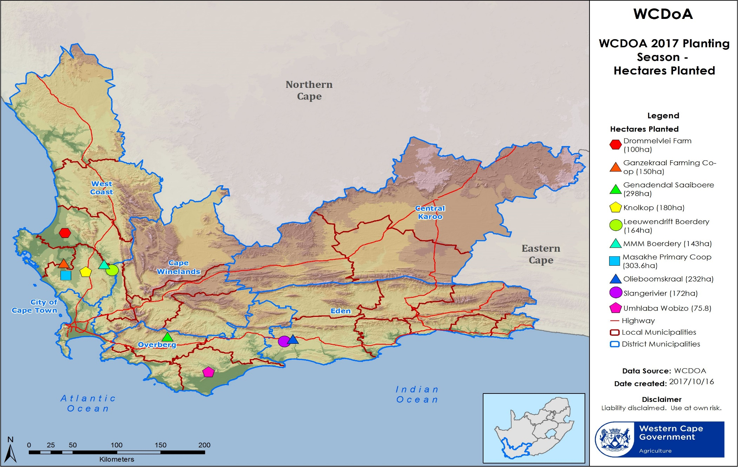
Location of projects

Slide 9
Avian Flu Outbreak – August 2017

Slide 10
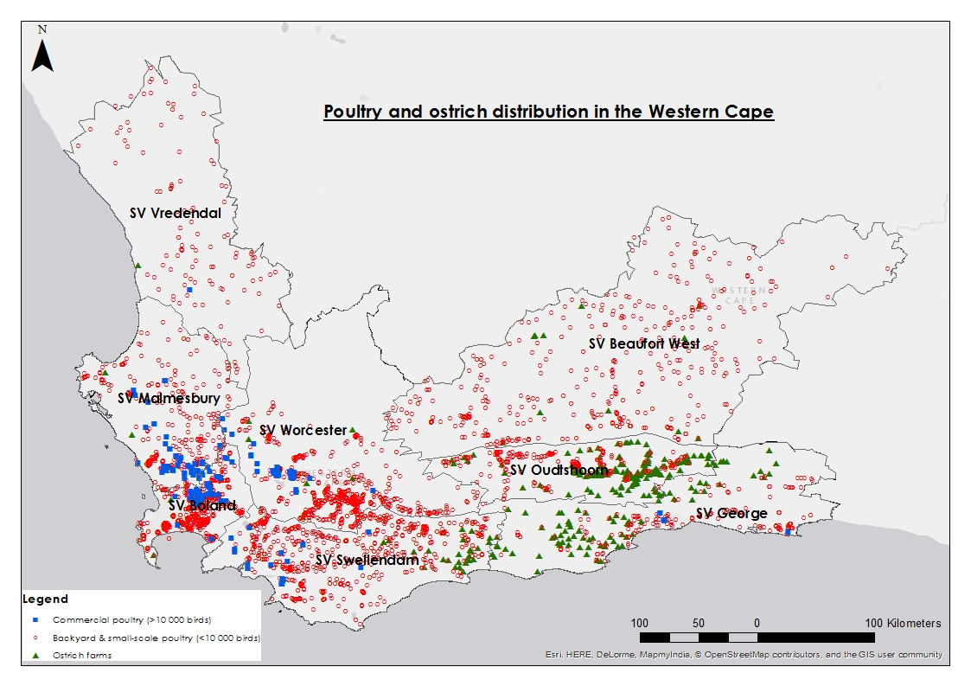
Distribution of farms
DPPA
Compiled by Dr Laura Roberts
Notes:
Includes parent, broiler and layer farms
About 29 million birds

Slide 11
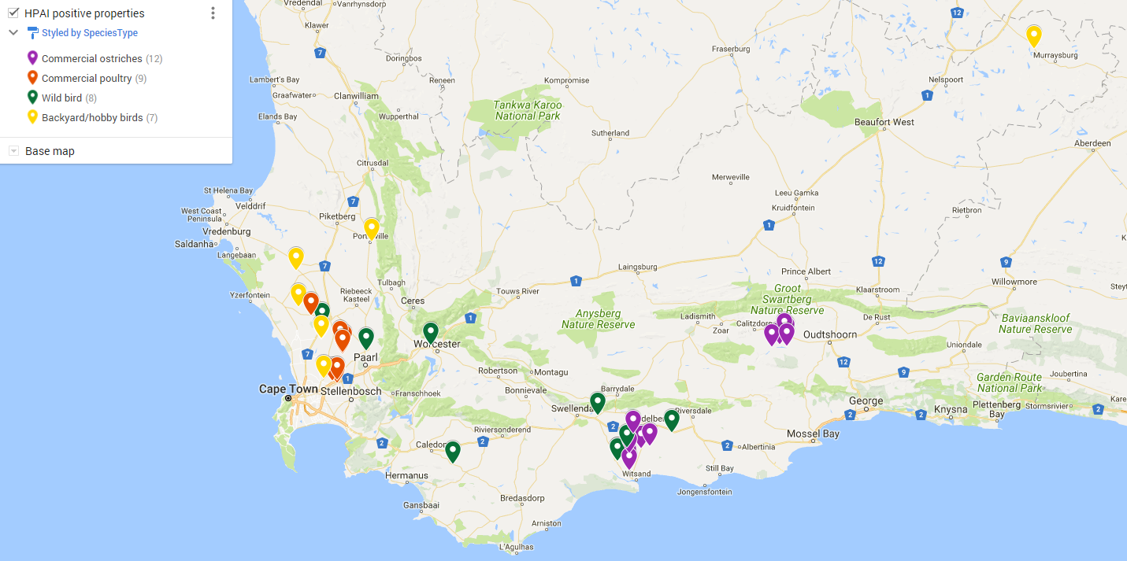
Confirmed and suspect AI cases

Slide 12
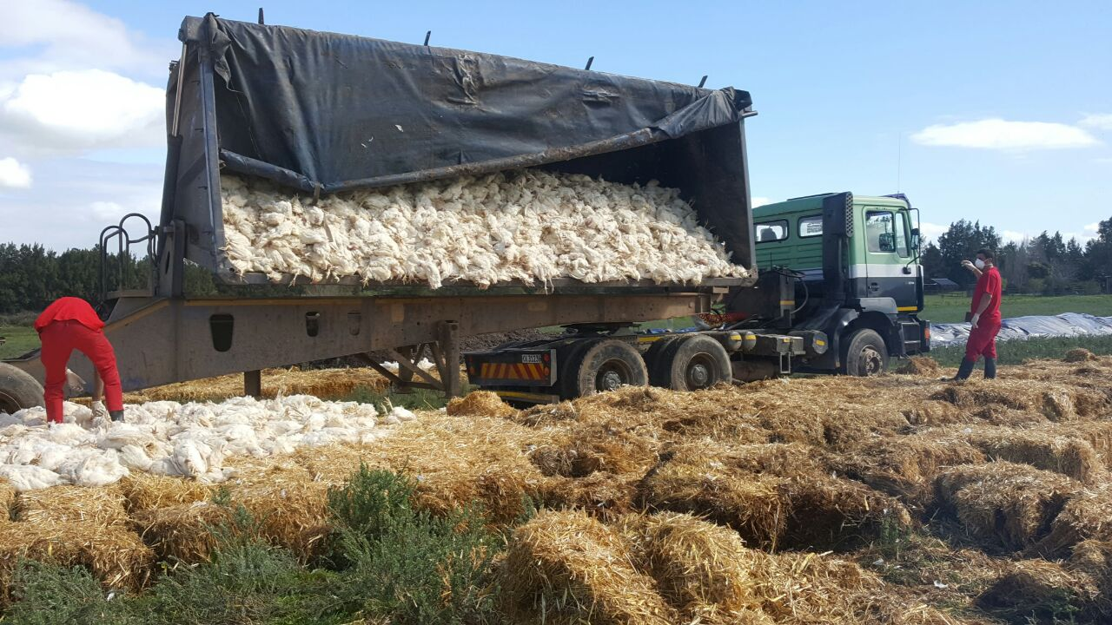
Disposal of infected material
IMPLICATION – No poultry project will be implemented until the outbreak is fully contained.
Notes:
Truck in picture – approximately 3000 birds

Slide 13
Potential impact of the drought and water restrictions
The affected areas are calculated using conservative boundary 10km radius
We utilise various data sources to estimate the economic contribution of irrigated farming
Two scenarios were introduced to measure the impact of redirecting water away from irrigated agriculture

Slide 14
Potential impact of the drought and water restrictions: Scenario 1
A 30% reduction in water allocation in the Affected Area leading to for the entire summer:
a) Fruit quality decline moving 15% of exported fruit into the local market (Apples, Table Grapes, Plums, Pears)
b) Wine grapes are harvested early, forcing 10% of grape volumes away from wine towards juicing or distilling
A: Fruit Industry
Industry GVA decline | (Job losses)
Apple: R82.7 million (427)
Grapes: R63.8 million (251)
Plums: R40.8 million (210)
Pear: R 30.5 million (157)
Total GVA: R 217 million
Total Jobs: 1047
B: Wine Industry Impact
Lower price: R786/ha vs R3244/ha)
Industry loses R91.3 million in GVA
Employment: 681 Job losses
No longer-term impact

Slide 15
Potential impact of the drought and water restrictions: Scenario 2
A total ban on agricultural irrigation for one season (from Agriculture to Urban use)
Fruit farmers choose stumping technique to preserve trees which shock the orchard growth cycle and long-term yield progression
Wine farmers takes off all grapes early in the season to build reserves for the next season, whole crop goes into waste products
A: Fruit Industry
All fruit goes into processing and waste (5% of normal price)
Costs the Industry R2.97 billion in the short term
Short term job losses: 11 190
Long term Impact:
Industry losses R1.3 billion in Gross Value of Production over 5 years
Additional Job losses: 6 716

Slide 16
Potential impact of the drought and water restrictions: Scenario 2
A total ban on agricultural irrigation for an extended period during the production season (from Agriculture to Urban use)
Fruit farmers choose stumping technique to preserve trees which shock the orchard growth cycle and long-term yield progression.
Wine farmers takes off all grapes early in the season to build reserves for the next season, whole crop goes into waste products.
B: Wine Industry Impact
Industry makes a loss of R695 million
Employment: 11 275 jobs lost
No longer-term impact on the vines

Slide 17
Conclusion
All agricultural production sectors are under heavy strain
This will lead to financial stress and put pressure on the wellbeing of rural communities
Reduction in the quality of produce – export position of province will be challenged.
Food and nutrition security may be affected – as fewer gardens will be supported.
Affected livestock farmers still need support to feed their breeding stock – limited animal feed in the Province

Slide 19
Joyene Isaacs
Head of Department
021 808 5006
021 808 5000
JoyeneI@Elsenburg.com

