Slide 1
2016/2017 Annual Report
Adv Makhosini Msibi (CEO)
Portfolio Committee

Slide 2
Presentation Content
Introduction
Governance
Performance Information
Human Resources
Audit Committee Report
Audit-General’s Report
Financial Information

Slide 3
Presentation Content
Introduction
Governance
Performance Information
Human Resources
Audit Committee Report
Audit-General’s Report
Financial Information

Slide 4
Purpose
Purpose:
To provide a report on the Annual Performance of the RTMC for the period 2016/2017 in line with Section 22 of the RTMCA, Section 55 of the PFMA and National Treasury Regulation 55.2
Scope of the report:
  Governance
  Performance Information
  Human Resources
  Auditor-General Report

Slide 5
Presentation Content
Introduction
Governance
Performance Information
Human Resources
Audit Committee Report
Audit-General’s Report
Financial Information

Slide 6
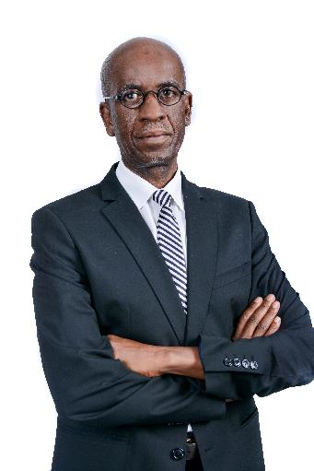
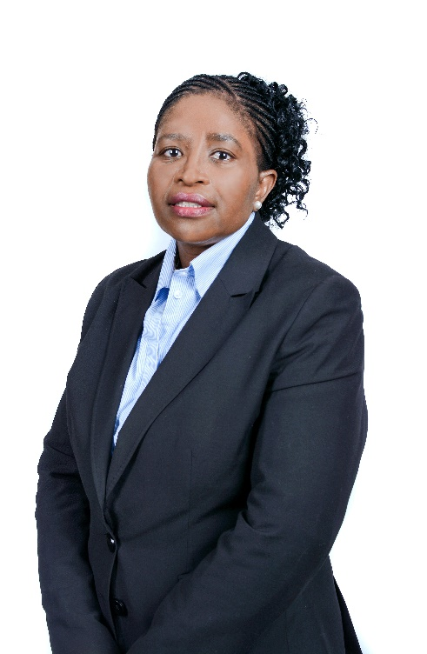
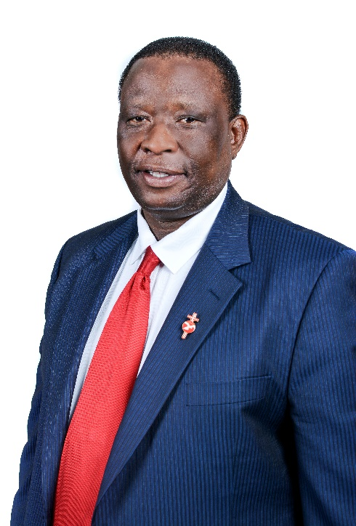
During the 2016/2017 FY, the Board of Directors welcomed three new members…
Three new non-executive directors were appointed, namely Prof Maredi Mphahlele, Ms Thandi Thankge and Dr Eddie Thebe.

Slide 7

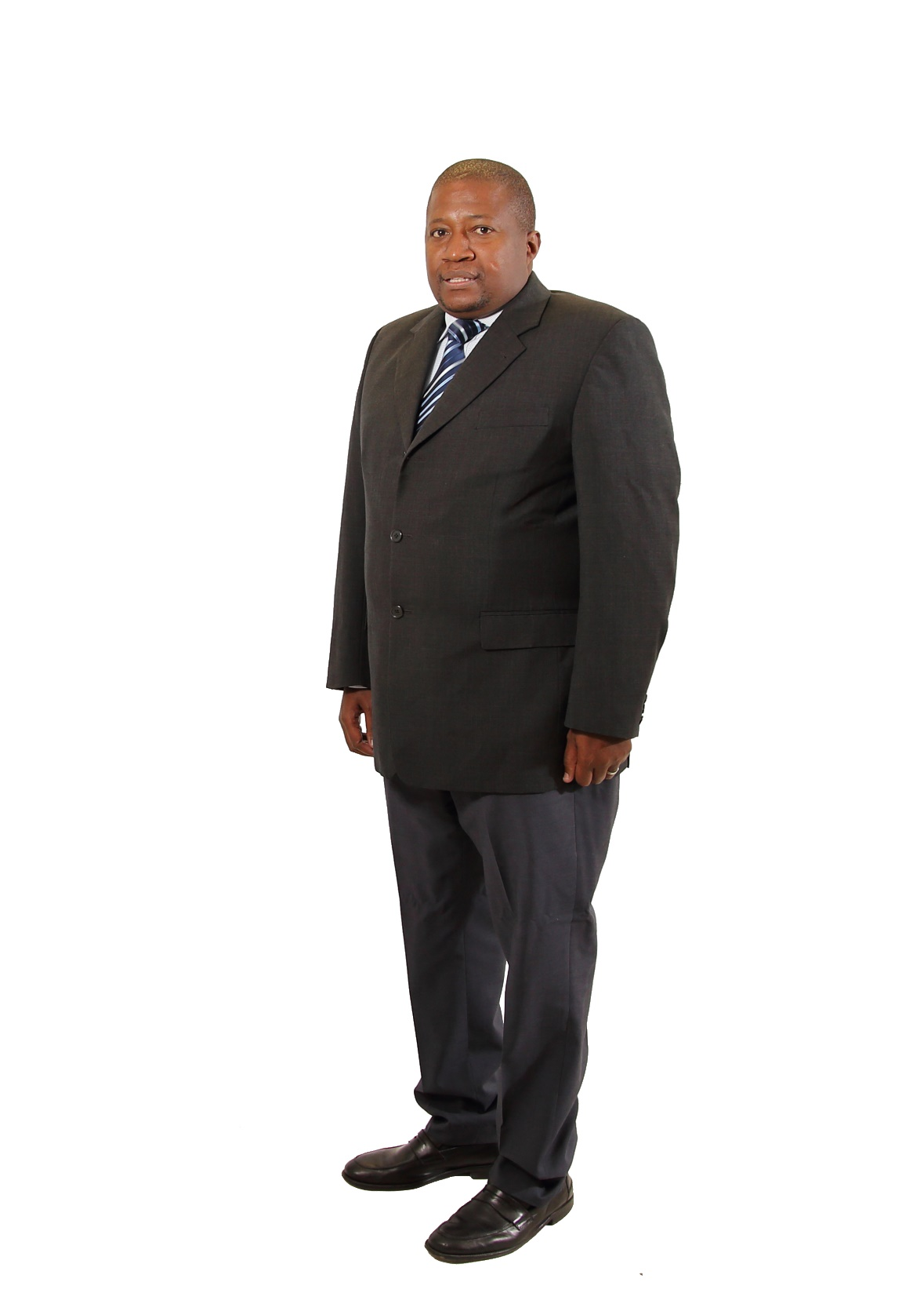

… and bid farewell to others members whose contribution was highly valued and appreciated
Three independent non-executive directors were not reappointed, namely, Messrs Sam Ledwaba, Rowan Nicholls and Paul Browning

Slide 8
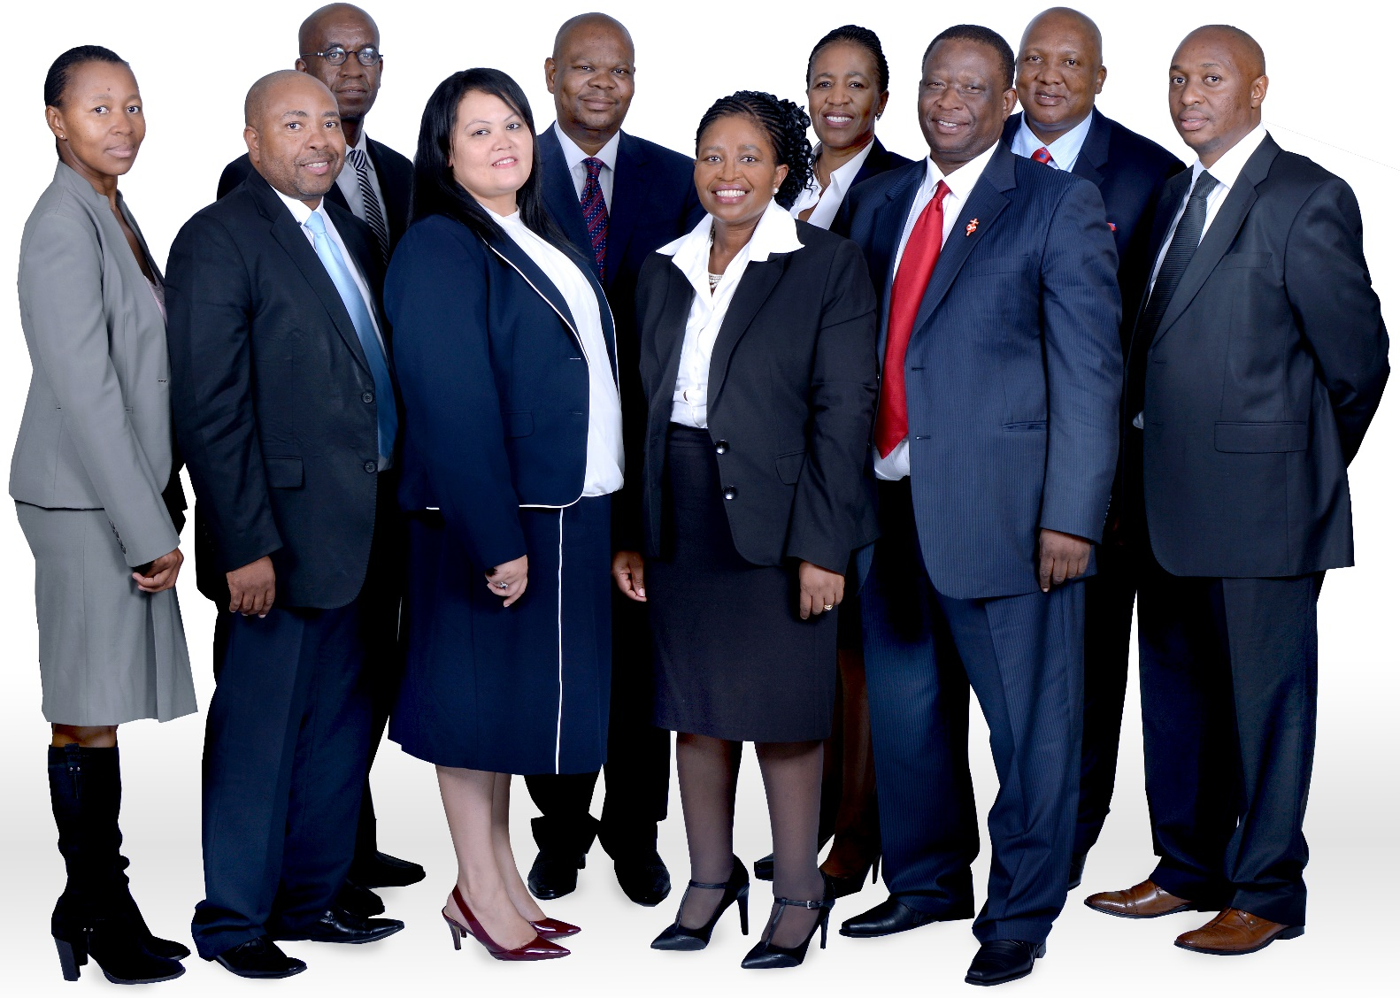
The current RTMC Board
During the 2016/2017 financial year, the Corporation held seven (7) Board meetings, including three (3) special Board meetings

Slide 9
Governance Report – 2016/2017
The RTMC duly attended the Portfolio Committee sittings as prescribed
The Board held seven (7) meetings for the year. The Board Committees held twenty (20) meetings in total
Audit and Risk Committee held Five (5) meetings, the report indicates among other that the Audit Committee is satisfied with the internal report
The RTMC has other Committees namely the Youth Structure and the National Advisory Road Safety Council which held four (4) meetings

Slide 10
Board Committees
The Board is supported by the following committees
Board
Company Secretariat
Audit and Risk Committee
Strategy and Monitoring Committee
Remuneration Committee
Social and Ethics Committee

Slide 11
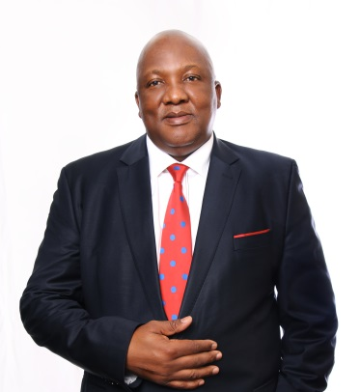

The Executive Team that led the organisation in the previous Financial Year
Chief Executive Officer
Executive Committee

Slide 12
Presentation Content
Introduction
Governance
Performance Information
Human Resources
Audit Committee Report
Audit-General’s Report
Financial Information

Slide 13
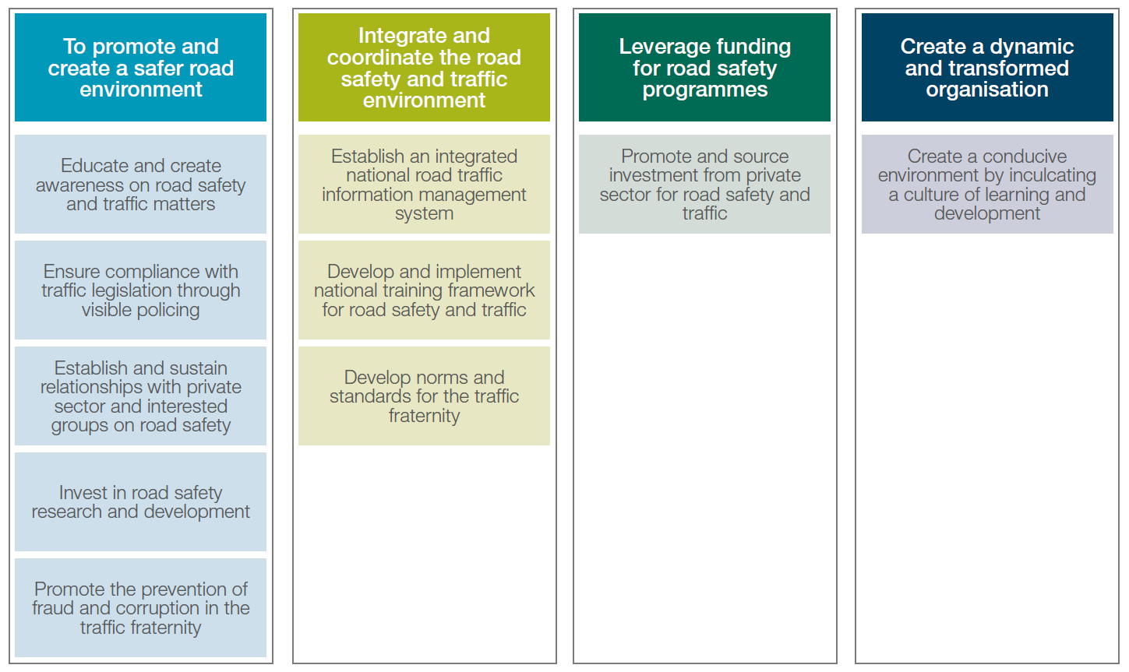
Refined 5 year (2015 – 2020) strategic goals, objectives in line with the mandate of the Corporation

Slide 14
Summary of performance for 2015/2016 and 2016/2017
Item | 2015/2016 KPIs | 2016/2017 KPIs
Not Achieved | The NRTLEC Funding model assessment reports | The NRTLEC Road shows undertaken to roll out the approved National Road Safety Strategy (The NRSS was approved on 29 March 2017 by Cabinet) Number of road safety programmes targeting youth implemented Developed training material for the road safety practitioner curriculum approved by the relevant independent quality assurer 1000 traffic officers trained on the NQF 6 qualification 1 road safety research report was not published

Slide 15
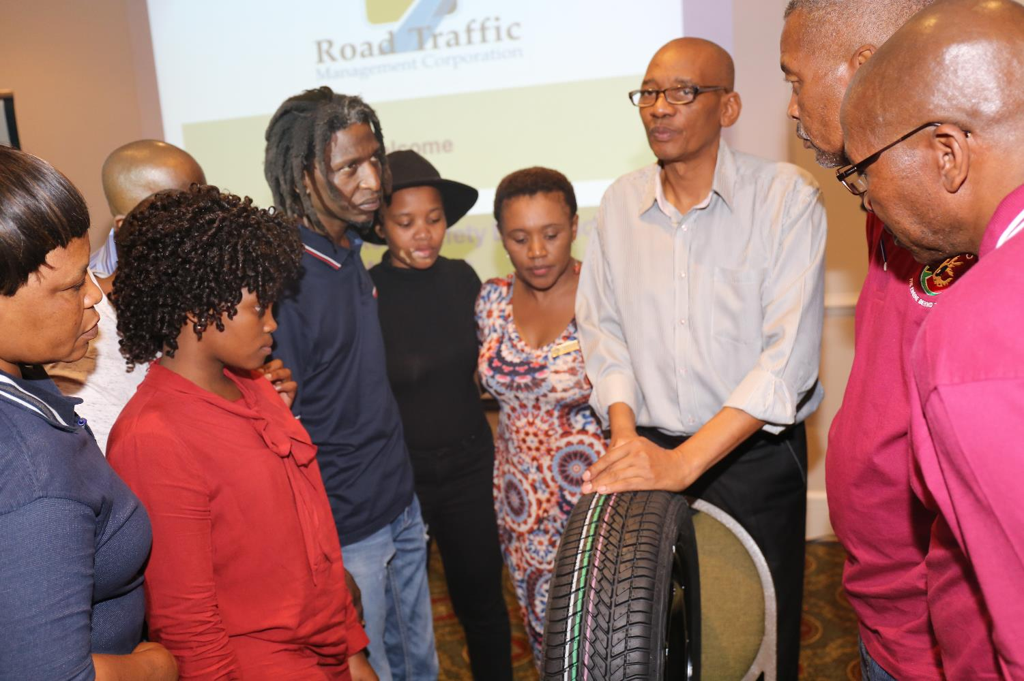

Achievements for 2016/2017 against the APP
Operations
Four evaluation reports produced on road safety transversal indicators Two programmes implemented focussed on youth (Driver and Institutions of higher learning) Five programmes for children (PET, Learner License, Debates, Scholar Transport, JTTC) Programmes focussed on drivers, passengers, pedestrians & cyclists Two programmes focussed on community (stray animal and interfaith) Seven state of road safety reports published (Easter, Festive, Quarter 1,2,3,4, Calendar)

Slide 16
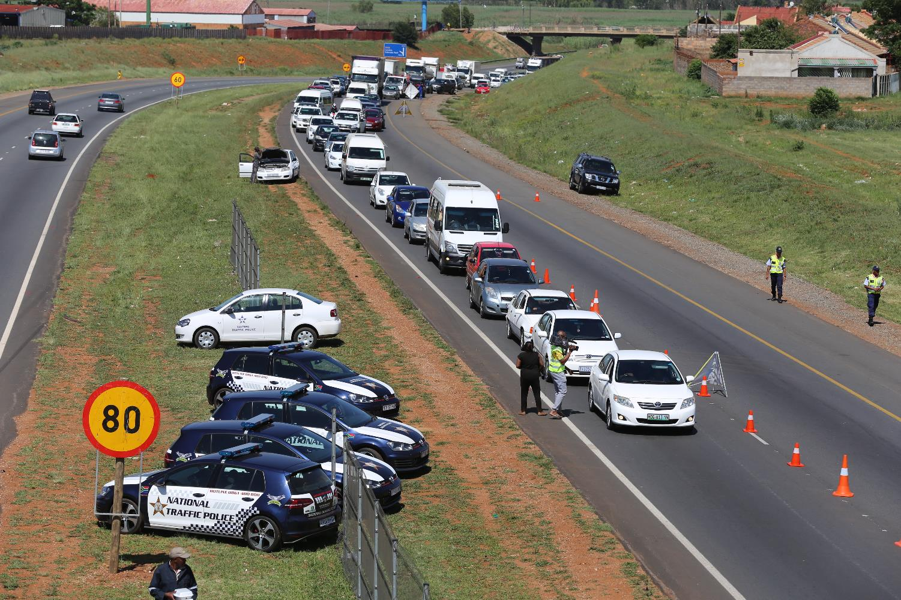
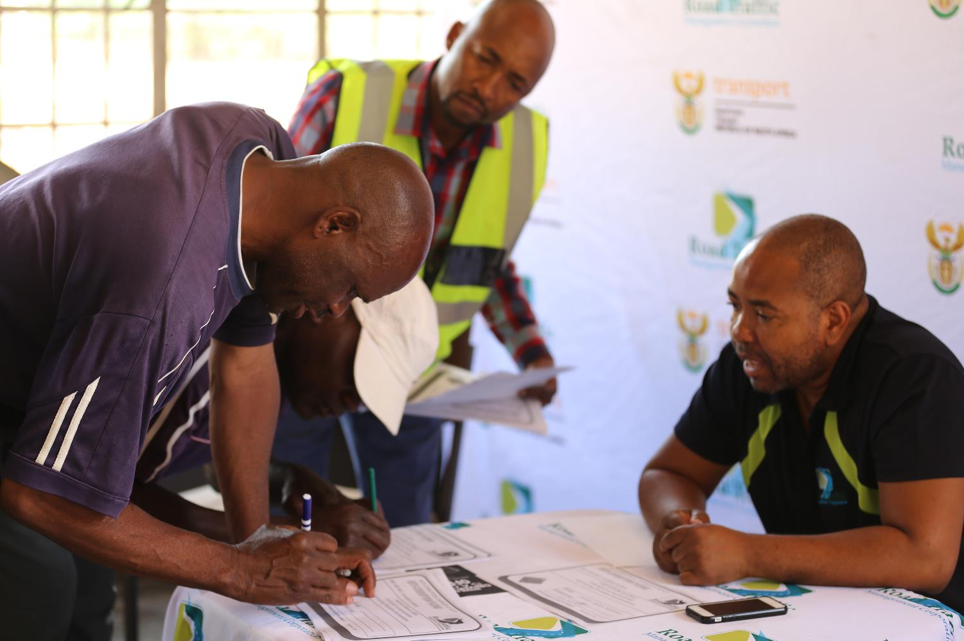
Achievements for 2016/2017 against the APP
Enforcement
872 enforcement interventions conducted Road Transport Inspectorate function transferred from CBRTA Four evaluation report produced on law enforcement transversal indicators
Traffic Intelligence and Security
100% of received cases investigated (69 cases) effected 45 arrests. Thirty Three (33) awareness sessions of fraud and corruption conducted at DLTC and the public

Slide 17
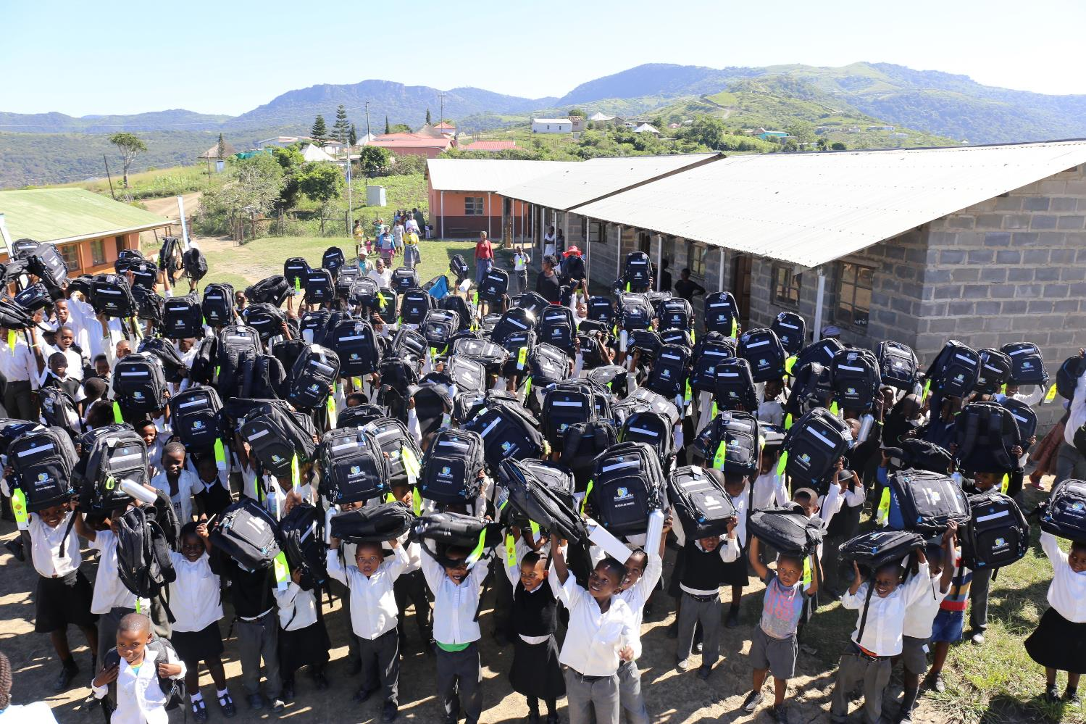
Achievements for 2016/2017 against the APP
Strategic Services
Ten (10) stakeholder engagements executed 12 National road safety marketing campaigns implemented Eight (8) corporate social responsibility programmes implemented. Two (2) research reports produced (Cost of crashes and Travel Offence Survey.
Support Services
5% revenue increase 80% of works skills plan 8% vacancy rate maintained against a target of 10% Five (5) ICT systems developed

Slide 18
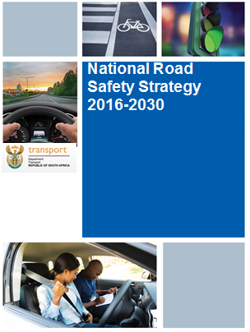
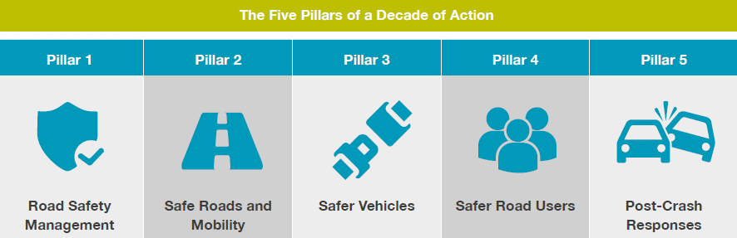
Approval of the 2016 – 2030 National Road Safety Strategy provides the country with a blueprint on addressing road carnage in RSA
  Cabinet approved the 2016 – 2030 National Road Safety Strategy on the 29th of March 2017

Slide 19
Under achievements and remedial actions
(1 of 2)
KPI | Remedial Action
NRSS Road shows | A decision was taken that the road shows will form part of a country wide campaign to communicate the approved NRSS by cabinet. The process will lead to the finalisation of the implementation plan and the required funding requirements for the NRSS.
Number of youth programmes implemented in institutions of higher learning | The under-achievements was addressed in April 2017
Training of 1000 traffic officers | The Target has been included in the 2017/18 APP. The number of traffic trainees to be trained will be inline with the available resources and infrastructure.

Slide 20
Under achievements and remedial actions
(2 of 2)
KPI | Remedial Action
Road Safety Practitioner Curriculum | The Corporation will be sourcing the necessary skills to finalise the modules which were not approved. The work will be finalised in 2017/18.
Review Committee | The delay in the appointment of the review committee resulted in the Corporation not being able to achieve the set-targets. The target has been included in the 2017/18 APP and will be finalised in 2018/19.
Research Report | The is a need for engineering not only in the RTMC but also in the Provinces and local municipalities. The capacity building programmes that the RTMC has started will address the challenges in the implementation of the South African Assessment Programme

Slide 21
Presentation Content
Introduction
Governance
Performance Information
Human Resources
Audit Committee Report
Audit-General’s Report
Financial Information

Slide 22
The growth of the Corporation has been positive
The current vacancy rate of the Corporation is 8%
The Corporation has a structure, Executive and Management posts have been filled

Slide 23
Presentation Content
Introduction
Governance
Performance Information
Human Resources
Audit Committee Report
Audit-General’s Report
Financial Information

Slide 24
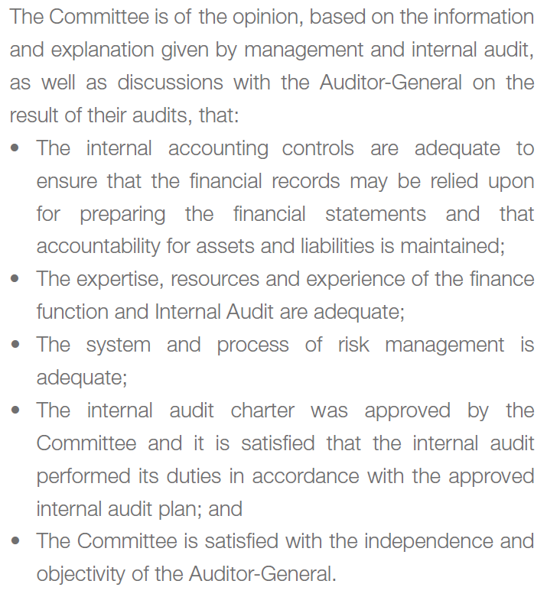
Audit Committee Report

Slide 25
Presentation Content
Introduction
Governance
Performance Information
Human Resources
Audit Committee Report
Audit-General’s Report
Financial Information

Slide 26
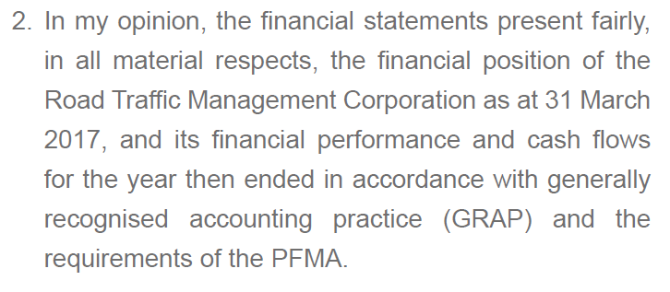
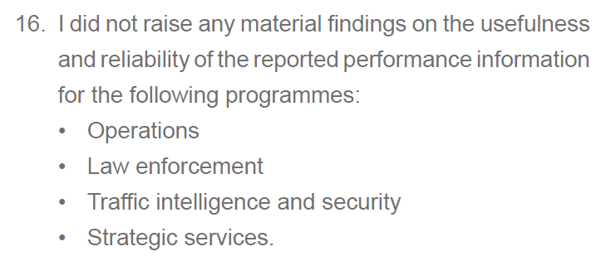
Auditor-General Report
The Corporation received a clean audit for the 2016/2017 financial year

Slide 27
Corporation’s Strategic Risks (1 of 3)
Identified Risk | Status as at April 2017
Legislative environment impedes the RTMC’s ability to achieve its objectives | Work aimed at enabling Legislative changes continues, these initiatives will inadvertently take longer to achieve owing to the required cumbersome process.
Inadequate human capital skills within the fraternity. | NQF Level 6 curriculum for Traffic Officer has been developed. NQF Level 6 curriculum for Road Safety Practitioners had been developed. Human Resources has developed a HR Strategy which is currently being implemented.
Lack of stakeholder coordination in order to achieve the mandate of RTMC. | The RTMC has developed a Stakeholder Management Framework. Fully implemented the Framework will stand the RTMC in good stead in achieving improved stakeholder participation and corporation in achieving its mandate. Considering the importance of Stakeholder management for the RTMC, this key area will be continuously monitored to ensure it remains effective

Slide 28
Corporation’s Strategic Risks (2 of 3)
Identified Risk | Status as at April 2017
Fraud and Corruption | Fraud and Corruption continue to plague our environment, while great strides have been made minimize this risk, it is clear that these practices will not be eliminated easily. Focused work to deal with these instances have been included in the 2017/18 APP. Gaining full control of the NaTIS system has already allowed National Traffic Anti-Corruption (NTACU) to have intelligent led investigation on fraud and corruption. The RTMC has established an Ethics management function. The said function will be based in the CEO’s office.
Lack of business continuity. | Disaster Recovery Plan aimed at identifying critical business process has been developed for our primary operating site Gaining full control of NaTIS has placed an increased responsibility on RTMC to improve and capacitate its ability to minimise the effect of disruption should a disaster occur.

Slide 29
Corporation’s Strategic Risks (3 of 3)
Identified Risk | Status as at April 2017
Unquantified impact analysis of programmes. | The RTMC has established a Monitoring and Evaluation function. Programme managers continue to be empowered to monitor and evaluate the effectiveness of set programmes.
Ineffective and inadequate information systems. | The RTMC has gained full control over the NaTIS system effective April 2017. Some certainty now exist as to the strategic direction the system could be employed towards. RTMC is assessing the reliability of the inherited system including the need for maintenance and due modernisation the capacity of the infrastructure is also monitored to minimize the risk of risk of service disruption. The RTMC is in the process of implementing an ERP system. This will eliminate the fragmentation of our information asset management.
The risk that the RTMC will not be financial sustainable. | The RTMC developed a funding model strategy and is in the process of implementation

Slide 30
Presentation Content
Introduction
Governance
Performance Information
Human Resources
Audit Committee Report
Audit-General’s Report
Financial Information

Slide 31
Budget Performance per Programme
Performance Environment
The Corporation overspent by 9% due to mainly Natis transfer into RTMC as well as Anti-corruption activities. No NDP goals and MTSF targets were affected negatively.

Slide 32
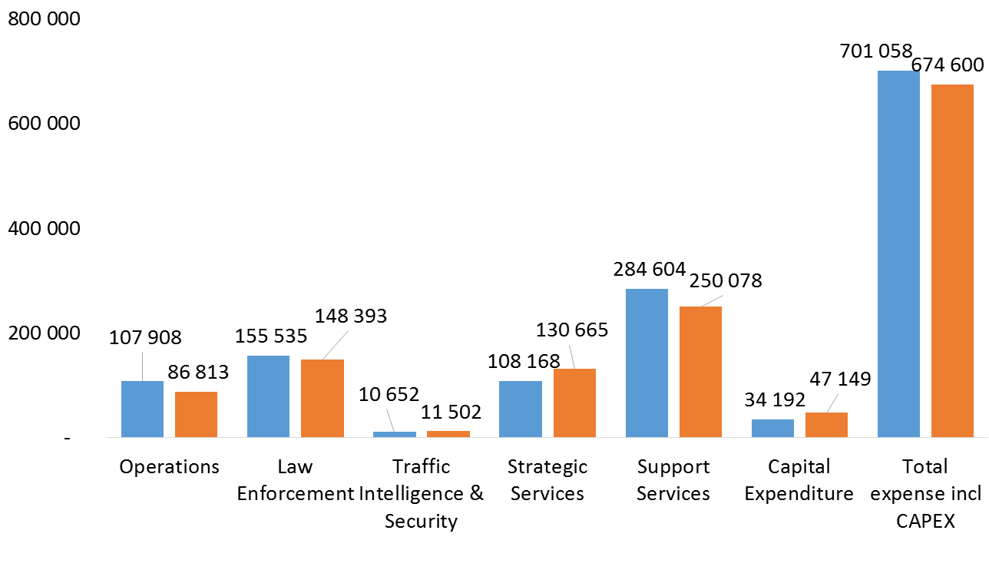
Budget Performance per Programme
Performance Environment

Slide 33
Budget Performance
Financial Environment
The staff compensation of employees increased by R67m to R374.5m from R307m in the previous year due to staff increases and other staff related costs.
Even though the Corporation reflected an overspending of R8.6m the amount is lower than the 2015/2016 financial year.
The Corporation spent R46.6m in the procurement of assets. The major cost drivers were the implementation of the new enterprise resource planning (ERP) system currently being implemented.

Slide 34



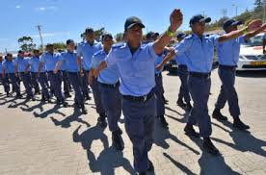

Challenges confronting the Corporation
Continous litigation due to the court battle
Implementation of 24/7 shift system for traffic
Financial sustainability
Challenges
Harmonisation of legislation

Slide 35

Thank You

