Slide 1

ANNUAL REPORT
17 October 2017

Slide 2
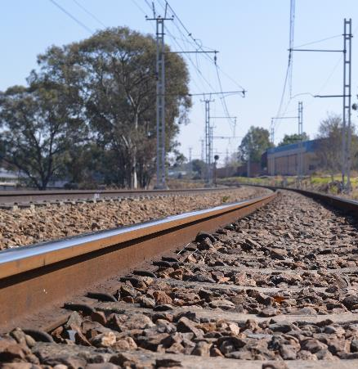
TABLE OF CONTENTS
AUDITOR GENERAL OPINION
AUDIT OUTCOMES – 4 YEAR PERSPECTIVE
2016/17 FINDINGS
PERFORMANCE TREND
KEY ACHIEVEMENTS
NON ACHIEVEMENTS
FLAGSHIP PROJECTS
SOCIAL RESPONSIBILITY
HR OVERVIEW
FINANCIAL OVERVIEW
HIGH STRATEGIC AND EMERGING RISKS
PLANNED INITIATIVES

Slide 3

AUDITOR GENERAL OPINION
UNQUALIFIED with
Non Compliance: Expenditure Management

Slide 4
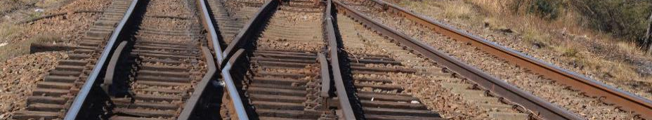
AUDIT OUTCOMES - 4 YEAR PERSPECTIVE
AREAS | FINANCIAL YEAR
 | 2013/14 | 2014/15 | 2015/16 | 2016/17
Number of Findings | 10 | 8 | 20 | 11
Number of recurring findings | 0 | 0 | 0 | 1

Slide 5
2016/17 FINDINGS
AREA | FINDING
Procurement and Contract Management | Extension of contract via deviation process
 | Deviations not included in deviations register
 | Invoices received before purchase orders issued
 | Inadequate contract management
Audit of predetermined objectives | Understated AoPO information disclosed
 | Reported achievements not consistent with planned and reported indicators
Expenditure | Payments not made within 30 days
Property, Plant and Equipment | FAR to GL reconciliations not dated
 | Asset verifications inadequately performed
 | Fixed asset register not complete (recurring finding)
 | Disposals of assets not authorised

Slide 6
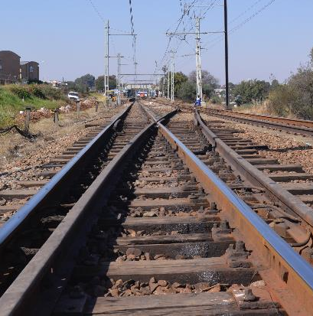
AUDIT OUTCOMES - 4 YEAR PERSPECTIVE
FINANCIAL STATEMENTS
FINANCIAL YEAR | OUTCOME
2013/14 | Unqualified
2014/15 | Unqualified
2015/16 | Unqualified
2016/17 | Unqualified

Slide 7
PERFORMANCE TREND

Slide 8
ACHIEVEMENTS

Slide 9
ACHIEVEMENTS

Slide 10
ACHIEVEMENTS

Slide 11
FLAGSHIP PROJECTS
Projects | Achievements
The Ergonomics Society of South Africa (ESSA) Conference | Showcased the role of human factors in rail and road transport; and Promoted awareness of the RSR’s training courses and technical awareness programmes aimed at promoting human performance, safety and the wellbeing of the general user population.
Certification of Train Drivers | MOU with PRASA; Licensing of 130 train drivers; 18 of whom are drivers of the new PRASA Electric Multiple Units (EMU) Trains; and Recommendations for licensing requirements in the RSR’s approval conditions to PRASA for the trial run of the new trains issued in early 2017.
Technology Reviews | PRASA EMU trains Transnet MDS projects (23E locomotives); 45D locomotives and new Trans Africa Locomotives
Technical Training – Railway Safety Inspector Qualification | Developed a Railway Safety Inspector curriculum in collaboration with the Community of Expert Practitioners. This qualification has been approved by Transport Education Training Authority (TETA) and submitted to the Quality Council for Trade and Occupations.

Slide 12
NON-ACHIEVEMENTS
APP Target | Reason for non-Achievement | Action Plan
Railway Reserve Regulation implemented | DoT requested that a Socioeconomic Impact Assessment System be conducted prior to Gazetting of the Regulation. | The impact assessment will be conducted during 2017/18.
Human Factor Regulation Implemented | DoT requested that a Socioeconomic Impact Assessment System be conducted prior to Gazetting of the Regulation. | The impact assessment will be conducted during 2017/18.
100 % Compliance to 50 % (10) of all PTI Improvement Directives issued during 2016/17 | 70 % of PTI Improvement Directives issued during 2016/17 were closed due to Operators being unable to implement the targeted improvement directives issued during 2016/17. | The outstanding directives will be followed up for implementation in 2017/18.

Slide 13
HUMAN RESOURCES

Slide 14
HR OVERVIEW
No of current employees
163
Head Office and Gauteng Region
No of projected employees
218
7
8
12
23
15
25
4
9
NB: The projected staff (green) relates to the approved staffing plan

Slide 15
VACANCY RATE

Slide 16
EMPLOYMENT EQUITY
ETHNICITY | MALE | FEMALE
AFRICAN | 88 | 90
COLOURED | 2 | 7
INDIAN | 1 | 0
WHITE | 9 | 4
TOTALS | 100 | 101
1. Turnover: 5%

Slide 17

WOMAN EMPOWERMENT

Slide 18
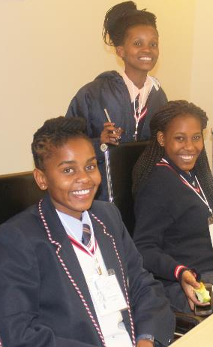
YOUTH DEVELOPMENT
18 interns participated in the RSR’s internal training programme;
Two interns progressed to the Trainee Inspector programme;
15 were absorbed into the RSR structure; and
1 Resigned;
Provided financial support to youth pursuing academic excellence in various academic institutions around the country
52 youth have been provided with the financial support as part of the RSR’s Youth Development initiative.

Slide 19
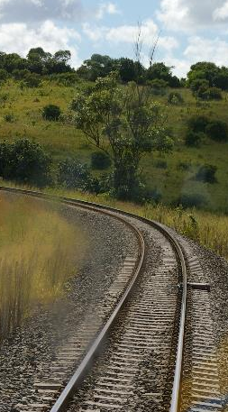

SDIX PERFORMANCE TREND
2014/15
SDIX Score 38
2016/17
SDIX Score 51
2015/16
SDIX Score 37.7
2016/17
SDIX Target 46

Slide 20
SDIX PERFORMANCE TREND
* This figure shows the RSR SDIX for 2014 (Blue); 2015 Index (Orange); 2016 Index (Purple), and 2016 RSA Global Innovation (GII) Index (Red).

Slide 21
FINANCE

Slide 22
YEAR-ON-YEAR REVENUE (R’000)

Slide 23
REVENUE VS EXPENDITURE (R’000)

Slide 24

BBBEE SPEND

Slide 25
REVENUE PROJECTIONS (R’000)

Slide 26
RISK

Slide 27
HIGH STRATEGIC RISKS
RISK | INHERENT RATING | RESIDUAL RATING | MITIGATIONS | RISK OUTLOOK
Insufficient cash flow | Very High | High | Budget committee focussing on cost minimisation and savings
 |  |  | Virtual office model to realise savings of head office rental and maintenance costs
 |  |  | 2017/18 Accruals to be factored into factored into 2018/19 budget
Unchanged
Regulatory Capture | Very High | High | RSR consolidated database for audit and inspection findings, occurrence findings and directives.
 |  |  | Increased monitoring of the closure of directives
 |  |  | Issuing of penalties, suspend and re-work licences
Improving
Delays in finalizing and promulgating regulations | Very High | High | Escalation of matter to RSR chairperson and DoT Deputy Minister
 |  |  | Involvement of DoT at conception stage of development of regulations
 |  |  | RSR standards being developed to strengthen the regulatory tools
Unchanged

Slide 28
EMERGING RISKS
EVENT OR SITUATION | RISK | RELATED STRATEGIC RISKS
New Rail Policy Creation of and positioning of the STER (Single Transport Economic Regulator) and the IRER (Interim Railway Economic Regulator) as suggested by new Rail Policy | Changes to the Policy landscape (New Rail Policy and amended RSR Act) may expand the regulatory mandate of the RSR without a corresponding increase in its funding structure. | Financial sustainability
 | The location of components of the STER or IRER within the RSR will dramatically increase our mandate and size (staff complement, budget, facilities etc.) and sustainability | Financial sustainability
Investigation of anonymous allegations | The investigation must be procedurally fair in order to avoid legal challenges to any of its findings. | New risk

Slide 29
PLANNED INTERVENTIONS
Facilitating the amendment of the RSR Act to provide for the generation of revenue from new revenue streams;
Revising its Permit Fee Model to take future macro-economic trends and investment climates into consideration; and
Exploring new revenue streams through the development of new products.
Improving year end cash positions and/or budget adjustments to accommodate year end accruals

Slide 30


THANK YOU
THANK YOU
THANK YOU

