Slide 1


^{when the sun rises}
^{we work hard to deliver}
STATE OF READINESSOF PLANTING SEASON
MPUMALANGA PROVINCE
17 October 2017

Slide 2

PRESENTATION OUTLINE
Introduction
Annual Rainfall and Mining Pressure
Ecological Zones and Commodity Competitive Advantage
Production Capacity of the Province
State of Readiness Financial Implications
Summary of the State of Readiness for the Province
Remarks for noting

Slide 3
INTRODUCTION
The Province has four agricultural; regions, namely Ehlanzeni South and Ehlanzeni North (Lowveld) ; Gert Sibande and Nkangala (Highveld)
The Department is focusing four commodities distributed across all four regions informed by APAP
Hon MEC launched the planting season of Phezukomkhono Mlimi in all four regions with the provincial event on the 13 October 2017 integrated with Provincial World Food Day celebration
The Province is enhancing the following tiers of production:
  Primary Production (Production Inputs, Mechanisation, Technical Advise, Financial Resources)
  Secondary Production (Processing, Packaging, Marketing, Logistics, Financial Resources)
Promoted fully fledged value chain in both animal and vegetable production
Promote new farming models methods such tunnels and use of drip irrigation for intensive farming and water saving respectively
Intensify the introduction of drought resistant commodities to more farmers to address the issues of drought that affects production
The Province is currently receiving good October rain and this is conducive for kick starting the planting season
This rain is very important for highveld area especially Nkangala as its planting season is shorter and annual rainfall is lowest.

Slide 4
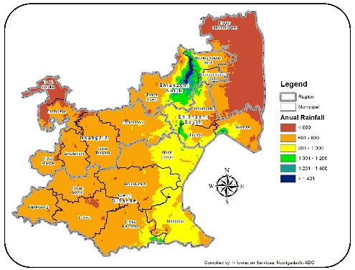
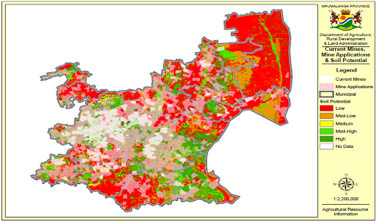
Annual Rainfall and Mining Pressure
Current Mines, Applications and Soil Potential
There is high expansion of mines in Nkangala and Gert Sibande taking much of arable land
Focus in these areas is to work in collaboration with the mines to use for agricultural production on rehabilitated land
Another focus is on high value crop under intensive farming method
Annual Rainfall
Most parts of the province indicates relatively low levels of rainfall
Extremely low levels of rainfall are experienced in Dr JS Moroka and some parts of Nkangala thus influencing the strategy of focusing on livestock and broiler production
Provide drought resistant seeds in most parts of Ehlanzeni and Nkangala

Slide 5
Agro-Ecological Zones and Competitive Advantage
GERT SIBANDE | NKANGALA | EHLANZENI NORTH | EHLANZENI SOUTH
Soya beans | Soya beans | Coffee | Sugar Cane
Sunflower | Sunflower | Wheat
Mushrooms | Cotton | - | Cotton
Vegetables | Vegetables | Vegetables | Vegetables
Sugar Beans | Sugar Beans | Sugar Beans | Sugar Beans
Maize | Maize | Maize | Maize (grains)

Slide 6
PRODUCTION CAPACITY OF PROVINCE
COMMODITY | TOTAL RSA PRODUCTION (‘000 TON) | TOTAL PRODUCTION MPUMALANGA PROVINCE (‘000 TON) | PERCENTAGE SHARE MPUMALANGA | RANKING
Maize | 12,050 | 2,870 | 24% | 2nd
Sorghum | 27,650 | 66,000 | 24% | 2nd
Soya beans | 516,600 | 262,500 | 51% | 1st
Sunflower | 801,000 | 37,500 | 5% | 3rd
Dry beans | 67,030 | 15,750 | 23% | 2nd
Citrus | 2,285,384 | 685,615 | 32% | 2nd
Banana | 405,000 | 145,800 | 36% | 2nd

Slide 7
STATE OF READINESS FINANCIAL IMPLICATIONS 14 OCTOBER 2017
SERVICES | Target | Type of Support | Fertilizers | Diesel/ Lubricants | Mechanization | Starter Pack | Fencing Material | Total Amount | Average budget /Support per individual activity
 |  | Seeds
Ilima/ Letsema Conditional Grant R 52 213 000
Households Supported through Agric interventions | 10 000 | 2 000 000,00 | 3 000 000,00 | - | - | - | - | 5 000 000,00 | 500,00
Hectares Provided with Mechanization | 14 000 | 9 105 834,65 | 4 474 140,31 | 2 240 160,00 | 4 410 315,00 | - | - | 20 230 449,96 | 1 445,03
Food Gardens Established and / or Maintained | 2 000 | 1 285 050,00 | - | - | - | 15 027 415,76 | 10 670 084,28 | 26 982 550,04 | 13 491,28
Total Ilima/ Letsema Conditional Grant |  | 12 390 884,65 | 7 474 140,31 | 2 240 160,00 | 4 410 315,00 | 15 027 415,76 | 10 670 084,28 | 52 213 000,00 | 5 145,44

Slide 8
SUMMARY OF THE STATE OF READINESS FOR MPUMALANGA PROVINCE NAME 2017/2018
District | Targeted Hectares | Beneficiaries | Seeds Ordered (Tons) | Fertilizers Ordered (Tons) | Mechanization Units (Tractors) | Overall Readiness Rating | Pesticides (Litres) | Business Plan Hectares | Difference in Ha
Ehlanzeni South | 3 080 | 1 232 | 90 tons | 210 tons | 14 | 100% | 0 | 3 080 | 0
Ehlanzeni North | 3 220 | 1 288 | 87 tons | 195 tons | 24 | 100% | 0 | 3 220 | 0
Nkangala | 3 220 | 1 288 | 88.45 | 117.5 tons | 27 | 100% | 0 | 3 220 | 0
Gert Sibande | 4 480 | 1 780 | 91.05 | 130 tons | 31 | 100% | 0 | 4 480 | 0
TOTAL | 14 000 | 5 588 | 356,5 | 652,5 | 96 | 100% | 0 | 14 000 | 0

Slide 9
REMARKS FOR NOTING
Procurement of all production inputs have been concluded.
Inputs have been delivered and distributed to the beneficiaries.
On Mechanization, the Province added private mechanization to supplement the Departmental fleet in order to achieve the targets.
The Province is envisaging to reach its targets 100 % before end of the 3rd quarter.
The Province is strengthening the involvement of commercial farmers in the development of the agricultural sector in the province.
Implement the off-take agreements within Government Nutrition Programme including Educations, Health as well as Correctional Services sectors to ensure sustainable and reliable market for all produce after harvesting.
Improve agro processing value through establishment of Agrihubs in each district to enhance access to markets by farmers
Enhance production capacity in communal land by including and involving full participation by traditional authority in their own space

Slide 10

^{when the sun rises}
^{we work hard to deliver}
THANK YOU

