Slide 1
Presentation to Portfolio Committee
Annual report 2016/17
Statistician-General (Pali Lehohla)

Slide 2

Content
Building a statistics system over 2 decades
Organisational and financial performance: 2016/17
Risks
Key priorities looking ahead

Slide 3
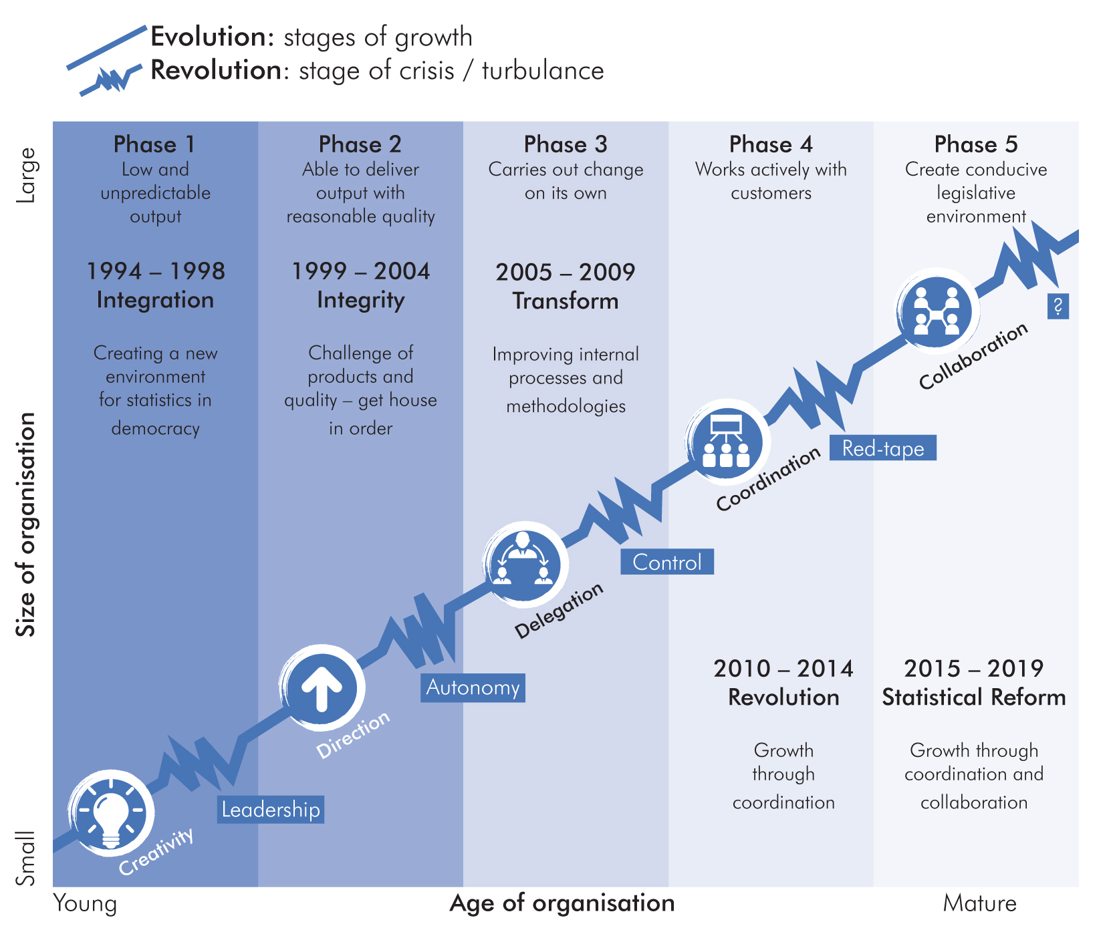
Building a statistics system
Notes:
Benchmarking: Canada,

Slide 4




Building a statistics system – major innovations over 2 decades
1995 - 99
2000 - 04
2005 - 09
2010 - 14
2015 - 17
Transformation of the statistics agency
Census 1996 - all inclusive
Review of economic statistics
Introduced household surveys
1999: New Statistics Act (6 of 1999) promulgated
Strategic focus: integration and transformation
Census 2001 released within 12 months
Established Corporate data processing centre
Restructuring economic statistics
Introduced GIS
Re-engineered Business register
Institutionalised Provincial offices
Introduced Project & programme mgt
Strategic focus: institutional & capacity building
New CPI methodology
New IES methodology
Re-engineered QLFS
Introduced Victims of Crime Survey
Expanded national footprint – 52 District Off
SASQAF gazette
Hosted ISI – established ISIbalo programme
Established CRUISE Strategic focus: improving statistical & governance processes &
1st MDG country report
SHaSA
Introduced LCS
Re-engineered PPI
Established a SANSS cluster for statistical coordination
Established Policy research unit
Legislative reform commenced
Innovation in dissemination of Census 2011
Strategic focus: partnerships & coordination
KZN CSS
CSS digital data collection
Demographic and health Survey
Moved into new building
GDP(E)
Statistical planning tools
Hosted 1st World Data forum on data revolution
Strategic focus: legislative reform

Slide 5
Key indicators today
ENVIRONMENT
GOVERNMENT
Agriculture
National, provincial & local spending
Ecosystems
Service delivery by municipalities
Emissions
Tertiary Institutions etc
CRIME & JUSTICE
ECONOMY
Victims of Crime
Key
GDP,
CPI,
PPI
Indicators
Primary, secondary
& tertiary sectors
Publish more than 250 releases
annually
POPULATION
SOCIETY
Population estimates
Employment/Unemployment
Migration & Tourism
Poverty and Inequality
Births, deaths
Service delivery
Mortality & causes of death
Living conditions
Health & nutrition
Education

Slide 6
Organisational performance 2016/17
Overall: 87%

Slide 7


Delivery of key projects in 2016/17
Community Survey | CS results launched in June
GDP(E) | Delivered in June
Integrative planning tools | Tools developed
New Building | Moved in August
Digital work place | Delivered through CSS and CS
Reweighting CPI | Delivered in January
Legislative reform | In progress

Slide 8
2006/07
2007/08
Unqualified
Governance
and audit trail
Unqualified
2008/09
2009/10
Unqualified
Unqualified
2010/11
2011/12
Unqualified
Qualified
2012/13
2013/14
Unqualified
Clean
2014/15
2015/16
Clean
2016/17
Clean
Clean

Slide 9


Living the risk
The reality
1
Cannot afford warm bodies
2
Critical posts gap increasing
3
Cannot fund critical legally committed activities
Notes:
Benchmarking: Canada,

Slide 10

Living the risk
Risk
Consequences
1
Inadequate funding to pay salaries in 2017/18
Key statistical releases will be delayed or will not go ahead – will cause a break in statistical series
Lead to fruitless and wasteful expenditure
Cannot afford
Warm bodies
2
Delivery of key series are impacted
Declining quality: Major series affected (GDP, CPI, Employment and Population estimates)
Losing intellectual capital
Critical posts
gap increasing

Slide 11
Living the risk
Risk
Consequences
1
TAB ONE
Add your own text here
CAPI Transition. Already invested R200m
  Staff in field and vehicles commissioned
  Labour action by fieldworkers
  Lead to fruitless and wasteful expenditure
Geo-referenced information frame
  Supplier already appointed. Legal liability
  All household surveys will revert back to manual listing of households
Census 2021 budget (R3,3 billion). Will need to revert back to costly old mode of collection
  Will impact on timeliness of release
  Old mode of collection very costly. Budget will be in excess of R7 billion
IUSSP: already committed R21 million.
  Exposure of international and national litigation
  International reputational risk
Cannot fund
critical legally
committed
activities
3

Slide 12
Key indicators at riks
GDP
IES/LCS – Poverty indicators
Consequence for
Economic growth
Consequence for
Socio-economic planning &
policy development
Determining the CPI basket
Employment
CPI
Key
Consequence for
Job creation
Consequence for
Inflation rate
Indicators
at risk
POPULATION estimates
Fertility & Mortality
Consequence for
DoRA
Consequence for
Health policy & planning

Slide 13

Key priorities
Legislative
reform
Modernise &
innovate
Maintain basic statistics
2017/18
Restructure &
rationalise
Integrated
Indicator framework
Value-added
products

Slide 14

Looking ahead
A
Data and digital revolution
1st phase: 1 January 2018
CAPI transition
B
Intergovernmental project
Managing relationships
Role of the SG
Trade statistics
Change in leadership
(w.e.f.
1 November 2017)
C
Legislative reform
Amendment Bill
Table in 2018
Institutional arrangements
D
Declining budget
Major risk for delivery
Cannot afford warm bodies
Decline in quality

Slide 15

Questions

