Slide 1
NYDA ANNUAL REPORT
2016/17 FINANCIAL YEAR
ANNUAL RESULTS
10 October 2017

Slide 2
VISION
To be a credible, capable and activist development agency that is responsive to the plight of South Africa’s youth.

Slide 3
MISSION
To mainstream youth issues into society, and
To facilitate youth development with all sectors of society.

Slide 4
VALUES
Integrity and honesty
Excellence
Respect and humility
Professionalism
Accessibility

Slide 5
PERFORMANCE

Slide 6
KPA 1: Economic Participation

Slide 8
Grants Issued by Branch
Total Grants Issued = 698
Durban branch issued most grants to youth owned enterprise.
Port Elizabeth branch issued most grants to individuals.
Polokwane branch issued the most grants to co-operatives.

Slide 9
Jobs Created & Sustained
Total = 3 718

Slide 10
Business Support Services (Non-financial support)
Total = 63 407

Slide 11
Community Development Projects Supported

Slide 12
KPA 2: Education & Skills Development

Slide 14
Kefiloe Lithebe 18 yrs | 1st Year ND Civil Engineering (CUT) | SMSF Beneficiary
“I am just a girl from an average family. I have two other siblings who are also at a university and my guardian was going through tough times paying for all of us.
The Solomon Mahlangu Scholarship Fund bailed me out.
I cannot imagine how I was going to be able to further my studies without it”.
#NYDA3rdCleanAudit

Slide 15
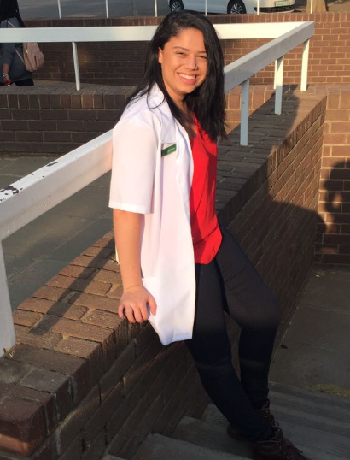
Lakin Sadie Seconds 21 yrs | Bachelor of Medicine & Surgery (MBChB) (UFS)| SMSF Beneficiary
“Only one of my parents works but still does not have a stable job, supporting me and my two brothers are still at school.
I am the first one in the family who has a privilege of going to university. When I got accepted at university for my degree which is my dream career, I had no idea how I would turn my dream into a reality. NYDA came to my rescue.
Honestly, I would not have been able to afford my studies without the Solomon Mahlangu Scholarship Fund. Now, I have the opportunity to become a doctor and will contribute to the community”.
#NYDA3rdCleanAudit

Slide 16
KPA 3: Health & Wellbeing

Slide 17
National Youth Service

Slide 18
GOVERNANCE

Slide 19
Governance
The Agency’s has achieved 100% of all Key Performance Indicators set for the financial year under review.
Auditor General of South Africa which expresses an opinion on the Agency’s financial statements, annual performance report and compliance with laws and regulations.
Massive achievements realized in the areas of financial management, performance information reporting and compliance when compared to 2013/14
 | 2013/14 | 2014/15 | 2015/16 | 2016/17
Financial management | 14% | 79% | 93% | 93%
Performance information reporting | 50% | 71% | 86% | 83%
Compliance | 14% | 57% | 86% | 92%

Slide 20
FINANCIAL MANAGEMENT

Slide 21
Financial Performance Highlights
Overall reduction in the transfer payment from R409 million to R405 million as third year of fiscal cuts came into effect.
Project and grant disbursements increased from R143.5 million to R171.8 million (19%)
Employee costs post restructuring reduced from R209 million to R143 million (32%)
R113.4 million raised and committed to support youth development programmes by donors and partners.
The Agency remains a going concern as assessed by its financial and liquidity positions

Slide 22
Financial Performance Highlights
Key Programmatic Area | Budget allocation | Expenditure | %
Economic Participation | R59 253 300 | R59 800 976 | 101%
Education and skills development | R74 099 686 | R75 833 780 | 102%
National Youth Service | R56 802 100 | R53 033 972 | 93%
Service Delivery Channel | R24 611 821 | R24 432 662 | 99%
Research and Policy | R10 173 573 | R10 457 187 | 103%
Administration | R81 283 719 | R84 870 959 | 104%
Employee costs | R145 529 300 | R142 576 896 | 98%
Total | R451 753 500 | R451 006 432 | 100%

Slide 23
Financial Performance Highlights

Slide 24
Financial Performance Highlights: Cost Containments
Reduction in annual allocation from National Treasury
- R409 million in 2015/2016 vs R405 million in 2016/2017
- Third year of fiscal cuts to the budget were effected.
NYDA relocated its Head Office Operations to 54 Maxwell Drive in Woodmead.
Savings from the move approximately R12 million per annum
(R40 million over the MTEF)
Further reduction administration, travel and outsourcing costs to compensate for reduced budget allocation.

Slide 25
HUMAN RESOURCES OVERVIEW

Slide 26
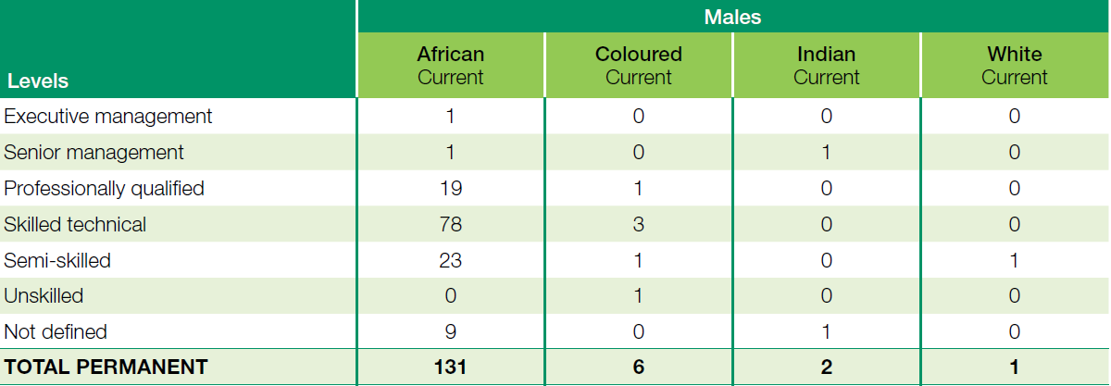
HUMAN RESOURCES OVERVIEW

Slide 27
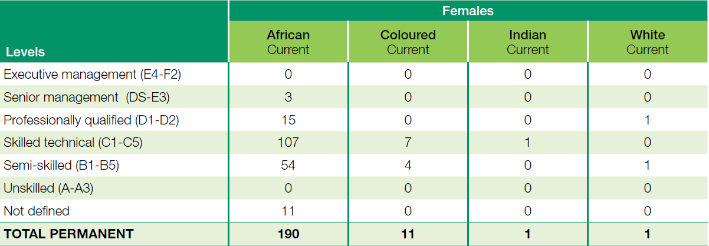
HUMAN RESOURCES OVERVIEW

Slide 28
HUMAN RESOURCES OVERVIEW

Slide 29
HUMAN RESOURCES OVERVIEW

Slide 30
THANK YOU!

