Slide 1
National School of Government Annual Report 2016/17 : A presentation to the Portfolio Committee
Prof. Richard M Levin
Principal: National School of Government
10 October 2017

Slide 2
Outline of Presentation
Key Message
Programme Performance: (Programmes 1 and 2)
Financial Performance
Human Resource Oversight
Corporate Governance
Conclusion

Slide 3
Key Message
The presentation to the Portfolio Committee provides the financial and non-financial performance of the National School of Government for the 2016/17 financial year, measured against the approved Annual Performance Plan (APP)
The NSG has exceeded its set training targets by 123% achievement, training a total of 64 513 learners in all training streams. This was achieved through a concerted team effort and commitment by NSG employees
In terms of the APP targets, Programme 1 achieved 14 out of the 17 targets (82%) and Programme 2 achieved 17 of the 19 targets (89%), representing an overall achievement of 86%
The NSG achieved all the three projects it set out in the programme of action for Outcome 12 of the Medium Term Strategic Framework (MTSF)
The revenue generated from training activities during this financial year amounted to R137m against a projection of R152m (90% achievement)

Slide 4
ANNUAL PERFORMANCE FOR PROGRAMME 1 (ADMINISTRATION)

Slide 5
Annual Performance for Programme 1
Some of the Performance Highlights
The average number of days for debt collection reduced to 48 days by the end of the financial year
100% of suppliers paid within 30 days
The NSG vacancy rate was at 7.5% against a 8% target by the end of the financial year
Three multi-lateral international exchanges/ capacity building initiatives were implemented
Workplans and budget for the EU project were finalised
Business process analysis was undertaken to analyse gaps within current business operations – towards the re-engineering of some of the critical business functions
Programme 1 had 17 targets of which 14 were achieved as planned

Slide 6
Performance Targets not Achieved for Programme 1
Performance targets not achieved | Annual Performance Status | Remedial action
Upskill 80% of NSG employees in line with the approved WSP, and evaluate application of learning to measure effectiveness | 70% (147/164) of employees’ were upskilled to match organisational Competency Framework | The NSG fell short of achieving the remaining 10% of the annual target during the fourth quarter. This was attributed to low uptake of some of the training offerings. Better planning and co-ordination, as well as realistic target setting for the new financial year
Develop and approve systems documentation for Student Information System | The implementation of the SIS System is part of the project of the EU programme. Delays were experienced in the issuing of an international tender by the EU | Significant work was undertaken during this financial year, including the study and development of the NSG Enterprise Architecture Elements and Network, as well as the preparation of the Terms of Reference. The overall EU project is on track.
MPAT results with overall score not less than 3, with 80% of scores at level 4 | The NSG has been consistently improving annually in terms of the MPAT compliance. It was only able to reach a score of 41% of performance indicator scores at level 4. The KRA on Financial Management received a score of 4 in all performance indicators | The NSG has put in place processes to coordinate and manage the compliance with MPAT. This includes the development of improvement plans for al key result areas

Slide 7
MPAT Score Performance Trend 2014-2016
There have been an improvements over the three years of assessment
There are a fewer scores of 1 (defined as non-compliance with legal\ regulatory requirements)
Performance indicators at a score of 4 have increased over the past three years.

Slide 8
ANNUAL PERFORMANCE FOR PROGRAMME 2 (PUBLIC SECTOR ORGANISATIONAL AND STAFF DEVELOPMENT)

Slide 9
Fourth Quarter Performance for Programme 2
Some of the Performance Highlights
29 training needs analyses were conducted for public service institutions during the financial year
63 quality evaluations have been carried out and 4 Application of Learning studies were undertaken
12 MOAs were entered into with the government departments and public sector institutions in order for the NSG to provide training
The NSG piloted the Executive Induction Programme (EIP), developed for salary levels 15 & 16 in the public service
6 NSG courses were developed/ reviewed and 10 courses were quality assured
The NSG developed open online courses to support self-paced learning, registering more than 4 000 learners in MPC, PILLIR & Ethics in Public Service
Programme 2 had 19 targets planned, 17 targets were achieved whilst 2 targets were not achieved

Slide 10
Performance Targets not Achieved for Programme 2
Performance targets not achieved | Annual Performance Status | Remedial action
Generate revenue of R151.9m by the Training Trading Account as part of the cost-recovery | A total of R137m was generated by the Training Trading Account, which represents an achievement of 90% | Acknowledging the challenges posed by the current demand-led funding model, the NSG commenced with work during the financial year to revise the funding model. Amongst considerations is an appropriation allocation from departmental training budgets and directive on compulsory courses offered by the NSG
Implement a hybrid model to achieve a balanced approach regarding training facilitation and provisioning | The NSG issued a call for interest on the website during the financial year, and was not able to undertake further activities in implementing Rutanang Ma Afrika | Despite the fact that the NSG did not fully implement Rutanang Ma Afrika during this financial year, it undertook initiatives such as the development of the Lead Facilitators Development Programme (LFDP) and rolled out to current public servants The NSG will undertake a screening of all interested parties in terms of Rutanang Ma Afrika campaign

Slide 11
Training Delivery: Per Stream
Training Stream | Annual Target | Annual Training Delivery
Leadership | 6 000 | 10 356
Management | 10 000 | 13 470
Administration | 4 000 | 4 700
Unemployed youth graduates (BB2E) | 2 750 | 3 163
Induction | 29 850 | 32 824
Total | 52 600 | 64 513

Slide 12
FINANCIAL PERFORMANCE

Slide 13
Financial Performance
Vote Account
The NSG received an unqualified Audit Report by the Auditor-General South Africa (AGSA) for the 9th consecutive year and clean audit for the 1st time
No virement was requested during the financial year under review
No irregular expenditure incurred during the financial year under review
All payments were processed within 30 days of receipt of invoices

Slide 14
Vote Account
Description | Final Appropriation | Actual Expenditure | Variance | Expenditure as % of final appropriation
 | R'000 | R'000 | R'000 | %
Administration | 88,590 | 87,663 | 927 | 99.0%
Public Sector Organisational and Staff Development | - | - | - | 0.0%
Total | 88,590 | 87,663 | 927 | 99.0%
Expenditure Per Classification
Description | Final Appropriation | Actual Expenditure | Variance | Expenditure as % of final appropriation
 | R'000 | R'000 | R'000 | %
Compensation of employees | 49,925 | 49,100 | 825 | 98.3%
Good and services | 35,638 | 35,536 | 102 | 99.7%
Transfers and subsidies | 134 | 134 | - | 100.0%
Payments for capital assets | 2,893 | 2,893 | - | 100.0%
Total | 88,590 | 87,663 | 927 | 99.0%

Slide 15
Financial Performance
Trading Account
The NSG Training Trading Entity is established in terms of the PFMA, and operates a Trading Account
The NSG Training Trading Entity received an unqualified Audit Report by the Auditor-General South Africa (AGSA) for the 9th consecutive year
No irregular expenditure incurred during the financial year under review
All payments were processed within 30 days of receipt of invoices

Slide 16
Trading Account
 | Final Appropriation | Actual Expenditure | Variance | Expenditure as % of final appropriation
REVENUE | R'000 | R'000 | R'000 | %
Transfers NSG | - | - | - | 0.0%
Rendering of services - course fees | 150,971 | 129,253 | (21,718) | 85.6%
Other Income | 2,434 | 7,458 | 5,024 | 306.4%
Total Revenue | 153,405 | 136,711 | (16,694) | 89.1%
EXPENDITURE
Employee benefits | (86,713) | (86,835) | (122) | 100.1%
Operating expenses | (124,478) | (108,014) | 16,464 | 86.8%
Transfers | (17,523) | (17,523) | - | 100.0%
Total Expenditure | (228,714) | (212,373) | 16,341 | 92.9%
Deficit | (75,309) | (75,662) | (353) | 100.5%

Slide 17
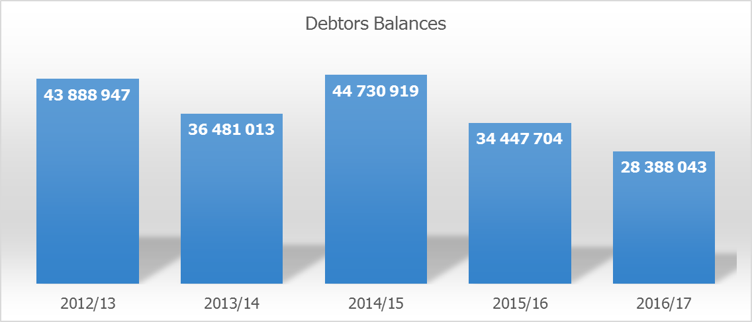
Training Trading Account Debtors
The debtors balance as at the 31 March 2017 was R28.3m. It is the lowest balance over the past 5 years. Included in the R28.3m are pre-invoiced balances amounting to R 9.9m and debt older than 1 year of R16.6m.

Slide 18
HUMAN RESOURCE OVERSIGHT

Slide 19
Vacancy Rate
The NSG has a total of 227 posts on the approved establishment for Programmes 1 & 2 with 210 posts filled, representing a vacancy rate of 7.5% by 31st March 2017.

Slide 20
Employment Equity

Slide 21
CORPORATE GOVERNANCE

Slide 22
Corporate Governance
The NSG improves corporate governance through implementing the following efforts:
Oversight meetings including the Audit, Risk and departmental management to ensure operational efficiency
Management Performance Assessment Tool (MPAT) is being closely monitored and managed in order to ensure institutional compliance. The NSG scored an outright 4 in the Key Result Area: Financial Management. Other performance indicators scored 4 (Strategic Planning, Audit Committee, Employee Health & Wellness, and Delegations)
Strategic risk assessment was adopted by the Risk Committee, the committee to continue with the monitoring of the risks implemented. The School has undertaken operational risk engagements towards the development of an operational risk register
The NSG received a CLEAN AUDIT for the Vote and UNQUALIFIED AUDIT for the Trading Account

Slide 23
Conclusion
The School achieved a successful performance with regard to training by reaching more than 64 000 learners being trained in the 2016/17 financial year
In acknowledging our performance in the financial year, we are also realistic about challenges we face within the NSG. For this reason, we are undertaking a business re-engineering of our core business functions. Our partnership with the DPSA on operations management will assist the NSG in finalising detailed business processes and standard operating procedures for all business functions
We continue with intensive work on international relations and strategic partnerships. This includes work with ENA, AMDIN and the Chinese Academy of Governance, amongst others
We continue making greater strides in engaging with the local sphere of government as well as state owned entities and aim to maintain and strengthen these relations

Slide 24
Thank you

