Slide 1
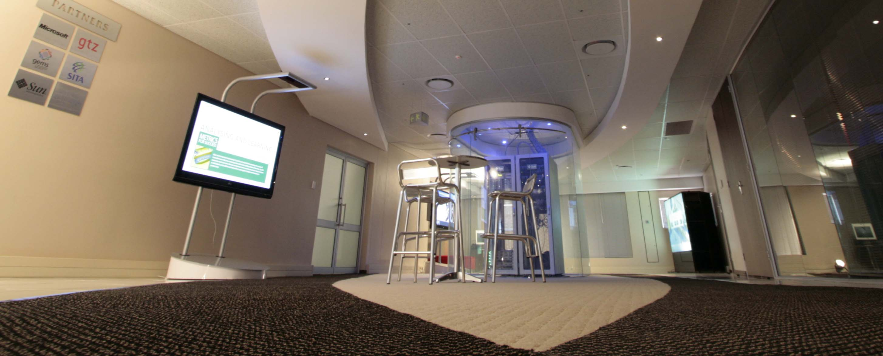


Presentation to Portfolio Committee
CENTRE FOR PUBLIC SERVICE INNOVATION
ANNUAL REPORT
(1 APRIL 2016 – 31 MARCH 2017)

Slide 2
OVERVIEW
Background
Purpose and scope of the report
Overview of the organisation’s performance for 2016/17
Achievements against strategic objectives
2016/17 targets not achieved
HR Oversight
2016/17 Expenditure outcome

Slide 3
Background
This report covers the organisation’s performance with regards to the achievement of targets as reflected in the 2016/2017 Annual Performance Plan (APP).
The report has been compiled by the executive members of the CPSI based on the analysis of the progress from the work streams.
The reported progress has been verified by the Internal Audit and Risk Management Unit and endorsed by the CPSI’s Audit and Risk Committee.
The report has been audited by the Auditor-General.

Slide 4
Purpose and scope of the report
The monitoring and reporting of the organisation's performance against its Annual Performance Plan (APP) is a requirement as per:
    Section 40(d) of the Public Finance Management Act, 1999 (Act No 1 of 1999), and
    National Treasury's Framework for Strategic and Annual Performance Plans (August 2010).
Accordingly the report has been submitted to:
    The Minister and Deputy Minister;
    The Director General of the DPSA for noting;
    The National Treasury; and
    The Department of Planning, Monitoring and Evaluation.
    The Audit and Risk Committee
    The Auditor General
This Annual Report highlights the overall performance of the organisation for 2016/17.

Slide 5
Overview of the Organisation’s Performance for 2016/ 17
Description | No of Annual Targets | Annual Targets Achieved | Annual Targets Not Achieved
Programme 1 Administration | 10 | 10 | 0
Programme 2 Public Sector Innovation | 18 | 17 | 1
Total | 28 | 27 | 1
During the 2016/17 Financial year the CPSI had 28 Targets, of which 10 were in Programme 1 and 18 in Programme 2.
As at the end of March 2017, 97% of the targets, as per the 2016/17 Annual Performance Plan, were achieved.

Slide 6
ACHIEVEMENTS AGAINST STRATEGIC OBJECTIVES Programme 1: Administration
All targets were achieved
All statutory reporting requirements were met
Relevant HR, Finance and SCM policies were implemented

Slide 7
ACHIEVEMENTS AGAINST STRATEGIC OBJECTIVES
Programme 2: Public Sector Innovation
Identification and confirmation of challenges for targeted solutions
The CPSI has investigated three service delivery challenges with the aim to identify or develop new solutions. These challenges were:
      Department of Home Affairs Service Delivery Reporting Tool: A daily reporting on various aspects of front office and back-office functionality, e.g. queues, cleanliness, working state of equipment, etc.
      Anti-Microbial Resistance (AMR) in State Hospitals: behavioural dynamics by medical practitioners that impact on the use and abuse of antibiotics leading to resistance to to the antibiotics.
  Co-ordinated Performance Reporting by public entities: Performance Management Information Reporting Tool for entities reporting to the Department of Trade and Industry.
Notes:
The details of the targets not achieved will be discussed in more detail in the next slides.

Slide 8
Programme 2: Public Sector Innovation cont’d
    Case Study Development
    During the 2016/17 financial year the CPSI developed five case studies for dissemination through the CPSI knowledge platforms and products:
    Revenue Information Management System (Gauteng Department of Transport)
    Diepsloot Community Alarm
    Foresight for Development in the SADC region (Skilling tool)
    Workplace Service Delivery of Medication
    Operation Sukuma Sakhe (Localised integrated service delivery approach)

Slide 9
ACHIEVEMENTS AGAINST STRATEGIC OBJECTIVES
Programme 2: Public Sector Innovation
Pilot, demonstrate and facilitate the replication of innovative models and solutions
Pilot projects
Bertha Gxowa Hospital Innovation Hub: The CPSI piloted a hospital based Innovation Hub to address the most persistent service delivery challenges through innovation. Some of the elements already initiated by the Hub during the 2016/17 financial year include:
        Pharmacy Improvement Project to assist the hospital to comply with sectoral National Core Standards through pharmacy optimisation on reducing waiting times.
        Patient flow System to optimise the discharge process including the creation of a dedicated discharge lounge in each ward resulting in reduced discharge times from 6 hours to less than 2 hours.
        Clinic for staff with a dedicated doctor to improve employee health and wellness and significantly reduce absenteeism.
        Recognition Awards Programme as part of entrenching the culture and practice of innovation within the hospital.
Helen Joseph Energy Efficiency Project: Development of a model to reduce the energy use in hospitals, identified as one of the major cost drivers. Introduces technical and behavioural interventions to reduce the energy consumption.
Notes:
The details of the targets not achieved will be discussed in more detail in the next slides.

Slide 10
ACHIEVEMENTS AGAINST STRATEGIC OBJECTIVES
Programme 2: Public Sector Innovation
Replication projects
The Saving Blood, Saving Lives project
  The project innovatively ensures the efficient use of blood and blood products by medical staff and thus eliminates wastage.
  In the 2016/17 financial year, this solution was subsequently replicated at various hospitals in Gauteng, namely, Bertha Gxowa Hospital where about R117 671 was saved between June 2016 and February 2017; Far East Rand hospital where R180 000 was saved between November 2016 and February 2017; and Leratong Hospital with an estimated savings of R42 000 per month since November 2016.
High Volume Cataract Project
  The CPSI facilitated the replication of the High Volume Cataract Project at Bheki Mlangeni Hospital in partnership with Chris Hani Baragwanath Hospital. This project ensures the efficient use of a theatre to double the number of cataract operations to assist in reducing a backlog of about 4000 eye operations in the Chris Hani Baragwanath Hospital.
Notes:
The details of the targets not achieved will be discussed in more detail in the next slides.

Slide 11
ACHIEVEMENTS AGAINST STRATEGIC OBJECTIVES
Programme 2: Public Sector Innovation
Schools Alarm Systems
  The CPSI further facilitated the replication of a crime prevention solution in 23 no-fee schools in Gauteng, in partnership with the provincial departments of Community Safety and Education as well as SAPS. The solution connects these schools to sector policing vehicles, police stations and Community Policing Forums (CPFs) for quicker response time to incidents of crime. In addition, three thousand five hundred (3 500) personal alarms have also been distributed to learners in these schools to help protect them from personal attacks between home and the schools.
Notes:
The details of the targets not achieved will be discussed in more detail in the next slides.

Slide 12
ACHIEVEMENTS AGAINST STRATEGIC OBJECTIVES
Programme 2: Public Sector Innovation
Innovation knowledge programmes, products and platforms
Sector-specific Workshops
The CPSI conducted four sector-specific workshops for 130 Hospital CEOs, Clinical Managers and other Health Officials in Limpopo, Mpumalanga and KZN where numerous health innovations, unearthed through the Annual Public Sector Innovation Awards Programme, were shared. The purpose of the workshops was to encourage the replication and mainstreaming of implemented public sector innovations within the Health Sector.
Furthermore, an innovation workshop was conducted for the Department of Home Affairs to continue to embed the culture and practice of innovation in the Department.
Notes:
The details of the targets not achieved will be discussed in more detail in the next slides.

Slide 13
ACHIEVEMENTS AGAINST STRATEGIC OBJECTIVES
Programme 2: Public Sector Innovation
The CPSI’s Annual Innovation Conference which draws delegates from all three spheres of government as well as the private, academic and non-governmental sectors, drew delegates from SADC countries and the People’s Republic of China in 2016. During the Ministerial Roundtable within the conference, the Minister for Public Service and Administration and Minister for Telecommunications and Postal Services engaged the delegates on the need for and the critical role of innovation in improving service delivery.
The 2016 Public Sector Innovation Awards Programme: Sixteen innovative projects were recognized and awarded for addressing service delivery challenges, including the Limpopo Provincial Treasury’s Revenue Enhancement Strategy Project which was awarded the coveted 2016 Innovator of the Year title. This project is an example of how departments can enhance revenue generation in the current dwindling equitable share.
The CPSI published two editions of Ideas that Work: The South African Public Sector Innovation Journal for public sector wide learning and replication. This Journal serves as a repository of public sector innovations and is used by many to kick-start innovations in their respective sectors as well as academic institutions in their public administration and other teaching programmes.
Notes:
The details of the targets not achieved will be discussed in more detail in the next slides.

Slide 14
ACHIEVEMENTS AGAINST STRATEGIC OBJECTIVES
Programme 2: Public Sector Innovation
Participating in regional and international innovation programmes for learning, sharing and profiling of South African innovations to strengthen good governance initiatives
In June 2016 the CPSI hosted the UNPAN Annual Capacity Building Workshop in partnership with the UNDP to enhance the participation of SADC member states in the Network and its activities relating to public sector innovation and the implementation of Sustainable Development Goals.
South Africa, through the CPSI, successfully delivered the 2016 (4th) All Africa Public Sector Innovation Awards Programme on behalf of the African Union, as part of the efforts towards achieving Agenda 2063. This culminated in a ceremony held in Addis Ababa in December 2016 to celebrate and recognise Africa’s successful public sector innovations that improve service delivery.
Notes:
The details of the targets not achieved will be discussed in more detail in the next slides.

Slide 15
2016/17 Target not achieved
During the period under review one target was not fully achieved. One service delivery challenge was investigated but no existing solutions were found, and therefore the challenge was posted on the Open IX Exchange for the development of a new solution.
Responsible unit | Target for 2016/17 as per Annual Performance Plan (APP) | Actual achievement as at 31 March 2017 | Deviation from the target | Remedial action
R&D | At least three service delivery challenges investigated and possible solutions identified | Although three service delivery challenges were investigated, potential solutions were identified for only two service delivery challenges | No potential solutions were found for one of the three challenges investigated | The challenge was posted on the Innovation Hub’s public Open IX Exchange platform for potential solutions in the 4th quarter.

Slide 16
HR OVERSIGHT
Establishment
The CPSI has 34 post on the staff establishment, 30 permanent and 4 posts additional to the establishment. There were 3 vacant posts as at 31 March 2017, all of which have since been filled in the current financial year.
Programme | Number on Establishment | Number permanent posts filled | Vacancy Rate | Number Additional to establishment posts filled
1 Administration | 18 | 16 | 11%
2 Public Sector Innovation | 16 | 15 | 6% | 4
Total | 34 | 30 | 9% | 4

Slide 17
HR OVERSIGHT (conti…)
Employment Equity
The CPSI staff employment equity is 67.65% female. The organization further exceeds the 50% target set for women in SMS (6 in number – 67.67%) and also exceeds 2% target set for disability (2 employees – 5.88%)
Programme | African Male | White Male | Total Male | African Female | White Female | Total Female
1 | 4 | - | 4 | 12 | 2 | 14
2 | 6 | 1 | 7 | 9 | - | 16
Total | 10 | 1 | 11 | 21 | 2 | 23
Disability | 2 (5.88%)
Total % | 29.41% | 2.94% | 32.35% | 61.76% | 5.88% | 67.64%

Slide 18
HR OVERSIGHT (conti…)
Performance Management
Approved PMDS Policy – implementation 1 April 2017
All employees (including ED’s) performance agreements for 2016/17 were signed before 31 May 2016.
2016/17 Annual performance assessments were finalized in September 2016.
Skills development
Employees attended training offered free of charge by National Treasury e.g. Logis, BAS and SCoA
Training needs were identified in the PDPs and these included short-term training related to areas of work.
There were no bursary requests for the 2016/17 financial year.

Slide 19
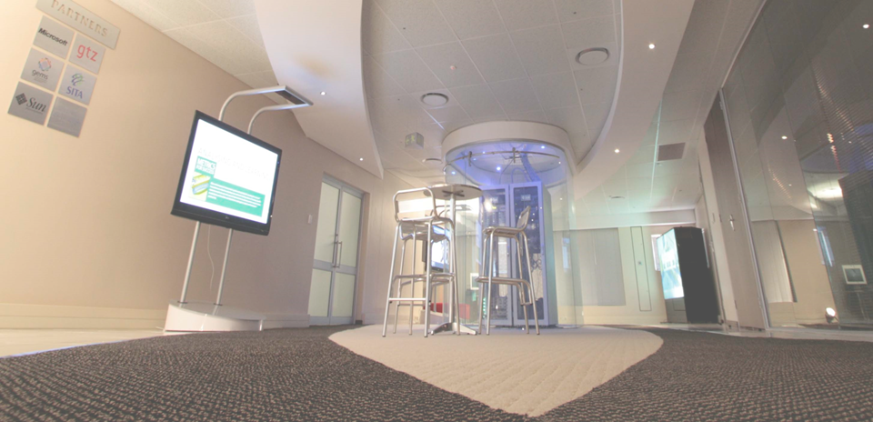
ANNUAL FINANCIAL STATEMENTS FOR THE 2016/17 FINANCIAL YEAR

Slide 20
Appropriation statement
Programme |  |  | 2016/17
 |  |  | Adjusted Appropriation R'000 | Virement | Final Appropriation R'000 | Actual Expenditure R'000 | Variance R'000 | Expenditure as % of final appropriation %
1. | Administration |  | 17 671 | 608 | 18 279 | 17 909 | 370 | 98.0%
2. | Public Sector Innovation |  | 14 423 | -608 | 13 815 | 13 498 | 317 | 97.7%
 | TOTAL |  | 32 094 | - | 32 094 | 31 407 | 687 | 97.9%
Departmental receipts |  |  |  |  | 3
Aid assistance |  |  |  |  | 7 839
Actual Revenue per Statement of Financial Performance |  |  |  |  | 39 936
Add: |  | Aid assistance |  |  |  | 3 134
Actual Expenditure per Statement of Financial Performance |  |  |  |  |  | 34 541

Slide 21
Appropriation statement
(continued)
Per Economic Classification | 2016/17
 | Adjusted Appropriation R'000 | Shifting of Funds R'000 | Final Appropriation R'000 | Actual Expenditure R'000 | Variance R'000 | Expenditure as % of final appropriation %
Current payments | 32 025 | -2 268 | 29 757 | 29 127 | 630 | 97.9%
Compensation of employees | 16 792 | -912 | 15 880 | 15 593 | 287 | 98.2%
Goods and services | 15 233 | -1 356 | 13 877 | 13 534 | 343 | 97.5%
Transfers and subsidies | - | 1 | 1 | 1 | - | 100.0%
Departmental agencies and accounts | - | - | - | - | - | 0.0%
Payments for capital assets | 69 | 2 267 | 2 336 | 2 279 | 57 | 97.6%
Buildings and other fixed structures | - | 806 | 806 | 806 | - | 100.0%
Machinery and equipment | 69 | 1 265 | 1 334 | 1 277 | 57 | 95.7%
Software and other intangible assets | - | 196 | 196 | 196 | - | 100.0%
TOTAL | 32 094 | - | 32 094 | 31 407 | 687 | 97.9%

Slide 22
Appropriation statement
(continued)
Description | 2016/17
 | Adjusted Appropriation R'000 | Shifting of Funds R'000 | Virement R'000 | Final Appropriation R'000 | Actual Expenditure R'000 | Variance R'000 | Expenditure as % of final appropriation %
Strategic Management | 3 703 | 20 | - | 3 723 | 3 698 | 25 | 99.3%
Corporate Resource Management | 7 664 | 1 418 | 608 | 9 690 | 9 583 | 107 | 98.9%
Office of the Chief Financial Officer | 6 304 | -1 438 | - | 4 866 | 4 628 | 238 | 95.1%
PROGRAMME 1: ADMINISTRATION | 17 671 | - | 608 | 18 279 | 17 909 | 370 | 98.0%
Research and Development | 3 030 | -317 | - | 2 713 | 2 493 | 220 | 91.9%
Solution Support and Incubation | 3 928 | 121 | -608 | 3 441 | 3 420 | 21 | 99.4%
Enabling Environment | 7 465 | 196 | - | 7 661 | 7 585 | 76 | 99.0%
PROGRAMME 2: PUBLIC SECTOR INNOVATION | 14 423 | - | -608 | 13 815 | 13 498 | 317 | 97.7%
Total | 32 094 | - | - | 32 094 | 31 407 | 687 | 97.9%

Slide 23
Appropriation statement (continued)
Programme 1: Administration
During the 2016/17 financial year, the CPSI had one vacant post; Deputy Director: Financial Management and Administration on salary 11, which resulted in underspending of R241 000 in the year under review. The process to fill the post was at an advanced stage at the end of the 2016/17 financial year, and filled in the 2017/18 financial year. An amount of R72 000 was unspent at year end, due to uniforms which were ordered for security and cleaning personnel but not delivered by 31 March 2017. These were only delivered and paid for in April 2017.
Programme 2: Public Sector Innovation
The budgeted payment to The Innovation Hub could not be processed, because the process of identifying and developing a possible solution for the Department of Home Affairs’ posted challenge was not concluded. In addition, the banking details of one supplier were not verified on the National Treasury’s Central Supplier Database by 31 March 2017, which resulted in the payment being made in April 2017. These mainly resulted in an underspending in Programme 2: Public Service Innovation.

Slide 24
Statement of Financial Performance
Description | Note | 2016/17 R'000
Annual appropriation | 1 | 32 094
Departmental revenue | 2 | 3
Aid assistance | 3 | 7 839
TOTAL REVENUE |  | 39 936
EXPENDITURE
Compensation of employees | 4 | 15 593
Goods and services | 5 | 13 534
Aid assistance | 3 | 3 134
Total current expenditure |  | 32 261
Transfers and subsidies | 6 | 1
Total transfers and subsidies |  | 1
Tangible assets | 7 | 2 083
Intangible assets | 7 | 196
Total expenditure for capital assets |  | 2 279
TOTAL EXPENDITURE |  | 34 541
SURPLUS FOR THE YEAR |  | 5 395
Reconciliation of Net Surplus for the year
Voted Funds |  | 687
Departmental revenue and NRF Receipts | 2 | 3
Aid assistance | 3 | 4 705
SURPLUS FOR THE YEAR |  | 5 395

Slide 25
Statement of Financial position
Statement of Financial position | Note | 2016/17 R'000
ASSETS
Current Assets |  | 5 398
Unauthorised expenditure | 11 | -
Cash and cash equivalents | 8 | 4 718
Prepayments and advances | 9 | 670
Receivables | 15 | 10
TOTAL ASSETS |  | 5 398
LIABILITIES
Current Liabilities |  | 5 398
Voted funds to be surrendered to the Revenue Fund | 11 | 687
Departmental revenue and NRF Receipts to be surrendered to the Revenue Fund | 12 | -
Payables | 13 | 6
Aid assistance unutilised | 3 | 4 705
TOTAL LIABILITIES |  | 5 398

Slide 26
Cash flow statement
Cash flow Statement | Notes | 2016/17 R'000
CASH FLOWS FROM OPERATING ACTIVITIES
Receipts |  | 39 936
Annual appropriated funds received | 1 | 32 094
Departmental revenue received | 2 | 3
Aid assistance received | 3 | 7 839
Net (increase)/ decrease in working capital |  | -714
Surrendered to Revenue Fund |  | -951
Surrendered to RDP Fund/Donor |  | -459
Current payments |  | -32 261
Transfers and subsidies paid |  | -1
Net cash flow available from operating activities | 14 | 5 550
CASH FLOWS FROM INVESTING ACTIVITIES
Payments for capital assets | 7 | -2 279
Net cash flows from investing activities |  | -2 279
CASH FLOWS FROM FINANCING ACTIVITIES
Net cash flows from financing activities |  | -
Net increase in cash and cash equivalents |  | 3 271
Cash and cash equivalents at beginning of period |  | 1 447
Cash and cash equivalents at end of period | 15 | 4 718

Slide 27
30 day payments
All Payments were made within 5.2 days of receipt of an invoice.
467 payments were processed over the 2016/17 financial year

Slide 28
AUDIT OUTCOME
The CPSI has achieved an unqualified audit outcome for the 2016/17 financial year. The audit outcome has regressed in comparison with that of the previous financial year.
The change from an unqualified audit opinion with no findings to a unqualified audit opinion with findings is due to challenges in internal control over monitoring of compliance with applicable laws and regulations in supply chain and contract management. This resulted in the following irregular expenditure:
  R63 000 due to non-compliance to the Preferential Procurement Regulations 2011 par 7.1; and
  R105 00 due to non-compliance to National Treasury SCM instruction not 3 of 2016/17

Slide 29
THANK YOU

