Slide 1
The Compensation Commissioner for Occupational Diseases (CCOD)
Presentation to Portfolio Committee on Health
Performance Update
10 October 2017
Slide 1

Slide 2
Highlights (2016/17)
  Increased benefit medical examinations (+21%) – 18 145 / 15 000*
  Increased certifications (+101%) – 20 149 / 10 000*
  Increased payments of claims (+60%) – 5 296 / 3 300*
  Increased inspections of mines (+58%) – 79 / 50*
  Increased outreach activities (+170%) – 27/10*
  Revenue from levies increased by 5% - R15m
  2 270 ex-mineworkers seen at Carletonville & Mthatha One Stop Service Centres
  2010/11 Annual Report & Audited Financial Statement – Disclaimer
  2011/12 Annual Report & Audited Financial Statement – Qualification on Revenue
  Raised profile of compensation / social protection reforms in national and international forums including Southern Africa Development Community
* Target for 2016/17

Slide 3
2016/17 Annual Performance Plan
Integration of Compensation Systems
Provision of decentralised services for current & ex-mineworkers
Effective and efficient management of the Compensation Fund
  Electronic database
  Increase in payment of claims
  Submit annual reports and financial statements

Slide 4
External Environment
Continued support of the Chamber of Mines, Gold Mining Companies and trade unions
Links with Department of Planning, Monitoring and Evaluation in Presidency and Department of Mineral Resources
Support of provincial Departments of Health
Support of social partners (World Bank, Global Fund, United Kingdom Agency for International Development)

Slide 5
Internal Environment
Disruptions to work by organised labour
Lack of support for reforms despite engagement
Declining budget
Inadequate infrastructure (outdated information technology, medical equipment)
Need for human resources (financial management, public health, radiology, information technology and legal)

Slide 6
Integration of Compensation Systems
Process led by Deputy Minister of Mineral Resources
5 task teams
  Policy & legislation
  Organisation & management
  Services
  Financing
  Communication
Summit held in May 2016
Report to Ministers of Health & Labour in October 2016

Slide 7
Integration of Compensation Systems
Approach of Department of Labour was that integration is not possible at this stage owing to the backlogs in the Compensation Fund (financial statements etc)
Trade unions wanted reforms to the Compensation for Occupational Injuries and Diseases Act (COIDA)
Commissioner introduced the ‘clean break’ principle of new workers only becoming part of COIDA

Slide 8
Legislation changes
Policy & legislative changes to Occupational Diseases in Mines and Works Act, 1973 (ODMWA)
  Engaged with employer groups, trade unions & other government departments
  In principle
    New workers in mines and works sector to be under Compensation for Occupational Injuries and Diseases Act (COIDA) in Department of Labour
    Ex-workers and current workers under ODMWA
    Governance model of a ring-fenced entity
    Levies to contribute to administration costs and benefits

Slide 9
Governance
6 Audit & Risk Committee meetings
4 Advisory Committee meetings
8 Management Committee meetings
Slide 9

Slide 10
Service Delivery
Planning of One Stop Service Centres in Kuruman and Burgersfort complete
  The centres are now being constructed and will open later this year
One Stop Service Centre opened in Mafiteng in Lesotho
Mobile health services were conducted in 6 districts in the Eastern Cape, 1 in Northern Cape, 1 in Mpumalanga, 1 each in Botswana, Lesotho, Mozambique & Swaziland
60 000 ex-mineworker or beneficiaries reached
Slide 10

Slide 11
Administration
Database of ex-workers
  Web based
  Linked to the TEBA database
  Pilot link to 4 mining companies for current workers
  Link to multiple databases
Payments
  Link with banks for improved access of ex-workers to financial services
  Link with Banking Association
  Automation of calculation of claim
Geo-locator mapping
Slide 11

Slide 12
Geo-locator Mapping
Mapped mines, mineworkers and health services
Innovative approach to tracking & tracing ex-workers
Slide 12

Slide 13
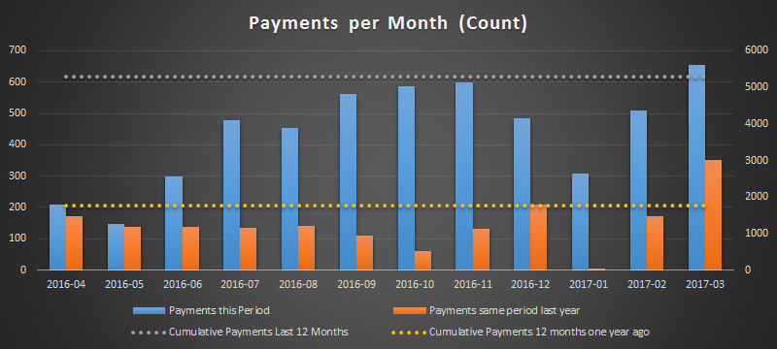
Compensation Payments (2016/17)
Slide 13

Slide 14
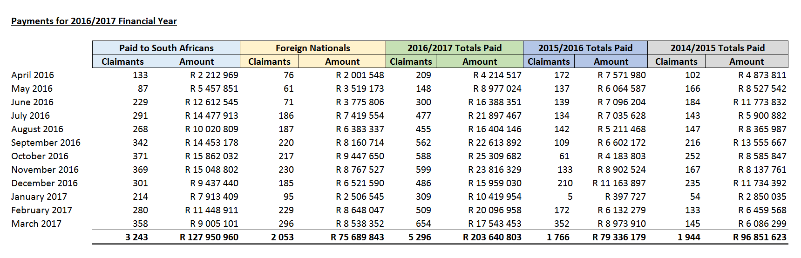
Comparative Payments (2014/15 – 2016/17)

Slide 15
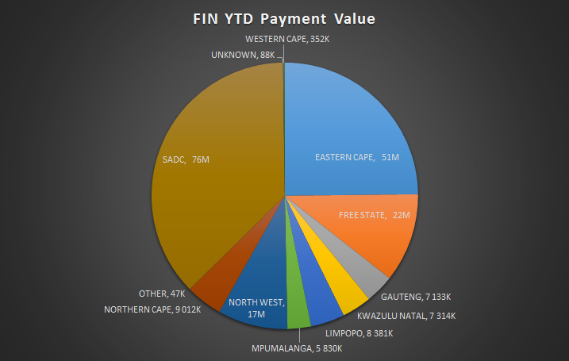
Payments per Region/Province (2016/17)
Slide 15

Slide 16
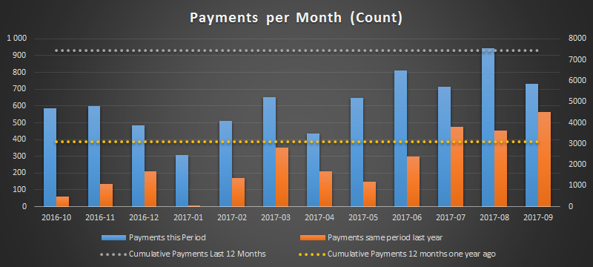
Compensation Payments (Sept 2017)
10 113 payments have been made since the commencement of tracking and tracing (February 2016) with a value of R332.6m
Slide 16

Slide 17
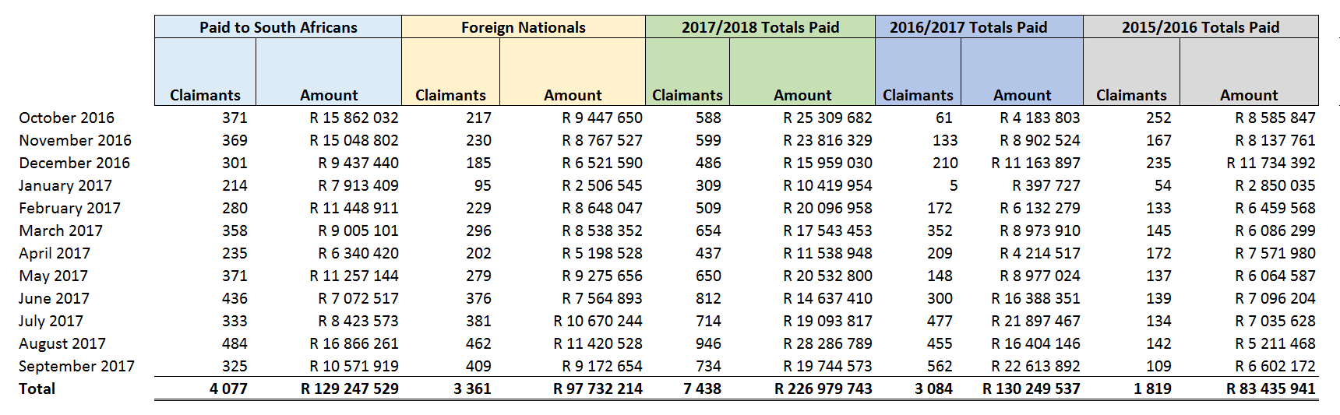
Comparative Payments (Sept 2017)

Slide 18
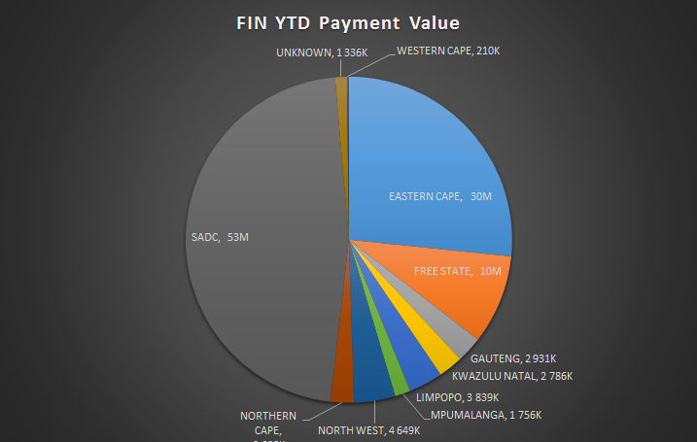
Payments per Region/Province (Sept 2017)
Slide 18

Slide 19
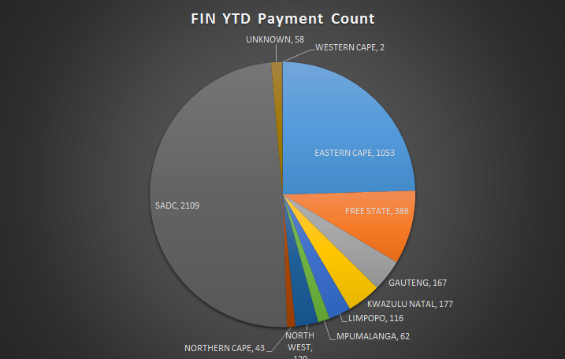
Payments per Region/Province (Sept 2017)
Slide 19

Slide 20
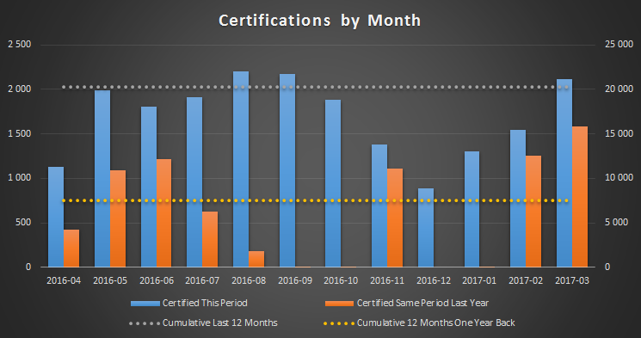
Certifications
Slide 20

Slide 21
Revenue
72% in 2016/17 (64% in 2015/16) of mines and works paid levies
Emphasis on completeness of register of controlled mines and works
Followed by the process of verifying controlled mine or work through inspections / triangulation with other databases
Inspections of risk shifts and levies
Levy workshop held

Slide 22
Financial
Actuarial valuation finalised
Financial statements
  2010/11 & 2011/12 signed off by Auditor-General of South Africa
  2010/11 – Disclaimer
  2011/12 – Qualification on Revenue
Above annual reports / audited financial statements awaiting printing at Government Printer

Slide 23
Financial Update
Actuarial valuation data (as at 31 March 2017) being prepared
Financial statements
  2012/13 processing completed
    Responding to audit queries
    Accounting Officer’s report prepared
  2013/14 processing completed
    Responding to audit queries
    Annual Financial Statements prepared on GRAP template
    Accounting Officer’s report prepared

Slide 24
Revenue Update
Special team led by Deputy Commissioner
Finalise register of controlled mines and works (Sept 17)
Verification of mines & works covering 80% of revenue
Accounting system code assigned | 327
Accounting system code assigned: gazette outstanding | 10
Accounting system code assigned: some action/info outstanding | 29
Closed - confirmed | 498
Controlled - not submitting | 14
Inspection/investigation required | 103
Inspectors currently investigating | 16
Submitting, no Pastel code | 5
Grand Total | 1002

Slide 25
Going Forward
7 One Stop Service Centres in neighbouring countries
Electronic link with the One Stop Service Centres
Capacity building initiatives with the Global Fund and New Partnership for Africa’s Development (NEPAD)
Study visits to learn and share with multilateral agencies and countries with extensive mining sector
Scientific workshop
  Timing of medical assessments
  Operational efficiency / claims management

Slide 26
Acknowledgement
Substantive financial, technical and operational input by Chamber of Mines, Gold Mining Companies & social partners
Final stages of a possible out-of-court settlement on the class action
  Complementary to the certification process and payment process of the Compensation Fund
Meetings of Minister with the stakeholders
Interactions with provincial departments, national departments and neighbouring country governments
Partnerships with non-governmental organisations
Engagement with trade unions, ex-mineworker associations and traditional leaders

Slide 27
Thank You
Dr Barry Kistnasamy Compensation Commissioner Department of Health kistnb@health.gov.za +27 11 356 5602 +27 72 220 0247
Slide 27

