Slide 1
Portfolio Committee
for Human Settlements
5th October 2017
2016/2017
ESTATE AGENCY AFFAIRS BOARD
ANNUAL REPORT
PRESENTATION

Slide 2
PRESENTATION STRUCTURE
OPENING REMARKS, HIGHLIGHTS AND OVERVIEW
OPERATIONAL AND PERFORMANCE REVIEW
FINANCIAL PERFORMANCE
CLOSING REMARKS

Slide 3
OPERATIONAL AND
PERFORMANCE OVERVIEW
Mr. Nikita Sigaba
(Acting Chief Executive Officer)

Slide 4
Chief Executive Officer’s Report
Property sector in general and the estate agency environment;
Growth in the secondary residential market;
Professionalisation of the real estate sector and Continuing Professional Education;
Consumer awareness campaigns and workshops;
Privyseal certification and authentication programme;
One Learner- One Estate Agency Youth Brigade Empowerment Programme;

Slide 5
Chief Executive Officer’s Report Cont/…
Acts of racism, discrimination and intolerance and the Equality Pledge;
The title deeds restoration programme;
Legislative review;
Registrations and renewals of Fidelity Fund Certificates;
Education and Training;
Disciplinary enquiries;

Slide 6
REMEDIAL ACTION PLANS - GOVERNANCE AUDIT FINDINGS
No | Audit Matter Raised | Management response
1. | Some signed minutes of board and sub-committee meetings not made available to auditors
2. | Resignation of three independent Audit and Risk Committee members after year end. | The resignations did not occur in the financial reporting period under review. No reasons were provided. The positions have since been advertised and the process of filling the vacancies is underway
3. | Non-independent Audit Committee members performed management functions as part of their Section 8A Committee duties from February 2017. | During the financial reporting period, the majority of members of the Audit and Risk Committee were independent. The resignations of the independent Audit and Risk Committee members only occurred after the financial year end. The CEO and CFO were also in attendance during the Audit and Risk Committee meetings
4. | Those charged with governance procured certain forensic professional services above R500 000 without following the competitive bidding process. Deviations were approved by the Section 8A Committee even though it was not impractical to invite competitive bids. | The matter was deemed to be urgent due to ongoing and unknown losses on the suspense accounts. The approval to deviate was based on a motivation by the Company Secretary as per the requirements of the PFMA.
Total board and committee meetings held | 28
Approved and signed minutes – submitted to auditors | 18
Draft minutes awaiting sitting of next meeting – submitted to auditors | 10

Slide 7
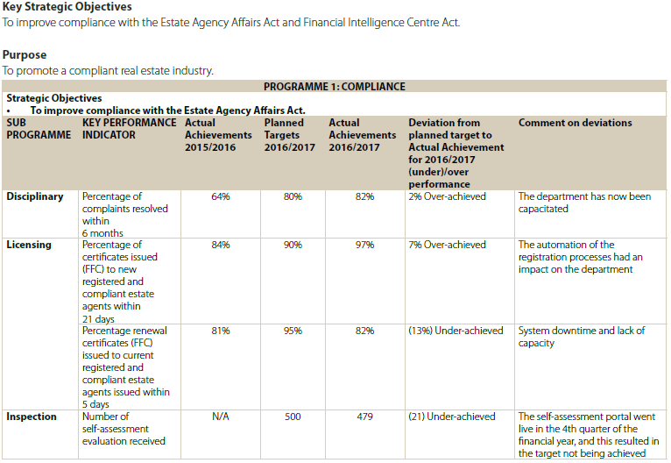
PERFORMACE AGAINST TARGETS IN THE ANNUAL PERFORMANCE PLAN - COMPLIANCE

Slide 8
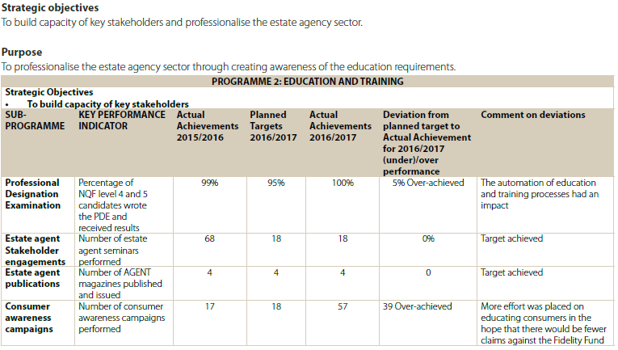
PERFORMACE AGAINST TARGETS IN THE ANNUAL PERFORMANCE PLAN – EDUCATION AND TRAINING

Slide 9
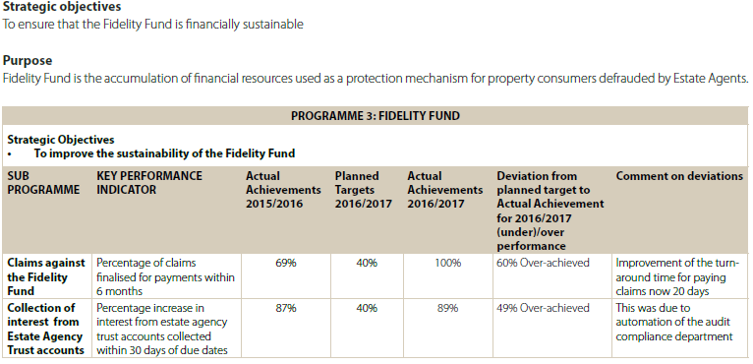
PERFORMACE AGAINST TARGETS IN THE ANNUAL PERFORMANCE PLAN – FIDELITY FUND

Slide 10
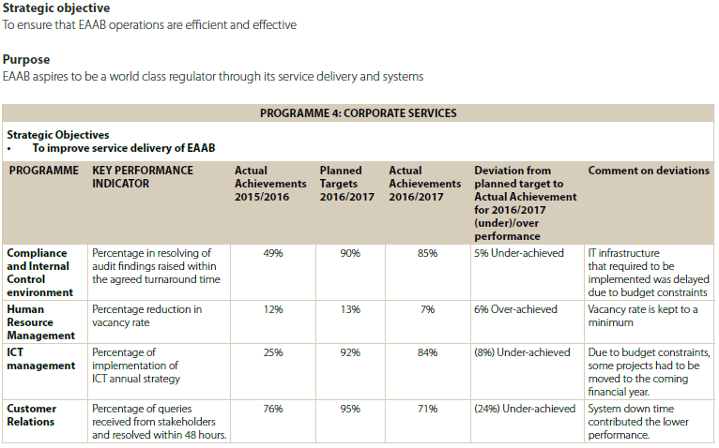
PERFORMACE AGAINST TARGETS IN THE ANNUAL PERFORMANCE PLAN – CORPORATE SERVICES

Slide 11
REMEDIAL ACTION PLANS - PERFORMANCE INFORMATION AUDIT FINDINGS
No | Audit Matter Raised | Root cause of audit finding | Remedial action to be implemented
1. | Some of the Key Performance Indicators were found to be not measurable Turnaround times for processing of claims and complaints | Some technical indicators were not measurable/available and some process descriptions were not adequately documented | All technical indicators are being reviewed for measurability of the key performance indicators. Process descriptions are also being updated to augment the technical indicators in achieving measurability.

Slide 12
REGISTRATIONS OF ESTATE AGENTS

Slide 13
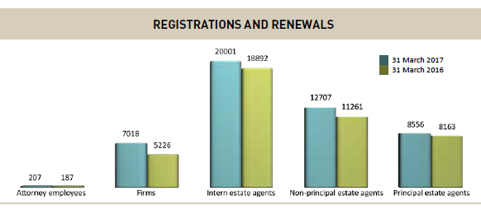

Slide 14
FIDELITY FUND CERTIFICATES BY - GENDER
The numbers relating to the gender of registered estate agents for the 2016/2017 financial year are indicated in the graph below.
 | 31 March 2017 | 31 March 2016
Male | 17 631 | 16 675
Female | 23 610 | 21 828
Total | 41 241 | 38 503

Slide 15
FIDELITY FUND CERTIFICATE – BY RACE
The racial distribution of registered estate agents for the 2016/2017 financial year is indicated below:
 | 31 March 2017 | 31 March 2016
African | 4 140 | 3 944
Coloured | 1 407 | 781
Indian | 1 853 | 1 984
White | 33 841 | 31 794
Total | 41 241 | 38 503

Slide 16
INVESTIGATIONS OF COMPLAINTS AGAINST ESTATE AGENTS

Slide 17
COMPLIANCE Cont/…
 | 31 March 2017 | 31 March 2016
Opening balance | 659 | 736
Complaints received | 6 529 | 4 821
Complaints investigated & finalised | 6 857 | 3 131
Pending finalisation | 331 | 659

Slide 18
Disciplinary Hearings
 | 31 March 2017 | 31 March 2016
Cases enrolled | 213 | 167
Convictions | 115 | 67
Acquittals | 39 | 23
Postponed/ withdrawn | 56 | 32
Appeals | 3 | 1

Slide 19
INSPECTIONS AND SELF-ASSESSMENTS

Slide 20
INSPECTIONS
 | Province | 31 March 2017 | 31 March 2016
1 | Eastern Cape | 2 | 20
2 | Free State | 8 | 22
3 | Gauteng | 22 | 211
4 | KwaZulu Natal | 9 | 69
5 | Limpopo | 3 | 22
6 | Mpumalanga | - | 18
7 | North West | 6 | 13
8 | Northern Cape | - | 6
9 | Western Cape | 13 | 93
 | TOTAL | 63 | 474

Slide 21
Self-assessment of Compliance
Principals of estate agencies were selected to complete the self-assessment of compliance electronic questionnaire, which was made available on the MyEAAB Agents Portal on the EAAB website.
Province | 31 March 2017
Eastern Cape | 39
Free State | 15
Gauteng | 178
KwaZulu Natal | 61
Limpopo | 7
Mpumalanga | 6
Northwest | 5
Northern Cape | 7
Western Cape | 161
TOTAL | 479

Slide 22
CONTRIBUTION TO MEDIUM TERM STRATEGIC FRAMEWORK (MTSF)
TARGETS

Slide 23
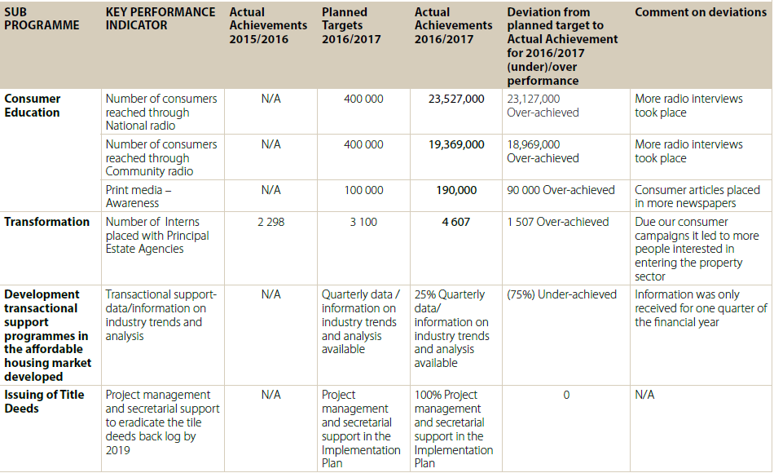
MTSF TARGETS

Slide 24
REMEDIAL ACTION PLAN - MTSF TARGETS AUDIT FINDINGS
No | Audit Matter Raised | Root cause of audit finding | Remedial action to be implemented
1. | Some of the Key Performance Indicators were found to be not measurable Listenership Transactional support data | All MTSF targets established and set by DHS. Some technical indicators were not measurable/available and some process descriptions were not adequately documented | All technical indicators are being reviewed for measurability of the key performance indicators. Process descriptions are also being updated to augment the technical indicators in achieving measurability.
2. | Insufficiency and inadequacy of evidence provided to support some achieved targets Readerships Project management Intern placement | The supporting documentation was not aligned to the technical indicators and process descriptions

Slide 25
FINANCIAL PERFORMANCE OVERVIEW
Mr. Thomas Makupo
(EAAB Acting Chief Financial Officer)

Slide 26
Estate Agency Affairs Board
ANNUAL REPORT AND
FINANCIAL STATEMENTS - 2016/2017

Slide 27
REMEDIAL ACTION PLANS - FINANCIAL INFORMATION AUDIT FINDINGS
No | Audit Matter Raised | Impact on audit report | Root cause of audit finding | Remedial action to be implemented
1. | Examination revenue not recognised in terms of GRAP 9 | Basis of qualified opinion | IT System Configuration – The system was configured to allocate a examination seat number, raise an invoice on completion of the online enrolment and payment of examination fees | The system configurations are currently being amended to ensure the recognition of examination revenue on the date when candidates sit for the examinations or when the candidate do not sit for the examination without an acceptable valid reason.
2. | Accuracy and completeness of revenue from fidelity fund certificates raised as an audit finding as a result of duplicate estate agent profiles found during an applications control audit | Basis of qualified opinion | The IT Configuration on matching of ID Numbers did not work as intended in that a few duplicate estate agent profiles were identified | The duplicate estate agent profiles, although only few were identified, brought into question the data integrity. The implementation of recommendation on the IT application controls and matching of ID numbers is currently in progress and will eliminate the future creation of duplicate profiles. The resolution of the duplicate estate agent profiles already identified has been finalised.

Slide 28
REMEDIAL ACTION PLANS - FINANCIAL INFORMATION AUDIT FINDINGS
No | Audit Matter Raised | Impact on audit report | Root cause of audit finding | Remedial action to be implemented
3. | Classification of unallocated receipts as a result of long outstanding receipts received without reference numbers | Basis of qualified opinion | Deposits into the EAAB account were made by estate agents without using the unique seven digit reference number allocated to them | The bank is in the process of recognising EAAB as a beneficiary, with relevant fields for references restricted to the seven digit reference. This will completely eliminate deposits without reference numbers which will end up in unallocated receipts. Implementations of recommendations arising from the audit of the suspense accounts

Slide 29
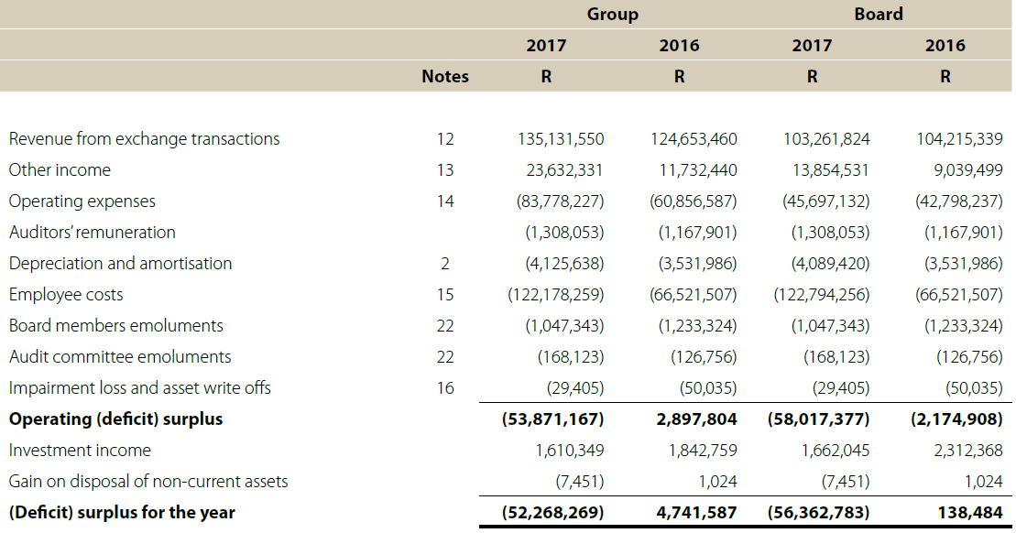
FINANCIAL PERFORMANCE

Slide 30
REASONS FOR SIGNIFICANT DEFICIT INCURRED
Accounting deficit of R38 million arising from the transfer of 45 employees from defined benefit pension plan to defined contribution pension plan – the deficit represented the difference between the pension fund obligation determined on a prescribed basis and the conversion credits awarded to the 45 employees on conversion.
Over-budgeting of revenue of R12 million – it was initially assumed that all estate agency firms will pay the R1 200 renewal fee, but to promote transformation in the sector, firms with revenue below R2,5 million were eventually exempted when the new regulations were published.

Slide 31
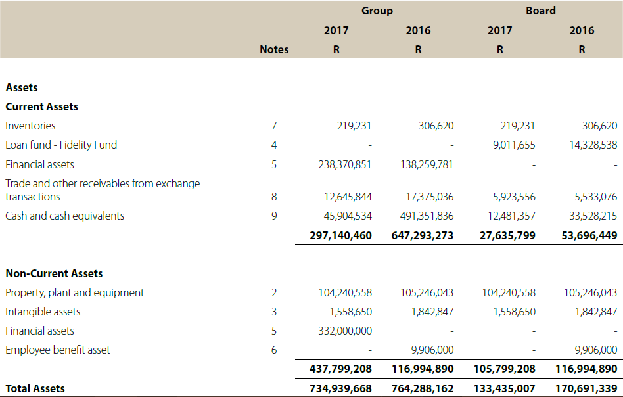
FINANCIAL POSITION - ASSETS
Notes:
Remove the Note numbers

Slide 32
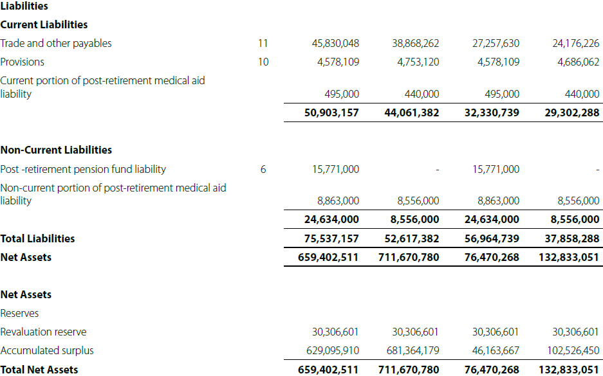
FINANCIAL POSITION – LIABILITIES & RESERVES

Slide 33
THANK YOU

