Slide 1
Annual Report 2016/17
Portfolio Committee on Human Settlements
04 October 2017

Slide 2
Presentation Contents
Opening remarks, Highlights and Overview : Rev. Dr. Vukile Mehana (Board Chair)
Performance Information : Adv. Seeng Letele (Chief Ombud)
Financial Performance : Themba Mabuya (CFO)
Future Operational Outlook : Adv. Seeng Letele (Chief Ombud)
Closing Remarks : Rev. Dr. Vukile Mehana (Board Chair)

Slide 3
1. Opening Remarks, Highlights and Overview
Rev. Dr. V. Mehana
Board Chairperson

Slide 4
Highlights for the year
Promulgation of the CSOS Act and Sectional Titles Schemes Management Act
(7th October 2016) meant the CSOS could:
Fully regulate the Community Schemes industry; and
Execute its full mandate of Dispute Resolution services.
CSOS officially Launched on 10th November 2016
Operational Highlights:
Commenced with the registration of Community Schemes (9th January 2017);
Commenced with the Adjudication of disputes;
Commenced with Schemes Governance Documentation Services; and
Collected the first CSOS Levy in the last quarter of the year to the amount of R30.3M

Slide 5
2. Performance Information:
Adv. Seeng Letele
Chief Ombud

Slide 6
Adjudication and Governance (p. 20 – 26)
As a result of the publication and proclamation of the Acts (7 Oct 16):
Registration of schemes commenced – 30 days from date of publication
Filing of Schemes Governance Documentation commenced – 90 Days from date of publication
CSOS Levies collected- 90 Days from date of publication
In terms of CSOS Act and the Regulations, all community schemes must pay CSOS on a quarterly basis a levy collected from unit owners as prescribed
CSOS received 1282 new applications for dispute for the year under review with a drastic increase following the proclamation of the ACTS (p. 20)
285 applications for dispute were resolved through conciliation with 141 referred to adjudication (1 Adjudication Order)
7434 Community Schemes were registered in the period under review from 25 000 initial applications received (having commenced on 9th January 2017)
208 Certificates were issued in relation to schemes governance documentation quality assurance

Slide 7
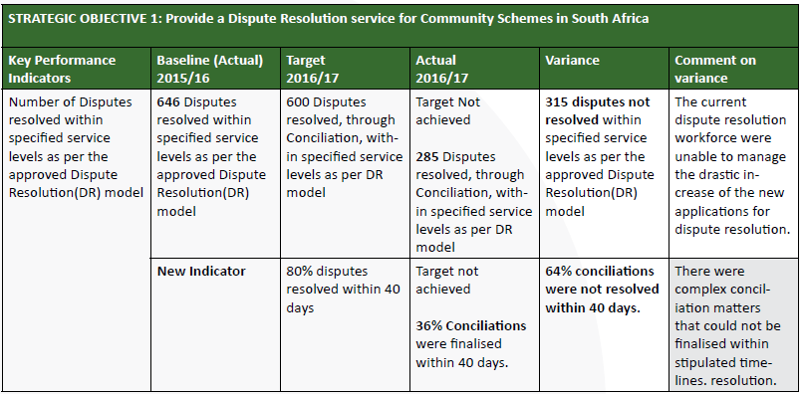
Performance Information – Strategic Objectives (p.24 - 26)
SO 1: RESOLVED COMMUNITY SCHEMES DISPUTES

Slide 8
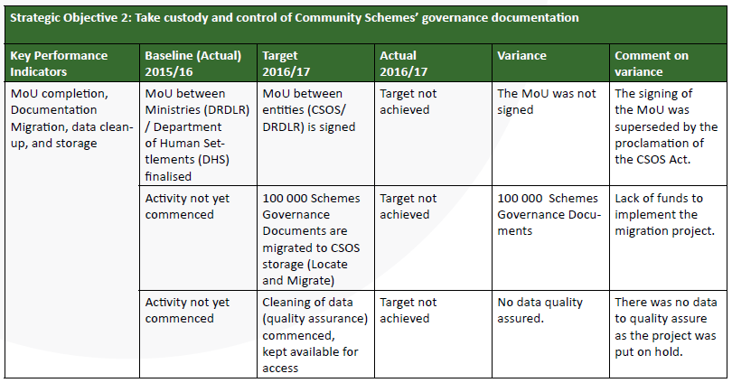
Performance Information – Strategic Objectives (p.24 - 26)
SO 2: TAKE CUSTODY AND CONTROL OF COMMUNITY SCHEMES GOVERNANCE DOCUMENTATION

Slide 9
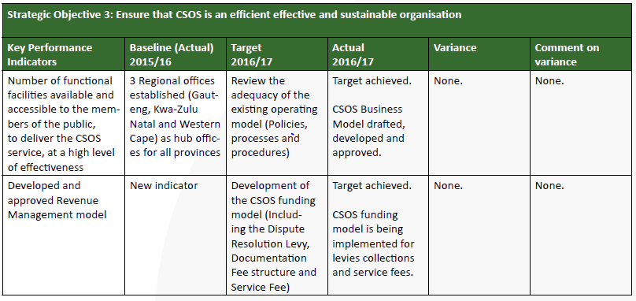
Performance Information – Strategic Objectives (p.24 - 26)
SO 3: ENSURE THAT CSOS IS MANAGED IN AND EFFICIENT AND EFFECTIVE MANNER

Slide 10
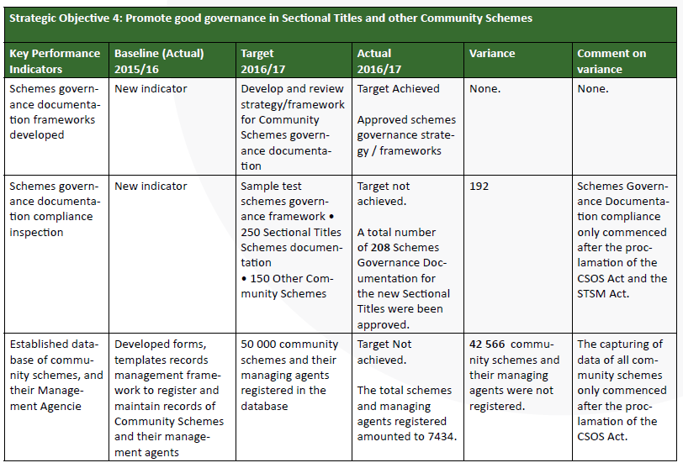
Performance Information – Strategic Objectives (p.24 - 26)
SO 4: Promote good governance in Sectional Titles and other Community Schemes

Slide 11
Performance Information – Strategic Objectives (p.24 - 26)
SO 5: Provide stakeholder training consumer education and public outreach programmes on Community
Schemes in South Africa
The reasons leading to targets not being met were mainly:
Budgetary constraints as the organization has not yet operationalized in relation to the collection of levies as planned and budgeted
Process and policy issues relating to the legal requirements to operationalize (Proclamation of ACTS and Regulations)
Legal frameworks still being implemented (Agreements between departments)

Slide 12
Future Operational Outlook
2018 – 2019 financial year
Implementation of Revenue Management Systems (SARS)
Capacitation - HR
Implementation of revised 2017/18 APP recently approved
Expansion of the operations into more Regions and Provinces, based on demand
Increasing income generation capabilities allow for improved scale and profile of the CSOS
Extensive Education and Training programmes in Community Schemes, and in the public domain
Deployment of applications and systems to ensure efficiency and build of industry trust

Slide 13
3. Financial Performance
Themba Mabuya
Chief Financial Officer

Slide 14
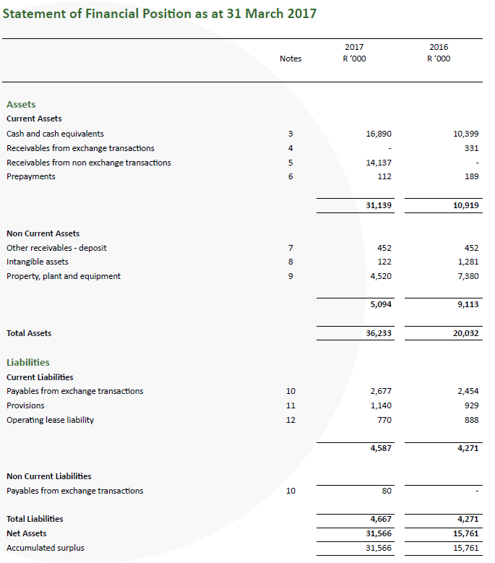
Annual Financial Statements

Slide 15
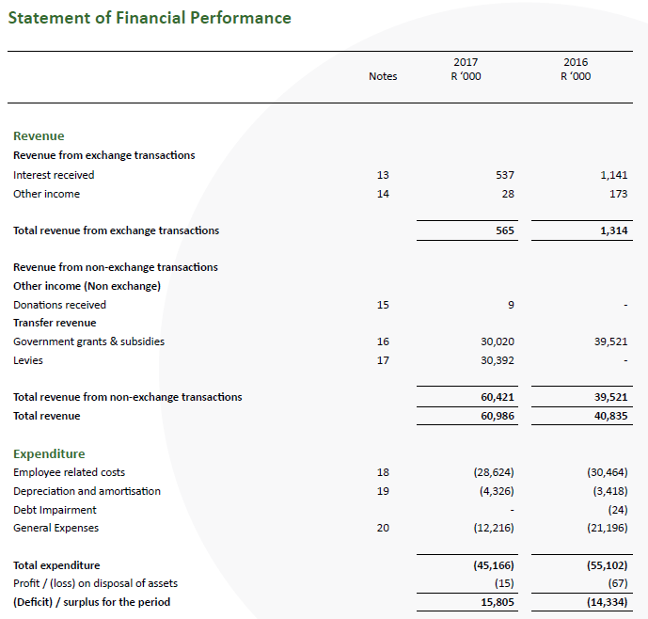
Annual Financial Statements (continued)

Slide 16
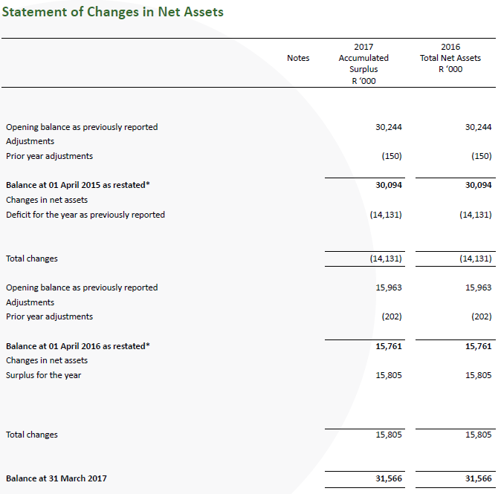
Annual Financial Statements (continued)

Slide 17
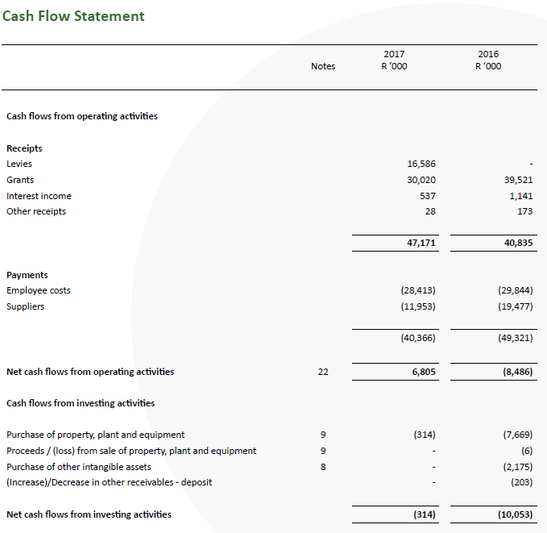
Annual Financial Statements (continued)

Slide 18
Remedial Audit Plan
FINDINGS | ACTION | TIME FRAME | PROGRESS | RESPONSIBLE PERSON
1. Non-exchange revenue and related receivables (No appropriate systems and processes in place) | Agreement with SARS to use ICT platform, database of community schemes, and collection. Ensure all systems are in place thru SARS engagement as an interim solution. Fast-track the registration process of community schemes. Ensure adequate financial resources are in place for future purchases of off-the-shelve collection system. | 31 March 2018 | Due to enter into an MOU. +/-30k registered community schemes. In the interim, make use of O S Holdings billing systems for production of statements | Acting Chief Ombud & CFO

Slide 19
Remedial Audit Plan Cont.
FINDINGS | ACTION | TIMEFRAME | PROGRESS | RESPONSIBLE PERSON
2. Contingent Liability (Non-disclosure of Accumulated Surplus) | Application to retain funds made to Treasury | Completed | Waiting for approval from Treasury thru dept. | Acting Chief Ombud & CFO
3. Irregular Expenditure (Actual expenditure exceeds approved budgeted expenditure) | CSOS has budgeted sufficiently to equally meet its short-term obligations. Implementation of systems is ongoing to collect levies. | Approved budget for 2017/18 under implementation. CSOS has begun collecting levies. | Budget for 2017/18 approved & Implemented. CSOS has started collecting levies. Working capital and liquidity have drastically improved. | Acting Chief Ombud & CFO

Slide 20
Remedial Audit Plan Cont.
FINDINGS | ACTION | TIMEFRAME | PROGRESS | RESPONSIBLE PERSON
4.Fruitless & Wasteful Expenditure (Effective steps not taken to prevent the expenditure of R20k) | A register on fruitless & wasteful expenditure will be compiled and control measures implemented. The amount entailed penalty fees incurred for flight changes from travel agency. Employees and Board Members will cautioned against cancelling flight and missing flight and for them to do proper travel planning. | 31 March 2018 | The implementation plan to commence as on 1 October 2017. | CFO

Slide 21
Remedial Audit Plan Cont.
FINDINGS | ACTION | TIMEFRAME | PROGRESS | RESPONSIBLE PERSON
5. Capacity (The Accounting Authority did not implement effective human resource management to ensure that adequate and sufficiently skilled resources were in place) | CSOS has already reinforced some of its business units since April 2017. For example: appointment of: two senior accountants 30 Part-Time Adjudicators (3 provinces) 18 interns The dept. has seconded nine officials to CSOS Positions of Chief Audit Executive, Legal Executive and Adjudicator-General have been advertised. CSOS has ensured that sufficient budget has been provided to improve capacity challenges. Additional vacancies to be filled in the 2018/19 financial year | 31 March 2018 | Two senior accountants appointed and will resume duties in November 2017. Part-Time Adjudicators and interns appointed and fully operational. Secondees from the dept. fully operational. Shortlisting of Chief Audit Executive, Legal Executive and Adjudicator-General in progress. Budget has been provided for the above appointments. | Acting Chief Ombud

Slide 22
Remedial Audit Plan Cont.
FINDINGS | ACTION | TIMEFRAME | PROGRESS | RESPONSIBLE PERSONS
6. Leadership (Leadership did not exercise oversight regarding financial and performance reporting, compliance and related controls). (Inadequate review of the financial statements and the annual performance report prior to submission for audit). | Ensure that all financial and performance reporting are reviewed and recommended and approved by governance structures and Board respectively. Ensure that controls, policies, procedures are in place and documented. A National Treasury template is/will be used to complete the statements. | Ongoing Ongoing Ongoing | The audit and finance committees consistently review and recommend financial and performance reporting prior to Board approval. Policies, controls and procedures are in place and are consistently been implemented. A National Treasury template is/will be used to complete the statements. | Board/ Board structures/Acting Chief Ombud/CFO and Internal Auditor

Slide 23
6. Closing Remarks
Rev. Dr. V. Mehana
Board Chairperson

Slide 24
Thank you

