Slide 1
Department of Small Business Development
Presentation on 2016/17 Annual Report to the Portfolio Committee on small Business Development
Date: 04 October 2017

Slide 2
Presentation Outline
Background and Purpose
Mandate, Vision, Mission and Values
Strategic Objectives
Organisational Environment
Overall performance
Key achievements
Performance by Programmes
Financial Management
Human Resource Management
Lessons Learnt
Way Forward

Slide 3
Background and Purpose
The purpose of the presentation is to brief the Portfolio Committee on Small Business Development on the 2016/17 Annual Report for the of the Department of Small Business Development (DSBD)

Slide 4
2. Mandate, Vision, Mission and Values
Mandate
How we will deliver
Vision
Where we want to be
Mission
Why we are here
To lead an integrated approach to the promotion and development of small businesses and cooperatives through a focus on the economic and legislative drivers that stimulate entrepreneurship to contribute to radical socio-economic transformation
A radically transformed economy through effective development and increased participation of SMMEs and cooperatives in the mainstream economy
To create a conducive environment for the development and growth of small businesses and cooperatives through the provision of enhanced financial and non-financial support services, and leveraging on public and private procurement

Slide 5
2. Mandate, Vision, Mission and Values - cont..
Values
How we will behave
Integrity: To consistently honour our commitments, uphold ethical, honest behaviour and transparent communication.
Professionalism: To serve with utmost respect, competence, mannerism and cooperate with all role players
Accessibility: To always be available and accessible in providing public services to our society
Commitment: To be committed to efforts of job creation, alleviating poverty, reducing inequality

Slide 6
3. Strategic Objectives
Alignment to Government Priorities
National Development Vision 2030 | Medium Term Strategic Framework | Strategic Goals | Strategic Objectives
chapter 3: economy that will create jobs | outcome 4: decent employment | An effective and efficient administration | To promote compliance and good governance To drive sound financial management and controls To maintain a sound performance planning, reporting and monitoring system To build human resource capability and promote a culture of high performance To promote external and internal communication on the work of the department

Slide 7
3. Strategic Objectives – Cont..
National Development Vision 2030 | Medium Term Strategic Framework | Strategic Goals | Strategic Objectives
chapter 6: inclusive and integrated economy | outcome 7: rural development | An enabling environment for competitive small businesses and co-operatives | To create a conducive legislative and policy environment for SMMEs and Co-operatives To drive integrated planning and monitoring for SMMEs and Co-operatives development in townships and rural areas To drive a comprehensive research agenda on key areas of support to SMMEs and Co-operatives To develop and implement a relevant international strategy
 |  | Sustainable small businesses and Co-operatives in rural and township areas | To design and implement targeted programmes to support new and existing small and medium enterprises in township and rural areas To increase participation of SMMEs and Co-operatives in the mainstream economy To coordinate and maximise support for SMMEs and Co-operatives through public and private partnerships

Slide 8
4. Organisational Environment
The DSBD is organised in terms of the following Programmes:
Programme 1: Administration
Programme 2: SMMEs and Cooperatives Policy and Research
Programme 3: SMMEs and Cooperatives Programme Design and Support

Slide 9
5. Overall performance
Branch | No. of Annual Targets | Achieved | Partially achieved | Not Achieved | Budget (R‘000) | Expenditure to-date (R‘000)
1. Administration | 14 | 12 (85.8%) | 1 (7.1%) | 1 (7.1%) | 113 956 | 98 925 (89.1%)
2. Policy and Research | 11 | 6 (54.5%) | 2 (18.2%) | 3 (27.3%) | 25 835 | 13 848 (53.6%)
3. Programme Design and Support | 13 | 9 (69.2%) | 0 | 4 (30.8%) | 1 178 648 | 1 084 267 (91.5%)
Total | 38 | 27 (71.05%) | 3 (7.9%) | 8 (21.05%) | 1 318 439 | 1 197 041 (90.8%)
There is a positive correlation between expenditure and programme performance
Policy and Research – a new programme, introduced in the 2016/17 financial year

Slide 10
5. Overall Performance – Cont…
Achieved: 100% or more;
Partially achieved: 75-99%; and,
Not achieved: below 75%.

Slide 11
.
6. Key Achievements Against Planned Targets for 2016/17 Financial Year

Slide 12
Administration
SG1: An efficient and effective administration
Unqualified audit outcome for the 2015/16 FY
Strived to pay all eligible creditors well within 30 days
Reduced vacancy rate – 9,8% (vs 16.3% in March 2016)
53.5% of SMS members employed were women
2.5% People with Disabilities
Met basic MPAT requirements: scored “3”

Slide 13
Smmes & Cooperatives Policy & Research
SG2: An enabling Environment for competitive small businesses and co-operatives
A new Branch – to develop research agenda for SMMES and cooperatives
Established the International Relations Unit
Stakeholder engagements on amendment of National Small Business Act
Conducted literature review and scoping reports on:
The review of the Integrated Strategy on the Promotion of Entrepreneurship and Small Enterprises
Sectoral prioritisation
Definition of SMMEs

Slide 14
Smmes & Cooperatives Policy & Research
SG2: An enabling Environment for competitive small businesses and co-operatives
Concluded a commissioned study on legislative and regulatory protocols impeding SMMES and Co-operatives
Developed an Integrated Planning, Monitoring and Evaluation Framework – to measure mainstreaming targets and evaluate programmes
Conducted assessment on progress in relation to the implementation of the Red Tape Reduction Guidelines within local municipalities

Slide 15
SMMES & Cooperatives Programme Design and Support
SG3: Sustainable small businesses and co-operatives in townships and rural areas
Supported 7 848 informal businesses through the IMEDP, in collaboration with United Nations Women, Ekurhuleni Metro, Seda, North West Development Corporation
Trained 271 cooperatives: 32 cooperatives linked to the Supplier Development Programme of the SAB Women-in-Maize programme under CROP17
Objective: skills development and improving livelihoods of women farmers
Approved six (6) Shared Economic Infrastructure Facilities (SEIF) – will contribute to informal business sector’s local economic development and job creation

Slide 16
Smmes & Cooperatives Programme Design and Support
SG3: Sustainable small businesses and co-operatives in townships and rural areas
Fourteen partnership agreements concluded
Seven projects approved in the pilot Enterprise Incubation Programme (EIP)
Spread across three provinces: Limpopo, Eastern Cape and Gauteng
Focus sectors: agriculture, wild-life tourism, creative industries, construction and automotive
Participated in 15 local government integrated planning forums
To align the LED/IDP plans with government’s overall sector priorities

Slide 17
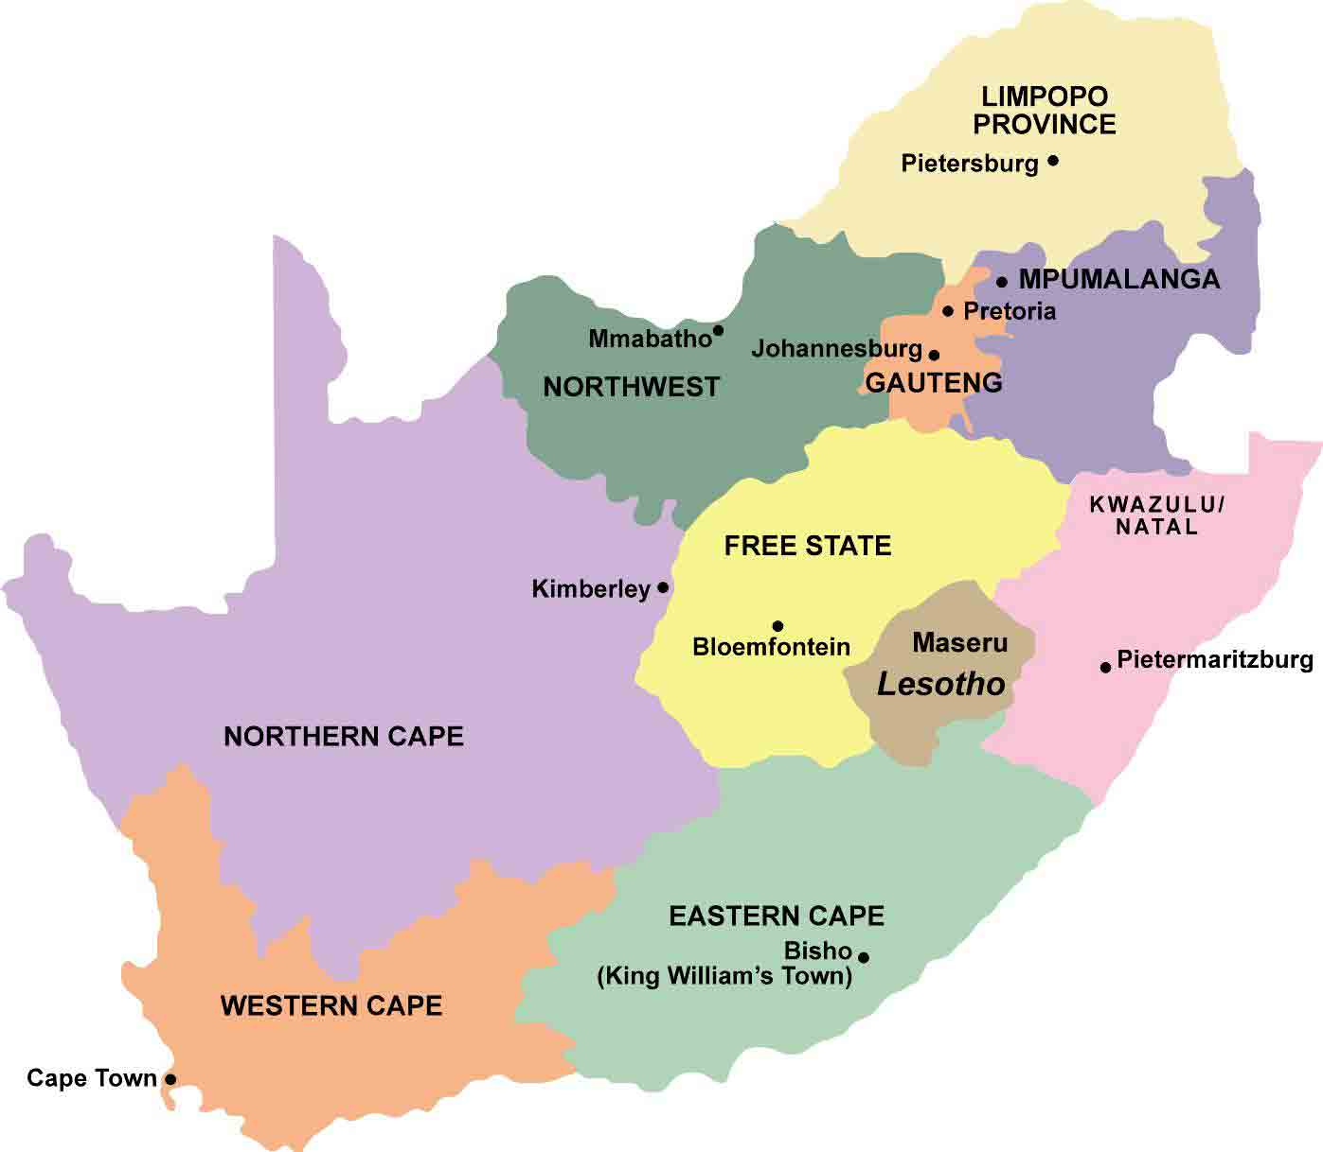
Provincial Spread: Support programmes
LP:
BBSDP – 46
EIP - 2
SEIF – 2
CIS - 114
NW:
BBSDP - 21
EIP - 1
SEIF – 1
CIS - 40
GP:
BBSDP - 228
EIP – 2
SEIF – 0
CIS - 82
MP:
BBSDP – 48
EIP – 0
SEIF – 0
CIS - 25
NC:
BBSDP – 7
EIP – 0
SEIF – 0
CIS - 2
KZN:
BBSDP – 147
EIP – 0
SEIF – 2
CIS - 43
FS:
BBSDP – 10
EIP – 0
SEIF – 0
CIS - 2
EC:
BBSDP - 42
EIP - 2
SEIF – 1
CIS - 84
WC:
BBSDP – 40
EIP – 0
SEIF – 0
CIS - 8

Slide 18
Provincial Spread – BBSDP Financial Distribution
Total: R268 009 263
Number: 589
R113 217 019
R18 291 951
R21 293 463
R8 570 787
R4 610 583
R66 229 401
R2 637 143
R14 397 986
R18 760 931

Slide 19
TPM Legacy Farming Primary Coop- Limpopo
TPM Legacy was funded with CIS, in February 2016, to the tune of R350k to purchase 2 boreholes, a power generator and fencing which was of great help for the success of the cooperative.
TPM Legacy was registered in 2012 and has 6 members, of which 4 are males and 2 are females. Four of the members are youth and only 2 are above the age of 35 years.
The cooperative is involved in crop production, producing green peas, butternut, chillies and other vegetables. Usually it takes three months for the produce to be harvested and sold to the market.
The largest market for the enterprise is the Johannesburg Market because it pays within a week unlike the big retailers that pay after 90 days or sometimes return the products damaged.
Jobs created and sustained: Their average monthly turnover is R65 000 after harvest period with a highest record of employing 18 people per day (during harvest time).
The coop intends to venture into agro-processing so that they can target hotel groups and other local retailers with value-added packaged items.

Slide 20
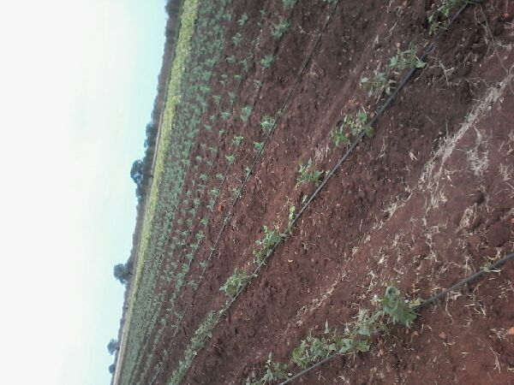
TPM Legacy Farming Primary Coop- Limpopo

Slide 21
Zero Hunger Primary Coop - Gauteng
On 1 September 2016 DSBD assisted the cooperative with garden tools and a bakkie to the value of R350k through CIS.
Zero Hunger was registered in 2012 and but started its operations in December 2015.
The cooperative’s core business is landscaping but distinguishes itself by its expertisie in plant conservation, soil management, garden design, construction and maintenance.
Four of its 8 members have undertaken technical training in the horticulture sector.
The cooperative has 8 members, 4 are females and 4 are males. Similarly 4 are youth and 4 are older than 35 years of age.
The cooperative has a three year contract (to expire in 2020) with City Parks to maintain City gardens.
Jobs created and sustained: Their average monthly turnover is R63 000, and this supports 15 employees including cooperative members.
The cooperative believes in perseverance, unity and honesty as critical success factors.

Slide 22
LQ Events Primary Coop - Gauteng
In August 2016, CIS assisted the cooperative with chairs, tables, umbrellas, gas stove and other catering equipment to the value of R350k.
LQ Events was registered in 2015 and is fairly new.
Its core business is catering and décor.
The cooperative has 5 members, 4 are females and 1 is male. Three members are youth and 2 are older than 35 years of age. 9 Jobs created and sustained.
The cooperative provides its services to weddings, parties and other community functions or events.
So far their average monthly revenue is R16 000.
The cooperative has registered in the Central Supplier Database and plan to do more functions for government and the private sector.

Slide 23
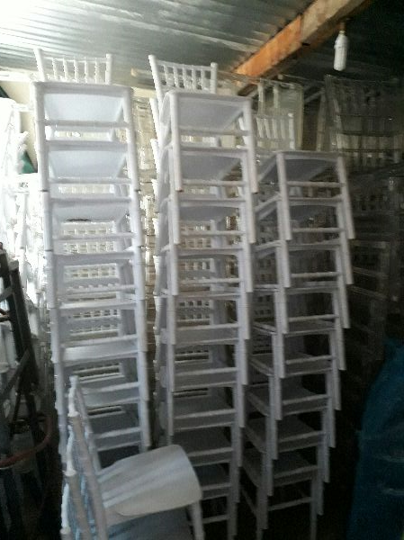
LQ Events Primary Coop - Gauteng

Slide 24
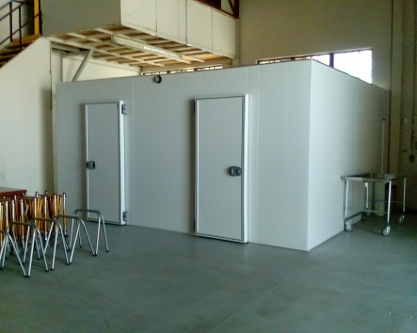
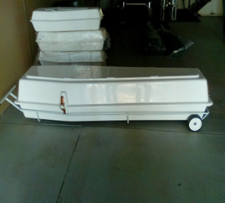
Motheo wa Modimolle Woodwork CC
Background
This is a majority female owned funeral parlour business that operates from Modimolle in Limpopo established in 2006 and mainly serves members of the general public with funeral and other related services.
Assistance with equipment to strengthen its service offering.
14 employees who contribute enormously to the success of the business.

Slide 25
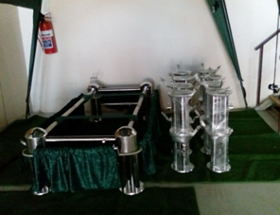
Motheo wa Modimolle Woodwork CC
Intervention
The business operates in an industry where quality of service is a crucial contributor to success.
BBSDP assisted them to acquire funeral services equipment (Body mortuary refrigeration plant, PA System, Body Boxes, High Stands, Church Trolleys, Grass Mats, Lowering Devices and Tents).
Impact of the intervention
At application their turnover was R 2.1 million and after assistance it increased to R 2.8 million the turnover.
The Business is currently employing 33 staff members.

Slide 26
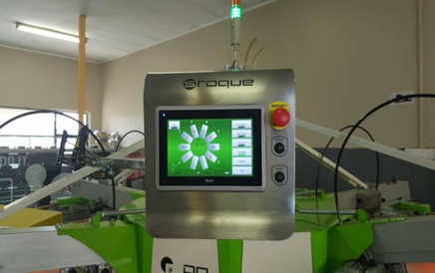
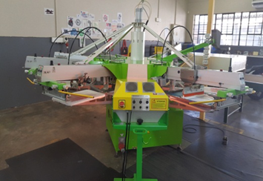
Mighty Media Enterprise Pty Ltd.
Background
Mighty Media is a close corporation which was started in 2008 by a black male, Mr Peter Matome Leshabane it is a 100% black owned business.
The company is operating from Pretoria in Gauteng. They specialize in the printing services for promotional items, branding & exhibitions, corporate gifts and printing technology.
Mighty Media has managed to retain its clients through its high quality services namely: Joyous celebration records, Polokwane Municipality, African National Congress and Big fish Music amongst others.

Slide 27
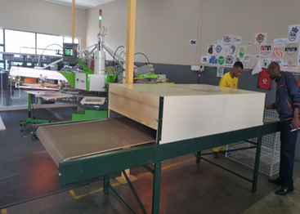
Mighty Media Enterprise Pty Ltd.
Intervention
BBSDP assisted the company to acquire the Industrial Printing Machine: Automatic Screen Printing Machine Model: YOUP10C06MC which cost R 342 500.00
Impact of the intervention
At application their turnover was R 10.1 million, and with the new machine their turnover increased by over 9%.
The acquisition of the screen printing machine shop enabled the business to extended customer base and increase revenue. As the business capacity and market base increased 12 jobs were sustained

Slide 28
Enterprise Incubator Programme (EIP): Projects Approved
Name Of Incubator | Name Of Applicant | Province and Location | Sector | Budget Approved | No. of Enterprises/Co-operatives To Be Incubated
Vegetable Market Access Logistic Infrastructure Incubator | Africa Excel Advisory Service Pty Ltd | Thohoyandou, Limpopo | Agriculture | R5 million | 14 Cooperatives
Matsila Small Business Incubation Project | Matsila Development Community Trust | Levubu, Limpopo
 |  |  |  | R8 million | 2 SMEs with 215 beneficiaries
Limpopo Wildlife Business Incubator | Limpopo Wildlife Business Incubator Pty Ltd | Bestekraal (Rustenburg), North West | Wildlife value chain | R8 million | 7 SMEs
Sibanye Gold Construction Incubator | Nunnovation Africa Foundation | Westonaria, Gauteng | Construction | R8 million | 30 SMEs
The South African Creative Industries Business Incubator | Imvula Holdings Pty Ltd | Eersterust (Pretoria), Gauteng | Creative Industries | R7 million | 50 SMEs
Nomakhwezi Benya Primary Cooperative | Nomakhwezi Benya Primary Cooperative | Nqamakwe, Eastern Cape | Agriculture | R8 million | 10 Cooperatives
South African Automotive Design Engineering Incubator (Saaed) | Steel Best Pty Ltd | Port Elizabeth, Eastern Cape | Automotive Manufacturing | R7 million | 7 SMEs

Slide 29
Nomakhwezi Benya Primary Cooperative
Background
Nomakhwezi Benya is a Primary Cooperative wholly owned by social entrepreneur of the same name.
The Primary cooperative is located in Ngqamakhwe in the Eastern Cape province.
It is in the Agriculture Sector and will incubate a total number of 10 Cooperatives.
As mentioned in the previous slide, the primary cooperative was approved to be supported with an amount of R8 million.
Impact on job creation
The incubator will create over 514 permanent and casual jobs over a period of three years within the local communities.
Jobs have been created for the implementation of the Enterprise Incubation Programme.
More that 500 temporary jobs were created during the infrastructural build for the project.

Slide 30
Nomakhwezi Benya Primary Cooperative
Impact on stimulation of local economy
Suppliers, contractors and retail shops from the eight surrounding towns have benefited.
The programme has injected over R5 million into these towns since April 2017.
The local economy has benefited through an increase in the procuring of equipment, building materials, construction services, and agricultural input materials.
Within the eight towns, the project has maintained more than 350 jobs during the handling and the procurement of goods and services for the Enterprise Incubation programme.

Slide 31
Nomakhwezi Benya Primary Cooperative
Envisaged impact on poverty alleviation
The programme is being implemented in a rural area surrounded by five administrative areas; Mkiva location, Cegcuwana location, Sokapase, Ndakane and Tyinira.
With a combined populated estimated at 67 394 men and women including youth, the Income dependency ratio of 22 people to 1, the project will help to provide food for 11234 people within our local community.

Slide 32
Matsila Community Development Trust
Background
The Matsila Development Community Trust is a development trust owned by the Community under the guidance of Chief Matsila.
The Development Community Trust is located in Levubu in the Limpopo province.
It is in the Agricultural Sector and will incubate two SMMEs that have a total of 215 beneficiaries.
The incubator was approved to be supported with a total amount of R8 million.
Impact on job creation
The project has so far made significant impact in improving the quality of life of the people of Matsila Village as 100 permanent jobs have already been created in vegetable and chicken farming.

Slide 33
Matsila Community Development Trust
Impact on stimulation of local economy
An important contribution of this project has been the capacity building of both the vegetable and chicken farms through skills development and training in the following areas:
Training of workers in preparation of tunnels and open field, soil fertility testing, irrigation management, spraying programs for disease, weed and pest control, pruning, plant production, harvesting and packaging techniques.
Other transversal skills acquired by employees include team work, health & safety, first aid, fire fighting, conflict resolution, general maintenance, basic planning skills, plumbing, basic mechanic, welding and basic building skills.
As part of the milestones of this project, both the vegetable and chicken farms have been registered as formal business enterprises owned by the workers.

Slide 34
Matsila Community Development Trust
Impact on stimulation of local economy
The capital injection on this project has enabled the enterprises under incubation to acquire the necessary tools and equipment including machinery such as hammer mills, feed mixers, delivery vehicles, cold storage facilities, chicken slaughtering equipment, vegetable packaging machines, and drip irrigation systems.
The project also provided the chicken farm with the necessary infrastructure such as chicken abattoir and broiler houses.
Envisaged impact on poverty alleviation
The net result of the project is that the Matsila community and surrounding villages are now able to buy chicken meat, eggs and vegetables at an affordable rate with less travel expenses.
The ability to purchase these food items will ensure that the community has access to adequate amount of affordable food.

Slide 35
.
7. Performance by Programme for 2016/17 Financial Year

Slide 36
6. Performance by Programmes
PROGRAMME ONE: ADMINISTRATION
Strategic Outcome Oriented Goal: An efficient and effective administration
Strategic Objective | Performance Indicator | Actual Performance against Target |  | Deviation from planned target for 2016/17 | Reasons for variance
 |  | Planned Target 2016/17 | Actual Achievement 2016/17
To promote compliance and good governance | Clean audit | Unqualified audit outcome for 2015/16 FY | Unqualified audit outcome for 2015/16 FY | N/A | N/A
To drive sound financial management and controls | Over or under-expenditure on annual budget | Maintain <5% over or under-expenditure on annual budget | 9.2% underspending on annual budget (R121 million) | 4.2% | Under expenditure was mainly as a result of under spending of R90.6 mil in the Transfer Payments due to challenges in the implementation of planned programmes; and under-spending in Compensation of Employees (CoE) and Goods and Services by R15.7 mil and R13.8 million respectively. Transfer payments refer to under-spending in the Cooperatives Incentive Scheme (CIS), National Informal Business Upliftment Programme (NIBUS) and the Enterprise Incubation Programme (EIP). Reasons for variance and corrective action in each of these areas are discussed in the Programme 3 report. In terms of CoE, corrective action is discussed below
 | 100% of payments to eligible creditors processed within 30 Days | 100% of payments to eligible creditors processed within 30 Days | 98% of payments to eligible creditors processed within 30 Days | 2% (156 of the 7450 eligible creditors were processed after 30 Days) | Logistical delays affected the achievement of this target.

Slide 37
6. Performance by Programmes
Strategic Objective | Performance Indicator | Actual Performance against Target |  | Deviation from planned target for 2016/17 | Reasons for variance
 |  | Planned Target 2016/17 | Actual Achievement 2016/17
To maintain a sound performance planning, reporting and monitoring process | Annual Performance Plans tabled | 2017/18 APP tabled in Parliament | 2017/18 APP tabled in Parliament on 8 March 2017 | N/A | N/A
 | Service Delivery Improvement Plan approved | SDIP produced and approved | SDIP produced and approved by accounting officer on 31 March 2017 | N/A | N/A
 | Quarterly performance reports submitted to DPME at end of each quarter | 4 Quarterly performance reports submitted to DPME after end of each quarter | 4 Quarterly performance reports submitted to DPME after end of each quarter | N/A | N/A
 | Annual reports tabled | DSBD Annual Report 2015/16 approved and tabled | DSBD Annual Report 2015/16 approved and tabled on 30 September 2016 | N/A | N/A
To build human resource capability and promote culture of high performance | Maintain a <10% vacancy rate | Maintain a <10% vacancy rate | 9.8% vacancy rate achieved | 0.2% | The department prioritised filling funded posts that were vacant during the financial year under review
 | 50% of Women (SMS) | 50% women in SMS | 53.5% women in SMS employed in the department | 3.5% | In order to reach the target, the department is committed to gender equality and prioritised recruitment and appointment of suitable women candidates in senior positions.
 | 2% of people with disability | 2% people with disability | 2.5% people with disability employed in the department | 0.5% | There were disclosures of disability from current employees.

Slide 38
6. Performance by Programmes
Strategic Objective | Performance Indicator | Actual Performance against Target |  | Deviation from planned target for 2016/17 | Reasons for variance
 |  | Planned Target 2016/17 | Actual Achievement 2016/17
To communicate the work of the Department of Small Business Development internally and externally | Projects profiles of Best Practices | 12 Project Profiles of Best Practices | 12 Project Profiles of Best Practices | N/A | N/A
 | Stakeholder Engagements | 8 Stakeholder Engagements | 19 Stakeholder Engagements | 11 Stakeholder engagements | There was an increased need for stakeholder engagements during the financial year under review, mainly due increased support for and awareness of the department’s existence. In addition, there were targeted stakeholder engagements throughout the financial year particularly during the Budget Vote Month, Youth and Women’s Months
 | Number of media engagements | 35 media engagements | 39 media engagements | 4 Media engagements | Given the crucial role the Department of Small Business Development plays in the economy and particularly during the current challenging economic environment, media generally takes a keen interest in the plans and programmes of the department to address unemployment and poverty.
 | Proactive Awareness Campaigns | 12 Awareness Campaigns | 21 Awareness Campaigns | 9 Awareness campaigns | In order to create awareness of products and services of the department and entities, the department embarked on Awareness Campaigns and was also involved in the launch of different projects during the financial year under review.

Slide 39
6. Performance by Programmes
PROGRAMME Two: SMMEs and Cooperatives Policy and Research
Strategic Objective | Performance Indicator | Actual Performance against Target |  | Deviation from planned target for 2016/17 | Reasons for variance
 |  | Planned Target 2016/17 | Actual Achievement 2016/17
2.1 To create a conducive legislative & policy environment for SMME's and Cooperatives | Conduct stakeholder consultation engagements on the amendment of the Small Business Act of 1996, as amended | Targeted stakeholder consultations on the amendment of the National Small Business Act of 1996 as amended | Two stakeholder consultation workshops on the National Small Business Act were successfully hosted; a consolidated report on the stakeholder consultations produced; and a report on proposed areas of amendment produced and submitted to the Minister for consideration. | N/A | N/A
2.2 To create a conducive legislative & policy environment for SMME's and Cooperatives | Reviewed and approved Integrated Strategy on the Promotion of Entrepreneurship and Small Enterprises | Reviewed integrated Strategy on the Promotion of Entrepreneurship and Small Enterprises | The review of the Strategy on the Promotion of Entrepreneurship and Small Enterprises was not completed. | The review of the strategy has been postponed to allow for an evidence based review based on the findings of the National Evaluation of the strategy. | DPME, in consultation with DSBD decided to include Integrated Strategy on the Promotion of Entrepreneurship and Small Enterprises in the National Evaluation Programme. Following Cabinet approval of the 2017/2018 National Evaluation programme, inclusive of the Integrated Strategy on the Promotion of Entrepreneurship, it was agreed to postpone the review of the strategy to allow for an evidence based review based on the findings of the National Evaluation.
2.3 To create a conducive legislative & policy environment for SMME's and Cooperatives | Research report on legislative and regulatory protocols impeding SMMEs and Cooperatives concluded | Research report on legislative and regulatory protocols impeding SMMEs concluded | The research report on legislative and regulatory protocols impeding SMMEs and Cooperatives was concluded. | N/A | N/A

Slide 40
6. Performance by Programmes
PROGRAMME Two: SMMEs and Cooperatives Policy and Research
Strategic Objective | Performance Indicator | Actual Performance against Target |  | Deviation from planned target for 2016/17 | Reasons for variance
 |  | Planned Target 2016/17 | Actual Achievement 2016/17
2.4 To drive an integrated planning and monitoring for SMMEs and Cooperatives development in townships and rural areas | A monitoring framework to monitor SMMEs and Cooperatives support, in terms of 30% public sector procurement programme, developed | Develop and implement a Monitoring framework to monitor SMMEs and Cooperatives support. | A pilot Monitoring and Evaluation framework was developed. Due to the fact that 30% public procurement programme was not operational, the testing and piloting of the programme was done on the Cooperatives Incentive Scheme. | N/A | N/A
 | 50% of total enterprises supported are women-owned enterprises | 50% of total enterprises supported are women-owned enterprises | 55% | Exceeded the target by 5% | This is a new target. As the Department historically focused on the empowerment of women thus had mechanism in place to advance and exceed the target.
 | 30% of total enterprises supported are youth-owned enterprises | 30% of total enterprises supported are youth-owned enterprises | 12% | 18% | This is a new target, which required a paradigm shift and completely new approach to implementation planning and reporting; and the department was unable to effectively plan for the delivery of this target. However, the participation of youth in the economy remains an important impact measurement, and, having identified the root causes, the department will correct these limitations in 2017/18.
 | 50% of total enterprises supported are from townships | 50% of total enterprises supported are from townships | 21% | 29% together with under reporting | As above. Additionally, this was a new target introduced in 2016/17. The department still relied on applications received without the deliberate strategies of solicit more applications from townships. It is also a reflection of systemic obstacles (e.g. vibrant townships economies that are unable to access or not aware of the services available). The department will work with provinces through their townships revitalisation programmes and focus its Stakeholder consultations and awareness campaigns on townships in 2017/18.
 | 30% of total enterprises supported are from rural areas | 30% of total enterprises supported are from rural areas | 28% | 2% together with under-reporting | As above, with specific reference to rural areas.

Slide 41
6. Performance by Programmes
PROGRAMME Two: SMMEs and Cooperatives Policy and Research
Strategic Objective | Performance Indicator | Actual Performance against Target |  | Deviation from planned target for 2016/17 | Reasons for variance
 |  | Planned Target 2016/17 | Actual Achievement 2016/17
2.5 To drive a comprehensive research agenda on key areas of support for SMMEs and Cooperatives | Research reports on SMMEs and Cooperatives key areas of support | 2 Research reports on key areas of support to SMMEs and Cooperatives | The key areas for research that were identified were: 1. The SMME Eco-System. The research was not finalised. A draft report was received by the end of the f/y 2. The SMME Definition. The research report on the SMME Definition has been finalised. | One (1) research report, on SMME Eco-System, was not finalised by the end of the financial year | Avoidable delays resulted in the procurement of a service provider occurring later (Q3 only) than planned and thus the study could not be concluded. Exco was however presented with a draft report. The report will be finalised in Q2 of the 2017/18 financial year
2.6 To drive a comprehensive research agenda on key areas of support for SMMEs and Cooperatives | Programme Evaluation reports on the planning, design and implementation of SMMEs and Cooperatives programmes | 1 Evaluation report on planning, design and implementation of SMME's and Cooperatives programmes | 1 Evaluation report on planning, design and implementation of SMME's and Cooperatives programmes was approved at the EXCO meeting held on 27 March 2017. | N/A | N/A
2.7 To develop and implement a relevant international relations strategy | Approved international relations strategy | Approved international relations strategy | The department’s International Relations Strategy was approved at the EXCO meeting held on 27 March 2017 | N/A | N/A

Slide 42
6. Performance by Programmes
PROGRAMME THREE: SMMEs and Cooperatives Programme Design and Support
Strategic Objective | Performance Indicator | Actual Performance against Target |  | Deviation from planned target for 2016/17 | Reasons for variance
 |  | Planned Target 2016/17 | Actual Achievement 2016/17
To design and implement targeted programmes to support new and existing small and medium enterprises in township and rural areas | Informal Businesses supported through the IMEDP | 7000 informal businesses supported through the IMEDP | 7848 | 848 additional Informal businesses were supported.. | Given the sheer size of the informal sector, the demand and with the support of multiple partnerships, the department was able to exceed the target of supporting informal businesses through further training. The department committed itself overreached to support the informal sector.
To increase participation of SMMEs and Cooperatives in the mainstream economy | Informal Business Infrastructure developed through SEIF | 6 Informal Business Infrastructure Projects approved through SEIF | 6 Informal Business Infrastructure Projects approved. The 6 projects are namely: Matsila Trust, Mnambithi, Inqguza Hill, Makhado, Umuziwabantu, Greater Taung. | N/A | N/A
 | Business Rescue Strategy developed | Business Rescue Strategy for small enterprises and Cooperatives developed | The Business Rescue Strategy was not developed during the financial year under review. | No developed Business Rescue Strategy | Although some milestones were achieved towards the target that, however, did not amount to the achievement target. This was due to lack of sufficient personnel to undertake the implementation of the target.

Slide 43
6. Performance by Programmes
PROGRAMME THREE: SMMEs and Cooperatives Programme Design and Support
Strategic Objective | Performance Indicator | Actual Performance against Target |  | Deviation from planned target for 2016/17 | Reasons for variance
 |  | Planned Target 2016/17 | Actual Achievement 2016/17
To increase participation of SMMEs and Cooperatives in the mainstream economy | Established CDA | Established CDA | The Cooperatives Development Agency was not established | The CDA was not established. | The lack of budget allocation affected the establishment of CDA. This was coupled by the delay in the proclamation of the Cooperatives Act. Some milestones were achieved towards the annual target; however, it did not amount to the achievement target.
 | Cooperatives supported through the CIS | 370 Cooperatives supported through Cooperatives Incentives Scheme | 240 Cooperatives supported through CIS. | Supported fewer Cooperatives than planned. | There were delays with the systems transfer from the dti to DSBD. This posed internal administrative challenges and resulted in the delay to finalise the migration of the CIS platform to the Department.
 | Cooperatives supported through training | 250 Cooperatives supported through training | 271 Cooperatives supported through training | 21 More Cooperatives supported through training | The department, through the German Co-Operative Raiffeisen Confederation – DGRV, managed to fulfil the high demand in training by Cooperatives during financial year under review.

Slide 44
6. Performance by Programmes
PROGRAMME THREE: SMMEs and Cooperatives Programme Design and Support
Strategic Objective | Performance Indicator | Actual Performance against Target |  | Deviation from planned target for 2016/17 | Reasons for variance
 |  | Planned Target 2016/17 | Actual Achievement 2016/17
To increase participation of SMMEs and Cooperatives in the mainstream economy | Small and Medium Enterprises Supported through financial and non-financial support | 600 small and medium enterprises supported through the BBSDP | 589 small and medium enterprises to be supported through the BBSDP | 11 less small business projects were approved. | This non-achievement was mainly due to internal administrative challenges faced by the Development Finance Unit.
 | Incubators supported through the Enterprise Incubation Programme | 7 incubators supported through the Enterprise Incubation Programme | 7 incubators supported through the Enterprise Incubation Programme as follows: Africa Excel Advisory Services Pty Ltd, Matsila Community Development Trust, Limpopo Wildlife Business Incubator, Nunnovation Africa Foundation, Imvula Trust, Nomakhwezi Darling Benya Primary Cooperative, Steelbest Manufacturing Pty (Ltd) | N/A | N/A

Slide 45
6. Performance by Programmes
PROGRAMME THREE: SMMEs and Cooperatives Programme Design and Support
Strategic Objective | Performance Indicator | Actual Performance against Target |  | Deviation from planned target for 2016/17 | Reasons for variance
 |  | Planned Target 2016/17 | Actual Achievement 2016/17
To coordinate and maximize support for SMMEs and Cooperatives through public and private partnerships | Partnership agreements entered into to support SMMEs and Cooperatives | 10 Partnership agreements entered into to support SMMEs and Cooperatives | 14 partnership agreements entered into to support SMMEs and Cooperatives. The supported incubators are located in the provinces of Limpopo, Eastern Cape, as well as Gauteng and are in the agriculture, wildlife value chain/tourism, creative industries, construction, and automotive industries. | 4 more agreements were entered into. | There is a high need in partnering with other stakeholders in order to fulfil the mandate of SMMEs and Cooperatives development. The Market Access Unit were effective and efficient during the discussions, negotiations, and finalisations of partnership agreements.
 | National co-location Programme Implemented | National co-location programme concept document and implementation plan approved. 27 National co-location points established | The national co-location programme concept document and implementation plan were approved. 27 National co-location points established. | N/A | The department, together with its agencies and partners, and in an effort to increase stronger alignment in the shared purpose of the Department and its agencies, committed to easing the business operating environment and reduce red tape for SMMEs and Cooperatives in the rural areas.

Slide 46
6. Performance by Programmes
PROGRAMME THREE: SMMEs and Cooperatives Programme Design and Support
Strategic Objective | Performance Indicator | Actual Performance against Target |  | Deviation from planned target for 2016/17 | Reasons for variance
 |  | Planned Target 2016/17 | Actual Achievement 2016/17
To coordinate and maximize support for SMMEs and Cooperatives through public and private partnerships | National Inter-Departmental SMMEs and Cooperatives Development Coordinating Committee established, quarterly reports produced. Develop integrated planning framework with national governments | National Inter-Departmental SMMEs and Cooperatives Development Coordinating Committee established Develop integrated planning framework with national governments 3 Quarterly reports prepared based on implementation of recommendations | The National Inter-Departmental Coordinating Committee was duly established An integrated planning framework with national governments was developed through Three (3) quarterly reports prepared based on the implementation of recommendations. | N/A | N/A
 | Develop integrated planning framework with provincial governments 4 Quarterly Inter Provincial Coordinating meetings | Develop integrated planning framework with provincial governments Quarterly Inter-Provincial coordinating report produced. | The Provincial Inter-Departmental Coordinating Committee was duly established with 4 (four) quarterly meetings held, and Three (3) quarterly reports prepared. | N/A | N/A
 | Integrated planning engagements with Local government departments through LED forums and reports produced | 15 Integrated planning engagements with Local government departments through LED forums and reports produced. | 15 Integrated planning engagements with Local government departments through LED forums and reports produced | N/A . | N/A

Slide 47
.
8. FINANCIAL MANAGEMENT

Slide 48
Overall Financial Performance 2016/17

Slide 49
Overall Performance
DSBD has spent R1 197 041 000 against a budget of R1 318 439 000.
This translates into 90.8% of the allocated budget
Underspent by R121 398 000 or 9.2%, which is R55 476 000 or 4.2% above the APP target of R65 922 000 or 5%.
This is a regression from R28 629 000 or 2.5% in 2015/16 financial year.

Slide 51
Expenditure Per Economic Classification

Slide 52
Reasons for Variance
Vacant post resulted in COE under spending by R15.7 million(12.1%), which is an improvement from the R18.4 million underspend in 2015/16 performance;
Under spending on related Goods and services by R13.8 million (17.6%) which is impacted on by vacant posts and non implementation of programmes such as non provision of infrastructure support to Informal Businesses and Cooperatives. Research projects worth R3 million delayed, such as the 2016 Annual Review, SMME Eco-system, SMME Definition, Research Agenda, Research Repository, as well as the Evaluation of the Integrated Enterprise Strategy contributed to a low spending. The signing of the SITA contract was delayed and resulted in fewer months being charged R2.7 million. Spending regressed compared to the R9 million underspent in 2015/16
Transfers underspent R90.6 million (8.2%) for the year. Spending regressed compared to R90.4 million compared to R152 thousand in 2015/16, due to:
CIS - R11.1 million remaining funds
DSBD received R150 million at the beginning of the 2016/17 financial year for two (2) new programmes.
b) NIBUS - R53.6 million – ZERO movement on expenditure
c) Non cash flow spending on EIP – R25.9 million for the year due to the late implementation of the programme
Capital Expenditure underspent by R1.3 million (31.2%)- R1 million was budgeted for the procurement of the DM’s vehicle.

Slide 53
Audit Outcome 2016/17
Auditor-General South Africa (AGSA)
Unqualified Audit Opinion
No Material Misstatements on the Annual Financial Statements (AFS)
2016/17 Audit resulted in 22 Findings compared to 35 during the 2015/16 audit
Areas of Concern
Strengthen fraud prevention interventions
Ethical conduct (awareness & monitoring)
Material misstatement on Performance Information (inadequate Evidence-based Reporting)

Slide 54
.
9. HUMAN RESOURCE MANAGEMENT

Slide 55
Functional and Organisation Structure
An organisational structure was developed and internal consultation started from mid September 2016.
Input provided by the Department of Performance Monitoring and Evaluation (DPME) and National Treasury (NT) during November 2016 on the DSBD draft Annual Performance Plan (APP) for 2017/18 significantly impacted the proposed structure and thus resulted in the process being halted.
Amendments to the strategy and APP ensued and was finalised toward the end of January 2017.
A decision was taken to revert to the Approved Start-up Structure from 1 April 2017.

Slide 56
Vacancy Rate and Women in SMS Targets
The Department succeeded in decreasing the vacancy rate to 9.8% (20 vacancies / 204 posts on the permanent establishment) mainly due to:
Prioritisation in filling vacant posts – The DSBD establishment increased with 37 new posts (30 permanent posts and 7 additional).
Alignment of the organisational structure.
The Department did well in exceeding the Cabinet Target of 50% women in senior management position - 53.5% (23 women / 43 senior managers).

Slide 57
People with a Disability Target
The Department did well in exceeding the Cabinet Target of 2% employment of people with a disability achieved a 2.5% (5 persons with a disability / 201 employees) rate over the last 2 quarters.
All cabinet targets are mainstreamed within DSBD which ensures a concerted effort whether during recruitment, development, promotion or retention.
Other Achievements
DSBD has been identified as a Best Practice Department with regard to:
Development of the Service Delivery Model
Achievement of the EE targets for employment of People with a Disability and Women in SMS

Slide 58
10. LESSONS LEARNT
Develop detailed implementation planning and systems to support programme implementation and monitoring, e.g. NIBUS.
Strengthen the monitoring and evaluation mechanism in relation to the disbursements of incentives.
Contradiction between opportunity, expectation and demand and the capacity to deliver
Cadre of leadership: with consistent, capable and committed to the task, the team delivers.

Slide 59
11. WAY FORWARD
Forge strategic partnerships with the other spheres of government to be partners in the delivery of our mandate, especially Municipalities.
Optimise the goodwill of other departments through the signing of transversal agreements, prioritise COGTA, NT, DIRCO, DAFF.
Enforce closer collaboration between Seda and Sefa.
Strengthen the monitoring and evaluation of the performance of agencies.

