Slide 1
Rural Housing Loan Fund
Presentation of the 2016/17 Annual Integrated Report
Portfolio Committee on Human Settlements
4 October 2017

Slide 2
Outline
Mandate and business model
Business environment and policy context
Development performance
Financial performance
Governance and audit outcomes

Slide 3
Mandate
People
Facilitate access to incremental housing finance for low income rural households
Rural
Communal land, rural towns and small towns
Monthly Income
Maximum R15 000
Focus remains under R3 500

Slide 4
Business model
Intermediaries
Carry credit risk of beneficiaries
Loan requirements
Unsecured, so can never lose homes
Cost of borrowing
National Credit Act
Market to clients
Are commercial intermediaries or CBOS
Lending
Wholesale funds to retail intermediaries for on lending
Must be repaid
Maximise housing choice of borrowers
Ideally disbursed through building merchants
Must be used for housing in rural areas
RHLF Pricing Policy: discounts to intermediaries who charge borrowers less
Most RHLF retail borrowers pay 15%

Slide 5
Business conditions in 2016/17
Tough market conditions persisted throughout the year:
Slow growth,
High Unemployment
Recession—last two quarters of the financial year
High levels of indebtedness still remain—high rejection rates at retail level
Despite challenging environment, targets were achieved mainly as a result of:
Growth strategies adopted by some intermediaries—extending footprint in the market we serve
RHLF Pricing Policy enabling significant majority of borrowers to access housing loans much cheaper than prescribed in the NCA Regulations

Slide 6
Policy context of delivery
In delivering housing loans, we take into account the following government policy imperatives:
Transformation of microfinance industry
Support SMMEs and co-operatives, including community based organisations
Support rural development—one of apex priorities of government
Support Special Presidential Package for mining towns
Medium Term Strategic Framework targets

Slide 7
DEVELOPMENT PERFORMANCE

Slide 8
Transformation imperatives
Start-up companies
Name of company | Black shareholding | Woman shareholding | RHLF shareholding | Place of operation
Kabo Financial Services Ltd | 67.34% | 67.34% | 32.66% | Lehurutshe, North West
Lehae Housing Finance Ltd | 80% | 80% | 20% | Harrismith, Free State
Igatsha Rural Development Finance (Pty) Ltd* | 80% | 60% | 20% | KwaDukuza, KwaZulu-Natal
Community based organisations
Name | Type | Interest rate | Place of operation
Shiyendele Building Club | Club/stokvel | 0% | Estcourt, KwaZulu-Natal
Thusanang Basadi Building Club | Club/stokvels | 0% | Orange Farm, Gauteng
Boikago SACCO | Savings and Credit Cooperative | Prime | Mmabatho, North West

Slide 9
Stakeholder Perspective: Broaden and deepen the reach of rural housing delivery
Good performance overall
Result of growth strategies pursued by some intermediaries

Slide 10
Loan Outcomes

Slide 11
Reporting against Medium Term Strategic Framework targets

Slide 12
Delivery in Prioritised Rural Nodes

Slide 13
Loans delivered to support Special Presidential Package for mining towns

Slide 14
Business Process

Slide 15
FINANCIAL PERFORMANCE

Slide 16
Financial Perspective: Capital Preservation

Slide 17
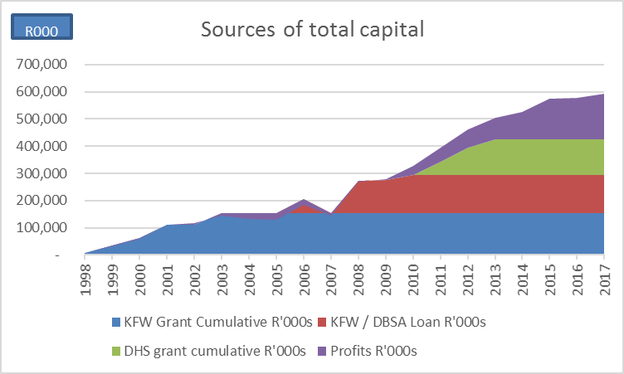
Capital base
Subsequent to year end a further R50 million was received from the DHS

Slide 18
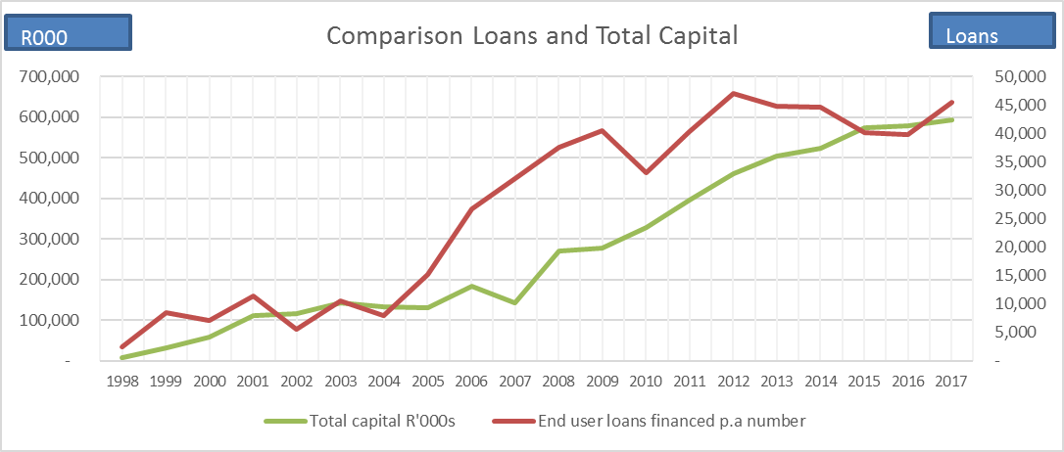
Annual households assisted compared to capital base

Slide 19
Learning and Growth Perspective

Slide 20
GOVERNANCE AND AUDIT OUTCOMES

Slide 21
Governance
Honourable Lindiwe Sisulu
Thembi Chiliza - Chairperson
Adrienne Egbers - Chair - Credit and Development Committee
Thembi Chiliza
Minister of Human Settlements
Board of Directors
Board Committee members
Reginald Haman - Chair - Audit and Risk Committee
Molefe Mothibe - Chair Human Resources, Ethics and Remuneration Coimmittee
Jabuilani Fakazi - Chief Executive Officer
Adrienne Egbers
Thembi Chiliza
Jabulani Fakazi
Molefe Mathibe

Slide 22
Audit outcomes
Independent Auditor’s Report | Outcome
Audit opinion of financial statements | Clean
Predetermined Objectives | No material findings on usefulness and reliability of the reported performance information
Compliance and legislation | Did not identify any instances of material non-compliance

Slide 23
Outlook for 2017/18
Tough market conditions persist:
Slow growth, unlikely to benefit from the interest rate reduction cycle
High Unemployment
Recession—lag effect
Downgrades and business/consumer confidence
High levels of indebtedness still remain
Internally: team focus on DFI consolidation and integration activities has implication for business in the short term

