Slide 1
Ownership Monitor
Research Report on the
ownership of JSE-listed companies
September 2017

Slide 2
Key themes
The structure of ownership of South African companies is linked to policy priorities on transformation and inclusive growth, macroeconomic and financial stability, and competition.
Black ownership should not be considered in isolation from other types of ownership - and their relationships with investment and economic growth.
Transformation of ownership is important for reducing inequality and promoting inclusive growth.
But the economy also needs a vibrant and inclusive equity market and an effective allocation of domestic and foreign capital towards growth-enhancing investment.

Slide 3
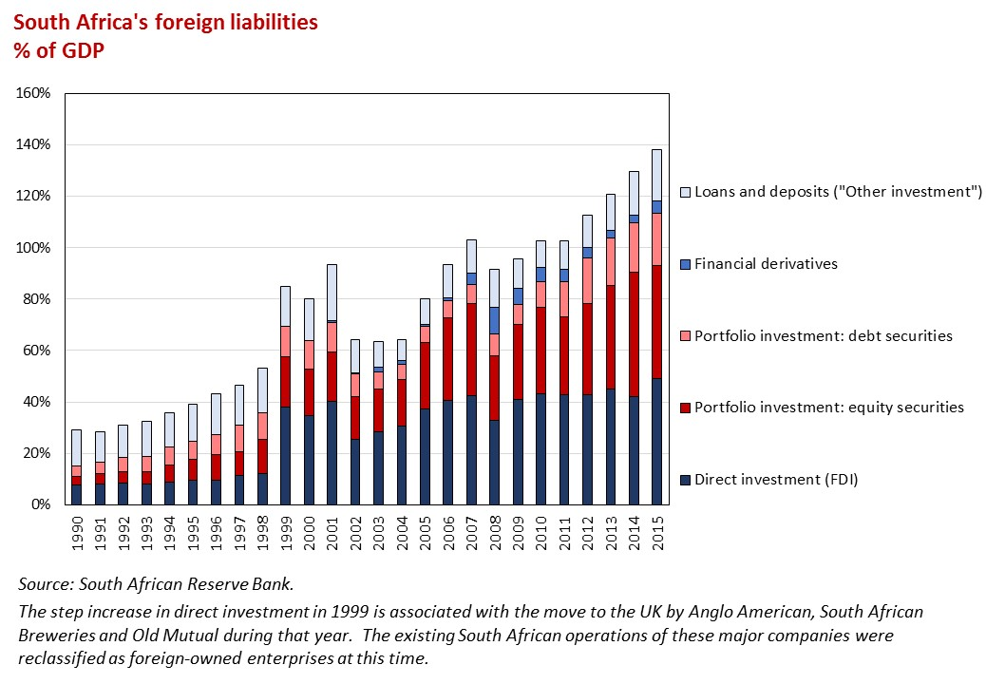
Foreign ownership
South Africa needs to attract foreign capital
Structural constraint of low domestic savings and high investment needs

Slide 4
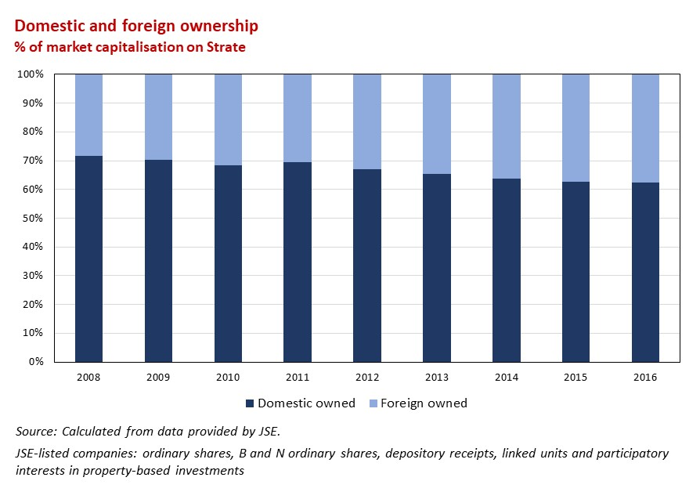
Foreign ownership
Foreign investors owned 38% of JSE-listed companies at end 2016 – including both foreign direct investment and foreign institutional investment.

Slide 5
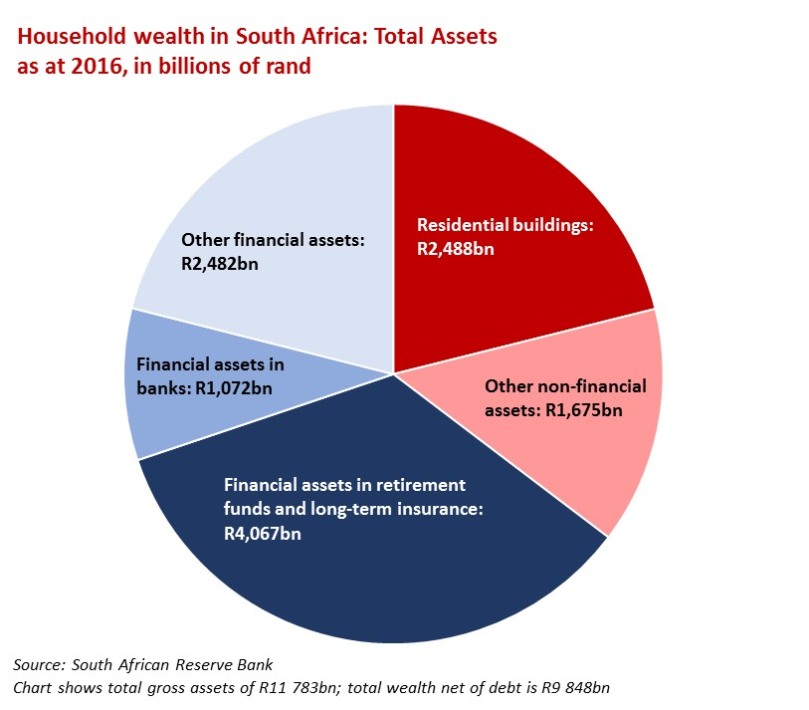
South African institutional investors
Institutional investors manage a substantial fraction of household wealth
Directing long-term savings to sectors of the economy that require capital
And forming a crucial component of a thriving equity market

Slide 6
South African institutional investors
Retirement funds, long term insurance companies and collective investment schemes held around 34% of JSE-listed companies at end 2016.
Investment managers reported holdings amounting to a further 14%.
South African institutional investment in JSE-listed equity At end 2016, in millions of rand
 | Total retail assets | JSE-listed equities % of total assets | JSE-listed equities % of market
Retirement funds | 4 103 802 | 40% | 24.4%
Long-term insurance companies | 1 207 079 | 26% | 4.8%
Collective investment schemes | 1 051 498 | 31% | 4.9%
Investment managers | 1 608 809 | 60% | 14.3%
Source: Calculated from data provided by Financial Surveillance Department (South African Reserve Bank) and JSE.

Slide 7
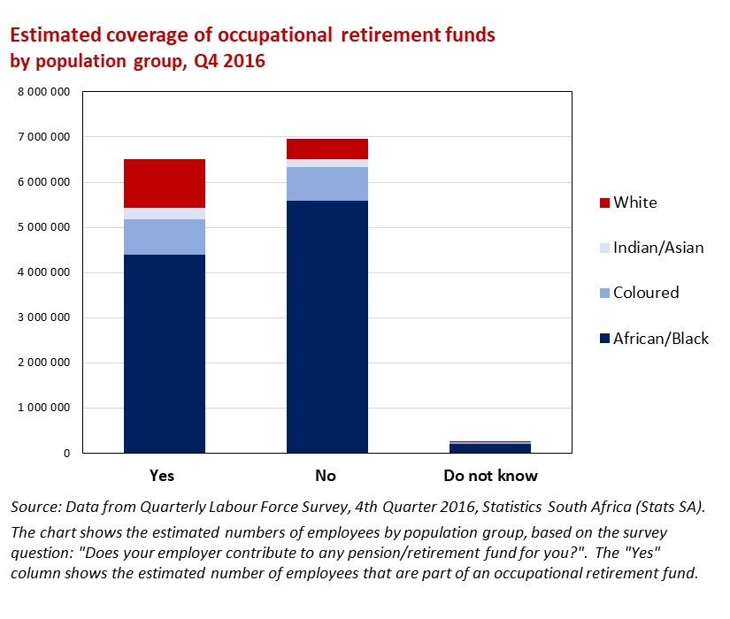
Coverage of retirement funds
Retirement funds span wealthy South Africans with bespoke plans and millions of workers and their dependents belonging to occupational schemes
Black participation in occupational funds (by numbers) is substantial but needs to improve
Job creation and income-generating opportunities support saving and wealth accumulation.

Slide 8
Major shareholders
Disclosure of major shareholders - holding 5% or more of a company’s shares
Major shareholders by type: Top 25 South African companies
 | Estimated value in R million² | % of Top 25 market capitalisation
Foreign companies, direct and indirectly via SA companies³ | 435,688 | 11%
GEPF and PIC⁴ | 429,166 | 11%
South African companies, excluding BEE companies | 203,700 | 5%
South African institutional investors, excluding GEPF and PIC | 49,188 | 1%
South African BEE companies and trusts⁵ | 44,719 | 1%
Private individuals | 41,986 | 1%
Foreign institutional investors | 37,656 | 1%
South African Government | 27,903 | 1%
Total estimated value of major shareholdings | 1,270,006 | 33%
Total market capitalisation of Top 25 companies | 3,810,608
Source: Annual Reports, Annual Financial Statements and corporate websites. Market capitalisation provided by JSE.

Slide 9
Black ownership
Most JSE-listed companies have implemented BEE deals
Deals identified at 83 out of the Top 100 companies (Intellidex, 2015)
Deals include new strategic BEE owners, employee share ownership schemes, broad-based community schemes
Some deals transfer shares in the listed company; others involve the sale of assets at the subsidiary or operational level
Net value generated between 2000 and 2014 of R317 billion (Intellidex, 2015)
Measuring BEE ownership is complex
Methodology set out in the B-BBEE Codes reflects the complexity of BEE deals
Ownership based on the Codes may look different from the actual black shareholders in a listed company

Slide 10
Ownership of Top 100 JSE-listed companies in 2013 Results from the Alternative Prosperity study on behalf of JSE
Direct black ownership | 10%
Black ownership through institutional (mandated) funds | 13%
Direct black ownership - based on B-BBEE Codes
BEE deals at the level of listed company (Top 100)
BEE ownership achieved through sale of asset transactions
Direct black retail ownership where identified
Indirect black ownership through institutional (mandated) funds
Retirement funds, long-term insurance policies and collective investment schemes
Measured on the basis of vested rights of identified black beneficiaries

Slide 11
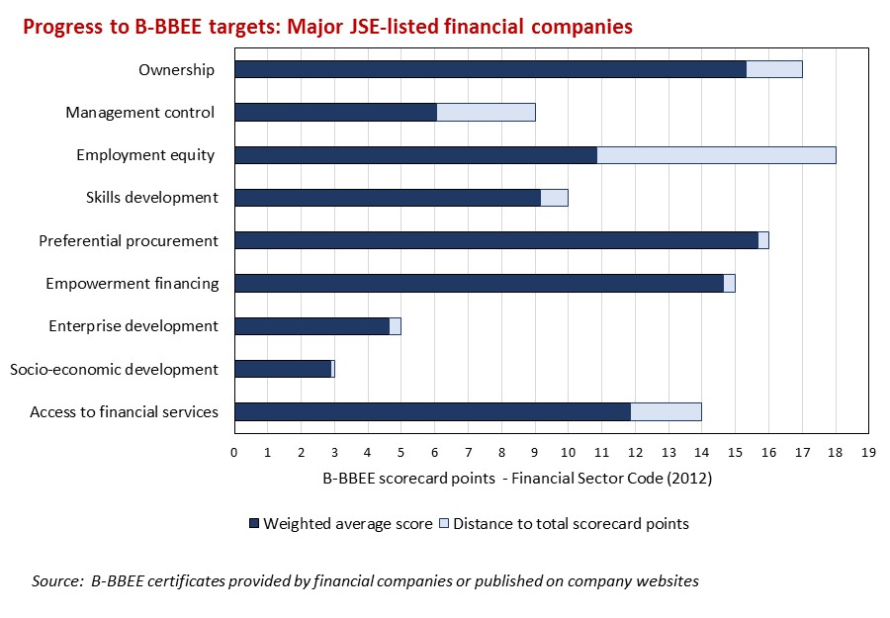

Slide 12
Ownership Monitor
Case Studies
September 2017

Slide 13
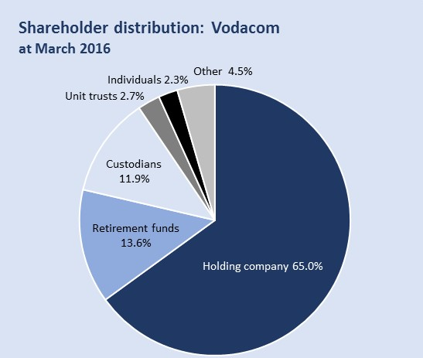
Case Study 1: Vodacom
Largest shareholder is ultimately foreign-owned: Vodacom’s largest shareholder is Vodafone Investments SA (Pty) Limited, which in turn is owned by Vodafone Group plc, based in the UK.
GEPF is a major shareholder: The Government Employees Pension Fund owns 12.7%.
BEE ownership is at the level of the SA operations of the group: Vodacom’s BEE transaction in 2008 distributed a 6.25% stake in the South African operations to employees, strategic partners and the black public. It has been reported that Vodacom is considering a new BEE transaction to replace the arrangements which expire in 2018.
Vodacom shareholders at March 2016
Major shareholders (above 5%)
Vodafone Investments SA (Pty) Limited* | 65.0%
Government Employees Pension Fund | 12.7%
All other shareholders | 22.3%
* Ultimate shareholder is Vodafone Group (UK)
Information from Annual Financial Statements 2016 and the Vodacom website

Slide 14
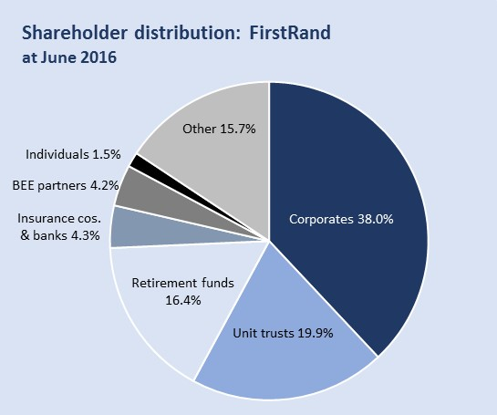
Case Study 2: FirstRand
Corporate ownership is substantial: RMB Holdings Limited (JSE-listed) holds 34.1% of shares.
PIC is a major shareholder: The Public Investment Corporation holds 9.5%, mainly reflecting funds managed on behalf of the Government Employees Pension Fund.
BEE ownership: FirstRand’s BEE partners directly hold 4.2%. FirstRand’s BEE deal implemented in 2005 is estimated to have generated around R23 billion in net value for black beneficiaries*.
Foreign versus domestic ownership: South Africans hold 70% of the company, foreign investors hold 22% and the remaining 8% has unknown nationality.
FirstRand shareholders at June 2016
Major shareholders (above 5%)
RMB Holdings Limited | 34.1%
Public Investment Corporation | 9.5%
Other significant shareholders
BEE partners | 4.2%
Financial Securities Ltd (Remgro) | 3.9%
All other shareholders | 48.3%
Information from Annual Financial Statements 2016 and the FirstRand website
* The Value of BEE Deals, Intellidex Research Report, June 2015

Slide 15
Case Study 3: Changing ownership - Barclays Africa Group
One of the largest inward investments in South Africa: Barclays Bank plc (UK) acquired a 57% shareholding in ABSA Group in 2005. ABSA became the Barclays Africa Group in 2013 following the acquisition of the African businesses of Barclays plc, with the Barclays plc holding increasing to 62%.
A gradual reduction in the foreign ownership: In 2016, Barclays plc began to reduce its shareholding in Barclays Africa, in order to lessen its global regulatory requirements. By June 2017, the Barclays plc holding stood at 23.4%. Shares have been sold to a mix of new and existing investors, both locally and internationally. The Public Investment Corporation has increased its investment in Barclays Africa and plans to further increase its holdings, with the Barclays plc stake eventually falling below 20%.
An opportunity for increasing black ownership: In 2017, Barclays Africa indicated that Barclays plc will make R2.1 billion of capital available to support a new BEE transaction.
Barclays Africa - Shareholder composition
 | December 2015 | December 2016 | June 2017
Barclays Bank plc | 62.3 | 50.1 | 23.4
Public Investment Corporation | 5.6 | 6.9 | 7.1
Other shareholders | 32.1 | 43.0 | 69.5
South African shareholders | 20.7 | 25.3 | 38.4
Foreign shareholders | 79.3 | 74.7 | 61.6
Data from Barclays Africa corporate website - Annual Reports and information on major shareholders

Slide 16
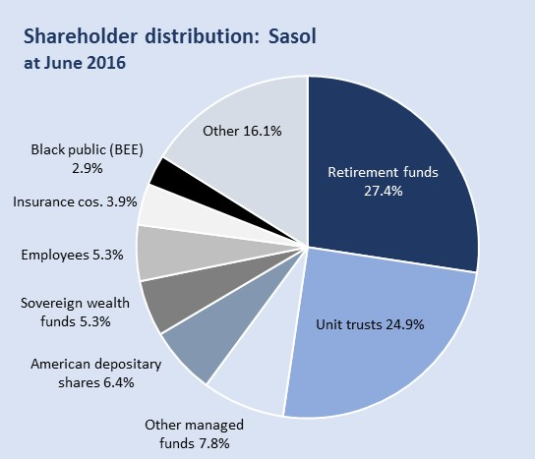
Case Study 4: Sasol
BEE ownership: BEE ownership is in the form of the Sasol Inzalo Employee Trust, Management Trust and Foundation and through public holdings of Sasol Inzalo shares, listed in the empowerment segment of the JSE. There is also a further class of Sasol BEE ordinary shares. Proposals have been announced for a new R21 billion BEE deal to replace the maturing Inzalo scheme, which is expected to mature in 2018 with no shares distributed.
Major shareholders: Sasol’s two major shareholders are the Government Employees Pension Fund (12.9%) and the Industrial Development Corporation (8.2%).
Types of shareholders: Retirement funds and unit trusts (domestic and foreign) hold just over half of the ordinary shares. Shares backing American Depositary Receipts listed on the New York Stock Exchange account for 6.4%. South African ownership is between 60% and 70%.
Sasol shareholders – Ordinary shares* at June 2016
Major shareholders (above 5%)
Government Employees Pension Fund | 12.9%
Industrial Development Corporation | 8.2%
Other shareholders - BEE
Sasol Inzalo Employees Trust | 3.6%
Sasol Inzalo Management Trust | 0.3%
Sasol Inzalo Foundation | 1.5%
All other shareholders | 73.5%
* A separate class of Sasol BEE shares is also listed on the JSE
Information from Annual Financial Statements 2016 and the Sasol website

Slide 17
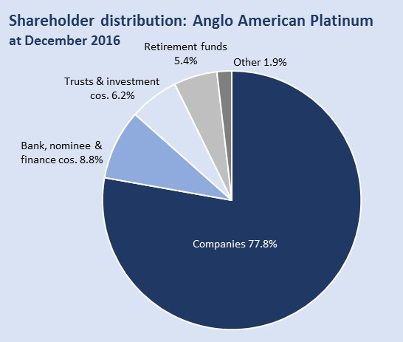
Case Study 5: Anglo American Platinum
Largest shareholder is ultimately foreign-owned: The dominant shareholder is Anglo South Africa Capital Proprietary Limited, which in turn is owned by Anglo American plc. No other shareholder individually holds in excess of 5% of shares.
BEE transactions at the operational and company level: BEE transactions have been implemented at the level of specific mining operations, creating strategic stakes in operations for BEE groups. There has also been an employee share scheme and community economic empowerment scheme at the company level.
Other shareholders: Banks, nominees and financial companies account for 8.8% of shares, followed by trusts and investment companies with 6.2% and retirement funds with 5.4%.
Anglo American Platinum shareholders at December 2016
Major shareholders (above 5%)
Anglo South Africa Capital Pty Limited* | 77.7%
All other shareholders | 22.3%
* Ultimate shareholder is Anglo American (UK)
Information from Annual Report 2016 and Anglo American Platinum website

Slide 18
Case Study 6: Exxaro
Exxaro was created through a BEE transaction in 2006 involving Kumba Resources, Anglo American plc, Eyesizwe Mining and the Industrial Development Corporation.
Under the BEE transaction, a BEE vehicle (Main Street 333) - in turn owned by various BEE partners – became the controlling shareholder.
The BEE structure matured in November 2016 and by the end of December 2016, the BEE partners held a reduced stake of 45.3%.
In January 2017, the BEE shareholding fell further to 37.7% following a share repurchase to settle debt obligations, implemented as part of the unwinding of the BEE deal.
In November 2016, Exxaro announced plans for a new BEE ownership structure to replace the matured deal. Under the transaction planned for 2017, the new BEE owner will hold a lower overall stake of 30% of the company.
Exxaro Shareholders at December 2016
Major shareholders (above 5%) |  | In November 2016, Exxaro announced a new BEE transaction to replace the maturing transaction with Main Street 333. Under the BEE transaction planned for 2017, the new BEE shareholder will hold 30% of the company.
Main Street 333 – BEE partners | 45.3%
Government Employees Pension Fund | 5.9%
Other shareholders - BEE
Exxaro Employee Empowerment Share Trust | 0.7%
All other shareholders | 48.1%
Information from Annual Financial Statements 2016 and Exxaro website

Slide 19
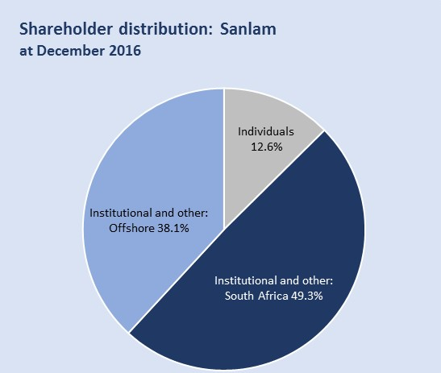
Case Study 7: Sanlam
Largest shareholder is the BEE partner: The single largest shareholder is the BEE partner Ubuntu-Botho Investments (Pty) Ltd, holding 13.5% of shares. The BEE deal implemented in 2004 is estimated to have created a net value of around R14.4 billion for black beneficiaries*.
GEPF is a major shareholder: The Government Employees Pension Fund owns a further 12.2%.
Types of shareholders: Individuals collectively hold 12.6% of Sanlam’s shares. South African institutions and other investors are the largest category with 49.3% percent of shares (including both major shareholders). Offshore institutions and other investors hold 38.1%.
Sanlam shareholders at December 2016
Major shareholders (above 5%)
Ubuntu-Botho Investments (Pty) Ltd | 13.5%
Government Employees Pension Fund | 12.2%
All other shareholders | 74.3%
Information from Annual Report 2016 and the Sanlam website
* The Value of BEE Deals, Intellidex Research Report, June 2015

Slide 20
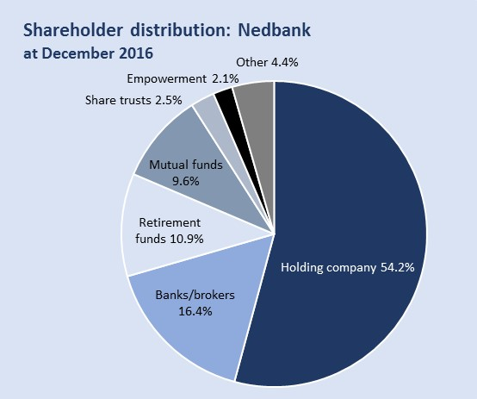
Case Study 8: Nedbank and Old Mutual
Largest shareholder in Nedbank is ultimately foreign-owned: Nedbank’s largest shareholder is the Old Mutual Life Assurance Company (and associates), in turn owned by the ultimate shareholder Old Mutual plc (UK).
GEPF is a major shareholder: The Government Employees Pension Fund holds 6.0%
BEE shareholders: Nedbank implemented a major BEE transaction in 2005, the Eyethu Share Scheme, including black business partners, employees, non-executive directors, clients and community interest groups.
Ownership structure will be changing: In 2016, Old Mutual plc announced plans for a managed separation of the Group’s business areas. It is expected that a strategic relationship will be maintained between Nedbank and Old Mutual Emerging Markets but that Old Mutual will reduce its stake to a minority position. The remaining shareholding in Nedbank will be distributed widely to Old Mutual shareholders Following the managed separation, Old Mutual Emerging Markets will be an independent company with a primary stock exchange listing in South Africa.
Nedbank shareholders at December 2016
Major shareholders (above 5%)
Old Mutual Life Assurance Company (SA) and associates* | 54.2%
Government Employees Pension Fund | 6.0%
All other shareholders | 39.8%
* Ultimate shareholder is Old Mutual plc (UK)
Information from Annual Financial Statements 2016 and Nedbank and Old Mutual websites

