Slide 1


STATE DIAMOND TRADER
2016/17 ANNUAL REPORT
Presentation to Parliamentary Portfolio Committee on Mineral Resources
04 October 2017

Slide 2
PRESENTATION OUTLINE
Legislative Mandate
Vision, Mission and Outcomes
Operating Model
Global Operating Environment
Key Performance Metrics
Strategic Constraints
The Next 10 Years – Unlocking Constraints
Concluding Remarks
Questions

Slide 3
LEGISLATIVE MANDATE
SDT established in terms of section 14 of the Diamonds Act, 1986 as amended
To promote equitable access to and local beneficiation of the Republic’s diamonds

Slide 4
VISION
Be a catalyst for
transformation and growth
of the local
diamond beneficiation industry

Slide 5
MISSION
Ensure acquisition of and equitable access to rough diamonds with particular focus on HDSAs
Promote the growth of the diamond beneficiation industry through relevant interventions
Establish and maintain a transformed client base of local diamond beneficiators

Slide 6
STRATEGIC OUTCOMES
A sustainable, globally competitive and transformed diamond beneficiation industry
Diamond industry enterprise development
Be an efficient innovative and development orientated organisation (continuous learning environment)

Slide 7
Alignment to National Outcomes
National Outcome | DMR Programme | SDT Strategic Objectives
Decent employment through inclusive economic growth | Equitable & Sustainable benefit from Mineral Resources | Promote the growth of the local diamond beneficiation industry
An efficient, competitive and responsive economic infrastructure network |  | Implement the outcomes of the South Africa Diamond Indaba (SADI) 2016
Environmental assets and natural resources that are well protected and continually enhanced
Create a better South Africa and contribute to be a better Africa and a better world | Equitable & sustainable benefit from Mineral Resources | Contribute towards youth skills development including youth from diamond mining host communities Ensure development and alignment of internal resources
Efficient, effective and development-orientated Public Service

Slide 8
OPERATING MODEL
SDT is a Government Business Enterprise, listed as a schedule 3B entity in terms of the PFMA, 1999 as amended
It is not funded by Government and has to generate income from margin applied on rough diamonds sold to clients
Margin kept at 4%

Slide 9
GLOBAL OPERATING ENVIRONMENT
In full-year 2016, rough and polished were both up, 13.2% and 2.1%, respectively, if not down in some categories and there are indications that excess polished inventory is building.
In U.S.A, retail diamond jewellery demand is underwhelming as large national retailers have underperformed.
In China, the industry’s second largest market, demand is improving but the market is not thriving.

Slide 10
GLOBAL OPERATING ENVIRONMENT
Manufacturers felt the disparity between rough and polished diamond prices resulted in profitability being squeezed
The beneficiation industry continued to look for innovative ways to survive (i.e. cutting edge technology)
Market favourable for traders and driven by speculation

Slide 11
KEY PERFORMANCE METRICS: TRADING

Slide 12
KEY PERFORMANCE METRICS: SALES TO CLIENTS
Sales to 100% black owned companies increased by 20% to R55m compared to previous financial year
Notes:
The Kimberley Process (KP) is a joint governments, industry and civil society initiative to stem the flow of conflict diamonds – rough diamonds used by rebel movements to finance wars against legitimate governments. Currently 54 member countries participate in KP

Slide 13
KEY PERFORMANCE METRICS: SALES TO HDSA CLIENTS
Notes:
The Board as appointed does not have representation from diamond beneficiators or the jewellery manufacturing sector

Slide 14
KEY PERFORMANCE METRICS: TRAINING FOR CLIENTS
13 HDSA clients participated in an ABSA bank enterprise development workshop facilitated by State Diamond Trader
10 HDSA clients participated at a workshop with SEDA focussing on business development
SDT continues to invite clients, in particular HDSA clients, to participate in various promotional activities

Slide 15
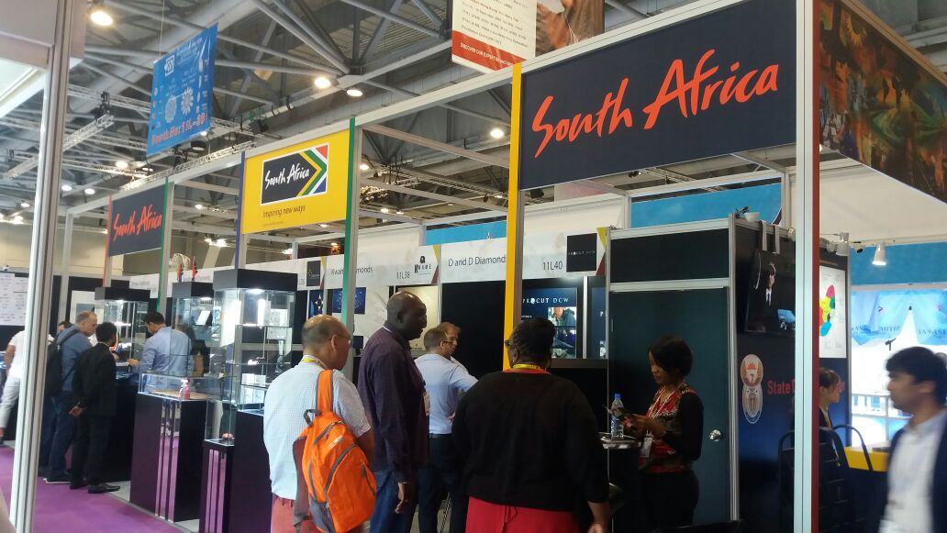
KEY PERFORMANCE METRICS: FACILITATING MARKET ACCESS
Continued promotion of access to international markets through
The 4th Hong Kong National Pavilion,. In total 16 companies participated, 11 of these being State Diamond Trader clients participated

Slide 16
KEY PERFORMANCE METRICS: FACILITATING MARKET ACCESS
Japan International Jewellery Show saw 5 clients of State Diamond Trader participating
Through partnership with SA Jewellery Council, implemented ideal and plan of expanding SA’s premier Jewellery Show, Jewellex, over 18 clients participated
Promoted diamonds and diamond industry in various provinces (NW, KZN, NC, FS) through its Provincial Promotions Activities plan

Slide 17
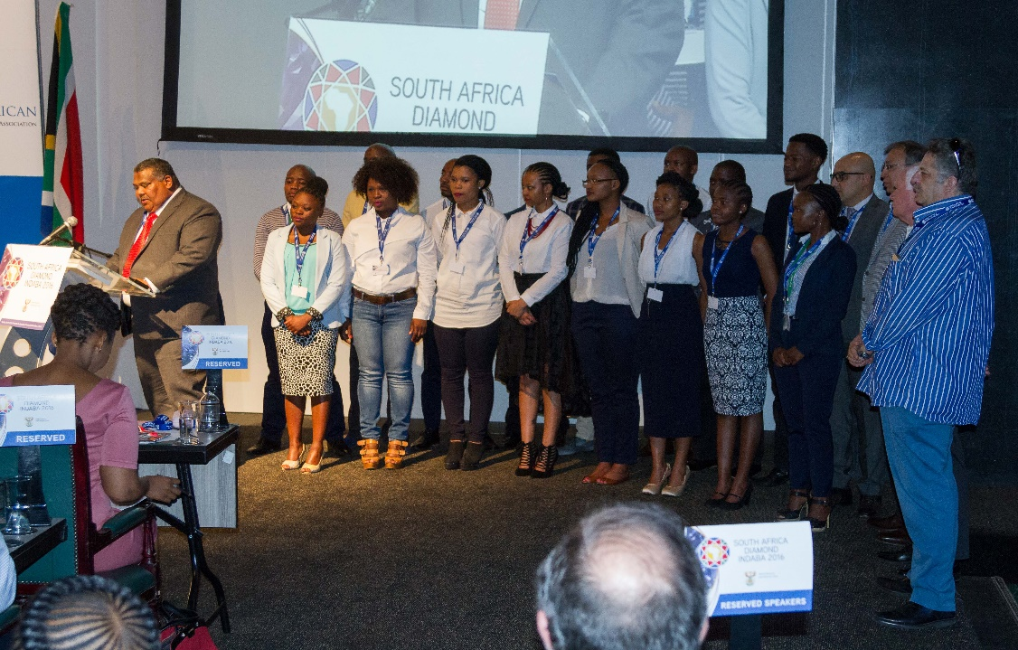
KEY PERFORMANCE METRICS: ENTERPRISE DEVELOPMENT PROGRAMME
17 young people participating in this programme
MQA providing financial support and industry partners factory based training

Slide 18
KEY PERFORMANCE METRICS: FINANCIALS

Slide 19
KEY PERFORMANCE METRICS: AUDIT REPORT
No material audit findings were identified hence State Diamond Trader managed to achieve clean audit.
Unqualified audit opinion was achieved both on Financial and Predetermined objectives.

Slide 20
STRATEGIC CONSTRAINTS
The State Diamond Trader continues to face these challenges in its operations:
Trading in Run of Mine means selling to clients a mix of what economically can beneficiate and what they deem uneconomical to beneficiate locally
No demand for certain types of goods means the State Diamond Trader bears the risk of holding onto the goods until it is able to sell
The disparity between rough and polished prices

Slide 21
STRATEGIC CONSTRAINTS
Volatile Rand/Dollar exchange rate is a major challenge when selling diamonds as clients negotiate in dollars and the entity sells at the rate it purchased at.
The “price-taker” position, in the purchasing of diamonds from producers in terms of section 59B of the Act.

Slide 22

THE NEXT 10 YEARS – UNLOCKING CONSTRAINTS
Key undertakings this financial year
  Board has mandated Management to review SDT strategy to better achieve developmental mandate of transformation and growth of local diamond beneficiation
  Including exploration of alternative sources of funding that will enable achievement of developmental mandate
Most importantly continued implementation of sound internal controls aimed at achieving a clean audit

Slide 23
CONCLUDING REMARKS
SDT continues to remain a key source of rough in a highly competitive diamond beneficiation environment
Review of strategy seeks to build on previous work whilst seeking innovative means of better achieving the mandate within a challenging environment
  Security of supply
  Transformation

Slide 24
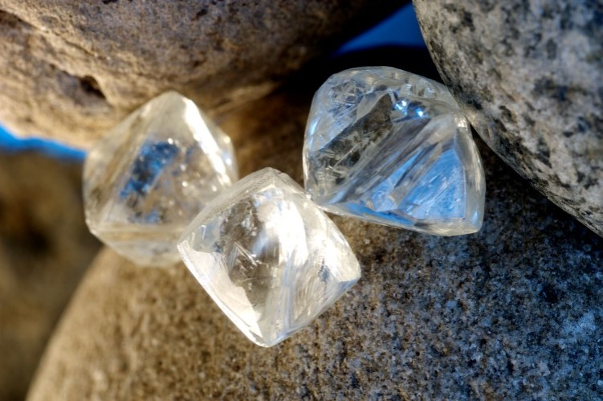
THANK YOU

