Slide 1
Portfolio Committee on Communications 2016/17 Annual Reports
A Presentation on Status of Portfolio
03 October 2017

Slide 2
Contents
Economic Downturn
Realties
Outcome 14
Midterm Review
Funding of Portfolio
An Inward Look of PCC
Recommendations Dashboard
2015/16 BRRR Recommendations
Parliament Processes to Track Recommendations
Auditor General Perspective
Entities Needing Attention:
SABC
Adhoc Committee Recommendations to PCC
MDDA
Minister’s Report
FPB
ICASA

Slide 3
Economic Downturn
For 2016 the economy shrunk by more than 1 per cent
Translate into declining average incomes for South Africans, impacting most severely on those at the lower end of the income distribution
(DPME Mandate Paper)
Notes:
The Mandate Paper
Aims to guide all spheres of Government and all Government entities to refine plans and develop budget proposals. The Mandate Paper therefore has to consider the specific functions and strengths of these institutions as well as the various pressures they face.
The Mandate Paper’s objective is to establish the strategic framework for decision-making on budget priorities that are required to advance the goals of the National Development Plan (NDP).

Slide 4
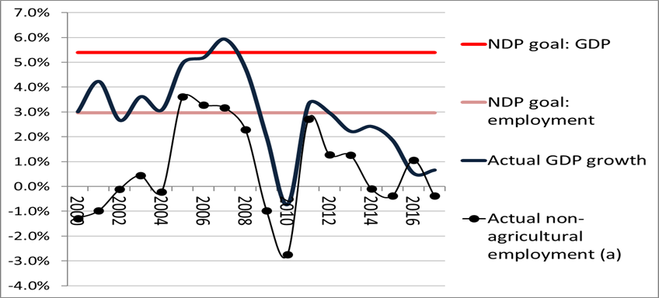
Economic Downturn Economic and employment growth rates compared to National Development Plan targets (2000 to 2016)
Source: Stats SA and South African Reserve Bank
Notes:
The National Development Plan is our roadmap towards socio-economic transformation.
Growth has slowed in contrast to the NDP targets of 5.4 per cent per year for GDP and 2.9 per cent for employment creation by 2030.
The growth slowdown can be related to both global and domestic factors.

Slide 5
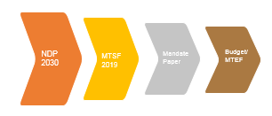
Realities
24 months left for the current administration
Constrained fiscal environment
Lack of adequate information systems in government to track progress towards the NDP 2030
Notes:
The Mandate Paper
Aims to guide all spheres of Government and all Government entities to refine plans and develop budget proposals.
The Mandate Paper’s objective is to establish the strategic framework for decision-making on budget priorities that are required to advance the goals of the National Development Plan (NDP).

Slide 6
Outcome 14
The 14 Outcomes of government are the catalysts for successful implementation of the NDP Goals
The NDP envisages an active citizenry that participates in the socioeconomic life of the country
The department’s work contributes in particular to outcome 14 (nation building and social cohesion) of the 2014-2019 medium term strategic framework
Notes:
The MTSF suggests that for the progressive attainment of nation building (unity of purpose and social cohesion) the following must be done:
The populace must have broad-based knowledge about and support for a set of values shared by all South Africans – Constitutional Values. These values provide the basis for a new South African identity.
Reduction of inequality of opportunity: reducing the impact of factors such as gender, ethnicity, place of birth and parental income and wealth and family background on people’s life chances. Success in life should depend on people’s choices, effort and talents, not their circumstances at birth. This can be done through reversing apartheid geography by establishing new spatial norms and standards – densifying cities, improving transport, strengthening the social wage and social security such that no South African lives below a minimum standard of living, growing the economy and employment and implementing a rural development strategy.
Redress including language, economic, spatial and cultural redress
Increased interaction between South Africans from different social and racial groups for people to discover in each other a common humanity. Public interaction is important for building trusting societies and debunking stereotypes. The sub-outcome includes improving the quality of public services; providing clean, pleasant localities for people to enjoy recreational activities; ensure there are adequate facilities for the majority of the population to play sport and that these are adequately maintained.
Growing strong leadership across society and a mobilised, active and responsible citizenry.
Fostering the creation of meaningful, sustainable social contracts, which could help propel South Africa onto a higher developmental trajectory

Slide 7
Outcome 14
Outcome 14 is cross-cutting and has an impact on all other outcomes
inculcates a feeling of belonging, accountability and responsible behaviour
is necessary to build trust, which is associated with stronger economic performance
The lack of expansion in the economy is placing a strain on employment and on budgets of government departments.
But still does not justify why such an important portfolio is underfunded

Slide 8
Midterm Review of progress towards the National Development Plan (NDP)
Only two entities are mentioned in the review:
ICASA developed a Code on Persons with Disabilities, as required by section 70 of the Electronic Communications Act 36 of 2005; and
the SABC has introduced sign language for its daily television news bulletins, and embarked on programming initiatives that incorporate sign language for viewers with hearing impairment.

Slide 9
Key Achievements of the Department in 2016/17 Financial Year
By its own accord, the Department has:
Achieved 76 percent of its planned targets for the year under review and up from 63% in 2015/16, i.e.
Extensive distributions and installations of DTT STB’s (136 364 registrations and 38 520 installations);
18 analogue transmitters have been switched off in the SKA areas;
MoU with DPW on training of STB installers with budget of R4 million
Held a two-day colloquium on Print Media Transformation;
However its core function is one with least successful delivery: (out of six targets, only two achieved)
In 2015/16, department committed to capacitating the Supply Chain Management during the 2016/17 financial - this service support is provided by GCIS

Slide 10
Funding of the Portfolio
R 1. 290 billion in the 2015/16 financial years
R 1. 349 billion in the 2016/17 financial years
R 1. 425 billion estimated for 2017/18 financial years

Slide 11
Funding of the Portfolio
91.3 per cent of the department’s budget (R1.35 billion) over the financial year was allocated for transfers to the state owned companies and regulatory institutions in its portfolio-down from 94 per cent in 2025/16
Leaving the Department with a mere R117.8 million for operations.
38.9 per cent allocated to Goods and Services, 57.7 per cent of which was on compensation of employees

Slide 12
PCC Inward Look

Slide 13
PCC Inward Look

Slide 14
PCC Inward Look
Sep-16 Recommendations
The joint Committees note that there are still gaps in the delivery of DTT;
There is a need for continuous engagement through meetings of joint committees;
The project is critical and it has to be concluded as a matter of urgency because the dual illumination (which was a serious concern to both Committees) is impacting negatively on Sentech, which is one of the best performing entities in relation to this project; and
While Members share the same sentiments with the Department and FPB on the intent of the Bill and that no Member wishes to delay the Bill any further, more consultation is required with all stakeholders.

Slide 15
PCC Inward Look
Systematization of Tracking of Recommendations
Recommendations must be time-bound
Protocol defeats the oversight model i.e. SABC board appointments
Programming of PCC must include presentation of responses to recommendations in a systematic manner

Slide 16
2015/16 Budget and Recommendations Review Report (BRRR)
A BSA study results indicated that citizens show a strong devotion to their country –
65 per cent of the population describe themselves as South Africans first; and
84 per cent South Africans, reflecting pride to be South Africans.
Needs to translate to economic transformation
While the Committee notes that some of the matters raised in the 2014/15 financial year BRRR report were responded to by the Minister during her interactions with the Committee, no formal written response to the specific recommendations as made by the Committee during the 2014/15 financial year were received.

Slide 17
2015/16 Budget and Recommendations Review Report (BRRR)
ensure that the Department reports quarterly on the implementation of the Committee recommendations;
ensure that the Department and entities implement the recommendations of the Auditor-General;
ensure reduction in the use of consultants by the entities of the Department;
speed up the process of filling critical vacancies within the two Departments;
ensure that Board Chairpersons of entities speed up the process of filling critical vacancies in key leadership positions;
make available the shareholder compacts that she has signed with the entities to enable the Committee to track progress; and
prioritise the transformation of the Print Media.

Slide 18
2015/16 Budget and Recommendations Review Report (BRRR)
The Committee will invite the National Treasury to address challenges of underfunding of the new Department of Communications.
The Committee is of the view that there is a need for audit of government property as a lot of money was spent on office rental. Other government departments must be brought in to assist the Department of Communications in acquiring its own building.

Slide 19
2015/16 Budget and Recommendations Review Report (BRRR)
The new Department will be expected to continue to expand its capacity in order to ensure successful implementation of its mandate in line with the National Development Plan.
Communication within the Departments’ portfolio should become central to its operations so that the transformation agenda of the communications sector is accelerated especially to the rural communities who are always in need to be integrated into mainstream economy.
A vibrant communication environment will ensure broader economic, social and political participation of the entire South African citizenry

Slide 20
Audit Outcomes of Communications Portfolio
While the clean Audit of the Department is commendable, and that it has managed to increase clean audits within its portfolio to 43 per cent by 2015/16 financial years, more needs to be done to ensure growth in this regards
It will become increasingly difficult to advocate for more funding when accountability lacks in the portfolio
7 auditees
6 auditees
6 auditees

Slide 21
Audit Outcomes Over Three Years – Communications Portfolio
Unqualified with no findings
Unqualified with findings
Qualified with findings
7 auditees
6 auditees
6 auditees
Notes:
It is imperative for the Committee to schedule in its programming the progress of implementation of the SABC Adhoc committee recommendations, particularly those addressed to the Committee. For this term, the Committee has scheduled the broadcasting Amendment bill for deliberations
The Report on MDDA by the Minister will be most welcomed, and should be seen as progress to wards resolving the challenges at the Agency. The Committee has to schedule a meeting with the Minister to find way forward
The Committee has scheduled a meeting with the Minister to brief Committee on status of FPB. It has also scheduled to deliberate further on the FPB amendment Bill.
A similar approach to that of SABC, MDDA and FPB should be followed in order to ensure that ICASA is also compliant
C

