Slide 1
Trends in air pollution in South Africa
Contents
Prof Rebecca M. Garland
Natural Resources and the Environment Unit, Council for Scientific and Industrial Research, Pretoria, South Africa
Extraordinary Associate Professor, Climatology Research Group, North West University, Potchefstroom, South Africa
Ensuring Full Compliance with the National Environmental Management: Air Quality Act
13 September 2017

Slide 2
Unpacking the topic
Context: Complexities of management and air pollution
Historical context
Snapshot: Where are we now?
What do we know about ambient pollution trends?
  Highlight some pieces of the puzzle
    Local information
    An assessment of international data
Emerging management concerns
Research trends to meet air pollution and air quality management concerns
Throughout I have highlighted data to illustrate points. Many times this is just an example or an area we have worked in → not to say problem is limited to only these sites, these points many times will hold true at other sites

Slide 3
About our group
Climate Studies, Modelling and Environmental Health Research Group sits within the Global Change Competency Area in the Natural Resources and the Environment Unit at CSIR
Focus of sub-group on Air Quality and Environmental Health
  Air quality modelling
  Health risk and impacts from air quality and climate change
  Air quality-climate change linkages
Use models and existing data to improve understanding of atmospheric science in region – we do some primary data collection, but generally in collaboration with others
Goal: provide evidence base to support decision makers in air quality and climate change
Presentation will highlight research from CSIR and research community

Slide 4
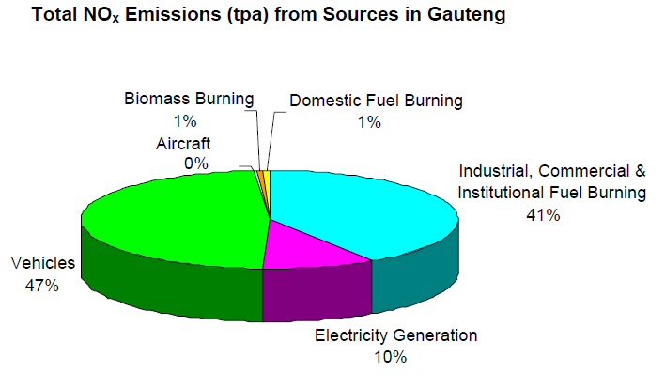
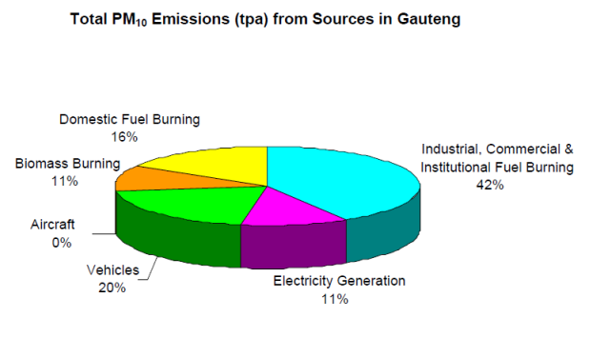
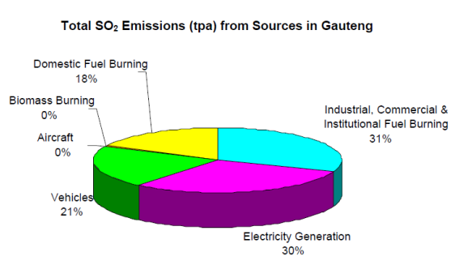
Complexities: Range of source
Understanding air quality and atmospheric science, and managing air quality are all complex
  Variety of sources → example: Each pollutant in dominated by a different source → AQ management needs a multi-sectoral approach
Only those things that you estimate will be on the pie chart
If not able to estimate some sources, those you can estimate look more important → estimates are only as good as data available
You can’t manage what you don’t count;
  Dust, Waste burning, Etc.
Emission inventories useful for identifying key sectors → but do not equate to what people breathe
NO_{X}
PM₁₀
SO₂
Gauteng AQMP 2009

Slide 5
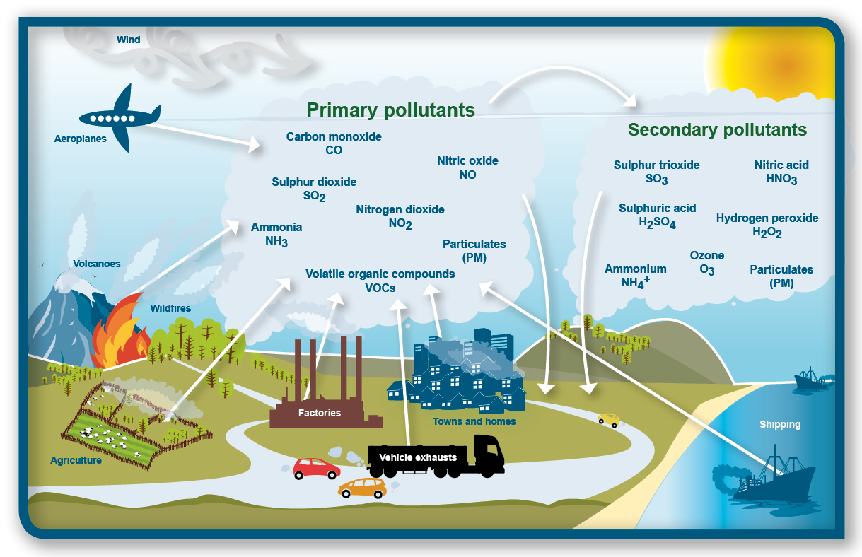
Ambient air pollution
http://www.environment.scotland.gov.uk/get-informed/air/air-quality/
Multiple sources of pollutions – low level and aloft
Multiple impacts of pollutions – health, ecosystem (deposition), agriculture (ozone and SO₂), water, materials, visibility, climate.
Indoor air pollution not shown here → potential for large health impact with domestic fuel use

Slide 6
What do we know?
Historical measurements
SO₂ and smoke (PM₁₀) concentrations measured by CSIR from 1950s (first in Tshwane)
PM₁₀ and SO₂ concentrations were seen to decrease in this time period (graph up to 1980)
PM₁₀ concentrations in figure are high (winter averages: April – Sept average; current annual std 40 µg/m³)
Our group currently in process to try to digitize these records to improve the historical analysis
Compliance monitoring is now source of routine air quality data → routine regulatory ambient monitoring now with government and SAWS
Kemeny , Clean Air Journal, 1980

Slide 7
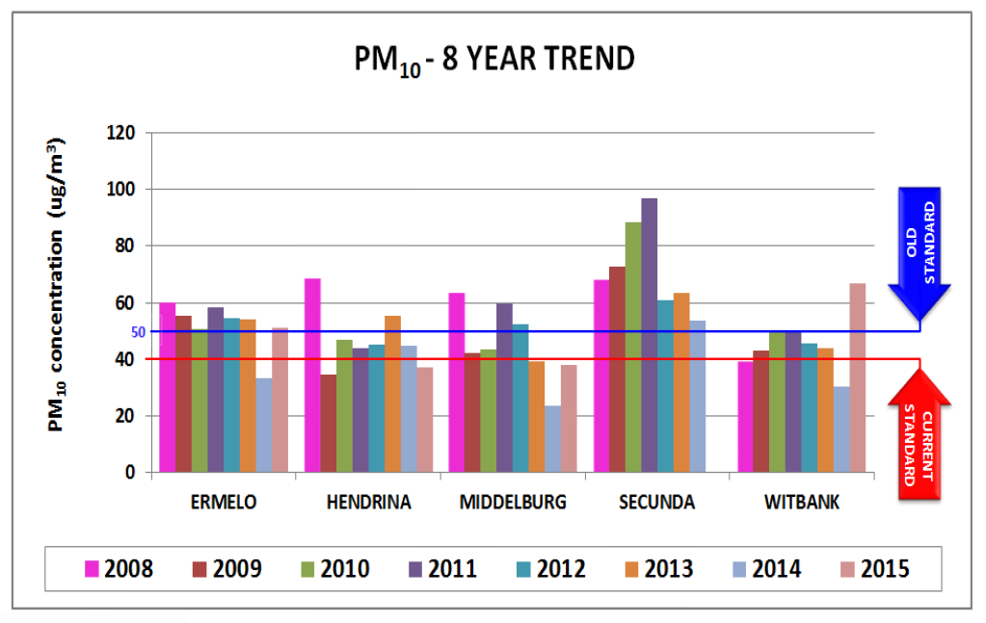
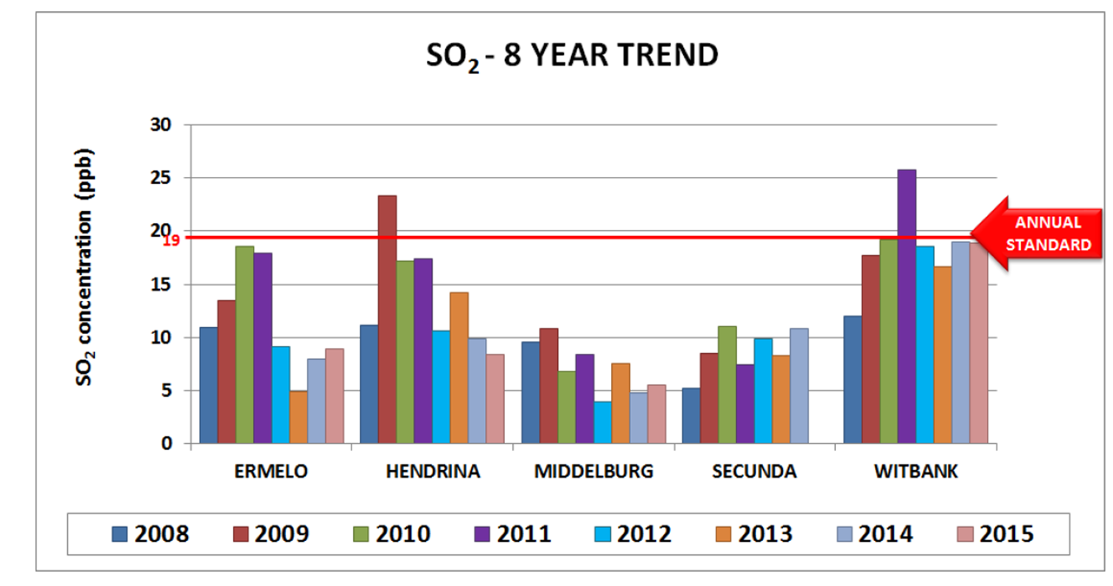
DEA reports on State of Air
HPA
National Air Quality Officer, Dr Thuli Khumalo, presents on the State of Air each year
Graphs here and next page → NACA Conference 2016 presentation (saaqis.org.za)
Highlighting a few slide from HPA and VTAPA
These are not unusual or unique
  Many places we have looked have PM and ozone exceedances in particular
  NO_{X} and SO₂ do have some exceedances, depending on what sources are near by
Khumalo, 2016
HPA

Slide 8
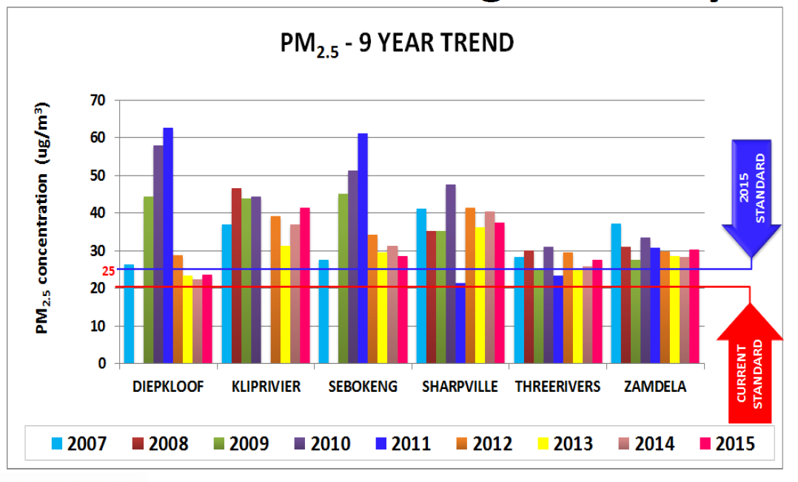
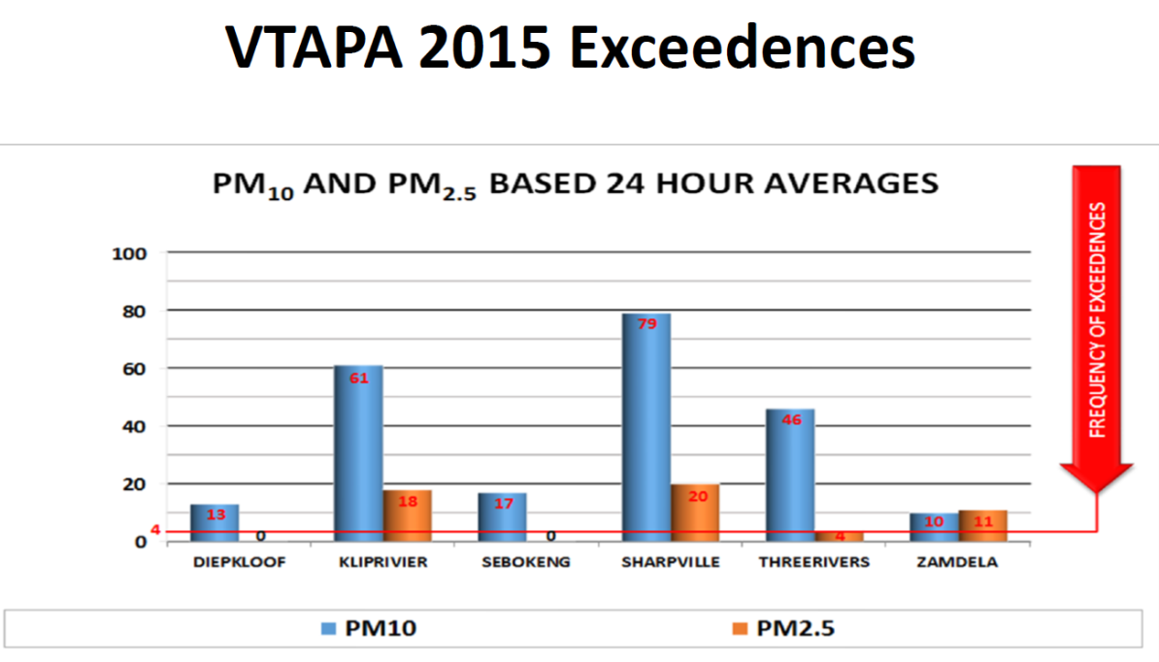
State of Air 2016
VTAPA
VTAPA example → numerous exceedances of PM
Varying levels of data completeness across years
National view of State of Air Quality → Monitoring sites get placed for a reason, and generally are in the polluted areas
Khumalo, 2016

Slide 9
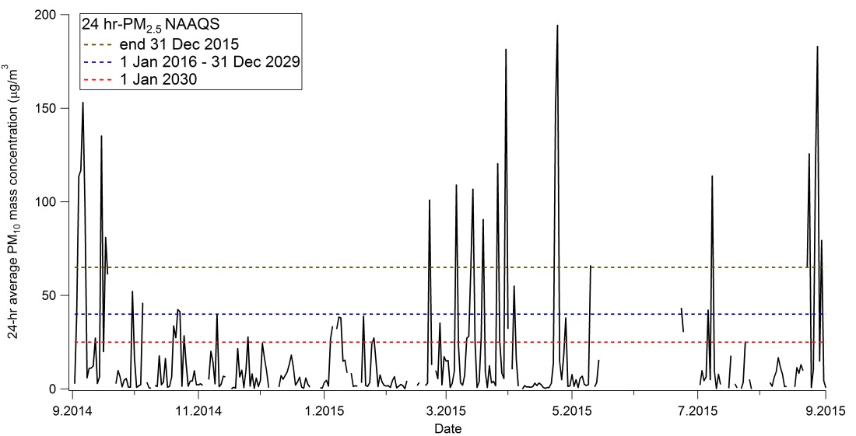
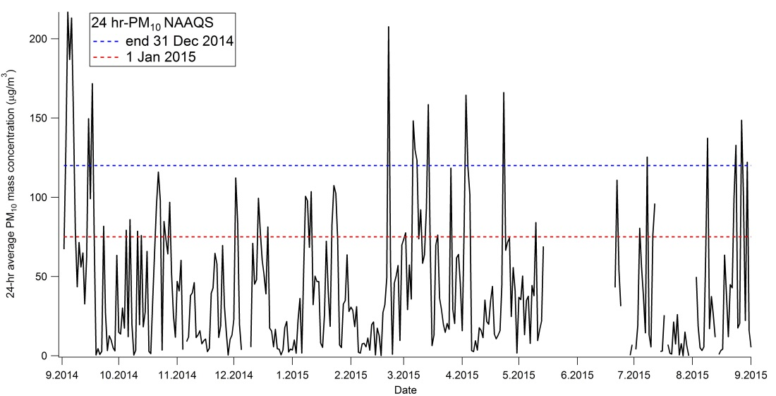
Background station
Background and regional stations important for understanding air quality status away from strong local sources
PM in particular. South Africa has a dry climate (most of country is semi-arid to arid), plus there is strong biomass burning → area of research at CSIR to estimate and model “background” concentrations from natural sources
SAWS Karoo site unique (Hantam National Botanical Garden, Nieuwoudtville, Northern Cape). Background site, also only site close to shale gas study area in SEA → PM in exceedance!

Slide 10
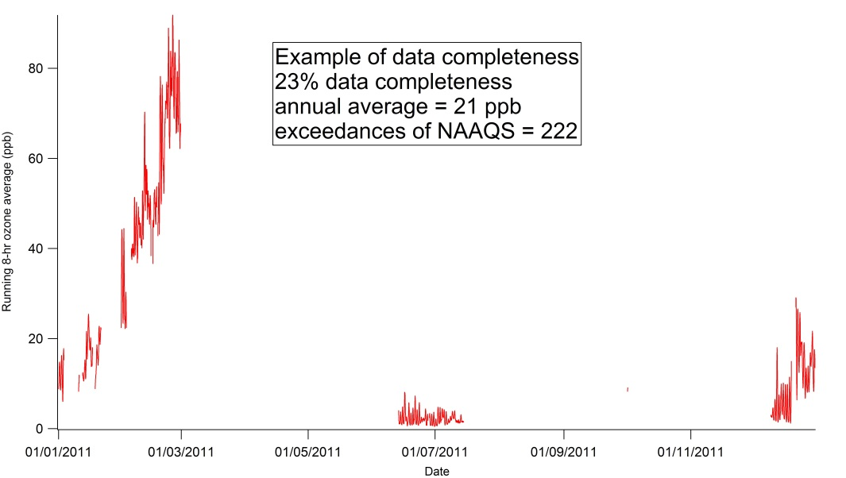
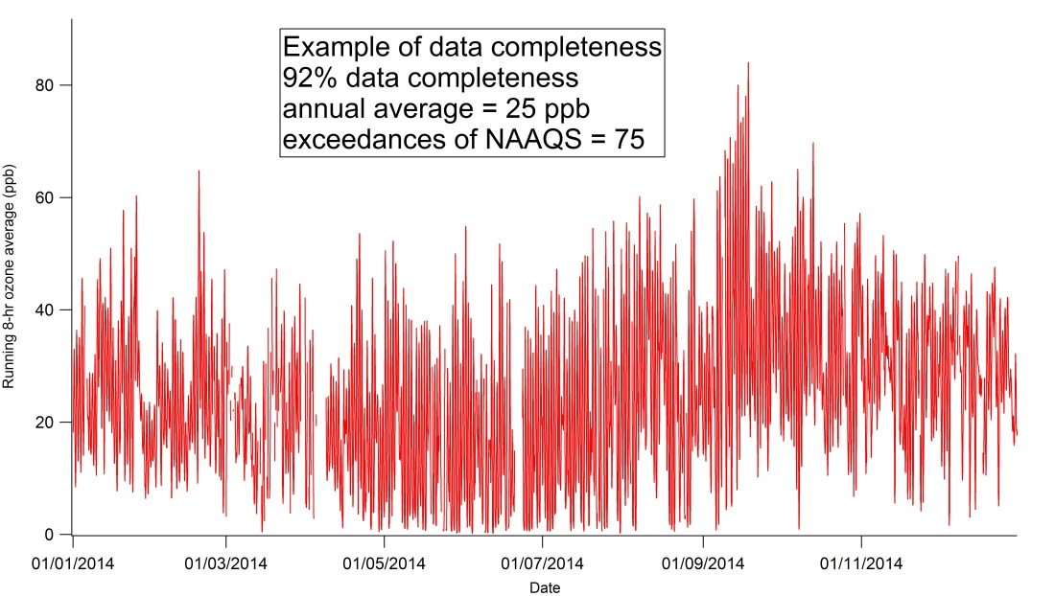
Exceedances and data completeness
One gap in monitoring data is that there are varying levels of data completeness → important when comparing exceedances and averages
Is 2011 (top) better than 2014 (bottom)?
This can make trend analysis difficult
Sustained support for compliance monitoring key

Slide 11
Example of ozone data available and exceedances
Example: City of Johannesburg analysis: 2004 Buccleuch few exceedances, but low fraction of available data
This analysis has also showed that ozone production in these sites are VOC limited →
  Must reduce NO_{X} and VOCs together to decrease ozone (both precursors)
  If only decrease NO_{X} emissions, will increase ozone
Borduas , Garland, et al., drat in preparation

Slide 12
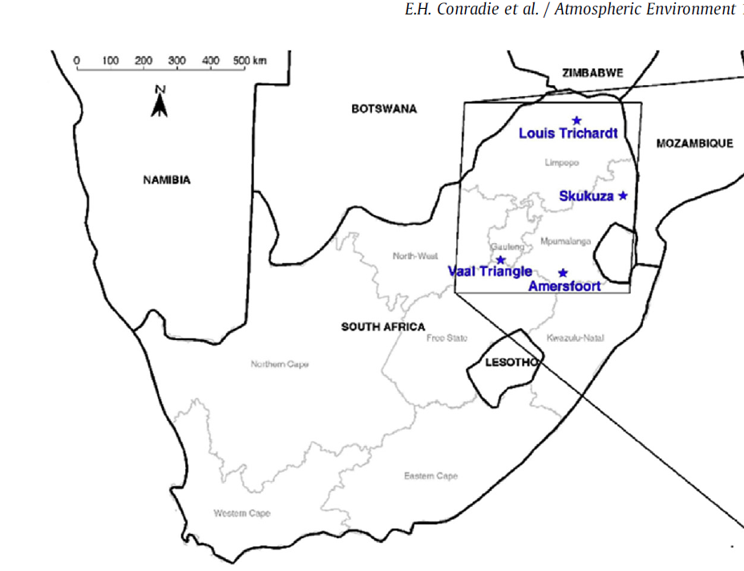
Trends: Long-term Deposition Measurements (IGAC DEBITS in Africa)
IDAF long-term measurements of deposition (multi-decadal)
Analysis of 4 sites (1986-1999 compared to 2009-2014)
Wet deposition (rain water), event based sampling
Increasing wet deposition flux of species associated with anthropogenic activities (sulphates, nitrates, ammonium ions)
Measured an increase in acidity of rain events
Regional and industrial sites
Conradie et al., 2016
IDAF sites run and maintained by the Atmospheric Chemistry Research Group, NWU; funding from Sasol, Eskom and NRF

Slide 13
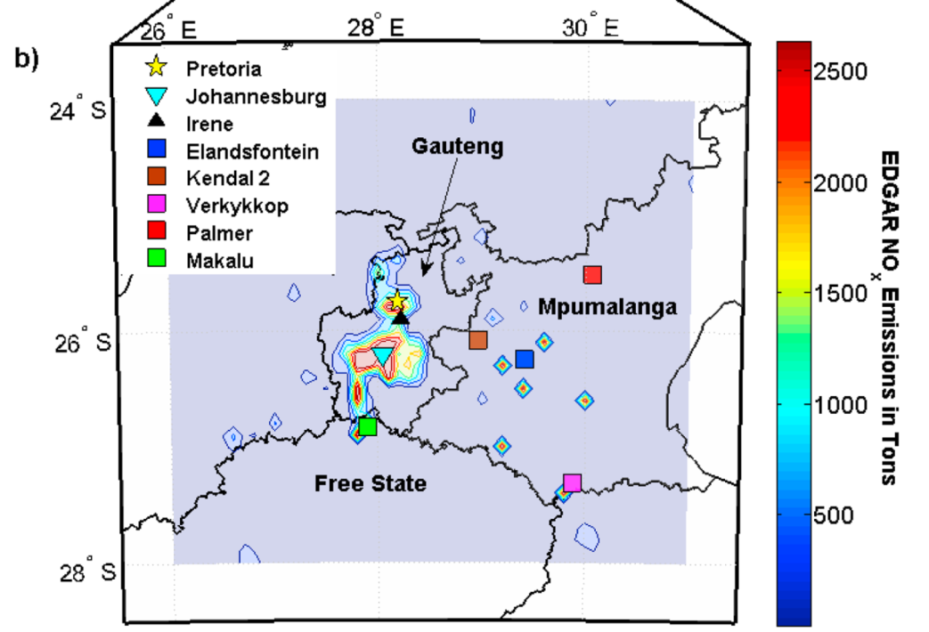
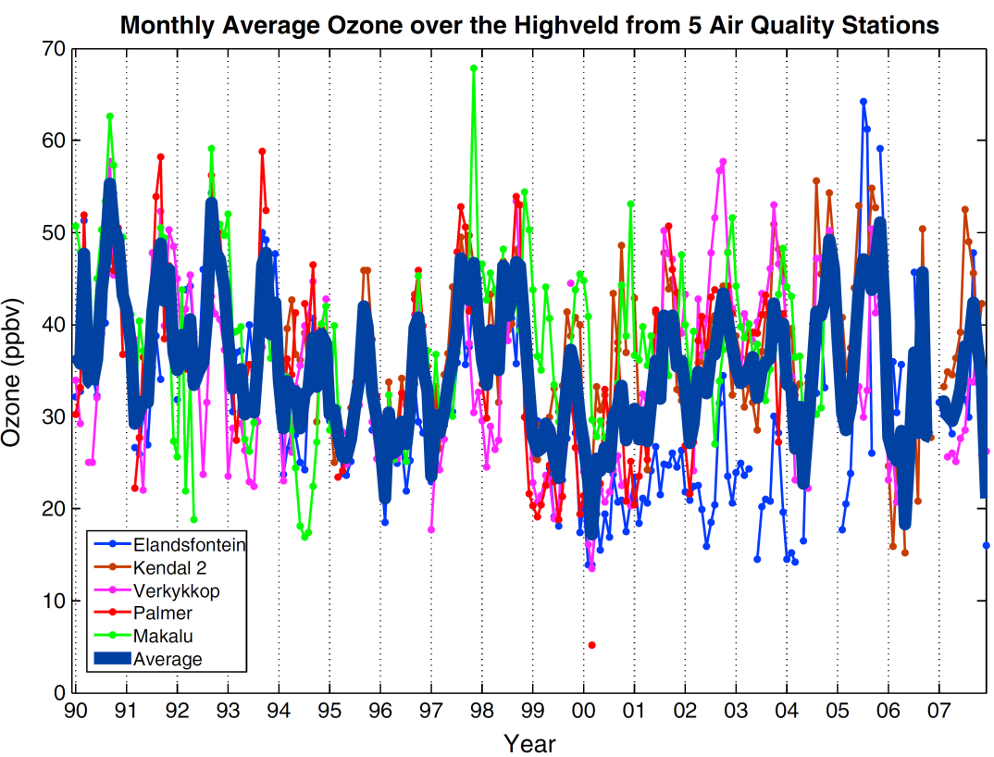
Trends: Ozone
Analysis to understand if El Niño-Southern Oscillation (ENSO) impacted ozone concentrations in the Highveld → El Niño typically drier and warmer
4 of 5 stations showed sensitivity to ENSO in Dec-May, with El Niño amplifying ozone formation
No trend in annual ozone
Palmer station exhibited slight negative trend (-0.92 ppb/yr) in spring (1990-2007)
Balashov, Thikpson, Piketh and Langerman., 2014

Slide 14
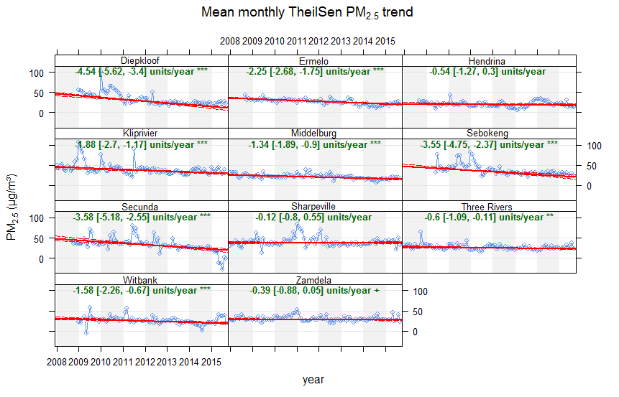
Trends: Preliminary analysis of PM_{2.5}
Compliance monitoring data → Trends can be difficult due to varying amount of data completeness. Trends need longer time series with complete data or no systematic biases
Older networks do have substantial record of data.
Statistically significant trends seen at all but three sites
Linear trends range -0.6 to -4.54 µg/m³
Need to continue to assess data and trends
Mean Monthly PM_{2.5} Trend
Dr Gregor Feig

Slide 15
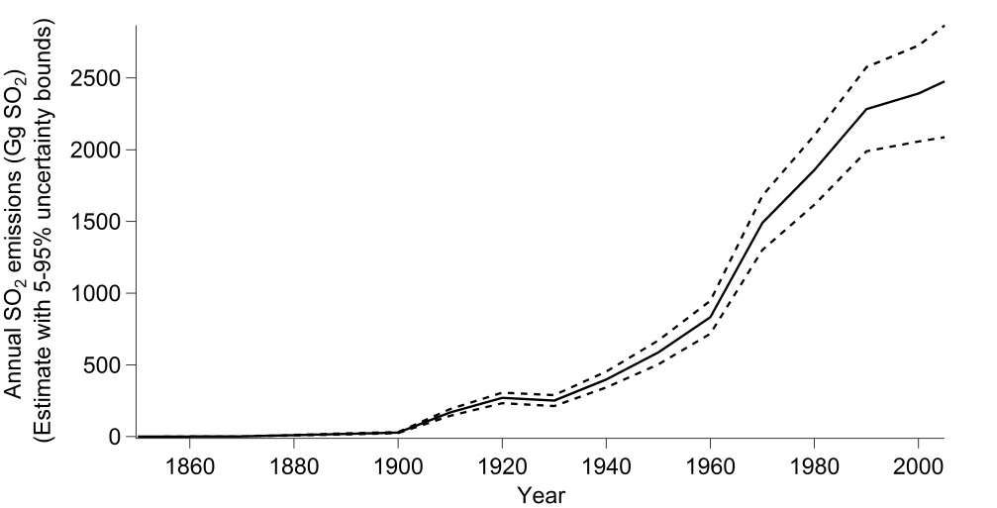
International databases: SO₂ emissions from international sources
International products available for air quality
  Emissions and global model outputs
CSIR assessed quality of input data in the Environmental Performance Indicator (EPI) for a 3R project for Chief Policy Advisor: Strategic Environmental Intelligence: Mr Peter Lukey
Comprehensive national SO₂ inventory not available for assessment to compare to EPI → however with NAEIS, this will be possible soon for industrial sources
  Non-industrial emission inventory necessary as well (e.g. vehicles, domestic burning, ships for SO2)
Ideally a locally derived estimate, which includes local fuel specifications and activity data, must be available such that researchers can include these data into their studies and indices.
Data from Smith et al., 2011
Winter concentrations (April – Sept) of SO₂
57 ppb
19 ppb (aa)

Slide 16
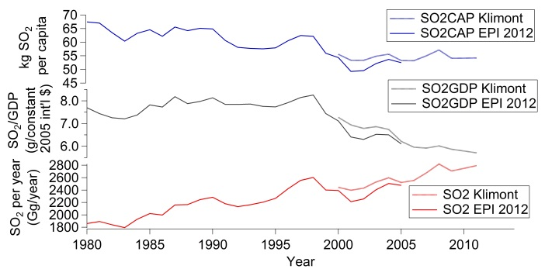
EPI SO₂ emission estimates
SO₂ emissions– increasing trend
SO₂ /GDP decreases after 1998– SO₂ emissions decoupled from GDP growth
SO₂ /CAP – slower decrease, but current plateau
But how robust are these trends? What is missing from international SO₂ emission databases? Local data needed → feed into international assessments
In understanding the impacts of management → also need to consider the counterfactual scenario (what would things have been like without AQ management)? Modelling is a key aspect
Garland et al., NACA Conference 2016

Slide 17
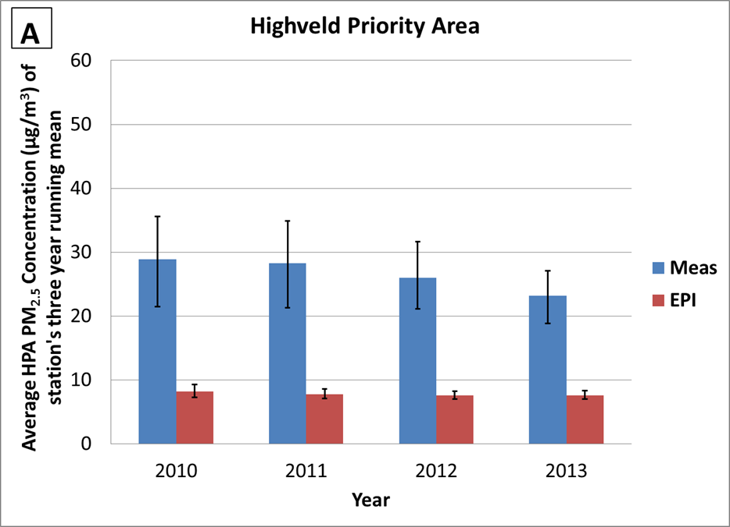
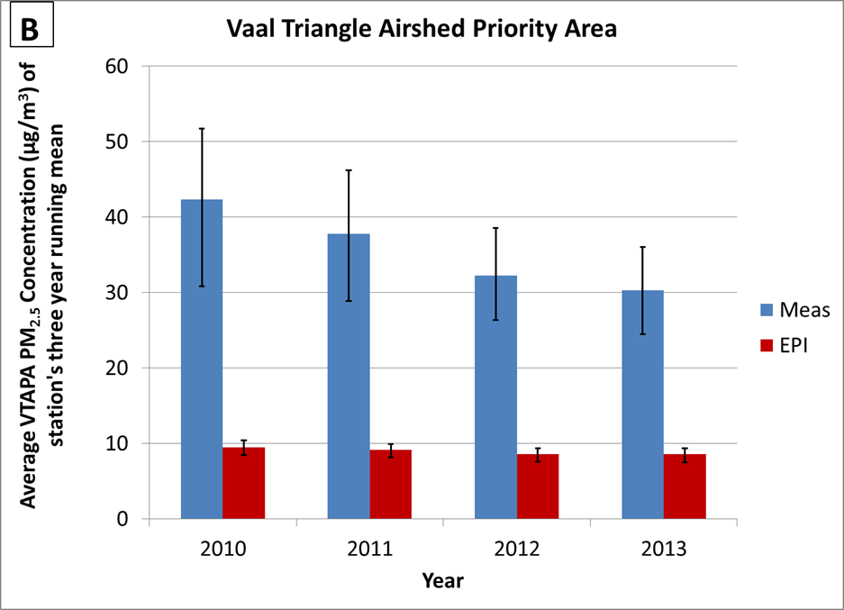
EPI PM_{2.5} comparison – average of priority areas
EPI underestimates PM_{2.5} ground-level values (same pattern across sites)
  Bars extend to 25th and 75th percentile of stations
Slight negative trend in averages (significance not tested)
Similar approach for PM_{2.5} in basis of Global Burden of Disease (Brauer et al., 2015))→ underestimating impacts
International datasets need to be tested for their applicability and utility - what can/should we use them for? They do get used by many stakeholders.
  Local emissions to feed into these studies
  Local ambient measurements to validate
Garland et al., Clean Air Journal 2017

Slide 18
Trends in research to support improving air quality
Continued compliance monitoring as well as targeted campaigns
Improvement, alignment and availability of emission inventories (all sources)
Assess use of international databases → what can we use, what can we improve?
Health: exposure assessments (indoor and outdoor)
Air quality models (Chemical Transport Models, e.g CAMx) that simulate “one atmosphere” and account for transformation of pollutants or the interaction of pollutants from different sources → simulate secondary pollutants
Holistic assessment of air quality and assessing multiple scenarios for multiple benefits and impacts → we would like to develop South African-tailored Integrated Assessment Models
Climate change and air quality linkages
  Mitigation: Co-benefits to improve GHG and AQ
  Adaptation: How will climate change impact air pollution?

Slide 19
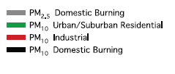

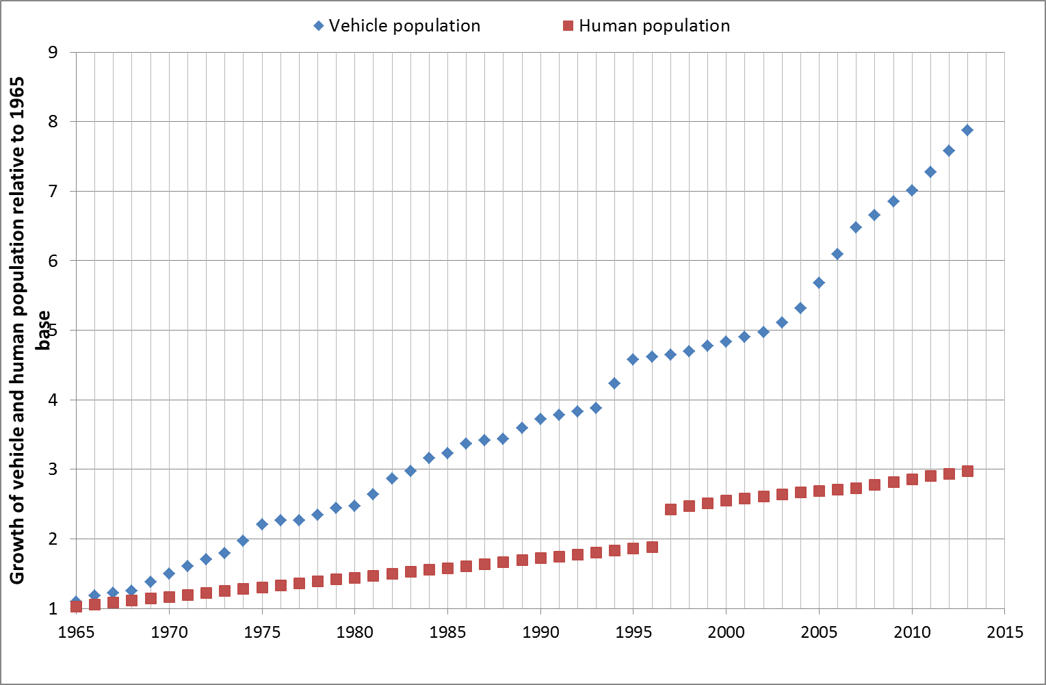
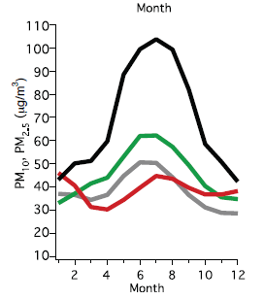
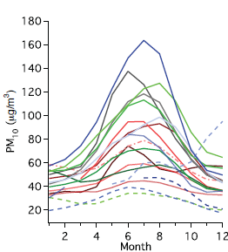
Management trends: mobile and diffuse sources
Low-level sources can have large impacts as in breathing zone of people
  Traffic emissions and domestic burning emissions
At sites across 4 monitoring networks (CoJ, CoT, VTAPA, Gauteng HPA sites), PM levels in township monitoring sites > than other types of sites
Vehicle population is increasing; Health impacts from traffic emissions
  Diesel exhaust → carcinogenic to humans (WHO, IARC)
  Prevalence of asthma has been associated with exposure to heavy truck traffic while living close to road (Gowers et al., 2012)
Hersey, Garland, et al., ACP, 2015
Sources: CSIR (2003), eNaTIS (2014), StatsSA (2013)

Slide 20
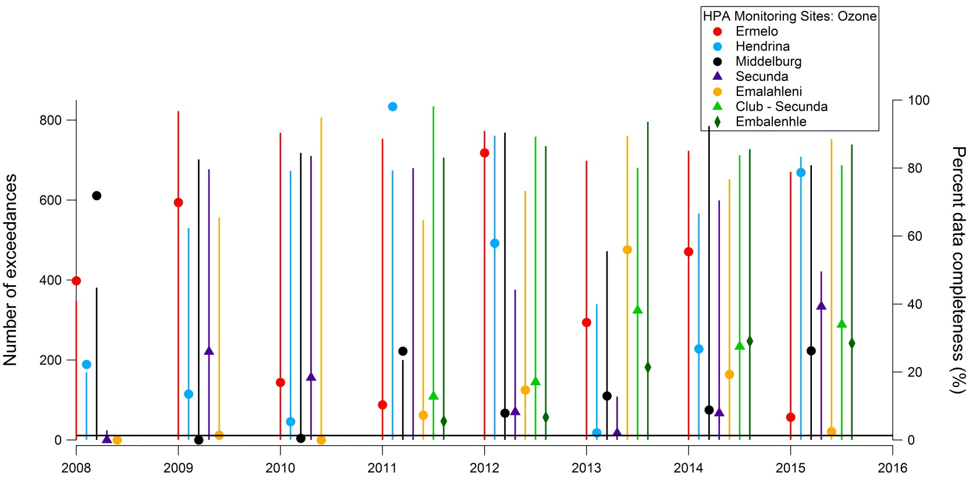
Management trends: Importance of understanding ozone
Large number of exceedances → Highlighting HPA sites (SAAQIS)
If simulated ozone concentrations are too low, why? This is why detailed measurements are necessary
Research needs
Emissions
Precursor monitoring
Modelling
Climate, agriculture and health impacts
Integrated assessment – multiple benefits

Slide 21
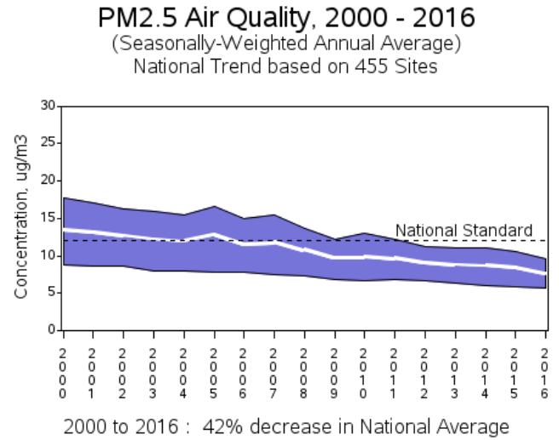
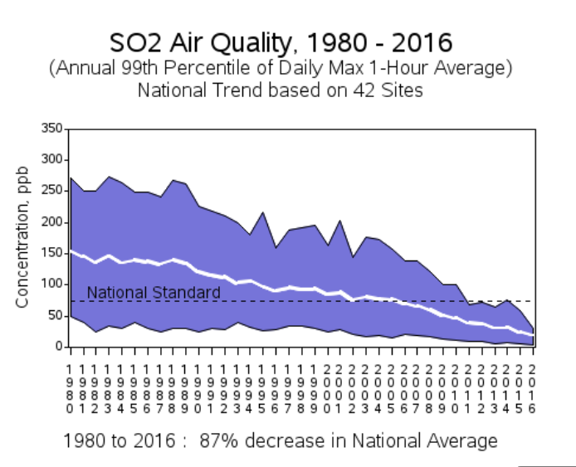
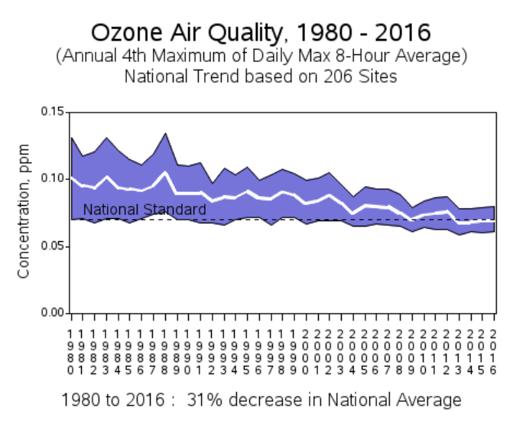
Ozone is notoriously difficult
Graphs of national trends from US EPA (Purple is 90% to 10% stations)
Highlights the long struggle with ozone
Sustained, targeted and effective management
But for this, need evidence base
  Modelling
  Monitoring
  Impacts (health, ecosystems and agriculture)
https://www.epa.gov/air-trends

Slide 22
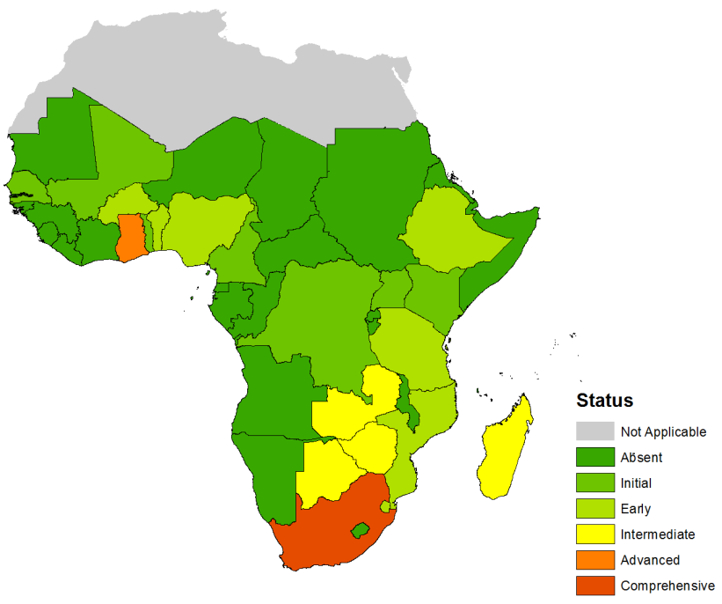
Positive trends in management and air quality
Scientists have tendency to point out gaps and issues
South Africa have the tools to improve air pollution
Improving air quality is difficult. It is an on-going process that needs continuous effort
  Technical knowledge
  Sustained support
  “invisible”
  Involvement of many stakeholders
Taken from Garland, Libenberg-Enslin et al., 2017; based on Schwela, 2012
Real benefits to improving AQ across sectors (health, agriculture, ecosystems, climate, water, infrastructure)
Complex situation: Diversity of sources and understanding the counterfactual scenario (M&E includes monitoring and modelling)
Research can assist to provide evidence base for effective decision-making

Slide 24
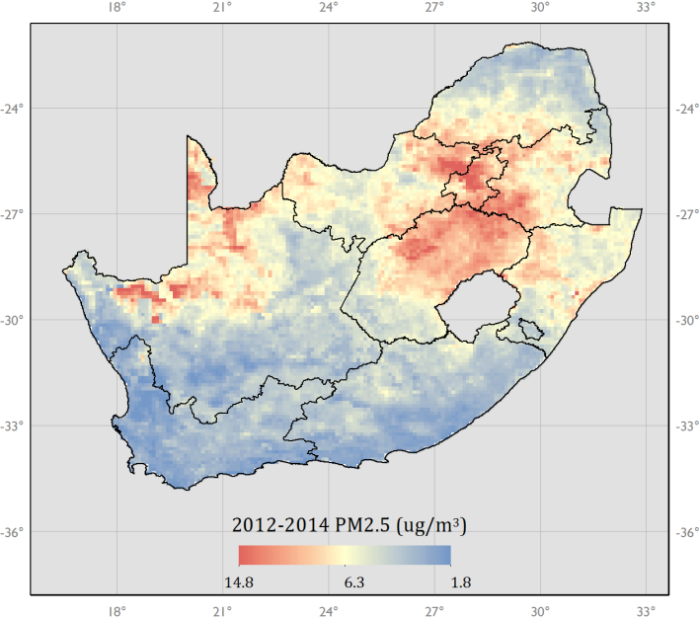
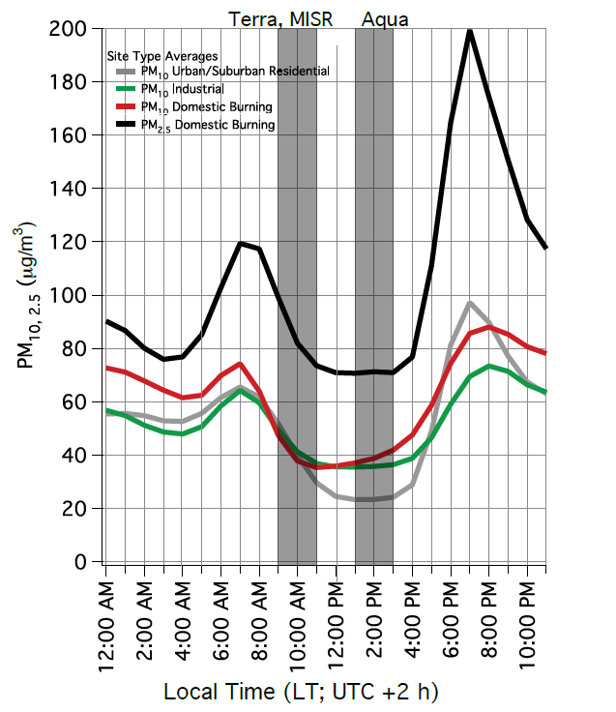
PM25
2013 three year running median of surface PM_{2.5} mass concentrations used as input into the EPI
EPI
National values for PM25 reported
Ground-level PM_{2.5} data available gridded as three-year running median (10 km resolution)
Ground-level PM_{2.5} data calculated from combination of satellites and models (e.g. vertical profiles) – satellite overpass time
Monthly values then calc three year moving median values. The median values were used to reduce the noise in the data from the satellite retrievals (van Donkelaar et al., 2015)
Hersey, Garland, et al., ACP, 2015

Slide 25
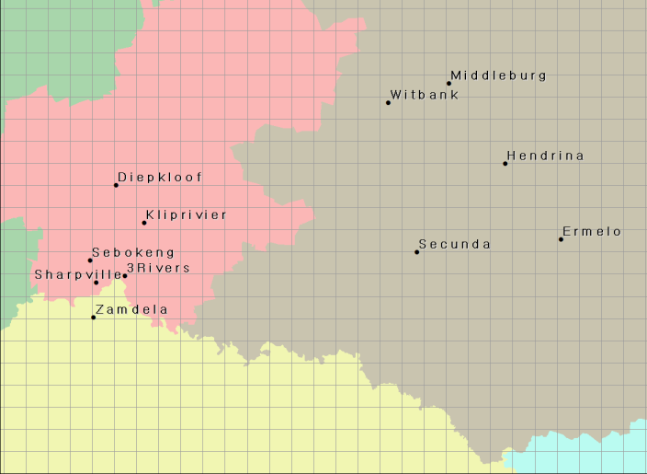
Local PM_{2.5} data
Local
Used PM_{2.5} ambient data available on SAAQIS for networks with long and continuous dataset – HPA and VTAPA
1 Jan 2008 – 1 October 2015. These data were quality checked (QC) by CSIR, and then averaged to monthly values, and processed to a corresponding three year moving median as reported in EPI data.
Did not use data completeness thresholds – concerns with losing too much data
Used all hours of day (not just overpass) – better estimate of ambient exposure

Slide 26
What is state of air quality? What are gaps?
Studies in many areas in South Africa find high levels of pollution → secondary pollutants (i.e. those formed in the atmosphere in particular are issues of concern → PM and ozone)
Compliance monitoring data → trends
Research is needed as air quality and air quality management are extremely complex
Local – international researchers link to improve understanding
NO_{x}-limited regime
VOC-limited regime
P(O₃)
NO_{x} concentrations

Slide 27
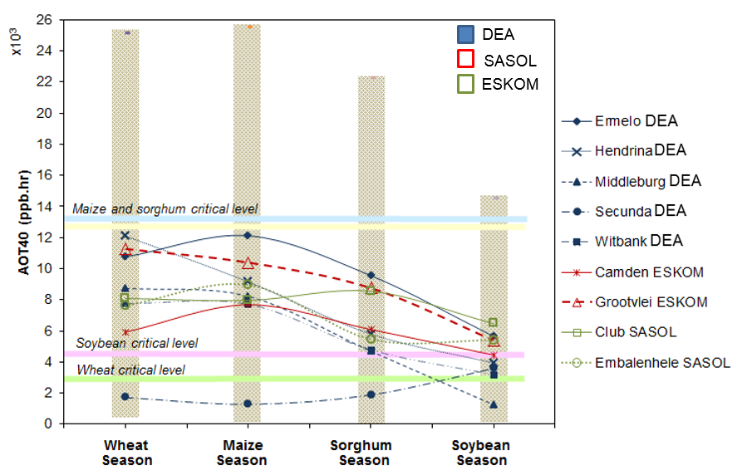
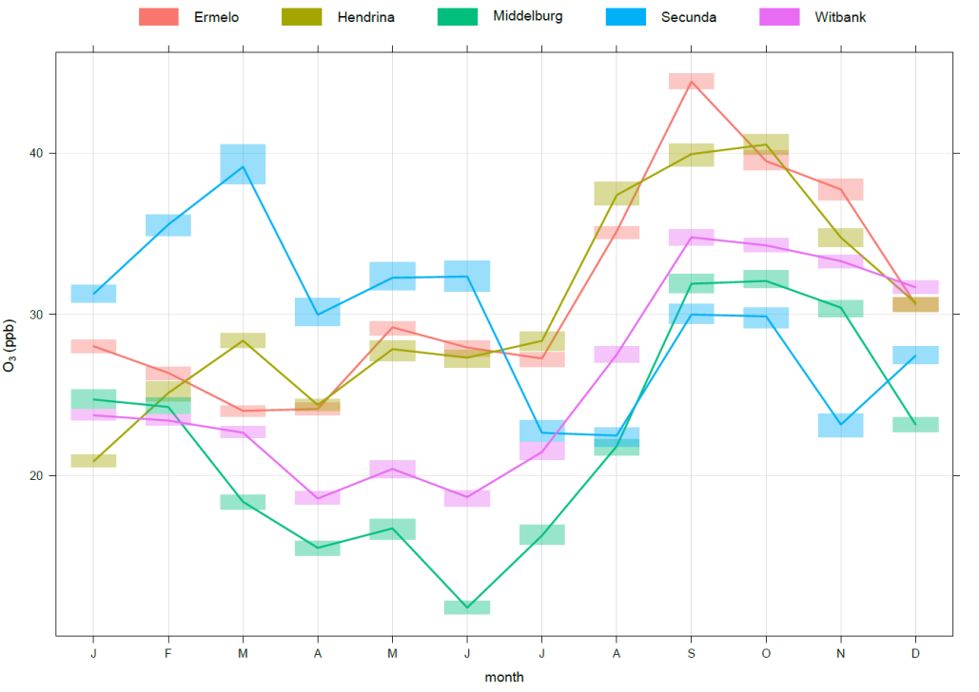
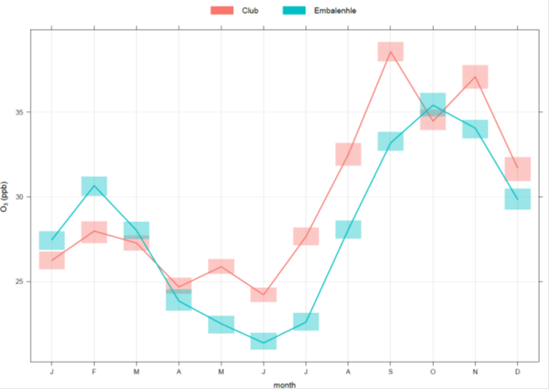
Multi year (2008-2015) AOT40
Crop | Function (y=relative yield x = AOT40 in ppm.hr) | Reference
Wheat (C3) | y=-0.0161x+0.99 | Fuhrer et al. (1986a) Temple (1990b)
Maize (C4) | y= -0.0036x+1.02 | Rudorff et al. (1996), Mulchi et al. (1995), Kress and Miller (1985)
Sorghum (C4) | y= -0.0036x+1.02 (same as maize was used) | Rudorff et al. (1996), Mulchi et al. (1995), Kress and Miller (1985)
Soybean (C3) | y=-0.0116x+1.02 | Heagle et al. (1988b), Heggestad et al. (1985, 1988), Mulchi et al. (1995) Heggestad and Lesser (1990), Heagle et al. (1987a, 1998), Fiscus et al. (1997)
Piqueras et al., in prep
Previously developed response functions were utilized to calculate the yield losses for each crop
Not based on South African cultivars: Similarly robust relationships not yet available
No AOT40 equation has been developed for sorghum. The same equation as maize was used because both are C4 plants
Across all sites except Secunda site (township in industrial area), the AOT40 is larger for wheat than soybean → ozone peaks in spring before rains
For maize and sorghum, on average the AOT40 is below the threshold → but large inter-annual variability across years

Slide 28
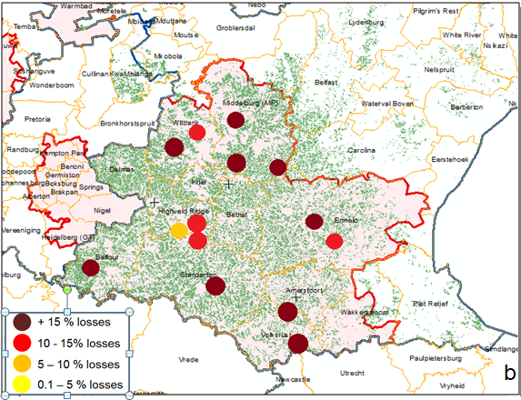
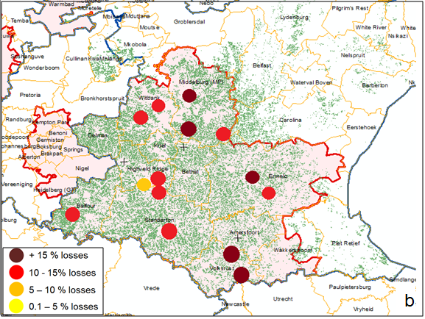
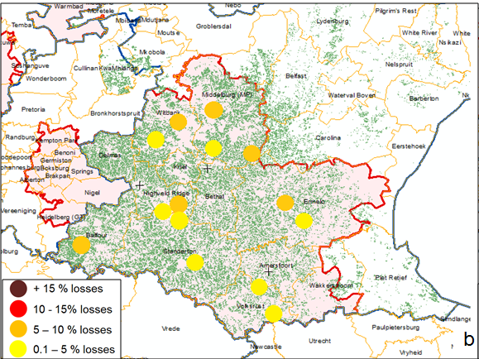
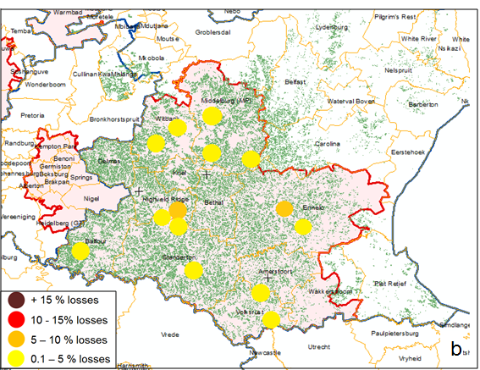
Estimated average annual percent yield losses per crop
Wheat
Maize
Yield losses calculated from AOT40 → Decrease in losses through seasons
No spatial trend seen
Sorghum
Soybean

Slide 29
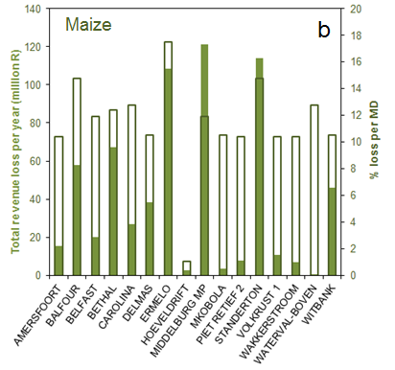
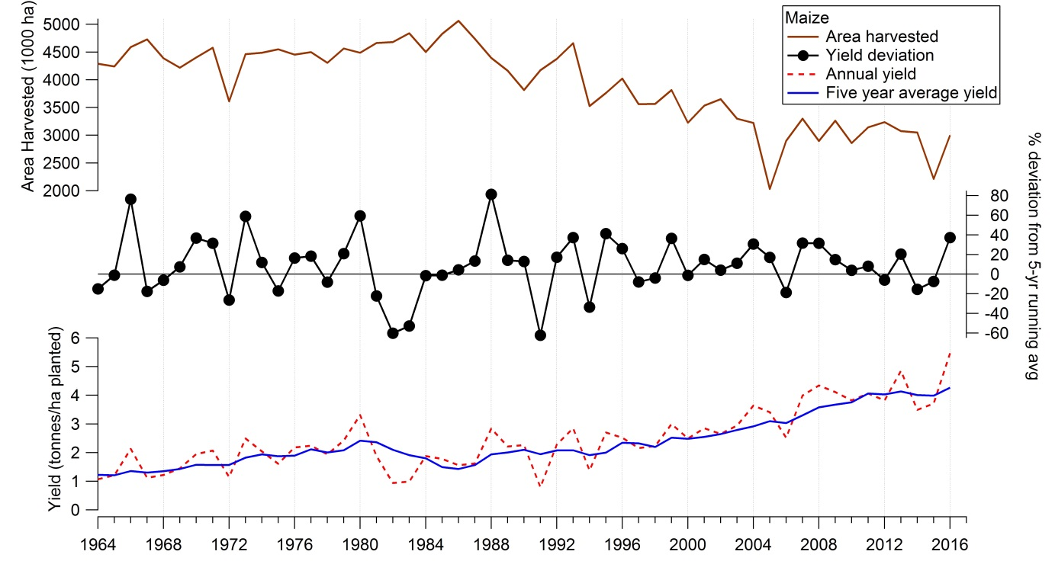
Estimated revenue loss due to ozone
The most affected crop is wheat (multi-year average yield loss (AYL) of 14.21% and multi-year average total annual loss (TAL) of $2.39 million in the region)
2nd: Maize (AYL of 11.42% and TAL of $49.9 million in the region)
3rd: Sorghum (AYL of 0.55% and TAL of $0.08 million in the region)
4th: Soybean (AYL of 0.12% and TAL of $0.32 million in the region)
“Maize is the most important grain crop in South Africa, being both the major feed grain and the staple food of the majority
of the South African population.” (DAFF, 2016)
$ 52.69 million total loss
% of national GDP = 0.02%
% of GDP in Mpumalanga = 0.37%

Slide 30
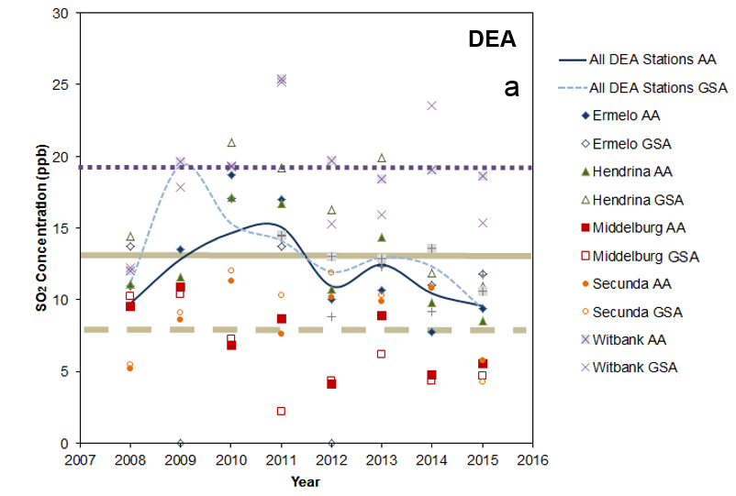
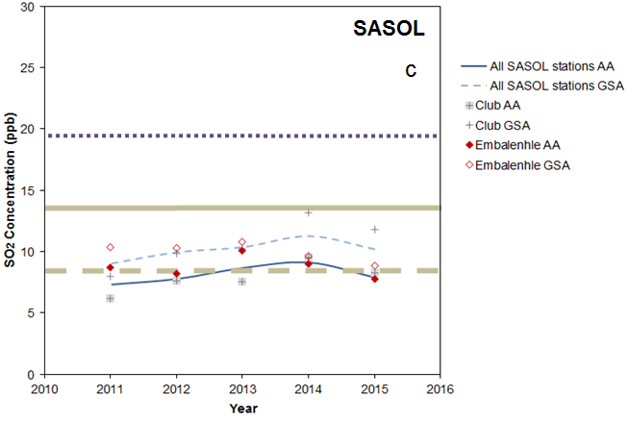
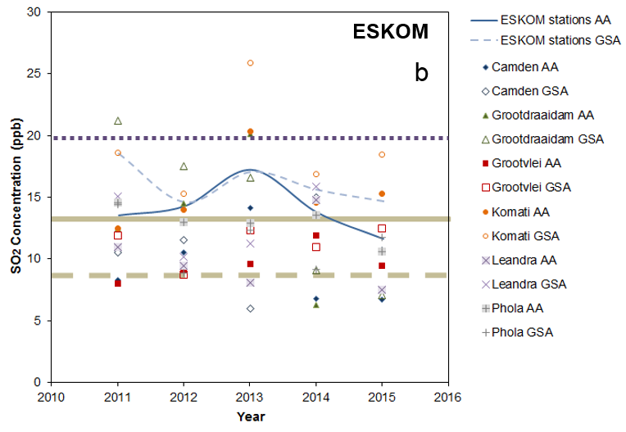
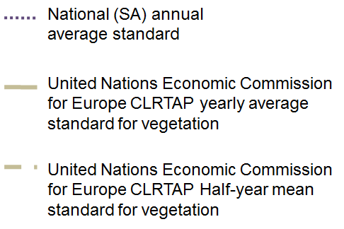
SO₂ results
Spatial and inter-annual variability of SO₂ concentrations
GSA average > Threshold
CLRTAP: Convention on Long-Range Transboundary Air Pollution

Slide 31
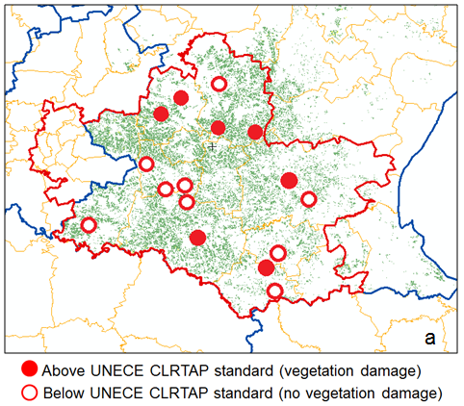
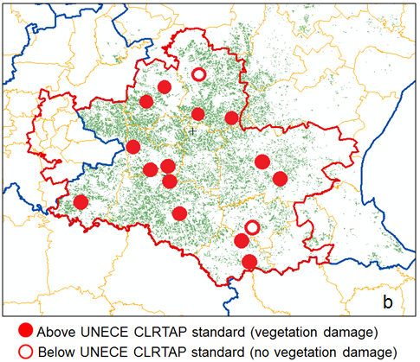
SO₂ spatial representation
Year
Many of the region’s magisterial districts also surpass the international SO₂ standards for agriculture during the growing season
Yield losses will be exacerbated due to SO2 emissions
  Quantification of these losses requires further research (response function development)
  Literature has shown that ozone‘s damage and SO₂ damage is cumulative and the intake mechanisms (adsorption through the plant‘s stomata) are similar.
SO2 has the potential to damage plants and acidify soil via acid rain
  This will most likely affect crops with a growing season in the rainy season
Monitoring in agricultural areas should be present
Currently, we are modelling HPA with CAMx → hope to use it for impact assessments
Half year
(growing season)

Slide 32
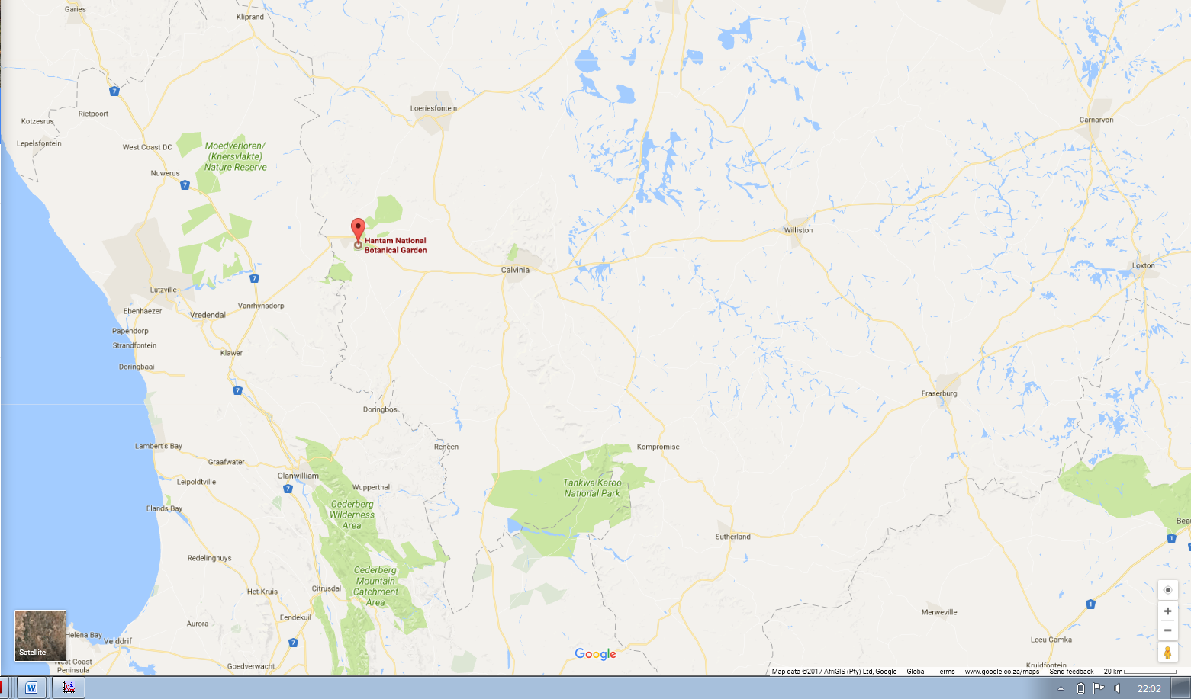

Slide 33


Nitrogen oxides + VOCs + hν = ozone
O₂
O₃
O•
NO_{x}
•OH, O₂
RO•
RO−O•
R
Notes:
Thank you Jen and Job for the introduction.
Present research
Twitter

Slide 34
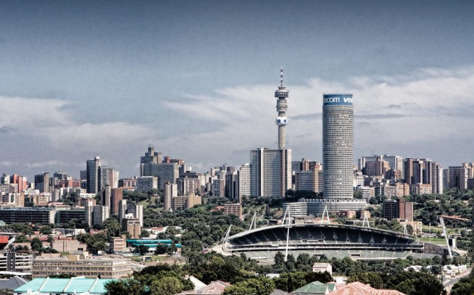
Ozone production in Joburg
Regulatory implications:
role of VOCs?
NO₂ + hν → NO + O
O + O₂ → O₃
NO + O₃ → NO₂ + O₂
NO + ROO → NO₂ + RO
VOC + OH + O₂ → H₂O + ROO
P(O₃)
NO_{x}-limited regime
VOC-limited regime
NO + O₃ → NO₂ + O₂
NO_{x} concentrations

Slide 35
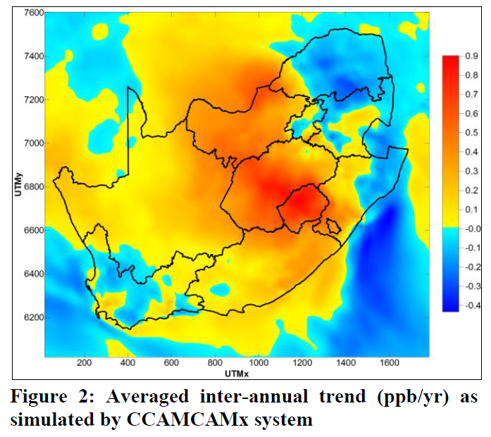

Air quality in Joburg – in the literature
South African O₃/NO_{x} literature:
Josipovic et al., Environ. Monit. Assess., 2010 found no NO_{x} and few O₃ exceedances in Highveld
Lourens et al., SAJS, 2011 saw few exceedances of O₃, NO_{x}, BTEX + O₃ peak in spring (anti-correlated with NO_{x})
Naidoo & Engelbrecht, (CSIR) 2013 analyzed the impact of climate on ozone production
Jaars et al., Atmos. Chem. Phys., 2014 measured hydrocarbons (xylene) at Welgegund
Padayachi et al., (CSIR) 2014 looked at O₃ in Joburg in 2005
Balashov et al., J. Geophy. Res., 2014 see ENSO sensitivity for NO_{x} and O₃
Lourens et al., SAJS, 2015’s photochemical box model determined that Joburg is VOC-limited

Slide 36


Ozone production at Newtown

