Slide 1
Holding polluters to account: What needs to happen to improve air quality in priority areas?
Air Quality Colloquium
Portfolio Committee on Environmental Affairs
13 September 2017
Centre for Environmental Rights

Slide 2
LIFE AFTER COAL CAMPAIGN

Slide 3
HIGHVELD PRIORITY AREA

Slide 4
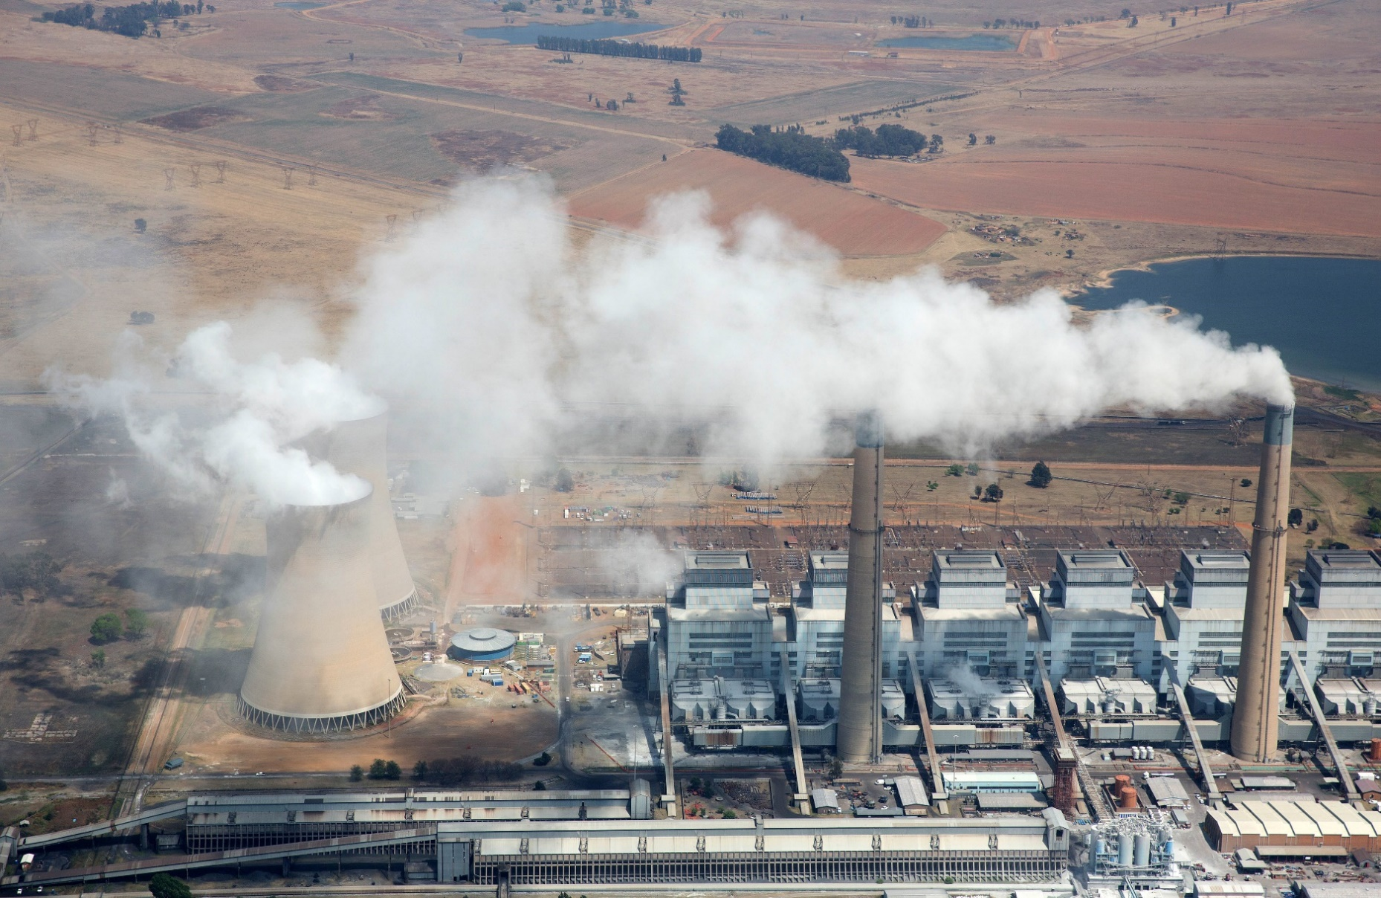
Mpumalanga Highveld: One of SA’s industrial heartlands
Home to 12 of Eskom’s coal power stations and Sasol’s Secunda refinery, among many hundreds of mines and other facilities.

Slide 5
10 years ago, following demands by civil society for intervention to address the significant air pollution: the Highveld was declared the 2nd priority area (after the Vaal Triangle) – HPA – under the Air Quality Act (AQA).
Department of Environmental Affairs (DEA): “people living and working in these areas do not enjoy air quality that is not harmful to their health and well-being”, as required by s24 of the Constitution.

Slide 6
AIR QUALITY MANAGEMENT PLAN
4 years later, in Nov 2012, AQMP published: main aim for ambient air quality in the HPA to comply with all health-based national ambient air quality standards (NAAQS). Standards set under the AQA that ambient air must meet in order for people to breathe that air without damaging their health.
Specific objectives committing the DEA, the Mpumalanga and Gauteng provinces, and the affected municipalities to start tackling the air quality problems.
Should be reviewed after 5 years.

Slide 7
 | 7 GOALS TO ADDRESS OVERALL OBJECTIVE
1 | By 2015, organisational capacity in government is optimised to efficiently and effectively maintain, monitor and enforce compliance with NAAQS
2 | By 2020, industrial emissions are equitably reduced to achieve compliance with NAAQS and dust fallout limit values
3 | By 2020, air quality in all low-income settlements is in full compliance with NAAQS
4 | By 2020, all vehicles comply with the requirements of the National Vehicle Emission Strategy
5 | By 2020, a measurable increase in awareness and knowledge of air quality exists
6 | By 2020, biomass burning and agricultural emissions are 30% less than current
7 | By 2020, emissions from waste management are 40% less than current

Slide 8
Participation in HPA process, leading to our own AQMP review
CER, groundWork, and the Highveld Environmental Justice Network (HEJN) have been supportive, active, and vocal participants in the various HPA processes for many years, with a particular focus on the Nkangala District Municipality (home to towns including eMalahleni, Middelburg, Delmas and Hendrina), which hosts significant industrial, electricity generation, mining, and manufacturing activity.
Frustrated with the lack of progress and the ongoing and devastating health impacts related to this failure, the CER has, with support from groundWork and HEJN, conducted its own analysis to determine whether the declaration of the HPA and the promulgation of the AQMP have improved air quality within the HPA to protect health; and if not, why not?

Slide 9
Used information from various sources, including annual reports of the National Air Quality Officer (NAQO); reports presented by government at HPA meetings; experts’ reports; the DEA’s own review of the AQMP; emission data available to us; submissions made by the DEA in Parliament; and our own participations and observations.
Given our experience and perceptions of municipalities’ difficulties in fulfilling their important responsibilities in regulating air quality under the Constitution (including being the licensing authority for atmospheric emission licences (AELs)), a questionnaire was developed:
to assess the views of the NDM and the eMalahleni Local Municipality on issues like: capacity, dust control, domestic fuel burning, industrial emissions, and whether air quality had improved since the HPA’s declaration, and
to evaluate the extent to which municipalities require assistance in meeting these obligations.

Slide 10
KEY FINDINGS
Air quality in the HPA remains poor and out of compliance with health-based NAAQS, despite a decade having passed since the HPA was declared. DEA’s own mid-term review of the AQMP, published in February 2017, confirms that emissions have not decreased significantly – if at all - over this period.
Continued non-compliance with NAAQS is likely, in large part, due to the failure of key major industrial facilities to reduce their emissions either adequately, or at all. The NAQO’s decision in early 2015 to grant postponements from compliance with the minimum emission standards (MES) to the biggest polluters in the HPA – Eskom and Sasol – has made it significantly more difficult for air pollution in the HPA to be reduced.

Slide 11
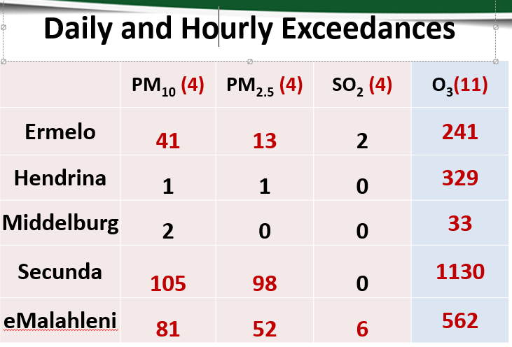
Multi-stakeholder Reference Group Meeting May 2017 State of the Air Report
May 2016-April 2017

Slide 12
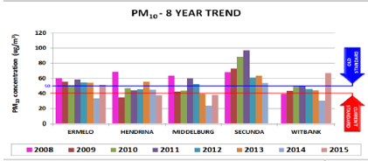
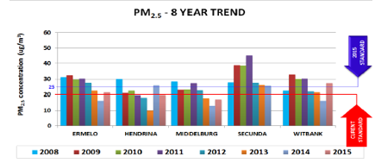
Red line: Standard from Jan 2015
Red line: Standard from Jan 2016
Stricter from Jan 2030

Slide 13
CAPACITY (Goal 1: 2015)
Neither NDM nor the local municipalities have enough money or dedicated, appropriately-trained and skilled staff to implement the HPA AQMP and to enforce AQA. Municipalities only have a few of the right people to do air quality management (AQM) work. These officials have too many responsibilities, and are over-stretched to the extent that they are unable to devote adequate time to AQM compliance and enforcement.
NDM has only 3 officials designated to do compliance monitoring and enforcement, and these municipal officials have undertaken few compliance inspections of polluting facilities. Various HPA municipalities do not have designated Air Quality Officers (AQOs) or AQMPs as required by AQA.

Slide 15
AIR QUALITY MONITORING
No sufficiently credible method of monitoring, tracking, and reporting air pollutant emissions in the HPA has been developed. Without adequately-functioning, accredited monitoring stations, we do not know whether the air quality is actually far worse than it appears.
The HPA ambient air quality monitoring network has deteriorated since its declaration – the 2012 HPA AQMP listed 23 monitoring sites with available data; the DEA’s review of the AQMP listed just 9 monitoring stations with available data – only 5 of which publish timeous monthly reports, available on the South African Air Quality Information System (SAAQIS) website.

Slide 16
ACCESS TO AIR QUALITY DATA
It is difficult to assess directly whether key industries have reduced emissions, given that neither government nor industries make key data and documents publicly available for review. Some information is available in industries’ annual emission reports and/or from the National Atmospheric Emissions Inventory System (NAEIS) and SAAQIS, but this information is not complete or updated, nor is it very easily accessible to the public. The accuracy of the available information is unknown.
Such information as is available has to be evaluated and interpreted by air quality experts, which is often not practical or affordable for affected people.

Slide 17
DUST EMISSIONS
Negligible measures have been taken for the past ten years to reduce dust emissions, particularly from mining activities – one of the major contributors to poor air quality in the HPA.
These measures include by-laws, and undertaking some compliance inspections when there are complaints about dust. The existing National Dust Control Regulations, 2013 have proved inadequate. The Department of Mineral Resources, which is responsible for regulating the environmental impacts of mines, including on air quality, is absent from the HPA process.

Slide 18
DOMESTIC AIR QUALITY
Limited steps have been taken to reduce air pollution in dense, low-income settlements. The draft Strategy to address Air Pollution in Dense Low-income Settlements, eventually published for public comment in July 2016, does not contain adequate, measurable, and progressive plans to address the complex challenges of indoor air pollution. The draft Strategy also fails to make adequate provision for the participation of community-based and non-governmental organisations in its design, implementation, review, and updating.
There has been no indication of when a final Strategy will be adopted and implemented.

Slide 19
WHAT DOES THIS MEAN?
HPA has, to date, dismally failed in its purpose: to improve air quality so that it at least meets the NAAQS. This means that HPA residents are having their Constitutional rights to an environment not harmful to health and wellbeing violated. The significant air pollution means that people are dying prematurely, and suffering from respiratory and cardiac illnesses that inhibit their prosperity and wellbeing.
Health impacts of coal fired power plants in South Africa, 2017: Dr Mike Holland: some $int 2.4 billion is the estimate annual health cost of Eskom CFPS emissions (more than R30 billion per year).
Excludes, among other things: mining and transport of coal, contamination of water; and impacts from blasting.

Slide 20
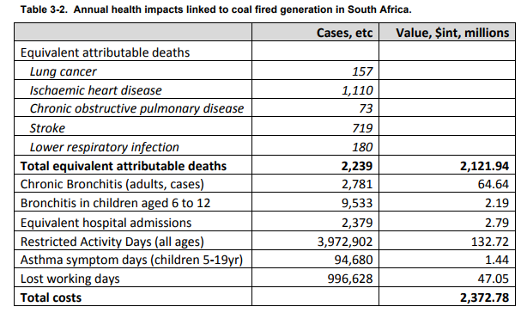
Medupi: 364 deaths (also with 453 cases of chronic bronchitis, 1552 cases of bronchitis in children ages 6-19, 15 412 asthma symptom days in children, all at a cost of more than $386 million per year)
Matimba: 262 deaths per year
Kendal: 210 deaths per year
Lethabo: 204 deaths per year
Matla and Tutuka: each with 192 deaths per year

Slide 21
WHAT NEEDS TO CHANGE?
People living in the HPA, and organisations that have been active and vocal participants in the HPA structures, are frustrated by government’s failure to protect health by reducing air pollution in priority areas. Pollution is not being adequately monitored or reduced, and polluters are not being held accountable.
Some minimum measures are required in order for the DEA to meet its Constitutional obligations under section 24 (the environmental right) and for all authorities to meet their AQA obligations.
These steps must be taken urgently by various authorities to demonstrate that improving air quality in the HPA is, in fact, a priority for government:

Slide 22
Given the continued NAAQS non-compliance, immediate steps must be taken to reduce emissions of pollutants:
All HPA facilities must comply with at least with the MES, but ideally with stricter emission limits. Having heard representations from the facilities and affected communities, the NAQO should use her AQA powers to consider withdrawing the MES postponements granted to Eskom and Sasol.
No further postponements of MES compliance or other licence variations that permit exceedances of licence emission standards should be allowed.
Licensing authorities must suspend the issuing of all new AELs in the HPA until there is consistent compliance with all NAAQS. Approval and licensing of any expansion plans of existing industries must be contingent on a simultaneous substantial reduction in emissions.
When facilities reach their scheduled end-of-life (esp. certain Eskom CFPSs), AELs must be withdrawn, and decommissioning and rehabilitation enforced.
The Dust Control Regulations must be amended to ensure adequate monitoring, measurement, and reduction of the significant dust emissions in the HPA, particularly from mining sources.

Slide 23
In recognition of the crucial importance of air quality compliance in the HPA, a comprehensive compliance monitoring and enforcement programme must be put in place by DEA and local authorities to ensure that violations of AELs are detected, and enforcement action taken against those who violate licence conditions.
Such enforcement action must include suspension of licences for facilities until such time as emissions comply with licence conditions.

Slide 24
The institutions charged with ensuring improved air quality in the HPA must be strengthened and appropriately resourced:
All government spheres must demonstrate accountability for the proper management of priority areas, recognising that they have an ongoing responsibility for implementing and enforcing approved priority area AQMPs.
HPA authorities must allocate adequate financial and human resources to fulfill AQM functions, including the right tools, training, and equipment to enable the reduction of emissions and improvement of the ambient air quality.
To bolster resources for compliance monitoring and enforcement, the DEA must give serious consideration to requiring all existing facilities in priority areas to pay a substantial annual licensing fee, instead of a once-off application fee.
Municipalities must take urgent steps to ensure the appointment and training of suitable AQOs, Environmental Management Inspectors, the development of AQMPs, and their incorporation into Integrated Development Plans.
The DMR, Department of Health – and other relevant departments, when appropriate – must participate in the HPA process to ensure that air pollution from mining is reduced, and human health impacts are addressed adequately.

Slide 25
To build trust in the integrity of the management of the HPA, and enable meaningful and informed participation by all stakeholders, there must be far greater transparency about regulation, monitoring, and compliance in the HPA:
AELs for all facilities in the HPA with significant polluting emissions must require real-time emissions monitoring, and that real-time emissions data be publicly available online and on request.
The air quality monitoring station network must urgently be improved upon and adequately managed and maintained, so as to produce verified, reliable HPA air quality data that are readily and publicly available.
The DEA and all licensing authorities within the HPA must make all AELs and annual emission reports submitted to them publicly available, and all licence-holders must be required to make these documents available on their websites and on request.

Slide 26
Centre for Environmental Rights
Pollution & Climate Change Programme
Tel: 021 447 1647
Email: rhugo@cer.org.za
Web: www.cer.org.za
Facebook: @CentreEnvironmentalRights
Twitter @CentreEnvRights

