Slide 1
“Proper measurement of ambient air quality: are we better or worse off?”
Air Quality Colloquium
Portfolio Committee on Environmental Affairs
13 September 2017
Eugene K. Cairncross

Slide 2
Outline
The importance of air quality monitoring
The provisions of NEM-AQA and the Framework
What is “proper air quality monitoring”
The national monitoring network
a collection of local networks
What (which pollutants) is being monitored?
The present
The future?

Slide 3
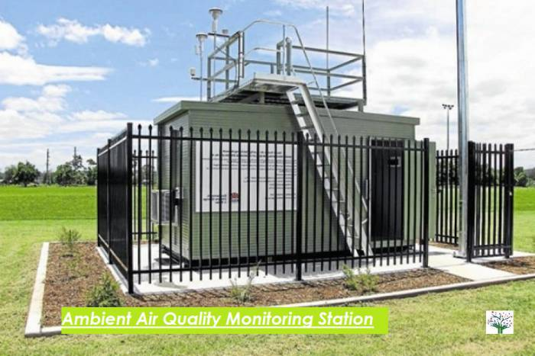
The importance of air quality monitoring
Referring to continuous monitors
Several instruments in a secure enclosure, usually temperature controlled
Instruments suck in air at a controlled rate; detectors measure pollutant concentrations, usually every few seconds.
In principle, the monitoring system gives accurate information on the concentrations of specific air pollutants, monitored continuously, but obviously the information is only valid for the specific site.
Other methods of assessing air quality, such as modelling, have to use the measured concentrations as a point of reference.

Slide 4
Provisions of the AQA and the Framework
AQA: 7. Establishment
(1) The Minister must, within two years of the date on which this section took effect, by
notice in the Gazette, establish a national framework for achieving the object of this
Act, which must include -
(a) mechanisms, systems and procedures to attain compliance with ambient air
quality standards;
…
(d) national norms and standards for air quality monitoring;
….
(f) national norms and standards for air quality information management

Slide 5
(2) National norms and standards established in terms of subsection (1) must be aimed at
ensuring -
(a) opportunities for public participation in the protection and enhancement of air
quality;
(b) public access to air quality information;
(c) the prevention of air pollution and degradation of air quality;
(d) the reduction of discharges likely to impair air quality, including the reduction of
air pollution at source;
(e) the promotion of efficient and effective air quality management;
(f) effective air quality monitoring;
(g) regular reporting on air quality; and

Slide 6
The Framework:
Sets out criteria for site selection
Criteria for recommended number of sampling points, in relation to factors such as the class (severity) of air pollution, the population density, ..
Site selection criteria related to each of the pollutants – PM (PM10, and later, PM2.5), SO2, NO2, CO, benzene, ozone ..
In addition, recognises different methods of monitoring – periodic, campaigns

Slide 7
What is “proper air quality monitoring”
Production of good (acceptable according to criteria) quality data
Spatial distribution and number of monitoring stations, and pollutants monitored, taking cognisance of factors such as the characteristics and sources of pollution, population distribution, etc..
Proper management of data
Accessibility of data
(AQA provides a more detailed description of what a “proper air quality monitoring system” would look like!)

Slide 8
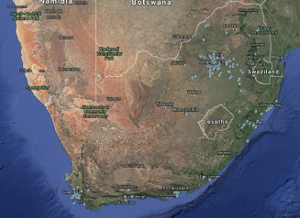
Saaqis website has the following map, but
what (which pollutants)is being monitored?
what is the quality of the data (does the station follow proper data quality assurance procedures for each pollutant monitored?
are procedures in place to validate (confirm that the reported data meet quality assurance standards)
Is the information accessible to the public?

Slide 9
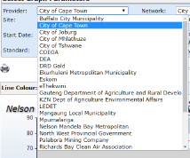
Saaqis website list:
A collection of 27 data providers.
How many are in fact submitting data? Quality of the data?
Question: Are they functioning to a uniform set of norms and standards, as required by AQA?

Slide 10
Accessing data via the saaqis website:

Slide 12
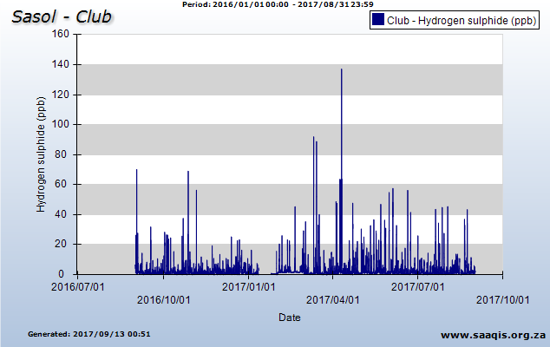
Note the difference between period 1 Jan 2016 to 31 Aug 2017 and the x axis period. Note data gaps.

Slide 13
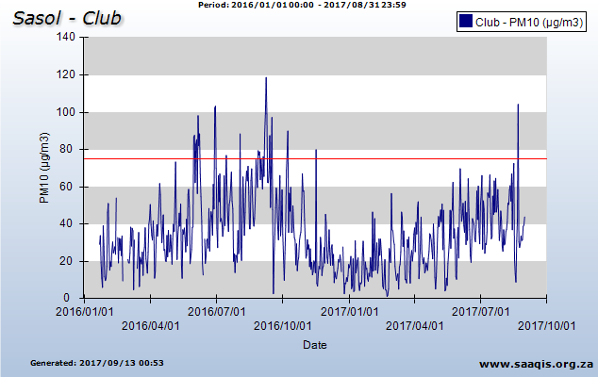

Slide 15
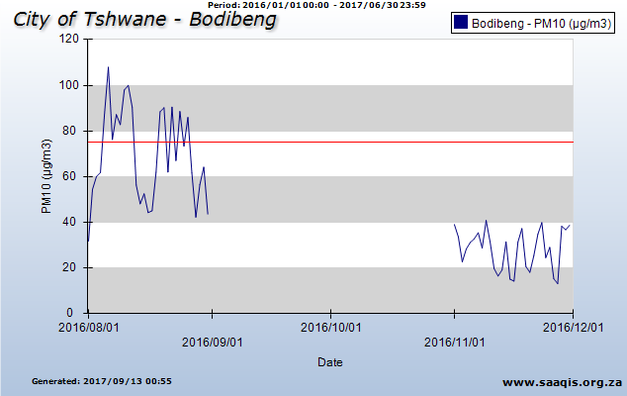
Note the poor data recovery; the data gap.

Slide 16
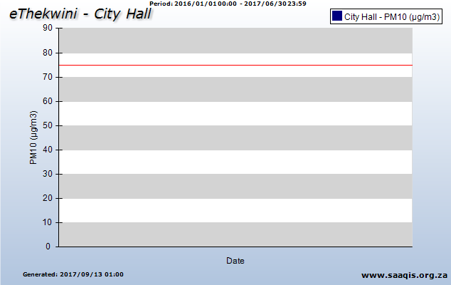

Slide 17
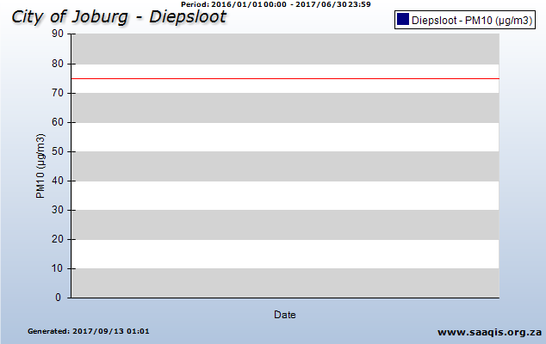

Slide 19
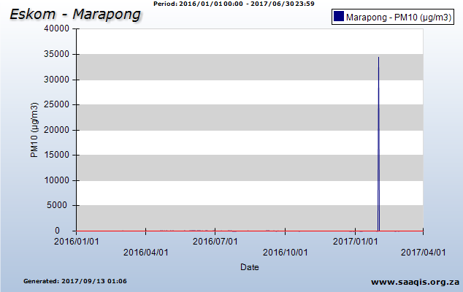

Slide 20
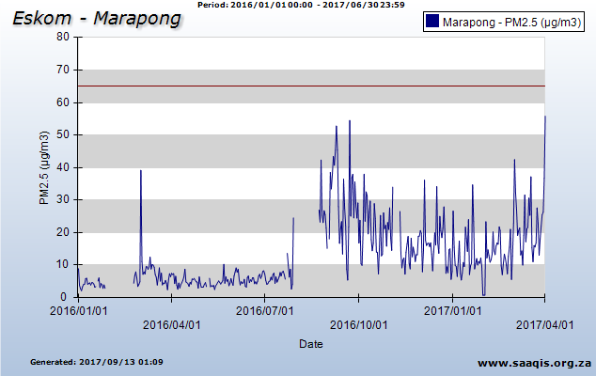

Slide 21
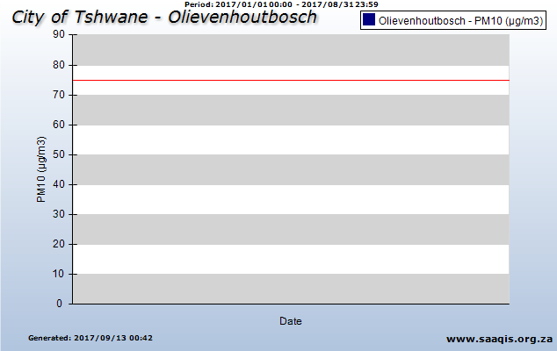

Slide 22
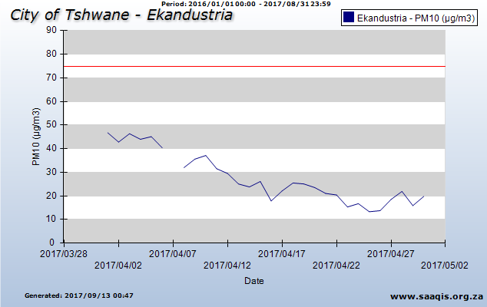
Note the difference between period 1 Jan 2016 to 31 Aug 2017 and the x axis period.

Slide 23
What is the current status of the monitoring network? Is it improving?
The question should be asked in relation to each pollutant – the monitoring of PM2.5 is most important from a health impact perspective.
Early 2016 I requested all available PM2.5 and /or PM10 data available, for 2012-2015, via saaqis (plus CoCT)
Of a total of about 100 MSs, only 36 provided (usable) data of either PM10 or PM2.5 or both
Of the 36, only 21 (i.e. about 20%) satisfied an annual data recovery benchmark of 80%. (SANAS – 90%)
In 2012, only 11 stations were monitoring PM2.5. A few more PM2.5 stations (2?) may have been added, but the monitoring of PM2.5 remains very poor.

Slide 24
Are things improving?
I don’t know! I don’t have access to accurate and credible information.
As far as I can tell, no!
What is the destination – compliance with the AQA and the Framework?
What is the solution? – for discussion.

Slide 25
Thank you Questions?

