Slide 1
Briefing on the Submission for the 2018/19 Division of Revenue
12 September 2017
For an Equitable Sharing of National Revenue

Slide 2
Background to the Submission
Submission made in terms of:
  Section 214(1) of the Constitution (1996)
  Section 9 of the Intergovernmental Fiscal Relations Act (1998)
  Section 4(4c) of the Money Bills Amendment Procedure and Related Matters Act (Act 9 of 2009)
Theme of 2018/19 Submission is: Intergovernmental Fiscal Relations System and Urban Development in South Africa
  Aim of submission: to make use of the potential of accelerated urbanisation using intergovernmental fiscal relations and tools to drive positive transformation of the economy toward attainment of rapid economic growth that reduces inequality and eliminates poverty
  Focus of previous submission was rural development

Slide 3
Outline of Submission Chapters
PART 1. Macroeconomic parameters underpinning urban development
Chapter 1: Introduction to Urban Development and IGFR
PART 2. City level productivity, competitiveness and wellbeing of residents
Chapter 4: Transport and Mobility
PART 3. Local Government Issues
Chapter 10: Information Communication Technology and City Governance
Chapter 2: Assessment of Integrated Urban Development Framework and Cities Support Programme
Chapter 11: Financing of Urban Municipalities and Own Revenue Diversification
Chapter 3: Cities Compaction: An Evaluation of Legislation and Policies
Chapter 6: Implications of Urbanisation Induced Learner Mobility on Education Planning and Funding
Chapter 5: Aligning Urban Housing Supply and the Unhoused Urban Population
Chapter 7: Industrial Diversity and Economic Performance in Urban Municipalities
Chapter 8: Effects of Municipal Spending on Urban Employment
Chapter 9: Funding and Policy to Support Urban Informal Employment

Slide 4
Chapter 1. Introduction to Urban Development and IGFR
In South Africa, urban areas are important
  Account for about 20% of the land
  Proportion of urban population increasing at a rapid rate leading to gap between demand and supply of urban services
  Approximately 60% of gross domestic product (GDP) is derived from urban economy
  Larger cities are enhancing participation in the global economy and smaller ones absorbing most of the rural-urban migration and strengthening linkages to the rural economy
Definition of urban: Two approaches are used in the Submission:
  StatsSA’s criteria on urban and rural classification based on settlement types
    Settlement types (2): Urban (formal & informal) and rural (traditional & rural)
  Cascade down to municipal area
    Municipalities (53): Metros, B1s and B2s (formal & informal)

Slide 5
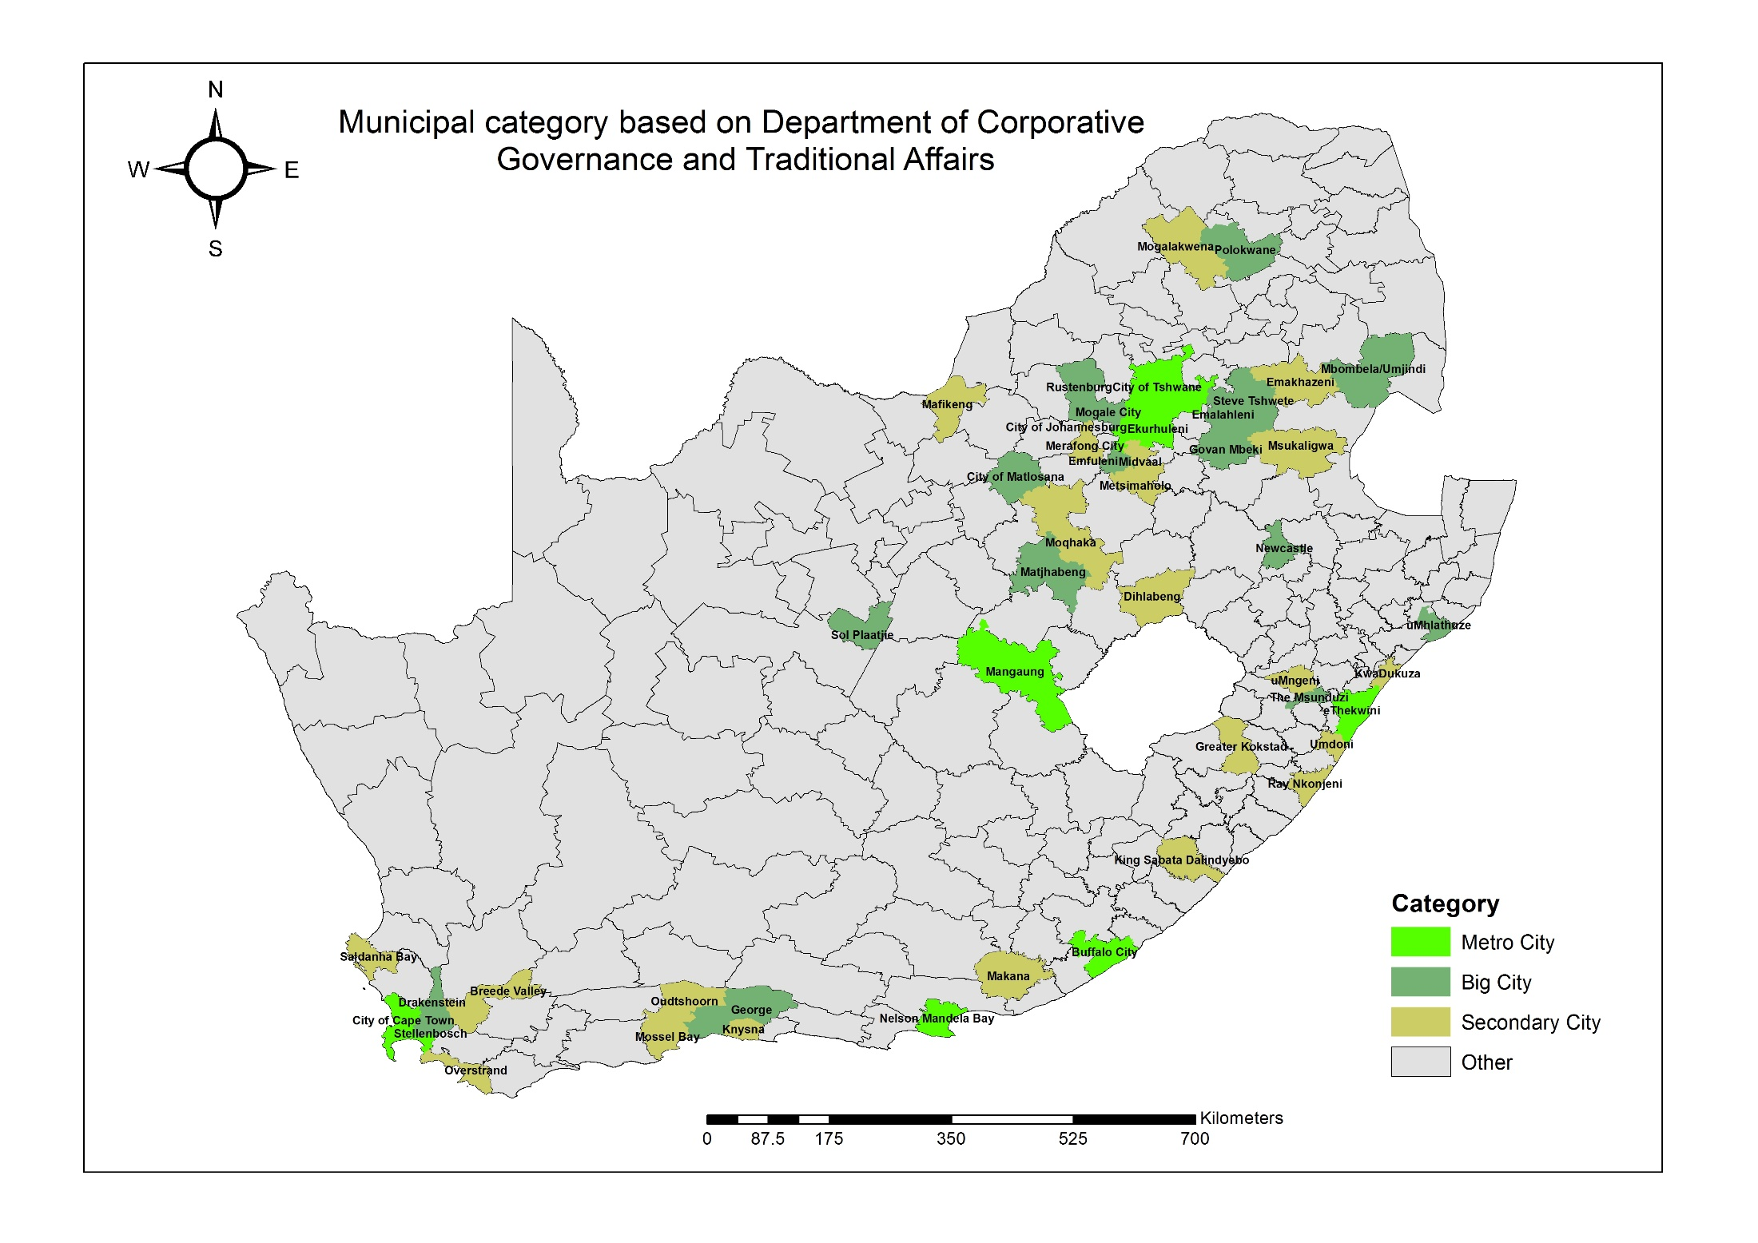

Slide 6
Urbanisation By Province and Settlement
Province | Urban |  |  | Rural |  |  | South Africa
 | 2000 | 2011 | Annual Growth Rate (%) | 2000 | 2011 | Annual Growth Rate (%) | 2000 | 2011 | Annual Growth Rate (%)
Western Cape | 3,787,434 | 4,933,785 | 2.4 | 442,954 | 327,954 | -2.7 | 4,230,387 | 5,261,739 | 2.0
Eastern Cape | 2,387,806 | 2,948,888 | 1.9 | 4,513,109 | 3,965,479 | -1.2 | 6,900,915 | 6,914,367 | 0.0
Northern Cape | 625,576 | 812,220 | 2.4 | 250,569 | 72,391 | -10.7 | 876,145 | 884,612 | 0.1
Free State | 2,026,699 | 2,364,841 | 1.4 | 781,997 | 392,262 | -6.1 | 2,808,695 | 2,757,103 | -0.2
KwaZulu-Natal | 4,422,634 | 5,109,401 | 1.3 | 4,632,324 | 5,580,124 | 1.7 | 9,054,958 | 10,689,525 | 1.5
North West | 1,422,508 | 1,537,879 | 0.7 | 2,173,855 | 2,149,150 | -0.1 | 3,596,363 | 3,687,029 | 0.2
Gauteng | 7,634,846 | 10,968,996 | 3.3 | 300,610 | 74,616 | -11.9 | 7,935,456 | 11,043,612 | 3.1
Mpumalanga | 1,274,669 | 1,590,116 | 2.0 | 1,793,727 | 1,799,774 | 0.0 | 3,068,396 | 3,389,889 | 0.9
Limpopo | 748,506 | 718,727 | -0.4 | 4,823,535 | 5,076,419 | 0.5 | 5,572,041 | 5,795,146 | 0.4
All provinces | 24,330,677 | 30,984,853 | 2.2 | 19,712,680 | 19,438,169 | -0.1 | 44,043,357 | 50,423,022 | 1.2
Table shows demographic shifts that occurred between 2000 and 2011
Increase in urban population, at an annual average growth rate of 2.2%
Decrease in country’s rural population, at an annual average growth rate of -0.1%, except KwaZulu-Natal (1.7%), Limpopo (0.5%) and Mpumalanga (0%)
How the expansion of urban areas is managed in future years will be critical for ensuring sustained economic growth and national development

Slide 7
Economic growth
The economy is unable to grow at a pace that can markedly reduce inequality, poverty and unemployment
It is unclear whether the ‘pattern of growth’ in South Africa has been pro-poor
Notes:
Growth is said to lack inclusiveness if the income or expenditure growth of the bottom 40 percent is consistently lower than the average income or consumption growth of the total population.

Slide 8
Unemployment, Poverty and Inequality
 | Unemployment | Poverty rate ($1.9/day PPP) | Poverty rate ($3.1/day PPP) | Inequality (Gini)
2006 | 22,6 |  |  | 0,72
2007 | 22,3
2008 | 22,5
2009 | 23,7 |  |  | 0,7
2010 | 24,9
2011 | 24,8 |  |  | 0,69
2012 | 24,9
2013 | 24,7 | 15,7 | 33,6
2014 | 25,1 | 15,6 | 33,6
2015 | 25,3 | 15,7 | 33,6 | 0.68
2016 | 26,7 | 15,9 | 34,1
2017 |  | 16 | 34,1

Slide 9
Poverty Dynamics By Region
South Africa is an upper middle income country
  But its poverty level is much higher than expected, given its GDP per capita
  Dwellers living in poverty in 2011:
=> Rural 68.8% ; (total pop rural is 35% (2015) )
=> Urban 30.9%
  The rate of reduction between 2006 and 2011:
=> Rural: 15%
=> Urban: 24%
  The workforce is predominantly urban based
  => With agriculture being predominantly rural based

Slide 10
Inequality and Growth By Metro and Province
Gini Coefficient across nine provinces, 2015 and 2016
Inequality stubbornly high across the country, though relatively lower for Northern Cape, North-West and Limpopo
Similarly, inequality high in the Metros but lowest in Cape Town, followed by Mangaung
Growth across Metros higher than the national average, demonstrating their growth engine capabilities
Gini Coefficient across metros, 2015 and 2016
GVA Growth across the Metro Municipalities

Slide 11
Chapter 1. Approach and Scene Setting
Chapter sets the scene by building and using long-term macro-micro model, in order to develop prospective scenarios for socio-economic consequences of government interventions from 2018 to 2030
  Model provides consistent framework to explore possible medium term developments, based on main structural features of the economy
  This type of modeling allows combining detailed databases with a sound micro-based theoretical framework capturing the interdependence and inter-linkages of markets.
  With such characteristics, dynamic CGE-microsimulation models are useful tools to assess the long term impact of shocks and structural reforms on growth, employment, poverty and inequality

Slide 12
Key Results I
Current economic situation, including its implications for sustainable development poses serious challenges. Within this context, the following key messages, distilled from a careful review of analyses and modelling, are of relevance for the implementation of the 2030 NDP agenda:
  Stability in the macroeconomic system underpins development
  Spheres of government need adequate fiscal space for accelerating development
  Development is multidimensional and context specific and driven by the structural transformation towards economic diversification, stable growth and improved living standards, balanced growth across the rural and industrial spaces
  Development planning, coordination and State capacity are important for achieving results

Slide 13
Key Results II
Infrastructure provision
  Improved provision of infrastructure would be reflected in lower cost of service delivery in the medium term, and higher public spending (and related demand for investment goods) in the shorter run
  The Gini coefficient would decline by 0.3 percentage point under the influence of three factors: higher direct taxes (mostly borne by richest households) to finance the investment; lower consumer prices for poor households who devote a larger share of their consumption to transport expenditures; and higher demand for informal labour
  Dynamic effects would include (i) higher labor supply of unskilled labor, (ii) lower savings and private investments.
The same applies to other public infrastructure and human capital

Slide 14
Recommendations
Over the medium term, Government should continue with a gradual programme of fiscal consolidation that entails reducing the budget deficit moderately but consistently. Such efforts to preserve fiscal sustainability must be maintained in the future, even with the addition of longer-term programmes such as the National Health Insurance
Government should actively and specifically continue pursuing the implementation of significant capital investment in public infrastructure that has a positive impact on total factor productivity and employment in the context of the National Development Plan
National government develop and promote the development of urban-rural relations by:
  Strengthening rural-urban linkages and policy coor­dination between rural and urban spaces;
  Ensuring rural infrastructure investments are better tar­geted;
  Promoting productive social safety nets; and
  Providing incentives to encourage new industries and businesses in rural areas as a strategy to decongest urban areas

Slide 15
Chapter 2. Assessment of Integrated Urban Development Framework and Cities Support Programme
Contextual urban challenge:
  Post-1994, Government introduced numerous policies driven by urgent need to address inequality and injustices of the past
  In recent times, National Treasury has championed the Cities Support Programme (CSP) while the Department of Cooperative Governance and Traditional Affairs (COGTA) coordinates the Integrated Urban Development Framework (IUDF)
  Notwithstanding ongoing efforts, there is still rapid urbanisation, urban inequality and poverty
Question: Are these urban policies, planning processes and practices a sound and adequate response to urbanisation challenges at the level of metropolitan cities?
Methodology:
  Chapter uses a combination of ex-post and ex-ante assessment methods
  Ex-post assessment applied predominantly to programmes that have been in existence for a long time while ex-ante assessment used in cases where implementation is in progress

Slide 16
Chapter 2. Findings of the Research
The Urban Development Framework (UDF) had intentions to deal with rapid urbanisation, urban poverty and inequality
  Suffered from inconsistency in its championing, coordination and lacked a specific funding instrument and implementation plan
The CSP has a strong coordination element, as the programme works with national government to shift policy in a way that makes it easier for cities to work more efficiently, while working with cities to ensure economic growth and a reduction in poverty
Taking lessons from the UDF, the IUDF process of preparation was more inclusive and consultative
  To ensure implementation, IUDF has identified coordination structures and also acknowledges COGTA as department responsible for integrated urban development and thus for collaborating with other stakeholders
  IUDF is an over-arching and multi-sectoral framework but lacks a specific own funding instrument, hence its successful implementation is dependent on various actors

Slide 17
Chapter 2. Recommendations
The Department of Cooperative Governance and Traditional Affairs and Department of Planning, Monitoring and Evaluation continue strengthening coordination and monitoring mechanisms (by ensuring that departmental sector plans and strategic investments are aligned to local spatial plans and priorities and coherent with national objectives espoused in the Integrated Urban Development Framework)
The Department of Cooperative Governance and Traditional Affairs and National Treasury consolidate the urban development related grants (for example incorporate the Integrated City Development Grant into the Urban Settlement Development Grant) so as to achieve the Integrated Urban Development Framework objectives and address urban development holistically

Slide 18
Chapter 3. Cities Compaction: An Evaluation of Legislation and Policies
In 2011 the Commission recommended that South Africa needed to pursue development of a compact city form as this urban form is more beneficial
Compact City is a high density urban settlement that has the following main characteristics:
  Central area revitalisation; High density development
  Mixed use development; Services and facilities: hospitals, parks, schools, leisure and fun
Policies of urban compaction involve:
  promotion of urban regeneration; revitalisation of town centers
  restraint on urban sprawl development; higher densities
  mixed-use development; promotion of public transport and
Benefits included lower costs and expenditures by households, a reduction in public infrastructure investment requirements, smaller public transport subsidies, and less carbon emissions
    Despite many strategies and policies espousing virtues of compact cities, urbanisation still characterised by sprawling. Against this backdrop, the chapter investigates whether city policies, spatial plans and regulations are responding to the call for compact cities and city regions

Slide 19
Chapter 3. Findings of the Research
Metros’ strategies, frameworks and guidelines demonstrate a clear understanding of compaction. There were clear objectives outlining what a particular policy instrument aims to achieve regarding compaction, however, implementation guidelines were inadequate and in some instances completely absent
There are neither incentives nor specific funding instruments for compaction. Furthermore, while a number of fiscal instruments that fund the built environment and spatial restructuring make reference to SDFs at municipal level, they are often not aligned to municipal SDFs
For spatial restructuring, there are generally weak linkages between the Municipal Systems Act and the Municipal Financial Management Act
  Personnel from city planning departments constantly develop strategies and policies that rarely make it into institutionalized implementation plans.
  There is a lack of consistency in institutionalization of existing spatial plans and policies because compaction policies cut across different sector departments
Metros feel compaction efficiently funded through an incentive grant similar to Built Environment Performance Plans (BEPPs)
  BEPPs are a requirement of the Division of Revenue Act in respect of infrastructure grants related to the built environment of metros, and is one of the eligibility requirements for the Integrated City Development Grant
  But grants obtained for BEPP are on their own insufficient to address compaction. Even though these grants are for spatial restructuring, compaction is treated as one of the many spatial restructuring plans and does not receive adequate attention and the required corresponding resources

Slide 20
Chapter 3. Recommendations
National Treasury introduces an incentive grant specifically targeted for city compaction, an urban form that has the potential to remedy ‘apartheid geography’ and bring the masses closer to opportunities of work and facilities. The spatial development grants currently accessed through the BEPPs treat compaction as only but a small and negligible component of spatial transformation

Slide 21
Chapter 4. Transport and Mobility
Contextual Urban Challenge
  Despite policy, implementation and performance of the full set of transport functions by urban municipalities has been relatively slow
      Only 4 cities have an operational bus service covering part of the city out of 13 cities that have been receiving national grant funding for Integrated Public Transport Network (IPTN) implementation
  Slow pace of cities acquiring assigned transport functions likely to perpetuate status quo in urban transportation (e.g. government spending more on public transport, costs of public transport falling disproportionately more on poor households, etc.)
  Urban municipalities face various challenges preventing them from assuming transport functions contained in the National Land Transport Act such as: inadequate and unsustainable funding, lack of capacity to implement policy, inadequate institutional structures and lack of policy monitoring
  This chapter investigates two main questions:
    Extent to which financial constraints are part of the reason for the slow uptake and performance of the full set of public transport functions
    Whether an urban municipality’s own sources of revenue can play a role in supplementing existing funding streams, and in doing so, support the uptake of public transport functions in urban municipalities

Slide 22
Chapter 4. Transport and Mobility
Findings of the research
  A funding gap exists between what is required for urban municipalities to implement and manage public transport networks, versus the funding that is available – this is due to significant capital requirements, and significant operating shortfalls resulting from high costs and limited system revenues
  If implemented efficiently, additional sources of income in large urban municipalities could provide additional sources of income for public transport functions
    Most promising potential sources of income to close the funding gap in urban municipalities include the fuel levy, parking levies, parking tariffs and congestion charges
Implications of the findings
    Additional alternative incomes sources do not solve funding challenge by themselves (with the exception of full retention of the fuel levy). Hence, national transfers to support public transport in large urban municipalities will still be required
  The current model of implementing the Public Transport Strategy is unaffordable. Instead, public transport costs should also be reduced and implementation approached incrementally to close the remainder of the funding gap

Slide 23
Chapter 4. Recommendations
The Department of Transport should review the public transport network grant; investigate options to shift sources of funding towards retaining locally earned fiscal revenue, and ring fencing the local income sources for public transport use. Examples include possible retention of a larger portion of the fuel levy generated in the municipality
  Develop case studies or support pilot projects in selected municipalities to develop key potential sources of funding; including funding related to parking, developer charges and ring fencing a portion of the fuel levy.
Department of Transport should approve and pilot the consolidation of public transport functions as defined in the NLTA within a well-capacitated city, with supporting funding (in line with previous Commission study). In this regard, the DoT should
  Identify the most appropriate options for arrangements outside of large urban municipalities where financial resources and capacity to take on the integrated function are more limited and
  Identify the legal and institutional structures needed to properly integrate planning and management across modes (including rail) into the broader management of municipal transport networks, which are also adequately funded by a conditional grant
Department of Transport should support the development of approaches to Integrated Public Transport Networks that support financial sustainability. These approaches should focus on leveraging the strengths of existing services, promoting incremental improvement of public transport based on affordability and impact, recognising the significant role that new technologies will play in providing demand responsive services, and considering alternative models of industry transformation. This could take the form of piloting and sharing learning from revised approaches to Integrated Public Transport Networks in one or more urban municipalities and should be funded through the Integrated Public Transport Network Grant or similar funding instrument

Slide 24
Chapter 5. Aligning Urban Housing Supply and the Unhoused Urban Population
Contextual Urban Challenge
  Population growth in urban population has not been matched by the number of new residential properties constructed and there has been a lack of understanding with respect to unhoused urban population and funding/policy and institutional constraints
Percentage of Population Growth in Metros from 2001 to 2015 Percentage of New Property in Metros

Slide 25
Chapter 5. Findings of the Research
In metros and secondary cities, unhoused population exists across all income groups
Highest number of unhoused population is found within households earning between R4 000 and R9 000 per month (housing value worth between R130 000 and R300 000)
  Households targeted by the government through Finance Linked Individual Subsidy Program (FLISP)

Slide 26
Chapter 5. Findings of the Research [cont.]
FLISP has performed poorly with respect to its targets set over the MTSF and is currently implemented differently by provinces and not according to the policy prescripts
  For example, according to the policy, FLISP should be implemented through the National Housing Finance Corporation (Human Settlements Development Bank) yet this is not the case (e.g. KZN uses Ithala, Limpopo uses Limpopo Economic Development Agency)
Challenges encountered with FLISP include:
  Inconsistency with respect to funding by provinces with each province independently determining how much to allocate for the programme and
  Allocations not guided by targets set
  There has been a positive recent development – in 2017/18 the proportion of funding from the HSDG per province has been ring-fenced for the implementation of FLISP
Policy gaps with respect to FLISP:
  Qualifying individuals who are single and cannot prove that they have financial dependants are excluded from the subsidy
There is misalignment of human settlements related infrastructure programmes and plans by the provincial departments of human settlements and other key departments including the provincial department of basic education and transport
  Results is uncoordinated infrastructure delivery

Slide 27
Chapter 5. Recommendations
The Department of Human Settlements should undertake a review of the Finance Linked Individual Subsidy Programme (FLISP) to find ways of ensuring that qualifying individuals who are single and without dependants are included as beneficiaries from the programme and that FLISP is implemented in a standardised manner across provinces
Provincial departments of human settlements and other key departments including the provincial departments of basic education and transport should align their delivery plans particularly for new human settlements development. This can be done by
  Establishing functional inter-sectoral coordination committees where relevant departments will meet to discuss new infrastructure development projects relating to habitable human settlements
  Ensuring that the portion of the Education Infrastructure Grant and funding from the Provincial Equitable Share are aligned to the portion of the Human Settlements Development Grant for new housing developments

Slide 28
Chapter 6. Implications of Urbanisation Induced Learner Mobility on Education Planning and Funding
Contextual urban challenge
  Scholar migration patterns are following urban development patterns
  Learners are concentrating in urban centres where education is perceived to be better
  Rapidly urbanising scholar population may result in adverse fiscal implications for the education system as a whole
  The chapter evaluates responsiveness of education fiscal transfers (PES and conditional grants) to changing spatial distribution of learners
Methodology
  Quantitative measurement of learner movement between provinces and within districts – leaner distribution and density

Slide 29
Chapter 6. Findings of the Research
Leaner mobility is largely prevalent between provinces and more dynamic within provincial districts
  Eastern Cape and Limpopo are main sending provinces while Gauteng is the largest receiving province
  Over 3400 schools in these provinces are at risk of becoming unviable due to mobility
Mobility increases with grade progression
  Has implications for school infrastructure in receiving provinces and districts
Average annual net migration | Leaner enrolment | School Age population | Net in/out migration % | Net in/out migration
Eastern Cape | -0.35% | -1.11% | -1.46% | -28 432
Free State | -0.36% | -0.90% | -1.26% | -8 564
Gauteng | 1.95% | 1.40% | 3.35% | 75 351
KwaZulu-Natal | 0.32% | -0.41% | -0.09% | -2 601
Limpopo | -0.24% | -1.37% | -1.61% | -28 159
Mpumalanga | 0.89% | 0.53% | 1.42% | 15 283
Northern Cape | 2.01% | 1.66% | 3.67% | 10 624
North West | -0.57% | -1.33% | -1.90% | -15 439
Western Cape | 0.88% | 0.44% | 1.32% | 14 439

Slide 30
Chapter 6. Findings of the Research [cont.]
The PES is fairly responsive to changing learner distribution patterns
  Education component per capita allocations are slightly similar – after adjusting for migration
  Raise concerns of equity given that Eastern Cape and Limpopo are poor
Infrastructure grants disproportionally benefit receiving provinces (Gauteng and Western Cape)
Budgetary effects of learner mobility are more evident at school level
  Leads to unviable schools that have to be closed or merged
  Has implications for learner transport
Mobility is not always well managed because provincial infrastructure plans do not account for spatial demographic shifts

Slide 31
Chapter 6. Recommendations
The National Treasury should incorporate weighted learner socio-economic profiles into the education component of the provincial equitable share (PES) formula as an additional indicator of education needs
Both the National Treasury and Department of Basic Education must ensure that the framework for Education Infrastructure Grant incorporate the need for Provincial Infrastructure plans to take into account spatial demographic patterns and forecast particularly when decisions to build, expand or maintain schools are made
The Department of Basic Education must allocate learners with unique identification numbers when they first enter the school system to (1) ensure that learners are allocated the requisite funding that is consistent with their socio-economic profile when they move between schools and (2) enable seamless tracking and measurement of movements across provinces and within districts

Slide 32
Chapter 7. Industrial Diversity and Economic Performance in Urban Municipalities
Contextual urban challenge
  Urban municipalities now account for an increasingly large share of GVA
    Metros alone account for over 40% of GVA
    Enhancing economic activity within urban municipalities now becoming a central focus of sub-national economic initiatives
    Focus coincides with (a) rising de-industrialisation of urban economic activities, (b) socio-economic challenges despite growth of urban areas/municipalities, and (c) prior minimal attention on leveraging economic potential of city regions/urban municipalities

Slide 33
Chapter 7. Industrial Diversity and Economic Performance in Urban Municipalities [cont.]
Policy Dimension of IGR support for cities
  Cities support programme (CSP) and DTI - Industrial Policy Action Plan (IPAP) that incorporates aspects of enhancing economic diversity
Review in submission shows that
  (a) Specialization more likely in smaller regions; (b) specialized structure may be a function of single firms/plants; (c) economic performance may be influenced by past specialization
Potential links between industrial structure (diversity/specialization) and regional economic performance likely to vary across regions
  From an IGFR perspective, do more industrially diversified regions perform better than more specialized ones?
  Is there a link between industrial/economic activity structure with (a) vulnerability to external shocks, and (b) employment within urban areas

Slide 34
Chapter 7. Industrial Diversity and Economic Performance in Urban Municipalities [cont.]
Findings of the submission
  Industrial diversification matters for economic performance based on growth in regional output (GVA) per capita. On the other hand, greater specialization can raise growth in average disposable incomes
  Existence of social support programmes benefiting the youth and the elderly helps ensure that urban municipalities with higher dependent populations do not experience slower growth in incomes
  Human capital accumulation beyond matric level matters for urban economic performance
  Potential gains to economic performance if urban municipalities transition to metropolitan status

Slide 35
Chapter 7. Recommendations
Through National Treasury, Government establish an economic diversification fund as part of its objective to support cities in promoting spatial transformation and economic growth.
  This fund can either be ring-fenced within existing grants linked to growth and spatial transformation of cities (such as integrated cities development grant)
  The fund must have specified minimum spending requirement to ensure that recipient municipalities spend allocated funds towards programmes that broaden and deepen spatial transformation and economic growth through diversification of economic activities within their jurisdictions

Slide 36
Chapter 8. Effects of Municipal Spending on Urban Employment
Contextual Urban Challenge
  South Africa has one of the highest unemployment rates in the world which has remained above 20% since 1994
  Despite the widespread perception that unemployment levels are generally lower in urban centres compared with the rest of the country, reality is that urban municipalities also face high unemployment levels that are almost as high as the national average
  The absorption rates in these urban municipalities are high, which lends credence to the continued migration of rural inhabitants to urban centres despite the high levels of urban unemployment
Average Unemployment and Absorption Rates in Metros, Secondary Cities (B1) and Large Towns (B2), 2009-2015

Slide 37
Chapter 8. Effects of Municipal Spending on Urban Employment [cont.]
Urban municipalities with their relatively higher labour absorption rates may offer an avenue through which the unemployment challenge could be alleviated
  Whilst labour market and job creation policies are national competencies, municipalities have various fiscal levers at their disposal that can serve to either facilitate or hamper employment creation in their jurisdictions
The objective of this chapter is to examine the indirect effects of municipal spending programmes on job creation
  Not premised on the belief that municipalities need to undertake the role of employer in order to alleviate the unemployment challenge, but rather from the point of view that their activities indirectly impact upon job creation
  The fiscal levers examined were spending on the Expanded Public Works Programme (EPWP), spending on the Community Works Programme (CWP) and infrastructure spending
Methodology
  The study employs descriptive statistics and a fixed effect model. The econometric equation estimated is as follows:

Slide 38
Chapter 8. Findings of the Research
Spending on the EPWP and CWP have a significant positive effects on total level of employment for metros but not for other urban municipalities, namely secondary cities and large towns
  This finding corroborates previous FFC research which found that EPWP employment opportunities were concentrated in metros. By design, the EPWP is intended to create short-term job opportunities as opposed to long-term employment. The results however, imply that the programme has the potential to create economic value through spill-over effects
Infrastructure spending showed no statistical significance for the urban municipalities
  This finding is surprising given that infrastructure spending is regarded as a key determinant of employment and economic growth

Slide 39
Chapter 8. Recommendations
The employment creation role of the Expanded Public Works Programme should be expanded to specifically target secondary cities and large towns
The departments of public works and cooperative governance and traditional affairs should carry out an assessment of the Expanded Public Works Programme integrated grant for municipalities to ascertain how the grant can be redesigned to encourage more secondary cities and large towns to apply for a bigger portion of this grant

Slide 40
Chapter 9. Funding and Policy to Support Urban Informal Employment
Contextual urban challenge
  Informality is poised to become an important driver of urbanisation because of low formal sector labour absorption rate
  Informal employment provides easy entry into the urban economy
  South Africa’s urban transformation is characterised by high unemployment and hostility towards informal employment
  Chapter assesses the role of cities and available intergovernmental policies and transfers for supporting informal employment
Methodology
  Employs a policy and budget review approach in terms of which the responsiveness of support programs is assessed

Slide 41
Chapter 9. Findings of the Research
Informal sector provides employment to 16% of employment in the country and metropolitan areas
Rapid urbanisation has not been accompanied by decline in unemployment
  High unemployment (25% average across the eight cities) coexist with high levels urbanisation (up to 100% in some metros)
Informal employment is not growing at a rate consistent with high unemployment due to a number of growth constraints
  Strict regulations, lack of access to services and finance
Support for informal sector takes different variations
  Policy making, regulation, stimulation and control

Slide 42
Chapter 9. Findings of the Research [cont.]
The policy package for supporting informal employment comprises national, provincial and local government interventions
  Nature of support grant funding, market access, easing municipal regulations, providing trading spaces and infrastructure
Local government approaches for dealing with informal employment or enterprises are predominantly regulatory
National and provincial policies are not backed by requisite funding allocations
  Informal sector only accounts for 2% of total available budget for supporting small businesses
Existing funding programs appear to operate independently with emphasis on central administration

Slide 43
Chapter 9. Recommendations
The Departments of Small Business Development, Cooperative Governance and Traditional Affairs and Provincial Departments of Economic Development consolidate, regularise into long-term budget line items and decentralise the different funding programmes (such as Jobs Fund, Informal and Micro-enterprise development programme, Shared Economic Infrastructure Facility program) for informal enterprise development (within national and provincial departments and DFIs) to metropolitan municipalities and secondary cities
The Department of Small Business Development in collaboration with the provincial departments of economic development must invest in grant beneficiary information management system to minimise double dipping and to monitor the impact of various funding support programmes including the Jobs Fund, Informal and Micro-enterprise development program, Shared Economic Infrastructure Facility programme
The Department of Small Business Development as the custodian of informal enterprise development policy and coordination with the cities should ensure that existing financial and non-financial support programmes holistically address informal enterprise growth constraints within the city space rather than focusing on formalising informal enterprises

Slide 44
Chapter 10. ICT and City Governance
Contextual urban challenge
  Core mandate of municipalities is the delivery of basic services
    To fulfil this mandate, municipalities need to run a basic administration
    Municipalities need to ensure that rapid urbanisation and the resultant increased demand for service delivery do not stifle ability to deliver services effectively and efficiently
      One avenue for ensuring a municipality and its human and financial resources are effectively and efficiently managed is to harness the capabilities of information and communication technologies (ICTs)
      Initial cost of investing in new technology is high and can be an inhibiting factor
  This chapter aims to (i) investigate extent to which urban municipalities prioritise spending on ICTs to improve internal operations and city governance and (ii) understand benefits and challenges of an ICT-led approach to city governance

Slide 45
Chapter 10. Findings of the Research
Category A metropolitan municipalities spend larger share of operating expenditure on ICT relative to secondary cities and large town. Metros generally have well resourced ICT departments
  Really at a stage where ICT is being used to revolutionalise service delivery
Critical factor that hampers spending on and greater utilisation of ICTs is the lack of recognition and support of senior management in terms of the value that ICT can unlock and this affects priority attached to ICT
One of the big issues that arose in interactions with municipalities regarding ICTs is implementation of the municipal standard chart of accounts (mSCoA) regulations
  Implementation of mSCoA requires municipalities to move away from numerous standalone, legacy systems to systems that allow for greater integration – as a result the implementation of the mSCoA regulations are ICT-intensive
  No specific funding instruments are available to municipalities to fund implementation of these national regulations. Whereas the Financial Management Grant does allow support for mSCoA implementation, the majority of municipalities interacted with, indicated that this grant was largely focussed on the placement of finance-related interns
    Across a number of municipalities, funding alone will not ensure benefits are derived from roll out of MSCoA. Other factors such as lack of capacity/capability all play a roll so change management is critical

Slide 46
Chapter 10. Recommendations
National Treasury should ensure that allocations for assisting municipalities with municipal standard chart of accounts implementation through the Financial Management Grant be ring-fenced and deliberately biased towards lesser resourced urban municipalities who struggle under the financial burden of attaining compliance with municipal standard chart of accounts financial reform
In the absence of a differentiated approach to the roll out of the nationally driven municipal standard chart of accounts regulations, National Treasury should ensure that technical assistance is provided to lesser resourced municipalities to assist with change management
  To this end National Treasury should deploy technical advisors to the most under capacitated and under resourced municipalities for a short period of time to assist with the shift to municipal standard chart of accounts compliance. This will assist in strengthening the successful implementation of this local government financial management reform

Slide 47
Chapter 11. Financing of Urban Municipalities and Own Revenue Diversification
Contextual urban challenge
  The twin challenges of rapid urbanisation and slow economic growth plus a stagnant property tax base placing tremendous fiscal pressures on the nation’s urban municipalities and also challenging ability of local governments to continue their current levels of public services
  Secondary cities and metros in particular require more resources to invest in infrastructure in order to attract new investment and build dynamic economies, increase employment, create vibrant communities and improve livelihoods. As urban challenges increase, so does the need for financial resources
  Although the 29 largest cities (21 secondary cities and 8 metros), have demonstrated significant fiscal effort (relative to other categories of municipalities), own revenue sources are insufficient to meet their obligations and requirements
  This Chapter identifies alternative financing mechanisms for large cities as well as measures that could be adopted to improve access to alternative financing mechanisms by large cities

Slide 48
Chapter 11. Findings of the Research
Large towns need to diversify revenue sources: There is no municipalities credit rating mechanism
Pooling Finance Mechanisms (i.e. municipalities that share, inter alia, a similar vision and credit characteristics coming together to access public sector funding, issue bonds or jointly access bank finance) satisfy most of the principles that define a good revenue option for large cities
Land Value Capture: (i.e. seizing the positive impact of municipal investments on land values and to use such funds as a source for financing municipal projects), are a potential source of revenue for large cities and successful implementation of this mechanism depends largely on the proper design of levy, a clear legal framework, effective land use management systems, well trained and capacitated persons charged with its implementation, and an efficient, accurate and timely land valuation
Public private partnerships constitute another viable alternative mechanisms for funding infrastructure in large cities, and require that the approval process is streamlined and specialised capacity to originate, implement and manage PPPs within municipalities is built

Slide 49
Chapter 11. Recommendations
National Treasury improves access to credit markets for large cities by:
  Allowing them to use their infrastructure grant funding allocations to leverage private capital.
  Establishing a credit rating mechanism for municipalities with the Development Bank of Southern Africa as the most suitable public entity to lead the establishment of this
  Requesting the Development Bank of Southern Africa to facilitate the creation of a special purpose vehicle to facilitate the pooling of financial resources by large cities for the purpose of joint bond issuance and lending to large cities
The Public Private Partnership Unit at National Treasury improves the public-private partnership deal flows within municipalities by:
  Streamlining the PPP approval process by subjecting only high value (above R100 million) and complex projects to rigorous feasibility studies
  Using the Financial Management Grant to build capacity within large cities in specialised skills in public-private partnership development, procurement, negotiating and monitoring.
  Incentivising public-private partnerships through adopting a national facility for financing feasibility studies in municipalities
National Treasury creates awareness of land value capture fiscal instruments among large cities and extends the scope of the Financial Management Grant to cater for capacity building in the design and implementation of land value capture mechanisms

Slide 50
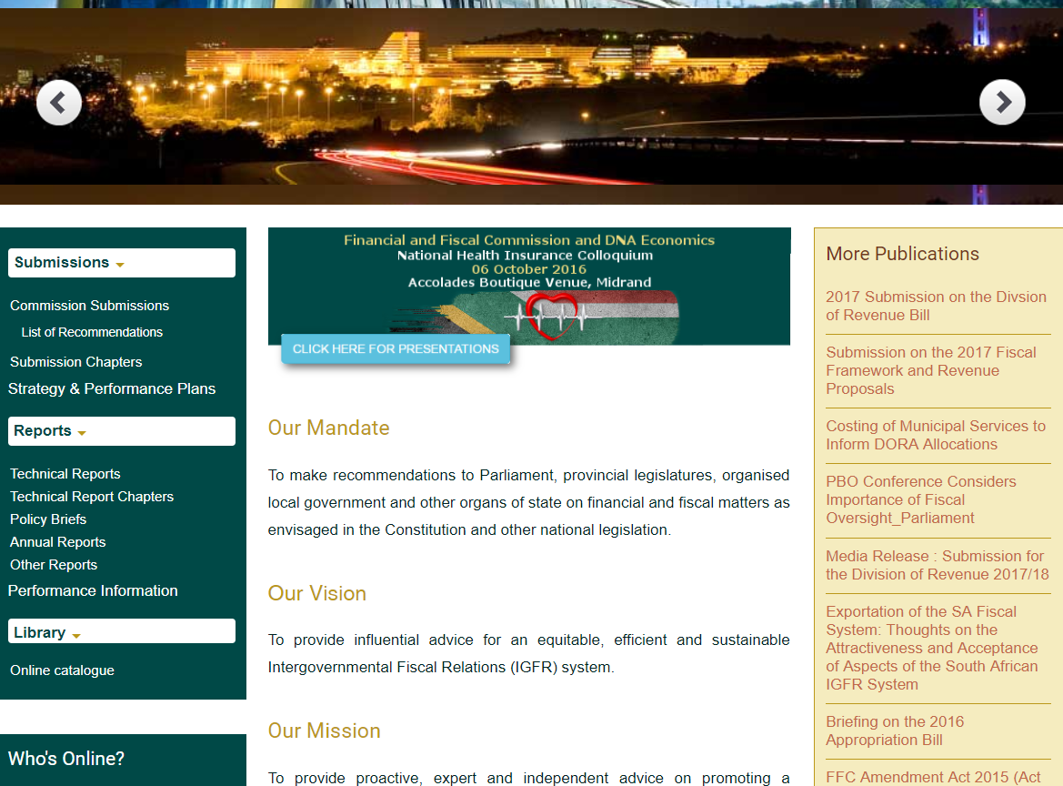
www.ffc.co.za

