Slide 1
Presentation to the Portfolio Committee on Trade and Industry
the dti’s First Quarter Performance Report
12 September 2017
Director-General
Lionel October

Slide 2
Presentation Outline
Strategic Goals and objectives
Global and Domestic Growth
First Quarter: Key Achievements
Financial Performance
First Quarter Performance Matrix

Slide 3
Strategic imperatives
Goals
VISION
Grow the manufacturing sector to promote industrial development, job creation, investment and exports
1. To facilitate transformation of the economy to promote industrial development, investment, competitiveness and employment creation
2. Build mutually beneficial regional and global relations to advance South Africa’s trade, industrial policy and economic development objectives;
3. Facilitate broad-based economic participation through targeted interventions to achieve more inclusive growth;
A dynamic industrial, globally competitive South African economy, characterised by inclusive growth and development, decent employment and equity, built on the full potential of all citizens.
Objectives
Improved conditions for consumers, artists and opening up of markets for new patents players
4. Create a fair regulatory environment that enables investment, trade and enterprise development in an equitable and socially responsible manner;
Strengthened capacity to deliver on the dti mandate
5. Promote a professional, ethical, dynamic, competitive and customer-focused working environment that ensures effective and efficient service delivery.

Slide 4
GLOBAL ECONOMIC growth
In its latest world economic outlook (WEO, July 2017), the IMF left its projections of global growth unchanged at 3.5% and 3.6% for 2017 and 2018, respectively.
On balance, risks to the global economy remain skewed to the downside.
      Inflated asset prices have increased the risk for a market correction
      Normalisation in monetary policy in the US points to possible tightening in overall global financial conditions.
The WEO July 2017 projections:
% y-o-y | 2016 | 2017 | 2018
Global GDP | 3.2 | 3.5 | 3.6
United States | 1.6 | 2.1 | 2.1
Euro Area | 1.8 | 1.9 | 1.7
Japan | 1.0 | 1.3 | 0.6
Advanced economies | 1.7 | 2.0 | 1.9
China | 6.7 | 6.7 | 6.4
India | 7.1 | 7.2 | 7.7
Russia | -0.2 | 1.4 | 1.4
Mexico | 2.3 | 1.9 | 2.0
Brazil | -3.6 | 0.3 | 1.3
Nigeria | -1.6 | 0.8 | 1.9
South Africa | 0.3 | 1.0 | 1.2
Sub-Saharan Africa | 1.3 | 2.7 | 3.5
EM & D economies | 4.3 | 4.6 | 4.8
Source: IMF, World Economic Outlook (July 2017)

Slide 5
DOMESTIC ECONOMIC OUTLOOK

Slide 6
SA IN A TECHNICAL RECESSION
SA fell into a technical recession. GDP contracted by an annualised 0.7% q-o-q (+0.6% y-o-y) in 2017Q1, following a decline of 0.3% in 2016Q4.
On a quarterly basis, production increased only in the agricultural and mining sectors, while it contracted in the rest of the sectors.
Agricultural output expanded by 22.2% q-o-q, following an increase in the production of field crops and horticulture production.
Mining output expanded by 12.8% q-o-q in line with higher production for gold, platinum and ‘other’ metal ores.
Unfortunately, the secondary sector contracted by 3.4% q-o-q in Q1 subtracting 0.6% points from overall GDP. The tertiary sector GDP fell by 2% and deducted 1.2% points from overall GDP, mainly because of the 5.9% q-o-q decline in trade (retail, wholesale, restaurants and hotels).
Looking ahead, agricultural production will likely continue to increase in line with the record bumper harvest of 15.97 million tonnes of maize in 2017, as per the latest estimate from the National Crop Estimates Committee.
Electricity output rebounded to 2.4% q-o-q during 2016Q4, after contracting by 2.5% in Q3.
o Other positive contributions to overall GDP came from trade (2.1% q-o-q), finance real estate and business services (1.6%), transport (2.6%), among other sectors.
• From a demand/ expenditure perspective, the slowdown in GDP was mainly on the back of weak consumption growth and constrained private fixed investment. Further downward pressure was added by declines in commodity prices, perceptions of weakening governance/ institutions, and rising policy uncertainty.
• Look ahead into 2017 and 2018, monetary and fiscal policies are expected to remain constrained, in line with their respective needs to keep inflation and the rising public debt contained.

Slide 7
MANUFACTURING UNDER PRESSURE
The Absa PMI fell by 3.8 points to 42.9 in July 2017. The PMI was last seen at these levels during the second half of 2009
The underlying indicators also deteriorated. The business activity index - a good proxy for manufacturing production - shaved off a significant 6.1 points to 39.3 against the backdrop of weak demand conditions. New orders also fell, while business expectations for the next six months remained subdued.
The July outcome depicts weaker manufacturing sector outlook. On a more positive note, however, some relief could come from easing inflationary pressures and possible further cuts in the policy interest rate.

Slide 8
BUSINESS CONFIDENCE still weak
The RMB/BER Business Confidence Index fell sharply to 29 points in 2017Q2, from 40 in Q1. These levels were last seen at these levels during the 2009 great recession.
Confidence was pulled down by weak business activity, domestic political risk and consequent sovereign credit rating downgrades. Respondents were more pessimistic about expectations for future operating conditions.
During Q2, confidence declined across all five surveyed sectors (motor trade, manufacturing, building and retail sector). In addition, confidence levels among all are currently sitting below the 50-neutral point.
In sum, business conditions deteriorated notably across the board, while weak domestic demand also weighed significantly. The overall weakness in business confidence bodes ill for private fixed investment growth and economic growth prospects.

Slide 9
CONSUMER CONFIDENCE DISSAPOINTS
The FNB/BER Consumer Confidence Index fell to -9 points in 2017Q2, from -5 in Q1. Consumers were downbeat on the outlook for domestic economic growth. This was likely a shock reaction to heightened domestic political risk and sovereign credit rating downgrades.
At these depressed levels, consumer confidence is likely to have a negative impact on retail sales and overall household consumer spending. Other factors putting a drain on confidence include tepid household income growth, higher personal income taxes, weak employment growth and falling household credit extension growth.
However over the next 12 months, consumers expect to see some improvement in their household finances. This is likely because of easing inflation pressures. Nevertheless, the majority of respondents continued to regard the present time as unsuitable to buy durable goods, i.e. big ticket items such as vehicles, furniture and appliances etc.

Slide 10
STICKY Domestic fixed investment
In 2016, real capital gross fixed capital formation (GFCF) contracted by -3.9%. This was the first annual negative rate since 2010. As a percentage of GDP, it fell below 20% for the first time since 2012.
During 2017Q1, however, domestic fixed investment growth slowed to 1% q-o-q, reflecting weak business confidence and policy uncertainty in SA.
Public corporations saw a decline of 2.7% q-o-q in real GFCF. In contrast for general government, real GFCF increased by 4.4%, supported by various infrastructure projects at the different levels of government.
Real GFCF for private business increased by 1.2% q-o-q, driven by capital outlays on residential buildings, machinery and other equipment.

Slide 11
sectoral Capital investment
According to the SARB’s latest quarterly bulletin, the decline in total fixed investment by private business enterprises has been broad-based across sectors since 2009.
Investment in electricity generation managed to continue growing, in line with the implementation of independent renewable energy projects.
Given the forward linkage to the manufacturing sector, lower mining output has contributed to the slowdown in fixed investment in manufacturing.
Growth in fixed capital formation in the transport and electricity generation sectors has been supported primarily by public corporations in line with the National Development Plan (NDP).

Slide 12
Poor Employment prospects
According Stats SA’s latest QLFS, the national unemployment rate remained unchanged at 27.7% in 2017Q2 compared to Q1. The unchanged jobless rate was facilitated by somewhat similar rates of contraction in the labour force (-0.7% q-o-q) and the number of unemployed persons (-0.6% q-o-q).
Compared to the previous quarter, job losses were recorded in construction (110 000), agriculture (40 000), mining (13 000), transport (11 000) and community and social services (9 000). Gains were recorded in trade (58 000), manufacturing (10 000) and utilities (2 000).
For SA, employment prospects remain weak for the near-term in line with poor domestic economic growth prospects. With business and consumer confidence at depressed levels, it is likely that this will not only result in reduced fixed investment, but also weaker employment growth. For the public sector, adherence to fiscal consolidation by the government is expected to weigh on employment growth.

Slide 14
Sa TRADE BALANCE in surplus
The latest trade statistics from the SARS indicated that the SA trade balance registered a trade surplus of R10.7 billion in June, up from a downwardly revised R7.2 billion surplus in May. Exports declined by 0.6% m-o-m but increased by 4.7% year-to-date.
Exports gained support from the recent rebound in commodity prices as well as stronger global growth. Imports fell by 4.2% m-o-m (-1.4% y-t-d) in line with continued weak domestic demand.
About 34% of exports were destined to five countries: China (R8.6 billion), Germany (R7 billion), the US (R6.3 billion), India(R4.6 billion), Japan (R4.1 billion). Roughly 28% of total imports came from China (R15 billion) and Germany (R9.1 billion).

Slide 15
Africa, a key market for sa products
During 2017Q1, SA exports to the rest of Africa amounted to R71 billion, down from R84 billion in 2016Q4.
About 35% of exports to Africa were mineral products (R13.9 billion) and machinery and mechanical appliances (R10.7 billion)
For Q1 of 2017, South Africa’s trade surplus with Africa is approximately R40 billion.
Exports from SA into the rest of Africa have slowed in line with weaker fiscal revenues, particularly for commodity exporters. Export revenues have come under pressure on the back of low commodity prices. Furthermore, the rand exchange rate has strengthened and remained resilient since 2016; this also likely weighed on intra-Africa export growth.
Regarding imports from the rest of the continent, SA has seen a mild upward trend in this regard after a sharp drop in early 2015. Support also likely came from the stronger rand exchange rate.

Slide 16

Key Achievements: First Quarter
1 April– 31 June 2017

Slide 17
Industrial Development
Industrial Participation
Agro Processing
The Agro-processing Support Scheme (ASS) for R 1 billion launched in May 2017 at Gallagher Estate on Africa’s Big seven event.
Cosmetics
Earth Elements received a contract from Clicks, and approved by NIPP
The company managed to get a contract from Clicks to supply 9 products at their 18 stores. the dti facilitated their application for NIPP and the company has been approved by NIPP.
SG 1: Facilitate transformation of the economy to promote industrial development, investment, competitiveness and employment creation

Slide 18
Industrial Development
Cosmetics
AfroBotanics South African Black owned company now in Clicks
AfroBotanics is woman-owned cosmetics company that manufactures ethnic hair care products. The company is now listed in Clicks and is featured in 377 retail stores in South Africa. The company has participated in trade shows funded by the dti under the facilitation by the cosmetics desk. The company also participated at the Kenya Outward Selling Mission (OSM) and has managed to secure some business deals.
BESPOKE Amenities Company in Kya Sand launch
Bespoke Amenities received an MCEP grant from the dti. The company has increased manufacturing capacity and they managed to buy and move into a new factory with the assistance of the dti. The new factory will be compliant to Good Manufacturing Practices (GMP), which is becoming a requirement from DoH. The company is now manufacturing bar soaps and lotions that they used to import from China for the hotel industry.
SG 1: Facilitate transformation of the economy to promote industrial development, investment, competitiveness and employment creation

Slide 19
Industrial Development
  Procurement
  SAA tender issued out, preference to be given to local manufacturers
  Tender Specifications and local content percentages were discussed with industry and SAA. The RFP has been sent out to industry and the Cosmetics sector desk is working very closely with SAA and industry to ensure participation of local industry.
  Designation
  The Board of Aberdare Cables has approved Phase 1 of an expansion in High Voltage cables production. Phase 1 will see an investment into production of up to 66KV cable. R30 million investment which will create an additional 25 Jobs to start in March 2018.
SG 1: Facilitate transformation of the economy to promote industrial development, investment, competitiveness and employment creation

Slide 20
Industrial Development
  Designation
  Electricity meters designation amended to include water meters at 40% local content.
  Circular for designation of Water Meters was published and circulated to organs of state by National Treasury in May 2017. The circular includes Residential Electricity Meters and Water Meters, and it replaces the Instruction Note on Residential Electricity Meters dated 4 August 2014. The Residential Electricity Meters was effective immediately following publication and the Water Meters came into effect on 22 June 2017.
SG 1: Facilitate transformation of the economy to promote industrial development, investment, competitiveness and employment creation

Slide 21
Industrial Development
Metals
  Localisation and factory openings:
  The department participated and witnessed the opening and launching of factories namely; Timken (Pomona- manufacturing of train wheel bearings); ABB (Modderfontein- Traction Transformer for electric locomotives) and Lucchini (Germiston- railway forged wheels) and transformer partnership (Electro Inductive Industries) with a black industrialist and Siemens.
  Transnet Engineering unveiled the Trans Africa Locomotive (TAL) in April, this loco has major export potential and suitable for use on branch lines and in the yard for shunting.
SG 1: Facilitate transformation of the economy to promote industrial development, investment, competitiveness and employment creation

Slide 22
Industrial Development
Metals
National Foundry Technology Network:
Quantas Foundry secured an ESKOM tender (R2 million) following an accreditation intervention (ISO9001). This foundry will supply a range of brackets to the SOE. This resulted in the retention of 50 jobs.
NFTN intervention at Jeorg Foundry with compliance requirements: (NEMA Act), averted foundry closure by DEA on air emission transgressions.
SG 1: Facilitate transformation of the economy to promote industrial development, investment, competitiveness and employment creation

Slide 23
Industrial Development
Metals
National Tooling Initiative
The first twelve candidates received the Toolmaker's Occupational Certificate under the new qualification SAQA Code 91796.
Trade Policy:
the dti supported the application from industry to increase the general rate of customs duty on prefabricated buildings from duty free to the maximum bound rate of 20% ad valorem; in order to protect the existing manufacturing capacity and to create of new jobs.
SG 1: Facilitate transformation of the economy to promote industrial development, investment, competitiveness and employment creation

Slide 24
Industrial Development
Primary Minerals Processing and Construction
Launched of the Nyanza titanium feasibility project in April supported by the dti Critical Infrastructure Fund. The plant will be the only titanium pigment producer in Africa after the closure of Huntsman’s Umbogontwini plant in 2015, and will create 1,300 jobs.
Thakadu group have completed BFS ( Bankable Feasibility study) into the development of a high purity battery grade Nickel sulphate (NISO4) from SA platinum producer-Lonmin’s crude Nickel sulphate stream.
the dti approved R8 million cluster support to the Mining Equipment Manufacturers of SA (MEMSA).
SG 1: Facilitate transformation of the economy to promote industrial development, investment, competitiveness and employment creation

Slide 25
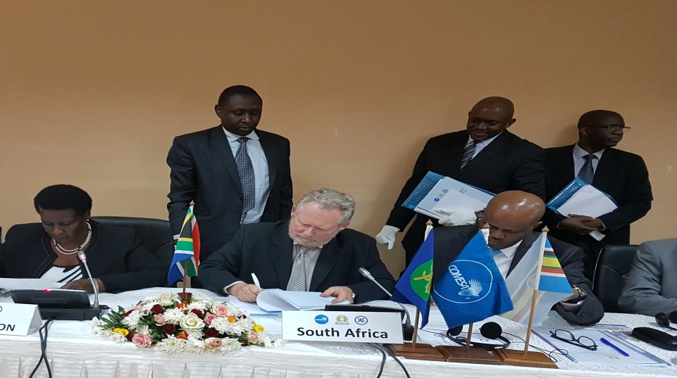
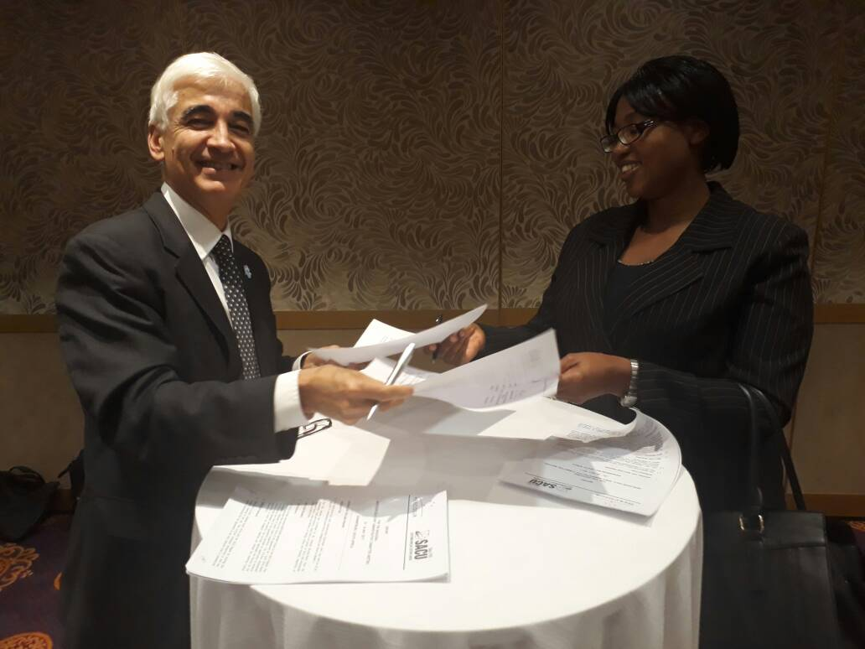
Trade, Investment & Exports
Conclusion of the Tripartite Free Trade Area Agreement
Agreement reached in Southern African Custom Union (SACU) to review the 2002 SACU Agreement with a view to develop an appropriate architecture for tariff setting and review the revenue sharing arrangement to address volatility and make provision for the implementation of cross-border projects.

Slide 26
Trade, Investment & Exports
South Africa Positions advanced in the Group of 20 with SA managing to play a key role in resisting a G20 agenda that would have undermined the Doha Development Agenda (DDA) in the World Trade Organizations (WTO) by advancing new policy issues that would undermine policy space especially for developing countries.
Modalities on Trade in Services approved and parameters for the Trade in Goods modalities agreed by African Union Ministers of Trade (AMOT) for the Continental Free Trade Area (CFTA).
Informal WTO Ministerial held in Paris with divergent views on key outcomes for 11th Ministerial Conference (MC11) – process agreed to avoid Ministerial being a negotiating session.
SG2: Build mutually beneficial regional & global relations to advance South Africa’s trade, industrial policy & economic development objective

Slide 27
Trade, Investment & Exports
Addressed United State of America (USA) concerns with regards to Tariff Rebate Quota (TRQ) on chicken thus avoiding an out-of-cycle review.
Significant progress achieved in the Southern African Customs Union – East African Community (SACU-EAC) tariff negotiations with 85% of the tariffs agreed.
SACU position agreed on the scope of Brexit negotiations.
SG2: Build mutually beneficial regional & global relations to advance South Africa’s trade, industrial policy & economic development objective

Slide 28
Trade, Investment & Exports
A total of 268 clients were assisted through the services rendered by the Export Helpdesk against the target of 200 for the period.
Significant amount of trade leads were generated through the Foreign Offices resulting in 295 leads disseminated to SA exporters against the target of 240.
Participation in the Global Export Passport Programme (GEPP) training was higher at 186 against the target of 130 as a result of improved cooperation with stakeholders.
SG2: Build mutually beneficial regional & global relations to advance South Africa’s trade, industrial policy & economic development objective

Slide 29
Trade, Investment & Exports
Participation in Joint Economic Committee (JEC) with France and in coordinating business delegation to accompany Minister and Deputy Minister to France to participate in Business Forum.
Accompany Deputy Minister (DM) to St Petersburg International Economic Forum (SPIEF) and support the DM’s participation on the Brazil, Russia, India, China and South Africa (BRICS) and Africa-Russia panel sessions.
Exports sales facilitated and recorded in the quarter amounted to R 2,166 billion to regions around the world.
SG2: Build mutually beneficial regional & global relations to advance South Africa’s trade, industrial policy & economic development objective

Slide 30
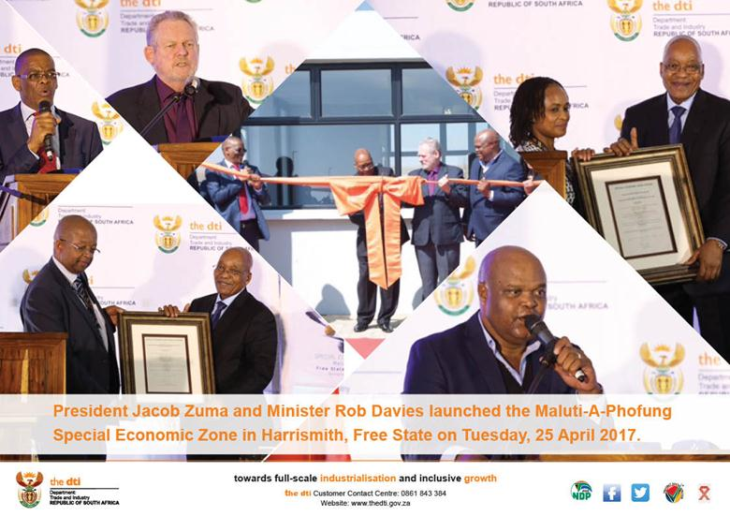
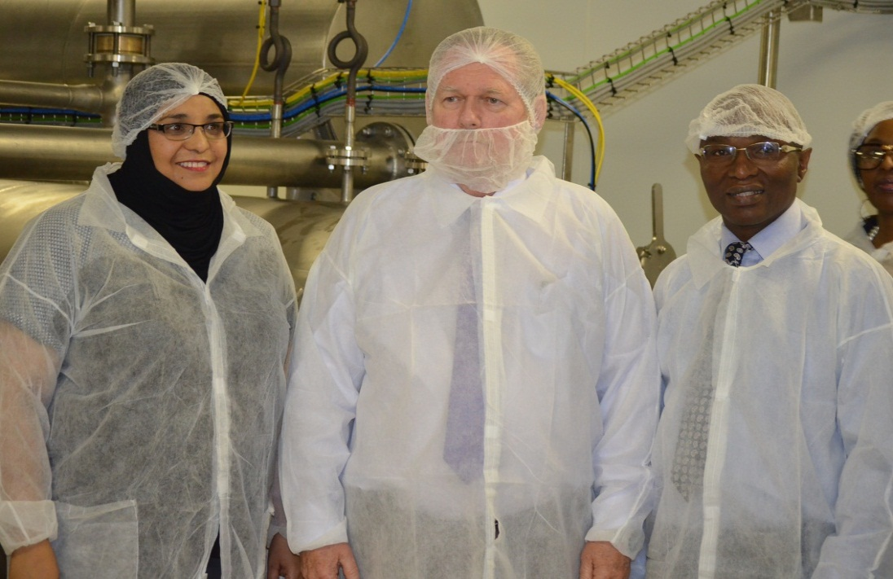
Special Economic Zones and Economic Transformation
Launch of Vulindlela Heights in Mthata and Babelegi Industrial Parks, in May 2017
Minister launched Black Industrialist companies; United Industrial Cables in June 2017 and K9 Pet Foods in May 2017
SG 3: Facilitate broad-based economic participation through targeted interventions to achieve more inclusive growth

Slide 31
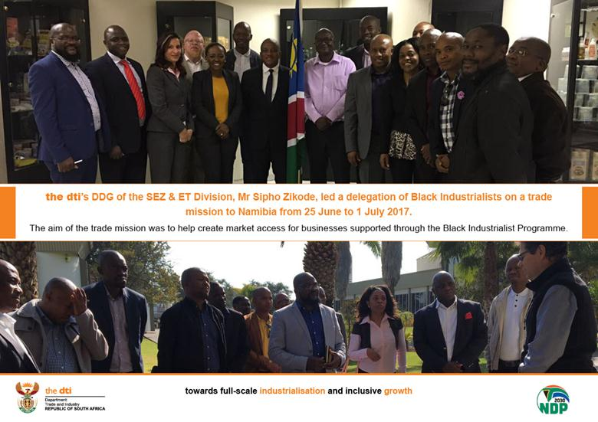
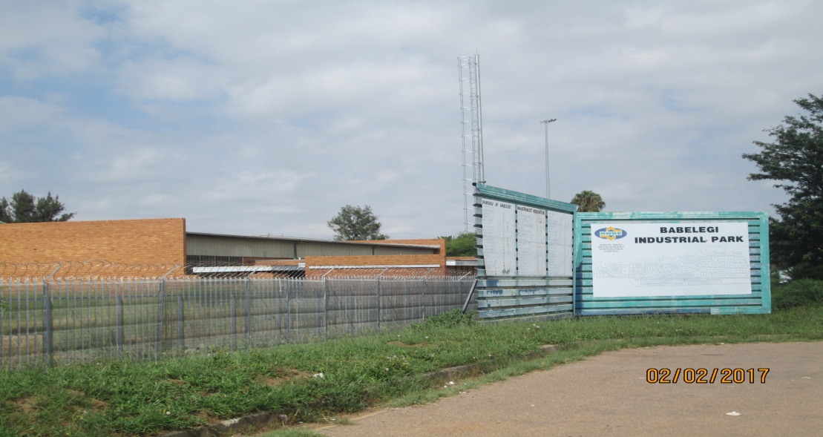
Special Economic Zones and Economic Transformation
The SEZ&ET lead 9 BI’s to Namibia from various sectors including Agro-processing, Pharmaceuticals, mining equipments, Chemicals and Metal Fabrications participating in a trade mission for access to markets from 25 June to 1 July 2017.
Launch of Vulindlela Heights in Mthata and Babelegi Industrial Parks, in May 2017.
SG 3: Facilitate broad-based economic participation through targeted interventions to achieve more inclusive growth

Slide 32
Special Economic Zones and Economic Transformation
Amendment of Draft Statement 005 submitted to the Minister for signing in June 2017; the Statement appoints the Broad-Based Black Economic Empowerment (B-BBEE) Policy Unit as the B-BBEE Verification Professional Regulator as well as introduces Empowerment Standards for Rating Agencies.
the dti hosted B-BBEE Advisory Council Workshop in June 2017 with the President, National departments’ Ministers, Chairpersons and CEOs of State Owned Companies (SOCs) and DFIs to consider proposals developed by the Council on radical socio-economic transformation.
Participated in the Gauteng Government Development Agency (GGDA) workshop with UK Based Companies in May 2017.
The B-BBEE Policy Unit was appointed to be a Member of the Task team that will tackle issues relating to B-BBEE Legislation.
SG 3: Facilitate broad-based economic participation through targeted interventions to achieve more inclusive growth

Slide 33
Special Economic Zones and Economic Transformation
Minister launched Black Industrialist companies; United Industrial Cables in June 2017 and K9 Pet Foods in May 2017.
the dti in conjunction with KwaZulu-Natal (KZN) Economic Development and Environmental Affairs Department; launched Black Industrialist Program in KZN led by Minister and MEC Zikalala in June 2017.
SG 3: Facilitate broad-based economic participation through targeted interventions to achieve more inclusive growth

Slide 34
Legislation and Regulation
Copyright Amendment Bill was introduced in Parliament in May 2017.
Seven education and awareness workshops were convened. In Limpopo (Tshakuma, Tzaneen, Ga-Masemola, Westernburg) and KwaZulu Natal
SG 4: Create a fair regulatory environment that enables investment, trade and enterprise development in an equitable and socially responsible manner

Slide 35

Administration & Co-ordination
50% of women in senior management
  All eligible creditor payments processed well within 30 days, with 43% of 4 144 creditors payment processed within 15 days and the remainder within 30 days.
3.34 people with disability
(SMS) Senior Management Service
SG 5: Promote a professional, ethical, dynamic and competitive and customer–focused working environment that ensures effective and efficient services delivery
35

Slide 36
Financial Performance
As at 3o June 2017

Slide 37
Financial performance – 30 JUNE 2017

Slide 39
Financial performance cont
Compensation of employees
As at 30 June 2017, the department’s expenditure on Compensation of Employees was R231 million or 107 percent of the YTD projections of R216 million. However, it should be noted that although expenditure is more than the YTD projections, it is still within the allocated budget.
Goods and services
As at 30 June 2017, expenditure on Goods and Services, compared to the YTD projections was 97 percent or R134 million. A lag in the projections is mainly due to invoices for services rendered not yet received from the service providers. Stringent cost containment measures implemented by the department were also a contributing factor.
39

Slide 40
Financial performance cont
Transfers and subsidies - Incentives
In pursuit of the department’s mandate to facilitate the transformation of the economy to promote industrial development, investment, competitiveness and employment creation, an amount of R525 million or 40% was disbursed to companies. The variance of 60% is mainly due to:
Outstanding compliance documentation required from applicants to finalise claims.
Claims that could not be processed as they were found to be non-compliant with the guidelines.
Funding agreements are still being finalised.
Transfers and subsidies – other transfers
Included under other transfers are funds disbursed to public corporations, departmental agencies, non-profit organisations as well as foreign governments and international organisations. For the reporting period, an amount of R813 million or 95% against the YTD projections of R858 million was disbursed.

Slide 41
Financial performance cont
Payments for capital assets
As at 30 June 2017, the department’s spending on payments for capital assets was R15 million against the YTD projections of R3.6 million. However, it should be noted that although expenditure is more than the YTD projections it is still within the allocated budget. This was as a result of payments made for the Turnkey backup solution, which commenced in the 2016/17 financial year but finalised in the 2017/18 financial year.

Slide 42
FIRST QUARTER Performance INFORMATION
As at 3o June 2017

Slide 43
FIRST QUARTER PERFORMANCE INFORMATION
DEPARTMENT OF TRADE AND INDUSTRY
Programme / Sub-Programme / Performance Indicators | 2017/18 Annual Target as per Annual Performance Plan (APP) | Quarter 1 Progress |  | Comments
 |  |  |  | Reason for Deviation | Corrective Action
 |  | Quarter 1 Target as per APP | Quarter 1 Output – Preliminary
Programme 1: Administration
3.1 Percentage (%) of staff turnover (unexpected) | 6,80% | 1,70% | 1,50% | Turnover projected was less than actual terminations against the annualised target of 1.7%. Permanent: 0.8% Additional (Contracts): 0.07% Interns: 0.6% | N/A
3.2. Percentage (%) of people with disability employed | 3,50% | 3,20% | 3.34% | Decrease in establishment numbers due to terminations increased disability percentage | N/A
3.3 Percentage (%) of Women employed in senior management positions | 50% | 48% | 50% | One male employee retired and this caused an increase in the percentage | N/A
3.4 Eligible creditors’ payments processed within legal timeframes | All eligible creditors’ payments made within 30 days | All eligible creditors’ payments made within 30 days | All eligible creditors’ payments made within 30 days (43% of 4 144 creditors invoices were processed within 15 days and the remainder within 30 days) | More stringent reviews on turnaround times on daily statistics | N/A
3.5 Number of outreach engagements and exhibitions | 65 outreach engagements | 20 | 12 | Slow demand of outreach engagements | The demand has started to pick up & will not necessitate any corrective action
3.5 Number of outreach engagements and exhibitions' | 49 exhibitions | 12 | 24 | Career Expos participation. Collaborated activities with agencies | N/A

Slide 44
FIRST QUARTER PERFORMANCE INFORMATION
DEPARTMENT OF TRADE AND INDUSTRY
Programme / Sub-Programme / Performance Indicators | 2017/18 Annual Target as per Annual Performance Plan (APP) | Quarter 1 Progress |  | Comments
 |  |  |  | Reason for Deviation | Corrective Action
 |  | Quarter 1 Target as per APP | Quarter 1 Output – Preliminary
Programme 2: International Trade and Economic Development
1.1 Number of status reports on regional economic integration | 2 status reports produced on progress towards conclusion of T-FTA and CFTA trade negotiations | Nil | N/A | N/A | N/A
1.2 Number of reports on Implementation of SADC-EU Economic Partnership Agreement (EPA) | 2 status reports on implementation of the EPA | Nil | N/A | N/A | N/A
1.3 Number of status reports on Global fora (e.g. BRICS, G20, AGOA, UK Brexit) | 4 status reports | 1 status report produced on engagements in Global For a | 1 status report produced on G20, AGOA and UK Brexit | N/A | N/A

Slide 45
FIRST QUARTER PERFORMANCE INFORMATION
DEPARTMENT OF TRADE AND INDUSTRY
Programme / Sub-Programme / Performance Indicators | 2017/18 Annual Target as per Annual Performance Plan (APP) | Quarter 1 Progress |  | Comments
 |  |  |  | Reason for Deviation | Corrective Action
 |  | Quarter 1 Target as per APP | Quarter 1 Output – Preliminary
Programme 3: Special Economic Zones and Economic Transformation
1.4 Number of SEZs submitted to Minister for designation | 2 | Nil | N/A | N/A | N/A
1.5 Number of implementation reports on the Industrial Parks submitted to Minister | 2 | Nil | N/A | N/A | N/A
1.6 Number of reports on implementation of the B-BBEE Amendment Act and Regulations submitted to the Minister | 2 | Nil | N/A | N/A | N/A
1.7 Number of new BIs supported in key sectors | 70 new BIs supported in IPAP sectors | 20 new BIs supported in IPAP sectors | 22 Bis supported in IPAP Sectors (5 Financial and 17 Non-Financial) | Due to increased advocacy there is an increase in the number of applications from BIs | N/A
Programme 4: Industrial Development
1.8 New iteration of IPAP submitted to Minister for tabling in Cabinet annually | Annual Rolling IPAP 2018/19 submitted to Minister for tabling in Cabinet March 2018 | Launch the Annual Rolling IPAP 2017/18 | Launched the Annual Rolling IPAP 2017/18 on 08 May 2017. | N/A | N/A
1.9 Number of implementation reports on IPAP tabled at Minister’s Review Meetings per year | Four | 1 | 1 IPAP Q4 report prepared and presented to the Minister on 10 April 2017. | N/A | N/A
1.10 Number of designation requests prepared for Minister per year | Two | Nil | Two (2) designation requests prepared for Minister i.e. Pumps and MV Motors; and Industrial Lead Acid Batteries. | The two designations received ministerial approval during Q1 | N/A
1.16 Value (Rand) of investment projects facilitated in pipeline | R45bn | R10bn | R14.38bn | Potential large projects from the Peoples Republic of China | N/A

Slide 46
FIRST QUARTER PERFORMANCE INFORMATION
DEPARTMENT OF TRADE AND INDUSTRY
Programme / Sub-Programme / Performance Indicators | 2017/18 Annual Target as per Annual Performance Plan (APP) | Quarter 1 Progress |  | Comments
 |  |  |  | Reason for Deviation | Corrective Action
 |  | Quarter 1 Target as per APP | Quarter 1 Output – Preliminary
Programme 5: Consumer and Corporate Regulation
2.1 Number of Socio-Economic Impact Assessment System (SEIAS) reports (previously RIA reports) developed for Minister’s approval | Four SEIAS reports on Companies, Gambling, Liquor and Credit Amendment Acts developed for Minister’s approval | Nil | Certified SEIAS reports for the Liquor and Copyright Amendment Bills. Draft SEIAS reports on the debt relief policy, Gambling and Companies Amendment Bills developed | N/A | N/A
2.2 Number of Bills developed for Minister's approval | 6 Bills on Companies, Gambling, Liquor, Credit, Copyright and Performers Protections Amendment Acts developed for Minister’s approval | Nil | Copyright Amendment Bill and Performers Protection Amendment Bills: Presented the Bills before the PC of Arts and Culture. Companies Preparation is being done for the Bill to be presented to ESEID Cluster. Credit: National Credit Policy Review on Debt Relief drafted and approved by the DG and the Minister for tabling in Parliament. Amendment Bill was presented at the ESEID DG’s cluster requesting approval to table before Cabinet. Gambling Amendment Bill was presented at the ESEID. The Liquor Amendment Bill was presented at the ESEID DG’s cluster requesting approval to table before Cabinet | N/A | N/A
2.3 Number of education and awareness workshops on policies and legislation conducted and report produced for Ministers approval | 24 education and awareness workshops on policies and legislation conducted and report produced for Ministers approval | 6 | 7 Education Awareness workshops were conducted in Limpopo and Kwa-Zulu Natal Report produced to Minister | 4 Education and Awareness workshops were convened in Limpopo as per the request from the municipalities and tribal authorities | N/A

Slide 47
FIRST QUARTER PERFORMANCE INFORMATION
DEPARTMENT OF TRADE AND INDUSTRY
Programme / Sub-Programme / Performance Indicators | 2017/18 Annual Target as per Annual Performance Plan (APP) | Quarter 1 Progress |  | Comments
 |  |  |  | Reason for Deviation | Corrective Action
 |  | Quarter 1 Target as per APP | Quarter 1 Output – Preliminary
Programme 6: Incentive Development and Administration
1.11 Value (Rand) of projected investments to be leveraged from projects/enterprises approved | R15bn | R2bn | R3.6 bn | Approved CIP and Film & TV projects resulted in high value of projected investments | N/A
1.12 Projected number of new jobs supported from enterprises approved | 3 000 | 600 | 2293 | Approved projects were both capital and labour intensive that resulted in high value of projected investments and jobs | N/A
1.13 Projected number of jobs to be retained from approved enterprises | 3 000 | 600 | 2267 | Approved AIS projects are sustaining high number of jobs | N/A
1.14 Number of enterprises/projects approved for financial support across all incentives | 800 | 150 | 150 | N/A | N/A
Programme 7: Trade and Investment South Africa
1.15 Number of companies assisted under EMIA in supporting value added exports | 784 | 228 | 163 companies benefited financially from EMIA | ITI Russia, Trade Missions to Cuba, USA and from South Sudan postponed to later in the year | Postponed activities are planned to be undertaken later in the year
Programme 8: Investment South Africa
1.16 Value (Rand) of investment projects facilitated in pipeline | R45bn | R10bn | R14.38bn | Potential large projects from the Peoples Republic of China | N/A

Slide 48
Ke ya leboga
Ke a leboha
Ke a leboga
Ngiyabonga
Ndiyabulela
Ngiyathokoza
Ngiyabonga
Inkomu
Ndi khou livhuha
Dankie
Thank you

