Slide 1
DBE/SRSA PRESENTATION TO THE PORTFOLIO COMMITTEE ON SPORTS AND RECREATION 12 SEPTEMBER 2017

Slide 2
PRESENTATION OUTLINE
Purpose 3
Implementation of the MoU DBE and SRSA 4
Sport facilities and Partners 7
2017/18- 18/19 Budget allocation for school sport 8
Challenges and Remedial Measures 9
MoU Review Process 10
Work Plan and Progress 13
Recommendations 14
Conclusion 15

Slide 3
PURPOSE
To brief the Portfolio Committee on Sport and Recreation on progress made by the Department of Basic Education and Sport and Recreation South Africa in the implementation of School Sport.

Slide 4
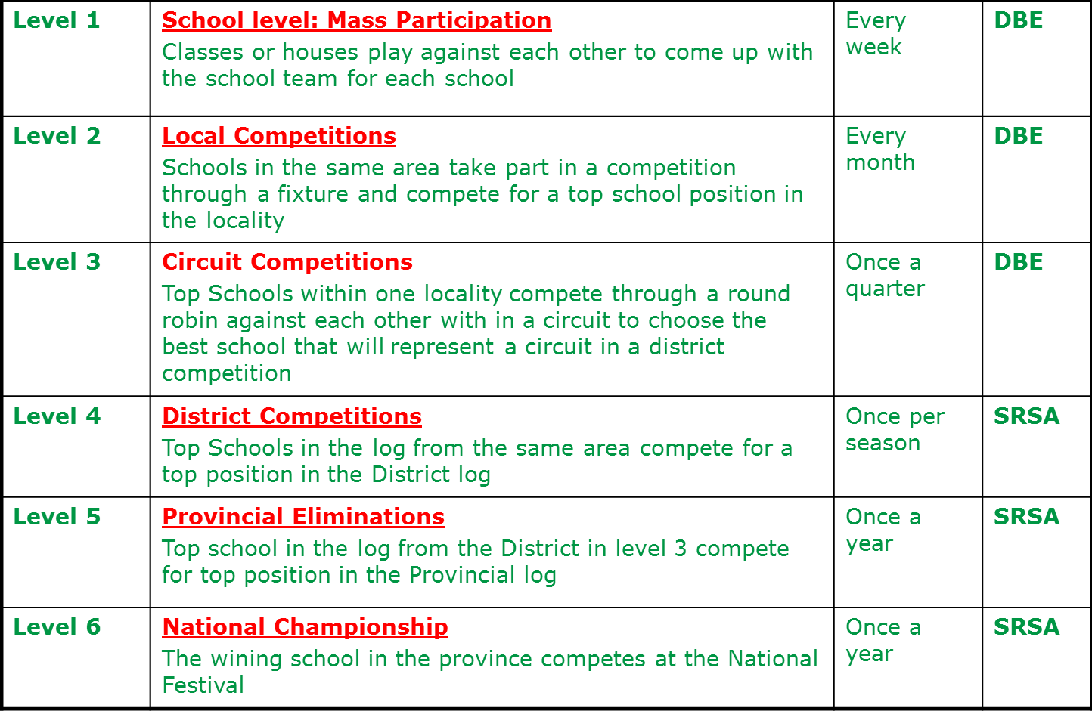
IMPLEMENTATION OF THE SCHOOL SPORT PROGRAMME ACCORDING TO THE MoU
The School Sport Programme is implemented according to the levels indicated below:

Slide 5
REFLECTION ON SCHOOL SPORT
The DBE-SRSA partnership has made significant progress.
A Joint National Task Team on Schools Sport was established
Comprises of National and Provincial Coordinators from DBE and SRSA, National Federations and School Code Structures
Meets Quarterly to monitor and review the School Sport Implementation Plan
Participating and registered schools have grown remarkably since the MoU came into effect
Broadened offering of sporting codes from 4 to 16
Segmentation of Annual School Sport Programme into Autumn, Winter and Summer Games
Links with Physical Education foregrounded

Slide 6
IMPLEMENTATION OF THE SCHOOL SPORT PROGRAMME ACCORDING TO THE MoU
Total number of registered schools as at May 2017
Province | No of Schools | Registered Schools | Percentage (%)
GP | 2 045 | 2 002 | 97.90
WC | 1 563 | 1 257 | 80.42
MP | 1 807 | 1 124 | 62.20
LP | 3 935 | 2 141 | 54.41
NW | 1 591 | 849 | 53.36
KZN | 5 955 | 3 426 | 57.53
FS | 1 351 | 664 | 49.15
NC | 560 | 255 | 45.54
EC | 5 558 | 1 782 | 32.06
TOTAL | 24 365 | 13 500 | 55.41

Slide 7
SPORTS FACILITIES AND PARTNERS
The Department implements the Accelerated Schools Infrastructure Delivery Initiative (ASIDI)
New schools are designed with care and support facilities such as sick bay, nutrition centre and sports facility
The Department has mobilised partnerships with the following entities in support of school sport:
1. Supersport Let’s Play - Department’s Schools Infrastructure Priority Project
2. UNICEF- Built six multi-purpose fields in schools
3. Cricket South Africa – Hub system
4. Motsepe Foundation - ten-year sponsorship that seeks to develop schools football and netball as well as choral and traditional music
5. Dreamfields - Five-A-Side football and mini-netball primary schools
The package of support from these partners includes building of multi-purpose sports facilities in schools

Slide 8
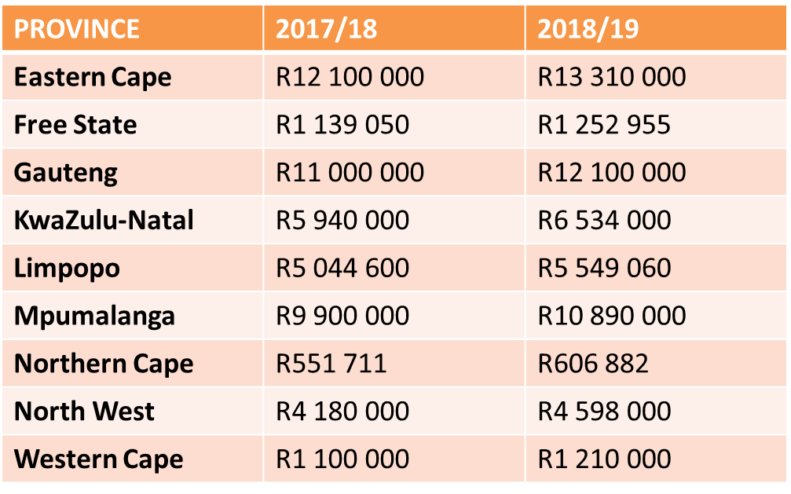
ALLOCATIONS FOR SCHOOL SPORT
BUDGET ALLOCATION

Slide 9
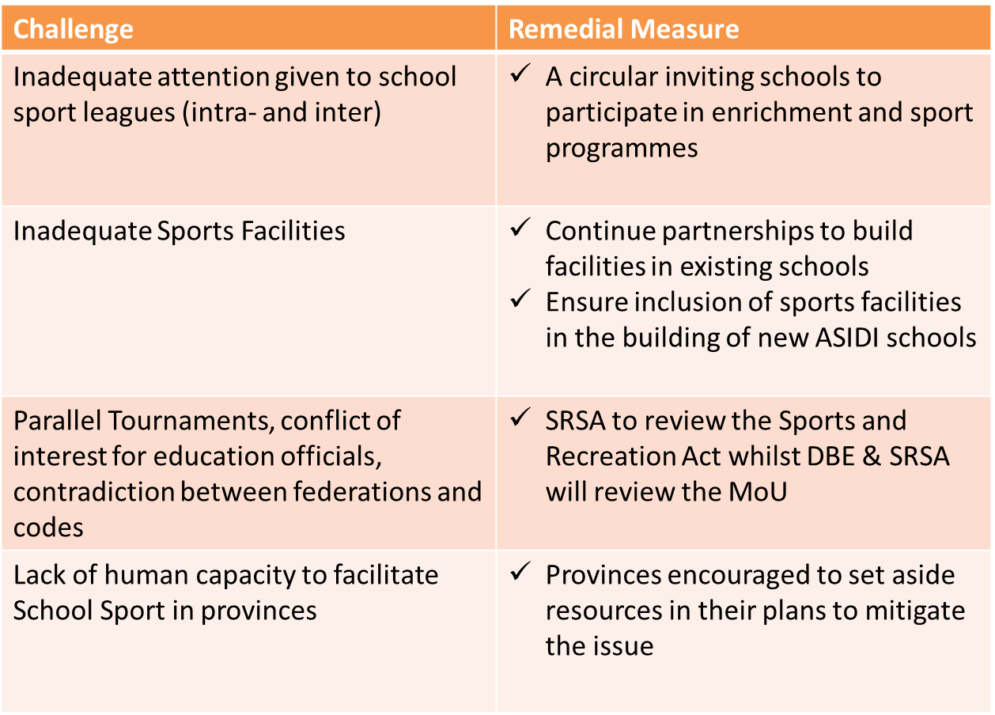
CHALLENGES & REMEDIAL MEASURES

Slide 10
PLANS TO REVIEW THE MoU
DBE and SRSA have started the MoU review process
The number of codes offered to be considered
The role of School Code Structures to be reviewed
Conflict of Interest of National, Provincial and District officials in education to be addressed
The nature of the National Championships is being reviewed
Sponsored tournaments to be reviewed

Slide 11
PRIORITY AREAS ON REVIEWING SCHOOL SPORT PROGRAMME
POLICY RELATED:
Inclusion of Combat Sports
Roles and responsibilities of SGB’s
School Sports policy
Sport focused school model
Physical Education implementation
MEMORANDUM OF UNDERSTANDING
School Sport Code Coordinating Structures
Inter and Intra School Sport participation (Level 1-3)
Allocation of Funding
Teachers’ incentives
Building of Sports Facilities in schools
Inclusion of the Sports Code in the MoU

Slide 12
PRIORITY AREAS ON REVIEWING SCHOOL SPORT PROGRAMME…
NATIONAL SCHOOL SPORT CHAMPIONSHIPS
A predictable, repetitive, competition is proposed. Consider LTPD, COSSASA and ISF
As a principle it should consist of:
1. Apex codes and two other codes
2.Maximum of three age groups, male and female and disabled
3. Alignment of National Federations and School Sport Code Structures
Winter Codes – Netball, Rugby, Football, for males and females.
Summer Codes – Cricket and Chess (non apex).
Autumn – Athletics and Aquatics(non apex).
Indigenous Games Codes for Schools to be incorporated into the IG Festival in September 2018.

Slide 13
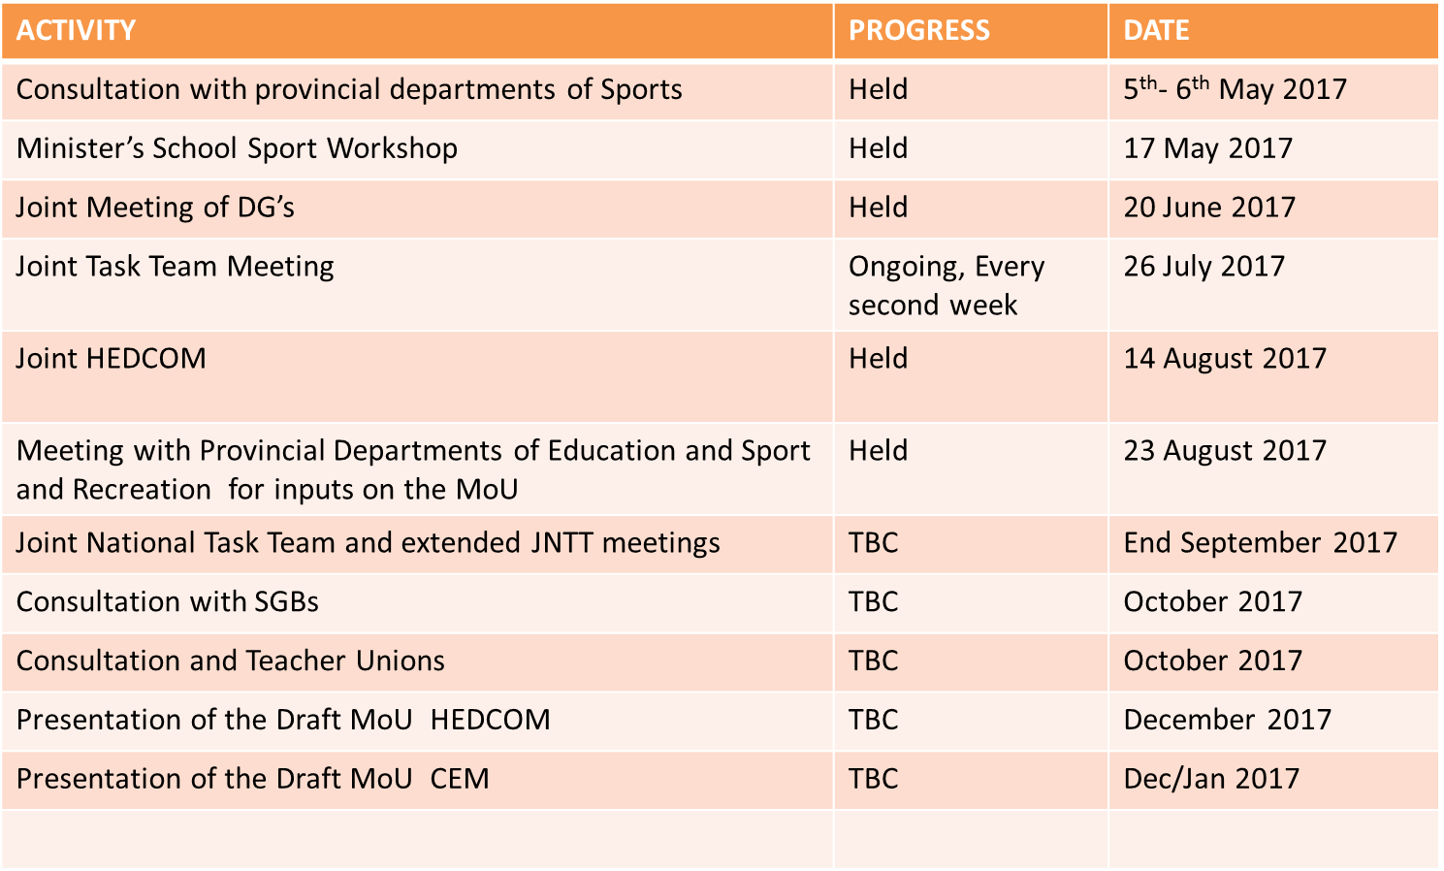
WORK PLAN AND PROGRESS

Slide 14
RECOMMENDATIONS
Costed and financially prudent business plan that will address the current financial challenges for the School Sport Programme at local level
This will require joint planning sessions between DBE and SRSA and consultation with key stakeholders
Five year School Sport Calendar for predictability of all school sport activities
Step by step guide to assist struggling district officials on the role they need to play in the implementation of school sport programme
Functional school sport structures
Sound monitoring plans that will ensure mass participation takes place at school and local levels
Advocacy for intra-school sport programme
Mini tournaments taking place at ward/circuit levels
Focus on Indigenous Games

