Slide 1
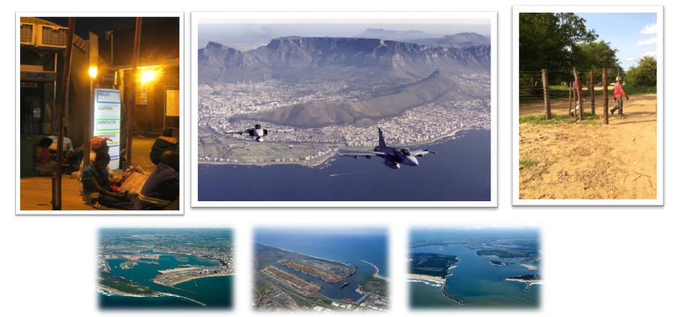
BORDER MANAGEMENT AUTHORITY (BMA) BILL, 2016 -OVERVIEW-
March 2017

Slide 2
PURPOSE
To provide an overview of the Border Management Authority (BMA) Bill, 2016, as approved by the Portfolio Committee on Home Affairs

Slide 3
OUTLINE
Key Risks and Challenges facing Border Management in South Africa
Political Mandate & Principles Informing the BMA Bill, 2016
Process to Date (September 2015 – March 2017)
Overview of the BMA Bill, 2016

Slide 4
KEY BORDER MANAGEMENT RISKS & CHALLENGES

Slide 5
GLOBAL BORDER MANAGEMENT CONTEXT
“Across the globe, insecure borders enable the trafficking of drugs, weapons, contraband, terrorist funding, materials related to weapons of mass destruction, conflict minerals, wildlife and people.” Ban Ki Moon, 2012
Globalisation has heightened the challenges of border management for sovereign states globally

Slide 6
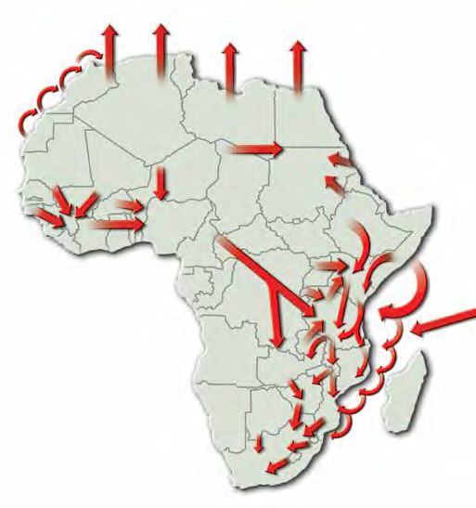
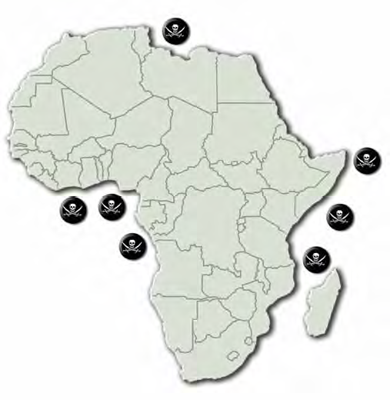
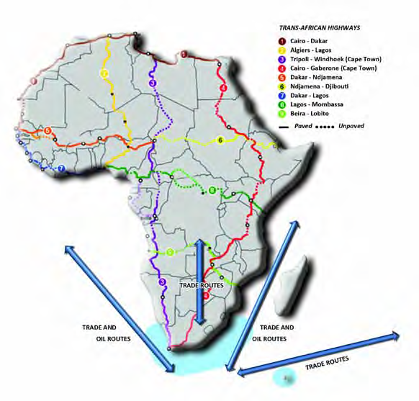
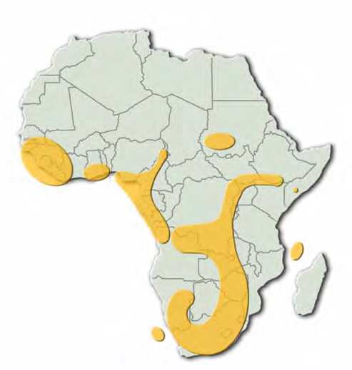
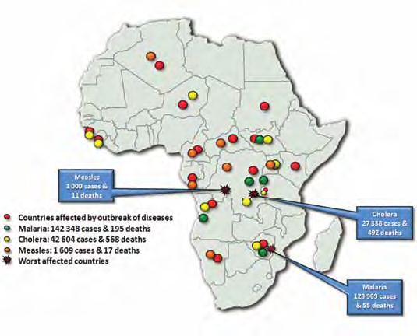
CHALLENGES RELATED TO PUBLIC HEALTH, NATURAL RESOURCES, INSECURITY, INFRASTRUTURE AND INSTABILITY ON THE CONTINENT
AFFECT SOUTH AFRICA
In Africa, about half of the increase in the migrant stock during 2010-2013 was the result of the movement of migrants from Northern Africa to Eastern Africa
Migration flows
Some Border Management Drivers
Piracy areas
State of Infrastructure
Disease Hotspots
Natural Resource Belts

Slide 7
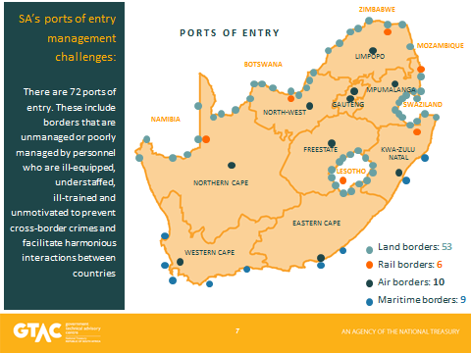
PORTS OF ENTRY IN SOUTH AFRICA

Slide 8
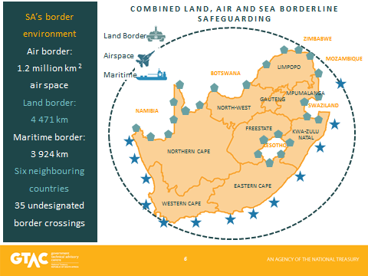
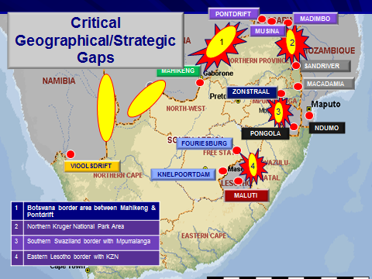
VULNERABILITIES IN THE BORDER ENVIRONMENT
South Africa has an extensive border environment: land, air and maritime
There are STRATEGIC GAPS along the land borderline and in the air and maritime border environment (limited permanent static surveillance)

Slide 9
SOME KEY CHALLENGES & RISKS FACING SOUTH AFRICA’S BORDER ENVIRONMENT
Limited surveillance capability & coverage over the country’s airspace; many small airstrips close to the borderline
Extensive maritime jurisdiction; Vessel Monitoring System (VMS) is transponder based; Large volumes of cargo pass through maritime Ports of Entry; illegal fishing; illicit movement of contraband and narcotics
Over 39m people move through 72 Ports of Entry annually; Extensive land (4471km) & coastal (3924km) borders; high number of Ports of Entry; 7 Transfrontier Conservation Parks; many informal border crossings; cross-border communities; inadequate border fences & patrol roads; strategic gaps in the borderline; wild-life poaching; illegal migration
Air
Sea
Land

Slide 10
FRAGMENTED MANAGEMENT OF THE SA BORDER ENVIRONMENT

Slide 11
HISTORY AND FAILURE OF FRAGMENTED BORDER MANAGEMENT
Since 1994 SA made gallant strides in demilitarising and deracialising the management of the country’s borders by introducing various capabilities to give effect to border management.
The consequence of establishing these various organs of state, e.g. immigration control, customs control, border policing etc., resulted in the emergence of a silo approach to border control, border law enforcement and border protection.
Various structures were subsequently put in place to attempt to coordinate the mandates and actions of these distinct organs of state in the border environment:
Border Affairs Committee Coordinating Committee (1996)
National Inter-Departmental Structure (NIDS) (1997)
Border Control Operational Coordinating Committee (BCOCC) (2001)
Inter-Agency Clearing Forum (IACF) (2010)
From at least the mid-2000 various studies and reports have pointed to the failure of these structures to address the systemic and structural problems of coordination model associated with fragmented border management.
It is against this background that Cabinet decided on the 26th of June 2013 to establish a Border Management Agency (BMA) in South Africa under an integrated approach

Slide 12
KEY FEATURES OF FRAGMENTED BORDER MANAGEMENT APPROACH
About 8891 state officials from at least 5 organs of state (DHA, SARS, DAFF, SAPS, DoH) are working at the country’s 72 Ports of Entry,
With different conditions of service and remuneration;
Implementing distinct Departmental mandates in at least 58 pieces of legislation;
With competing priorities and deliverables;
Having dissimilar tools of trade and equipment;
With some systems that are not automated, e.g. DOH and DAFF;
Engaging in limited sharing of information; and
Lacking a single management, command and control structure.

Slide 13
KEY FEATURES OF FRAGMENTED BORDER MANAGEMENT APPROACH
The consequences of the above fragmentation are:
Non-aligned and often poor border control-related service delivery ;
Ineffective facilitation of the movement of persons and goods (unnecessary delays and cost to clients)
Compromised joint efforts and outcomes resulting from different risk management tools and approaches;
The ineffective utilisaton of public resources due to limited information sharing;
Inability to enforce a standard approach in dealing with border law enforcement transgressions;
A higher volume of Illegal goods entering the country;
Corruption and organised crime thriving in a fragmented management environment
An increase of undocumented foreign nationals within the country; and
Siloism with agencies focusing on their own mandates.

Slide 14
POLITICAL MANDATE AND PRINCIPLES INFORMING THE BMA BILL

Slide 15
POLITICAL MANDATE
3 June 2009
In the State of the Nation Address: President JG Zuma stated that government “will start the process of setting up a Border Management Agency” in South Africa
26 June 2013
Cabinet decided:
To establish a BMA that would include the ceding of functions from relevant organs of state
Implementation steps
DHA designated as the lead department for the BMA
10 December 2014
Cabinet approved:
BMA Vision
Key priorities for the Transitional Period (2015-2016)
DHA to assume the lead agency role for the BCOCC
BMA should be established by December 2016
23 September 2015
Cabinet endorsed:
That the draft BMA Bill, 2015 should be introduced into Parliament

Slide 16
PRINCIPLES INFORMING THE BMA BILL
BMA will be outcomes focused: Balance facilitation of legitimate trade and travel functions, while simultaneously addressing security risks
BMA will be established as a single implementation entity:
Under a single executive authority
Constituted as a single accounting authority
Established by an enabling Act
BMA will assume control of all Ports of Entry and borderline functions:
Ports of Entry functions: Immigration control; customs control; human health inspection; bio-security; inspections of animals, fish and associated foodstuffs and products; inspections of plants and related products; border policing; and full custodianship for infrastructure at land Ports of Entry
Maritime environment: BMA Coast Guard will be established to patrol up to the extent of the Exclusive Economic Zone
Land borderline: BMA Border Guard will be established to patrol an area of 10km from the international border
Air border environment: The South African National Defence Force (primarily through the South African Air Force) will assume responsibility

Slide 17
PRINCIPLES INFORMING THE BMA BILL
BMA will be established as a command and control organisation with complete management authority within all Ports of Entry and border law enforcement areas
A basket of border law enforcement functions will be ceded and/or transferred from relevant organs of state to the BMA
The BMA will be established on the basis of primarily “frontline integration” of border law enforcement functions at Ports of Entry and the border law enforcement areas.
The establishment of a National Border Risk Management and Targeting Centre will be key to the functioning of the BMA

Slide 18
PRINCIPLES INFORMING THE BMA BILL
The BMA will establish its own organisational culture, identity and conditions of service:
Foster a uniform organisational culture and identity: One face, one brand, one uniform; and Uniform conditions of service for all staff
Ongoing learning and professional development
Zero tolerance for all forms of corruption and unethical behaviour
Employ public servant cadres of high integrity and a Batho Pele ethos
The BMA will assume operational responsibility for Port of Entry infrastructure and maintenance: Differing approaches will be taken at land, air and sea Ports of Entry:
Air and sea ports of entry must comply with the legitimate requirements of BMA to satisfy domestic security and functional requirements as well as international licencing requirements
BMA will assume full legal and functional responsibilities for land ports of entry accommodation and infrastructure
A new policy paradigm of integrated border management for SA

Slide 19
VISION OF THE BMA
Border Guard responsible for frontline border law enforcement
Armed border law enforcement organ of state
Approximately 9000 public servants
Implementing over 40 laws
Responsibility for all Ports of Entry & land and maritime borders
Single command and control authority in the border environment

Slide 20
PROCESS TO DATE
SEPTEMBER 2015 – MARCH 2017

Slide 21
PROCESS OF CONSULTATIONS
(September 2015 – May 2016)
Cabinet approved the introduction of the draft BMA Bill to Parliament on the 23rd of September 2015 (based on intergovernmental consultations, gazetting of the draft BMA Bill for public comment & socio-economic impact assessment)
Three (3) engagements took place at the Public Service Council Bargaining Chamber (PSCBC)
Seven (7) engagements took place at the NEDLAC
Bilateral meetings were convened separately with Labour (4 meetings) and Business (4 meetings)
Consultations and inputs from the Office of the State Law Advisor (OCLSA) on the draft BMA Bill
Notes:
The content of this slide conforms to what was indicated as ASSUMPTIONS in previous BMA presentations. However, we do not regard all the statements made as ASSUMPTIONS as per the definition of an assumption.

Slide 22
OUTCOME OF CONSULTATIONS
(September 2015 – May 2016)
BMA Bill, 2016 addressed key concerns:
Constitutional concerns have been addressed
Some substantive provisions have been revised
Structure and outline of the draft Bill has been revised
Minor drafting matters have been addressed
Overall Cabinet approved policy direction and outcomes remains unchanged
Notes:
The content of this slide conforms to what was indicated as ASSUMPTIONS in previous BMA presentations. However, we do not regard all the statements made as ASSUMPTIONS as per the definition of an assumption.

Slide 23
AREAS OF DISAGREEMENT IN THE NEDLAC PROCESS: NOVEMBER 2015 – MAY 2016
Only three (3) substantive areas of disagreement could not be resolved at NEDLAC:
Establishment of the Authority: Labour disagrees that the BMA will be a Schedule 3A national public entity in terms of the Public Finance Management Act, 1999 (Act No. 1 of 1999) since it views this as privatisation of government functions. Business is of the view that the risks are too high in establishing a new Agency. Government is of the view that all the main substantive concerns raised by Labour are addressed in the revised Bill.
Security Vetting Process: Labour and Business have a longstanding disagreement with Government on the security vetting process across Government institutions. Their view is that it is ineffective and inefficient. Government is of the view that a security vetting process is an absolute necessity for all future BMA officials and employees.
Routine Searches: The view of Business was that officials should only be permitted to search goods and persons where there are reasonable grounds to believe that a warrant is likely to be granted, if applied for, and that the delay in applying for such a warrant would defeat the object. Government is of the view that routine searches at ports of entry, and within the border law enforcement area, cannot be subjected to these limitations.
Notes:
The content of this slide conforms to what was indicated as ASSUMPTIONS in previous BMA presentations. However, we do not regard all the statements made as ASSUMPTIONS as per the definition of an assumption.

Slide 24
PARLIAMENTARY PROCESS
(May 2016 – MARCH 2017)
BMA Bill, 2016 was introduced into Parliament in May 2016.
The Portfolio Committee on Home Affairs gazetted the BMA Bill, 2016 for public comments in August 2016 and processed these submissions and inputs.
Some of the important revisions made to the BMA Bill, 2016 by the Portfolio Committee on Home Affairs included:
The definition of “airspace”;
Insertion of a provision for the BMA to facilitate the collection of revenue within the border law enforcement area and at ports of entry;
Insertion of a provision related to the terms of office of the Commissioner and Deputy Commissioner;
Insertion of a provision to deal with the appointment and functions of a maximum of two Deputy Commissioners;
Notes:
The content of this slide conforms to what was indicated as ASSUMPTIONS in previous BMA presentations. However, we do not regard all the statements made as ASSUMPTIONS as per the definition of an assumption.

Slide 25
PARLIAMENTARY PROCESS
(May 2016 – March 2017)
Some of the important revisions made to the BMA Bill, 2016 by the Portfolio Committee on Home Affairs included (cont.):
Revised provision relating to limitation of rights;
Insertion of a provision to deal with quarterly reporting on the performance of the BMA;
Improved drafting related to the provisions on the powers of entry, search, seizure, arrest and detention;
Insertion of a provision for the Minister of Home Affairs as the Chairperson of the Inter-Ministerial Consultative Committee & a revised list of members of this Committee;
Insertion of a provision requiring the Commissioner to be consulted when the Minister delegates his functions or powers to either a Deputy Commissioner or any official of the BMA;
Insertion of a provision requiring draft regulations to be submitted to Parliament for comments;
Various drafting style matters have been addressed to achieve better interpretation.
Notes:
The content of this slide conforms to what was indicated as ASSUMPTIONS in previous BMA presentations. However, we do not regard all the statements made as ASSUMPTIONS as per the definition of an assumption.

Slide 26
OVERVIEW OF BMA BILL, 2016

Slide 27
OVERVIEW OF BMA BILL, 2016
No. | Sections | BMA Bill, 2016
1 | Chapters | 11
2 | Clauses | 41
3 | Schedules | 0
Notes:
The content of this slide conforms to what was indicated as ASSUMPTIONS in previous BMA presentations. However, we do not regard all the statements made as ASSUMPTIONS as per the definition of an assumption.

Slide 28
STRUCTURE OF BMA BILL, 2016
LONG TITLE
PREAMBLE
CHAPTER 1
DEFINITIONS, APPLICATION AND OBJECT OF THE ACT
Definitions
Application of Act
Object of Act
CHAPTER 2
BORDER MANAGEMENT AUTHORITY
4. Establishment of Border Management Authority
5. Functions of Authority
6. Composition of Authority
CHAPTER 3
COMMISSIONER AND DEPUTY COMMISSIONERS
7. Appointment of Commissioner and Deputy Commissioners
8. Terms of office of Commissioner and Deputy Commissioners
9. Removal of Commissioner and Deputy Commissioners from office
10. Conditions of service and remuneration of Commissioner and Deputy Commissioners
11. Functions of Commissioner and Deputy Commissioners
12. Delegation by Commissioner
CHAPTER 4
APPOINTMENT AND FUNCTIONS OF OFFICIALS
13. Appointment of officials
14. Commissioned officers
Duties, functions and powers of officers of border guard
CHAPTER 5
EMPLOYMENT TERMS AND CONDITIONS OF OFFICIALS
16. Terms and conditions of employment
17. Limitation of rights
CHAPTER 6
POWERS OF ENTRY, SEARCH, SEIZURE ARREST AND DETENTION
18. Powers of entry, search, seizure, arrest and detention
19. Routine searches and seizures
20. Powers relating to vessels within maritime borders
21. Arrested or detained persons and seized goods

Slide 29
STRUCTURE OF BMA BILL, 2016
CHAPTER 7
FUNDS AND IMMOVABLE PROPERTY
22. Funds of Authority
23. Immovable property
CHAPTER 8
COMMITTEES AND IMPLEMENTATION PROTOCOLS
24. Inter-Ministerial Consultative Committee
25. Border Technical Committee
26. Advisory committees
27. Implementation protocols
CHAPTER 9
GENERAL
28. Delegation by Minister
Review or appeal of decisions
Ports, points or places of entry or exit with approval of Minister
Annual Report
Exemption from payment of fees or tolls
33. Confidentiality
Liability
Offences and penalties
Regulations
CHAPTER 10
TRANSITIONAL PROVISIONS
37. Transfer of employees from organ of state to Authority
38. Assets, liabilities and funds
39. Ports, points and places of entry or exit
40. Recognised trade unions
CHAPTER 11
SHORT TITLE AND COMMENCEMENT
41. Short title and commencement

Slide 30
BMA BILL, 2016 OVERVIEW
Issue | Bill | Comment
BMA Name | Authority | Authority is appropriate given the function of the BMA in asserting the sovereignty of the Republic and authority of the State.
Tagging | 75 | The Bill does not place legal obligations on provinces to carry out BMA functions Bill needs to be processed by the NCOP, but concurrence is not required with the NA
Notes:
The content of this slide conforms to what was indicated as ASSUMPTIONS in previous BMA presentations. However, we do not regard all the statements made as ASSUMPTIONS as per the definition of an assumption.

Slide 31
BMA BILL, 2016 OVERVIEW
-Long Title-
“To provide for the establishment, organisation, regulation, functions and control of the Border Management Authority; to provide for the appointment, terms of office, conditions of service and functions of the Commissioner and Deputy Commissioners; to provide for the appointment and terms and conditions of employment of officials; to provide for the duties, functions and powers of officers; to provide for the establishment of an Inter-Ministerial Consultative Committee, Border Technical Committee and advisory committees; to provide for delegations; to provide for the review or appeal of decisions of officers; to provide for certain offences and penalties; to provide for annual reporting; to provide for the Minister to make regulations with regard to certain matters; and to provide for matters connected therewith.”
Notes:
The content of this slide conforms to what was indicated as ASSUMPTIONS in previous BMA presentations. However, we do not regard all the statements made as ASSUMPTIONS as per the definition of an assumption.

Slide 32
BMA BILL, 2016 OVERVIEW
-Preamble
Envisaged outcomes of the BMA :
contribute to the socio-economic development of the Republic;
ensure effective and efficient border law enforcement functions at ports of entry and the border;
contribute to the facilitation of legitimate trade and secure travel;
contribute to the prevention of smuggling and trafficking of human beings and goods;
prevent illegal cross-border movement;
contribute to the protection of the Republic’s environmental and natural resources; and
protect the Republic from harmful and infectious diseases, pests and substances;

Slide 33
BMA BILL, 2016 OVERVIEW
Chapter 1: Definitions, Application & Objects of Act
Chapter 1 |  | Summary
Clause | Heading
1 | Definitions | 27 definitions outlined Examples: ‘‘border law enforcement functions’’ means functions conferred on the Authority by law and in terms of this Act; ‘border law enforcement area’’ means, in respect of— (a) the land border, a distance of 10 kilometres or any reasonable distance inside the internationally recognised borders of the Republic; and (b) the maritime borders, a distance of 10 kilometres or any reasonable distance on the landward side of the baselines extending seaward to the outer limit of the Exclusive Economic Zone as defined in the Maritime Zones Act, 1994 (Act No. 15 of 1994)
Notes:
The content of this slide conforms to what was indicated as ASSUMPTIONS in previous BMA presentations. However, we do not regard all the statements made as ASSUMPTIONS as per the definition of an assumption.

Slide 34
BMA BILL, 2016 OVERVIEW
Chapter 1: Definitions, Application & Objects of Act
Chapter 1 |  | Summary
Clause | Heading
2 | Application of the Act | Act applies to the BMA Applies to border law enforcement functions at Ports of Entry and the border law enforcement areas The border protection functions of the SANDF , including within the airspace, and postal services excluded from the Act
3 | Objects of Act | Primary objects of Act are to establish and empower the BMA to achieve: integrated border law enforcement; and cooperation and coordination on border management generally
Notes:
The content of this slide conforms to what was indicated as ASSUMPTIONS in previous BMA presentations. However, we do not regard all the statements made as ASSUMPTIONS as per the definition of an assumption.

Slide 35
BMA BILL, 2016 OVERVIEW
Chapter 2: Border Management Authority
Chapter 2 |  | Summary
Clause | Heading
4 | Establishment of the Authority | The Authority is an organ of state that is established as a national public entity, contemplated in Part A of Schedule 3 of the Public Finance Management Act, 1999, which will also be an armed organisation. All border law enforcement functions within the border law enforcement area and at ports of entry will be performed exclusively by the officers of the Authority.
5 | Functions of the Authority | All border law enforcement functions will be performed at ports of entry and within the border law enforcement area. These functions pertain to, amongst others, agriculture, environmental affairs, immigration and customs. The BMA will facilitate revenue collection within the border law enforcement area and at ports of entry. BMA functions will be transferred by way of a proclamation by the President (i.e. in terms of section 97 of the Constitution) to the Minister.
Notes:
The content of this slide conforms to what was indicated as ASSUMPTIONS in previous BMA presentations. However, we do not regard all the statements made as ASSUMPTIONS as per the definition of an assumption.

Slide 36
BMA BILL, 2016 OVERVIEW
Chapter 2: Border Management Authority
Chapter 2 |  | Summary
Clause | Heading
6 | Composition of the Authority | The Authority is composed of a Commissioner, Deputy Commissioners, a border guard (which comprises officers and commissioned officers) and support staff. The Minister must determine the staff establishment and organisational structure of the Authority after consultation with the Commissioner.
Notes:
The content of this slide conforms to what was indicated as ASSUMPTIONS in previous BMA presentations. However, we do not regard all the statements made as ASSUMPTIONS as per the definition of an assumption.

Slide 37
BMA BILL, 2016 OVERVIEW
Chapter 3: Commissioner and Deputy Commissioners
Chapter 3 |  | Summary
Clause | Heading
7 | Appointment of the Commissioner and Deputy Commissioners | The President appoints the Commissioner and Deputy Commissioners of the Authority, who must be South African citizens with tertiary qualifications appropriate to the post and a minimum of 10 years of appropriate senior management experience. The Minister of Home Affairs is empowered to designate a Deputy Commissioner to act as Commissioner.
8 | Terms of Office of the Commissioner and Deputy Commissioners | The Commissioner and a Deputy Commissioner holds office for an agreed term not exceeding five years, which may only be extended once for a further period not exceeding five years. The Commissioner and Deputy Commissioner must vacate his or her office at the age of 65. However, the President may retain the Commissioner for a further period not exceeding two years.
Notes:
The content of this slide conforms to what was indicated as ASSUMPTIONS in previous BMA presentations. However, we do not regard all the statements made as ASSUMPTIONS as per the definition of an assumption.

Slide 38
BMA BILL, 2016 OVERVIEW
Chapter 3: Commissioner and Deputy Commissioners
Chapter 3 |  | Summary
Clause | Heading
9 | Removal of the Commissioner and Deputy Commissioners from Office | This clause provides for the President to remove and suspend the Commissioner or Deputy Commissioners from office on account of misconduct, continued ill-health, loss of confidence, etc. The removal process is subject to the Promotion of Administrative Justice Act, 2000 (Act No. 3 of 2000).
10 | Conditions of Service and remuneration of the Commissioner and Deputy Commissioners | The Commissioner and Deputy Commissioner’s conditions of service and remuneration are determined by the President, after consultation with the Minister. The remuneration and other benefits of the Commissioner and Deputy Commissioners are determined by the President after consultation with the Minister and the Minister of Finance.
Notes:
The content of this slide conforms to what was indicated as ASSUMPTIONS in previous BMA presentations. However, we do not regard all the statements made as ASSUMPTIONS as per the definition of an assumption.

Slide 39
BMA BILL, 2016 OVERVIEW
Chapter 3: Commissioner and Deputy Commissioners
Chapter 3 |  | Summary
Clause | Heading
11 | Functions of the Commissioner and Deputy Commissioners | This clause outlines the main functions and responsibilities of the Commissioner as the Chief Executive Officer and accounting authority of the Authority, and the commander of the border guard. The Minister, after consultation with the Commissioner, and Commissioner shall delegate functions to the Deputy Commissioners or any officials of the Authority.
12 | Delegation by the Commissioner | The Commissioner is authorised to delegate, in writing, to any official of the Authority any function or power conferred, or duty imposed, in terms of the envisaged Act or any other legislation.
Notes:
The content of this slide conforms to what was indicated as ASSUMPTIONS in previous BMA presentations. However, we do not regard all the statements made as ASSUMPTIONS as per the definition of an assumption.

Slide 40
BMA BILL, 2016 OVERVIEW
Chapter 4: Appointment and Functions of Officials
Chapter 4 |  | Summary
Clause | Heading
13 | Appointment of officials | The Commissioner must determine and implement a uniform recruitment procedure and appoint persons to the fixed staff establishment. Officials of the Authority consist of officers and commissioned officers, i.e. members of the border guard, and support staff. All officials must undergo an appropriate security clearance and officers must be issued with an identification card.
14 | Commissioned officers | This clause provides for the Minister to confer a temporary or permanent commission on the Commissioner, Deputy Commissioner and any officer of the Authority. The minimum qualifications of such commissioned officers are outlined. The Minister may cancel a commission after consultation with the Commissioner.
Notes:
The content of this slide conforms to what was indicated as ASSUMPTIONS in previous BMA presentations. However, we do not regard all the statements made as ASSUMPTIONS as per the definition of an assumption.

Slide 41
BMA BILL, 2016 OVERVIEW
Chapter 4: Appointment and Functions of Officials
Chapter 4 |  | Summary
Clause | Heading
15 | Duties, functions and powers of officers of the border guard | This clause outlines the main duties, functions and powers of officers of the border guard. The officers must execute all functions, duties and powers that may be conferred on them in accordance with the envisaged Act. Officers may also exercise any power conferred on them as peace officers in terms of section 334(1) of the Criminal Procedure Act, 1977.
Notes:
The content of this slide conforms to what was indicated as ASSUMPTIONS in previous BMA presentations. However, we do not regard all the statements made as ASSUMPTIONS as per the definition of an assumption.

Slide 42
BMA BILL, 2016 OVERVIEW
Chapter 5: Employment Terms and Conditions of Officials
Chapter 5 |  | Summary
Clause | Heading
16 | Terms and conditions of employment | This clause outlines the terms and conditions of employment of all officials (i.e. both officers of the border guard and support staff) of the Authority, as determined by the Minister in consultation with the Minister of Finance. Officials become members of the GEPF. The Commissioner may prescribe a framework for compensation for officials and their dependants when officials are injured or killed in the line of duty. This must be done after consultation with the Minister.
17 | Limitations of rights | This provides that, subject to the Constitution, the rights of officers may be limited in the prescribed manner and to the extent necessary for purposes of border law enforcement and the safety of officers. Officers may from time to time be subjected to, inter alia, searches, inspections and security clearances.
Notes:
The content of this slide conforms to what was indicated as ASSUMPTIONS in previous BMA presentations. However, we do not regard all the statements made as ASSUMPTIONS as per the definition of an assumption.

Slide 43
BMA BILL, 2016 OVERVIEW
Chapter 6: Powers of Entry, Search, Seizure, Arrest and Detention
Chapter 6 |  | Summary
Clause | Heading
18 | Powers of entry, search, seizure, arrest and detention | This clause provides for instances when officers may exercise their powers to enter, search or seize, arrest or detain with or without a warrant.
19 | Routine searches and seizures | This clause authorises an officer to, without a warrant, conduct a roadblock or set up a checkpoint within the border law enforcement area or at a port of entry with the written approval of the Commissioner.
Notes:
The content of this slide conforms to what was indicated as ASSUMPTIONS in previous BMA presentations. However, we do not regard all the statements made as ASSUMPTIONS as per the definition of an assumption.

Slide 44
BMA BILL, 2016 OVERVIEW
Chapter 6: Powers of Entry, Search, Seizure, Arrest and Detention
Chapter 6 |  | Summary
Clause | Heading
20 | Powers relating to vessels within maritime borders | This clause refers to an officer’s powers relating to vessels within maritime borders, which powers do not require a warrant.
21 | Detailed or arrested persons and seized goods | This clause refers to an officer’s powers to detain, arrest and seize goods and to hand over such to an appropriate organ of state.
Notes:
The content of this slide conforms to what was indicated as ASSUMPTIONS in previous BMA presentations. However, we do not regard all the statements made as ASSUMPTIONS as per the definition of an assumption.

Slide 45
BMA BILL, 2016 OVERVIEW
Chapter 7: Funds and Immovable Property
Chapter 7 |  | Summary
Clause | Heading
22. | Funds of the Authority | The Authority’s funds consist of funds appropriated annually by Parliament, government grants and any other monies legally acquired by it. Customs related revenue, collected within the border law enforcement area and at ports of entry, is excluded from the funds of the BMA.
23. | Immovable property | This clause makes provision for the management of immovable property. The Commissioner may, with the Minister’s approval, acquire, maintain and dispose of immovable property for the purposes of fulfilling the objects of the Bill. The Minister must, in accordance with the PFMA, determine the policy and procedure for the acquisition, maintenance and disposal of immovable property. Any landlord or owner of immovable property that hosts a port of entry is obliged to provide and maintain reasonable accommodation for the Authority, as determined by the Minister. The Authority is liable for associated service fees and costs.
Notes:
The content of this slide conforms to what was indicated as ASSUMPTIONS in previous BMA presentations. However, we do not regard all the statements made as ASSUMPTIONS as per the definition of an assumption.

Slide 46
BMA BILL, 2016 OVERVIEW
Chapter 8: Committees and Implementation Protocols
Chapter 8 |  | Summary
Clause | Heading
24. | Inter-Ministerial Consultative Committee | The purpose of the Committee is to consult on any matter related to the Authority’s functions or any domestic or international legislation that may affect the Authority’s functions. Key Cabinet Ministers are identified as members. The Minister of Home Affairs is the chairperson.
25. | Border Technical Committee | The function of this Committee is to advise the Inter-Ministerial Consultative Committee on the implementation of legislation, policies and protocols related to border management, the application, outcomes and operational effectiveness of legislation, policies, protocols, structures, standards, procedures related to border management, and any matter referred to it by the Inter-Ministerial Consultative Committee or the Commissioner.
Notes:
The content of this slide conforms to what was indicated as ASSUMPTIONS in previous BMA presentations. However, we do not regard all the statements made as ASSUMPTIONS as per the definition of an assumption.

Slide 47
BMA BILL, 2016 OVERVIEW
Chapter 8: Committees and Implementation Protocols
Chapter 8 |  | Summary
Clause | Heading
26. | Advisory Committees | This clause provides that the Minister may, as and when the need arises, appoint one or more advisory committees to advise the Minister and the Commissioner on any matter concerning border management and the functioning of the Authority.
27. | Implementation Protocols | This clause provides that the Authority may, in accordance with section 35 of the Intergovernmental Relations Framework Act, 2005 (Act No. 13 of 2005), enter into implementation protocols relating to border management issues.
Notes:
The content of this slide conforms to what was indicated as ASSUMPTIONS in previous BMA presentations. However, we do not regard all the statements made as ASSUMPTIONS as per the definition of an assumption.

Slide 48
BMA BILL, 2016 OVERVIEW
Chapter 9: General
Chapter 9 |  | Summary
Clause | Heading
28. | Delegation by the Minister | This clause provides that the Minister may, in writing, delegate to the Commissioner , a Deputy Commissioner or any official any function or power conferred, or duty imposed, on the Minister that is permitted to be delegated, with the exception of certain listed functions and powers. Provision is made for the Commissioner to be consulted.
29. | Review or appeal of decisions | This clause provides for reviews or appeals by any person aggrieved by the decision of either an officer of the Authority or the Commissioner.
Notes:
The content of this slide conforms to what was indicated as ASSUMPTIONS in previous BMA presentations. However, we do not regard all the statements made as ASSUMPTIONS as per the definition of an assumption.

Slide 49
BMA BILL, 2016 OVERVIEW
Chapter 9: General
Chapter 9 |  | Summary
Clause | Heading
30. | Ports, points or places of entry or exit with approval of Minister | This clause provides for the designation, determination, appointment, prescription, withdrawal or cancellation of ports, points or places of entry or exit with approval by the Minister.
31. | Annual Report | This clause provides for reporting by the Commissioner to the Minister and the Minister to Parliament on the annual report, financial statements and the report of auditors.
Notes:
The content of this slide conforms to what was indicated as ASSUMPTIONS in previous BMA presentations. However, we do not regard all the statements made as ASSUMPTIONS as per the definition of an assumption.

Slide 50
BMA BILL, 2016 OVERVIEW
Chapter 9: General
Chapter 9 |  | Summary
Clause | Heading
32. | Exemption from payment of fees or tolls | This clause provides that when performing any function or exercising any power in terms of the envisaged Act, an officer, including the vehicle in which the officer is being transported and any person accompanying the officer, is exempted from the payment of any fee or toll to enter or use any public or private premises, thoroughfare or ferry.
33. | Confidentiality | This clause provides that, subject to the Protected Disclosures Act, 2000, an official may not disclose any confidential or personal information acquired in the performance of the Authority’s functions to any person, except under certain specified circumstances.
Notes:
The content of this slide conforms to what was indicated as ASSUMPTIONS in previous BMA presentations. However, we do not regard all the statements made as ASSUMPTIONS as per the definition of an assumption.

Slide 51
BMA BILL, 2016 OVERVIEW
Chapter 9: General
Chapter 9 |  | Summary
Clause | Heading
34 | Liability | This clause provides that, except in respect of unlawful conduct that is committed negligently or intentionally, the Minister, the Authority, the Commissioner or its officials are not liable for any damage or loss caused by the exercise of any power, the performance of any duty in terms of the envisaged Act or the failure to exercise a power or perform a duty under the envisaged Act.
35 | Offences and penalties | Offences include, inter alia, where any person negatively hinders or obstructs the work of the Authority or for where an official solicits a bribe, etc. The period of imprisonment for convictions varies between up to 24 months and a maximum of 10 years.
Notes:
The content of this slide conforms to what was indicated as ASSUMPTIONS in previous BMA presentations. However, we do not regard all the statements made as ASSUMPTIONS as per the definition of an assumption.

Slide 52
BMA BILL, 2016 OVERVIEW
Chapter 9: General
Chapter 9 |  | Summary
Clause | Heading
36 | Regulations | This clause empowers the Minister to make regulations on various matters affecting the Authority, after consultation with the Commissioner. In relation to particular labour matters the Minister may only make regulations after consultation with the trade unions that engage in collective bargaining with the Authority. The Minister must, before making any regulations under the Act, publish the draft regulations in the Gazette for public comments for a period of not less than 30 days. Parliament must also be given the opportunity to comment on draft regulations.
Notes:
The content of this slide conforms to what was indicated as ASSUMPTIONS in previous BMA presentations. However, we do not regard all the statements made as ASSUMPTIONS as per the definition of an assumption.

Slide 53
BMA BILL, 2016 OVERVIEW
Chapter 10: Transitional Provisions
Chapter 10 |  | Summary
Clause | Heading
37 | Transfer of employees from organ of state to Authority | This clause provide for various matters pertaining to the transfer of employees to the Authority, which includes, inter alia, that the employee may not upon transfer suffer any reduction in remuneration or amendment of conditions of service.
38 | Assets, liabilities and funds | This clause provide for various matters pertaining to the transfer of assets, liabilities and funds and that it should be managed in terms of the Public Finance Management Act.
39 | Ports, points and places of entry and exit | This clause recognizes ports of entry at the time of the commencement of the Act. It also empowers the Minister to withdraw or cancel a designation, determination, appointment or prescription of a port, place of entry or exit in terms of this Act.
Notes:
The content of this slide conforms to what was indicated as ASSUMPTIONS in previous BMA presentations. However, we do not regard all the statements made as ASSUMPTIONS as per the definition of an assumption.

Slide 54
BMA BILL, 2016 OVERVIEW
Chapter 10: Transitional provisions
Chapter 10 |  | Summary
Clause | Heading
40 | Recognised Trade Unions | This clause states that any reference to trade unions recognised by the Authority in this Act must be read as a reference to the trade unions that are recognised by, or parties to, collective bargaining arrangements with other organs of state.
Notes:
The content of this slide conforms to what was indicated as ASSUMPTIONS in previous BMA presentations. However, we do not regard all the statements made as ASSUMPTIONS as per the definition of an assumption.

Slide 55
BMA BILL, 2016 OVERVIEW
Chapter 11: Short Title and Commencement
Chapter 11 |  | Summary
Clause | Heading
41 | Short Title and Commencement | This clause provides for the short title and commencement of the Act. The Act is called the Border Management Authority Act, 2016. The year will change depending on when the President assents to the Bill. The President may determine different dates for the commencement of different provisions of the Act or the application of the Act in respect of different parts of the border law enforcement are or different ports of entry.
Notes:
The content of this slide conforms to what was indicated as ASSUMPTIONS in previous BMA presentations. However, we do not regard all the statements made as ASSUMPTIONS as per the definition of an assumption.

Slide 56
INTENDED BENEFITS OF THE BMA
Creation of customer service efficiencies through streamlined, integrated operations at the Ports of Entry.
A formalised relationship between the BMA and relevant organs of state to enhance security and management of the border environment.
Improvement in shared information, risk profiling and mitigation and enforcement to create an integrated border environment picture.
A focussed approach to the optimisation of Port of Entry operations and processes to enhance efficiencies through maximum compliance and minimum administrative costs and delays.

Slide 57
INTENDED BENEFITS OF THE BMA
Effective utilisation of financial, human, infrastructure and accommodation resources in the implementation of border management functions at a Port of Entry as an agent for multiple border management authorities.
Improved sterility and integrity of Port of Entry and border law enforcement areas and processes.
Improvement in management, discipline and transparency with a single line of sight authority at a Port of Entry within a larger command and control organizational environment.

Slide 58
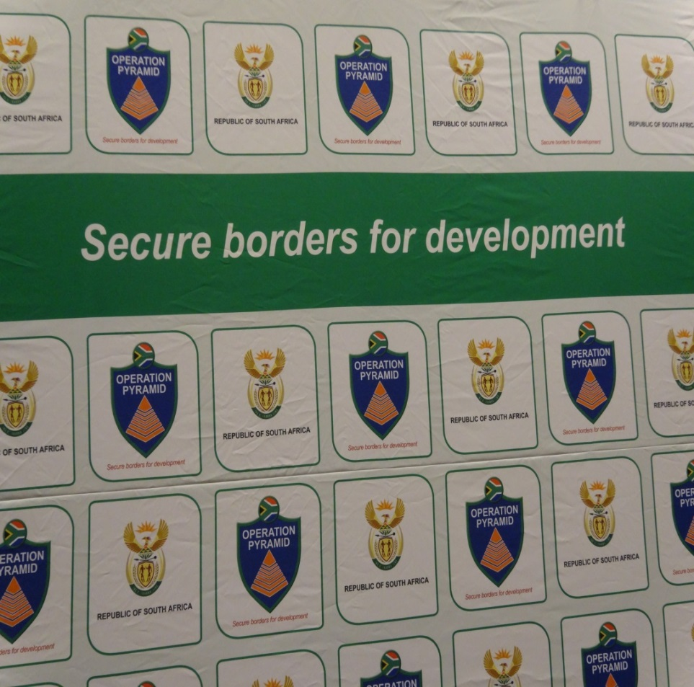
THANK YOU

