Slide 1
Presentation to Portfolio Committee
South African Tourism Annual Report 2016/17
08 September 2017
Slide no. 1

Slide 2
Contents
Strategic Overview ( slides 3-6)
Governance and Organisational Structures (slides 7-8)
Auditor General’s Report (slides 9-10)
Situational Analysis (slides 11-19)
2016/17 Audited Performance Information (slides 20-53)
Governance Information (slides 54-58)
Human Resource Management (slides 59-62)
Audited Statement of Financial Performance for 2016/17 (slides 63-77)
Abbreviations and Acronyms (slide 78)
Slide no. 2

Slide 3
Strategic Overview
Slide no. 3

Slide 4
Vision
Mission
To position South Africa as an exceptional tourist and business events destination that offers a value-for-money, quality visitor experience that is diverse and unique.
To contribute to inclusive economic growth by increasing the volume of travellers and the value contributed to the South African economy.
Values
Respect and recognition for our people;
Acting with integrity;
Caring for our employees;
Responsibility and the acceptance of accountability for the outcomes of our actions; and
Pushing the boundaries of excellence in everything we do.
Annual Report Page 16
Slide no.4

Slide 5
Legislative Framework and Governance
NO | LEGISLATIVE FRAMEWORK | BRIEF DESCRIPTION APPLICABLE TO SOUTH AFRICAN TOURISM
1. | South African Tourism established in terms of the Tourism Act no 3 of 2014 | Establishes governance and accountability of South African Tourism to the SA Tourism Board appointed by the Minister. to provide for the continued existence of the South African Tourism Board to establish a National Convention Bureau to market South Africa as business tourism destination to provide for the establishment of the Tourism Grading Council
2. | Public Finance Management Act (PFMA) | Established in terms of the Tourism Act no 3 of 2014 and listed as a Schedule 3a Public Entity (PFMA) Promote transparency, accountability, and sound management of the revenue, expenditure, assets and liabilities of the institutions to which this Act applies.
3. | National Treasury Regulations and related Practice Notes | Regulating financial, non-financial as well as fiscal matters
4. | Reserve Bank Regulations | Management of international payments, opening of foreign bank accounts and transfer of funds
Annual Report Page 17
Slide no. 5

Slide 6
Legislative Framework and Governance cont.
NO | LEGISLATIVE FRAMEWORK | BRIEF DESCRIPTION APPLICABLE TO SOUTH AFRICAN TOURISM
5. | National Tourism Sector Strategy (NTSS) | Sector strategy aligned to the priorities of the Medium Term Strategic Framework (MTSF) Growing tourism beyond 2020, Alignment to Government’s priorities of job creation and GDP contributions Growing the domestic tourism market and position SA as tourism and business events destination
6. | National Development Plan (NDP) | Tourism is one of development pillars for economic growth – Chapter 3
Annual Report Page 17
Slide no.6

Slide 7
Governance and Organisational Structure
Slide no. 7

Slide 8
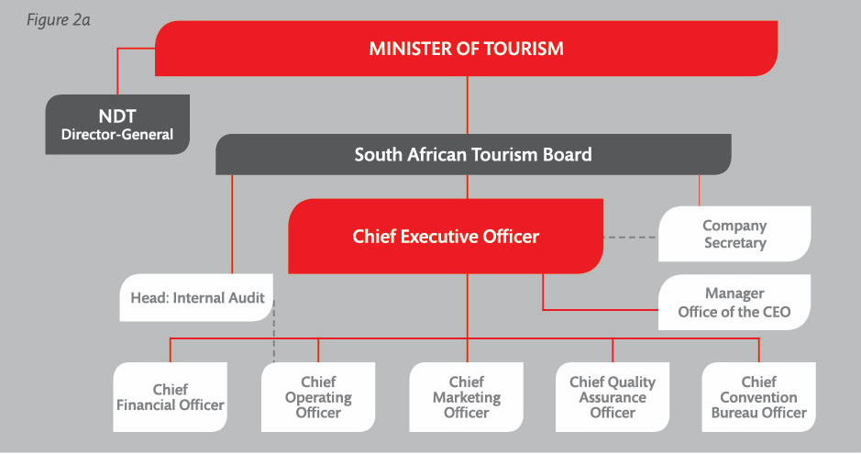
Organisational Structure
Slide no.8
Annual Report Page 18

Slide 9
Auditor General’s Report
Slide no. 9

Slide 10
Auditor-General’s Report
SA Tourism received its 16th unqualified audit report in 2016/17.
The Auditor General certified that:
- the financial statements were free from material misstatements;
- no instances of material non-compliance to specific matters in key legislations were found; and
- no significant deficiencies were found in internal controls.
Predetermined Strategic Objectives | Usefulness | Reliability
Strategic Objective 1 Contribute to the South African economy by increasing the number of travellers into and within South Africa. | Unqualified | Unqualified
Annual Report page 89 – 91
Slide no. 10

Slide 11
Situational Analysis
Slide no. 11

Slide 12
Global Tourism Performance in 2016
According to the United Nations World Tourism Organisations (UNWTO) World Tourism Barometer (January 2017), international tourist arrivals grew by 3.9% to reach a total of 1.235 billion worldwide.
Emerging markets led tourism growth in 2016, with Asia and Australasia growing by 8.4% and Africa growing by 8.1% compared to 2015.
Arrivals in Sub-Saharan Africa grew by 10.7%, with South Africa being the main driver of this upturn, growing by double digits of 12.8% to reach more than 10 million international tourist arrivals in 2016.
Annual Report Page 24

Slide 13
South Africa’s Tourism Performance in 2016
Annual Report Page 24

Slide 14
South Africa’s Tourism Performance in 2016
South Africa witnessed a 12.8% increase in international tourists – from 8.9 million in 2015 to 10 million in 2016. This is far in excess of the 3.9% growth in tourist arrivals globally.
South Africa’s revenue from international tourism grew by 10.8%, from R68.2 billion in 2015 to R75.5 billion in 2016. The tourists’ average length of stay was 9.2 nights in 2016, down from 9.5 nights in 2015.
All regions showed positive growth in tourists into the country in 2016, leading with Asia by 30.3%, North America with 14.9%, Europe recorded15.8%, Australasia with 10.9%, Africa land markets with11.4%, and Africa air markets recorded 5.3%.
Annual Report Page 24

Slide 15
  Domestic Tourism Performance in 2016
Annual Report Page 25

Slide 16
  Domestic Tourism Performance in 2016
Domestic tourism revenue increased by 12% to total R26.5 billion in 2016, compared to R23.6 billion in 2015. The domestic tourists who took a trip in this period spent more per trip and more per day than in previous years.
Notwithstanding a 12.3% increase in the domestic spend in 2016, the total number of trips declined by 0.7%.
On average, South Africans each took 2.1 trips in 2016 – an increase compared to 2.0 trips in 2015.
Domestic trips can be divided into holiday trips with 11% of all trips taken, business trips accounted for 8%, whilst trips to visit friends and relatives (VFR) accounted for 70%, amongst others. In 2016, holiday trips taken within South Africa fell by 3.1%, from 2.7 million to 2.6 million.
Domestic tourists’ length of stay grew from 4.2 nights in 2015 to 4.3 nights in 2016. The total number of bed nights increased by 0.9%.
Annual Report Page 25

Slide 17
  Business Events Landscape in 2016
The South African business events industry has witnessed growth in the last 10 years.
In 2016 South Africa was ranked 34th globally as a meetings destination, four places higher than the previous year, cementing the country’s status as the number one ranked business events destination in Africa and the Middle East.
In 2016 South Africa hosted 125 ICCA-registered international and regional meetings and conferences, which attracted just under 74 000 delegates.
These events represented 538 combined conference days and generated approximately R1.1 billion directly to the economy.
Out of 12 293 conferences held globally that met the ICCA ranking criteria, South Africa accounted for 1% of the total.
Annual Report Page 25

Slide 18
  Tourism Grading Landscape in 2016
According to Statistics South Africa (StatsSA), South Africa’s accommodation industry has more than 10 000 accommodation establishments, 50% of which are graded.
During the year under review, the administration of the NDT’s Tourism Incentive Programme (TIP) for grading support was transferred to the TGCSA and automated. This transfer and automation has allowed for a greater accessibility and uptake in funding support for new grading applications and annual membership renewals.
The integration of Service Excellence Programme, offered by NDT, into the quality assurance system will improve the impetus for grading.
Surveys conducted indicate a continued improvement in the perceptions of the value of grading.
There has been a net increase in both the number of graded establishments and rooms achieved for the year.
Annual Report Page 25

Slide 19
Organisational Environment
In 2016/2017 South African Tourism developed its 5-in-5 strategy, with a goal of delivering five million additional tourists in the next five years – four million international tourists and one million domestic holiday trips.
This was followed by the development and partial implementation of a Marketing Investment Framework (MIF) to identify the markets to invest in to improve Return on Investment (ROI) and the marketing and overheads budget ratio .
Subsequently, South African Tourism reconfigured its operating model in order to deliver on this strategy by undertaking an organisational review process (known as Project Ignite).
These two projects, 5-in-5 strategy and Project Ignite, due to their consultative nature, helped boost staff morale and encourage a common vision among employees.
Annual Report Page 26

Slide 20
Organisational Performance Results for 2016/17
Slide no. 20

Slide 21
Reporting Periods - KPIs
Key Performance Indicator | Reporting Period
Number of international tourist arrivals | January - December E.g. Q1= January –March as approved in Strategic Plan and Annual Performance Plan
Number of domestic holiday trips | January - December E.g. Q1= January –March as approved in Strategic Plan and Annual Performance Plan
Total revenue achieved | January - December E.g Q1= January –March as approved in Strategic Plan and Annual Performance Plan
A percentage of brand positivity of South Africa as a tourist destination achieved | Twice a year February and November Q1 and Q2 Financial year reporting = February Brand Tracker results Q3 Financial year reporting = November Brand Tracker results Annual Financial year reporting = Average of February and November
Number of graded establishments | April – March aligned to the financial year as per the approved Strategic Plan and Annual Performance Plan
Number of business events hosted in South Africa | January - December E.g Q1 Financial year reporting = January –March as approved in Strategic Plan and Annual Performance Plan
Slide no 21

Slide 22
Organisational Performance for 2016/17
SA Tourism achieved annual targets for six of its 14 KPIs:
  Number of international tourist arrivals achieved;
  Total tourism revenue achieved;
  Reviewed leisure tourism market portfolio;
  Stakeholder engagement matrix in consultation with stakeholders;
  Unqualified audit; and
  Staff turnover rate achieved.
SA Tourism did not achieve targets for eight of its 14 KPIs:
  Number of domestic holiday trips;
  Number of business events hosted in South Africa;
  Number of business delegates hosted in South Africa;
  Percentage of brand positivity achieved;
  Stakeholder satisfaction score;
  Number of graded accommodation establishments;
  Number of graded rooms; and
  Staff satisfaction score
Slide no 22

Slide 23
Performance Information 2016/17
Strategic objectives | Performance indicator | Actual achievement 2015/2016 | Planned target 2016/2017 | Actual achievement 2016/2017 | Deviation from planned target to actual achievement for 2016/2017 | Comment on deviations
Contribute to the South African economy by increasing the number of travellers into and within South Africa | Number of international tourist arrivals achieved | 8 903 773 | 9 077 995 | UNWTO Aligned: 10 044 163 (January-December 2016) Financial year: 9 945 373 (April 2016 –March 2017) | +10.6% +9.6% | Annual target was exceeded by 10.6% due to a positive year-on-year performance in tourist arrivals of 12.8% from 8 903 773 for the period January-December of 2015 to 10 044 163 in 2016. This significant growth was experienced from all source markets and was driven by: - Improved value-for-money perception due to the weakening of the Rand; - Improved perception of safety vis-à-vis the global environment; - Economic recovery by some source markets; - Additional visa facilitation centres across China; - Re-introduction of direct air routes in Brazil and China; and - Various in-market promotional activities.
Annual Report Pages 29 - 32

Slide 24
Performance Information 2016/17
Strategic objectives | Performance indicator | Actual achievement 2015/2016 | Planned target 2016/2017 | Actual achievement 2016/2017 | Deviation from planned target to actual achievement for 2016/2017 | Comment on deviations
Contribute to the South African economy by increasing the number of travellers into and within South Africa | Number of domestic holiday trips achieved | 2 700 000 | 3 059 764 | UNWTO Aligned: 2 600 000 (January-December 2016) Financial year: 2 950 000 (April 2016 –March 2017) | -15% -3.6% | Target was not met due to an overall decline in the number of trips taken, from 24.5 million in 2015 to 24.3 million in 2016. The South African economy was constrained resulting in a decline in disposable income, with affordability remaining the main deterrent to taking a trip i.e. fewer holiday trips.
Annual Report Pages 29 - 32

Slide 25
Performance Information 2016/17
Strategic objectives | Performance indicator | Actual achievement 2015/2016 | Planned target 2016/2017 | Actual achievement 2016/2017 | Deviation from planned target to actual achievement for 2016/2017 | Comment on deviations
Contribute to the South African economy by increasing the number of travellers into and within South Africa | Number of business events hosted in South Africa | 108 | 138 | 125 | -9.4% | Target was not achieved due to ICCA disqualifying 16 out of 141 events that were hosted and submitted by South Africa.
 | Number of business delegates hosted in South Africa | New KPI | 77 567 | 73 866 | -4.8%
 | Total tourism revenue achieved (billion rand) | R91.7 billion | R95.7 billion | UNWTO Aligned: R102 billion (January-December 2016) Financial year: R95.1 billion (April 2016 –March 2017) | +6.6% -0.6% | Target was exceeded due to the 12.3% growth in Total Domestic Direct Spend (TDDS) (slide 15) and the 11% growth in Total Tourist Foreign Direct Spend (TTFDS) (slide 13).
Annual Report Pages 29 - 32

Slide 26
Performance Information 2016/17
Strategic objectives | Performance indicator | Actual achievement 2015/2016 | Planned target 2016/2017 | Actual achievement 2016/2017 | Deviation from planned target to actual achievement for 2016/2017 | Comment on deviations
Build positive awareness of the South African experience | Percentage of brand positivity achieved | New KPI | 40% | 38% | -2% | Target was not achieved due to a substantial reduction of the marketing and advertising budget, thus affecting brand visibility globally and in-market.
Reposition South African Tourism to be recognised as a tourism and business events industry leader in market intelligence, insights and analytics | Reviewed leisure tourism market portfolio | New KPI | Approved market portfolio | Target achieved. The Marketing Investment Framework (MIF), which identified the markets that South African Tourism will invest in over the period 2017-2021, was approved.
Annual Report Pages 29 - 32

Slide 27
Performance Information 2016/17
Strategic objectives | Performance indicator | Actual achievement 2015/2016 | Planned target 2016/2017 | Actual achievement 2016/2017 | Deviation from planned target to actual achievement for 2016/2017 | Comment on deviations
Collaborate with stakeholders and partners to deliver on South African Tourism’s mandate | Stakeholder satisfaction score | New KPI | Set baseline | Not achieved |  | The stakeholder satisfaction survey was deferred and will be conducted post Project Ignite.
 | Stakeholder engagement matrix in consultation with stakeholders | New KPI | Approved stakeholder engagement matrix in consultation with stakeholders | Target achieved. The stakeholder engagement matrix has been included in the Stakeholder Management Framework and is aligned to the stakeholders that were surveyed during the Ministerial Review as well as stakeholders identified as important/ influential in delivering against business objectives.
Slide no 27
Annual Report Pages 29 - 32

Slide 28
Performance Information 2016/17
Strategic objectives | Performance indicator | Actual achievement 2015/2016 | Planned target 2016/2017 | Actual achievement 2016/2017 | Deviation from planned target to actual achievement for 2016/2017 | Comment on deviations
Improve visitor experience in line with the brand promise | Number of graded establishments | 5 230 | 5 650 | 5 354 | -17.5% | Although the performance on graded establishments and rooms is below target for the year, a steady net increase has been achieved in the number for the fiscal year. This is due to membership cancellations despite basket of benefits and Tourism Incentive Programme (TIP) support.
 | Number of graded rooms | New KPI | 122 686 | 118 869 | -3.1%
Annual Report Pages 29 - 32

Slide 29
Performance Information 2016/17
Strategic objectives | Performance indicator | Actual achievement 2015/2016 | Planned target 2016/2017 | Actual achievement 2016/2017 | Deviation from planned target to actual achievement for 2016/2017 | Comment on deviations
Create an organisational culture of work satisfaction, excellence and innovation to improve effectiveness and operational efficiency | Staff satisfaction score | New KPI | 3.7 | 2.9 | -21.6% | Target was not achieved. The following were identified as areas for improvement: - Training and development; - Pay and benefits; and - Structure and policy implementation, mainly with reference to the application of PFMA requirements in country offices. South African Tourism’s operations in jurisdictions other than South Africa find it difficult to implement some aspects of the PFMA and National Treasury(NT) regulations, yet remain efficient and competitive. There are ongoing engagements with NT for special dispensations and to reduce the risk arising from currency loss.
Annual Report Pages 29 - 32

Slide 30
Performance Information 2016/17
Strategic objectives | Performance indicator | Actual achievement 2015/2016 | Planned target 2016/2017 | Actual achievement 2016/2017 | Deviation from planned target to actual achievement for 2016/2017 | Comment on deviations
Create an organisational culture of work satisfaction, excellence and innovation to improve effectiveness and operational efficiency | Unqualified report by AGSA | New KPI | Unqualified audit report | Target achieved. South African Tourism received an unqualified audit report from the AGSA.
 | Staff turnover rate achieved | New KPI | 7% | 6.6% | +0.4%
Annual Report Pages 29 - 32

Slide 31
Strategies to Overcome Areas of Under-performance
KEY PERFORMANCE INDICATOR | STRATEGIES
Number of holiday trips | Based on the recent Domestic Market segment research, identifying new segments to focus on; South African Tourism will put more emphasis in those areas to build the culture of travel, convert and defend existing travellers, as well as increase the frequency of travel. These will result in the increase of holiday trips and total domestic trips.
Brand positivity | South African Tourism will commence implementation of its 5-in-5 Framework from 2017/18. This Framework is supported by detailed plans for each strategic thrust as well as a well configured operating model to drive efficiencies within the organisation.
Number of business events achieved in South Africa
Number of business delegates achieved in South Africa
Number of graded establishments achieved | The grading criteria have been recently reviewed to make grading more accessible. Furthermore the collaboration with NDT on the TIP subsidy implemented in the year under review will yield rewards by the improvement of ease of access for SMMEs.
Number of graded rooms achieved
Annual Report Page 46

Slide 32
Leisure Marketing Overview in 2016
Slide no. 32

Slide 33
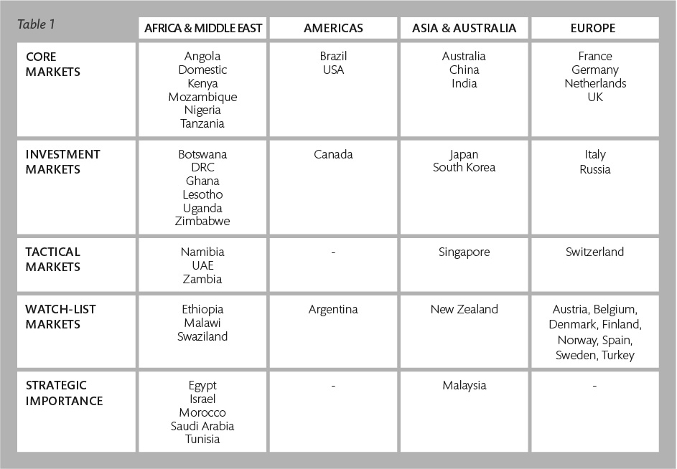
5th Leisure Tourism Market Portfolio - 01/04/2014 – 30/03/2017
Annual Report Page 33

Slide 34
Tourism Performance at a glance
Annual Report Page 35

Slide 35
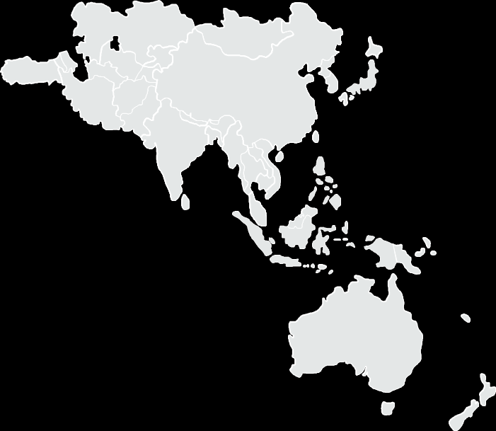
In-country Marketing Highlights
Australasia
Strategic focus
  Inspire Australians and New Zealanders to consider South Africa as a destination by showcasing authentic experiences and enticing them to visit friends and relatives.
Campaign highlights
  The Western Cape hosted the Australian Society of Travel Writers’ AGM.
PR value
  PR value: R117.1 million
Trade activity
  Partnerships with airlines promoted special fares. A five-city trade educational was led by a local influencer.
  China
Strategic focus
  Capitalise on high interest in South Africa by partnering with and educating the trade to sell the benefits of a South African holiday to the Chinese.
Campaign highlights
  A consumer campaign and the “Wow in Every Moment” media roadshow in Beijing, Shanghai and Hong Kong. Five familiarisation trips hosted 50 media and celebrities.
PR value
  R1.1 billion
Trade activity
  Partnerships were sealed with trade partners and educational workshops were held.
Annual Report Pages 37 - 38

Slide 36
In-country Marketing Highlights
India
Strategic focus
  Increased Indian arrivals, defend South Africa’s leading position on wildlife, and build its position in the “adventure”, “breathtaking experiences” and “value for money” categories.
Campaign highlights
  The Fastest 50 trade sales campaign during the World Cup in India encouraged frontline sales staff sell trips to South Africa.
Trade activity
  Strategic partnerships were entered into with key media titles and members of the travel trade.
  Japan
Strategic focus
  Provided the Japanese trade with fresh itineraries that promote South Africa’s variety of attractions while building consumers’ confidence in the destination.
Campaign highlights
  Media launch of the “A Wow in Every Moment” campaign and a Japanese goodwill ambassador highlighting South Africa as an attractive destination.
PR value
  R1.6 billion
Trade activity
  Trade workshops in Osaka and Tokyo saw 30 South African businesses promoting their products. Trade partnerships were formed during the Japan Outbound Tourism Council conference
Annual Report Pages 37 - 38

Slide 37
In-country Marketing Highlights
South Korea
Strategic focus
  Partner with and educate the trade to package, promote and sell South Africa in a way that improves tourist arrivals and builds brand awareness.
Campaign highlights
  A partnership with the TV Home Shopping programme resulted in at least 600 Korean bookings to travel to South Africa.
Trade activity
  Included a Korean trade familiarisation visit to South Africa.
Annual Report Pages 37 - 38

Slide 38
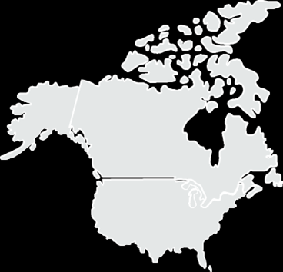
In-country Marketing Highlights
United States of America
Strategic focus
  Create a vivid picture of South Africa as a desirable “safari-plus” destination by showcasing iconic, activity-rich experiences that demonstrate value for time and money.
Campaign highlights
  The #WowSouthAfrica campaign, launched with partners, showcased South Africa’s variety of experiences in close proximity, targeting the “wanderluster” and millennial markets.
PR value
  R2.5 billion
Trade activity
  About 4 000 trade representatives were trained and two familiarisation trips were undertaken.
Annual Report Pages 37 - 38

Slide 39
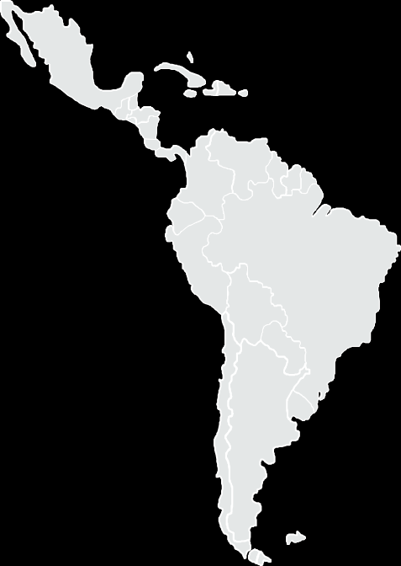
In-country Marketing Highlights
Brazil
Strategic focus
  Inspire desirability of South Africa by working with the trade to position it as iconic, value-for-money destination with easy-to-do experiences.
Campaign highlights
  Thirty journalists were hosted, familiarisation trips took place and the “Meet South Africa” and “Experiences in South Africa” campaigns were rolled out.
PR value
  R289 000
Trade activity
  Partnerships with tour operators educated the travel trade. A roadshow showcased South African products to buyers in Sao Paulo, Rio de Janeiro and Belo Horizonte.
Annual Report Pages 37 - 38

Slide 40
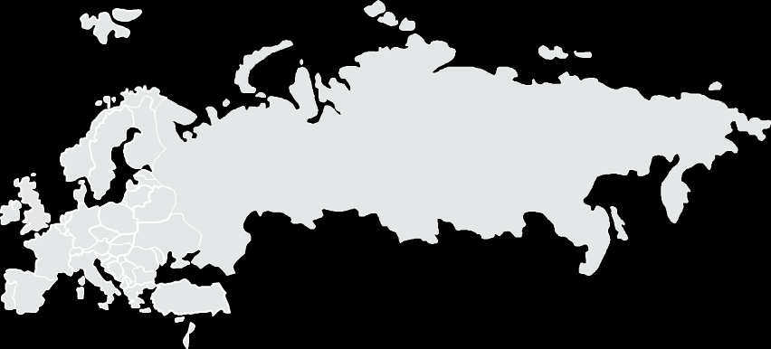
In-country Marketing Highlights - Europe
Germany
Strategic focus
  Made 2016 a “big year” with an extensive marketing campaign targeting German travellers.
Campaign highlights
  A film promoting South Africa was shown in cinemas, the Schätzt Dich nach Südafrika PR campaign was rolled out and 72 journalists and influencers were hosted.
Trade activity
  Partnerships were entered in with 274 tour operators and 2 000 travel agents were trained.
  The Netherlands
Strategic focus
  Inspired the Dutch traveller to visit South Africa by showcasing varied, authentic experiences with welcoming South African locals, while empowering trade partners to sell South Africa.
Campaign highlights
  The “Wat Sê Jy?” online campaign introduced Dutch “wanderlusters” to South Africa’s languages, cultures and people.
PR value
  R56 million
Trade activity
  A roadshow saw 20 South African products presented to 200 Dutch trade, four familiarisation trips were undertaken, and Dutch and Belgian trade agreements were sealed
Annual Report Pages 37 - 38

Slide 41
In-country Marketing Highlights - Europe
Nordics
Strategic focus
  Ignite consumer interest for South Africa while positioning the country as a preferred destination by partnering with the South African travel trade operating in these markets.
Campaign highlights
  Two roadshows identified future partners, and a South Africa-themed reality TV show called Taste Expedition was aired in Sweden and five other countries.
Trade activity
  Nordic trade and media interacted with 28 South African suppliers, including SMMEs, during a hosting trip.
  South Europe
Strategic focus
  Motivate the Italian trade to sell South Africa by creating consumer demand through shareable content. Convert French consumers to visit South Africa by providing compelling information and deals. Ignite consumer interest in Spain by partnering with the South African travel trade.
Campaign highlights
  A radio campaign in France; digital media buy and creating shareable blog content in Spain.
Trade activity
  In Italy, 45 members of the trade attended a trade forum. In France, 700 travel agents were trained to package deals, and 10 travel agents and four media were hosted on a familiarisation trip. In Spain, 13 trade and media were hosted at the FITUR trade show and a TV channel produced a programme on South Africa
Annual Report Pages 37 - 38

Slide 42
In-country Marketing Highlights - Europe
United Kingdom and Ireland
Strategic focus
  Partner with the trade to sell South Africa as a value-for-money holiday destination. Inspire targeted British travellers by showing them that South Africa is fun, safe and friendly.
Campaign highlights
  The #FindYourWild consumer activation and the Mumford and Sons pop-up exhibition in London, plus the #UnmissableSAMoments photographic competition. Presenter Phillip Schofield’s South African trip was featured on ITV’s This Morning, and Masterchef UK filmed in Cape Town.
Trade activity
  Fourteen South African businesses took part in a roadshow, exposing them to 105 travel agents in Glasgow, Manchester and London.
Annual Report Pages 37 - 38

Slide 43
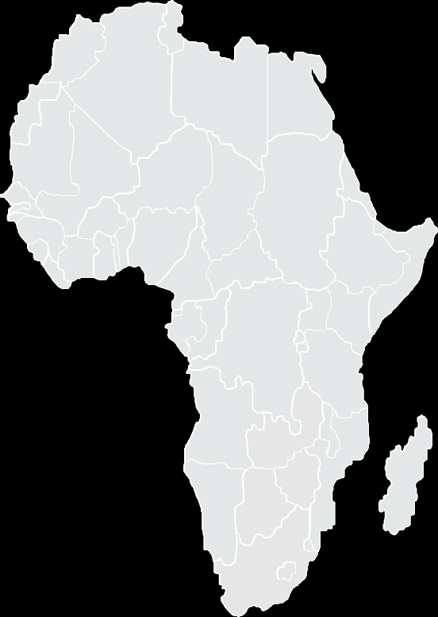
In-country Marketing Highlights - Africa
The “Allow Us” campaign gave South Africa a presence in all African markets across TV, radio and social media platforms.
  West Africa
To position South Africa as a friendly and welcoming destination with a variety of contemporary experiences, West African influencers shared “Meet South Africa” content with their social media followers, reaching some 60 million people.
Partnership agreements were signed with in-market trade representatives and trade associations to disseminate destination information.
More than 500 trade members were trained on the destination during workshops across five cities.
Almost 50 trade partners were hosted on familiarisation trips.
Thirteen South African product owners met stakeholders and members of the travel trade in Nigeria and Ghana.
South African Tourism won the award for best stand design at the Akwaaba African Travel Market in Lagos.
East Africa
Kenya’s Capital FM covered the Standard Bank Joy of Jazz Festival live, yielding significant reach and impact.
South Africa successfully participated in the Magical Kenya Travel Expo.
Ten businesswomen from Uganda were hosted in South Africa.
Annual Report Page 39

Slide 44
Domestic Marketing Highlights
The “A Million New Experiences Are Only a Sho’t Left Away” campaign sought to stimulate local holiday travel, by partnering with and educating booking channels to promote value-for-money deals.
Trade partnerships targeted the “build” (building a culture of travel) and “convert” (converting VFR travellers to travel for leisure purposes) market segments.
Consumer deal-driven activations promoting rail travel were rolled out to inspire locals to book a Sho't left holiday (a short trip or weekend getaway).
Campus activations saw students receiving co-branded International Student Identity Cards promoting discounted holiday travel deals within South Africa.
Social tourism partnerships across all nine provinces to entrench a culture of holiday travel.
Partnerships with unconventional players to improve access to consumer deals and increase holiday trips
Drive transformation through online campaign with TOMSA and the TGCSA highlighting the hidden tourism gems to ensure new experiences and SMEs.
Hosting of just under 100 journalists and influencers - generating PR coverage to the value of R123 million.
Media partnerships contributed to a successful #TourismForAll Tourism Month campaign, launched in the Free State.
Annual Report Page 40

Slide 45
Tourism Grading Council of South Africa
Slide no.45

Slide 46
Grading of Establishments
The TGCSA quality grades establishments according to eleven categories across all 9 provinces. The categories are as follows:
Backpacker & Hostelling
Bed & Breakfast
Caravan & Camping
Country House
Game Lodge
Nature Reserve
Guest House
Hotel
Lodge
MESE (Meetings, Exhibitions, and Special Events venues)
Self catering
  Exclusive Use
  Shared vacation

Slide 47
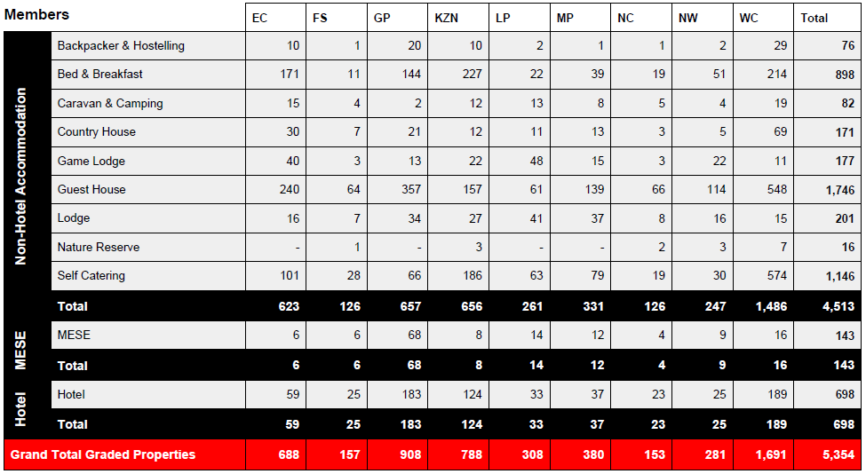
Total Number of Graded Establishments
As at 31 March 2017

Slide 48
TGCSA Performance
In the year under review, South African Tourism’s Grading Council drove positive perceptions of the importance of grading in the industry by refining its value proposition and tailoring communication per client category, showing that quality assurance is about partnering with product owners to help drive profitability through sustaining their quality of business.
In collaboration with the NDT, the Grading Support Programme, which allowed for up to a 90% discount on grading fees, 80% for Tourism Incentive Programme members, and 10% for TOMSA members, was streamlined.
In order to entrench the value proposition of grading, the triennial review of grading criteria has been implemented and is nearing completion.
A detailed research into the perceptions of grading has commenced and will assist in refining the value proposition and address both operational and strategic challenges.
Annual Report Page 41

Slide 49
South African National Convention Bureau
Slide no.49

Slide 50
Business Events, Exhibitions and Strategic Events
In the year under review it continued to co-ordinate the bidding for international conventions as well as liaise with other organs of government and suitable bodies to promote South Africa as a business tourism destination.
Number of Conference Days: 401
Number of Delegates:
139 936
Estimated Economic Impact: R1.3 billion
78 Submissions
Number of Conferences hosted (ICCA and non-ICCA) | Delegates | Conference Days | Estimated Economic Impact
141 | 76 196 | 595 | R 1.1 b
Number of Secured Bids (between 2018 – 2023) | Delegates | Estimated Economic Impact
137 | 138 111 | R 2.1 b
Annual Report Page 42

Slide 51
INDABA 2016: Objectives for INDABA 2016
To maintain INDABA’s status as one of the top three exhibitions of its kind on the international travel trade tourism calendar, by countering the effect of competitor trade shows.
To align all strategic partners and stakeholders from both government and the private sector to ensure that there is a focused partnership approach to create growth in the tourism sector.
To ensure the right product mix was available to attract buyers, with a specific emphasis on developing the SMME tier of product for trade show readiness, in the form of the Hidden Gems and speed marketing initiatives.
To showcase and promote Southern Africa as a prominent destination to the international market in an effective exhibition environment.
To leverage on existing relationships with key local and international stakeholders to maximise awareness and to ensure that visitors, especially key buyers, were able to take maximum advantage of the opportunities and deals on offer – facilitating the “buyer/seller” networks and sustainable transactions. South African Tourism placed a greater focus on the training and development of exhibitors on the online diary and matchmaking system, the mobile app as well as well as product positioning in preparation for the show.
To aggressively grow the number of “quality” international buyers. This growth was to be sourced from South African Tourism’s key global markets, namely the UK, USA, Germany, France, the Netherlands, India, Japan, China, Australia, Canada, Kenya, Nigeria, Brazil and Africa. South African Tourism entrenched stricter control measures for hosted buyers in particular, to ensure that the mandatory number of meetings per day were adhered to.
To align with the business objectives of exhibitors and become a conduit for exhibitors to
achieve real value and return on their investment.
Annual Report Page 43

Slide 52
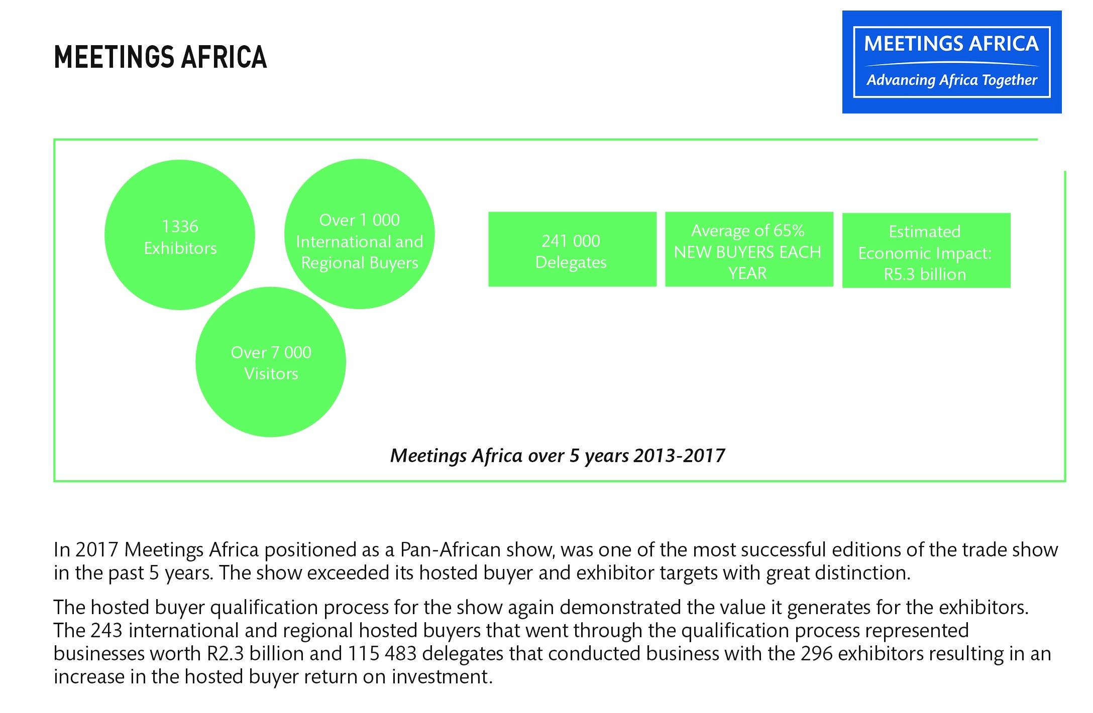
Annual Report Page 44

Slide 53
Lilizela Tourism Awards
The Lilizela Tourism Awards, launched by the Minister of Tourism in 2013, are regarded as South Africa’s premier travel and tourism awards.
They aim to recognise and celebrate business excellence in tourism, and the contribution these establishments make to South Africa’s global competitiveness, GDP, job creation and black economic empowerment.
In 2016 it celebrated its fourth year and attracted 1 122 entries from all over the country. Of these, 589 finalists were selected nationwide and each province held its own awards ceremony, during which 265 provincial winners were awarded.
The provincial shortlist was further narrowed down, and a total of 54 national winners were honoured by the Minister of Tourism at a gala event on 16 October 2016.
Awards were made in a number of categories including the Service Excellence Award (with sub-categories Accommodation, Visitor Experience, Tourist Guides and Tour Operators); Entrepreneurship (for emerging tourism businesses); Sustainability and Good Governance.
Annual Report Page 44

Slide 54
Governance Information
Slide no. 54

Slide 55
South African Tourism Board
The Minister of Tourism, in terms of the Tourism Act of 2014, appoints South African Tourism Board members. The Board consists of not fewer than nine, and not more than 15 members. The Board further includes an official representing the Department of Tourism, also appointed by the Minister.
The Board, in its capacity as the Accounting Authority of South African Tourism, is charged with responsibility for oversight of governance. It is responsible for setting the strategic direction of the organisation through the establishment of strategic objectives and key policies, and monitors the implementation of strategies and policies through a structured approach. The Board has the authority to lead, control, manage and conduct the business of South African Tourism.
The Board meets quarterly or more frequently if circumstances require. It monitors the executive management by ensuring that all material matters are subject to Board approval. Members of the Executive Committee attend Board meetings by invitation.
The Board members fulfil their roles, duties and functions with due regard to the fiduciary responsibilities bestowed on them in line with the Tourism Act. The Board members have a duty to become fully acquainted with all issues pertaining to the operations of South African Tourism to enable them to properly fulfil their duties.
As required by the King III guideline, all Board members have access to the advice and services of the company secretary and are entitled to seek independent professional advice concerning the affairs of South African Tourism.
Annual Report Page 52

Slide 56
Board Meeting Attendance for 01 April 2016 to 31 March 2017
NAME | BOARD MEETING 31 May 2016 | BOARD LEKGOTLA 22-24 August 2016 | BOARD MEETING 23 November 2016 | SPECIAL BOARD MEETING 26 January 2017 | BOARD MEETING 15 March 2017 | SPECIAL BOARD MEETING 29 March 2017
Tanya Abrahamse (appointed acting chairperson on 27 October 2015 and Chairperson on 7 April 2016) | P | P | P | P | O | P
Thebe Ikalafeng (appointed Deputy Chairperson on 7 April 2016) | O | P | O | P | P | P
Ayanda Ntsaluba | P | P | P | P | P | P
Graham Wood | P | P | P | P | P | O
Chichi Maponya | O | P | P | O | P | P
Oregan Hoskins | P | P | P | O | P | P
Michelle Constant | P | O | P | P | P | P
Colin Bell | P | P | P | O | P | P
Amor Malan | P | O | O | O | O | P
Judy Nwokedi | P | P | P | P | P | P
Mmaditonki Setwaba | P | P | P | O | P | O
Yacoob Abba Omar | P | P | P | P | P | P
Enver Duminy (appointed on 26 August 2016) |  |  | P | P | P | P
Mmatsatsi Ramawela (appointed on 26 August 2016) |  |  | P | O | P | P
Annual Report Page 60

Slide 57
Board Remuneration For the period 01 April 2016 to 31 March 2017
Annual Report Page 67

Slide 58
Report from the Audit and Risk Committee
In line with the PFMA and the King IV Report on Corporate Governance recommendations, Internal Audit provides the Audit and Risk Committee and management with the assurance that the internal controls in place are adequate, effective and serving desired purposes.
A formal risk identification was conducted during the period under review, and the Board prioritised the effective monitoring and management of the strategic risks that affected the business.
It was noted that no matters were reported that indicated any material deficiencies in the systems of internal control or any deviations thereof.
In line with the statutory requirements and Audit Standards, the independence of the Internal Audit Unit has been assessed.
Annual Report Page 73

Slide 59
Human Resource Management
Slide no. 59

Slide 60
Human Resource Information
The Board-approved structure has 202 positions versus our head count of 155 positions.
South African Tourism is operating at 76.73% occupancy rate against the approved staff establishment with the remaining 30.32% recorded as vacancy rate.
Where there are vacant senior management positions internal arrangements were made through the appointment of internal staff members on acting and secondment contracts.
Toward the latter part of 2016, South African Tourism commenced with the Organisational Design process known as Project Ignite. The purpose of which is to reconfigure the organisation to deliver on strategy and align internally.
Employee engagement positively contributes to staff morale, productivity and a sense of belonging. For this reason, South African Tourism endeavours to inculcate open communication at all levels.
Annual Report Page 77 - 84

Slide 61
South African Tourism Employment Equity Statistics
The employment equity (EE) figures are based on the South African employees at head office and South African country managers based in-country.
While international offices have the promotion of diversity in their labour laws, EE targets do not bind them and South Africa’s EE legislation does not affect them.
For the period of under review, the EE targets for South African Tourism were determined in consideration of EE legislation, and the economically active population (EAP) profile for Gauteng as a guideline.
76.77% of South African Tourism staff are South African.
Annual Report Page 77 - 84

Slide 62
South African Tourism Employment Equity Statistics
Levels | Female
 | African |  | Coloured |  | Indian |  | White
 | Current | Target | Current | Target | Current | Target | Current | Target
Top management | 1 | 1 | - | - | - | - | 2 | 2
Senior management | 2 | 2 | - | 1 | 1 | 1 | - | -
Professional qualified | 14 | 16 | 3 | 3 | 4 | 4 | 6 | 5
Skilled | 19 | 22 | 6 | 6 | 3 | 3 | 4 | 4
Semi-skilled | 10 | 12 | - | - | - | - | - | -
Unskilled | 2 | - | - | - | - | - | - | -
Total | 48 | 53 | 9 | 10 | 8 | 8 | 12 | 11
Levels | Male
 | African |  | Coloured |  | Indian |  | White
 | Current | Target | Current | Target | Current | Target | Current | Target
Top management | 1 | 2 | - | - | - | - | 2 | 2
Senior management | 1 | 1 | - | 1 | - | - | 1 | 1
Professional qualified | 9 | 10 | 2 | 2 | 2 | 2 | 4 | 3
Skilled | 11 | 12 | 1 | 1 | - | - | 2 | 2
Semi-skilled | 5 | 6 | - | - | 1 | 1 | - | -
Unskilled | - | - | - | - | - | - | - | -
Total | 27 | 31 | 3 | 4 | 3 | 3 | 9 | 8
Annual Report Page 77 - 84

Slide 63
Audited Statement of Financial Performance for 2016/17
Slide no. 63

Slide 64
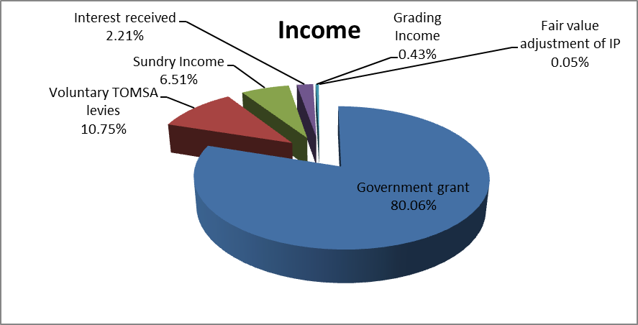
Graphical Presentation of Statement of Financial Performance
The two main sources of income for SA Tourism remains income from NDT (R1.024 bil) and TBCSA (R137.6 mil). These two revenue streams contribute 90.81% to SA Tourism’s total income. (Page 93 of Annual Financial Statements)
The remaining 9.19% relates to interest income (R28.3 mil), Grading Income (R20.6 mil) and Sundry Income of R 83.4 mil. (Page 93, 116, 117, 122 of Annual Financial Statements).
Sundry income comprises of income from exhibitions such as Indaba and Meetings Africa. ( Page 93 and 116 of Annual Financial Statements).
Annual Report Pages 92 - 132

Slide 65
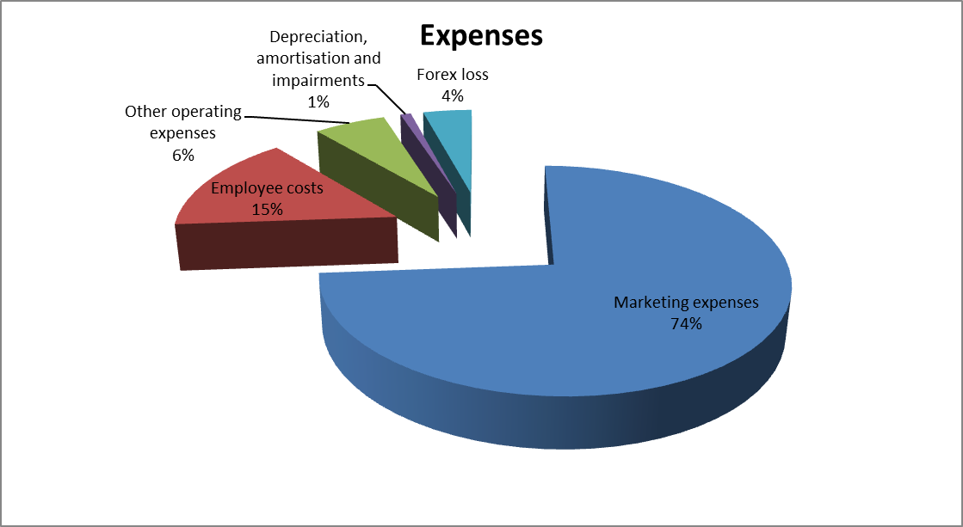
Graphical Presentation of Statement of Financial Performance
In line with our mandate, marketing expenses remains SA Tourism’s highest cost. R 914.4 mil represents 74% of total expenses relates to marketing expenses. ( Page 93 of Annual Financial Statements)
Employee costs makes up 15 % of total expenses. It is important to note that this also includes salaries and cost of living allowances for locally recruited international staff members. ( Page 93 of Annual Financial Statements).
Annual Report Pages 92 - 132

Slide 66
Statement of Financial Performance
The balance comprises of Loss on disposal of assets, auditors’ remuneration and bad debts
( Page 93 and 117 of Statement of Financial Performance).
SA Tourism shows operating surplus before fair value adjustment of Investment Property i.e.
( non-operating activities which have an impact on the bottom line.)
The fair value adjustment of R 645k is due to capital appreciation of the property in Amsterdam.
( Page 93 & 130 of Annual Financial Statements).
Annual Report Pages 92 - 132

Slide 67
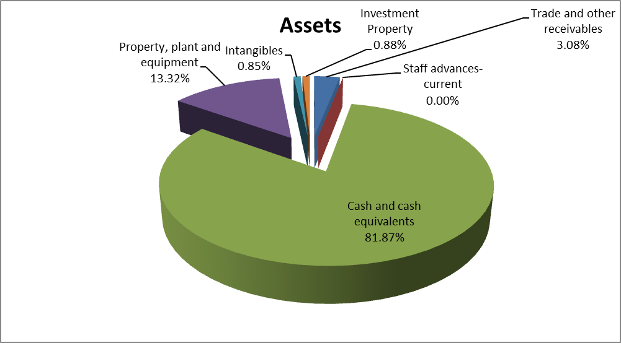
Graphical Presentation of Statement of Financial Position
81.87% of total assets relates to cash and cash equivalents made up mainly of all SA Tourism’s current and investment accounts. (Page 92 and 110 of Annual Financial Statements)
Remaining balances comprises of Trade and other receivable (R20.7 mil); Property plant and equipment (R89.7 mil); Intangible assets (R 5.7 mil and Investment property (R5.95 mil). ( Page 92, 110, 111-113 and 130 of Annual Financial Statements)
Trade and other receivable includes balances of prepayments for office leases.
Annual Report Pages 92 - 132

Slide 68
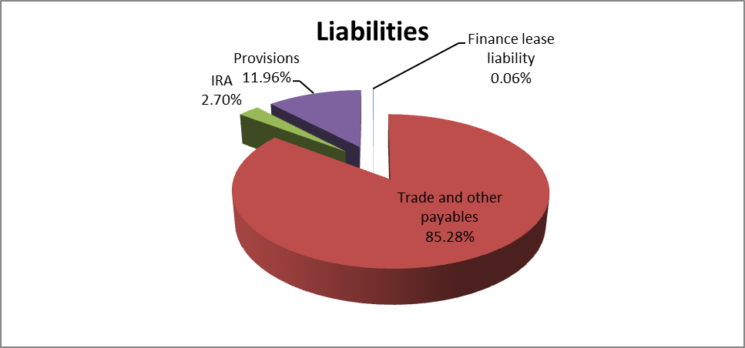
Graphical Presentation of Statement of Financial Position
Trade and other payables makes up 85.28% of total liabilities.( Page 92 & 114 of Annual Financial Statements).
Income received in advance of R9.85 mil is due to additional amounts received from NDT to be used in the next financial year for 2017 Tourism Indaba Market access. (Page 92 & 114 of Annual Financial Statements).
Provisions relates to provision for legal proceedings; post retirement health benefit and VAT liabilities in UK. (Page 92 & 115 of Annual Financial Statements).
Annual Report Pages 92 - 132

Slide 69
Financial Performance against Budget
 | 2015/16 |  |  | 2016/17
Objective | Budget | Actual expenditure | (Over)/Under expenditure | Budget | Actual expenditure | (Over)/Under expenditure
 | R'000 | R'000 | R'000 | R'000 | R'000 | R'000
Business enablement/ Administration | 117 385 | 125 040 | (7 655) | 123 842 | 139 570 | (15 728)
Contribute to the South African economy by increasing the number of travellers into and within South Africa. | 801 798 | 849 985 | (48 187) | 795 660 | 857 162 | (61 502)
Build positive awareness of the South African experience * | 205 947 | 246 619 | (40 672) | 218 303 | 183 676 | 34 627
Reposition South African Tourism to be recognised as a tourism and business events industry leader in market intelligence, insights and analytics. | - | - | - | 34 000 | 34 000 | -
Collaborate with stakeholders and partners to deliver on South African Tourism’s mandate | - | - | - | 3 121 | 2 695 | 426
Improve visitor experience in line with the brand promise. | 48 425 | 34 528 | 13 897 | 46 909 | 40 473 | 6 436
Total | 1 173 555 | 1 256 172 | (82 617) | 1 221 835 | 1 257 576 | (35 741)
Annual Report Page 46

Slide 70
Financial Performance against Budget: Material variance analysis
It is important to bear in mind that budgets are cash based while actual expenditure includes both cash and non-cash items as actual expenses are accounted for in terms of applicable accounting standards and uses accrual basis.
Business enablement
The over expenditure is attributable to non-cash items such as depreciation and amortisation of assets, which are presented in the Statement of Financial Performance.
Contribution to South African economy by increasing the number of travellers into and within South African.
Actual expenditure was more than budgeted due to the foreign currency exchange loss of R 51.3 million incurred during the 2016/17 financial year as presented in Statement of Financial Performance.

Slide 71
Financial Performance against Budget: Material variance analysis
Build positive awareness of the South African experience
South African Tourism will commence implementation of its 5-in-5 Framework from 2017/18. This Framework is supported by detailed plans for each strategic thrust as well as a well configured operating model to drive efficiencies within the organisation. This will include reassessing and realigning the brand to be appealing, resilient and competitive.
Improve visitor experience in line with the brand promise
The grading criteria was recently reviewed to make grading more accessible. The collaboration with NDT on the TIP subsidy implemented in the year under review will yield rewards by the improvement of ease of access for SMMEs.

Slide 72
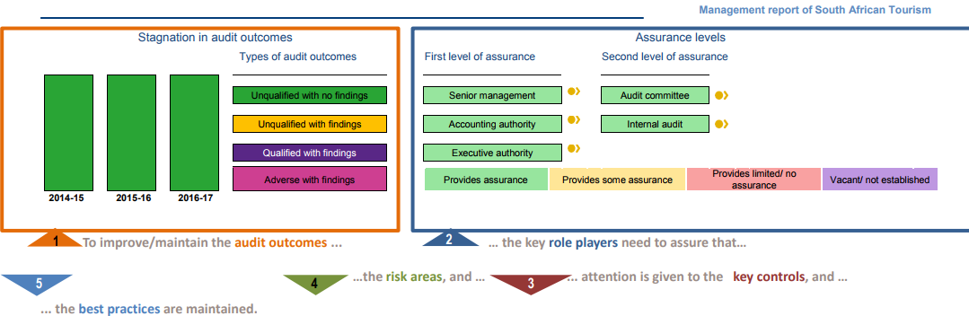
2016-17 Audit outcomes

Slide 73
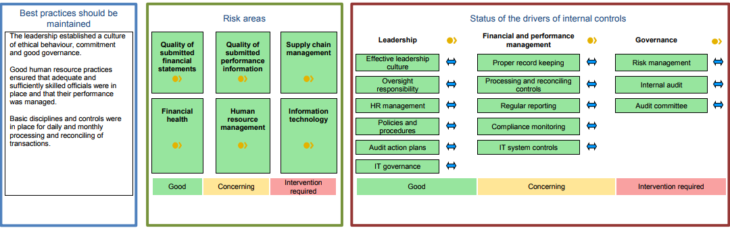
2016-17 Audit outcomes (continued)

Slide 74
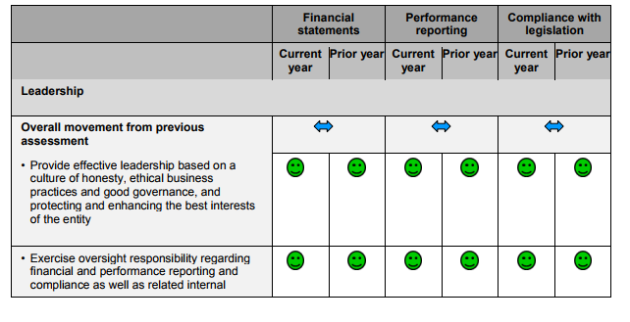
Auditor General’s assessment of internal controls: Leadership

Slide 75
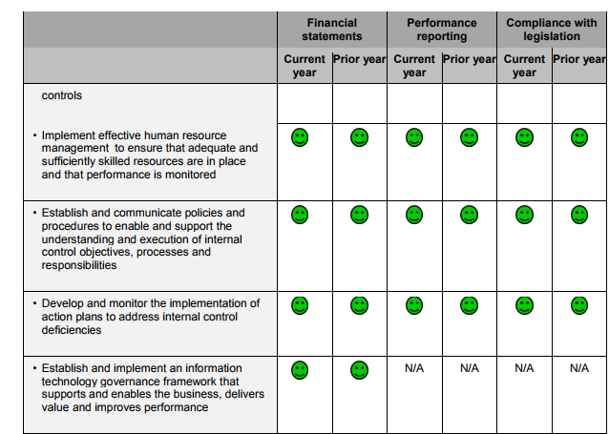
Auditor General’s assessment of internal controls: Leadership continued

Slide 76
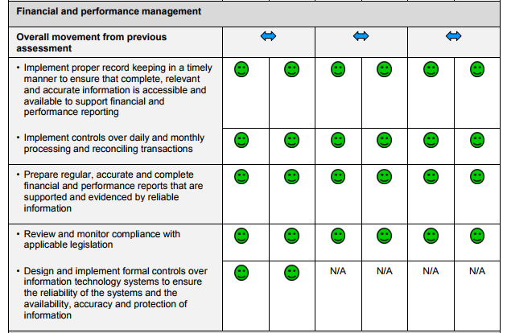
Auditor General’s assessment of internal controls: Financial and performance management

Slide 77
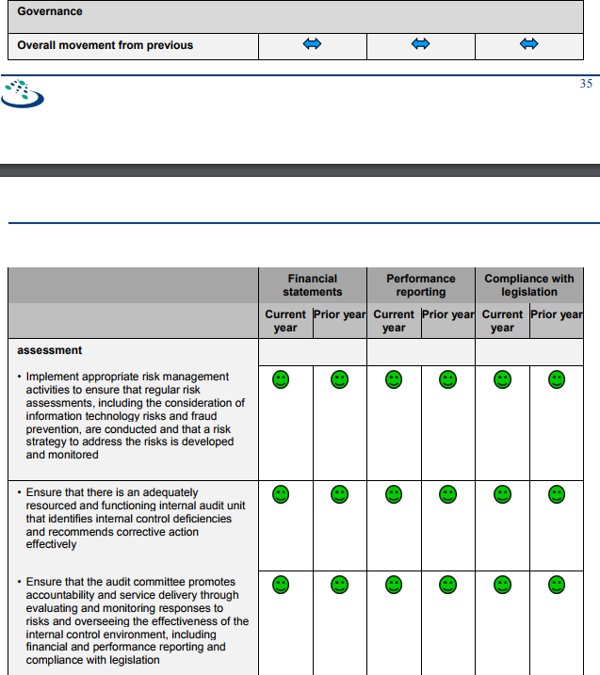
Auditor General’s assessment of internal control: Governance

Slide 78
Abbreviations and Acronyms
ADV – Advertisement
AGSA – Auditor-General of South Africa
APP – Annual Performance Plan
BRICS – Brazil, Russia, India, China and South Africa
CCBO – Chief Convention Bureau Officer
CEO – Chief Executive Officer
CFO – Chief Financial Officer
CMO – Chief Marketing Officer
COO – Chief Operating Officer
CPI – Consumer Price Index
CQAO – Chief Quality Assurance Officer
DG – Director-General of the National Department of Tourism
DIRCO – Department of International Relations and Co-operation
DMC – Destination Management Companies
DPME – Department of Performance, Monitoring and Evaluation
DTGS – Domestic Tourism Growth Strategy
EXCO – Executive Management Committee of South African Tourism
GDP – Gross Domestic Product
ICCA – International Congress and Convention Association
IIA – Institute of Internal Auditors
JMA – Joint Marketing Agreement
MICE – Meetings, Incentives, Conventions and Events
MIF – Marketing Investment Framework
MRRSAT – Ministerial Review Report on South African Tourism
MTEF – Medium-Term Expenditure Framework
MTSF – Medium Term Strategic Framework
NDP – National Development Plan
NDT – National Department of Tourism
NT – National Treasury
NTSS – National Tourism Sector Strategy
PFMA – Public Finance Management Act (Act No. 1 of 1999)
PR – Public Relations
PTA – Provincial Tourism Agencies
ROI – Return on Investment
SADC – Southern African Development Community
SANCB – South African National Convention Bureau
StatsSA – Statistics South Africa
SMME – Small, Medium and Micro-Sized Enterprises
TBCSA – Tourism Business Council of South Africa
TDDS – Total Tourism Direct Spend
TEP – Tourism Enterprise Partnership
TIP – Tourism Incentive Programme
TGCSA – Tourism Grading Council of South Africa
TTFDS – Total Tourist Direct Spend
TOMSA – Tourism Marketing South Africa
UK – United Kingdom
UNWTO – United Nations World Travel Organisation
USA – United States of America
VFM – Value for Money
VFR – Visiting Friends and Relatives

Slide 79
THANK YOU

