Slide 1
Presentation Outline
Presentation to the Portfolio Committee on Trade and Industry
the dti
Annual Report 2016-17 Presentation
12 September 2017
Director-General
Lionel October

Slide 2
Presentation Outline
Economic Context
Strategic Goals and objectives
Annual Performance :
      Key Achievements
      Summary of achievement of targets
      Financial Management
      Audit result
Elements of this presentation were compiled using information courtesy of the Media Relations and Marketing unit within the dti

Slide 3
Overview
    the dti achieved a Clean Audit- financial statements are free from material misstatements and no material findings reported on performance objectives or non-compliance with legislation.
    99.62 of the allocated budget of R10.3 billion was spent.
    50% women in senior management positions and 34% people with disabilities were employed.
    All eligible creditors were paid within 30 days.
    Through Black Industrialist programme over R3 billion of investments were leveraged, creating 7 000 new jobs.

Slide 4
Executive Summary
    Broad Based lack Economic Empowerment regulations were gazette and the Commission operationalized.
    8th Iteration of IPAP launched – with strengthened support for Black - Industrialists and Economic Transforamtion to grow productive sectors such as Agriculture, Manufacturing and Mining.
    6 Industrial Parks were approved for refurbishment.
    Equity Equivalent Investment Programme is ensuring skills development, enterprise development and research, leading to the creation of 241 job opportunities.

Slide 5
Strategic imperatives
Goals
VISION
Grow the manufacturing sector to promote industrial development, job creation, investment and exports
1. To facilitate transformation of the economy to promote industrial development, investment, competitiveness and employment creation
2. Build mutually beneficial regional and global relations to advance South Africa’s trade, industrial policy and economic development objectives;
3. Facilitate broad-based economic participation through targeted interventions to achieve more inclusive growth;
A dynamic industrial, globally competitive South African economy, characterised by inclusive growth and development, decent employment and equity, built on the full potential of all citizens.
Objectives
Improved conditions for consumers, artistics and opening up of markets for new patents players
4. Create a fair regulatory environment that enables investment, trade and enterprise development in an equitable and socially responsible manner;
Strenghtened capacity to deliver on the dti mandate
5. Promote a professional, ethical, dynamic, competitive and customer-focused working environment that ensures effective and efficient service delivery.

Slide 6
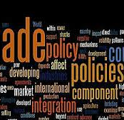
Economic Context

Slide 8
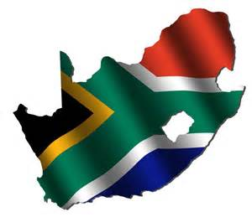
Domestic Economic Context

Slide 9
SA avoided recession in 2016
Economic activity stalled in 2016 with growth of only 0.3% in 2016 compared with 1.3% in 2015.
This is the third year in a row that growth slowed and the lowest recorded since 2009.
However, the SA economy avoided recession in 2016, largely as a result of the positive growth rate in the tertiary sector which grew by 1.4 per cent.
Domestic economy is expected to grow at a rate of 0.8% and 1.6% in 2017 and 2018, respectively.
It remains unclear whether these projections will hold given the recent (April 2017) downgrade of the country’s credit rating to sub-investment grade.

Slide 12
Auto sector dominate SA manufactured exports
From 2007 to 2016, vehicles topped the list of the exported manufactured goods reaching R772 billion.
The Americas and Europe were the top export destinations of SA manufactured motor vehicles for transport of persons.
Metals were South Africa’s second largest manufactured export product to the world. The top three export destination for this commodity were Asia (in particular China) recording R291 billion, Europe R159 billion and Africa R97 billion.
Machinery and equipment ranked the third largest manufactured export with exports totalling R588 billion in the last decade (2007 to 2016). Exports to Africa accounted for 44 per cent and Europe 35 per cent of total machinery exports.

Slide 15
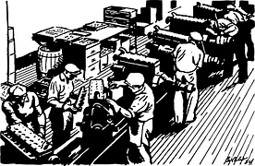
Key Achievements: annual report
1 April 2016– 31 march 2017

Slide 16
Industrial Development

Slide 17
Industrial Development
Instruction notes issued for designations during the financial year were for steel and steel products to ensure the maximum utilisation of existing steel fabrication capacity across the infrastructure build programme.
the dti invoked provisions of Section 9.3 of the Preferential Procurement Policy Framework Act, 2000 (Act No. 5 of 2000) to engage the South African National Roads Agency Limited (Sanral) to secure the localisation of steelworks in the Mtentu and Msikaba bridge projects in Eastern Cape, and mandated the local purchase of stationery procured by state-owned companies and municipalities.
Progress has been made in supporting several local companies to improve their competitiveness and increase their export capabilities. This has been done either through funding, technology transfer or linking local players with global OEM value supply chains.
  Highlights include an agreement between the dti, South African Airways Technical (SAAT) and an NIP obligor to revive the aircraft engine maintenance, repair and overhaul capabilities of SAAT.
Industrial financing interventions have significantly contributed to rescue, revival and growth in several sectors. The Industrial Development Corporation (IDC) was the major source of dedicated industrial financing, having disbursed R9.1 billion between April 2016 and February 2017 across various IPAP sectors.
SG 1: Facilitate transformation of the economy to promote industrial development, investment, competitiveness and employment creation

Slide 18
Industrial Development
In a joint investment project with the IDC, Beijing Automobile International Corporation began building its new R11 billion vehicle manufacturing plant, which is set to create 2 500 direct jobs.
Toyota South Africa opened a R6.1 billion assembly line to produce its Fortuner and Hilux models, R1.9 billion of which will go towards supplier tooling, R1.4 billion to in-house tooling, and the remainder to in-house facilities and buildings to cater for new press machines. The project attracted five new international suppliers, while creating about 2 000 new jobs in the supply chain.
Ford South Africa invested R11.5 million in the construction and operation of a new job training and entrepreneurial development centre, which opened in October 2016.
Volkwagen South Africa has invested R120 million in a new 21 000 try-out press to improve manufacturing capabilities.
Mercedes Benz South Africa awarded a tender to Great North Transport for the supply, maintenance and financing of 150 commuter buses, with Marcopolo South Africa as the bus body builder. The approved total bid price, including repairs and maintenance is R511.6 million over a five-year period.
SG 1: Facilitate transformation of the economy to promote industrial development, investment, competitiveness and employment creation

Slide 19
Industrial Development
BMW South Africa has unveiled a purpose-built solar carport that allows its electric vehicle range to charge using solar energy. BMW is also set to expand its shared services centre and IT operations centre, which is one of only two specialist hubs globally, with the aim of increasing personnel in both operations by 220 people.
Footwear manufacturing increased by 2 million pairs in the first quarter of 2016 and employment creation continued. Exports in the leather and footwear sector have begun to increase as well.
Bombardier Transportation launched its propulsion and control facility in Elandsfointein, eastern Gauteng, in July 2016. The new 6 000m² facility will produce Bombardier Mitrac high- power propulsion equipment for use in Transnet’s locomotives project.
In September 2016, AVK Valves officially launched its new R200-million plant in Benoni, eastern Gauteng, in partnership with Premier Valves. The plant features improved engineering processes, computer numeric-controlled machines and a training facility.
MTU South Africa unveiled its newly upgraded workshop facility in Cape Town in October 2016. It will assemble diesel engines for 232 diesel locomotives that China North Rail is to deliver to Transnet as part of the locomotive build programme.
SG 1: Facilitate transformation of the economy to promote industrial development, investment, competitiveness and employment creation

Slide 20
Industrial Development
China North Rail delivered two Complete Knock Down (CKD) diesel locomotives for final assembly at Transnet Engineering’s Durban facility.
Transnet Engineering unveiled its locally manufactured Trans-Africa diesel-powered locomotive, which is particularly suitable for use on branch lines and in shunting yards.
the dti launched a R100-million tomato processing plant in Tzaneen by Dursots-All Joy. The factory is expected to assist in addressing the increased demand for tomato paste in South Africa while ensuring business for 15 commercial farmers in the area. The plan is to ultimately employ 300 people.
In partnership with National Treasury and the deciduous fruit industry, the Western Cape provincial government has established the Deciduous Fruit Development Chamber commercialisation programme. This will disburse R120 million in funding to emerging fruit farmers to grow their businesses to fully commercial status.
SG 1: Facilitate transformation of the economy to promote industrial development, investment, competitiveness and employment creation

Slide 21
Industrial Development
The year under review saw a R1 billion investment by AB Inbev in South Africa to realise localisation as part of its offer to acquire rival brewer SABMiller. Of the R1 billion investment, R610 million will be used to support new emerging farmers and commercial farmers to enable South Africa to change from a net importer of hops to a net exporter of hops and value-added malt.
GWK Farm Foods unveiled a technologically advanced wheat mill, pasta plant and biscuit factory, one of the most modern and technologically advanced new food production facilities in Africa. Of the R400 million investment, R60 million went towards expandeding silo capacity at the plant to service the new facility. More than 400 temporary employment opportunities were created during construction, while more than 100 permanent jobs have created at the new plant.
The Renewable Energy Independent Power Producer Procurement (REIPPP) attracted investments valued at R194.1 billion, including R53 billion (27%) from foreign sources. It created 28 484 jobs and generated R256.2 million in socioeconomic development contributions and R80.5 million in enterprise development contributions.
SG 1: Facilitate transformation of the economy to promote industrial development, investment, competitiveness and employment creation

Slide 22
Industrial Development
MPACT opened a R350 million polyethylene terephthalate recycling plant that created 1 000 indirect jobs. The operation has resulted in South Africa becoming the 24th country overall and the first in Africa to meet Coca-Cola’s certification requirements to package their soft drinks.
Yangtze Optics Africa Company launched its R150 million investment in a 15 000 meter square fibre optic plant at Dube Trade Port in May 2016. The investment is expected to create approximately 150 new jobs for the Chinese company to supply fibre optic cables and fibre to the home solutions and local telecommunications players including Telkom, Neotel, Vodacom, MTN, Cell C and Vumatel.
Tronox opened its new, R3.3 billion Fairbreeze mineral sands mine in KwaZulu-Natal, its main product titanium dioxide. 250 direct jobs and 1 000 indirect jobs have been created.
SG 1: Facilitate transformation of the economy to promote industrial development, investment, competitiveness and employment creation

Slide 23
Trade, Investment & Exports

Slide 24
Trade, Investment & Exports
A new Economic Partnership Agreement (EPA) was concluded with the European Union and will lead to improved market access for some agricultural products such as seafood, wine, canned fruit, sugar and ethanol.
In 2016, the dti led a process to secure South Africa’s continued participation in the African Growth and Opportunity Act (AGOA), a unilateral preferential programme that offers duty-free market access to 5 235 tariff lines into the United States.
A compact and more nuanced Integrated National Export Strategy (INES) was launched in March 2016. The development of this INES, or “Export 2030”, inalignment with a concerted market diversification strategy, contributed to increasing South Africa’s exporter base and promoting trade.
SG 2: Build mutually beneficial regional & global relations to advance South Africa’s trade, industrial policy & economic development objective

Slide 25
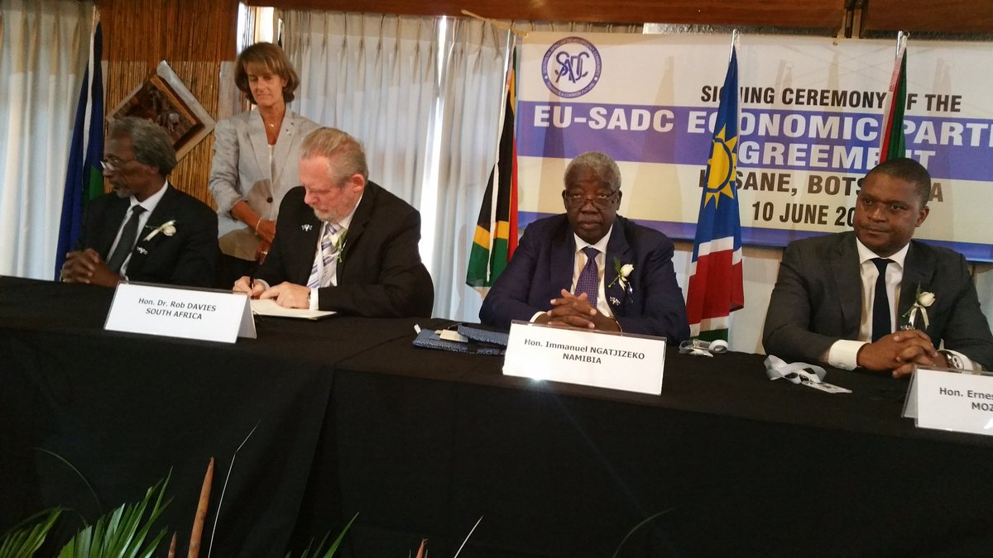
Trade, Investment & Exports
Minister Dr Rob Davies and European Union Ambassador briefing the Media on the Signed Economic Partnership Agreement with the EU
SG 2: Build mutually beneficial regional & global relations to advance South Africa’s trade, industrial policy & economic development objective

Slide 26
Trade, Investment & Exports
A number of investment projects were launched during the reporting period. This has created a number of jobs, as outlined below:
May:
New polyethylene terephthalate production plant established in Wadeville, Ekurhuleni. Mpact invests R350 million, and the project is expected to employ 1 085 people by completion. Dursots launches its new tomato paste plants in Tzaneen and Musina, Limpopo. Toyota launches it new Hilux and Fortuner
July
July 2016: HBM-SA launches a R60 million latex condom facility at Dube Trade Port, creating 145 jobs.
August 2016:
Launch of the Dormac Dry Dock facility at Durban Port. Launch of the IBM research lab at Wits University, Johannesburg.
October 2016:
Launch of 3M expanded facility in Ekurhuleni.
November 2016:
Hitachi to build a pilot seawater desalination and water reuse integrated system in Durban.
December
December 2016: Yangtze Optics Africa Cable launches its plant at Dube Trade Port.
SG 2: Build mutually beneficial regional & global relations to advance South Africa’s trade, industrial policy & economic development objective

Slide 27
SEZ & Economic Transformation

Slide 28
SEZ & Economic Transformation
In 2016/17, the department embarked on the first phase to revitalise 10 identified industrial parks.
        Botshabelo Industrial Park in Free State was the first to be launched,
        followed by Seshego Industrial Park in Limpopo,
        Isithebe Industrial Park in KwaZulu-Natal and Queendustria Industrial Park in Eastern Cape.
The first phase of the revitalisation programme included security infrastructure upgrades, the replacement of top structure and wastewater treatment plant repairs.
SG3: Facilitate broad-based economic participation through targeted interventions to achieve more inclusive growth

Slide 29
SEZ & Economic Transformation
Six Industrial Parks were approved for refurbishment under the Critical Infrastructure Programme, and 13 special economic zone (SEZ) projects were approved for top structure infrastructure
        Phuthaditjhaba,
        Garankuwa,
        Seshego,
        Nkowankowa,
        Ekandustrial, and
        Bodirelo
SG3: Facilitate broad-based economic participation through targeted interventions to achieve more inclusive growth

Slide 30
SEZ & Economic Transformation
In pursuit of driving economic transformation and increased participation in industrialisation, the programme expended R98 million of its allocated budget. Of the R98 million, 12% was used for transfer payments to the National Productivity Institute, the Council for Scientific and Industrial Research: Fibre and Textile Centre of Excellence, and the Black Business Council.
In the first full year of operation of the Black Industrialists programme, 36 companies received financial assistance, with support of approximately R1 billion; investments of over R3 billion have been leveraged thereby creating 7,000 new direct jobs.
SG3: Facilitate broad-based economic participation through targeted interventions to achieve more inclusive growth

Slide 31
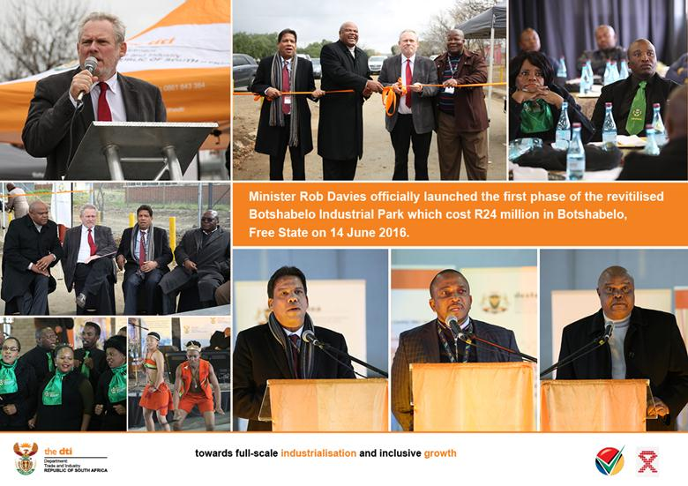
SEZ & Economic Transformation
SG3: Facilitate broad-based economic participation through targeted interventions to achieve more inclusive growth

Slide 32
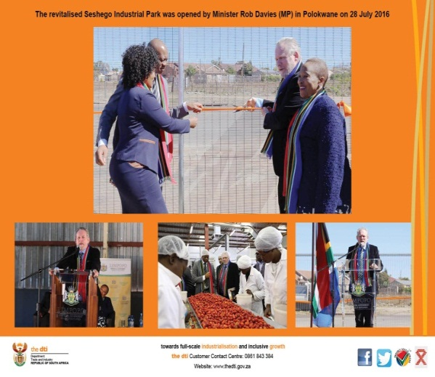
SEZ & Economic Transformation
SG3: Facilitate broad-based economic participation through targeted interventions to achieve more inclusive growth

Slide 33
Regulation

Slide 34
Legislation and Regulation
Five Bills on Companies, Copyright, Performers’ Protection, Liquor and Gambling Amendment Bills developed for Minister’s approval
One monitoring report on implementation of legislation developed for Minister’s approval
SG 4: Create a fair regulatory environment that enables investment, trade and enterprise development in an equitable and socially responsible manner
34

Slide 35
FINAL CREDIT LIFE INSURANCE REGULATIONS
The Regulations make provision for the following:
Applicability to credit providers
Maximum prescribed cost per month, that a credit provider may charge a consumer;
Two options for the calculation of the cost, (either on the deferred amount at the inception of the credit agreement or on the deferred amount from time to time under the credit agreement);
The settlement of the outstanding balance of the consumer’s total obligations under the credit agreement, in the event of the consumer’s death or permanent disability;
The settlement of all the consumer’s obligations under a credit agreement that become due and payable for specific periods in the event of the consumer’s temporary disability and in the event of the consumer becoming unemployed or unable to earn an income;
SG 4: Create a fair regulatory environment that enables investment, trade and enterprise development in an equitable and socially responsible manner

Slide 36
FINAL CREDIT LIFE INSURANCE REGULATIONS
The Regulations make provision for the following cont..:
That no cost relating to occupational disability may be included in the cost of the insurance, where a consumer is a pensioner on the date that the credit life insurance policy is entered into.
That no cost relating to the risk of becoming unemployed or being unable to earn an income may be included in the cost of the credit life insurance, where a consumer is not employed on the date that the credit life insurance policy is entered into;
That the insurance policy may include the cost relating to the risk of the consumer being unable to earn an income other than as a result of retrenchment or occupational disability, where a consumer is self-employed in the formal or informal sector, or employed in the informal sector on the date the credit life insurance policy is entered into;
That the cost must be determined having regard to the actual risk and liabilities associated with the credit agreement, whether such risk is determined with reference to the life insured’s individual risk profile or underwritten on a group basis;
Insurance industry specific exclusions and limitations, waiting periods and benefits in addition to minimum benefits to be included in the insurance policy; and
Annual charging of the cost and substitution of one insurance policy with another.
SG 4: Create a fair regulatory environment that enables investment, trade and enterprise development in an equitable and socially responsible manner

Slide 37
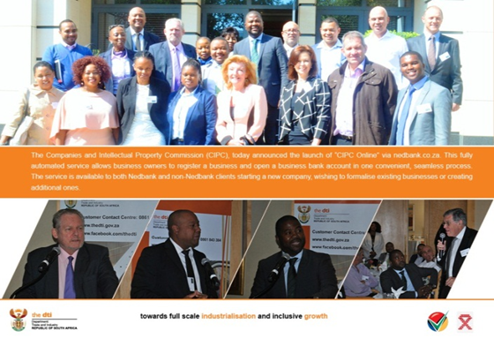
Legislation and Regulation
SG 5: Promote a professional, ethical, dynamic and competitive and customer–focused working environment that ensures effective and efficient services delivery

Slide 38
Administration

Slide 39

Administration & Co-ordination
Vacancy Rate at 7% (funded posts only)
50% of women in senior management
3.4% people with disability
Payment of all eligible creditors within 30 days.
(SMS) Senior Management Service
SG 5: Promote a professional, ethical, dynamic and competitive and customer–focused working environment that ensures effective and efficient services delivery

Slide 40
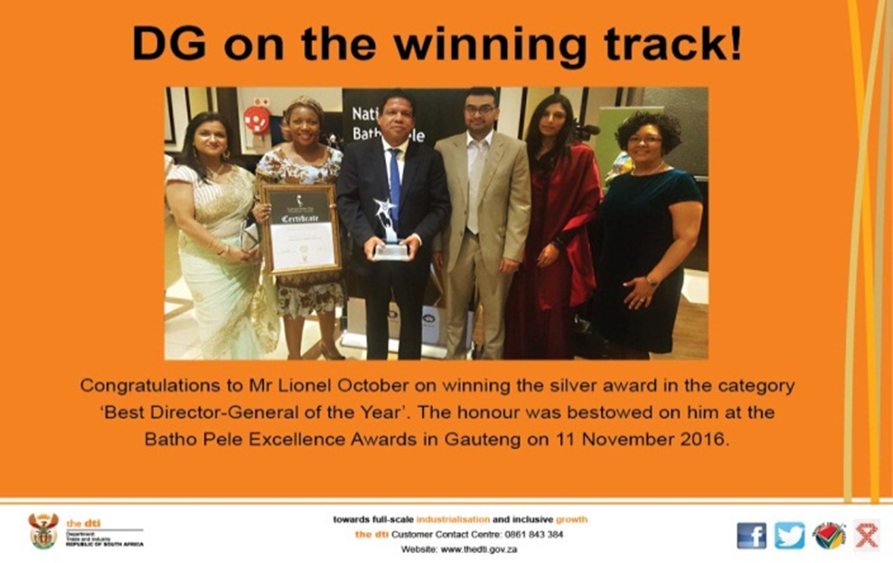
Administration & Co-ordination
the dti won big at the National Batho Pele Excellence Awards, with the Director General receiving the Silver awards in the Best Director -General of a National Department
SG 5: Promote a professional, ethical, dynamic and competitive and customer–focused working environment that ensures effective and efficient services delivery

Slide 41
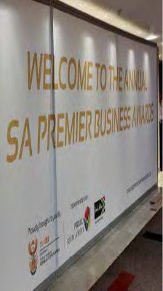

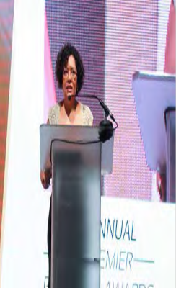
Administration & Co-ordination
the dti hosted the 4th annual edition of the South African premier Business Awards under the theme “rewarding Business Excellence”
SG 5: Promote a professional, ethical, dynamic and competitive and customer–focused working environment that ensures effective and efficient services delivery

Slide 42
Financial Performance
Annual 2016/17

Slide 43
financial results OVERVIEW: 2016/17
During the 2016/17 financial year, the department spent 99.62% of its allocated budget of R10.3 billion.
This spending pattern should be considered in the context of the Departmental cost drivers, comprising of:
75.03% or R7.7 billion transferred to beneficiaries across the various incentive scheme programmes.
10.17% or R1 billion to other transfer payments – comprising of departmental agencies, foreign governments and international organisations, and others.
The remaining 14.80% was utilised for operational expenditure.

Slide 44
financial results OVERVIEW: 2016/17 …CONT
As depicted in the graph above, there has been consistency in the spending pattern of the department against its budgetary allocation over the past five years, where the under-spending has been below 2% of the allocated budget for each specific year.

Slide 45
financial results OVERVIEW: 2016/17 …CONT
Per programme |  | Final appropriation | Actual expenditure | Variance | Expenditure as % of final appropriation
 |  | R'000 | R'000 | R'000 | %
1. | Administration | 721,505 | 699,139 | 22,366 | 96.9%
2. | International Trade and Economic Development | 116,070 | 116,024 | 46 | 100.0%
3. | Special Economic Zones and Economic Transformation | 112,492 | 97,589 | 14,903 | 86.8%
4. | Industrial Development | 1,722,289 | 1,722,245 | 44 | 100.0%
5. | Consumer and Corporate Regulation | 295,763 | 295,381 | 382 | 99.9%
6. | Incentive Development and Administration | 6,896,306 | 6,895,186 | 1,120 | 100.0%
7. | Trade Export South Africa | 455,836 | 454,588 | 1,248 | 99.7%
8. | Investment South Africa | 69,256 | 69,244 | 12 | 100.0%
TOTAL |  | 10,389,517 | 10,349,396 | 40,121 | 99.6%

Slide 46
AUDIT OUTCOME
Annual 2016/17

Slide 47

Audit reporT
the dti achieved a clean audit i.e opinion with no findings. This means that the Department's 2016/2017 financial statements are free from material misstatements and there were no material findings reported on performance objectives or non-compliance with legislation.

Slide 48
Ke ya leboga
Ke a leboha
Ke a leboga
Ngiyabonga
Ndiyabulela
Ngiyathokoza
Ngiyabonga
Inkomu
Ndi khou livhuha
Dankie
Thank you
48

