Slide 1


RATIONALISATION OF ICT STATE OWNED ENTITIES AND ITS IMPACT ON BROADBAND ROLLOUT
Robert Nkuna: Director General
5 September 2017

Slide 2
CONTENTS
Introduction
Policy Imperatives
Case for Broadband Rollout
SOE Capability Assessments
SOE Implementation Approach
SOE Implementation Roadmap
Legislative and Regulatory Considerations
SOE Rationalisation Implementation
Conclusion

Slide 3
Introduction
  The Rationalization of ICT SOEs is informed by government policy positions as pronounced in various documents such;
    the Presidential Review Committee Report on SOEs,
    the National Development Plan,
    SA Connect; and
    the Integrated ICT Policy White Paper
  All these documents indicate the need for alignment of SOEs in order to achieve the developmental objectives and aspirations of South Africa
  Therefore our aim of rationalization seeks to harmonize available enterprise capabilities so that they can be streamlined for efficiency in the best interest of service delivery

Slide 4
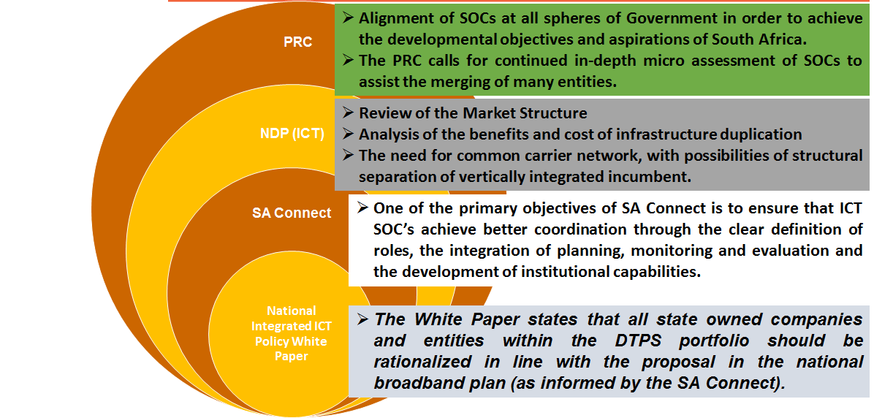
Policy Imperatives

Slide 5
Case for Broadband
  There is anecdotal narrations from various reports (like the World Bank, World Economic Forum and IMF reports) regarding the impact of broadband growth which indicates that each 10 percentage points of broadband penetration results in :
    1.21% increase in per capita GDP growth in developed countries
    1.38% increase in developing countries
  Therefore, investment in broadband rollout will put the country on its way to achieve:
    Increased economic growth and
    improved service delivery
  Thus, it is important that the ICT sector plays its critical role of ensuring that South Africa has improved Infrastructure and innovative technologies.

Slide 6
Broadband….
  The NDP notes ICTs act as a critical enabler of economic activities in an increasingly networked world
  Not only do they provide important direct opportunities for manufacturing, service provision and job creation, but also contribute to economic development through enhanced communication and information flow that improves productivity and efficiency
  Given the immense potential benefits of broadband, it is fundamental that Governments, especially in a developmental states such as South Africa, play an active role in rolling-out of broadband infrastructure and services to the full benefit of all citizens

Slide 7
SOE Capability Assessment
  As part of the rationalisation process, assessments of the SOE’s current capabilities were undertaken in 2016/17 to understand:
    Available duplicated resources and infrastructure
    Mandates implications and
    The base to craft a new direction that leads to efficiency
  The assessment outcome shows the current state of affairs:
    Infrastructure duplications
    Inefficiencies
    Poor coordination
    Wastage of scarce financial resources

Slide 8
Duplicated Services
  Most SOEs are characterized by poor governance and a lack of clear understanding of their mandates in context of a developmental state.
  The funding mechanisms of SOEs are very weak – leading to poor performance in the execution of their socio-economic mandates.
  As a result of duplications, there are a lot of inefficiencies and lack of effectiveness and wastage of scarce financial resources.
  There is serious lack of co-ordination among SOEs that should otherwise complement each other.
  The DTPS portfolio of SOE’s constitutes the immediate scope in which the DTPS rationalisation project will be focusing on and yet is cognisant of other ICT capabilities that reside outside the of DTPS such as Eskom, Transnet, SANRAL and PRASA which forms part of the broader government.

Slide 9
Approach to Rationalization
The main objective of the SOE rationalization exercise is to move away from the current fragmented mode of service delivery to a more consolidated approach with the idea to classify the entities into two categories/structures:
  Consolidation of the broadband infrastructure entities to form the State ICT Infrastructure Company or National Broadband Network Company (NBN Co) and
  Formation of the ICT services related company (State IT Company).
The implementation of this project would set a foundation for successful execution of digitized business processes and robust technology infrastructure

Slide 10
NBN Co Implementation Roadmap

Slide 11
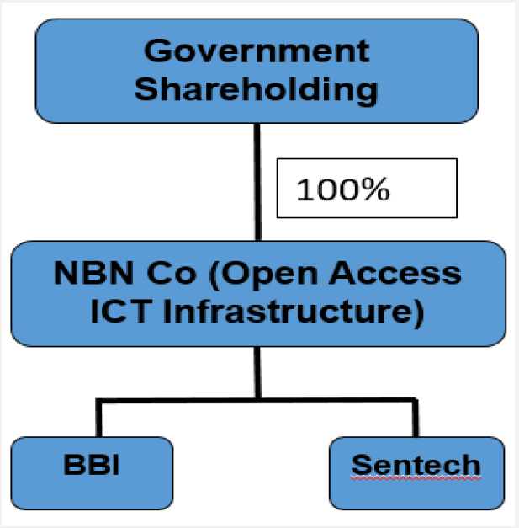
Establishment of NBN Co – Phase 1
NBN Co Implementation Roadmap
  Phase 1 – BBI and Sentech merger to form NBN is considered for the following benefits:
    Both are infrastructure companies providing carrier services through their ECNS licenses
    There will be disaggregation of the value chain for the extraction of more value.
    Facilitation of competition, reduction of broadband rollout and services costs
    Will provide Sentech with much needed broadband capacity for signal distribution
Figure 6: Phase1 - BBI and Sentech Merger

Slide 12
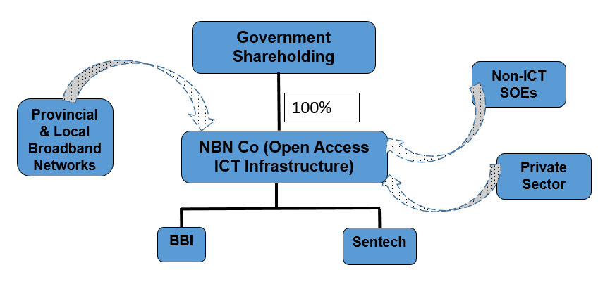
Phase 2: Access Agreements btw NBN Co and others
NBN Co Implementation Roadmap
  Phase 2(a) – Access agreement between NBN Co and Non-ICT SOEs (Eskom, Transnet, PRASA & SANRAL)
  Phase 2(b) – Access agreement between NBN Co and Provincial, and Local Governments Broadband networks
  Phase 2(c) – Access agreement between NBN Co and Private Sector
Agreements between NBN Co and
other companies

Slide 13
SA Connect
Connect government, business and individual users
Enabled by Government through aggregated procurement of services. (Phase 1 and 2 will ensure 100% connectivity to Government facilities.)
To build an enabling ICT infrastructure for the connected government
Government
Infrastructure
Enabled by government through policy (spectrum – Coverage and capacity spectrum, Infrastructure non-duplication and sharing (open access) and Streamlined/Coordinated application and approval process for deployment rapid deployment).
Mobile and fixed broadband initiatives by public and private sector.
Enabled by government through policy (spectrum – Coverage and capacity spectrum, Infrastructure non-duplication and sharing (open access) and Streamlined/Coordinated application and approval process for deployment rapid deployment).
Mobile and fixed broadband initiatives by public and private sector.
Individual
Business
An enforceable business case(s) needs to be developed for government to become an anchor tenant to ensure meaningful government-to-government, government-to-citizen and government-to-business engagements with the supply of its own infrastructure network through the rationalized SOCs.

Slide 14
Role of NBN Co. On SA Connect
  Contrary to the current duplicated mandates Sentech and BBI’s services are meant to be complimentary.
  BBI as a long distance entity can provide high speed bandwidth capacity to SA Connect identified Districts as follows:
    Direct fibre connectivity in those districts/Government facilities where there is fibre rolled out.
    Fibre to the Sentech Base Stations
  Sentech with its Microwave and Satellite capabilities can provide last mile connectivity to the Districts/Government facilities.
  Also Sentech can provide broadcasting services through BBI’s fibre for digital broadcasting.
  The Sentech/BBI merger can enable rural connectivity due to the presence of Sentech’s high sites in most of these areas.

Slide 15
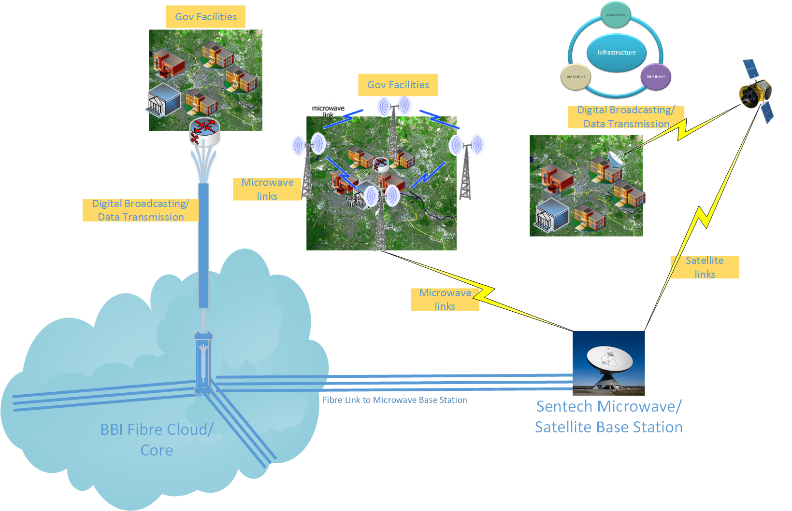
SA Connect

Slide 16





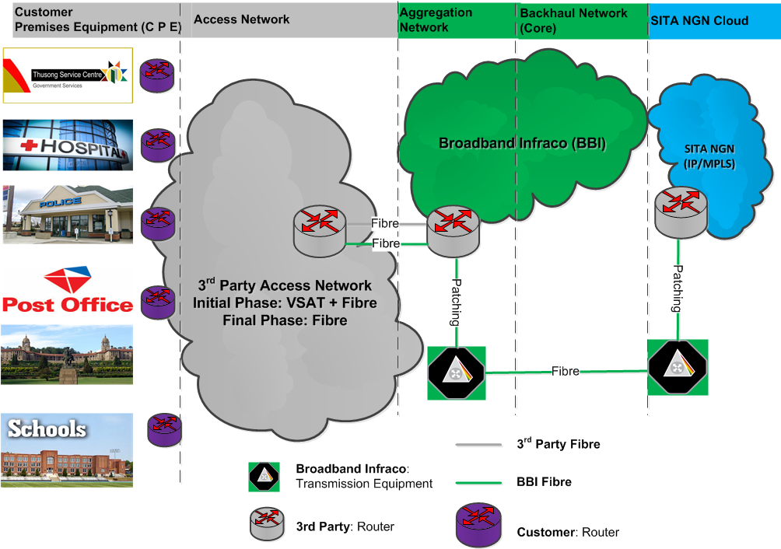
End-End SA Connect by ICT SOCs
Entity | Function
SITA | Internet Connectivity
 | Access to Government Applications
BBI | Aggregate ICT network infrastructure
Sentech | Satellite/Microwave last mile connectivity
Others | Terrestrial last mile connectivity (wired and wireless)
Access Providers
Mandate
Internet & Applications
Connectivity
Access Network
Access Network:
Fibre+ Satellite + Microwave
Operator Fibre
Operator Router

Slide 17
STATE IT Company
Below are the State IT Company’s focus areas:
  Research and Development
  Innovation
  Localization (Local procurement and open source)
  Cybersecurity
  Procurement of IT Products and Services
  e-Government Implementation
  IT Services Management

Slide 18
Legislative and Regulatory Considerations
  There are legislatives and regulatory aspects which need to be considered with regards to the implementation of the NBN Co and the IT Co.
  General legislatives and regulatory considerations:
    Corporate Law (Companies Act of 2008)
    Public Finance Management Act (PFMA)
    Electronic Communications Act (licensing)
    All affected SOCs mandates and legislations will be reviewed in line with the rationalization project
    Competition Law to give effect to mergers
    Labour Relations Act, 1995 ("LRA")
  A further detailed legal assessment will be conducted to ensure compliance to all relevant laws and regulations.
  Subject to Cabinet approval of the business cases, the Department will start work on the 2 Bills for submission to Cabinet and Parliament.

Slide 19
Implementation Plan
Analysis of the SOC founding legislations
Development of Phase 1 roadmap
Perform due-diligence process for phase 1 implementation
Development of the mandates for State ICT Infrastructure Company
Development of the mandates for State IT Company
Explore Critical levers like funding, legislative and regulatory affairs in detail
Seek Cabinet approval on the principles that will guide the implementation of the ICT SOE Rationalization Project by the end of the third quarter
Detailed legislative development

Slide 20
Conclusion
In line with the PRC Report and the NDP, the DTPS through the ICT SOE rationalisation project, seeks to achieve consolidation of ICT resources in order to capitalize on available technology capabilities and convergence of available resources to deliver robust digitized services across Government.
Having considered the severity of the challenges raised (which include amongst others, infrastructure duplication, wastage of scarce financial resources, etc.) the department is determined to move from the current fragmented mode of service delivery to a more consolidated approach by creating an NBN Co and the State IT Company.

Slide 21
Thank You

