Slide 1
STATE OF THE MDDA
AUGUST 2017
Presentation to the Portfolio Committee on Communications

Slide 2
Contents
1 | MDDA Mandate
2 | MDDA Vision, Mission & Values
3 | Legislative Environment
4 | National Development Plan
5 | Alignment with DoC
6 | 2016/2017 and Q1 Performance
7 | Initiatives Going Forward
8 | MDDA Strategic Five Year Priorities
9 | Review of MDDA Act
9 | MDDA Strategic Five Year Priorities
10 | Review of MDDA Act
11 | MDDA Status Quo

Slide 3
MDDA Mandate
Encourage ownership of, and access to, media by HDGs as well as by historically diminished indigenous language and cultural groups
Encourage the development of human resources and training, and capacity building, within the media industry, especially amongst HDGs
Encourage the channeling of resources to the community media sectors
Raise public awareness with regard to media development & diversity issues
Support initiatives which promote literacy and a culture of reading
Encourage research regarding media development & diversity
Liaise with other statutory bodies such as ICASA and USAASA
Section 16 & 32 of the Constitution provides for freedom of expression and access to information
MDDA Act 2014 of 2002

Slide 4
MDDA Vision, Mission & Values
An accessible, transformed and diversified media
Leading media development, transformation and diversification in South Africa
֍ Integrity ֍ Accountability ֍ Inclusivity ֍ Ubuntu
֍ Professionalism

Slide 5
Legislative Environment
Electronic Communication Act no. 35 of 2005
Promotion of Administrative Justice Act.No.3 of 2000 (PAJA)
.
Public Finance Management Act No.1 of 1999 (PFMA)
The Independent Communications Authority of South Africa Act, Act no. 13 of 2000
White Paper on Broadcasting Policy
(1998)
Independent Broadcasting Authority Triple Inquiry Report
(2000)
Regulations of the Independent Communication Authority of South Africa (2010)
Community Television Broadcasting Services Position Paper (2004)

Slide 6
National Development Plan
The National Development Plan - Vision 2030 (NDP) informs the MDDA’s Medium Term Strategic Framework (MTSF) priorities.
Outcome 6 relates to an efficient, competitive and responsive economic infrastructure network. This highlights the role of the MDDA in assisting community media to harness the power of a rapidly changing telecommunications environment.
Outcome 12 relates to an efficient, effective and development orientated public service. This speaks to the character and nature of the MDDA as an institution and the values it should champion.
Outcome 14 relates to nation building and social cohesion as it envisions a society where South Africans will be more conscious of what they have in common than their differences. It directs the MDDA’s approach when supporting and enabling content and production elements.

Slide 7
Alignment with DoC
DoC Strategic Goal
Goal 1 - Effective and efficient strategic leadership, governance and administration
Goal 2 - A responsive communications policy regulatory environment and improved country branding
Goal 3 - Transformed communications sector
MDDA Strategic Outcome Orientated Goal
Goal 1 - Capable and accomplished organisation in support of the delivery of the MDDA mandate by 2019
Goal 3 - Body of knowledge on the community-based media sector established through focused innovation, research and development efforts to support policy development
Goal 2 - Media transformation promoted through the growth of community-based media in South Africa
A
L
I
G
N
M
E
N
T

Slide 8
2016/2017 and Q1 Performance
Diversity Technology Sustainability Environmental Social Cohesion Science & Technology Competitiveness
Socio- Economic Nation Building Community Media Transformation Online Indigenous Languages Gender Living with Disabilities Youth Online Job Creation Community News
Content Revenue Generation Digital Migration Skills
Value Chain Enterprise Development Community radio Marketing community TV Active Citizens Community Media Governance Online Freedom of Expression Adspend
Media Access Informed Citizens Participatory Democracy

Slide 9
2016/17 Performance

Slide 10
2017/2017 Q1 Performance Overview
Total targets per Programme
Total targets achieved per Programme
Total targets not achieved per Programme
Governance & Administration Grant and Seed Funding Partnerships, Public Capacity Building & Innovation, Research & Devt
Awareness & Advocacy Sector Devt

Slide 11



2016/2017 Key Achievements –
Media Transformation
MDDA approved more community media projects than in any previous year since it awarded its first project in 2004. In line with mandate to support projects in historically disadvantaged communities, support weighted towards projects in rural areas:
40 community broadcast projects. 28 projects supported in 15 rural district municipalities. 9 funded projects led by youth.
10 Small Commercial projects and 8 community print projects, including enabling projects to go digital. 11 projects in 8 rural district municipalities, with 7 led by youth.
198 direct jobs created from community broadcast projects funded.

Slide 12

2016/2017 Key Achievements - Funding
R72 million raised, highest level in 1 year in MDDA history. Continued stakeholder engagement to ensure MDDA is financially empowered to make significant impact.
MDDA-DoC MoU to facilitate R21 million for supporting community radio stations with broadcast studio equipment.
MDDA implementing revised broadcast equipment policy with significant benefits, eg economies of scale and improved SLAs.
MDDA engaging mainstream print media houses to revive funding and enable community media print to operate with minimal interference.
.

Slide 13


2016/2017 Key Achievements –
Social Integration
Expansion of powerful initiative for building social integration and cohesion between communities.
First initiative launched in 2015 for Mamelodi and Eersterus to share broadcast platform, now known as Poort FM, using existing station Mams FM. Poort FM held first AGM in 2016/2017.
Development of second, more encompassing initiative – Khayelitsha/Gugulethu social integration in Western Cape, based on Radio Zibonele in Khayelitsha. Cape Peninsula African Communities expressed commitment to Social Integration Project at public dialogue in Cape Town.

Slide 14
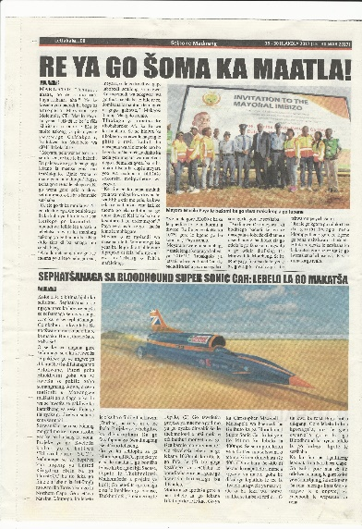

2016/2017 Key Achievements –
Capacity Development
MDDA and SAASTA MoU: 25 interns at community projects in 7 provinces to develop reporting on science related matters.
MDDA/SEDA partnership: business enterprise development.
Soul City programme: awareness of gender based violence in schools. 111 representatives from 37 community radio stations trained.
Press Code E-Learning: 100 community media journalists.
AIP Women in Community Publishing Forum
Grantee Orientation Workshop on funding contract commitments/reporting
MiCTSETA MoU for training rural-based community radio stations.

Slide 15

2016/2017
Key Achievements - Research
Wide ranging study commissioned on impact of MDDA on community media development and diversity
Findings will play crucial role in sharpening and refining its strategy going forward as well as provide valuable input into the review of the MDDA Act.
Draft delivered – August 2017

Slide 16

2016/2017 Key achievements –
Stakeholder Engagement
Pilot outreach to raise awareness of MDDA and community media amongst stakeholder groupings..
Engagements with Broadcast funders resuscitated relationships, eg Multichoice renewed funding contract and awarded discretionary R12m.
Engagement with SALGA identified way forward for joint partnership between MDDA and municipalities to assist community media.

Slide 17
2017/2018 Q1 Highlights
Q1
Disbursed R8,811,000 to community broadcast media and R2,133,000 to small commercial and community print projects
Staff competency assessments completed and personal development plans drawn up.
Engagement on proposed agreement between DSTV Media Sales and Competition Tribunal. Allocation will be managed by MDDA
Permanent HR & Corporate Affairs Manager appointed will intensify recruitment.

Slide 18

Initiatives Going Forward
  Media Transformation
  Community Media Indaba 2017
  Increased support for media supporting people living with disabilities
  Developmental funding model
  Social Integration projects
  Enhanced focus on Language diversity
  Increased support for digital migration and
  digital news platforms
  Content Diversity Strategy for community media
  Sustainability strategy for community media
  Regulation
    ICASA Moratorium and Content Monitoring – engagement on issues facing community broadcasting sector
    Enhanced Media Literacy training
    Increased outreach programme covering all 9 provinces
    Monitoring and Evaluation.
    Strengthened monitoring and evaluation
    Implementation of aftercare programme
    Bilateral meetings with SABC, GCIS and ICASA

Slide 19
MDDA Strategic Five Year Priorities
Lead MDDA Act Review Processes: reconfiguration of the MDDA Act to support changes in the sector.
Organisational Renewal: review the current MDDA organisation structure, capacity, policy frameworks and funds to promote enhanced organisational delivery.
Build Knowledge-based Organisation: promote implementation of cutting-edge research responsive to sectoral dynamics.
Expand Funding and Capacity for Community Media Development: review sustainability model to ensure media diversity and transformation.
Position MDDA as a Leader in the Community Media Sector: contribute to increased Public and Media Sector Awareness in order to influence national policy.

Slide 20
Review of MDDA Act
Issues to be covered in review of MDDA Act include but not limited to:
Governance
Composition of MDDA Board
Timeframe for appointment of Board members
Conditions for participation of Broadcast and Print sector on MDDA Board
Inclusion of telecom sector and data providers in funding regime
Legislated funding regime
  question around broadcast infrastructure funded
Mandatory 30 % for all government departments at national, provincial and local

Slide 21
MDDA Status Quo

Slide 22
Leadership Ethos
MDDA Board constituted of
Diverse members
Committed and developmental in approach
Activist in nature
Board inherited a wounded organization
Board intervention focused on organizational development and staff capacity building.
Overall objective to build a vertically integrated knowledge based learning organization.

Slide 23
State of the Agency
Past four months has seen deterioration, incoherence and lack of leadership at management level
Consequently
Recruitment has stalled
Relationships have broken down
Divide and rule leadership style
Lack of leadership and exclusion of management and staff during audit period, resulting in a report lacking context
Non-attendance at crucial meetings
Lack of implementation of Board and planned decisions
Misleading reporting
Summarily cancellation of critical service provider contracts in midst of delivery
Unauthorised signing of agreements/contracts
Making commitments with no capacity to deliver
Excluding Board in communications with the Deputy Minister

Slide 24
Corrective Action by Board
MDDA Board requested the secondment of the ACEO to be rescinded
MDDA Board has sent action points to be addressed by the ACEO and the achievement of these will be monitored by the Board weekly as per the Minister’s intervention
Implementation of Organizational Development/Renewal Intervention by Board

Slide 25
Personnel Information
Total post establishment is 38 funded posts
Total number of posts filled is 26 (25 Permanent and 1 Fixed-Term Contract)
Total number of funded vacant posts is 12
2 posts are filled in an acting capacity – ACEO and ACFO
The remaining 10 vacant posts are in the following areas:
1 post – Office of the CEO
3 posts – Office of the Company Secretary
1 post – Internal Audit
1 post – Communications
2 posts – Strategy, Monitoring and Evaluation
2 posts – Projects
Interviews for permanent CEO on Saturday, 26 August, 2017

Slide 26
Staff Capacity
Flawed recruitment process:
Staff have been employed who do not meet minimum requirements
Reference checks and assessments not carried out.
Interview and appointment records not kept
Weak performance management
Tension between Board and staff due to:
Job insecurity
Lack of innovation in executing staff responsibilities
Expectations by the Board of staff not met due to lack of individual capacity
Misalignment between Interpretation by staff of media development and diversity mandate and Board’s interpretation despite integration of all members of Agency in strategic planning and discussions at Board meetings

Slide 27
Funding Pressures - Internal
Market related packages which will attract and retain competent staff in key positions
Capacity building interventions to drive policy development and compliance monitoring
Workflow re-design of grant funding process to improve service delivery and project management
Automated records management system and capital expenditure budget to continually improve IT environment

Slide 28
Funding Pressures - External
External Funding pressures
Overdue Transmission costs – Radio. Sentech debt R25 million
Community media – Board Governance trainings
Community print media funding
Community media election coverage and participation
Broadcast equipment support for DTT readiness
Print publications capacity building on benefits of E-Commerce and strategic shift
Critical skills on-site capacity building interventions from M& E recommendations

Slide 29
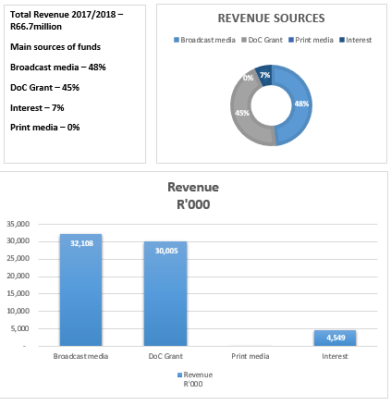
Sources of Revenue

Slide 30
Revenue Analysis
 |  | Medium Term Expenditure Framework
 |  | 2017/18 | 2018/19 | 2019/20
Transfers & Grants Received |  | 62,113,095 | 63,563,095 | 64,944,095
 | DoC - Government grants | 30,005,000 | 31,455,000 | 32,836,000
 | Media Stakeholders
 | Broadcast media | 32,108,095 | 32,108,095 | 32,108,095
 | Print media | 0 | 0 | 0
Other Income |  | 4,548,778 | 4,821,704 | 5,111,007
 | Interest Received | 4,548,778 | 4,821,704 | 5,111,007
 | Other income | 0 | 0 | 0
Total Revenue |  | 66,661,872 | 68,384,799 | 70,055,101
Three main sources of income-:
Department of Communications (DoC): Agency receives on average R31 m/yr
Broadcast and Print funders: Agency’s external fundraising resulted in MDDA currently receiving average of R35 million from broadcast funders. Stakeholder engagement initiatives to revive print media funding stream.
MDDA Fundraising: Over the medium term, Agency is developing a business case to secure additional external funding from the private sector and other funders.

Slide 31
Expenditure Analysis
 | Medium-term estimate
R thousand | 2017/18 | 2018/19 | 2019/20
Administration | 22,762 | 23,760 | 24,740
Community media | 40,149 | 40,693 | 41,211
Research - Monitoring & Evaluation | 1,500 | 1,573 | 1,642
Strategy, Policy, Advocacy, Capacity building, M&E | 2,250 | 2,329 | 2,463
Total expenditure | 66,661 | 68,355 | 70,056
Over MTEF, spending focus on promoting media development and diversity through financial and nonfinancial support to community broadcasting and community and small commercial print projects.
Grant funding will be allocated to ensuring sustainability, through strengthening of existing small commercial, community print and community broadcast projects.
Seed funding for new small commercial, community print and community broadcast projects will be allocated from transfers from DoC and external funders.
Spending on these activities expected to amount to R125 million over MTEF.

Slide 32
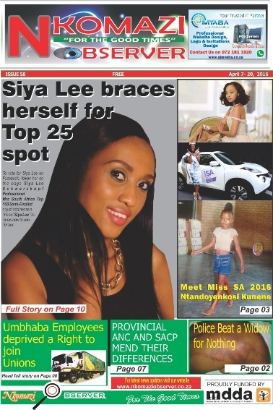

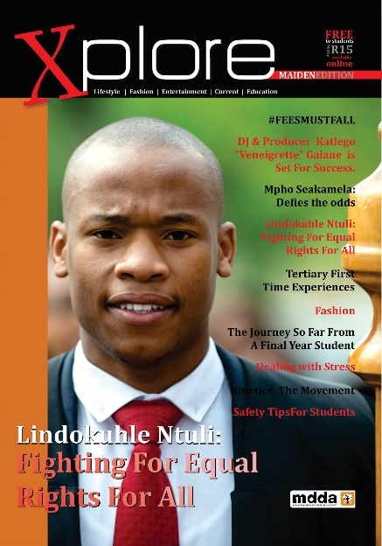
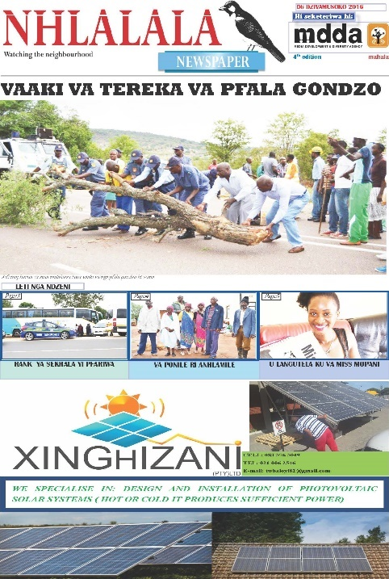



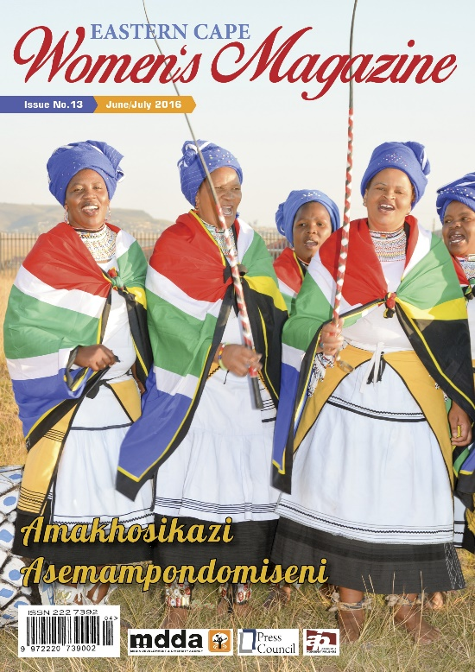




Thank You

