Slide 1
BIODIVERSITY ECONOMY LAB
Portfolio Committee Briefing
29 August 2017

Slide 2
Presentation Outline
The Lab contributes to the Government’s 9 point plan
Lab Initiatives
Update on the Wildlife Economy
Update on the Bioprospecting Economy

Slide 3
The Lab contributes to the Government’s 9 point plan
1
Revitalising agriculture and the agro-processing
value chain
Adding value to our mineral wealth (advancing
beneficiation and support to the engineering and
metals value chain)
2
The output of the Lab contributes to points 1, 4, 5 and 6 of the Government’s 9 Point Plan
3
More effective implementation of a higher impact
Industrial Policy Action Plan
4
Unlocking the potential of small, medium and micro enterprises, cooperatives and township enterprises
5
Operation Phakisa (Oceans Economy, Mining, Health, Tourism, Basic Education, etc)
6
Encouraging private sector investment
7
Resolving the energy challenge
8
Moderating workplace conflict
State reform and boosting the role of state-owned companies, information and communications technology infrastructure or broadband roll-out, water, sanitation and transport infrastructure
9

Slide 4
The Lab has produced 29 initiatives and several recommendations to address the key challenges experienced by the streams
Wildlife
C&M Tourism
Bioprospecting
Actively facilitate transformation of the sector through land access and support programmes for new entrants
Drive growth through unlocking demand, and promoting ‘value’ and products (e.g. game meat)
Create an enabling environment for the wildlife sector
Address the reputational and conservational risks of the sector
Identify and elevate events, routes and attractions along the coastline
Support high potential projects by unlocking roadblocks that are delaying implementation
Promote SA as a coastal and marine tourism
Enhance skills and SMME creation
Streamline and coordinate permitting
Increase supply through mass cultivation and sustainable harvesting
Increase demand and local value addition through better coordination of stakeholders harnessing existing initiatives and addressing the innovation chasm
Simplify the regulatory environment to enhance growth
Transform the sector through direct involvement of communities and TK holders
15 initiatives
9 initiatives
5 initiatives

Slide 5
Wildlife Economy
Priority Projects

Slide 6
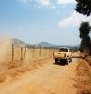
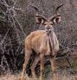
This initiative proposes to triple the number of projects receiving support from the Working for Wildlife programme
2
Working for Wildlife Program
Working for Wildlife
Today’s scope
Expansion
Projects per year
The R25 million includes basic infrastructure, capture, translocation, skills development and mentorship, veterinary and extension.
Infrastructure support
Game donations and expanded infrastructure
Skills development
Planning
Project management
Implementation
Game loans and donations
Translocation
Capture
Extension and veterinary
Land rehabilitation
~10
Today
2030
Estimated funds required
per project
R10m
R25m

Slide 7
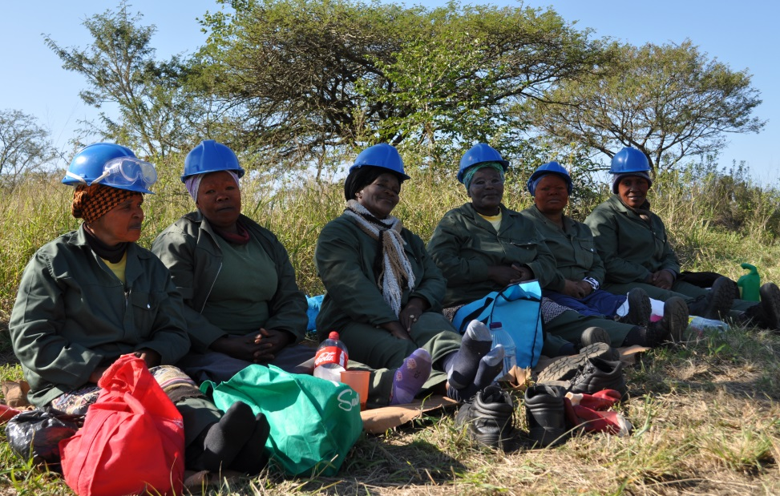
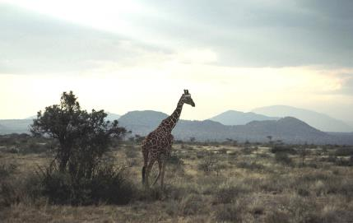
Vision for the Wildlife Economy
LAB VISION AND ASPIRATIONS
“A THRIVING, INCLUSIVE AND SUSTAINABLE WILDLIFE ECONOMY FOR THE WELL-BEING OF ALL SOUTH AFRICANS”

Slide 8
ENVISAGED ECONOMIC GROWTH FOR THE WILDLIFE SECTOR
 | SHORT TERM 2017 | MEDIUM TERM 2021 | LONG TERM 2030
Jobs | x | 15384 Jobs | 100 000 jobs
Economic growth | Yearly Growth of 10% | Yearly Growth of 10% | Yearly Growth of 10%
Transformation indicator | 20 wildlife businesses PDI owned supported (through game donation, funding, business development and training) 800 000 ha under PDI ownership and use rights will be mapped 100 PDI owned SMMEs supported to engage in the wildlife economy (97 PDI owned SMMEs supported so far) | 20% of wildlife businesses PDI owned (% of the 9000 existing game farms) 5 000 000 ha under PDI ownership and use rights will be mapped 1000 PDI owned SMMEs supported to engage in the wildlife economy | 30% of wildlife businesses PDI owned (% of the 9000 existing game farms) 10 million ha of wildlife ranches/game farms under PDI ownership 4,000 PDI owned SMMEs supported to engage in the wildlife economy

Slide 9
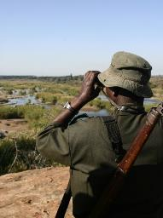
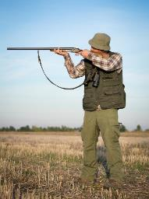
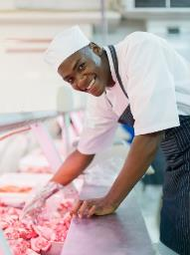
The wildlife sector comprises 3 sub-sectors
CONTEXT AND OPPORTUNITY
1
Wildlife ranching
2
Wildlife activities
1
Wildlife products
Primary activities:
Breeding
Live sale
Primary activities:
Wildlife Viewing
Trophy Hunting
Biltong Hunting
Primary activities:
Game Meat Processing
Skin and Hide Production
Other products (e.g. curios and decorations)
Secondary contributors:
Live captures
Translocation Services
Veterinary Services
Fencing and maintenance
Secondary contributors:
Accommodation
Transport
Equipment & Supplies (Arms, Ammunition etc.)
Taxidermy
Secondary contributors:
Packaging and Transportation

Slide 10
The Wildlife Economy Lab developed detailed plans for 15 initiatives and 6 additional initiatives
INITIATIVES
Recommendations¹
Driving growth through promoting ‘value’ and products
Creating an enabling environment for the wildlife sector
Facilitating transformation
1
Identify and prioritise 10m Ha for transformation of wildlife economy
7
Formalise SA game meat market and create a network of game meat processing facilities
9
Create an enabling legislative environment through the amendment of NEMBA
2
Coordinate existing support mechanisms under a ‘Wildlife Support Unit’ to efficiently support new entrants to the industry
8
Implement a campaign that drives participative transformation and consumer growth for wildlife-related activities and products
10
Develop and implement wildlife industry standards
3
Increase capacity and support for at least 300 Community Entities including community property agreements (CPAs), trusts and traditional authorities
11
Implement a national wildlife economy branding scheme
ii
Promote sustainable use as a foundation for conservation and growth of biodiversity economy
12
Develop and implement an electronic wildlife permitting system and centralised database
4
Create supply-chain linkages and capacitate 4,000 SMMEs (new and existing) to locally capture the value of ancillary goods and services to the wildlife economy
iii
Develop a strategic marketing campaign and value proposition for mixed game and livestock systems
13
“Re-position” the Wildlife Forum as an efficient interdepartmental/ industry collaboration and co-ordination platform to promote the benefits of the Wildlife Economy
5
Operationalise the uMfolozi Biodiversity Economy Node as a pilot for the wildlife node concept
iv
Establish mechanisms to allow for holistic and integrated management of animal health and conflict issues at the livestock-wildlife interface
14
Develop an integrated knowledge/ evidence generating and sharing platform to support the wildlife economy
6
Empower 4,000 emerging entrepreneurs and farmers through focused capacity-building programmes
v
Fast track the development of norms and standards to actively manage and mitigate critical wildlife economy risks such as intensive and selective breeding, animal diseases and invasive species
15
Leverage protected areas to unlock economic potential
i
Develop a toolkit of effective wildlife business, stewardship and partnership models
vi
Develop, upskill and resource extension services to facilitate the growth of the wildlife economy
1 Recommendations will be included with high level activities, but these will not have 3ft plans

Slide 11
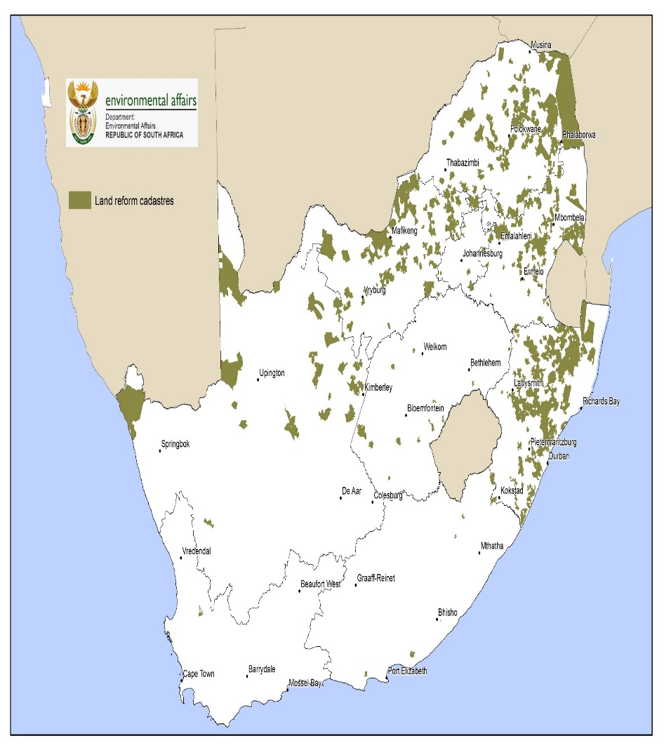
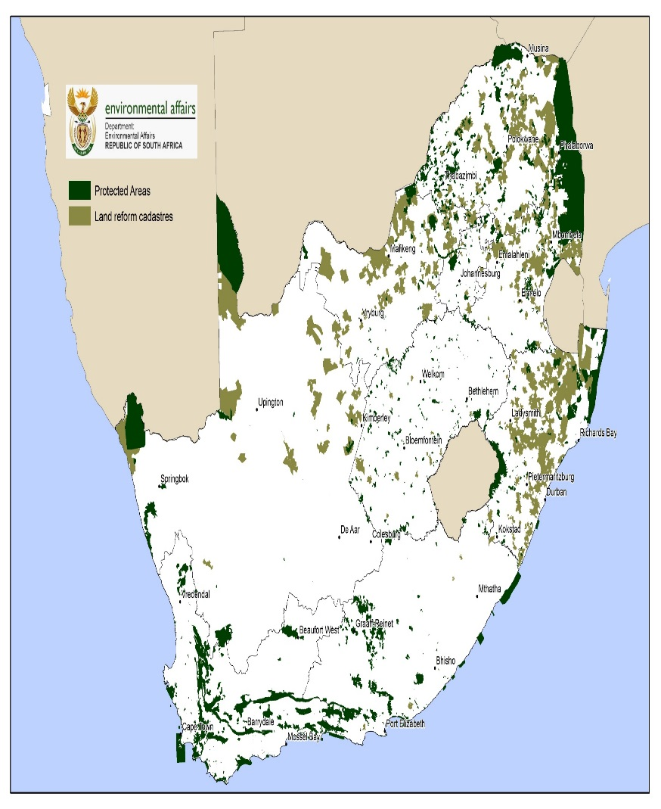
INITIATIVE 1: Identify and prioritise of 10m ha for transformation of the wildlife economy through a national land audit
Initial map of potential land to be considered for transformation of the wildlife sector has been identified consisting of data set of Claimed Land Reform Game Farms and Protected Areas.
Institutional mechanism – mapping technical team (SANBI, DRDLR, DAFF and DEA
Land reform cadastrals
Biodiversity Hotspots
Protected Areas
Owners profiles including registration numbers

Slide 12
INITIATIVE 2 : Coordinate existing support mechanisms under a ‘Wildlife Support Unit’ to efficiently support new entrants to the industry
Ground trothing concluded on 40 potential Wildlife-based enterprises under Black-ownership.
15 wildlife Business concepts/plans developed and three approved for funding.
19 Black-owned game farms benefited from the game donation programme-
Game donation to black-owned qualifying wildlife enterprise is being implemented by Conservation Authorities
National game Donation framework for common principles and standardisation of core approaches drafted and approval in process
Institutionalisation of Biodiversity Economy by Conservation Authorities/Entities
Provincial transformation Fund (NW), Game donation Policies (SanParks and most provinces), Biodiversity economy steering committees (provinces).
Financing for Biodiversity Economy (Public and Private investment)
Current DEA funding stands at R66,6m through EPIP programme with potential for further funding in the new EP Funding Cycle
Pledge of R100m by Commission on Restitution of Land Rights to support People and Parks related Biodiversity Economy programme (Business Plan development (R20m) and Project implementation (R80m)
MOU with Department of Small Business Development already funded 1 project at (R8m)

Slide 13
INITIATIVE 2: Game Donation (Policy, Implementation reporting)
Name of beneficiary | Number of Game species donated | Location
From South African National Parks
Khomani San CPA | 20 Zebras | Northern Cape
Mashishimane CPA | 6 Hippos | Limpopo Province
Matsila Community Development Trust | 5 Buffalos | Limpopo Province
Limpopo Department of Economic Development, Environment and Tourism
Balepye CPA | Burchel’s Zebra (11), Kudu (50), Blue Wildebeest (50), Impala (50), Eland (12), Giraffe (25) | Limpopo Province
Tshivhula CPA | Burchel’s Zebra (10), Blue Wildebeest (17), Impala (10), Gemsbok (12) | Limpopo Province
3 PDIs | Burchel’s Zebra (20), Eland (5), Giraffe (5) | Limpopo Province
Molekwa CPA | Burchel’s Zebra (14), Eland (4), Blue Wildebeest (16), Impala (20) | Limpopo Province
Mr. R Hlusani | Impala (20) | Limpopo Province
Mashishimale CPA | Burchel’s Zebra (18), Eland (2) | Limpopo Province
Mr. Sanele Nqala | Impala (20) | Limpopo Province

Slide 14
INITIATIVE 2: GAME DONATIONS
Name of beneficiary | Number of Game species donated | Location
Northen Cape Department of Environment and Nature Conservation
New Holme - Siya Bulela | 4 Buffalos | Northern Cape Province
Newcastle - Ms K Sebusi, Ms T Ditsebe and Mr. T Dipico | 12 Buffalos | Northern Cape Province
Game trail safaris (Retreat Game farm)- Mr O. Manhe | 4 Buffalos | Northern Cape Province
Blobersdale - Ms Noedine Collette Isaacs- Mpulo and Mr C. Mostert | 4 Buffalos | Northern Cape Province
Marrick Safaris - Mr C van Wyk | 4 Buffalos | Northern Cape Province
Eastern Cape Parks and Tourism Agency (ECPTA)
Nkhonkoni Game Breeders – Mr Xolile Dasheka | Springbuck (25) Blesbuck (30) Black Wildebeest (30) Cape Baffalo (10) Red Hartebeest (20) | Eastern Cape
Mia Family Trust – Ms Mayatula | Kudu (15) Bontebok (5) Red Hartebeest (30) Eland (10) | Eastern Cape
Policy framework for game donation incorporates monitoring systems.
Ongoing process of Game donation, new call for applications issued by SanParks and Provinces.

Slide 15
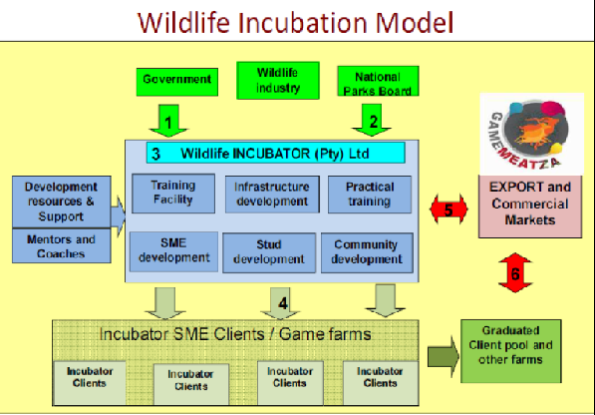
INITIATIVE 4: Create supply chain linkages and capacitate 4,000 SMMEs (new and existing) to locally capture the value of ancillary goods and services to the wildlife economy)
The Limpopo Wildlife Business Incubator, with the support from the DEA , have secured funding amounting to eight (8) million from the Department of Small Business Development (DSBD) under the Enterprise Incubation Programme (EIP) . Incubator will initially focus on developing the BOP to promote game ranching, meat production, harvesting, processing and market development.
Minimum incubator outputs 3 year funding:
The start and growth of at least 15 new emerging
wildlife ranches over a period of 5 years
Create at least 1000 new sustainable jobs a period of 5 years
Transfer and development of skills and;
Increased contribution of the sector to food security.
39 new entrants in Professional Hunting Industry trained through the South African Wildlife College with the support of North West Parks Board.
A platform created for 70 emerging game farmers to interact with the dynamics of the hunting industry (Hunting, ranching, tanneries and value added services)

Slide 16
INITIATIVE 5: Operationalise 11 Biodiversity Economy Nodes
Confirmed biodiversity economy nodes
KwaZulu Natal Province
Greater UMfolozi
Greater Isimangaliso
North West Province
Molopo
Great Pilanesburg Heritage Park
Greater Groot Marico
Limpopo Province
Greater Makuya
Greater Letaba
Greater Schuinsdraai
Greater Lekgalametsi
Greater Masebe/Moepel
Mpumalanga Province
Greater Ehlanzeni
Greater Loskop Dam
Northern Cape Province
Greater Kimberley
Greater Colesburg
Greater Kuruman
Eastern Cape Province
Greater Camdeboo
Greater Mount Zebra
Greater Amatole
Greater Pondoland
Greater Addo
Greater Tsitsikamma

Slide 17
INITIATIVE 15: Leverage Protected Areas to unlock economic potential
Conducting feasibility studies and associated business plans for the 6 independent clustered sites across identified provinces (Limpopo, Mpumalanga, Eastern Cape, KZN and Free State)
Conducting skills audit for selected communities surrounding protected areas
5 Co-management agreements facilitating for beneficiation concluded since the Biodiversity Economy Lab was conducted taking it to 21 overall.
People and Parks Programme re-oriented its approach around the Biodiversity Economy.

Slide 18
Number of Wildlife Priority Projects in 9 provinces: Identified through engagements over the past three years and call for projects proposals
Limpopo
24sites
13 sites
7 sites
Mpumalanga
4
Gauteng
2 sites
North West
11 sites
4 sites
Free state
KwaZulu Natal
14 sites
Northern Cape
17 sites
Eastern Cape
Western Cape
2 sites

Slide 19
NB: This is based on the requirements for first phase of the projects

Slide 20
Criteria for project selection
Land ownership or clear tenurial rights
Conducive ecological infrastructure to support the wildlife or bio-prospecting economic activities
Contribution to conservation
Clear governance structures
Applicant must be Black as defined in the Broad-Based Black Economic Empowerment Act 53 of 2003;
In terms of partnership arrangements Black people must have more than 51% ownership in the wildlife and/or bioprospecting/ biotrade business venture
Labour intensive job creation with emphasis on youth, women and individual with disabilities, people who have already started their businesses in need of government support
There must be a good spread of support in all the provinces

Slide 21
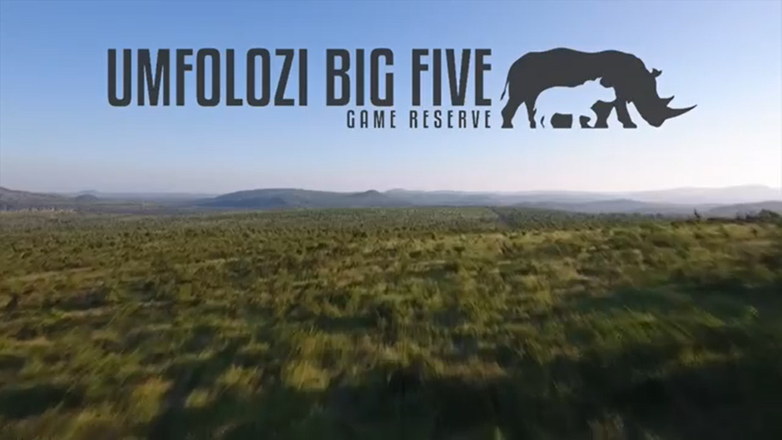
https://youtu.be/coQFq_NgT48

Slide 22
Bioprospecting Economy

Slide 23
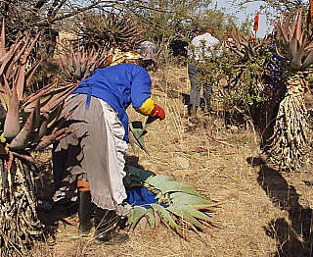
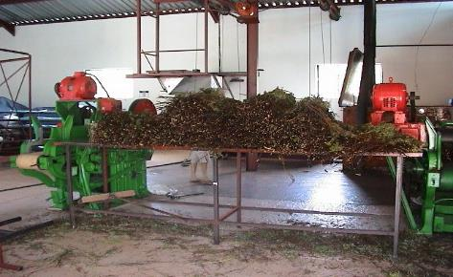
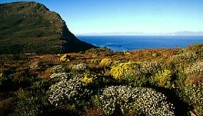
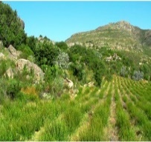
South Africa is globally recognised for the sustainable and inclusive commercial use of its biodiversity
Vision

Slide 24
The bioprospecting economy has the potential to grow to R1.7 billion GDP contribution at 10% p.a. and add 10 000 new jobs by 2030
GDP contribution
Job creation (permanent)
Key assumptions
R billion
000 jobs
GDP contribution is calculated from the sector output, or total revenue, using a ratio of GDP to output (23%)
Baseline job data is based only on permanent jobs not seasonal harvesting employment
Job creation is based on an increase in cultivation jobs of 1 000 per annum
+10% p.a.
+7% p.a.
1.7
16
6
0.3
2013
2030
2015
2030

Slide 25
ENVISAGED ECONOMIC GROWTH FOR THE BIOPROSPECTING SECTOR
 | SHORT TERM 2016 | MEDIUM TERM 2019 | LONG TERM 2030
Jobs | x | x | 10 000 jobs
Economic growth | Yearly Growth of 10% | Yearly Growth of 10% | Yearly Growth of 10%
Transformation indicator |  | Develop 5 species and site based cultivation business plans for SMMEs and communities Develop in total 100 hectares of cultivation sites focusing on communal and restituted land, poverty nodes and rural development needs | Develop 25 species and site based cultivation business plans for SMMEs and communities Develop in total 500 hectares of cultivation sites focusing on communal and restituted land, poverty nodes and rural development needs

Slide 26
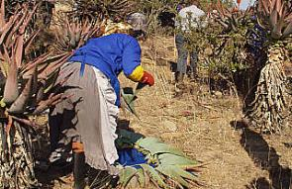
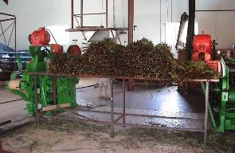
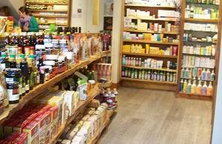
Bioprospecting sector overview
CONTEXT
Revenue
Resources
Processing and trade
Final domestic products
R 0.26 b
R 0.92 b
R 2.08 b
Both wild harvestors and farmers supply the sector
The market is largely focused on plant resources
Primarily trade in indigenous plant species, of which 70% are exported as raw materials
Operate in two categories
Trade of raw and semi-processed materials
Development and sale of intermediary products
Development and sale of final value added products
The trend towards “natural” products demand is high and customers pay a price premium for goods with indigenous resources

Slide 27
With the 5 detailed initiatives, the Lab intends to reach its Aspirations through 2030
How the Lab intends to reach the Aspirations
10% GDP contribution growth through 2030
GDP growth through 2030
10%
Cultivation
4%
BioPANZA activities
5%
Regulations
1%
Creation of 10,000 jobs
Job growth through 2030
10 000
Cultivation and
wild harvesting
BioPANZA activities

Slide 28
Key initiatives to drive growth in the Bioprospecting Economy
How do we increase the supply?
How do we increase demand and local value addition?
Promote a mass cultivation drive of 25 plant species of strategic importance and increase cultivation by 500 hectares per annum
Establish a coordinating and facilitating BioPANZA (Bio Products Advancement Network South Africa) to harness existing initiatives and to address the innovation chasm
Promote applied research, local processing, innovation and product development; and to promote the use and awareness of products with IBRs
1
3
Define management plans to ensure sustainable wild harvesting of 7 high value plant species to safeguard long term supply
2
Regulatory
Fast tracking amendments of Chapter 6 of National Environmental Management Biodiversity Act (NEM:BA) to ease compliance while ensuring protection of the rights and benefits of traditional knowledge (TK) holders and alignment with Nagoya Protocol on Access and Benefit Sharing
4
5
Improve efficiencies in the Bioprospecting Access and Benefit Sharing (BABS) permitting system
Transformation is a cross cutting essential

Slide 29
PROGRESS

Slide 30
The Lab has identified 25 high potential species to cultivate in 9 provinces
1
Province | No. of projects
Kwa-Zulu Natal | 4
Mpumalanga | 5
North West | 2
Northern Cape | 6
Limpopo | 5
Eastern Cape | 3
Free State | 1
Western Cape | 2
Gauteng | 1
TOTAL
5
Limpopo
3
1
2
4
5
Mpumalanga
1
2
3
1
North West
1
Gauteng
4
5
4
2
4
Free state
KwaZulu Natal
3
6
1
3
2
2
1
Northern Cape
1
2
Eastern Cape
3
2
Western Cape
1
1

Slide 31
11 priority species targeted for cultivation in various projects across the country
1
Priority species | Project | Value Chain Segment | Project potential
Harpagophytum procumbens (Devil’s claw) | Abbey Medicinal Plants Witdraai Medicinal Plants Glen Red Devil’s Claw Northern Cape Hub | Resource segment | Job creation, local value-addition, SMME development, R&D, product development.
Sutherlandia frutescens (Cancer bush) | Nourivier Medicinal Plants, Witdraai Medicinal Plants | Resource segment Processing & trade | Job creation, local value-addition, SMME development
Aspalathas spp (Rooibos) | Nieuwoudteville Rooibos Project | Resource segment Processing & trade | Job creation, local value-addition, SMME development, ABS compliance, local product development.
Cyclopia sp (Honeybush) | GEF 6 Honeybush Project | Resource segment Processing & trade | Job creation, local value-addition, SMME development, ABS compliance, local product development
Pelagonium sidoides (Umsangela) | Makonde Indigenous Food Processing Project | Resource segment Processing & trade | Job creation, local value-addition, SMME development, Food security
Sceletium tortuosum (Kanna) | Nourivier Medicinal Plants Witdraai Medicinal Plants, | Resource segment Processing & trade | Job creation, local value-addition, SMME development

Slide 32
11 priority species targeted for cultivation in various projects across the country
1
Priority species | Project | Value Chain Segment | Project potential
Siphonochilus aethopicus (African Ginger) | African Ginger Project | Resource segment Processing & trade Product development | Job creation, local value-addition, SMME development, ABS compliance, local product development
Tylosema esculentum (Marama bean) | Witdraai Medicinal Plants | Resource segment | Job creation, local value-addition, local product development, R&D
Warburgia salutaris (Pepperbark tree) | Malebocho Muthi Gargen | Resource segment | Job creation, local value-addition, SMME development, ABS compliance, local product development
Lippia javanica | Hi Hanyile Essential Oils | Resource segment Processing & trade Product development | Job creation, local value-addition, SMME development, ABS compliance, local product development
Helichrysum odoratissimum (Impepho) | Vryheid Project | Resource segment | Job creation, local value-addition, SMME development, ABS compliance, local product development

Slide 33
Management plans to ensure sustainable harvesting of 7 Priority species
2
Background information on Aloe ferox and Honeybush spp developed for the BMPs.

Slide 34
BioPANZA would be set up in a network partnership model
3
DST
(CSIR/TIA)
DEA
(SANBI)
This model was chosen to leverage existing structures and resources to prevent additional bureaucracy and spending
The Partnership would be hosted at an identified institution with 1-2 full time employees
The network manager would ensure efficient coordination of the partnership
The program manager would oversee efficient program delivery and monitoring and evaluation in each partner
Provinces
Local govt
the dti
(SABS)
BioPANZA
Network manager
Program manager
Traditional
authorities
DED
(IDC)
Academia
DAFF
(ARC)
Industry
associations
DRDLR
Notes:
So let’s do it – where does the money flow in American Airlines’ constellation? We're going to have a bit of a competition here and try and guess in order.
I will give you the first one, the loser here is American Airlines, they're return on invested capital is about 2%... rounded up. Who do you think is next? Who is the next biggest loser? Any guesses? <Run as audience interaction>
Order is as follows
United: They have been through Chapter 11 and cleaned up their balance sheet
Travel agents: the internet has drained value from their intermediation role
Air frame makers. concentrated industry but with aggressive volume competition
South West. The best airline, but in a tough industry.
Airports: earning pretty much infrastructure returns.
Lessors: actually do much better than the guys who build the planes.
Web travel agents and Booking platforms: here there is a network effect
Jet engines: they’ve done a very good job of creating a business model that works.
Fuel suppliers: juicy profits
Pilots: Interestingly, the total winner in all of this is actually the pilots
The important overall idea though is that value flows very unevenly and it flows to the point of scarcity. These players are all interacting with each other in the tussle of market competition, but only a few beat the market

Slide 35
3
Strategy definition role for BioPANZA
Role
Execution of the role
Sets top down targets based on sector strategy
BioPANZA defines targets required to achieve the strategy
BioPANZA works with partner entities to define their targets
BioPANZA approves targets
Launches new efforts to close gaps with the with strategic objectives
BioPANZA identififies gaps in progress in achieving entities targets
BioPANZA defines the strategy to fill those gaps
Continuously facilitates budget allocation for initiatives
BioPANZA continuously collects and help entities prepare new budget requests for BioPANZA initiatives
BioPANZA engages existing bodies (i.e., treasury and ministries) to approve the budget for BioPANZA initiatives throughout the year

Slide 36
INITIATIVES – BioPANZA - BIO PRODUCTS ADVANCEMENT NETWORK SOUTH AFRICA
3
Conflict resolution role for BioPANZA
Role
Execution of the role
Mandates and coordinate entities to work together on topics that cut across entities
BioPANZA owner identifies 2030 vision topics that cut across entities and mandate collaboration and governance over those topics
Delivery Unit suggests additional topics based on their activities (i.e., Labs, problem solving support)
BioPANZA mandates the Delivery Unit to facilitate collaboration and solve problems on selected cross cutting topics
Takes decisions to solve conflicts between entities on BioPANZA initiatives
BioPANZA owner host conflict resolution meetings on a monthly basis, convening heads of entities linked to conflict to be solved
DU suggest to BioPANZA owner which conflicts needs resolution
BioPANZA owner escalate to the steering committee

Slide 37
Establishment of BioPANZA progress
3
BioPANZA concept and TOR developed
Leadership structure established – DEA + DST + DTI
Task Implemented to date:
Honeybush Community of Practice (CoP) established for the Eastern & Western Cape Provinces.
Sustainable harvesting guidelines developed for the Honeybush CoP.
Small Grants Programme established for community projects on honeybush through GEF 6 programme.
Collaboration between the DEA and the ABS Capacity Building Initiative established
Business Plan developed for an Aloe ferox commercial venture with Umzimkhulu community in KwaZulu- Natal.

Slide 38
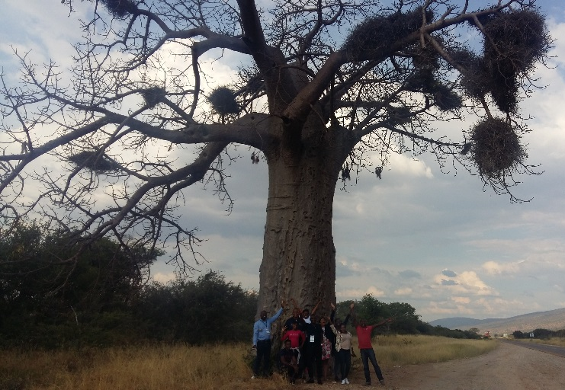
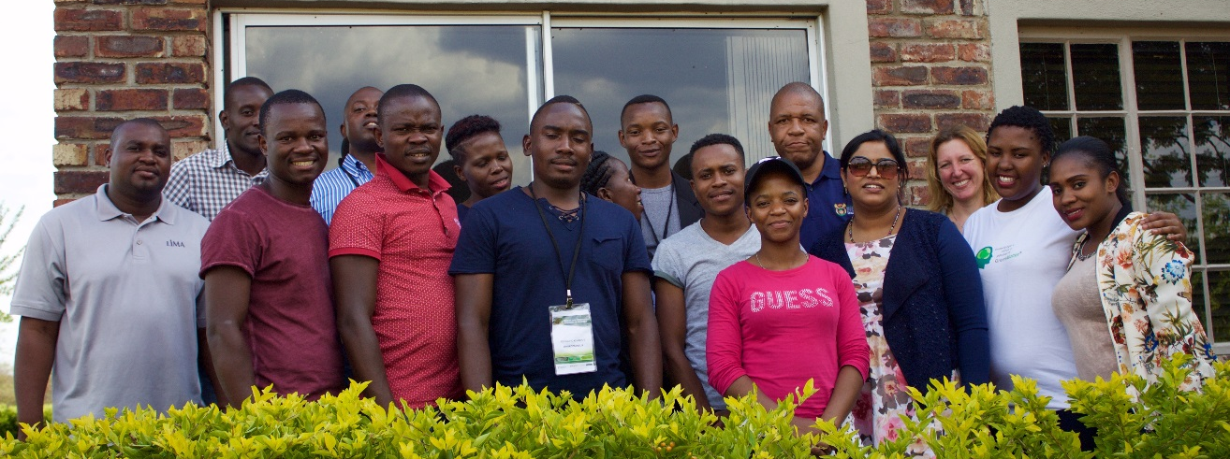
BIOPROSPECTING SECTOR PROGRESS MADE TOWARDS 2019 TARGETS
Conceptualised and conducted a Biodiversity Social Entrepreneurship Programme: A case for Baobab, Limpopo Province, 19-21 April 2017
Target Group: Entrepreneurs
Number of Participants: 19
Output: One applicant/potential entrepreneur linked with 3 mentors from EcoProducts, Botanica Natural Products and South African Essential Oil Business Incubator

Slide 39
Chapter 6 Legislative Amendment – Timelines and process map
4
Step
July 2016 -Jan
Fast track
Assumption
1. Update the Current Concept Note
May-Sept 2016
Amendment of all NEMBA chapters
BABS regulation review will be conducted concurrently to the legislative review
Establish a dedicated technical task team to support the Legal Team
2. Review international, national and provincial legislation
May-Sept 2016
3. Develop the Socio-economic Impact assessment
July-Sept 2016
4. Rationalisation and Drafting of Amendment Bill
5. Initiate Parliamentary process
Feb 2018- June 2019

Slide 40
NEMBA updating progress
4
Conducted a stakeholder wide consultation on the drafting of NEMBA
Established a technical task team to inform the amendment process.
Conducted a multi-stakeholder workshop to consult on the technical document produced by the Technical Task Team.
Initiated the Drafting of the Bill
CURRENT STATUS
Bill is ready for Intergovernmental Consultation Process

