Slide 1

Role of Cooperative Banking in the transformation of the financial services sector
Public Hearings on Financial Sector Transformation
23 August 2017
David de Jong - Supervisor: CFIs
Kobus van Niekerk - Head Central Support Services
Nomadelo Sauli - Head Capacity Building

Slide 2
TABLE OF CONTENTS
  Financial services sector structure and transformation
2. Cooperative Banking as one of the proposed solutions
  Cooperative banking sector growth inhibitors
Requisite building blocks
5. Case study

Slide 3
1. FINANCIAL SECTOR STRUCTURE & TRANSFORMATION

Slide 4
1.1 FINANCIAL SECTOR CONTEXT
Context of Financial Transformation
Legacy: The legacy of the past in South-Africa created an economy, with a concentrated formal sector controlling the economy to the exclusion of the majority of the population. This created an unequal society.
The focus of this discussion is on the Transformation of the Financial Services Sector using cooperative banking as a tool.

Slide 5
1.2 WHAT NEEDS TO BE DONE?
Economic Transformation:
The economy must be transformed to be inclusive for all its citizens
Co-operatives and Co-operative Financial Institutions (CFIs) including cooperative banks have the potential to play a significant role in the transformation of the economy, and as such should be at the fore-front of the financial sector transformation agenda.

Slide 6
1.3 WHAT COMPONENTS SHOULD BE LOOKED AT?
Financial Services Transformation:
Ownership – previously disadvantaged excluded in participating meaningfully in mainstream banking as owners of financial services institutions
Concentration – new entrants could bring about fair competition and as such lower costs, thus addressing issues of financial inclusion
Inclusive growth – stimulation of township and rural economies through focus on SMME financing, incubation and development – to an extent also addressing issues of inequality

Slide 7
2. COOPERATIVE BANKING AS ONE OF THE PROPOSED SOLUTIONS

Slide 8
2.1 WHAT IS CO-OPERATIVE BANKING?
Like credit unions, cooperative banks are owned by their members and follow the cooperative principles of one person, one vote. Unlike credit unions, however, cooperative banks are often regulated under both banking and cooperative legislation. They provide services such as savings and loans to members, and some participate in the wholesale markets for bonds, money and even equities.^{[2- Wikipedia]}

Slide 9
2.2 BENEFITS OF CO-OPERATIVE BANKING?
Investment in local communities
Localisation, and investment into local community
Network amongst co-operative banks to provide economies of scale
Savings, loans and insurance products that take all classes needs into account
Investments into technology and economy
Ownership and control of the institutions localised

Slide 10
2.2 BENEFITS OF CO-OPERATIVE BANKING?
2.2.1 Savings mobilisation within a community
Encourages savings culture
Seeks to re-invest the money back into the same community which mobilised the resources
Directly benefit that community by ploughing back surplus funds and/or paying out dividends to members
Co-ops and other SMMEs invested with CFI as members can obviously benefit in the form of a good return on the money invested in the CFI as savings

Slide 11
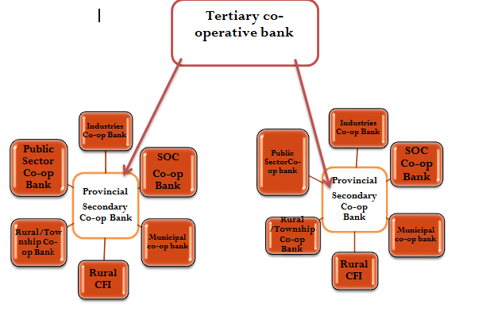
2.3 SOLUTION 1: COOPERATIVE BANKING NETWORK

Slide 12
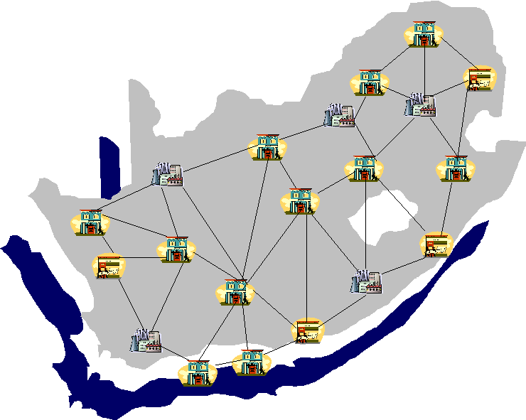
2.3 SOLUTION 1: COOPERATIVE BANKING NETWORK –
TECHNOLOGICALLY ENABLED – ACCESS TO NPS

Slide 13



2.3 SOLUTION 2: FINANCIAL INTERMEDIATION
CBDA needs to ensure – CFIs at the centre of local business ecosystem
Raw Material
Processing
Manufacturing
Storage
Distribution
Marketing and Supply Coops
Consumer Co-operatives
Agriculture Co-operatives
Financial Co-operatives
Worker Co-operatives- Labour intensive e.g. mining; construction; textiles; and arts and craft
Slide source DTI

Slide 14
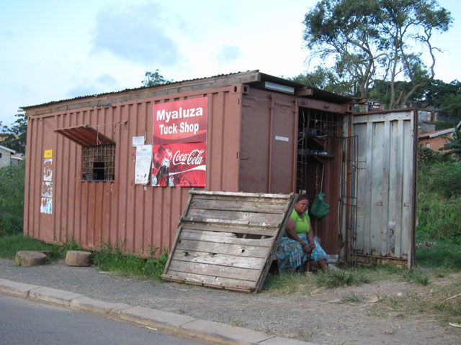
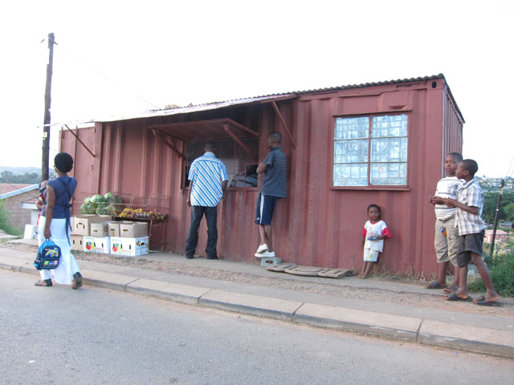
www.spazanews.co.za
Spaza Shops
+/- 100 000
Turnover R7bn pa
Employs 2 to 3 people
Support av – 4 family members
Also addressing issues of unemployment

Slide 15
2.3 SOLUTION 3: FINANCIAL SOLUTIONS
Enhanced CFI model to deal with
Access to Finance
Housing
Education
Savings
Insurance Products Savings
Investment Options/ Wealth creation
CFI Model
Financial Education
Debt rehabilitations & debt management services
Business Insurance Products Savings
Mentorship & Coaching – Business Acumen
Non-Financial Support – record keeping, financial management
Package for SMEs
Other Support
Access to markets, bulk buying
Access to Capital
Asset and Working Capital

Slide 16
3. COOPERATIVE BANKING SECTOR GROWTH INHIBITORS

Slide 17
3. COOPERATIVE BANKING SECTOR GROWTH INHIBITORS
Sector under capitalised
Low skills base
Little or no banking processes in place
Unknown (Co-operative Banking is not known as an alternative in South Africa)
Very sophisticated competitors
Legislative and regulatory framework
Inadequate support and capacity building

Slide 18
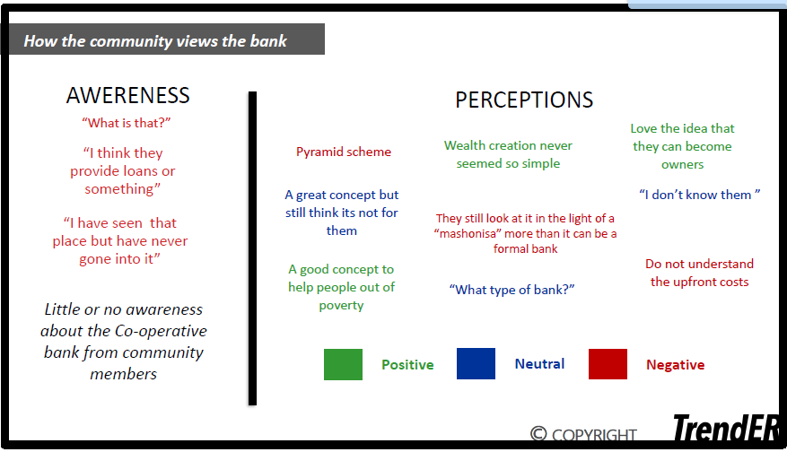
COOPERATIVE BANKING SECTOR GROWTH IINHIBITORS –
current awareness & perseptions

Slide 19
4. REQUISITE BUILDING BLOCKS

Slide 20
4. REQUISITE BUILDING BLOCKS
Adequately capacitated Co-operative Banks Development Agency
Well coordinated, multi-stakeholder capacity building interventions
Shared services (Access to NPS, technology and back-office support)
Enabling legislation and regulation

Slide 21
4. Requisite Building Blocks -
Holistic CFI Support
Improved operational efficiency
* People
(skills & competencies, roles & responsibilities, PMS,segregation & controls, governance)
* Process
(understanding, reengineering
Policies, procedures and reporting)
* Technology
Improved effectiveness
Informal, formal training, mentorship, coaching and other capacity building interventions – match theory with practice.
Recognition, loyalty, reliability and trustworthiness
Develop strong CFI brand
Brand ambassadors
Build marketing campaigns
Business Transformation
Organisational Development
Branding & Marketing
PPP (Private & Intergovernmental) –Holistic CFI Support – towards vision 2020

Slide 22
Requisite Building Blocks –
Type of support
The proposal is that SEFA, SEDA, DSBD & CBDA work together in a more coordinated manner towards a more holistic and efficient Cooperative Banking Support.
Currently all 3 agencies work in a fragmented manner yet they have the same vision that of building a vibrant cooperative sector through different mandates;
A more coordinated approach will have greater impact and ensure a stronger cooperative sector
The support will look at:
Capitalisation of the sector
Start-up support (financial support)
Alternative capital instruments
Incubation Programme
Mentorship
Centralised non-financial support
Technology
Banking system
Branding & Marketing
Creating a strong brand for the sector

Slide 23
5. CASE STUDY - SOWETO

Slide 24
CASE STUDY – SOWETO –
Study by Dr Mazwai
Access to finance
  Collateral
  Low credit score
  High risk
  Poor record keeping
  Low business management capabilities
  Limited financial records
Inability to expand
Big business edging out small business
Formal vs informal businesses
Draconian bylaws
Mantombi Cleaning Services
Bongi’s Spaza Shop
+1 million residents
Contributing ± R30bn a year to Gauteng’s economy
Consumer spending of about R5bn a year
Mnisi Panel beaters
Bopanang Manufacturers
Frank’s Fast Foods
Khanyi’s Kiddies Parties
Lebo’s Executive Beauty Bar

Slide 25

CASE STUDY – SOWETO –
Current Soweto Economy
Naledi
Pimville
Zola
CURRENT SOWETO ECONOMY
Diepkloof
Dobsonville
R5bn
Protea Glen
Jabavu
Orlando
Dlamini

Slide 26
CASE STUDY – SOWETO –
Revitalisation through Coop Banking
Access to finance
Business incubation hub
  Business skills training
  Resource sharing
  Bulk buying
  Compliance assistance to meet regulatory requirements
Business growth & sustainability
New business ventures
Partnerships with big business
Reduce unemployment
Money circulating within & remaining in Soweto
Small business Association CFI
NPO/NGO’s Association CFI
Soweto
Co-operative Bank
Soweto residents CFI
Informal traders CFI
Soweto Stokvels CFI
Tarverners Association CFI

Slide 27
CASE STUDY – SOWETO –
Coop banking advantages
Specially designed for member’s needs.
Ownership
As the owner you form part of the decision making and share in the profits
Savings facilities
Access to affordable tailor made credit
Service
Loans facilities
Customer service orientated, since the customer is the owner
Other products
Additional products to suit members needs i.e. funeral policy, small business loans

Slide 28
Communities moving towards self-reliance
through coop banking
Self driven ASSET BUILDING towards independence & self-reliance
HUMAN CAPITAL
BUSINESS CAPITAL
PHYSICAL CAPITAL
SMME growth
Employment creation
Housing
Renewable energy
Technology
Education
Skills
Training
Aligned to the NDP - township revitalization & employment creation
Tool for other govt departments – SEFA, DSBD, Transport, Housing, EDD, etc

Slide 29
THANK YOU

