Slide 1
Presentation of North West Status Report To The Portfolio Committee on Home Affairs
Presenter: M.I Mantlhasi
Acting Provincial Manager
North West Province
22 August 2017

Slide 2
Table of Contents
CONTENT | SLIDE NO.
Provincial Overview and Footprint Introduction and Background Provincial Management and Demarcation Operating Model Summary of the current footprint of the North West Province | 5 6 7-15
Provincial Performance 2016/17 Birth Registration and Projected annual target 2013/14 – 2017/18 Overview Analysis Birth Registration within 30 days - 2016/17 Birth Registration within 30 days - 2017/18 Comparative Analysis of Birth Registration for Q1 : 2013/14 – 2017/18 Late Registration of Birth ID Smart Card – 2016/17 ID Smartcard - 2017/18 Mobile Offices | 16 17 18 19 20 21 22 23 24

Slide 3
Table of Contents
CONTENT | SLIDE NO.
100% of detected employers charged 100% of detected transgressors of departmental legislation 100% of detected undocumented foreigners deported (direct deportations) 100% of detected undocumented foreigners transferred to Lindela 80% of detected fraudulent marriages & marriages of convenience cases finalised 100% of valid invoices settled within 30 days | 25 26 27 28 29 30

Slide 4
Table of Contents Continue
CONTENT | SLIDE NO.
Finance and Support Services Staff Profile Employment Equity Provincial Capacity and Recruitment & Selection Labour Relations Cases Staff Development Budget Revenue Collected Fleet Management Asset Management Stakeholder Management | 31 32 33-36 37 38 39 40 41 42 43 - 44
Achievements Challenges | 45 46

Slide 5
INTRODUCTION & BACKGROUND
The total population of the North West Province is 3,7 million which constitute 6.8 % of the country's population.
For the period 2011 – 2016 the province experienced a net migration of 95 598 (196 223 out-migrants & 291 821 in-migrants).
There are four (4) district and eighteen (18) local municipalities.
Mining is the major contributor to the provincial economy supported by cattle and mixed crop farming.
Source: StatsSA Mid Term Population Estimates

Slide 6
PROVINCIAL MANAGEMENT AND DERMACATION
Provincial Manager
(Acting)
Ms. Irene Mantlhasi
Director:
Finance & Support
Mr Stephen Tiley
Dr Kenneth Kaunda District
DMO:
Ms. M.E Dontso
(acting)
Bojanala District
DMO:
Mr. M. C. Rambuda
Ngaka Modiri District
DMO:
Mr. N.C Shabalala
Dr RS Mompati District
DMO:
Ms. M.E Dontso
(acting)
Office Managers
1 Large Office
2 Medium offices
1 Small office
Office Manager
1 Large office
4 Medium offices
1 Small office
1 Thusong Centre
Office Managers
1 Large office
5 Medium offices
1 Small office
Office Managers
0 Large office
3 Medium offices
1 Thusong Centre

Slide 7
SUMMARY OF THE CURRENT FOOTPRINT FOR THE NORTH WEST ROVINCE
TYPE OF OFFICE | DHA current footprint | Operational | Comments
Local Office Large | 3 | 3 | None
Local Office Medium | 14 | 14 | None
Local Office Small | 3 | 3 | None
Health Facilities (Connected) | 36 | 35 | 1 Health facility (Ramatlabama) has network challenges
Thusong Service Centre | 2 | 2 | None
Total | 58 | 57

Slide 8
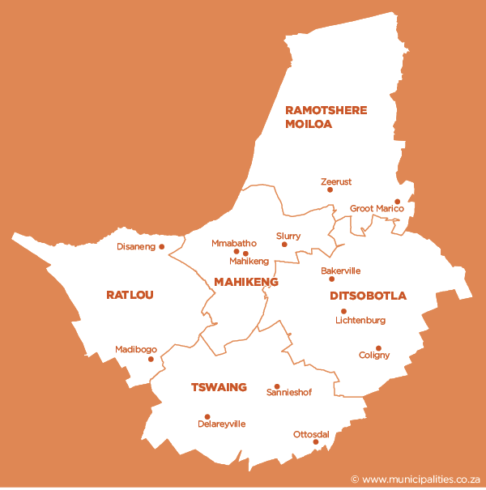
Ngaka Modiri Molema District
Local Municipality | DHA Presence
Ramotshere Moiloa | (1) Zeerust MO
Mahikeng | (3) -Mahikeng Provincial Office, -Molopo MO & - Mmabatho LO
Ditsobotla | (2) -Lichtenburg & -Itsoseng MOs
Ratlou | (1) Madibogo SO
Tswaing | (1) Atamelang MO
In terms of progress, the Province acquired space at Madibogo and has a staff compliment of two officers servicing the public daily. Madibogo Small Office is +/- 10 kilometers away from Ratlou Local Municipality offices where a suitable accommodation was identified. When the construction of the said building is completed, we will be able to move in as agreed with the Municipality.

Slide 9
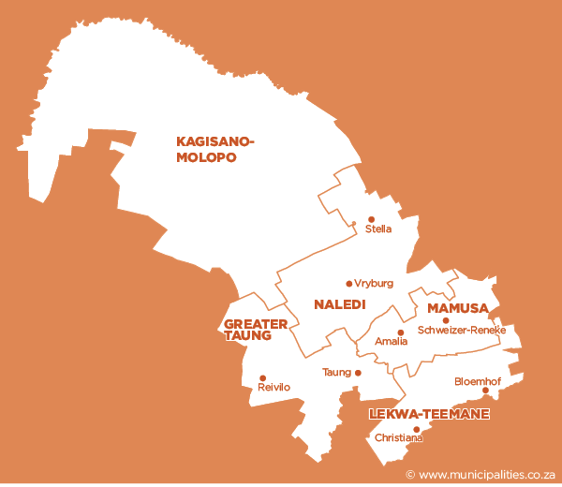
DR Ruth Segomotsi Mompati District
Local Municipality | DHA Presence
Kagisano/Molopo | (2) -Ganyesa MO - Morokweng THC
Naledi | (1) Vryburg MO
Mamusa | (0) – Schweizer Reneke Hospital
Taung | (1) Taung MO
Lekwa -Teemane | (0) –Bloemhof & – Christiana Health Facilities
This District Municipality is the most economically depressed in the Province and there are no DHA offices in two local municipalities. In order to establish DHA Foot Print in these Municipalities, we were able to connect online Birth & Death Registration System at Bloemhof, Christiana and Schweizer-Reneke Health Facilities in Lekwa-Teemane and Mamusa Local Municipality respectively. The Province also make use of mobile offices to mobilise clients to apply for Smart ID cards at Vryburg or Wolmaransstad offices. The District remains a developmental node in the Province

Slide 10
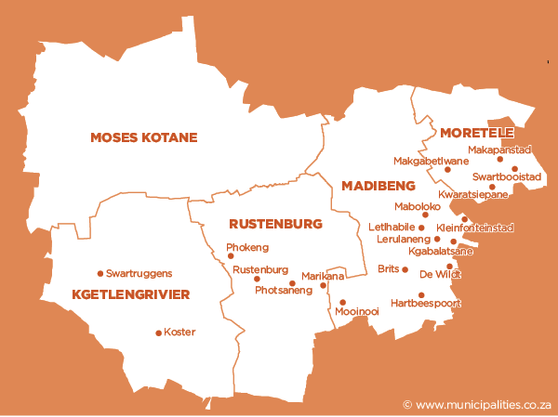
Bojanala District
Local Municipality | DHA Presence
Moretele | (2) Makapanstad MO, Leretlhabetse THC & Mobile Unit
Moses Kotane | (2) -Mankwe & -Madikwe MO
Madibeng | (1) Brits MO
Rustenburg | (1) Rustenburg LO
Kgetleng river | (1) Swartruggens SO
The previous demarcation resulted in a gap of service delivery in Moretele Local Municipality. The area is presently serviced by a mobile office with four officials. Space has been secured at Leretlhabetse/ Lebotlwane Thusong Centre. To address the problem of service accessibility in the Kgetleng River Local Municipality, the Province opened a small office in Swartruggens and five dedicated staff were appointed. This office is also taking care of the community living in and around Koster as well as surrounding farms

Slide 11
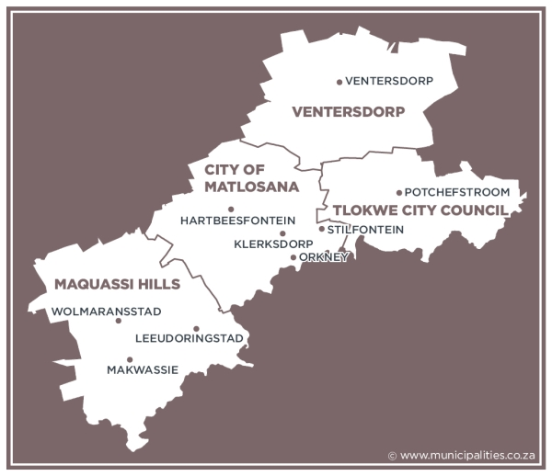
Dr Kenneth Kaunda District
Local Municipality | DHA Presence
Tlokwe/Ventersdorp 405 | (1) Ventersdorp SO
 | (1)Potchefstroom MO
Matlosana | (1) Klerksdorp LO
Maquassie Hills | (1)Wolmaransstad MO
The district is adequately covered and has an office in each local municipality.

Slide 12
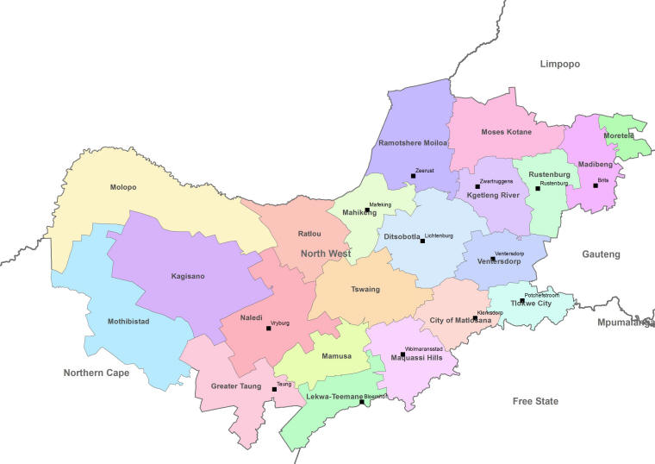
Online Health Facilities
(Registration of birth 0-30 days)
Bojanala Platinum District (7)
Job Shimankana Tabane Provincial Hospital
Moses Kotane Hospital
Swartruggens CHC
Pella CHC
Brits Hospital
Bapong CHC
Letlhabile CHC
Dr Ruth Segomotsi Mompati District (8)
Joe Morolong Hospital
Huhudi CHC
Stella CHC
Schweizer – Reneke Hospital
Bloemhof CHC
Ganyesa Hospital
Taung Hospital
Christiana CHC
Total = 15
The Province managed to register 50 104 births during the financial year 2016/17. The province achieved by 107% followed by two provinces (Limpopo & Western Cape) with 101% respectively.

Slide 13
Online Health Facilities
(Registration of birth 0-30 days)
Ngaka Modiri Molema District (11)
Mahikeng Provincial Hospital
Victoria Private Hospital
Montshiwa Town Clinic
Unit 9 CHC
Ramatlabama CHC (Propose to move equipment to Montshiwa Stadt Clinic)
General De La Rey Hospital
Gelukspan Hospital
Itsoseng CHC
Atamelang CHC
Ratlou CHC
Lehurutshe Hospital
Dr Kenneth Kaunda District (10)
Klerksdorp Provincial Hospital
Anncron Private Hospital
Wilmedpark Private Hospital
Jouberton CHC
Botshabelo CHC
Ventersdorp CHC
Potchefstroom Hospital
Potchefstroom Medi Clinic
Leeudoringstad CHC
Nic Bodenstein Hospital
Total = 21
The Province managed to register 50 104 births during the financial year 2016/17. The province achieved by 107% followed by two provinces (Limpopo & Western Cape) with 101% respectively.

Slide 14
Manually Serviced Health Facilities Registering births 0 – 30 days
Sesobe Clinic
Molatedi Clinic
Mmatau Clinic
Mogwase Clinic
Brits Medi Clinic
Oukasie Clinic
La Femme Private Hospital
Fencrest Hospital
Tlhabane CHC
Dinokana CHC
Tlokweng Clinic
Alabama Clinic
Tigane Clinic
Vryburg Private Hospital
Mamusa CHC
Morokweng CHC
Tlakgameng CHC
Ganyesa CHC
Total = 18
While awaiting connectivity to the rest of Health Facilities in the Province, offices continued to collect birth applications manually and processed them at the offices.
14

Slide 15
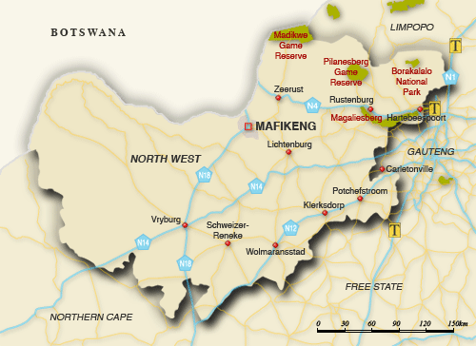
Manually Serviced Health Facilities Registering births 0 – 30 days
Ngaka Modiri Molema (10)
Disaneng CHC
Makgobistad CHC
Montshioa Stad CHC
Ottosdal Hospital
Sannieshof Hospital
Delareyville Hospital
Dinokana CHC
Lehurutshe Clinic
Bodibe CHC
Coligny Clinic
Dr Ruth Segomotsi Mompati (5)
Vryburg Private Hospital
Mamusa CHC
Morokweng CHC
Tlakgameng CHC
Ganyesa CHC
Total = 15
2
1
1
2
2
1
1
1
1
2
2
2
2
1
1
While awaiting connectivity to the rest of Health Facilities in the Province, offices continued to collect birth applications manually and processed them at the offices.

Slide 16
PROVINCIAL PERFORMANCE 2016/17
Review Period | Total Quarterly Targets | Achieved | Not Achieved
Q 1 | 8 | 8 | 0
Q 2 | 8 | 7 | 1
Q3 | 8 | 8 | 0
Q4 | 8 | 8 | 0
The Province did not achieve payment of invoices within 30 days during Q1 of 2016/17
The Province achieved 7 out of the 8 targets (88%) during 2016/17
Birth Registration within 30 calendar days
Smart ID Cards issued (received at offices) to 2,200,000 citizens
100% Of detected employers in contravention of the Immigration Act (Act 13 of 2002) charged
100% Of detected transgressors in contravention of the Immigration Act (Act 13 of 2002) charged
100% Of Undocumented foreigners deported within 30 calendar days
100% Of Detected undocumented foreigners transferred to Lindela within 20 calendar days
100% of Detected fraudulent marriages & marriage of convenience cases finalised (investigation and recommendation submitted) within 60 days
Target not achieved during the Financial Year 2016/17
100% of valid invoices settled within 30 days of certification

Slide 17
BIRTH REGISTRATION COMPARISON AND PROJECTED ANNUAL TARGET
 | Baseline projected Actual | % Contribution to the annual target | Projected annual target | Target | Actual performance | Achieved/not achieved
2013/14 |  | 3.5% | 33 139 | 33 139 | 38 129 | Achieved
2014/15 | 38 129 | 3.7% | 38 395 | 38 395 | 45 404 | Achieved
2015/16 | 45 404 | 6.3% | 47 261 | 47 261 | 45 121 | Not achieved
2016/17 | 45 121 | 4.5% | 46 653 | 46 653 | 48 681 | Achieved
2017/18 Projection | 48 681 | 6.6% | 49 315 | 49 315
Formula to determine the provincial targets
Projected Annual Performance of the province/Projected Annual Performance of the branch x 100/1
The target for 2017/18 was increased because of the over achievement in the preceding year (2016/17)

Slide 18
OVERVIEW ANALYSIS
DHA APP PLAN TARGETS 750 000
ANNUAL TARGET (APRIL 2016 – MARCH 2017) | PERFORMANCE STATUS | PLANNED ACTIONS TO ACHIEVE THE TARGET
46 653 Birth registered within 30 calendar days | Q1Target = 11 791 Actual Performance = 12 614 Variance = 823 % achieved = 107% Q2 Target = 11 667 Actual Performance = 12 728 Variance = 1 061 % achieved = 109% Q3 Target = 11 117 Actual Performance = 11 672 Variance = 555 % achieved = 105% Q4 Target = 12 078 Actual Performance = 13 090 Variance = 3 703 % achieve = 108% Overall Provincial Performance = 107% | Awareness to pregnant women was conducted during pre-natal visit at HF’s. The Province used birth occurrence registers to follow-up on all unregistered babies at HF’s. High birth and LRB volume areas were identified to promote early birth registration. Meetings were held with HF’s management and sub-district offices. Officials were deployed on rotational basis to attend to HF’s on weekends and public holidays Unconnected HF’s were visited on Weekly basis to register new born babies. Mobile Offices deployed for birth registration in all far remote areas. Offices monitored implementation of NW Birth Registration Strategies.

Slide 19
OVERVIEW ANALYSIS
DHA APP PLAN TARGETS 750 000
ANNUAL TARGET (APRIL 2017 – MARCH 2018) | PERFORMANCE STATUS | PLANNED ACTIONS TO ACHIEVE THE TARGET
49 315 Birth registered within 30 calendar days | Q1 Target = 12 679 Actual Performance = 13 054 Variance = 375 % achieved = 103% NB: Although the margin of achievement compared to the previous years is lower, the province registered more babies in relation to the same quarters in the previous years. | Awareness to pregnant women was conducted during pre-natal visit at HF’s. The Province used birth occurrence registers to follow-up on all unregistered babies at HF’s. High birth and LRB volume areas were identified to promote early birth registration. Officials were deployed on rotational basis to attend to HF’s on weekends and public holidays (deployment stopped on 15th June 2017 due to working hours dispute) Unconnected HF’s were visited on weekly basis to register new born babies. Offices monitored implementation of NW Birth Registration Strategies.

Slide 20
Comparative Analysis of birth registration for Q1: 2013/14 – 2017/18

Slide 21
LATE REGISTRATION OF BIRTHS (31DAYS-1YR, 1-7 YRS, 7-14YRS & 15YRS & ABOVE)
ITEMS | 2016/17 | Q1 2017
Opening Balance | - | 2740
Number of LRB applications received/on hand | 10378 | 5773
Number of LRB applications adjudicated | (7626) | (2074)
Number of applications finalised | 6981 | 2008
Number of applications rejected | 38 | 18
Number of cases/files closed | 12 | 24
Number of applications referred to IMS for investigations | 595 | 24
BALANCE BROUGHT FORWARD | 2 740 | 3 699
Offices are conducting adjudication on the spot for category 31 days to 1 year.
Turnaround time is 180 days for category 31days to 1 year, 1-7years & 7-14 years
Turnaround time for category 15 years & above is 120 days.
Cases older than the prescribed period are closed after three attempt to get the client.
Notes:
Utilise the slides on DDG:CS presentation for LRB

Slide 22
OVERVIEW ANALYSIS
DHA APP PLAN TARGETS
ANNUAL TARGET (APRIL 2016– MAR 2017) | PERFORMANCE STATUS | PLANNED ACTIONS TO ACHIEVE THE TARGET
176 227 Smart ID Cards issued to citizens 16 years of age and older | Q1Target =40 040 Actual Performance = 51 622 Variance =11 582 % achieved =129% Q2 Target = 44 080 Actual Performance = 45 978 Variance = 1898 % achieved = 104% Q3 Target = 48 027 Actual Performance = 51 838 Variance = 3811 % achieved =108% Q4 Target = 44 080 Actual Performance = 74 573 Variance = 30 493 % achieved = 169% Overall Provincial Achievement = 127% | Offices visited Villages//churches through invitations and special arrangements for marketing. Extended hours (Super Sunday) Continued to invite schools learners turning 16 years and grade 12 learners for application of Smart ID Card on specific days. Intensified arrangements with SASSA, Old age homes and sector Departments, etc. Distributed flyers at hot spot areas. Effective utilization of stakeholder forums. Weekly marketing through local media. .

Slide 23
OVERVIEW ANALYSIS
DHA APP PLAN TARGETS
ANNUAL TARGET (APRIL 2017– MAR 2018) | PERFORMANCE STATUS | PLANNED ACTIONS TO ACHIEVE THE TARGET
253 663 Smart ID Cards issued to citizens 16 years of age and older | Q1Target = 68 489 Actual Performance = 52 808 Variance = (15 681) % achieved = 77,1% NB: Although the target is not achieved the province managed to issue more cards in this quarter compared to the same period in the previous years. | Offices visited Villages//churches through invitations and special arrangements for marketing. Distributed flyers at hot spot areas. Effective utilization of stakeholder forums. Marketing through local media (Local radio stations & newspapers) although it is expensive. CHALLENGES Local radio stations no longer willing to provide free slots for marketing of the ID smartcard. Limited budget available for communication in the province (each district allocated R5000.00). Change of requirements for first time applicants (parents to accompany applicants) impacted on the number of learners coming to offices to apply.

Slide 24
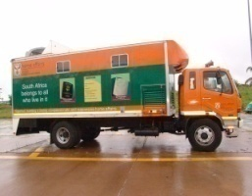
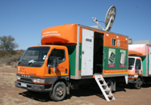
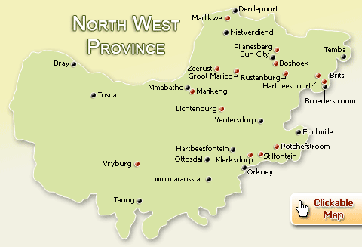
MOBILE OFFICES
The province has a total of 11 mobile units of which 3 are fully functional and the remaining 8 are only driveable. Province is responsible for roadworthy and maintenance of the units. Channel Management is in charge for maintenance of generators, satellite dishes, computer hardware and software.

Slide 25
OVERVIEW ANALYSIS
DHA APP PLAN TARGETS
ANNUAL TARGET (APRIL 2016– MAR 2017) | PERFORMANCE STATUS | ANNUAL TARGET (APRIL 2017– MAR 2018) | PERFORMANCE STATUS
100% Of detected employers in contravention of the Immigration Act (Act 13 of 2002) charged | Q1Target = 100% Actual Performance = 24/24 Variance = 0 % achieved = 100% Q2 Target = 100% Actual Performance = 31/31 Variance = 0 % achieved = 100% Q3 Target = 100% Actual Performance = 33/33 Variance = 0 % achieved = 100% Q4 Target = 100% Actual Performance = 24/24 Variance = 0 % achieve = 100% Overall Provincial Performance = 112/112 (100%) | 100% Of detected employers in contravention of the Immigration Act (Act 13 of 2002) charged | Q1Target = 100% Actual Performance = 26/26 Variance = 0 % achieved = 100%
Notes:
Replicate for all IMS targets

Slide 26
OVERVIEW ANALYSIS
DHA APP PLAN TARGETS
ANNUAL TARGET (APRIL 2016– MAR 2017) | PERFORMANCE STATUS | ANNUAL TARGET (APRIL 2017– MAR 2018 | PERFORMANCE STATUS
100% Of detected transgressors in contravention of the Immigration Act (Act 13 of 2002) charged | Q1Target = 100% Actual Performance = 700/700 Variance = 0 % achieved = 100% Q2 Target = 100% Actual Performance = 605/605 Variance = 0 % achieved = 100% Q3 Target = 100% Actual Performance = 383/383 Variance = 0 % achieved = 100% Q4 Target = 100% Actual Performance = 398/398 Variance = 0 % achieve = 100% Overall Provincial Performance = 2086/2086 (100%) | 100% Of detected transgressors in contravention of the Immigration Act (Act 13 of 2002) charged | Q1Target = 100% Actual Performance = 392/392 Variance = 0 % achieved = 100%
Notes:
Replicate for all IMS targets

Slide 27
OVERVIEW ANALYSIS
DHA APP PLAN TARGETS
ANNUAL TARGET (APRIL 2016– MAR 2017) | PERFORMANCE STATUS | ANNUAL TARGET (APRIL 2017– MAR 2018 | PERFORMANCE STATUS
100% Of undocumented foreigners deported within 30 calendar days (Direct Deportations) | Q1Target = 100% Actual Performance = 68/68 Variance = 0 % achieved = 100% Q2 Target = 100% Actual Performance = 47/47 Variance = 0 % achieved = 100% Q3 Target = 100% Actual Performance = 6/6 Variance = 0 % achieved = 100% Q4 Target = 100% Actual Performance = 16/16 Variance = 0 % achieve = 100% Overall Provincial Performance = 137/137 (100%) | 100% Of undocumented foreigners deported within 30 calendar days (Direct Deportations) | Q1Target = 100% Actual Performance = 40/40 Variance = 0 % achieved = 100%
Notes:
Replicate for all IMS targets

Slide 28
OVERVIEW ANALYSIS
DHA APP PLAN TARGETS
ANNUAL TARGET (APRIL 2016– MAR 2017) | PERFORMANCE STATUS | ANNUAL TARGET (APRIL 2017– MAR 2018 | PERFORMANCE STATUS
100% Of Detected undocumented foreigners transferred to Lindela within 20 calendar days | Q1Target = 100% Actual Performance = 314/314 Variance = 0 % achieved = 100% Q2 Target = 100% Actual Performance = 348/348 Variance = 0 % achieved = 100% Q3 Target = 100% Actual Performance = 84/84 Variance = 0 % achieved = 100% Q4 Target = 100% Actual Performance = 95/95 Variance = 0 % achieve = 100% Overall Provincial Performance = 841/841 (100%) | 100% Of Detected undocumented foreigners transferred to Lindela within 20 calendar days | Q1Target = 100% Actual Performance = 192/192 Variance = 0 % achieved = 100%
Notes:
Replicate for all IMS targets

Slide 29
OVERVIEW ANALYSIS
DHA APP PLAN TARGETS
ANNUAL TARGET (APRIL 2016– MAR 2017) | PERFORMANCE STATUS | ANNUAL TARGET (APRIL 2017– MAR 2018 | PERFORMANCE STATUS
80% of Detected fraudulent marriages & marriage of convenience cases finalised (investigation and recommendation submitted) within 60 days | Q1Target = 80% Actual Performance = 0 Variance = 0 % achieved = 100% Q2 Target = 80% Actual Performance = 0 Variance = 0 % achieved = 100% Q3 Target = 80% Actual Performance = 1/1 Variance = 0 % achieved = 100% Q4 Target = 80% Actual Performance = 3/3 Variance = 0 % achieved = 100% Overall Provincial Performance = 4/4 (100%) | 80% of Detected fraudulent marriages & marriage of convenience cases finalised (investigation and recommendation submitted) within 60 days | Q1Target = 80% Actual Performance = 1/1 Variance = 0 % achieved = 100%
Notes:
Replicate for all IMS targets

Slide 30
OVERVIEW ANALYSIS
DHA APP PLAN TARGETS
ANNUAL TARGET (APRIL 2016– MAR 2017) | PERFORMANCE STATUS | ANNUAL TARGET (APRIL 2017– MAR 2018 | PERFORMANCE STATUS
100% of valid invoices settled within 30 days of certification | Q1Target = 100% Actual Performance = 225/226 Variance = (1) % achieved = 99,56% Q2 Target = 100% Actual Performance = 280/280 Variance = 0 % achieved = 100% Q3 Target = 100% Actual Performance = 325/325 Variance = 0 % achieved = 100% Q4 Target = 100% Actual Performance = 210/210 Variance = 0 % achieve = 100% Overall Provincial Performance = 1031/1032 (99,9%) NB: Non performance in quarter 1 was due to BAS shutdown from 16 March 2016 and orders were generated at Head Office. Suppliers details changed without updating National Treasury. (Time delay of system interface between DHA & NT) | 100% of valid invoices settled within 30 days of certification | Q1Target = 100% Actual Performance = 239/239 Variance = 0 % achieved = 100%
Notes:
Replicate for all IMS targets

Slide 31
STAFF PROFILE
LEVEL | FEMALE | DISABILITY | MALE | DISABILITY | TOTAL
3 | 37 | 0 | 20 | 2 | 57
5 | 16 | 1 | 3 | 0 | 19
6 | 163 | 3 | 95 | 7 | 258
7 | 26 | 1 | 25 | 1 | 51
8 | 29 | 0 | 34 | 1 | 63
9 | 4 | 0 | 1 | 0 | 5
10 | 8 | 0 | 12 | 1 | 20
11 | 1 | 0 | 1 | 0 | 2
12 | 2 | 0 | 2 | 0 | 4
13 | 1 | 0 | 3 | 0 | 4
14 | 0 | 0 | 0 | 0 | 0
Total | 287 | 5 | 196 | 12 | 483
Notes:
Mr Tiley to update

Slide 32
EMPLOYMENT EQUITY
SLARY LEVEL | AFRICAN |  | COLOURED |  | INDIAN |  | WHITE |  | TOTAL
 | MALE | FEMALE | MALE | FEMALE | MALE | FEMALE | MALE | FEMALE
3 | 20 | 36 | 0 | 1 | 0 | 0 | 0 | 0 | 57
5 | 3 | 15 | 0 | 1 | 0 | 0 | 0 | 0 | 19
6 | 86 | 150 | 3 | 5 | 2 | 0 | 4 | 8 | 258
7 | 23 | 22 | 1 | 2 | 0 | 0 | 1 | 2 | 51
8 | 33 | 28 | 0 | 0 | 0 | 0 | 1 | 1 | 63
9 | 1 | 3 | 0 | 1 | 0 | 0 | 0 | 0 | 5
10 | 11 | 6 | 0 | 1 | 0 | 0 | 1 | 1 | 20
11 | 1 | 0 | 0 | 0 | 0 | 0 | 0 | 1 | 2
12 | 1 | 2 | 0 | 0 | 0 | 0 | 1 | 0 | 4
13 | 2 | 1 | 0 | 0 | 0 | 0 | 1 | 0 | 4
TOTAL | 181 | 263 | 4 | 11 | 2 | 0 | 9 | 13 | 483

Slide 33
PROVINCIAL CAPACITY – FILLED AND UNFILLED POSTS
Total Establishment | Filled as at 30 June 2017 | Vacant Funded
498 | 483 | 15
 | Capacity Rate: 97% | Vacancy Rate: 3%
Recruitment and Selection: The process was suspended from February 2016 to 31 March 2017. Posts
were reprioritised and funded from 1st April 2017
Post | Date Advertised | Date Shortlisted | Interview Date | Offer letter issued (Y/N) | Date offer letter issued
Provincial Manager (PM : NW) | 20/2/2017 | HEAD OFFICE | HEAD OFFICE | No | Post done by Head Office (SMS)
Personnel Practitioner (PM: NW) | 13/3/2017 | 3/4/2017 | 11/4/2017 | YES | 17/5/2017
Notes:
Mr Tiley to update

Slide 34
Recruitment and Selection
Post | Date Advertised | Date Shortlisted | Interview Date | Offer letter issued (Y/N) | Date offer letter issued
Cleaner (PM:NW) | 19/7/2017 | To be done | To be done | Not yet | Not yet done
ASD : DITO (Dr Ruth Segomotsi Mompati) | Done by HQ | Done by HQ | Done by HQ | No | Done by HQ
Immigration Officer (LO Mmabatho) | 03/03/2017 | 21/04/2017 | 02/05/2017 | YES | 01/06/2017
Administration Clerk (LO Mmabatho) | 29/05/2017 | 28/06/2017 | 04/07/2017 | Not yet done | Not yet done
Administration Clerk (LO Mmabatho) | 29/05/2017 | 28/06/2017 | 04/07/2017 | Not yet done | Not yet done
Notes:
Mr Tiley to update

Slide 35
Recruitment and Selection
Post | Date Advertised | Date Shortlisted | Interview Date | Offer letter issued (Y/N) | Date offer letter issued
Chief Administration Clerk (SO Khunwana) | 3/3/2017 | 21/4/2017 | 26/4/2017 | Yes | 5/6/2017
Local Office Manager : Ganyesa | 3/3/2017 | 4/4/2017 | 10/4/2017 | Yes | 15/5/2017
Local Office Manager : Taung | 19/5/2017 | 7/6/2017 | 20/6/2017 | Yes | 6/7/2017
Local Office Manager : Mankwe | 3/3/2017 | 4/4/2017 | 10/4/2017 | Yes | 15/5/2017
Cleaner : Mafikeng | 29/05/2017 | 23/06/2017 | 03/07/2017 | No | Not yet done
Notes:
Mr Tiley to update

Slide 36
Recruitment and Selection
Post | Date Advertised | Date Shortlisted | Interview Date | Offer letter issued (Y/N) | Date offer letter issued
Admin Clerk : MO Wolmaransstad | 03/03/2017 | 06/04/2017 | 11/04/2017 | YES | 22/05/2017
Civic Service Supervisor : MO Mankwe | 03/03/2017 | 03/04/2017 | 07/04/2017 | YES | 15/06/2017
Civic Service Supervisor : MO Mankwe | 03/03/2017 | 03/04/2017 | 07/04/2017 | YES | 15/06/2017
Notes:
Mr Tiley to update

Slide 37
LABOUR RELATIONS CASES
KEY AREA | NUMBER OF CASES | OUTCOMES
Fraud & Corruption | 7 cases: false birth registration 4 cases: fraud birth registration 5 cases: aiding and abetting 1 case: fraud marriage 2 cases: fraud ID 1 case: misuse of state vehicle | Cases referred to Employee Engagement and Civic Services for cancelation of identity numbers. Awaiting outcomes of disciplinary hearings.
Improper Conduct | 6 cases: failure to submit monthly compliance checklist. 1 case: malicious language 1 case: insubordination 1 case: harassment 1 case: failure to hand over 1 case: unacceptable conduct | Finalised Finalised Pending Finalised Finalised Finalised
SANCTIONS
Dismissals | 0
Suspension | 1 | 1 month suspension without pay : May 2017 : corruption)
Warnings | 10 | 7 written warnings 3 final written warnings

Slide 38
STAFF DEVELOPMENT
Training conducted during Quarter 1 of 2017/18 | Number of officials enrolled
Personnel Administration | 1
Mentorship | 4
Diversity management | 33
TOTAL | 38

Slide 39
SUMMARY OF BUDGET
2017/18 FY (Q1; April 2017 till June 2017)
ITEM | BUDGET | EXPENDITURE | AVAILABLE | ACTUAL % | IDEAL % | SHORTAGE / SURPLUS
 |  |  | BUDGET |  |  | (% VARIANCE)
Compensation | 150 708 000.00 | 37 815 015.00 | 112 892 985.00 | 25.09 | 25 | 0.09
Goods and Services | 9 698 000.00 | 1 779 235.95 | 7 978 764.05 | 18.35 | 25 | -6.65
Machinery & Equipment | 2 599 000.00 | 65 125.80 | 2 533 874.20 | 2.51 | 25 | -22.49
Provincial and local Governments | 112 000.00 | 24 312.00 | 87 688.00 | 21.71 | 25 | -3.29
Households. | 145 000.00 | 437 698.96 | (292 698.96) | 301.86 | 25 | 276.86
Total G&S | 12 554 000.00 | 2 306 372.71 | 10 307 627.29 | 18.37 | 25 | -6.63
Overall Performance | 163 262 000.00 | 40 121 387.71 | 123 200 612.29 | 24.57 | 25 | -0.43

Slide 40
REVENUE COLLECTED
DISTRICT | Revenue Collected during financial year 2016/17 | Revenue Collected during Q1 of 2017/18
Bojanala Platinum District | R 19 187,170.00 | R 3 992,200.00
Dr Kenneth Kaunda District | R 10 932,010.00 | R 2 469,014.00
Dr Ruth Segomotsi Mompati District | R 2 922,460.00 | R 763,985.00
Ngaka Modiri Molema | R 11 608,067.00 | R 2 853,485.00
Total Revenue Collected | R 44 649,707.00 | R 10 078,684.00

Slide 41
FLEET MANAGEMENT
KEY AREA | NUMBER | PERCENTAGE
Vehicles
Number of vehicles in the Province | 80 | 100%
New vehicles received | 0 | 0%
Number of Functional vehicles | 72 | 90%
Number of vehicles involved in accidents | 8 | 10%
Mobile offices
Number of mobile offices | 11 | 100%
Number of dysfunctional mobile | 8 | 72%
Number of Functional mobiles | 3 | 28%

Slide 42
ASSET MANAGEMENT
ASSET MANAGEMENT IN NORTH WEST
TOTAL NUMBER OF ASSETS | 9567
TOTAL VALUE OF ASSETS | R 63 287 118.79
NUMBER OF VERIFIED ASSETS | 9555
VALUE OF VERIFIED ASSETS | R 63 231 238.37
NUMBER OF UNVERIFIED ASSETS | 12
VALUE OF UNVERIFIED ASSETS | R 55 880.42
PERFORMANCE | 99.85%

Slide 43
STAKEHOLDER MANAGEMENT
Province | District | Local | Launched/Not Launched
North West | Ngaka Modiri Molema | Mahikeng Local Stakeholder Forum | Launched
 |  | Ramotshere Moiloa Local Stakeholder Forum | Launched
 |  | Ditsobotla Local Stakeholder Forum | Launched
 |  | Ratlou Tswaing Local Stakeholder Forum | Launched
 | Bojanala Platinum | Rustenburg Local Stakeholder Forum | Launched
 |  | Madibeng Local Stakeholder Forum | Launched
 |  | Moses Kotane Local Stakeholder Forum | Launched
 |  | Kgetleng Rivier Local Stakeholder Forum | Launched
 |  | Moretele Local Stakeholder Forum | Launched
 | Dr Ruth Segomotsi Mompati | Greater Taung Local Stakeholder Forum | Launched
 |  | Naledi Local Stakeholder Forum | Launched
 |  | Kagisano Molopo Local Stakeholder Forum | Launched
 |  | Lekwa Teemane Local Stakeholder Forum | Launched
 |  | Mamusa Local Stakeholder Forum | Launched

Slide 44
STAKEHOLDER MANAGEMENT
Province | District | Local | Launched/Not Launched
North West | Dr. Kenneth Kaunda | Matlosana Local Stakeholder Forum | Launched
 |  | Tlokwe/Ventersdorp 405 Local Stakeholder Forum | Launched
 |  | Maquassie Hills Local Stakeholder Forum | Launched
North West Provincial Stakeholder Forum |  |  | To be launched

Slide 45
Achievements
The province was the top achiever in terms of birth registration within 30 days with 107% followed by Limpopo & Western Cape with 101% respectively during the 2016/17 financial year.
The province managed to register more babies within 30 days in quarter 1 of the current financial year as compared to the same period in the past 4 years as follows:
2013/14 = 9 275 (109%)
2014/15 = 10 523 (110%)
2015/16 = 11 400 (104%)
2016/17 = 12 614 (107%)
2017/18 = 13 054 (103%)
During the financial year 2016/17 the province achieved the ID Smartcard target by 128,9%. The comparison was made for the 1st quarter of past 3 financial years:
2014/15 = 26 084 (86%)
2015/16 = 34 756 (92%)
2016/17 = 51 622 ( 128,9%)
2017/18 = 52 808 (77,1%)
All immigration targets were achieved.
Support from stakeholders ( traditional authorities, local media, taxi associations, churches etc.
The Province managed to register 50 104 births during the financial year 2016/17. The province achieved by 107% followed by two provinces (Limpopo & Western Cape) with 101% respectively.
The Province managed to register 50 104 births during the financial year 2016/17. The province achieved by 107% followed by two provinces (Limpopo & Western Cape) with 101% respectively.
Province managed to register 50 104 births during the financial year 2016/17. The province achieved by 107% followed by two provinces (Limpopo & Western Cape) with 101% respectively.
The Province managed to register 50 104 births during the financial year 2016/17. The province achieved by 107% followed by two provinces (Limpopo & Western Cape) with 101% respectively.

Slide 46
Challenges
No DHA footprint in two municipalities.
There is a shortage of branded IMS vehicles for detection, arrest and deportation.
Office accommodation challenges for Provincial office, Rustenburg Large office and Taung Medium Office.
The province did not achieve payment of invoices target in 2016/17 due to BAS shutdown from 16 March 2016 and orders were generated at Head Office. Suppliers details changed without updating National Treasury (Time delay of system interface between DHA & NT).
Attempt by Foreign Nationals to register themselves or birth of their babies in our National Population Register through Late Registration of Birth process.
Connected health facilities not fully optimized (requires enhancement of IT equipment and network e.g. online verification system and ADSL

Slide 47
KE A LEBOGA
BAIE DANKIE
THANK YOU

