Slide 1
STATUS OF MPUMALANGA PROVINCE
PRESENTER
ACTING PROVINCIAL MANAGER:
MS ND CHILOANE
22 August 2017

Slide 2
CONTENT
Provincial Overview
Civic Services
Immigration Affairs
Human Resource Management and Labour Relations
Counter Corruption and Security Services
Finance and Supply Chain Matters
Achievements and Challenges
2

Slide 3
PROVINCIAL OVERVIEW
Mpumalanga means “Place where the Sun Rises” and people are drawn to the province by its magnificent scenery, fauna and flora, and the fascinating remnants of the 1870 gold-rush era.
Bordered by Mozambique and Swaziland in the east, and Gauteng in the west, it is situated mainly on the high plateau grasslands of the Middleveld, which roll eastwards for hundreds of kilometers. In the north-east, it rises towards mountain peaks and terminates in an immense escarpment. In some places, this escarpment plunges hundreds of meters down to the low-lying area known as the Lowveld.
The majority of the population (4.3 million) currently residing in the Mpumalanga were born in the province. About 169 172 Mpumalanga residents were born in Gauteng. Those that were born in Limpopo (155 000) migrated to Mpumalanga, and 116 132 from Mpumalanga were born outside of South Africa.
The poverty headcount in Mpumalanga achieved a slight decrease from 7,9% in 2011 and 7,8% in 2016. 273 886 of households in Mpumalanga reported that they had ran out of money in the last 12 months before the survey was conducted. 14,8 % of households in Mpumalanga missed a meal over the same period.
Mpumalanga Community Survey 2016 results (Published by STATS SA)
3

Slide 4
PROVINCIAL OVERVIEW
An abundance of citrus fruit and many other subtropical fruit – mangoes, avocados, litchis, bananas, papayas, granadillas, guavas – as well as nuts and a variety of vegetables are produced here. Mbombela is the second-largest citrus-producing area in South Africa and is responsible for one third of the country's export in oranges. The Institute for Tropical and Subtropical Crops is situated in Mbombela.
Carolina-Bethal-Ermelo is mainly a sheep-farming area, but potatoes, sunflowers, maize and peanuts are also produced in this region.
Most of the manufacturing production in Mpumalanga occurs in the southern Highveld region, especially in the Highveld Ridge where large petrochemical industries such as Sasol II and III are located. Large-scale manufacturing occurs especially in the northern Highveld area, in particular, chrome alloy and steel manufacturing. In the Lowveld subregion, industries are concentrated around the manufacturing of products from agricultural and raw forestry material. The growth in demand for goods and services for export via Maputo will stimulate manufacturing in the province.
Mpumalanga is very rich in coal reserves. The country’s major power stations, three of which are the biggest in the southern hemisphere, are situated in this province.
One of the country’s largest paper mills is situated at Ngodwana, close to its timber source. Middelburg produces steel and vanadium, while Witbank is the biggest coal producer in Africa.
INFORMATION GATHERED FROM: HTTP://GOV.ZA/
4

Slide 5
PROVINCIAL DEMOGRAPHICS AS PER MID YEAR REVIEW 2016
District Municipality | Local Municipality | ²m Land mass | Population (2016)
Ehlanzeni | City of Mbombela | 7,141 | 695,913
 | Bushbuckridge | 10,248 | 546,215
 | Nkomazi | 4,787 | 410,907
 | Thaba Chweu | 5,719 | 101,895
Sub Total | 4 | 27,895 | 1,754,930
Nkangala | Emalahleni | 2,678 | 455,228
 | Dr JS Moroka | 1,416 | 246,016
 | Emakhazeni | 4,736 | 48,149
 | Steve Tshwete | 3,976 | 278,749
 | Thembisile Hani | 2,384 | 333,331
 | Victor Khanye | 1,568 | 84,151
Sub Total | 6 | 16,758 | 1,445,624
5

Slide 6
PROVINCIAL DEMOGRAPHICS AS PER MID YEAR REVIEW 2016 continue
District Municipality | Local Municipality | ²m Land mass | Population
Gert Sibande | Msukaligwa | 6,016 | 164,608
 | Albert Luthuli | 5,559 | 187,629
 | Dipaleseng | 2,645 | 45,232
 | Goven Mbeki | 2,955 | 340,091
 | Lekwa | 4,557 | 123,419
 | Mkhondo | 4,882 | 189,036
 | Pixley Ka Seme | 5,227 | 85,395
Sub Total | 7 | 31,841 | 1,135,410
District Municipality | ²m Land mass | Population | Comment
Ehlanzeni | 27,896 | 1,754,931 | Largest population
Nkangala | 16,758 | 1,445,624
Gert Sibande | 31,841 | 1,135,409 | Largest land mass
Provincial Total | 76,495 | 4,335,964
6

Slide 7
SENIOR MANAGEMENT STRUCTURE: ORGANOGRAM
Acting Provincial Manager
Ms ND Chiloane
Director:
Finance & Support
Mr K Pahlane
Ehlanzeni District
District Manager Operations
Ms ND Chiloane
Nkangala District
District Manager Operations
Ms ME Makatu
Gert Sibande District
District Manager Operations
Post not funded
Office Managers
10 Offices
12 Health Facilities
Office Managers
7 Offices
9 Health Facilities
Office Managers
7 Offices
10 Health Facilities
7

Slide 8
FOOTPRINT
Services | Ehlanzeni District | Nkangala District | Gert Sibande District | Total
Local Offices Large | 1 | 1 | 1 | 3
Local Offices Medium | 9 | 6 | 6 | 21
Local Offices Small (Permanent) | 3 | 3 | 2 | 8
Local Offices Small (Thusong Centres) | 5 | 1 | 3 | 9
Local Office Small (Visiting points) | 6 | 7 | 10 | 23
Civic Service Offices | 24 | 18 | 22 | 64
Health Facilities | 12 | 9 | 10 | 31
Mobile Offices | 5 | 4 | 2 | 11
Total | 41 | 31 | 34 | 106
8

Slide 9
FOOTPRINT ILLUSTRATION (MAP)
9

Slide 10
ACHIEVEMENT ON PROVINCIAL TARGETS
Key performance area | Annual Target 2016/17 | Annual Performance 2016/17 | Annual Target 2017/18 | Target Quarter 1 2017/18 | Performance Quarter 1 2017/18 | Comments
Births registered within 30 calendar days | 62,256 | 60,338 97% (-1,918) | 61,398 | 15,785 | 16,252 102.96% (+467)
Smart ID Cards issued (received at offices) to citizens | 167,597 | 195,876 117% (+28,279) | 275,520 | 74,390 | 53,484 71.9% (-20,906)
% Of detected employers in contravention of the Immigration Act (Act 13 of 2002) charged | 100% | 100% (47/47) | 100% | 100% | 120% (12/10) | Fiela II Operations
% Of detected transgressors in contravention of the Immigration Act (Act 13 of 2002) charged | 100% | 100% (1,593/1,593) | 100% | 100% | 511% (450/88) | Fiela II Operations
% Of undocumented foreigners deported within 30 calendar days (Direct Deportations) | 100% | 100% (2,912/2,912) | 100% | 100% | 100% (472/472)
% Of Detected undocumented foreigners transferred to Lindela within 20 calendar days | 100% | 100% (187/187) | 100% | 100% | 100% (56/56)
% of Detected fraudulent marriages & marriage of convenience cases finalised (investigation and recommendation submitted) within 60 days | 80% | 100% (79/79) | 80% | 80% | 100% (27/27)
% of valid invoices settled within 30 days of certification | 100% | 97.58% (1,091/1,118) | 100% | 100% | 96.20% (177/184)
10
Notes:
Overview

Slide 11
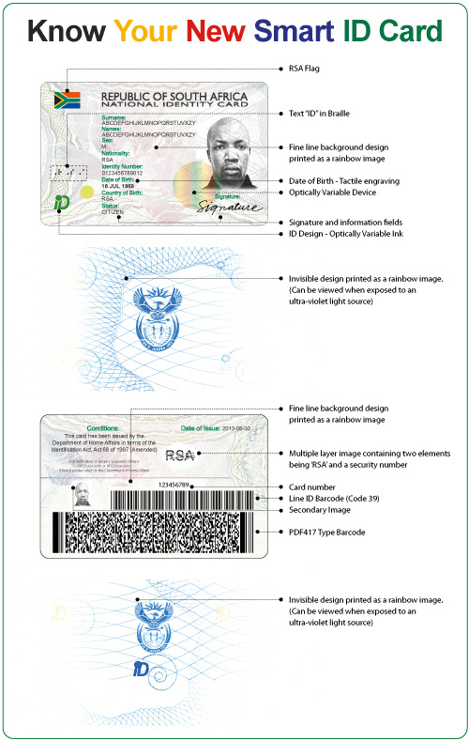
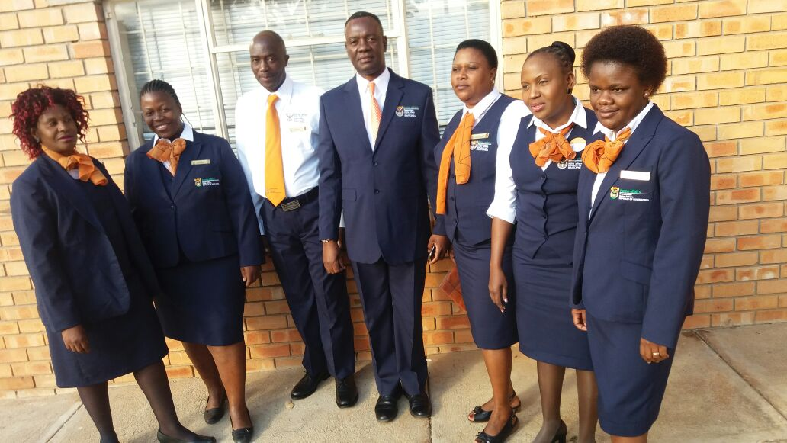
CIVIC SERVICES
11

Slide 12
SMART ID CARD OFFICES & APPLICATION VOLUME
Office | FLO | Target 2016/17 | Actual 2016/17 | Variance | Quarter 1 Target 2017/18 | Quarter 1 Actual 2017/18 | Variance
Nelspruit | 4 | 26,880 | 23,850 | 3,030 | 7,258 | 5,457 | 1,801
Barberton | 2 | 13,440 | 5,324 | 8,116 | 3,629 | 1,532 | 2,097
Komatipoort | 2 | 13,440 | 11,047 | 2,393 | 3,629 | 3,427 | 202
Mashishing | 3 | 20,160 | 13,835 | 6,325 | 5,443 | 3,596 | 1,847
Malelane | 1 | 6,720 | 10,620 | 3,900 | 1,814 | 3,023 | 1,209
Mhala | 5 | 33,600 | 14,310 | 19,290 | 9,072 | 3,541 | 5,531
White River | 2 | 13,440 | 13,830 | 390 | 3,629 | 3,390 | 239
Ehlanzeni District | 19 | 127,680 | 92,816 | 34,864 | 34,474 | 23,966 | 10,508
Witbank | 3 | 20,160 | 22,704 | 2,544 | 5,443 | 5,140 | 303
Belfast | 1 | 5,040 | 3,787 | 1,253 | 1,814 | 838 | 976
Middelburg | 3 | 20,160 | 16,677 | 3,483 | 5,443 | 3,436 | 2,007
Nkangala District | 7 | 45,360 | 43,168 | 2,192 | 12,701 | 9,414 | 3,287
12
Notes:
Districts

Slide 13
SMART ID CARD OFFICES & APPLICATION VOLUME
Office | FLO | Target 2016/17 | Actual 2016/17 | Variance | Quarter 1 Target 2017/18 | Quarter 1 Actual 2017/18 | Variance
Ermelo | 2 | 13,440 | 11,218 | 2,222 | 3,629 | 2,826 | 803
Carolina | 1 | 5,040 | 2,372 | 2,668 | 1,814 | 648 | 1,166
Bethal | 2 | 13,440 | 8,819 | 4,621 | 3,629 | 1,959 | 1,670
Eerstehoek | 2 | 13,440 | 6,819 | 6,621 | 3,629 | 3,785 | 156
Piet Retief | 2 | 13,440 | 10,209 | 3,231 | 3,629 | 2,490 | 1,139
Secunda | 2 | 10,080 | 8,683 | 1,397 | 3,629 | 2,107 | 1,522
Standerton | 2 | 10,080 | 7,637 | 2,443 | 3,629 | 1,549 | 2,080
Volksrust | 2 | 13,440 | 3,967 | 6,113 | 3,629 | 1,061 | 2,568
Gert Sibande District | 15 | 89,040 | 59,724 | 29,316 | 27,216 | 16425 | 10,791
Province | 41 | 262,080 | 195,708 | 66,372 | 74,390 | 49,805 | 24,585
13
Notes:
Districts

Slide 14
INTERVENTIONS TO ASSIST IN SMART ID CARD TARGET
Interventions
PERFORMANCE IMPROVEMENT PLAN: SMART ID CARD
STRATEGIES | ACTIONS PER STRATEGY | IMPACT / ANTICIPATED IMPACT
Stakeholder Forums | Standing item on agenda for meetings Stakeholder Forum program of action (IDP, ICROP), public /private collaboration to transport applicants to offices Working closely with SASSA on the lists of pensioners provided | Increase in applications for smart ID cards
Continued invitations to stakeholders / schools / businesses / private institutions | Written invitations Verbal invitations through presentations Social media | Improved performance
Marketing/Public Awareness | Source free media slots (print & electronic media, radio stations (local and provincial) Distribution of pamphlets/flyers/ & posters at strategic areas by Youth & Cadres as well as via Mobile Offices Exhibitions at local malls Market the product during community meetings with the assistance of Traditional Leadership and Ward Councillors | More clients visiting offices to apply for Smart ID Card
14

Slide 15
INTERVENTIONS TO ASSIST IN SMART ID CARD TARGET
Interventions
PERFORMANCE IMPROVEMENT PLAN: SMART ID CARD
STRATEGIES | ACTIONS PER STRATEGY | IMPACT / ANTICIPATED IMPACT
Operation Vuka Sisebente | To provide Provincial GCIS with promotional material for distribution to War Rooms. | More clients visiting offices to apply for Smart ID Card
15

Slide 16
SMART ID CARD FOOTPRINT AND ROLL OUT
District | Modernised Offices | Offices to be rolled out 2017/18
Ehlanzeni | Nelspruit | Hazyview
 | Barberton
 | Komatipoort
 | Mashishing
 | Malelane
 | Mhala
 | White River
Total | 7 | 1
Nkangala | Witbank
 | Belfast
 | Middelburg
Total | 3 | 0
16
Notes:
Indicate what is connected and what still need

Slide 17
SMART ID CARD FOOTPRINT AND ROLL OUT
District | Modernised Offices | Offices to be rolled out 2017/18
Gert Sibande | Ermelo
 | Carolina
 | Bethal
 | Eerstehoek
 | Piet Retief
 | Secunda
 | Standerton
 | Volksrust
Total | 8 | 0
Provincial Total | 18 | 1
17

Slide 18
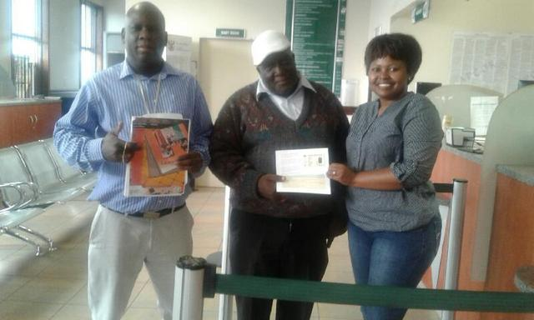
SMART ID CARD FOOTPRINT AND ROLL OUT
Analysis
In Ehlanzeni District 7 out of the 10 Local Offices (large and medium) have been Modernized. One office (Hazyview) will be modernised in 2017/18. The infrastructure at the two remaining offices (Mapulaneng and Nkomazi) are currently a challenge. Alternative accommodation has been identified at Nkomazi. As soon as the relevant processes have been finalised this office will be modernized. Alternative accommodation is being looked for at Mapulaneng
3 Out of the 7 Medium and Large offices in Nkangala District have been modernized. Infrastructure of the remaining 4 offices do not allow the offices to be modernised. Delmas office is in the process of being upgraded, Alternative accommodation has been identified for Kwa-Mhlanga and Siyabuswa.
All 7 Large and Medium offices in Gert Sibande District are modernised as well as 1 Small Office
First Smart ID Card handed out at Belfast
18

Slide 19
BIRTH REGISTRATION AT ONLINE HEALTH FACILITIES
District Municipality | Hospital | Personnel | Target 2016/17 | Actual 2016/17 | Variance | Annual Target 2017/18 | Quarter 1 Target 2017/18 | Quarter 1 2017/18 Actual | Variance
Ehlanzeni | Rob Ferreira | 1 | 1,089 | 840 | 249 | 787 | 262 | 273 | 11
 | Medi Clinic | Roaming | 1,699 | 1,634 | 65 | 1,589 | 427 | 422 | 5
 | Barberton | Roaming | 11 | 59 | 48 | 109 | 0 | 0 | 0
 | Matikwane | Roaming | 187 | 458 | 271 | 408 | 0 | 202 | 202
 | Lydenburg | 1 | 820 | 824 | 4 | 733 | 219 | 208 | 11
 | Matibidi | Roaming | 252 | 332 | 80 | 348 | 75 | 129 | 54
 | Sabie | Roaming | 269 | 113 | 156 | 127 | 72 | 0 | 72
 | Mapulaneng | Roaming | 270 | 13 | 257 | 0 | 0 | 1 | 1
 | Tintswalo | Roaming | 0 | 884 | 884 | 760 | 199 | 272 | 73
 | Tonga | Roaming | 1 | 45 | 44 | 0 | 0 | 49 | 49
 | Shongwe | Roaming | 0 | 0 | 0 | 0 | 0 | 0 | 0
 | Themba | Roaming | 1,879 | 390 | 1,489 | 108 | 3 | 462 | 459
Sub Total | 12 | 2 | 6,479 | 5,592 | 887 | 4,971 | 1,257 | 2,018 | 761
Nkangala | Witbank | Roaming | 498 | 4 | 494 | 2 | 2 | 0 | 2
 | Live Cosmos | Roaming | 4 | 0 | 4 | 0 | 0 | 0 | 0
 | HA Grove | Roaming | 0 | 0 | 0 | 0 | 0 | 0 | 0
 | Bernice Samuels | Roaming | 138 | 0 | 138 | 0 | 0 | 0 | 0
 | Kwa-Mhlanga | 1 | 351 | 0 | 351 | 0 | 0 | 1 | 1
19

Slide 20
BIRTH REGISTRATION AT ONLINE HEALTH FACILITIES
District Municipality | Hospital | Personnel | Target 2016/17 | Actual 2016/17 | Variance | Annual Target 2017/18 | Quarter 1 Target 2017/18 | Quarter 1 2017/18 Actual | Variance
 | Middelburg | 1 | 0 | 5 | 5 | 1 | 1 | 0 | 1
 | Vlaklaagte | Roaming | 0 | 0 | 0 | 0 | 0 | 0 | 0
 | Siyabuswa Clinic | Roaming | 0 | 0 | 0 | 0 | 0 | 0 | 0
 | Mmamehlake | Roaming | 0 | 1 | 1 | 0 | 0 | 0 | 0
Sub Total | 9 | 2 | 991 | 10 | 981 | 3 | 3 | 1 | 2
Gert Sibande | Ermelo | Roaming | 356 | 320 | 36 | 269 | 97 | 39 | 58
 | Carolina | Roaming | 38 | 0 | 38 | 0 | 0 | 0 | 0
 | Bethal | Roaming | 250 | 450 | 200 | 439 | 52 | 137 | 85
 | Embuleni | Roaming | 158 | 0 | 158 | 0 | 0 | 60 | 60
 | Piet Retief | Roaming | 141 | 304 | 163 | 228 | 62 | 140 | 78
 | Trichard (Highveld Medi Clinic) | Roaming | 787 | 607 | 180 | 643 | 163 | 128 | 35
 | Evander | Roaming | 110 | 52 | 58 | 45 | 9 | 8 | 1
 | Standerton | Roaming | 238 | 13 | 225 | 13 | 0 | 34 | 34
 | Elsie Ballot | 1 | 0 | 0 | 0 | 0 | 0 | 0 | 0
 | Amajuba | Roaming | 0 | 0 | 0 | 0 | 0 | 0 | 0
Sub Total | 10 | 1 | 2,079 | 1,746 | 333 | 1,637 | 383 | 546 | 163
Province | 31 | 5 | 9,549 | 7,348 | 2,201 | 6,611 | 1,643 | 2,565 | 922
20

Slide 21
BIRTH REGISTRATION AT HEALTH FACLITIES
Analysis
There are 31 health facilities in Mpumalanga that are / were connected. Currently 15 are functional, but some challenges are still being experienced. 16 Health Facilities are not functional.
District | Number of Health Facilities | Number Functional
Ehlanzeni District | 12 | 9
Nkangala District | 9 | 0
Gert Sibande District | 10 | 6
Total | 31 | 15
21

Slide 22
OFFICE BIRTH STATISTICS
District Municipality | Offices | Personnel | Target 2016/17 | Actual 2016/17 | Annual 2017/18 | Quarter 1 Target 2017/18 | Quarter 1 2017/18 Actual
Ehlanzeni | 24 | 26 | 25,837 | 25,201 | 26,594 | 6,928 | 6,238
Nkangala | 18 | 19 | 14,904 | 15,290 | 15,444 | 3,948 | 4,152
Gert Sibande | 22 | 18 | 11,966 | 12,499 | 12,749 | 3,266 | 3,297
TOTAL | 64 | 63 | 52,707 | 52,990 | 54,787 | 14,142 | 13,687
Offices include: Large, Medium and Small Offices
OFFICES AND HEALTH FACILITIES: BIRTH STATISTICS
District Municipality | Target 2016/17 | Actual 2016/17 | Annual Target 2017/18 | Quarter 1 Target 2017/18 | Quarter 1 2017/18 Actual
Ehlanzeni | 32,315 | 30,793 | 31,565 | 8,185 | 8,256
Nkangala | 15,895 | 15,297 | 15,447 | 3,951 | 4,153
Gert Sibande | 14,046 | 14,248 | 14,386 | 3,649 | 3,843
TOTAL | 62,256 | 60,338 | 61,398 | 15,785 | 16,252
22

Slide 23
INTERVENTIONS IDENTIFIED ON BIRTH REGISTRATION TARGET
Interventions
PERFORMANCE IMPROVEMENT PLAN: BIRTHS
STRATEGIES | ACTIONS PER STRATEGY | IMPACT / ANTICIPATED IMPACT
Stakeholder forums | Standing point on agenda | Increase in birth registration within 30 days Reducing LRB’s Awareness and understanding by communities about the stringent measures that were implemented for LRB’s
Distribution and displaying of pamphlets | Distribution at taxi ranks, shops, malls, imbizo’s, meetings, schools etc by officials and Mobile Offices | Increase in birth registration within 30 days Reducing LRB’s
To engage with local radio station in order to assist with slots to inform clients about the importance of birth registration within 30 days. | Approach GCIS to provide schedule/ radio slots. | Communicate directly with local communities to encourage compliance with the Birth registration policy and other DHA services.
23
Notes:
Offices
Online scanners
adsl

Slide 24
INTERVENTIONS IDENTIFIED ON BIRTH REGISTRATION TARGET
Interventions
PERFORMANCE IMPROVEMENT PLAN: BIRTHS
STRATEGIES | ACTIONS PER STRATEGY | IMPACT / ANTICIPATED IMPACT
Provide requirements list to all clinics in the area to give to prospective mothers on what to bring when registering their children. | Hold Meetings with sisters in charge Establish registers in all clinics | Mothers providing required documentation for the registration of the birth within 30 days.
Installation of ADSL lines | Continue with the installation | Register birth and issue birth certificate immediately at the health facility. Reduction of clients for birth registration within 30 in offices
Operation Vuka Sisebente | To provide Provincial GCIS with promotional material for distribution to War Rooms. | Increase in birth registration within 30 days Reducing LRB’s
24
Notes:
Offices
Online scanners
adsl

Slide 25
LATE REGISTRATION OF BIRTH –ALL CATEGORIES
Category | 2016/17
 | Opening 01/04/2016 | Application received | Total applications 2016/17 | Approved | Deferred | Rejected | Files closed | Closing 31/3/2017
1 – 7 Years | 765 | 2,840 | 3,605 | 2,655 | 30 | 30 | 181 | 739
7 – 14 Years | 145 | 468 | 613 | 405 | 17 | 7 | 44 | 157
15 and Above | 303 | 1,473 | 1,776 | 763 | 152 | 159 | 240 | 614
Total | 1,213 | 4,781 | 5,994 | 3,823 | 199 | 196 | 465 | 1,510
Category |  | Quarter 1 2017/18 |  |  |  |  |  | Closing Balance Quarter 1 2017/18
 | Opening 01/04/2017 | Application received | Total applications Q1 2017/18 | Approved | Deferred | Rejected | Files closed
1 – 7 Years | 739 | 754 | 1,493 | 500 | 24 | 3 | 31 | 959
7 – 14 Years | 157 | 112 | 269 | 109 | 9 | 2 | 4 | 154
15 and Above | 614 | 416 | 1,030 | 386 | 60 | 43 | 53 | 548
Total | 1,510 | 1,282 | 2,792 | 995 | 93 | 48 | 88 | 1,661
Files closed: Applicant has been invited for interview (x3). Did not show up
25

Slide 26
MOBILE OFFICE INFORMATION
2016/17
Drivable Yes/No | Functional Yes/No | Staff Capacity | KM travelled | Total area visits | Statistics generated for 2016/17
6 – Yes 5 - No | 4 – Yes 7 - No | 12 Mobile Managers (1 is utilised as the Mobile Office Co-ordinator) | 5,927 | 97 | ID First issue | 901
 |  |  |  |  | ID Re-Issue | 36
 |  |  |  |  | Birth Registration 0 -30 days | 203
 |  |  |  |  | ID’s handed out | 321
11 | 11 | 12 | 5,972 | 97 | TOTAL APPLICATIONS 1,140
Quarter 1 2017/18
Drivable Yes/No | Functional Yes/No | Staff Capacity | KM travelled | Total area visits | Statistics generated for Quarter 1 2017/18
10 – Yes 1 - No | 4 – Yes 7 - No | 12 Mobile Managers (1 is utilised as the Mobile Office Co-ordinator) | 13,294 | 129 | ID First issue | 1,309
 |  |  |  |  | ID Re-Issue | 158
 |  |  |  |  | Birth Registration 0 -30 days | 78
 |  |  |  |  | ID’s handed out | 328
11 | 11 | 12 | 13,294 | 129 | TOTAL APPLICATIONS 1,545
26

Slide 27
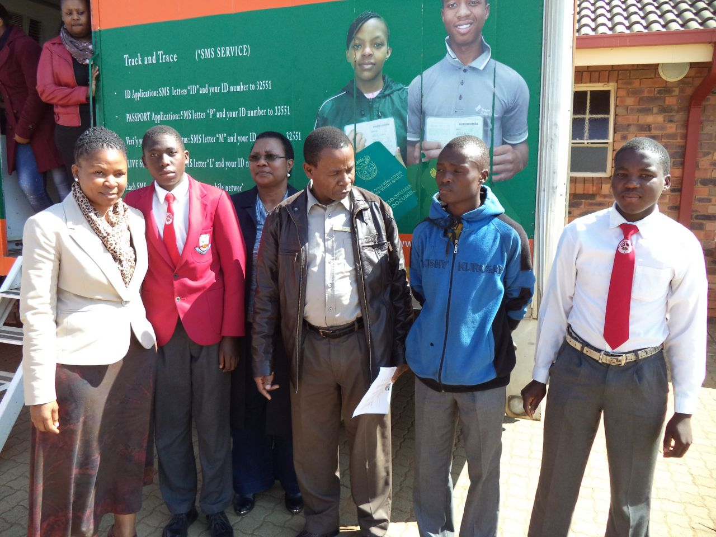
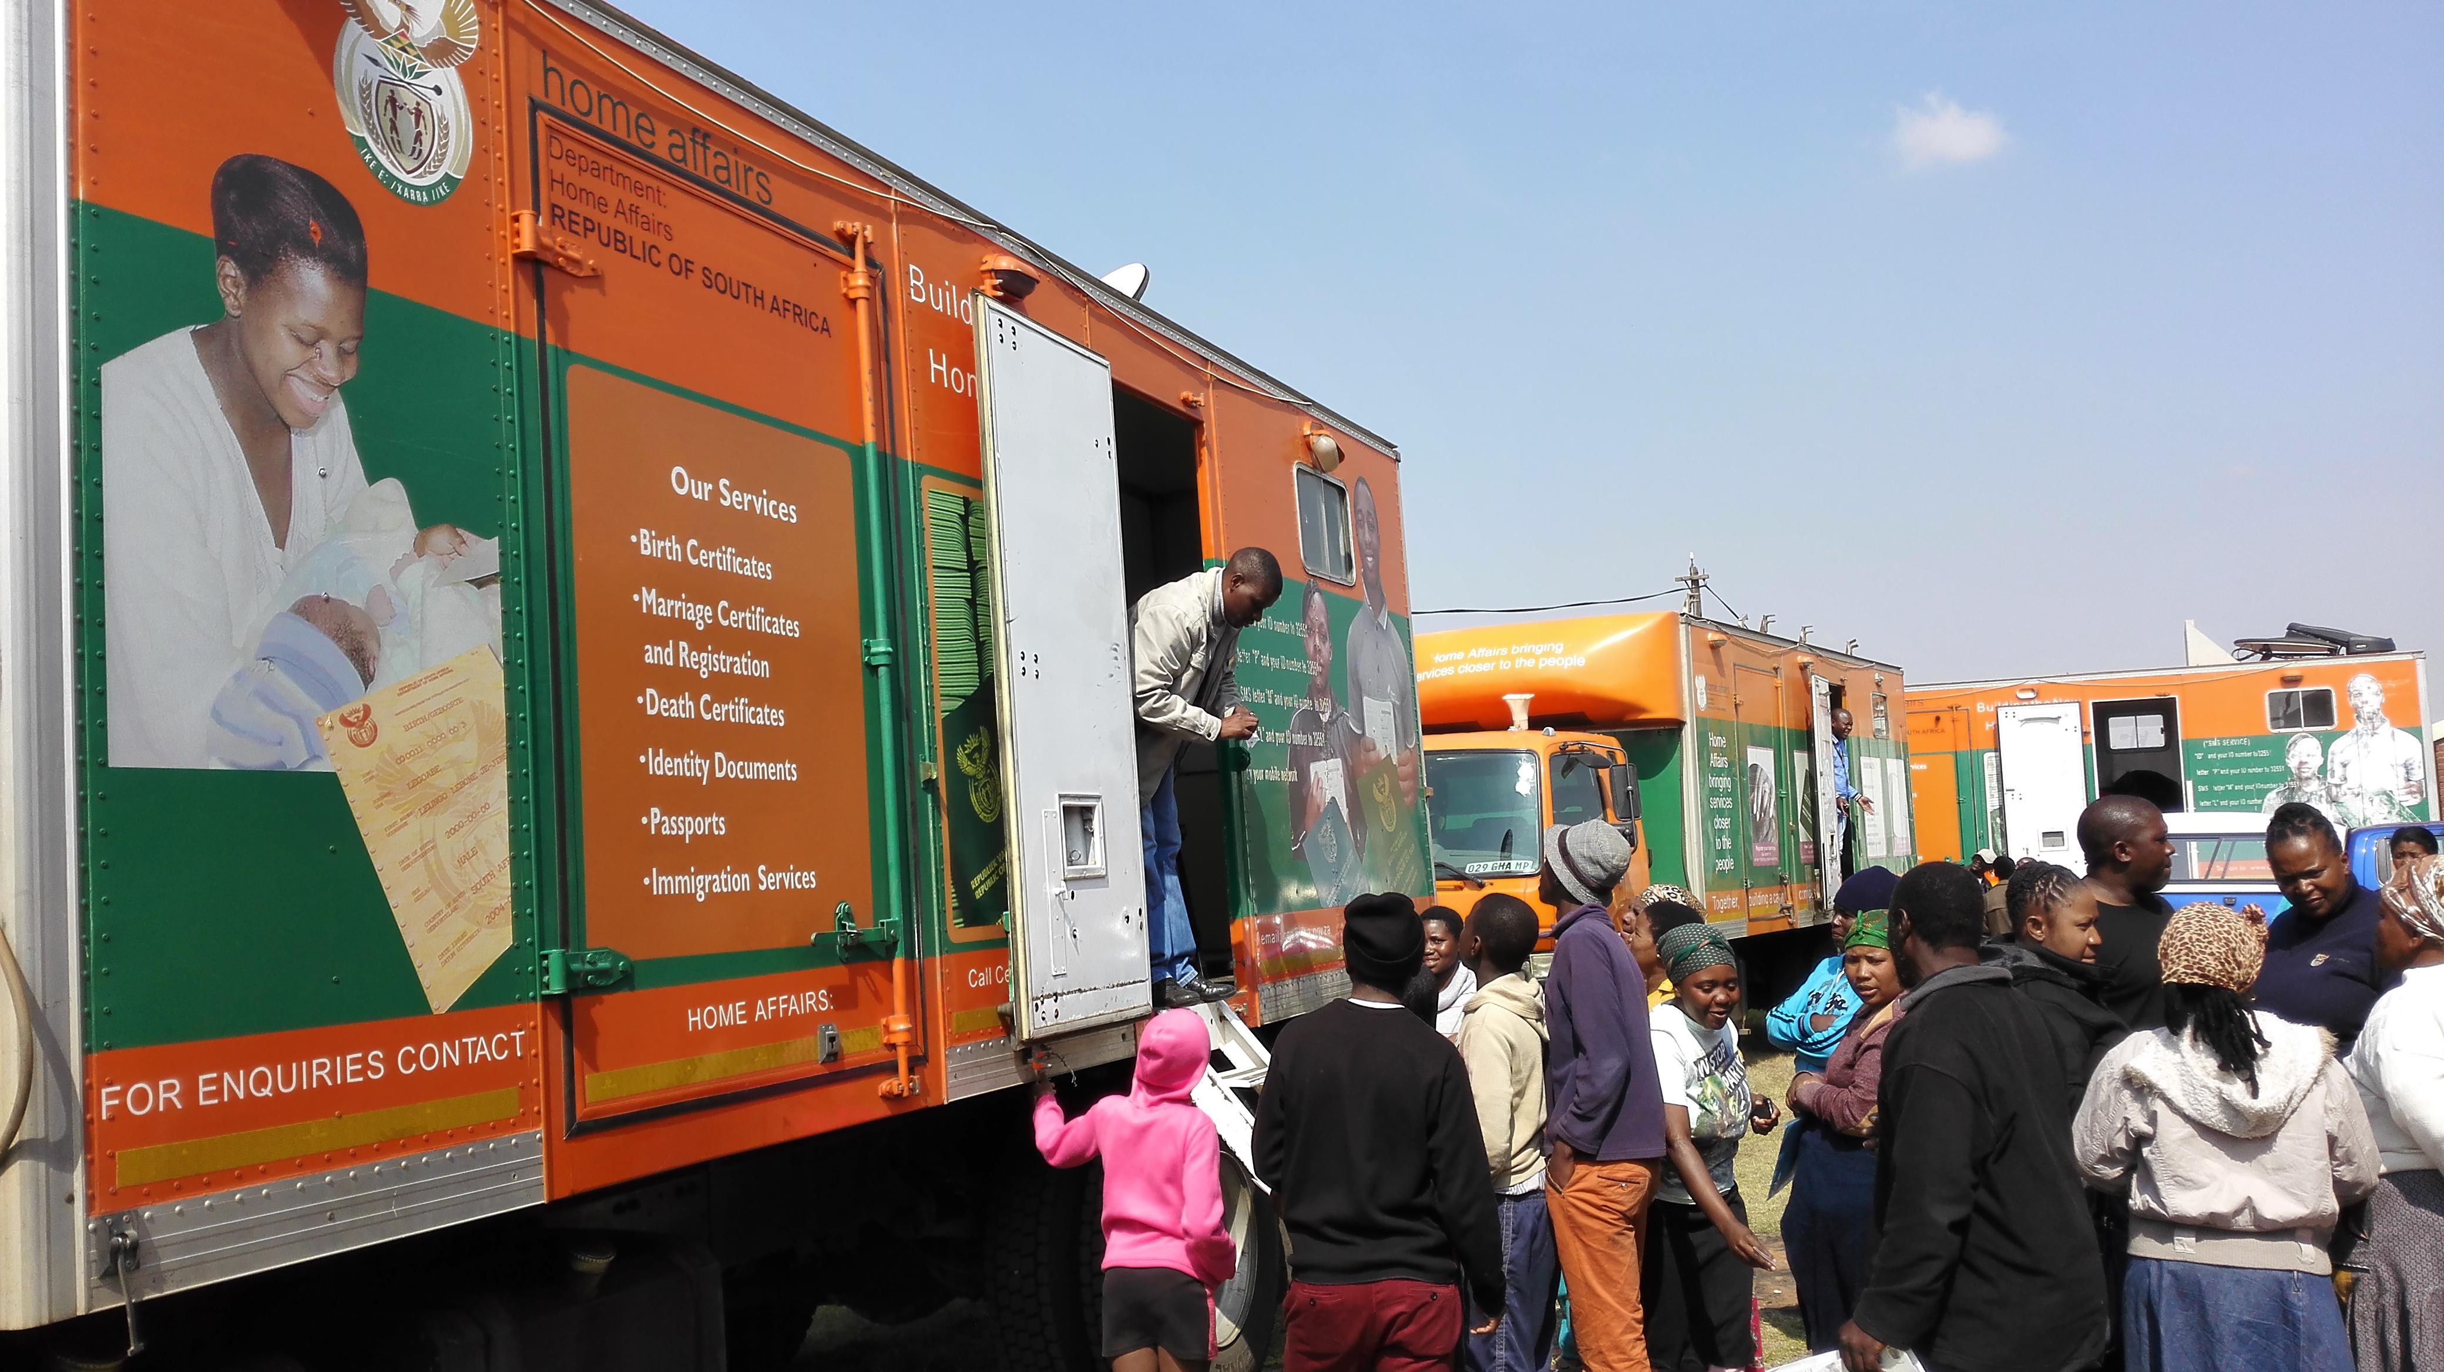
27

Slide 28
UNCOLLECTED SMART ID CARDS as at 30 June 2017
Office | Total | Strategies and awareness to communities
Nelspruit | 996 | Lists compiled and submitted to CDW’s. Discussed during Stakeholder forum meetings as well as mentioned in all other meetings that are attended. Schools are informed. Media slots
Barberton | 272
Komatipoort | 749
Mashishing | 845
Malelane | 271
Mhala | 802
White River | 734
Witbank | 754
Belfast | 186
Middelburg | 934
Ermelo | 637
Carolina | 156
Bethal | 486
Eerstehoek | 920
Piet Retief | 570
Secunda | 299
Standerton | 303
Volksrust | 184
TOTAL | 10,098
28

Slide 29
UNCLAIMED ID’S as at 30 June 2017
Total | Strategies to distribute
3,362 | Mobile Offices assist with distribution Lists compiled and submitted to CDW’s. Discussed during Stakeholder forum meetings as well as mentioned in all other meetings that are attended. Media slots Door to door delivery
29

Slide 30
UNABRIDGED CERTIFICATES
2016/17
Opening 1 April 2016 | Number Received | Total number for 2016/17 | Number Finalised | Number of Equivalent letters issued | Number of applications older than 8 weeks (31/03/2017) | Closing balance 2016/17
5,892 | 5,373 | 11,265 | 5,113 | 1,072 | 4,153 | 1,999
Quarter 1 2017/18
Opening Balance 1 April 2017 | Number received | Total number Q1 2017/18 | Number Finalised | Number of Equivalent letters issued | Number of applications older than 8 weeks | Closing Balance Quarter 1 2017/18
5,316 | 2,750 | 8,066 | 2,248 | 273 | 2,289 | 3,529
30
Notes:
Statistics duplicates
Change the slide
comment

Slide 31
AMENDMENTS , RECTIFICATIONS AND DUPLICATES
2016/17
Service | Opening Balance 1 April 2016 | Number received | Total | Number Finalised | Closing balance
Amendments & Rectifications | 2,389 | 4,288 | 6,677 | 2,911 | 3,766
Duplicates | 508 | 1091 | 1,599 | 694 | 905
Quarter 1 2017/18
Service | Opening Balance 1 April 2017 | Number received | Total | Number Finalised | Closing balance
Amendments & Rectifications | 3,766 | 1,592 | 5,358 | 990 | 4,368
Duplicates | 905 | 361 | 1,266 | 246 | 1,020
31
Notes:
Statistics duplicates
Change the slide
comment

Slide 32
STAKEHOLDER FORUMS
Forum | Forum Established | Meetings After Launch | Active programs within Municipalities
Provincial Stakeholder Forum | 01/03/2017 | 05/05/2017
Ehlanzeni District Forum | Maintained | 08/11/2016 29/11/2016 02/12/2016 31/03/2017 23/07/2017
City of Mbombela | 24/11/2016 | 03/12/2016 | ICROP
Bushbuckridge | 25/11/2016 | 23/03/2017 | ICROP, Mayoral Imbizo
Nkomazi Local | 29/11/2016 | 07/12/2016 15/03/2017 21/06/2017 | ICROP, IEC Meetings, community meetings Smart ID card mobilization
Thaba-Chweu | 23/11/2016 | 27/07/2017 | ICROP; Birth registration, ID awareness
32

Slide 33
STAKEHOLDER FORUMS
Forum | Forum Established | Meetings After Launch | Active programs within Municipalities
Nkangala District Forum | 09/03/2017
Emalahleni | 18/11/2016 | 31/05/2017
Emakhazeni | 13/10/2016 | 8/02/2017 16/05/2017 | ICROP
Thembisile Hani | 09/03/2017 | None | ICROP
Steve Tswete | 14/02/2017 | 21/06/2017
Dr JS Moroka | 06/12/2016 | 27/01/2017 16/02/2017 23/03/2017 14/06/2017 28/06/2017 | IDP, ICROP
Victor Khanye | 23/11/2016 | None | ICOP
33

Slide 34
STAKEHOLDER FORUMS
Forum | Date Forum Established | Dates of Meetings After Launch | Active programs within Municipalities
Gert Sibande District | 25/11/2016 | None (Meeting was scheduled for February 2017 – Speaker was unfortunately not available)
Pixley Ka Seme | 01/11/2016 | None | None
Lekwa | 07/02/2012 | 18/02/2016; 14/06/2016 09/11/2016; 14/03/2017 | ICROP
Msukaligwa | 03/11/2016 | 17/2/2017 (meeting cancelled due to no quorum) 26/5/2017 (Meeting cancelled due to non availability of chair and vice chair person) | All war room attended by office for project : Operation Vuka Sisebente ( Stakeholders present at these meetings)
Chief Albert Luthuli | 22/03/2017 | 11/07/2017 | ICROP; Awareness on ID Smart Card and 0-30 days application
Mkhondo | 10/11/2016 | 13/02/2017 09/05/2017 04/06/2017
Dipaliseng | 08/03/2017 | None | ICROP
Govan Mbeki | 25/01/2017 | 07/06/2017 | ICROP
34

Slide 35
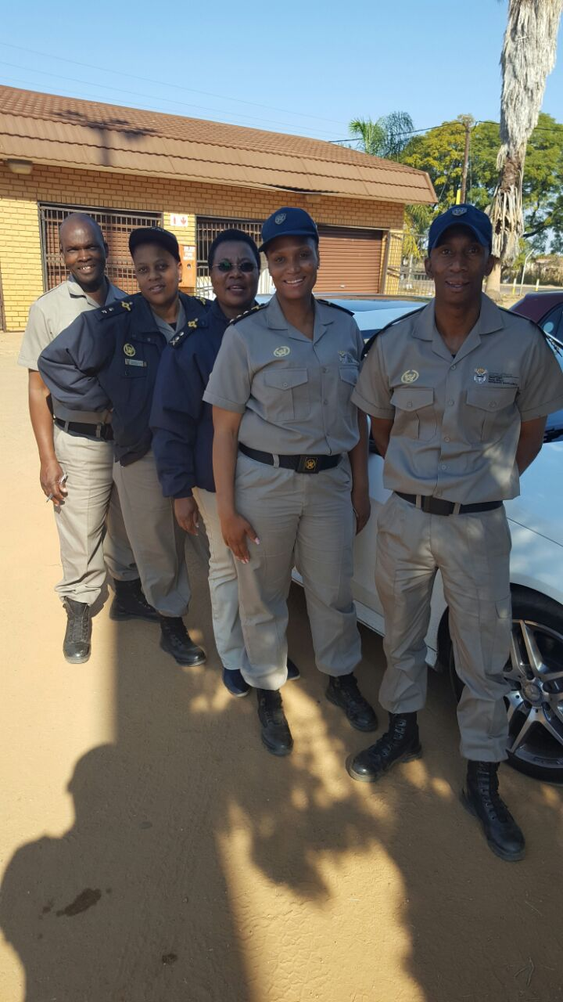
IMMIGRATION
35

Slide 36
IMMIGRATION SERVICES
Key performance area | Target 2016/17 | Actual 2016/17 | Quarter 1 Target 2017/18 | Quarter 1 2017/18 Actual
% Of detected employers in contravention of the Immigration Act (Act 13 of 2002) charged | 100% | 100% (47/47) | 100% | 120% (12/10)
% Of detected transgressors in contravention of the Immigration Act (Act 13 of 2002) charged | 100% | 100% (1,593/1,539) | 100% | 511% (450)
% Of undocumented foreigners deported within 30 calendar days (Direct Deportations) | 100% | 100% (2,912/2,912) | 100% | 100% (472/427)
% Of Detected undocumented foreigners transferred to Lindela within 20 calendar days | 100% | 100% (187/187) | 100% | 100% (56/56)
% of Detected fraudulent marriages & marriage of convenience cases finalised (investigation and recommendation submitted) within 60 days | 80% | 100% (79/79) | 80% | 120% (12/10)
Cases referred to inspectorate % of cases referred to Inspectorate completed in 28 working days in provinces | 80% within 28 days | 95% (3,002/3,149) | 80% within 28 days | 92% (519/564)
General inspection of businesses: Number of inspections of businesses | 808 | 980 | 202 (annual target: 808) | 436
36
Notes:
Ask here about orders to leave and Letter of good cause

Slide 37
IMMIGRATION SERVICES CONTINUE
 | 2016/2017 |  |  | Quarter 1 2017/2018
Service | Number received | Number approved and issued | Number rejected | Number received | Number approved and issued | Number rejected
Orders to Leave | 145 | 145 | n/a | 143 | 143 | n/a
Letters of Good Cause | 502 | 482 | 20 | 154 | 90 | 64
Service | Opening Balance 01/07/2017 | Number received until 31/07/2017 | Number confirmed by court | Comments
Court Ruling Section 34 (1) (Illegal Foreigners in detention) | 64 | 359 | 335 | Cases confirmed by Magistrate within 48 hours (difference of 24 : still to appear before Magistrate)
37
Notes:
Ask here about orders to leave and Letter of good cause

Slide 38
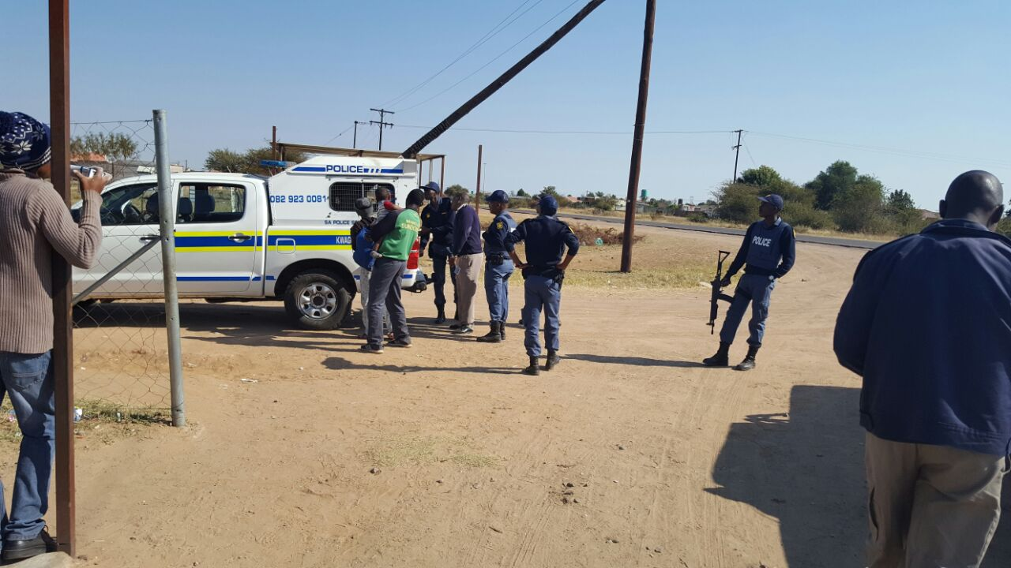
IMMIGRATION SERVICES CONTINUE
OPERATIONS
 | 2016/17 |  |  |  | Quarter 1 2017/18
Type of operation | Number of operations | Transgressors | Employers | Deportation Transfers | Number of operations | Transgressors | Employers | Deportation Transfers
Fiela II Thunderstorm Road Blocks Farm Inspections Cross Border Basadi Arrive Alive Festive Season | 112 | 991 | 38 | 628 | 33 | 373 | 10 | 210
38
Notes:
Ask here about orders to leave and Letter of good cause

Slide 39
CASES WITHDRAWN BY COURT
2016/2017 |  |  |  | Quarter 1 2017/18
Number of Cases withdrawn | Country of Origin | Reasons for withdrawal | After withdrawal what was the role of DHA | Number of Cases withdrawn | Country of Origin | Reasons for withdrawal | After withdrawal what was the role of DHA
108 | Mozambique India Pakistan Zimbabwe Malawi Tanzania Swaziland Somalia Ethiopia Bangladesh Cameroon | No proof of ownership of the business. No interpreter Valid documentation produced Insufficient evidence Asylum Seekers Minor Prosecutor indicated she was not informed about the operation and released all detainees | Order to report at refugee office. Minors were handed to social services Orders to leave issued Matter was reported to the detective branch Commander to look into Matter escalated to the Judicial Magistrate | 32 | Malawi Bangladesh Ethiopia Mozambique | Asylum Seekers Area of Jurisdiction | Order to report at refugee office. Orders to leave issued Matter was reported to the detective branch Commander to look into Matter escalated to the Judicial Magistrate
39
Notes:
Ask here about orders to leave and Letter of good cause

Slide 40
EMPLOYERS CHARGED
District | 2016/2017
 | Number of Employers Charged | Transgression | Outcome of Cases
Ehlanzeni | 36 | Employing illegal immigrants Sec 49 (3) | 28 x Admission of guild paid: R43,900 4 x Cases withdrawn 1 x Case struck from roll due to area of jurisdiction 1 x Lawyer produced documents to prove that accused is not the director of the company and is therefore not responsible for employing illegal Foreigners. 1 x Docket missing (Detectives) 1 x Judge indicated that there is no proof that illegal foreigners found in truck are working for company
Nkangala | 1 | Employing illegal immigrants Sec 49 (3) | Case postponed
Gert Sibande | 10 | Employing illegal immigrants Sec 49 (3) Aiding and abetting | 6 x Admission of guild paid: R5,800 1 x Case withdrawn 2 x Pending case 1 x Suspended sentence
TOTAL | 47
40
Notes:
Ask here about orders to leave and Letter of good cause

Slide 41
EMPLOYERS CHARGED
District | Quarter 1 2017/18
 | Number of Employers Charged | Transgression/s | Outcome of Cases
Ehlanzeni | 8 | Employing illegal immigrants Sec 49 (3) | 5 x Admission of Guild fines paid: R10,000 2 x Postponed 1 x Further investigation
Nkangala | 3 | Employing illegal immigrants Sec 49 (3) | 1 x Admission of Guild fines paid: R500 1 x Postponed 1 x Withdrawn due to insufficient evidence
Gert Sibande | 1 | Employing illegal immigrants Sec 49 (3) | Employer still to appear
TOTAL | 12
41
Notes:
Ask here about orders to leave and Letter of good cause

Slide 42
HUMAN RESOURCE MANAGEMENT
42

Slide 43
CAPACITY LEVELS
Districts | Offices | Establishment | Filled | Interns | Funded & Vacant
 | Provincial Office | 21 | 20 | 12 | 3 (PM and 2 Interns)
Ehlanzeni | DMO Ehlanzeni | 6 | 6 |  | 0
 | Nelspruit | 47 | 47 |  | 0
 | Civic Centre | 2 | 2 |  | 0
 | Kanyamazane | 1 | 1 |  | 0
 | Barberton | 9 | 8 |  | 1 (Level 10)
 | Hazyyview | 19 | 18 |  | 1 (Level 6)
 | Oakley | 1 | 1 |  | 0
 | Malelane | 8 | 7 |  | 1 (Level 10)
 | Komatipoort | 16 | 16 |  | 0
 | Matsulu | 1 | 1 |  | 0
 | Mashishing | 16 | 16 |  | 0
 | Sabie | 3 | 3 |  | 0
 | Mapulaneng | 8 | 8 |  | 0
 | Casteel | 2 | 2 |  | 0
 | Mhala | 24 | 24 |  | 0
 | Nkomazi | 18 | 17 |  | 1 (Level 6)
 | Mgobodzi | 1 | 1 |  | 0
 | Matsamo | 3 | 3 |  | 0
 | White River | 15 | 15 |  | 0
 | Kabokweni | 2 | 2 |  | 0
Sub Total |  | 202 | 198 | 0 | 4 (excluding 2 interns)
43
Notes:
Change structure to establishment

Slide 44
CAPACITY LEVELS
Districts | Offices | Establishment | Filled | Interns | Funded & Vacant
Nkangala | DMO:Nkangala | 3 | 3 |  | 0
 | Witbank | 47 | 44 |  | 1 (Level 8) 1 (Level 6) 1 (Level 7)
 | Kriel | 1 | 1 |  | 0
 | Delmas | 7 | 6 |  | 1 (Level 10)
 | Belfast | 7 | 5 |  | 2 (Level 6)
 | Kwa-Mhlanga | 19 | 19 |  | 0
 | Middelburg | 21 | 21 |  | 0
 | Mkobola | 11 | 9 |  | 1 (Level 10) 1 (Level 6)
 | Verena | 2 | 2 |  | 0
 | Siyabuswa | 14 | 14 |  | 0
 | Mbibane | 2 | 2 |  | 0
 | Mmamehlake | 1 | 1 |  | 0
 | Marapyane | 2 | 2 |  | 0
Sub Total |  | 137 | 129 | 0 | 8
44
Notes:
Change structure to establishment

Slide 45
CAPACITY LEVELS
Districts | Offices | Establishment | Filled | Interns | Funded & Vacant
Gert Sibande District | DMO: Gert Sibande | 1 | 1 |  | 0
 | Ermelo | 26 | 25 |  | 1 (Level 7)
 | Carolina | 4 | 2 |  | 2 (Level 6)
 | Bethal | 12 | 09 |  | 1 (Level 8) 2 (Level 7)
 | Eerstehoek | 17 | 17 |  | 0
 | Mpuluzi | 1 | 0 |  | 1 (Level 6)
 | Piet Retief | 15 | 15 |  | 0
 | Secunda | 13 | 13 |  | 0
 | Balfour | 2 | 2 |  | 0
 | Tholulwazi | 2 | 2 |  | 0
 | Standerton | 8 | 8 |  | 0
 | Thuthukani | 1 | 1 |  | 0
 | Volksrust | 7 | 7 |  | 0
Sub Total |  | 109 | 102 | 0 | 7
Provincial Total |  | 469 | 449 | 12 | 20 2 Interns
45
Notes:
Change structure to establishment

Slide 46
CAPACITY LEVELS
SUMMARY OF PROVINCE (as at 31 July 2017)
Area | Establishment | Filled | Vacant
Civic Affairs | 337 | 320 | 17
Immigration Inspectorate | 74 | 72 | 2
DMO Structure | 10 | 10 | 0
Support Services | 48 | 47 | 1
Interns | 14 | 12 | 2
Total | 483 | 461 | 22
46
Notes:
Change structure to establishment

Slide 47
DETAILS OF ADVERTISED POSTS
Post | Date advertised | Circular | Short listed | Interviewed | Offer letter issued (Y / N)
Chief Administration Clerk (Bethal) | 3 March 2017 | HRMC 21/17/7L | 10 May 2017 | 13 June 2017 | No, awaiting HO to give go ahead with extending of letters
Administration Clerk (Mpuluzi) | 3 March 2017 | HRMC 21/17/9NN | 11 May 2017 | 15 June 2017 | No, awaiting HO to give go ahead with extending of letters
Administration Clerk (Witbank) | 11 July 2017 | HRMC 47/17/16t | Capturing of applications | Capturing of applications | N/A
Senior Administrative Officer (Witbank) | 3 March 2017 | HRMC 21/17/4B | Awaiting re-advertising | Awaiting re-advertising | N/A
ASD Local Office Manager (Malelane) | 3 March 2017 | HRMC 21/17/1o | 12 May 2017 | 05 June 2017 | No, awaiting HO to give go ahead with extending of letters
ASD Local Office Manager (Mkobola) | 3 March 2017 | HRMC 21/17/1P | 12 May 2017 | 07 June 2017 | No, awaiting HO to give go ahead with extending of letters
47
Notes:
Change structure to establishment

Slide 48
DETAILS OF ADVERTISED POSTS
Post | Date advertised | Circular | Short listed | Interviewed | Offer letter issued (Y / N)
Local Office Manager (Delmas) | 3 March 2017 | HRMC 21/17/1N | 12 May 2017 | 06 June 2017 | No, awaiting HO to give go ahead with extending of letters
Front Office Clerk (Carolina) 2 Posts | 3 March 2017 | HRMC 21/17/9MM | 10 May 2017 | 14 June 2017 | No, awaiting HO to give go ahead with extending of letters
Front Office Clerk (Belfast) 2 Posts | 3 March 2017 | HRMC 21/17/9LL | 10 May 2017 | 20 June 2017 | No, awaiting HO to give go ahead with extending of letters
ASD Local Office Manager (Barberton) | 19 May 2017 | HRMC 39/17/1a | Not shortlisted yet | Not interviewed yet | N/A
Chief Administration Clerk (Ermelo) | 19 May 2017 | HRMC 39/17/5 | Not shortlisted yet | Not interviewed yet | N/A
48
Notes:
Change structure to establishment

Slide 49
DETAILS OF ADVERTISED POSTS
Post | Date advertised | Circular | Short listed | Interviewed | Offer letter issued (Y / N)
Front Office Clerk (Mkobola) | 19 May 2017 | HRMC 39/17/6h | Not shortlisted yet | Not interviewed yet | N/A
Immigration Officers (Hazyview) | 19 May 2017 | HRMC 39/17/8a | Not shortlisted yet | Not interviewed yet | N/A
Immigration Officer (Nkomazi) | 19 May 2017 | HRMC 39/17/8b | Not shortlisted yet | Not interviewed yet | N/A
49
Notes:
Change structure to establishment

Slide 50
PROVINCIAL EQUITY
Per salary level | AFRICAN |  |  | COLOURED |  |  | INDIAN |  |  | WHITE |  |  | PEOPLE WITH DISABILITY | GRAND TOTAL
 | FEMALE | MALE | TOTAL | FEMALE | MALE | TOTAL | FEMALE | MALE | TOTAL | FEMALE | MALE | TOTAL
Province | 245 | 190 | 435 | 6 | 0 | 6 | 2 | 0 | 2 | 10 | 8 | 18 | 18 | 461
Demographic targets | 42.1% | 51.0% |  | 0.1% | 0.2% |  | 0.1% | 0.6% |  | 2.5% | 3.5% |  | 2.0% | 100%
Percentage Representation | 53.1% | 41.2% |  | 1.3% | 0.0 |  | 0.4% | 0.0 |  | 2.2% | 1.7% |  | 3.9% | 100%
3 | 16 | 7 | 23 | 1 |  | 1 |  |  |  |  |  |  | 1 | 24
5 | 7 | 5 | 12 |  |  |  |  |  |  |  |  |  | 3 | 12
6 | 157 | 100 | 257 | 2 |  | 2 |  |  |  | 2 | 1 | 3 | 9 | 262
7 | 28 | 33 | 61 | 2 |  | 2 |  |  |  | 5 | 1 | 6 | 2 | 69
8 | 13 | 22 | 35 | 1 |  | 1 | 1 |  | 1 | 2 | 4 | 6 | 2 | 43
9 | 1 | 1 | 2 |  |  |  | 1 |  | 1 |  |  |  | 1 | 3
10 | 14 | 11 | 25 |  |  |  |  |  |  |  | 1 | 1 |  | 26
11 | 1 | 1 | 2 |  |  |  |  |  |  |  |  |  |  | 2
12 | 1 | 2 | 3 |  |  |  |  |  |  | 1 | 1 | 2 |  | 5
13 | 2 | 1 | 3 |  |  |  |  |  |  |  |  |  |  | 3
14
(Interns) | 5 | 7 | 12 |  |  |  |  |  |  |  |  |  |  | 12
50

Slide 51
PEOPLE MANAGEMENT AND PERFORMANCE
PMDS: Status
People management | Achievement | Status summary
Performance agreements signed (2017/18) | 99% | 3 outstanding Performance Agreements Reasons: Cross Transfer – official not on MP establishment yet. Agreement was done but not captured Official on Sick Leave (TIL submitted) Dispute – escalated to Labour Relations
Moderation (2016/17) | All Districts have been assessed. Outstanding are PM’s office. Proposed dates for finalisation of bonus cases: 24 – 25 August 2017. Due date for moderation: 31 August 2017
51

Slide 52
PEOPLE MANAGEMENT AND PERFORMANCE
Analysis of staff patterns: Policy on Incapacity Leave & Ill-health Retirement
 | 2016/17 |  |  |  | 2017/18
Salary Levels | Total days | Number of Employees on PILIR | Number of PILIR applications | Average days per employee | Total days | Number of Employees on PILIR | Number of PILIR applications | Average days per employee
(13-16) | 0 | 0 | 0 | 0 | 0 | 0 | 0 | 0
(9-12) | 127 | 1 | 1 | 127 | 59 | 2 | 2 | 29.5
(6-8) | 536 | 15 | 33 | 35.7 | 300 | 9 | 21 | 33.33
(3-5) | 0 | 0 | 0 | 0 | 49 | 3 | 3 | 16.33
TOTALS | 663 | 16 | 34 | 41.44 | 408 | 14 | 26 | 29.14
52

Slide 53
SKILLS OVERVIEW
Highest Qualification | Total Number | % Total
Below matric | 24 | 5.35%
Grade 12/FET | 248 | 55.23%
National Diploma | 131 | 29.18%
Degree | 42 | 9.35%
Post Grad Diploma | 2 | 0.45%
Honours | 1 | 0.22%
Masters | 1 | 0.22%
Ph. D
Post Grad Degree
Total | 449 | 100%
53

Slide 54
BURSARY INFORMATION
District | Total | Course
Ehlanzeni | 9 | B-Tech Public Management Masters in Business Administration Masters in Public Management Bachelor in Commence Public Administration ND: Public Relations Management
Nkangala | 2 | B-Admin BCOM Business administration
Gert Sibande | 3 | Post graduate in HR Communication Science Masters in Business Leadership
TOTAL | 14
54

Slide 55
SKILLS DEVELOPMENT
Training Intervention | Number attending
Induction training | 21
Induction training to Cleaners | 8
Civic Services Uniform training | 48
Anger Management: | 12
Diversity Management | 12
IRE training | 14
Training on Recruitment and Selection practices | 43
Cadet / Learnership Programme | 11
Supply Chain Management training | 3
Mentorship | 2
6 x Labour Relations and Security workshops | 48
Total | 222
Training Intervention | Stakeholders | Number attending
Training for Funeral Undertakers (training was presented by Learning Academy as well as 1 official from Witbank) | Funeral Undertakers | 105
55

Slide 56
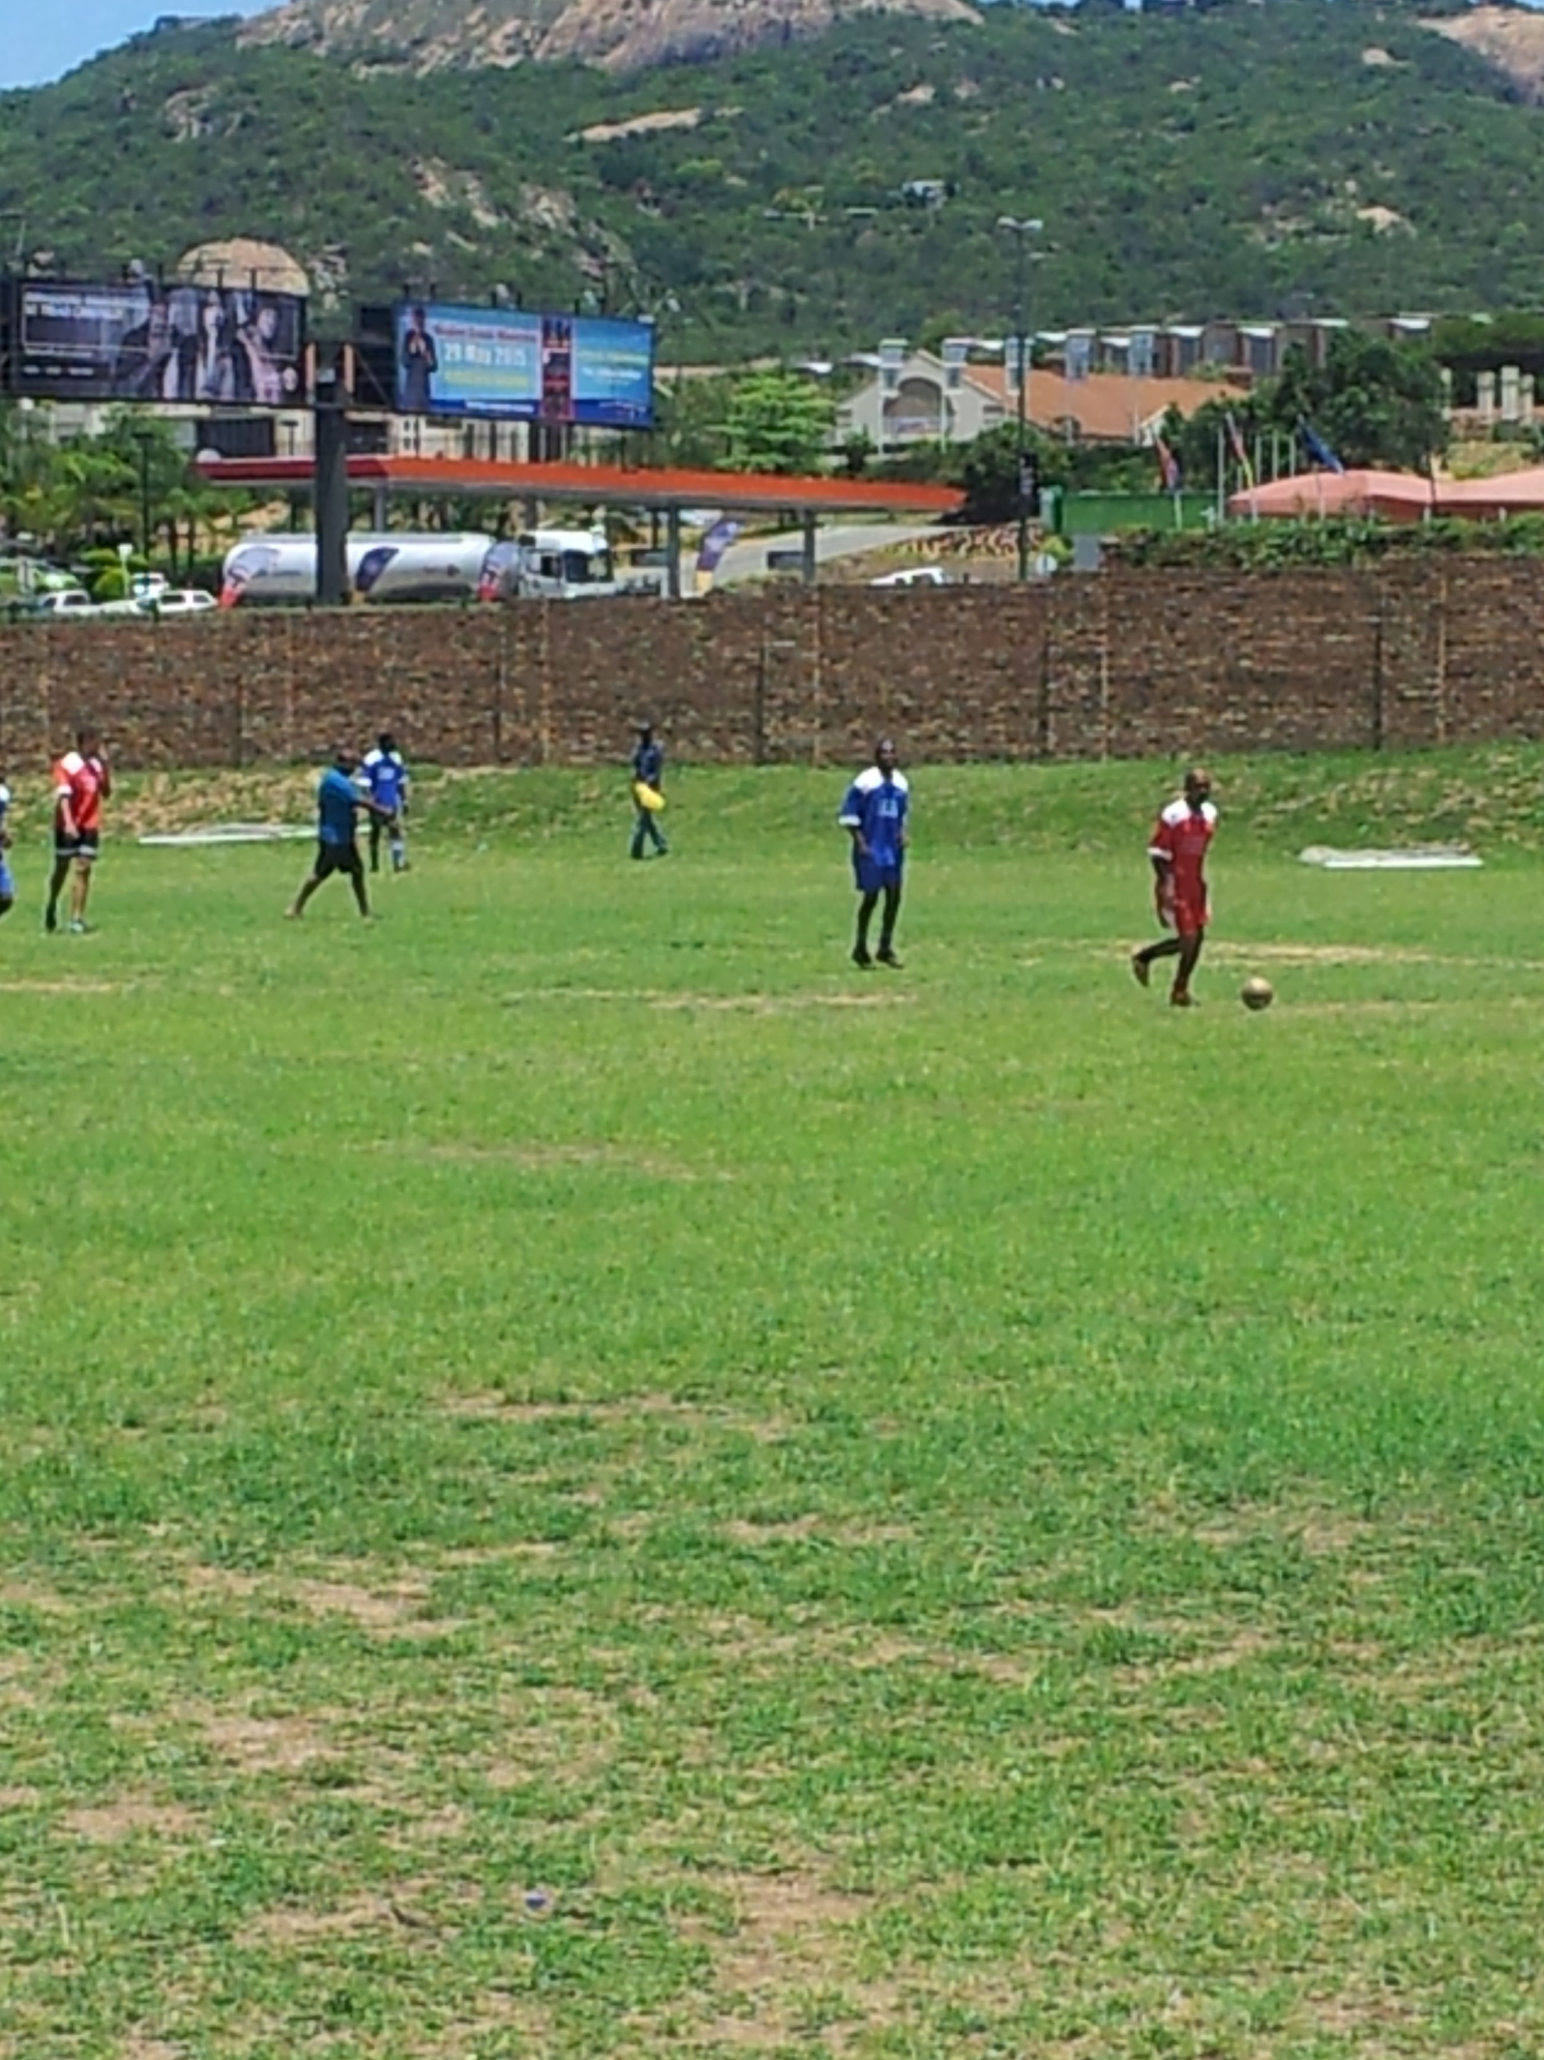
EMPLOYEE WELLNESS PROGRAMMES
2016/2017 |  | Quarter 1 2017/18
Month | Programme | Month | Programme
May | Tekkie Day - stickers bought to support casual day and people with disabilities Employees attended Wellness day presented by Vision World SA for Optometrist, Audiologist and Physiotherapy ICAS Marketing Candle light Memorial | April | Soccer matches
 |  | May | Soccer matches
June | GEMS Fitness and Substance Abuse awareness. Blood drive | June | Alcohol, drug and substance abuse Old mutual did a presentation Condom distribution Healthy eating (matching blood type) Sport
July | ICAS presentation during the provincial meeting Men’s Forum ICAS presentation on Stress
August | Soccer matches
September | Heritage and wellness day
October | Breast cancer
November | Red Ribbon month
December | HIV and AIDS awareness
February | Mpumalanga hosted National Peer educators meeting STI & Condom awareness
March | Sport month.
56

Slide 57
LABOUR RELATIONS CASES
2016/17 |  |  |  | 2017/18
Allegations | Number of cases | Status | Outcome | Allegations | Number of cases | Status | Outcome
Gross Dishonesty | 02 | Finalized | Dismissal | Fraud | 01 | Pending disciplinary hearing
Dishonesty | 02 | Finalized | Three (3) months suspension without pay. | Contravening Civic Service Act/Policy | 01 | Pending disciplinary hearing
Negligence | 01 | Finalized | Final Written Warning | Gross negligence | 01 | Pending disciplinary hearing
Improper conduct | 02 | Finalized | Written Warnings
None compliance with leave policy | 01 | Finalized | Written Warning
Contravening Civic Service Act/Policy | 01 | Not Guilty | N/A
57
Notes:
Kept the old info in as reference

Slide 58
COUNTER CORRUPTION CASES 2016/17
2016/2017
Allegations | Finalised / pending | Outcome/ Impact
Smart ID Cards stolen / lost due to negligence | Finalised | Official pleaded guilty and paid for lost cards
Loss of Stamps. | Finalised | Official was referred to Employee Wellness
Processing passports without owners being present | Finalised | Pending at Labour Relations
Demanding money from deportees | Finalised | Pending at Labour Relations
Discrepancies in financial records | Finalised | Official involved was dismissed on another charge and this case was referred to SAPS (criminal case)
Fraudulent birth registration (2 x cases) | Finalised | Pending at Labour Relations
Fraudulent birth registration (2 cases) | Finalised | Official dismissed, but appealed
Suspected fraudulent registration of marriage | Finalised | Official dismissed, but appealed
Alleged selling of Identity Document of a deceased person | Finalised | Case was investigated. Allegations unfounded
Processing a passport of a wanted person (without person being present) | Finalised | Pending at Labour Relations
Fraudulent Birth Certificate issued | Pending | Pending at Labour Relations
Mission is alleged to have issued visitors visa unprocedurally. | Finalised | Pending at Labour Relations
Alleged unlawful release of Illegal Foreigners | Pending | Official was dismissed
58

Slide 59
COUNTER CORRUPTION CASES - Q1 2017/18
Quarter 1 2017/18
Allegations | Finalised / pending | Outcome/ Impact
Alleged fraudulent birth registration | Pending | n/a
A Public member fraudulently registered children of foreigners in order to receive SASSA grants | Pending | n/a
Fraudulent ID application | Pending | n/a
Unlawful issuance of enabling documents | Pending | n/a
59

Slide 60
SECURITY SERVICES (as at 31 June 2017)
Office | Cash in Transit services (Yes / No) | Frequency of collection | Alarm system (Y / N) | Security guard structure (how many day and how many nights) | Security Equipment
 |  |  |  |  | Are there any other security equipment in the offices? If there is please indicate what it is | Status of the equipment
Nelspruit | Yes | 5 x weekly | No | 3 days/1 night | CCTV | Not functioning neither control room
Barberton | Yes | 5 x weekly | No | 2 days/2 nights | CCTV, Walkthrough detector/x-ray | 50% cameras are functioning, walkthrough detector and x-ray machine not functioning
Hazyview | Yes | 5 x weekly | No | 1 day/2 nights | None
Komatipoort | Yes | 5 x weekly | No | 1 day/2 nights | None
Mashishing | Yes | 5 x weekly | No | 1 day/2 nights | CCTV | Needs major service
Sabie | No | n/a | No | 1 day/1 night | None
Mapulaneng | Yes | 5 x weekly | No | 1 day/1 night | None
Malalane | Yes | 5 x weekly | No | 1 day/2 nights | None
Mhala | Yes | 5 x weekly | No | 2 days/1 night | CCTV, walkthrough detector/x-ray | 70% cameras are functioning walkthrough detector and x-ray not functioning
Nkomazi | Yes | 5 x weekly | No | 1 day only | None | In the process of relocating
White River | Yes | 5 x weekly | No | 1 day/2 nights | None | Strongly recommended, CCTV
Witbank | Yes | 5 x weekly | No | 3 days/2 nights | CCTV, x-ray machine | Both need major services
Belfast | Yes | 5 x weekly | No | 1 day/1 night | None
60
Notes:
Kept in the old info as reference

Slide 61
SECURITY SERVICES
Office | Cash in Transit services (Yes / No) | Frequency of collection | Alarm system (Y / N) | Security guard structure (how many day and how many nights) | Security Equipment
 |  |  |  |  | Are there any other security equipment in the offices? If there is please indicate what it is | Status of the equipment
Siyabuswa | Yes | 5 x weekly | No | 1 day only | None
Ermelo | Yes | 5 x weekly | No | 2 days/2 nights | None
Bethal | Yes | 5 x weekly | No | 1 day/2 nights | None
Eerstehoek | No | n/a | No | 2 days/2 nights | CCTV, X-RAY | Both not functioning
Piet Retief | Yes | 5 x weekly | No | 1 day/2 nights | None
Secunda | Yes | 5 x weekly | No | 1 day/2 nights | None
Standerton | No | n/a | No | 2 days/2 nights | None
Volksrust | Yes | 5 x weekly | No | 1 day/1 night | None
Mkobola | Yes | 5 x weekly | No | 1day only | None
Middelburg | Yes | 5 x weekly | No | 2 days/1 night | None
Carolina | No | n/a | No | 1 day/1 night | None
KwaMhlanga | Yes | 5 x weekly | No | In Government Complex with own security | None
Delmas | Yes | 5 x weekly | No | 1 day/1 night | None
61
Notes:
Kept in the old info as reference

Slide 62
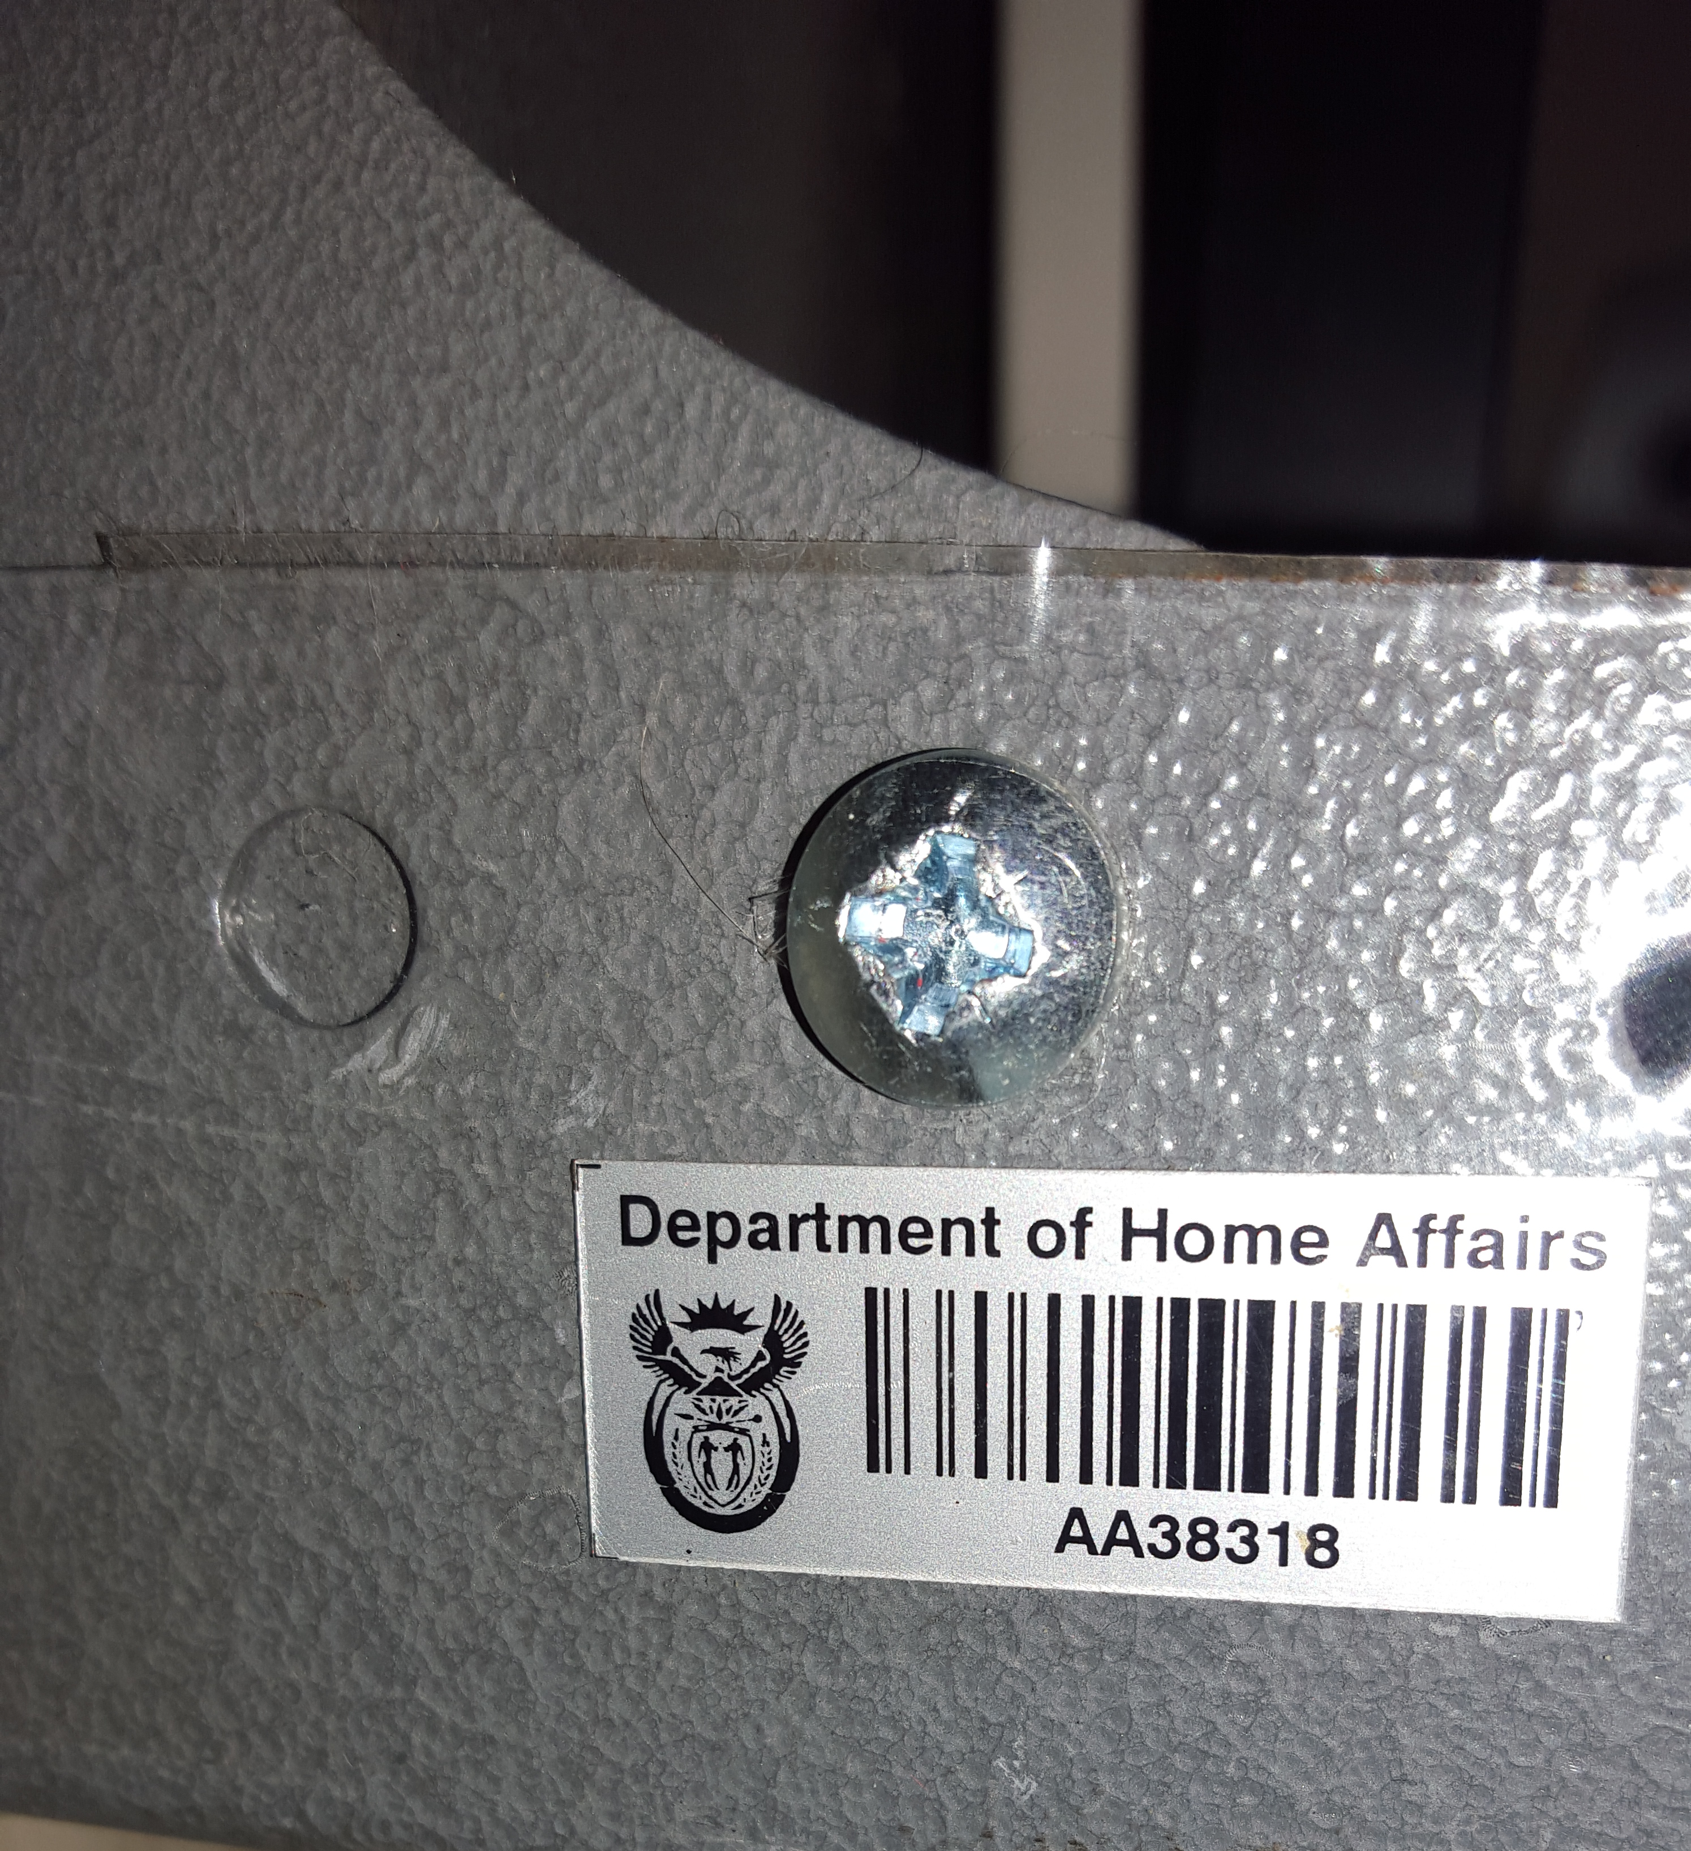
FINANCE, ASSET MANAGEMENT & SUPPLY CHAIN MANAGEMENT
62

Slide 63
BUDGET AND EXPENDITURE (as at 31 June 2017)
Budget Item | Budget 2017/18 | Actual Expenditure YTD | YTD Savings/ Overspending | YTD Budget Expenditure (%)
Compensation of Employees | 146,593,000 | 36,432,257 | 110,160,743 | 25%
Goods and Services | 12,872,000 | 1,746,400 | 11,125,600 | 14%
Provincial & Local Government | 112,000 | 0 | 112,000 | 0%
Households | 145,000 | 6,507 | 138,493 | 4%
Machinery and Equipment | 1,037,000 | 53,962 | 983,038 | 5%
TOTAL | 160,759,000 | 38,239,126 | 122,519,874 | 24%
63

Slide 64
ASSET MANAGEMENT AND SCM FUNCTIONS
Nr of Assets on BAUD | Value | Verified assets | Value of assets verified | Assets not verified | Value of assets not verified | Percentage Compliance
12,179 | R78,715,149.82 | 12,074 | R78,233,426.11 | 105 | R392,723.71 | 99.14%
Valid invoices paid within 30 days
 | 2016/2017 |  |  | Quarter 1 2017/18
Type | Target 2016/17 | Number of Invoices | Value | Target 2017/18 | Number of Invoices | Value
Invoices received | 100% | 1,118 | R5,022,966.84 | 100% | 184 | R952,227.29
Invoices paid within 30 days | 100% | 1,091 | R4,908,451.02 | 100% | 177 | R914,150.73
Total |  | 97.58% (27) |  |  | 96.20% (7)
Reasons for non-achievement: Roll back of the Receipt invoice link functionality which was included in Release 8.1 Interim 06. The Receipt Invoice functionality is now back to the original state. Payment approval limit exceeded M024 0417 – Error experienced on Commitments and Payments
64

Slide 65
REVENUE COLLECTED
Province | 2016/2017 | Quarter 1 2017/18
Cash and Point of Sale | R52,435,990.88 | R4,067,006.86
65

Slide 66
FLEET MANAGEMENT (April 2016 – June 2017)
Local Offices
District Municipality | Departmental vehicles | G-Fleet Vehicles | Vehicles Disposed | G-Fleet Vehicles returned | Number of Vehicles in use
Ehlanzeni | 31 (including 5 Mobile Offices) | 24 | 0 | 1 | 55
Nkangala | 23 (including 4 Mobile Offices) | 6 | 0 | 2 | 29
Gert Sibande | 14 (including 2 Mobile Offices) | 10 | 0 | 2 | 24
Grand Total | 68 | 40 | 0 | 5 | 108
Ports of Entry
District Municipality | Departmental vehicles | G-Fleet Vehicles | Vehicles Disposed | G-Fleet Vehicles returned | Number of Vehicles in use
Ehlanzeni | 8 | 4 | 0 | 2 | 12
Gert Sibande | 6 | 2 | 0 | 0 | 8
Grand Total | 14 | 6 | 0 | 2 | 20
66

Slide 67
LEASE PERIOD OF OFFICES
District Municipality | Office | Rental per month | Lease start | Lease end | Outstanding leases / Comments
City of Mbombela Umjindi | PM Offices | 91,048.05 | 01/12/2013 | 30/11/2018
 | Nelspruit | 201,986.64 | 01/10/2014 | 30/09/2017 | New lease already signed. Lease period 01/10/2017 – 30/07/2020 (lease amount per month: R204,730.78)
 | Hazyview | 40,292.58 | 01/08/2016 | 30/07/2021
 | White River | 57,442.87 | 01/12/2016 | 30/11/2019
 | Msogwaba | 5,236.43 | 01/01/2014 | 31/12/2018
 | Barberton (parking) | 5,400.00 | 01/10/2014 | 30/09/2017
Thaba Chweu | Sabie | 18,330.25 | 01/12/2016 | 30/11/2019
Nkomazi | Malelane | 77,951.12 | 01/09/2016 | 31/08/2019
 | Komatipoort | 84,513.15 | 01/01/2017 | 31/12/2019
Bushbuckridge | Casteel (TH) | 1,985.97 | 01/05/2016 | 30/06/2019
Emakhazeni | Belfast | 43,183.82 | 01/05/2016 | 31/04/2019
Steve Tswete | Middelburg | 68,722.44 | 01/06/2014 | 30/05/2017 | Request for renewal of lease was done.
67

Slide 68
LEASE PERIOD OF OFFICES
District Municipality | Office | Rental per month | Lease start | Lease end | Outstanding leases
Msukaligwa | Ermelo | 100,440.45 | 01/11/2016 | 31/11/2018 | Request was done for alternative accommodation
Albert Luthuli | Eerstehoek | 55,545.50 | 01/07/2014 | 30/06/2017 | Request for renewal of lease was done. Currently awaiting Bid Committee from PWD
Mkhondo | Piet Retief | 46,347.88 | 01/09/2013 | 31/08/2018
Lekwa | Standerton | 48.228.32 | 01/08/2015 | 31/07/2020
Dipaliseng | Secunda | 71,895.32 | 01/06/2014 | 31/05/2019
Goven Mbeki | Bethal | 49,994.57 | 01/07/2014 | 30/06/2019
Albert Luthuli | Carolina | 11,981.19 | 01/02/2016 | 31/01/2019
Total |  | 1,032,298.23
68

Slide 69
STATE OWNED BUILDINGS
District Municipality | Office
Ehlanzeni | Barberton Mashishing Mhala Nkomazi (Department of Justice) Mapulaneng (Department of Justice)
Nkangala | Kwa-Mhlanga Siyabuswa Mkobola Witbank
Gert Sibande | Volksrust
TOTAL | 10
69

Slide 70
Achievements & Challenges
70

Slide 71
ACHIEVEMENTS
No | Achievement | Impact on service delivery
1 | Province achieved target on Smart ID Cards issued for 2016/17 | Clients able to access services
2 | Birth registration within 30 days for Quarter 1 of 2017/18 achieved. | Reduction of LRB’s
3 | No findings by Auditor- General for 2016/17 for the Province on Revenue, HR, Asset Management, Finance and Supply Chain Management
4 | Collaboration with local radio station (Ligwala-gwala FM). Free slots for public education / awareness | Information clearly communicated to public Achievement of Smart ID Cards issued in 2016/17 and achievement of birth registration within 30 days for Quarter 1(2017/18)
71

Slide 72
CHALLENGES AND KEY DECISION REQUIRED
No | Challenge | Key decisions required
1 | Shortage of support staff. Currently there are no Back office clerks in offices to perform support functions. Provincial Office also needs additional staff as there is no provision made for Supply Chain Management officials to ensure segregation of duties. There is only one official responsible for all labour relations cases, one official for counter corruption investigations etc. | Funding required
2 | Saturday Working hours | Matter is currently being addressed by DG
3 | IMS Vehicles There are currently 8 IMS bakkies in use for deportations. All these vehicles have travelled more than 200 000 km. | Funding required to replace and obtain additional Deportation Vehicles
4 | Sheriff when executing court orders targets service delivery offices | Legal representation needed in Province
5 | Blocked Identity Numbers Allegations made: persons were deported etc during the former regime but they are allegedly South African Citizens. Former Presidents De Klerk and Mandela told them that everybody should apply for ID’s before the 1994 elections. Now the ID’s are blocked | Investigations to be done and recommendations be made
72

Slide 73
CHALLENGES AND KEY DECISION REQUIRED
No | Challenge | Key decisions required
6 | Connectivity at Health Facilities. ADSL lines have been installed in many facilities, but the connectivity is still very slow. | IS to investigate alternative solution
7 | Reluctance for change to Smart ID Card | Phasing out of Green ID book
8 | Infrastructure in rural areas (for example: Mapulaneng) | Construction of State Owned facilities
73

Slide 74
THANK YOU

