Slide 1
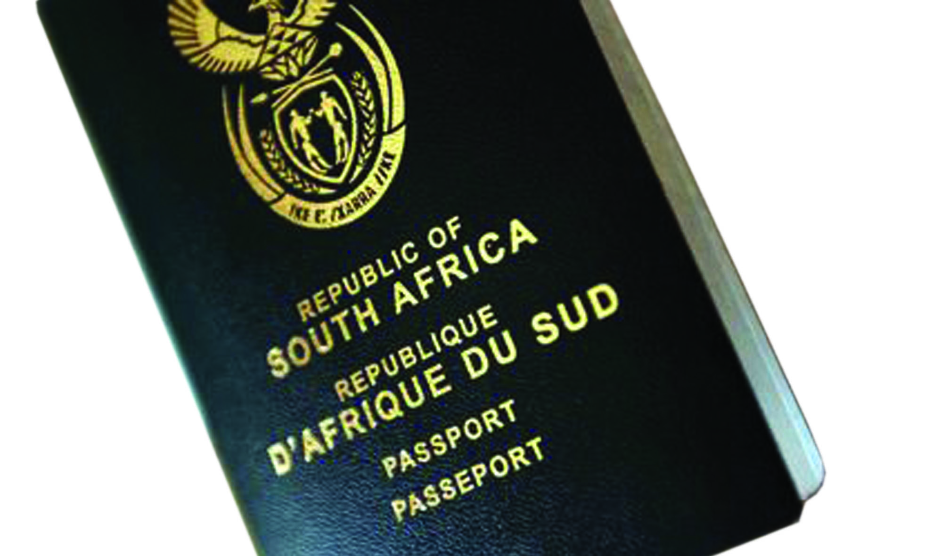
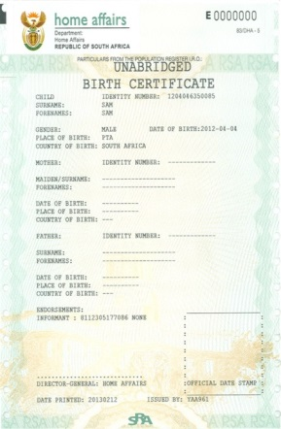
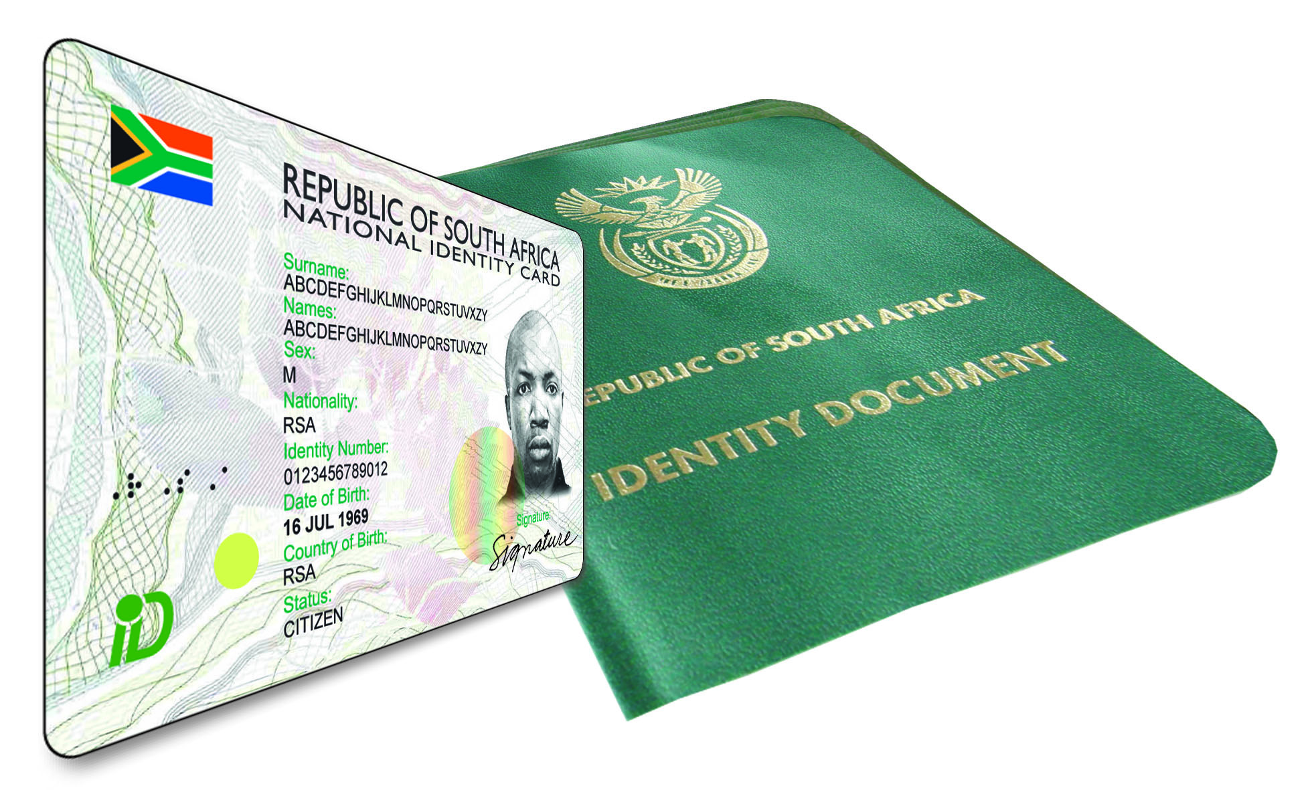
State of the Western Cape Province
As at end June 2017
Presented on !5 August 2017 by: Provincial Manager: Yusuf Simons
Notes:
1

Slide 2
Content
Provincial Overview
Geographical layout of the Province
Governance Structure (alignment span of control for DMO structures to enhance service delivery)
High level overview of Western Cape Province: access to clients
Footprint expansion during the past 5 years
Provincial Archive
Current burning issues: Facilities
Alphabetical list of all facilities
Health facilities
Provincial Archive
High volume offices and queue management strategies.
Future expansion
Provincial Resources:
Staff compliment
Progress in achievement of equity targets
Vetting
Employee Wellness programmes
Moetapele – reward & recognition
Employee Engagement
Counter Corruption
Provincial Fleet
Budget and cost reduction measures

Slide 3
Content
Stakeholder engagement and integrated governance:
Civic services
Immigration Services
Outreach programmes
Provincial Performance in relation to APP targets 2017/2018 and strategies developed to achieve
Birth Registration
Late Registration of Births
ID Smart Cards
Payment of invoices within 30 days

Slide 4
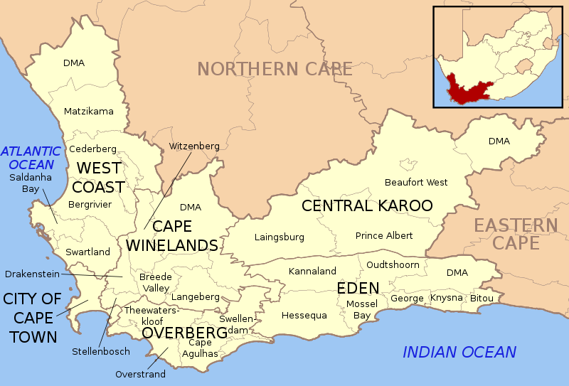
Geographical outlay of Western Cape Province
1x Metro: City of Cape Town, 5 x District Municipalities (West Coast, Cape Winelands, Central Karoo, Overberg, Eden) Reporting to Head Office: PoE : 3 x Sea Ports: Cape Town, Saldanha, Mosselbay, 1x Land Port, 1 x International Airport – Cape Town (National key point), Refugee Reception Centre directly to Pretoria.
4

Slide 5
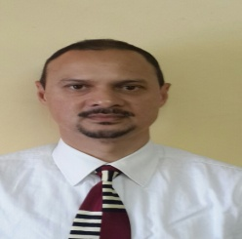
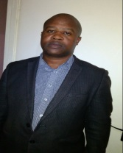
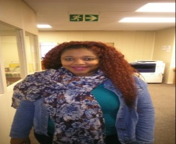
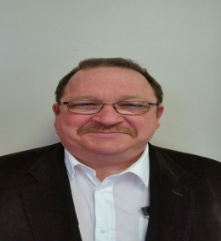
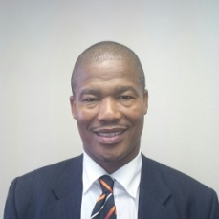
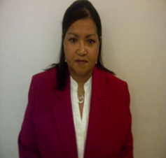
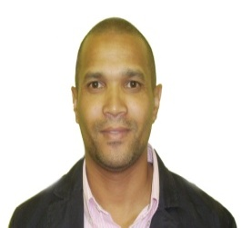
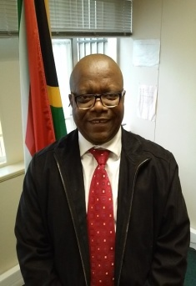
Western Cape Management Team as at end June 2017:
Provincial Manager: Western Cape
Mr. Y Simons
(A) IMS Coordinator: Mr T Xabendlini
(A) Provincial Coordinators Ms. T Ndlovu & Ms N Madolo
(A) Director: F&S : Ms. A vd Berg
(A) DMO: Cape Metro
Mr. I Mokgele
DMO:
Overberg Ms S Davids
(A) DMO: Cape Winelands. R Gabriels
(A) DMO: West Coast Mr G Kotze
DMO: Central Karoo & Eden :Mr.M Ngaka
Note: Funded vacant posts for : DMO Cape Metro and West Coast in process of being filled

Slide 6
High level summary: footprint and access to clients
Available | Comments
28 x Front Offices within 5 Districts and 1 Metro 1 x permanent contact point – Ladysmith 27 x Connected Health Facilities 11 x Mobile Offices 1 x Bank - Standard Bank Canal Walk 1 x Provincial Office (sharing space with Cape Town Large Office) Provincial Archive Facility established at Bellville Office | 22 x Modernised Front Offices (11 urban, 11 rural) and 1x Bank 79% of our Offices are modernised Stellenbosch and Grabouw earmarked for modernisation in 2017/2018 Out of the 23 local municipalities within the WC only 1 is without a DHA facility (Bredevalley)

Slide 7
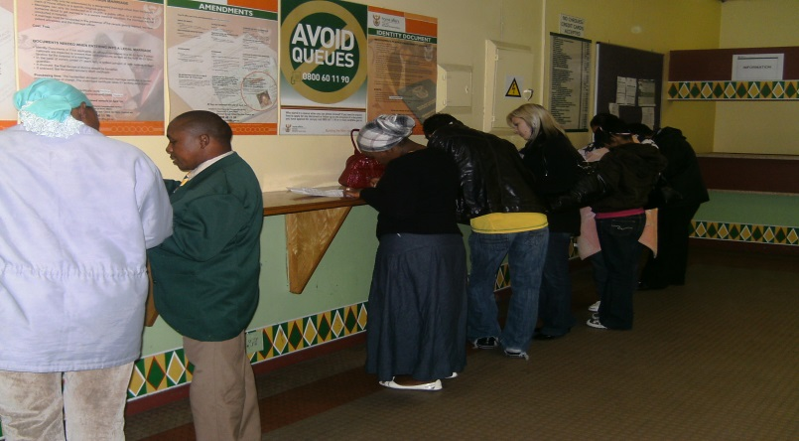
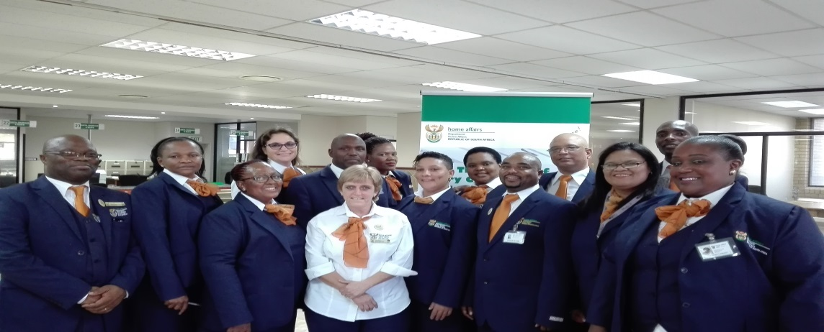
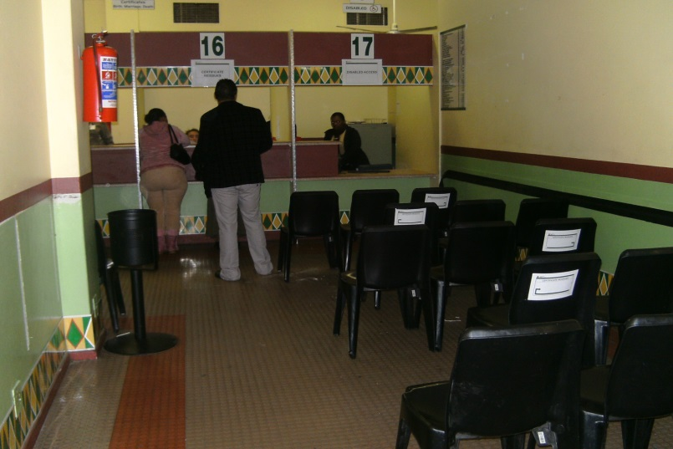
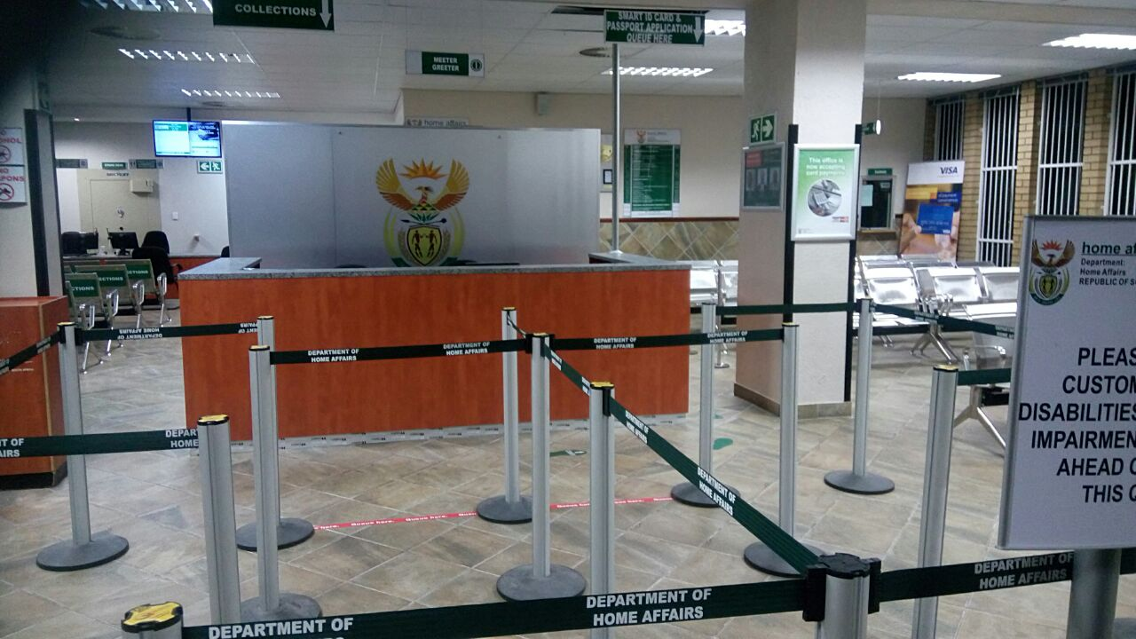
Highlights Q 1
The new Bellville Office was officially opened by Minister Professor H Mkhize
Before: Boston Centre
After: ABSA Building

Slide 8
Re-alignment of DMO structure to support service delivery needs w.e.f 2017/04/01
District/ Area | Details of DMO | Position held | Population
Cape Metro | Mr I Mokgele | Acting DMO | 3 740 026
Cape Winelands (inclusive of Somerset West Office) | Mr R Gabriels | Acting DMO | 787 490
West Coast (Inclusive of TSC Atlantis) | Mr G Kotze | Acting DMO | 391 766
Overberg | Ms S Davids | Acting DMO | 258 176
Eden & Central Karoo | Mr M Ngaka | DMO | 650 137
TOTAL |  |  | * 5 827 595
8
Notes:
8

Slide 9
Re-alignment of DMO structure to support service delivery needs continued
Number of Metro's & Districts | DMOs Filled | Vacant funded | Never funded | Clustered Districts and number of offices responsible for: | Number of Offices | Number of support staff
6 | 1 | 3 | 2 | West Coast (ASD acting as DMO) | 5 | 1x DITO, 1x Acting co- ordinator (L6).
 |  |  |  | Eden & Central Karoo | 7 | 2x DITO, 1x Secretary, 1x Acting Co-ordinator (L7).
 |  |  |  | Cape Winelands (DD acting as DMO) | 7 | 1x DITO, 1x Acting Co-ordinator (L7)
 |  |  |  | Cape Metro (DD acting as DMO) | 6 | 1x DITO, 1x Acting Co-ordinator (L8), 1x Sec (L7).
 |  |  |  | Overberg (DD acting as DMO) | 3 | 1x Acting co-ordinator (L6)
Recruitment process for 2x DMOs finalized
9
Notes:
9

Slide 10
Footprint expansion over the past 5 years
District | Office name | Type | Modernized (Yes/No) | Reason for establishment
Cape Metro | Atlantis | Office | Yes | Disadvantaged community No/poor public transport infrastructure More than 50km from nearest DHA facility
Overberg | Bredasdorp | TSC | Yes | Rural farming communities
Cape Winelands | Ceres | TSC | Yes | Rural farming communities
 | Robertson | TSC | Yes | Rural farming communities
 | Prince Albert | TSC | Yes | Proximity to nearest DHA facility
 | Mosselbay | TSC | Yes | Situated within a huge fast growing informal settlement with migrant workers from EC
 | Ladismith | Contact Point | No | Proximity to other DHA facilities Community request to political office bearers
 | Riversdale | Health facility | No | Proximity to other DHA Facilities Huge disadvantaged rural community with high childbirth rates for teenage mothers
 | Vredenburg | Contact Point | No | Proximity to nearest DHA facility Saldanha – economic hub of the West Coast Fast growing informal settlements – migrant workers

Slide 11
Burning issues : Facilities
Vredenburg:
Municipality gave DHA notice for termination of lease at Swemmer & Levine Building w.e.f. 30 June 3017,
Municipality provided alternative facility – DHA in process of refurbishing with the view of modernizing the office in 2018/2019,
Office is currently functioning from back of the building whilst refurbishment of front office are in process.
Malmesbury:
Landlord served DHA with a notice for lease termination and require DHA to vacate w.e.f 31 July 2017,
DPW requested to negotiate extension of notice period until DHA secured a suitable alternative accommodation,
DPW in process of negotiating extension with the landlord,
DPW requested not to tender due to time constraints but to follow a negotiated strategy.

Slide 12
Alphabetical list of WC Offices and classification
PROVINCE | SERVICE POINT NAME | DISTRICT MUNICIPALITY NAME | LOCAL MUNICIPALITY NAME | URBAN / RURAL | OFFICE - STREET ADDRESS
WC | ATLANTIS/ HARTEBEESKRAAL | City of Cape Town MM | City of Cape Town MM | URBAN | Mpcc Hartebeeskraal, 1 Notthingham Street, Atlantis
WC | BEAUFORT WEST | Central Karoo DM | Beaufort West LM | RURAL | 3 De Vries Street, Thusong Centre, Beaufort West, 6970
WC | BELLVILLE | City of Cape Town MM | City of Cape Town MM | URBAN | Boston Centre, 85 Voortrekker Road, Bellville,7530
WC | BREDASDORP | Overberg DM | Cape Agulhas LM | RURAL | 109 Park Street, Bredasdorp
WC | CALEDON | Overberg DM | Theewaterskloof LM | RURAL | 11 Haw Street, Caledon
WC | CAPE TOWN | City of Cape Town MM | City of Cape Town MM | URBAN | Faircape Buiding, 56 Barrack Street, Cape Town
WC | CERES | Cape Winelands DM (Boland) | Witzenberg LM | RURAL | Panorama Street, Bellavista, Ceres, Erf no: 2628
WC | GEORGE | Eden DM | George LM | URBAN | 109 York Street , Telkom Building ,George 6530
WC | GRABOUW | Overberg DM | Theewaterskloof LM | RURAL | Old Traffic Department, Grabouw 7160
WC | KHAYELITSHA | City of Cape Town MM | City of Cape Town MM | URBAN | C/O Tsolo And Mzala Street, Khayelitsha, 7793
WC | LAINGSBURG | Central Karoo DM | Laingsburg LM | RURAL | Cnr Main & 3Rd Avenue, Goldnerville Laingsburg
WC | MALMESBURY | West Coast DM | Swartland LM | URBAN | 5 Piet Retief Street Malmesbury, 7300
WC | MITCHELL'S PLAIN | City of Cape Town MM | City of Cape Town MM | URBAN | 1 Alpha Street ,Beacon Valley,Mitchell'S Plain
WC | MOSSEL BAY | Eden DM | Mossel Bay LM | RURAL | Thusong Service Centre, 108 Adriaans Street, KwaNonqaba, Mossel Bay

Slide 13
Alphabetical list of WC Offices and classification
PROVINCE | SERVICE POINT NAME | DISTRICT MUNICIPALITY NAME | LOCAL MUNICIPALITY NAME | URBAN / RURAL | OFFICE - STREET ADDRESS
WC | NYANGA (NONTSUMPA) | City of Cape Town MM | City of Cape Town MM | URBAN | C/O New Eisleben & Miller Street, Crossroads, 7755
WC | OUDTSHOORN | Eden DM | Oudtshoorn LM | RURAL | 73 Dassie Road, Bridgton, Oudtshoorn, 6625
WC | PAARL | Cape Winelands DM (Boland) | Drakenstein LM | URBAN | 39 Castle Street, Paarl
WC | PRINCE ALBERT | Central Karoo DM | Prince Albert LM | RURAL | Adderley Street 1, Prince Albert, 6930
WC | ROBERTSON | Cape Winelands DM (Boland) | Breede River/Winelands LM | RURAL | 40 Paddy Street, Robertson Thusong Centre, Robertson
WC | SIMUNYE (PLETTENBERG BAY) | Eden DM | Bitou LM | RURAL | Xipula Street,Kwanokathula,Plettenbergbay
WC | SOMERSET WEST | City of Cape Town MM | City of Cape Town MM | URBAN | Department of Labour building, 117 main Road, Somerset West, 7130
WC | STELLENBOSCH | Cape Winelands DM (Boland) | Stellenbosch LM | URBAN | C/O Ryneveld And Jan Cilliers Street. Stellenbosch
WC | SWELLENDAM | Overberg DM | Swellendam LM | RURAL | 01 Vollenhoven Street, Railton, Swallendam
WC | VICKY ZIMI (CITRUS DAL) | West Coast DM | Cederberg LM | RURAL | Vicky Zimri Thusong Centre,Bohemia Street, 7340
WC | VREDENBURG | West Coast DM | Saldanha Bay LM | RURAL | 10 Main Road, Vredenburg
WC | VREDENDAL | West Coast DM | Matzikama LM | RURAL | C/o Hoerskool and Bult Street, Vredendal Thusong Centre, 8160
WC | WORCESTER | Cape Winelands DM (Boland) | Breede Valley LM | URBAN | 71-73 Adderley Street Worcester 6850
WC | WYNBERG | City of Cape Town MM | City of Cape Town MM | URBAN | Maynard Mall, Level 2, 70 Main Road, Wynberg, 7824

Slide 14
Number of Health facilities
REGION | NUMBER OF HEALTH FACILITES | STATUS (ONLINE OR NOT) | NUMBER OF STAFF
 |  |  | Permanent level 5 | Additional capacity deployed (Level 6)
Cape Metro | 35 | 17 connected 18 not connected | 7 | 18 3 Mobile operators 8 Permanently stationed at Hospital
Cape Winelands | 9 | 3 connected 6 not connected | 3 (each official is visiting a public and private hospital a day
Eden District | 8 | 5 connected 3 not connected | 1 | 5 1 Mobile operator
Central Karoo | 2 | 0 connected 2 not connected | 0 | 1
West Coast | 3 | 1 connected 2 not connected | 1 | 2 1 Mobile operator
Overberg | 3 | 1 Connected 2 not connected | 1 | 1
Total | 60 | 27 Connected 33 Not connected | 13 | 41 ( Some of the facilities are not visited each day but by arrangement between the office manager and health facility.

Slide 15
Provincial Archive: Bellville Large Office
The Bellville Office is the first Office to accommodate a Provincial Archives:
Benefits of the Provincial Archive Facility:
Secured safe keeping of records,
Controlled access to public records,
Free up space in local front offices
Lockable safes for Supply Chain Management (SCM) payment batches
Documents stored according to approved archiving standards
The Provincial archives are divided as follows:
Cape Winelands
Central Karoo
Cape Metro
Overberg
Eden
West Coast
Provincial Office
Cape Town International Airport (CTIA) and Cape Town Port of Entry
Process:
Local Offices provided the opportunity twice a year (June & December) to list live archives and transfer to the Bellville facility
2. Disposal listing will be done once annually to apply for approval of destruction of expired archives from the Accounting Officer

Slide 16
High Volume Offices and queue management strategies
Efforts to reduce waiting times:
Signage displayed on queue poles placed outside of the office to categories queues into:
Smart card and passport applications,
Smart card and passport collections,
Legacy system applications (Birth-, Death- registration, Temporary ID Certificates).
Prioritize client categories: Elderly, pregnant mothers, mothers with infants
Scholars with uniform accompanied by parents are prioritised
Compulsory for office managers to visit front office areas every 2 hours and interact with clients
Floorwalkers direct clients and communicate approximate waiting times to clients inside of the office
Radio Bulletin during peak periods to direct clients to low volume offices (morning & afternoon slots)
7. Continuous communication to clients when high volumes are experienced

Slide 17
Going forward: Footprint expansion
Cape Metro: Du Noon
informal settlement on the outskirts of Cape Town
prone to service delivery protest
Cape Metro: Bonteheuwel
Huge disadvantaged densely populated settlements
Will alleviate pressure by reducing client influx at Cape Town and Bellville Offices
Hessequa: Riversdale
Very poor farming communities
Very far from nearest DHA facilities - high childbirth rates for teenage mothers
Cape Winelands: De Doorns
Big informal settlements Farm workers
Area is prone to incidents of Xenophobia
Security cluster – priority area
Modernization 2017/2018 FY
Stellenbosch Office to alleviate client volumes at Somerset West, Bellville and Paarl Office
Grabouw: Huge informal settlements prone to service delivery protest, will service fishing communities of Hawstone and Overstrand areas

Slide 18
Provincial Resources

Slide 19
Staff breakdown per office:
District | Office Name | Total number of funded posts | Number funded vacancies | Filled as at 30 June 2017 | Number of staff Civic Services | Number of IMS members | Support staff (OM, Cleaners, Security, Sate Accountants etc.)
 | DMO Cape Metro | 9 | 2 | 7 | 4 | 0 | 3
 | Large Office Cape Town | 99 | 1 | 98 | 74 | 15 | 9
 | Large Office Khayelitsha | 43 | 2 | 41 | 32 | 6 | 3
 | Medium Office Bellville | 57 | 0 | 57 | 54 | 0 | 3
 | Medium Office Mitchell's Plain | 27 | 1 | 26 | 23 | 0 | 3
 | Medium Office Nyanga | 25 | 0 | 25 | 24 | 0 | 1
 | Medium Office Wynberg | 40 | 0 | 40 | 38 | 0 | 2
Cape Metro | 53% | 291 | 4 | 287 | 245 | 21 | 21
 | DMO Cape Winelands | 3 | 1 | 2 | 0 | 0 | 2
 | Large Office Paarl | 31 | 5 | 30 | 24 | 5 | 1
 | Medium Office Somerset West | 15 | 0 | 15 | 15 | 0 | 0
 | Medium Office Stellenbosch | 8 | 0 | 8 | 8 | 0 | 0
 | Medium Office Worcester | 18 | 0 | 18 | 14 | 3 | 1
 | PSP Ceres | 6 | 2 | 4 | 4 | 0 | 0
 | PSP Robertson | 4 | 0 | 4 | 4 | 0 | 0
Cape Winelands | 15% | 85 | 8 | 81 | 69 | 8 | 4

Slide 20
Staff breakdown per office continued
District | Office Name | Total number of funded posts | Number funded vacancies | Filled as at 30 June 2017 | Number of staff Civic Services | Number of IMS members | Support staff (OM, Cleaners, Security, Sate Accountants etc.)
 | DMO Central Karoo | 1 | 0 | 1 | 0 | 0 | 1
 | Medium Office Beaufort West | 14 | 5 | 9 | 8 | 1 | 0
 | PSP Prince Albert | 4 | 1 | 3 | 3 | 0 | 0
 | TH Laignsburg | 3 | 0 | 3 | 3 | 0 | 0
Central Karoo | 4% | 22 | 6 | 16 | 14 | 1 | 1
 | Medium Office Oudtshoorn | 14 | 0 | 14 | 11 | 3 | 0
 | DMO Eden | 3 | 0 | 3 | 0 | 0 | 3
 | Large Office George | 32 | 2 | 30 | 25 | 3 | 2
 | Medium Office Mosselbay | 7 | 2 | 5 | 4 | 1 | 0
 | TH Plettenberg Bay | 5 | 1 | 4 | 4 | 0 | 0
Eden | 11% | 61 | 5 | 56 | 44 | 7 | 5
 | DMO West Coast | 1 | 0 | 1 | 0 | 0 | 1
 | Medium Office Malmesbury | 20 | 0 | 20 | 16 | 3 | 1
 | Medium Office Vredendal | 7 | 1 | 6 | 5 | 1 | 0
 | TH Atlantis | 5 | 0 | 5 | 5 | 0 | 0
 | PSP Vredenburg | 4 | 0 | 4 | 4 | 0 | 0
 | TH Citrusdal | 3 | 1 | 2 | 2 | 0 | 0
West Coast | 7% | 40 | 2 | 38 | 32 | 4 | 2

Slide 21
Staff breakdown per office continued
District | Office Name | Total number of funded posts | Number funded vacancies | Filled as at 30 June 2017 | Number of staff Civic Services | Number of IMS members | Support staff (OM, Cleaners, Security, Sate Accountants etc.)
 | Medium Office Caledon | 14 | 0 | 14 | 10 | 3 | 1
 | PSP Bredasdorp | 5 | 2 | 3 | 3 | 0 | 0
 | PSP Grabouw | 3 | 0 | 3 | 3 | 0 | 0
 | PSP Swellendam | 3 | 0 | 3 | 3 | 0 | 0
Overberg | 5% | 25 | 2 | 23 | 19 | 3 | 1
PMO: WC | PMO: WC (5%) | 26 | 2 | 24 | 0 | 0 | 24
Total number of staff |  | 550 | *29 | 525 | 423 | 44 | 58
53% of the total staff compliment is within the Cape Metro – contributes 80% to the APP targets
The Province has a vacancy rate of 5,1% which is below the prescribed DPSA rate of 10%,
* 25 posts i.e. 19 x vacancies filled w.e.f. 30 June 2017 and 6 x offer letters issued at the end of June 2017
1x Post reserved for Arbitration Award,
6 x Promotions.

Slide 22
Progress in achieving equity targets on 3 July 2017
 | AFRICAN |  |  | COLOURED |  |  | INDIAN |  |  | WHITE
 | FEMALE | MALE | TOTAL | FEMALE | MALE | TOTAL | FEMALE | MALE | TOTAL | FEMALE | MALE | TOTAL
WESTERN CAPE | 190 | 114 | 304 | 108 | 80 | 188 | 3 | 2 | 5 | 38 | 9 | 47
Provincial EAP by Population Group and Gender | 16.1% | 19.9% |  | 22.5% | 26.2% |  | 0.1% | 0.4% |  | 6.6% | 8.2%
DHA Percentage Representation | 34.9 | 21.0 |  | 19.9 | 14.7 |  | 0.6 | 0.4 |  | 7.0 | 1.7
 | PEOPLE WITH DISABILITY
Level | 13 (2%)
Breakdown per level
3 | 1
5 | 2
6 | 4
7 | 3
8 | 2
9
10 | 1
Province achieved 2% representation for physically challenged persons - Staff ranging throughout level s 3- 10
Representation: males = 38% , Females 62%.

Slide 23
Vetting as at Q1
Clearances | Civic Services & Inspectorates | POE/ RRC | TOTAL
Top Secret | 13 | 1 | 14
Secret | 28 | 81 | 109
Confidential | 264 | 9 | 273
In Process | 111 | 16 | 127
Subtotal | 416 | 107 | 523
None | 107 | 50 | 157
Expired | 9 | 1 | 10
TOTAL | * 532 | 158 | 690
Data not inclusive of all newly appointed members
Enhanced screening processes implemented by Sate Security Agency w.e.f 01 July 2017:
Number of interviews increased from 3-5 for a secret clearance and
3 – 6 interviews for a top secret clearance

Slide 24
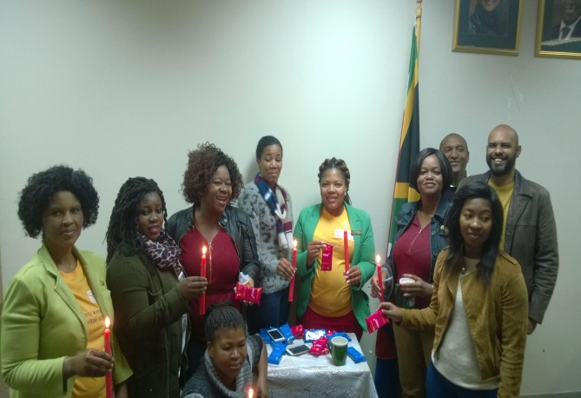
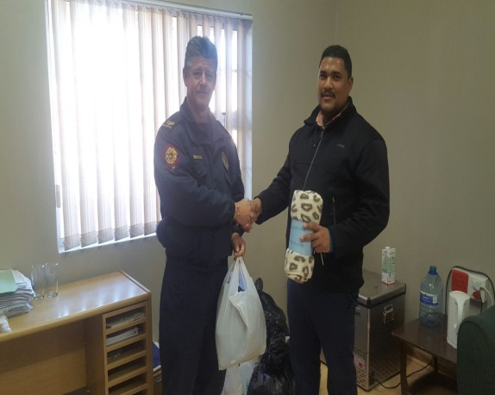
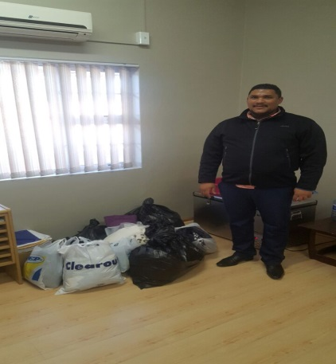
Employee Wellness Activities: Q1
Dates | Activities
15 May 2017 | Candle light memorial
20 June 2017 Distribution of Sanitary Pads | Information session regarding birth registration and ID applications, Hand over of Sanity Towels to girls
16 Youth day | Distribution of Blanket, soup and bread to people who sleep by the streets Distribution of receiver blankets for babies Hand over of clothing to fire victims of Knysna Fire disaster.
Candle light memorial: George Office
Hand over of blankets and clothing

Slide 25
Moetapele / Reward and Recognition
Initiative | Activities |  | Impact
Moetapele Champions for each office elected by staff | Monitoring and reporting to Management and Moetapele Forum: Wearing of nametags, Cleanliness of offices, Maintenance of Attendance Registers Dress code |  | Support Office Managers in an attempt to improve customer experience
DHA Annual Award & Recognition Ceremony : Excellence Awards
Best performing Province |  | All 2016/2017 strategic targets achieved
Employee of the Year |  | Ms Kamana (Provincial Managers: Office)
Best Managed District |  | Mr M Ngaka (Eden & Central Karoo District)
Local Office of Excellence |  | Ms N Mntonjeni (Plettenbergbay Office)
Most innovative Manager (creativity and innovation) |  | Mr S Qwabe ( Mosselbay Office)

Slide 26
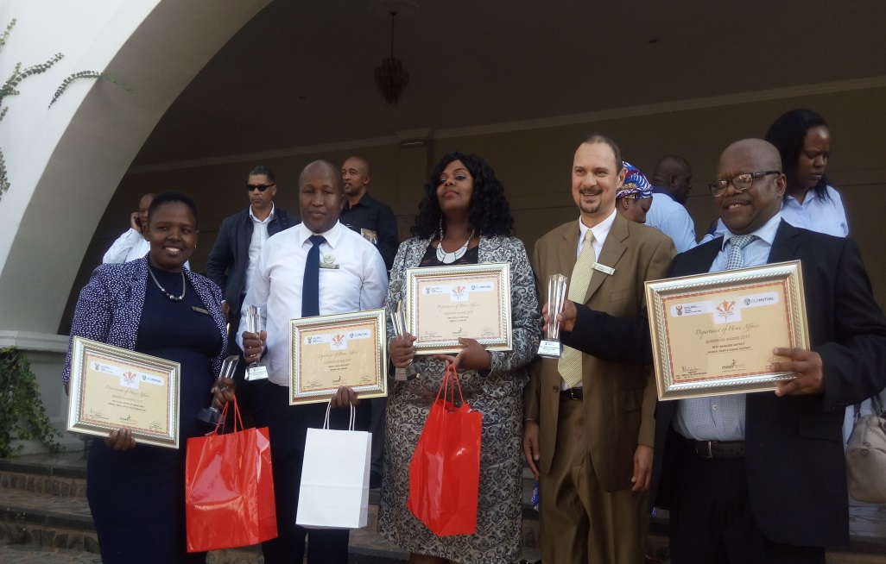
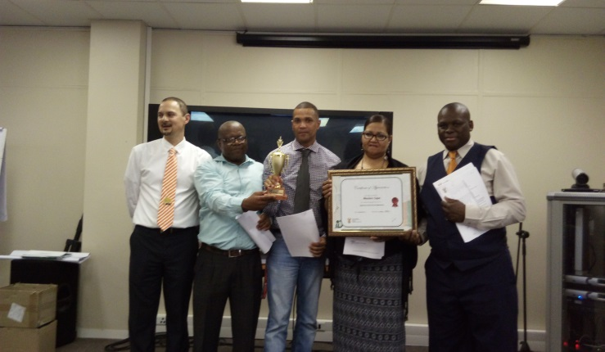
Moetapele / Reward and Recognition
Provincial Award & Recognition Ceremony
A Provincial Reward ceremony was also conducted to reward employees whom went the extra mile in efforts to achieve the 2016/2017 birth registration targets (i.e. employees volunteered to work on Saturdays and Sundays) .
National Excellence Awards 2016/2017
Provincial Moetapele Awards

Slide 27
Employee Engagement
MISCONDUCT CASES AS AT END JUNE 2017
STATUS | TOTALS | SUPPORT SERVICES | CIVIC SERVICES | IMMIGRATION SERVICES | REFUGEE SERVICES
Lodged | 10 | 0 | 7 | 3 | 0
Finalized | 2 | 0 | 2 | 0 | 0
Pending | 5 | 0 | 5 | 3 | 0
2 Cases relating to Abscondmend/excessive absenteeism: Paarl Office – Hearings finalised.
1 Case relating to excessive absenteeism: CTN Large Office – Hearing in process of finalisation.
1 Case of excessive absenteeism: Wynberg – Pending.
1 Case of fraudulent birth certificates: Wynberg – Pending – case closed after employee passed away on 25/07/2017.
1 Case of insubordination & dereliction of duty – Somerset West – Pending.
1 Case of abscondment: Bellville Office – pending.
1 case of Assault: Cape Town Harbour – pending.
2 cases relating to the unlawful entry and departure of an illegal foreign national (Cape Town International)

Slide 28
Counter Corruption & Security Q1
 | Number of cases received Q1 | Nature of cases
Corruption cases reported | 5 | 2 x Fraud, 3x corruption
Investigations finalised | 5
Unfounded cases | 5
Note: 2 x recommendations made to secure processes 1 x Refugees, 1x Civic Services
Security Services:
Stakeholder Forum established with Fidelity Cash Management
80% Offices compliant with appointment of Fire Marshals
Security Risk Assessment concluded at Swellendam and Roberston Offices
Going forward:
Arrange training intervention for Fire Marshalls and First Aiders,
Evacuation plans in process of being finalised in collaboration with local municipalities
Fire drill

Slide 29
High level overview of resources within the Western Cape
Area under review: | Available | Comments
Transport | Total number of vehicles on WC Asset Register = 80 Vehicles Service providers: 59 Departmental – Standard Bank 15 GMT 6 G-fleet (Immigration Bakkies) | The Province (Civic Services and PMO) returned 13 vehicles (3x G-Fleet, 10 x GMT) to service providers as part of its cost reduction measures. Aging fleet is costly to maintain & becoming risk Fleet services (rental & utilization cost consumes 67% of the annual budget).
Allocation of Provincial Fleet:
Office | Number allocated
Provincial Office | 6
Civic services: Front Offices | 37
Mobile Offices | 11
Immigration customized | 6
Ports of Entry (CTPECC & CTIA) | 7
Refugee Office | 4
Ministries | 8
DGs Office | 1

Slide 30
Western Cape Budget and expenditure as at end June 2017
Economic Classification | Expenditure | Commitment | Voted | Available | % Spend
Compensation of Employees | 41,064,422 | 0 | 172,416,000 | 131,351,578 | 24%
Goods & Services | 2,200,980 | 792,522 | 10,139,000 | 7,145,498 | 30%
House Holds | 5,358 | 0 | 145,000 | 139,642 | 4%
Machinery & Equipment | 124,843 | 299,407 | 1,403,000 | 978,750 | 30%
Prov & Local Gove | 54,205 | 0 | 112,000 | 57,795 | 48%
 | 43,449,808 | 1,091,929 | 184,215,000 | 139,673,263 | 24%
Note:
Linear expenditure trend as at end of June 2017 = 24% within 2% prescribed threshold.
Over the past two FY the Province required a bailout of between R4-R4,5m annually on its G&S budget
During 2016/2017 FY the Province introduced cost reduction measures as depicted in the next slide to stay within voted funds.

Slide 31
Cost reduction measures implemented 2016/2017 FY
Description | Saving
Fleet reduced with 13 vehicles (3x G-fleet& 10x GMT) | 1,800,000
Traveling - Flight, Accommodation & Car rental reduced from R 3, 878 352 to R1,360 591(current) Video/ telephone conferencing with DMOs weekly | 2,517,761
Franking machines returned - license fees | 76,000
DMOs requested to keep KM claimed at 1500 km, may exceed (2000 km) every 2nd months when attending EMM
Management meetings every 2 months- saving costs related to catering R216 000 (FY 15/16) to R10 940 (current) Weekly EXCO - Teleconference with Managers in outer Districts | 205,060
Limited procurement of toner and cartridges - all general staff in offices connected to photocopy machines for printing, scanning and faxing- Only Oki Ribbons procured spend 2015/2016 FY R 319 660 vs. R 250 038 - 2016/2017 FY. | 69 622
 | 4,598,821

Slide 32
Stakeholder engagement

Slide 33
Stakeholder engagement
Stakeholder | Nature of co-operation
Dept. of Justice | Court processes regarding Immigration (IMS) cases
SAPS | Participate in IMS operations Civic Services taking of affidavits and render support during outreach programmes i.e. fire disasters
Dept. of Health | Birth registration projects Created a Provincial Engagement Platform created / Task team deals with process related issues.
SASSA | Information sharing and attending to referrals from SASSA
Dept. of Labour | Information sharing Participate in IMS operations
Dept. of Social Development | Information sharing and referrals Social Workers reports for late registration of birth
NGOs: Molo Songololo & Child Welfare | - Birth registration of abandoned children
Medi Clinics | - Birth registration

Slide 34
Stakeholder engagement
Stakeholder | Nature of co-operation
Marriage Officers Forum | Discussion / Resolutions on day to day operational issues Discussion and awareness on new developments within the DHA and Marriage legislation
Funeral Undertakers | In process of developing a Provincial database of Death Registrars Training programmes in place and on going
DHA led Stakeholder forums: Launched and active: Provincial – Launched Feb 2017 Eden-, Overberg- Central Karoo District Municipalities | Joint outreach programmes, Information sharing Assistance in eradication of Late registration of Births Oversight function of DHA Offices and service delivery

Slide 35
Immigration Services: Joint operations DHA led
The Provincial Immigration Units facilitated 2x DHA led operations and
Participated in 11 joint operations led by stakeholders
DATE | DISTRICT | OPERATION | STAKEHOLDERS | OUTCOME | IMPACT
30/05/2017 | Cape Winelands | Franschhoek Business inspection in | Department Home Affairs, Department of Labour and SAPS | 4x arrests 4x dockets opened 3x releases | Visibility of immigration and awareness on legislation governing employment of foreign nationals
25/07/2017 | Eden | Outdshoorn 4 x foreign owned shops/businesses and Asla Construction were Visited and searched | SAPS, Department of Labour (inspectors), Oudtshoorn Municipality (Law Enforcement) and SARS (Customs). | 4 x arrests 4x dockets were opened | Awareness on the legislations that govern employment of foreign nationals

Slide 36
Immigration Services: Joint operations DHA led
DATE | DISTRICT | PLACE OF OPERATION | STAKEHOLDERS | OUTCOME | IMPACT
09/05/2017 | Cape Winelands | Klupmuts | SAPS and Dept. of Home Affairs | 12x arrests 12x dockets opened | IMS visibility
15/05/2017 | Overberg | Swellendam | SAPS and Dept. of Home Affairs | 12x arrests | IMS visibility
16/05/2017 | Cape Metro | Nyanga cluster | Dept. Of Home Affairs and SAPS | No arrests | IMS visibility
17/05/2017 | Cape Metro | Parow | Dept. Of Home Affairs and SAPS | No arrests | IMS visibility
17/05/2017 | Cape Winelands | Ceres | Dept. Of Home Affairs and SAPS | 7x arrests | Awareness on the legislations that govern employment of foreign nationals
8/06/2017 | Central Karoo | Laingsburg CBD and Farms |  | 9x arrests | Awareness on the legislations that govern employment of foreign nationals

Slide 37
Immigration Services: Joint operations DHA led
DATE | DISTRICT | PLACE OF OPERATION | STAKEHOLDERS | OUTCOME | IMPACT
19/06/2017 | Cape Metro | Cape Town Canal Walk Spur Melkbostrand Spur Waterfront Spur Sea Point Spur | Home Affairs and Department of Labour | All foreign nationals were not on duty | Awareness on the legislations that govern employment of foreign nationals
21/07/2017 | Eden | Ladismith Business Inspection | Dept. Of Home Affairs and SAPS | No arrests | Awareness on the legislations that govern employment of foreign nationals
26/07/2017 | Cape Metro | Cape Town Houtbay, Imizamoyethu Informal settlement | Dept. Of Home Affairs and SAPS | 8 x foreign nationals were arrested | IMS visibility
27.06.2017 | Central Karoo | Beaufort West N1 | Dept. Of Home Affairs and SAPS | 2 x arrests | IMS visibility
2017.07.06 | Cape Winelands | De Doorns CBD | Dept. Of Home Affairs and SAPS | 6 x Arrest | IMS visibility

Slide 38
Immigration Services Burning issues
Constitutional Court Ruling :
Confirmation of detention for all illegal foreigners detained for deportation must be confirmed within 48 hours
Operations prior to Constitutional Court Ruling:
Detention without following a Court process in all cases (Detainee could exercise a choice)
Impact on current operations:
If detention was not confirmed in Court the illegal foreigner (detainee) must be released
Immigration challenged over weekends and Courts to hear cases are limited
Proposed solution:
Department of Justice to look at dedicating Courts to fast track processes.

Slide 39
Outreach Programmes Q1
Event | Nature of Programme
Fire Disaster – Imizamo Yethu : Cape Metro (March 2017) | Waving of fees for birth certificates, Temporary ID Certificates Impact: Destitute clients assisted with enabling documents: Re-issue ID applications - 506 Re-issue birth certificates issued - 265 Temporary ID certificates issued - 68 Re-issue marriage certificates issued - 4 Re-issue death certificates issued - 1 Birth registrations – 4
Ministerial Outreach Social Development - Langa – May 2017 | Late Registration of Births Hand over of 10 x Birth Certificates

Slide 40
Outreach Programmes Q1 Continued
Event | Nature of Programme
Sinenjongo Primary School- June 2017 | Awareness on DHA services Hand over of sanitary pads to girls
Fire Disaster – Knysna | Emergency Thusong Outreach for Fire Victims of Knysna and Bitou Municipalities Municipality sponsored clients Impact: 5 Officials deployed 88 Smart ID Card applications processed 27 Birth certificate re-issues 4 Marriage certificate re-issues

Slide 41
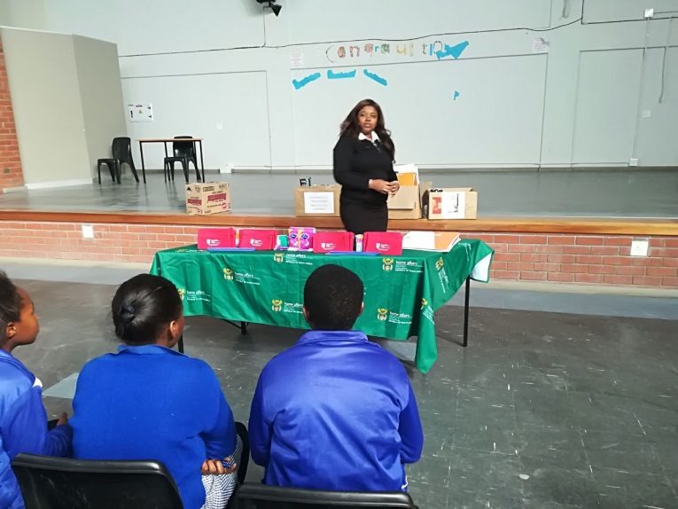
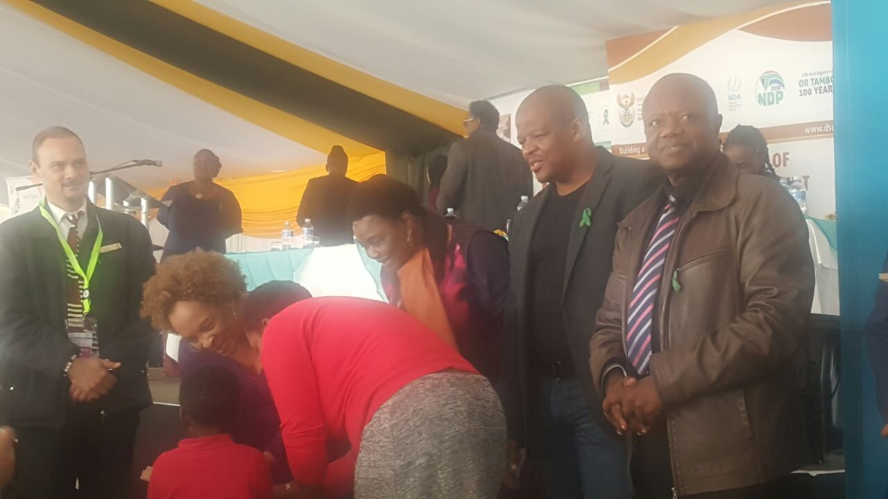
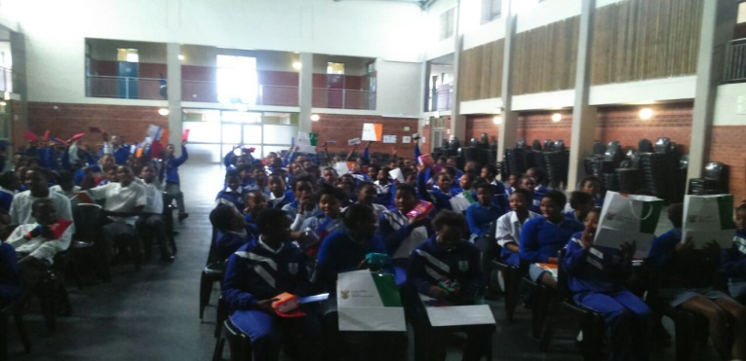
Outreach Programmes Q1 Continued
Sinenjongo Primary School
Ministerial Outreach: Langa

Slide 42
Progress in relation to Q1 2017/2018 APP Targets

Slide 43
OVERVIEW ANALYSIS: Q1 2017/2018 PERFORMANCE
During the 2016/2017 Financial Year the WC Province was the only Province to achieve all its strategic targets:
Birth Registration within 30 days,
ID Smart Card issued to clients,
100% Payment of invoices within 30 day for 12 months.

Slide 44
OVERVIEW ANALYSIS Q 1: 2017/2018
\\
Executive Summary
PROGRESS TOWARDS ACHIEVING STRATEGIC OBJECTIVES QUARTER 1 PERFORMANCE
WC Province achieved 5 out of the 8 targets (62.5%) for Quarter 1:
100% Of detected employers in contravention of the Immigration Act (Act 13 of 2002) charged
100% Of detected transgressors in contravention of the Immigration Act (Act 13 of 2002) charged
100% Of Undocumented foreigners deported within 30 calendar days
100% Of Detected undocumented foreigners transferred to Lindela within 20 calendar days
80% of Detected fraudulent marriages & marriage of convenience cases finalised (investigation and recommendation submitted) within 60 days
Three targets that were not achieved (37.5%):
Birth Registration within 30 calendar days
Smart ID Cards issued (received at offices) to 3,200,000 citizens
100% of valid invoices settled within 30 days of certification
 | Review Period | Total Quarterly Targets | Achieved | Not Achieved
 | Q 1 | 8 | 5 | 3

Slide 45
Births registered within 30 calendar days: Q1 2017/2018
ACHIEVED 2016/2017
Province | AT 2016/17 | T Q1 | AP Q1 | T Q2 | AP Q2 | T Q3 | AP Q3 | T Q4 | AP Q4 | Annual Performance | Variance | Percentage
WC | 80,891 | 20,133 | 20,645 | 19,958 | 19,915 | 20,405 | 18,698 | 20395 | 22715 | 81973 | 1082 | 101%
NOT ACHIEVED Q1 2017/2018
Annual | Target | Actual Performance (2016/17) | Actual Performance (2017/18) | Variance | %
80891 | 20797 | 20 645 | 20 791 | (6) | 99.97%

Slide 46
Births registered within 30 calendar days: Q1
Strategies were implemented:
Additional resources deployed to high volume health facilities
All available resources withdrawn from back office operations and directed to birth registration
Increased capacity with the deployment of:
16 Work Exposure Learners (assumed duty 01/02/2017) trained on completion of birth registration forms and deployed at high volume health facilities
Staff required to report directly to Health Facilities
All secretaries and back office staff engaged in phoning and tracing mothers from Hospital Registers
Transport
2 x vehicles prioritized from Provincial Office and 1x from West Coast to support Cape Metro Offices
NOT ACHIEVED

Slide 47
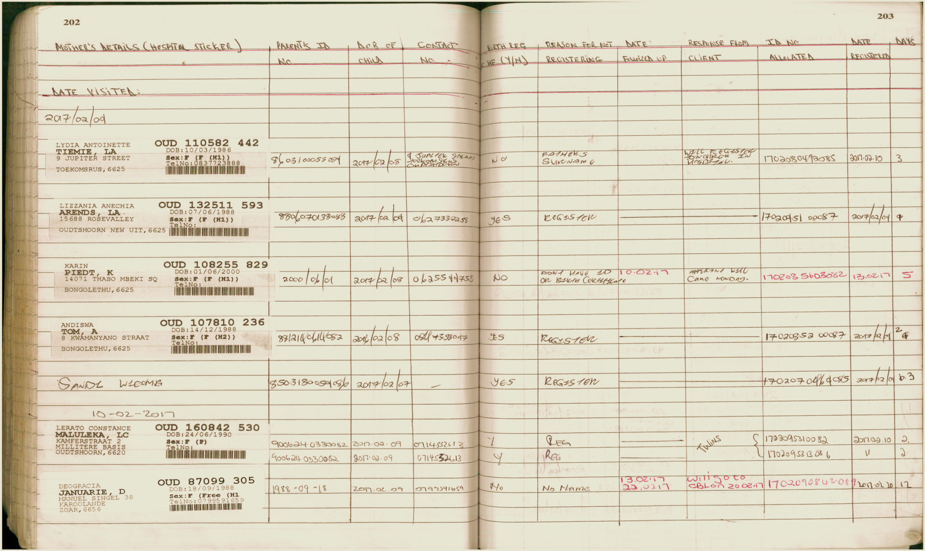
FOLLOW-UP HOSPITAL REGISTER EXAMPLE
46

Slide 48
Western Cape Birth TARGETS 2016/17 FY
During 2016/2017
Birth Registration Offices = 39% vs Birth Registration Health Facilities = 61%
Health Facilities Birth Registration 100 and less (next slide)
92% Certificates Issued
61%
Registration
39% Registration
100% Population
Note: 100% Population = Annual Target

Slide 49
Smart ID Cards issued (received at offices): Q1 2017/2018
ACHIEVED 2016/2017
Province | Provincial contribution to the APP target | T Q1 | AP Q1 | T Q2 | AP Q2 | T Q3 | AP Q3 | T Q4 | AP Q4 | Annual Performance | Annual Variance | Percentage
WC | 218,966 | 48,160 | 93,089 | 56,835 | 82,340 | 57,136 | 75,367 | 56835 | 94441 | 345237 | 126271 | 158%
WC BANKS | 0 | 0 | 162 | 0 | 304 | 0 | 459 | 0 | 985 | 1910 | 0 | -
NOT ACHIEVED Q1 2017/2018
Province | Provincial contribution to the APP target | Target | Actual Performance | Actual Performance | Variance | %
 |  | 2017/18 | Quarter 1 2016/17 | 2017/18 |  | Actual Performance
 |  | Q 1 |  | Q 1 |  | Q1
WC | 390510 | 105439 | 93,089 | 77,564 | (27,875) | 74.6%
WC BANKS | 0 | 0 | 162 | 1,041 | 0

Slide 50
Smart ID Cards issued (received at offices): Q1
Strategy implemented to achieve:
Provincial ID smart Card Champion mandated to closely monitor progress,
Resources (peripherals and computers) re-allocated from smaller offices to larger Centres,
DMOs required to report on targets and strategies to achieve during Extended Management Meetings,
Activation of Grabouw and Stellenbosch Office during Q2 and Q3 of 2017/2018,
Revisited and revised front office process flow to achieve optimum performance at high volume offices,
55 x learners (recruited through the recruitment company EOH) deployed to high volume offices within the Metro to do floor walking

Slide 51
SMART ID CARD APPLICATIONS CONTINUED
Inputs submitted i.r.o. additional resource needs to achieve the 2017/2018 target
Province was advised on 30 June 2017 that procurement process was concluded,
Equipment awaited.
Possible review of targets – due to impact of working hour negotiations (Saturdays)
(NB: without these resources the WC will not be able to achieve the target)
 |  | Additional PC
1 | Wynberg | 8
2 | Bellville | 10
3 | Malmesbury | 2
4 | Mitchells Plain | 1
5 | Worcester | 3
6 | Nyanga | 3
7 | Khayelitsha | 8
8 | Paarl | 6
9 | Cape Town | 10
10 | Somerset West | 4
11 | Ceres | 1
12 | Mosselbay | 2
13 | George | 2
 |  | 60

Slide 52
LATE REGISTRATION OF BIRTHS : CHALLENGES AND INTERVENTIONS
Challenges | Interventions
Rural/farming service areas (no transport system for communities) Poverty stricken service areas (i.e. communities not able to travel or pay R140) High illiteracy levels (i.e. citizens don’t know their ID numbers) Migration of people Smart Id Card is still voluntary | Schools informed to encourage learners to apply for ID Smart card Stakeholder platforms used to encourage communities to apply Applicants at Thusong mobile outreaches transported by provincial Department of Local Government & Housing to smartcard offices to apply Local radio station broadcasting for clients to apply and collect their smart ID cards
50

Slide 53
100% of valid invoices settled within 30 days of certification: Q1
Not achieved = 97%
Month | No of Invoices | Amount | No of invoices paid within 30 days | Amount of invoices paid within 30 days | No of invoices exceeding 30 days
Apr-17 | 47 | R 605,532.90 | 40 | R 602,863.50 | 7
May-17 | 145 | R 548,655.67 | 144 | R 536,972.16 | 1
Jun-17 | 125 | R 512,972.95 | 125 | R 512,972.95 | 0
Totals | 317 | R 1,667,161.52 | 309 | R 1,652,808.61 | 8
NOT ACHIEVED
Reasons for non achievement:
Budgets captured by the end of April 2017- Standard Chart of Accounts (SCOA V5) challenging to install on systems,
4 invoices were captured with incorrect date – corrective action implemented.
Strategy to improve performance:
Additional capacity appointed (Senior State Accountant) to improve monitoring and control over invoices

Slide 54
Performance previous financial year 2016/2017
Achieved
Month | No of Invoices | Amount | No of invoices paid within 30 days | Amount of invoices paid within 30 days | No of invoices exceeding 30 days
Apr-16 | 27 | 271,550.34 | 27 | 271,550.34 | 0
May-16 | 78 | 556,581.68 | 78 | 556,581.68 | 0
Jun-16 | 93 | 650,352.62 | 93 | 650,352.62 | 0
Jul-16 | 110 | 626,169.52 | 110 | 626,169.52 | 0
Aug-16 | 142 | 970,641.49 | 142 | 970,641.49 | 0
Sep-16 | 130 | 715,355.38 | 130 | 715,355.38 | 0
Oct-16 | 77 | 422,727.48 | 77 | 422,727.48 | 0
Nov-16 | 143 | 916,412.64 | 143 | 916,412.64 | 0
Dec-16 | 114 | 432,124.86 | 114 | 432,124.86 | 0
Jan-17 | 128 | 389,614.72 | 128 | 389,614.72 | 0
Feb-17 | 201 | 221,130.23 | 201 | 221,130.23 | 0
Mar-17 | 134 | 792,061.20 | 134 | 792,061.20 | 0
TOTALS | 1377 | 6,964,722.16 | 1377 | 6,964,722.16 | 0
During the 2016/2017 FY all invoices were paid within 30 days for 12 months.

Slide 55
Thank you
Questions & Comments

