Slide 1
Presentation to Portfolio Committee on Telecommunications and Postal Services
USAASA & USAF Performance Report - Quarter 3 of 2016/2017
15 August 2017
Lumko Mtimde
Chief Executive Officer
“Universal Access and Service to ICT for All”

Slide 2
Vision, Mission & Values
Mission:
To facilitate the rollout of adequate Information and Communication Technology (ICT) infrastructure to enable universal access to under-serviced areas in South Africa.
To facilitate ICT service to under-serviced areas and thereby contributing to the reduction of poverty and unemployment in South Africa.
To promote and pursue the goal of Universal Access and Services and contribute to the sharing and preservation of information in order to build South Africa’s sustainable knowledge society.
Values:
Batho Pele – We believe in providing excellent, efficient and effective service to all customers and stakeholders.
Integrity – We uphold high standards of trust; condemn bribery and corruption; and uphold honesty and respect in all interactions with stakeholders.
Accountability – We foster employee ownership and responsibility in ensuring quality service.
Innovation – We support employee creativity in delivering all our services.
Transparency – We encourage openness in all our activities.
Teamwork – We strive to create a harmonious work environment, where all employees and contributors are respected.
Vision:
“Universal Access and Service to ICT for All”.

Slide 3
Legislative Mandate of USAASA
NDP | In line with the NDP, USAASA through USAF projects provides broadband infrastructure and ICT connectivity in the underserved
SA Connect | Provides guidance on building an access or core network, coordinates building programmes for efficiency, and promote universal access through efficient spectrum allocation, and focuses on driving uptake and usage through the provision of affordable services and devices, using the government as an anchor tenant for the core network
SIP 15 | USAASA always ensures the alignment of the USAF projects to the SIP 15 goal of “ 100% access to digital ICTs to all South Africans by 2020 as a driver of new economic opportunities and digital equity”
USAASA Mandate Strive to promote the goal of universal access and universal service. Make recommendations to enable the Minister to determine what constitutes universal access, universal service and under-serviced areas. Conduct research into and keep abreast of ICT trends. Survey and evaluate extent of achievement of Universal Service & Universal Access. Make policy recommendations to Minister and Regulator. Continuously evaluate effectiveness of ECA in respect of achieving Universal Service & Universal Access. Manage the Universal Service and Access Fund (USAF) Competitive tender for Universal Service & Access projects in under-serviced areas in order to roll out infrastructure and services by the licensees |  |  | MTSF Outcome |  |  | 9 Point Plan
 |  |  | Outcome 1 | Quality basic education |  | Applicable to broadband roll-out. Nr 7. Unlocking potential of SMME’s; Cooperatives; townships and rural enterprises Nr 8. Reform & boosting of the role of SOE’s ICT or broadband infrastructure rollout
 |  |  | Outcome 2 | A long and healthy life for all
 |  |  | Outcome 3 | Decent employment through inclusive economic growth
 |  |  | Outcome 4 | Skilled and capable workforce to support an inclusive growth path
 |  |  | Outcome 5 | An efficient, competitive and responsive economic infrastructure network
South Africa Connect Policy Target |  |  | International Measurements
Broadband access in Mbps user experience |  | 90% at 5Mbps 50% at 100Mbps | WEF Ranking = 48 (70) World Economic Forum Global Competitiveness Index 2016-2017 |  | ITU Ranking 88 ICT Development Index 2016

Slide 4
USAASA Performance against Corporate Plan KPIs
Seven (7) KPIs have been achieved during the third quarter period and Three (3) KPI are delayed target and Targets were as set out in the diagram and table below.
Strategic Objectives | KPI | Annual Target | Q3 Target | Actual Performance | Outcomes | Variance Explanation
Optimise organisational efficiency by 2021 to support the project delivery of the Universal Service Fund | Human capital training and development programmes aligned to organisational strategy | Implement the organisational Work Skills Plan (WSP) | Implement the Work Skills Plan (WSP) interventions to address identified skills gaps | Round Table Clean Audit planned training was implemented in terms of the WSP | Achieved | The target was achieved as planned
Optimise organisational efficiency by 2021 to support the project delivery of the Universal Service Fund | Optimally functional Human Resources policies and systems aligned to organisational strategy | Review and implement functional human resources policies | Review Performance & Progression policy | The Performance & Progression policy was still in a draft format at the end of the quarter under review | Not achieved | Performance & Progression policy had not yet been approved by the Board as planned in the 3rd quarter
Optimise organisational efficiency by 2021 to support the project delivery of the Universal Service Fund | Optimally functional Human Resources policies and systems aligned to organisational strategy | Develop and Implement an HR Service Level Agreement (SLA) | Monitor and report on SLA implementation | HR SLA was not implemented during the quarter under review | Not achieved | The Human Resources (HR) SLA was approved by the Board on way of a round robin passed between the 22nd December 2016 and the 29th December 2016, implementation thereof will commence in the last quarter of the financial year

Slide 5
USAASA Performance against Corporate Plan KPIs
Strategic Objectives | KPI | Annual Target | Q3 Target | Actual Performance | Outcomes | Variance Explanation
Ensure availability of automated and integrated business processes by 2021 to support the project delivery of the Universal Service Fund | Automated and integrated business processes | ERP system rollout an SAP capacity building | ERP System maintenance and support | The delayed targets of Quarter 1 (ERP system Go-Live) were achieved in Quarter 3. Subsequently, the Q2 & Q3 targets for ERP support and maintenance were also achieved. This support and maintenance are for all SAP ERP systems in Dev, QA, & Production. | Achieved | The target was achieved as planned
Ensure availability of automated and integrated business processes by 2021 to support the project delivery of the Universal Service Fund | Automated and integrated business processes | ERP system rollout and SAP capacity building | Capacitation of IT human resources through training on SAP Critical skills | IT Human Resources capacitated through SAP Technical Training during Quarter 3 | Achieved | The target was achieved as planned
Ensure availability of automated and integrated business processes by 2021 to support the project delivery of the Universal Service Fund | Percentage availability of business systems to support USAASA and USAF business processes and operations | 98.5% availability of business systems in line with the approved IT Service Level Agreement (SLA) | Monitor and Report on percentage availability of business systems | Actual percentage availability of business systems is 99.% | Achieved | The target was achieved as planned
*Provide legally sound services to the Agency by 2021 to support the project delivery of the Universal Service and Access Fund | Number of days for providing **legal services in accordance with relevant legislation and policy | Ensure sound legal services are provided to the Agency | Promote legal compliance by providing written legal opinions and/or advice within 7 working days and drafting contracts with 21 working days from date of receipt of all relevant information | Written legal opinions and/or advice within 7 working days and drafting contracts with 21 working days | Achieved | The target was achieved as planned

Slide 6
USAASA Performance against Corporate Plan KPIs
Strategic Objectives | KPI | Annual Target | Q3 Target | Actual Performance | Outcomes | Variance Explanation
USAASA established as a centre of excellence for universal access and universal service market information, knowledge and expertise by 2021 | Information on impact of the provision of universal access and universal service | Monitor and evaluate the impact of universal access and universal service provision on access gaps and disseminate the findings | Consolidated impact assessment report developed on the six (6 identified USAF subsidised local municipal areas developed and presented to key stakeholders | Consolidation of impact assessment report on the six (6 identified USAF subsidised local municipal areas was not done end of the 3rd quarter | Not Achieved | The process of data analysis had not started as at the end of the quarter
Positioning the Agency as a focal point for universal service and access to ICT | Positive messages about the Agency on media and social platforms | Implementation of the Stakeholder Engagement Strategy and Integrated Communications Policy | Implementation of the Stakeholder Engagement Strategy and Integrated Communications Policy | The Agency participated in four BDM Imbizo projects through Interviews, Branding and Exhibition in Limpopo, Free State and KZN. USAASA also participated stakeholder in (buy-in) engagement meetings through the Broadband project that is being rolled out in the OR Tambo District Municipality in the Eastern Cape. Buy-in meetings with Municipal managers for the District, as well as the (School) Principals forum: the Qumbu District were conducted during the quarter under review | Achieved | The target was achieved as planned

Slide 7
USAASA Performance against Corporate Plan KPIs
Strategic Objectives | KPI | Annual Target | Q3 Target | Actual Performance | Outcomes | Variance Explanation
Promotion of legal and regulatory compliance by 2021 to support the project delivery of the Universal Service and Access Fund | Clean administration in compliance with applicable legal and regulatory prescripts | Compliance with the Public Finance Management Act (PFMA) and Treasury Regulations Checklist for Public Entities | Monitor and report on organisational compliance with the PFMA and Treasury Regulations Checklist for Public Entities | PFMA and Treasury Regulations Compliance Checklist updated for Quarter 3 | Achieved | The target was achieved as planned

Slide 8
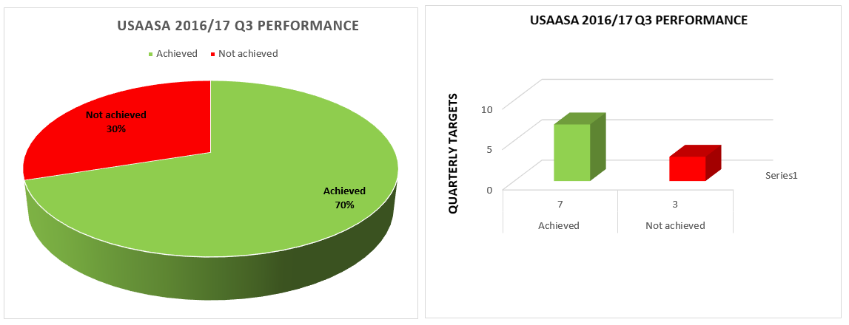
Summary of USAASA 2016/17 Performance
USAASA Q3 Performance Outcomes
7 of the 10 planned Q3 targets were achieved, being 70% of the total planned targets
3 of the 10 planned Q3 targets were not achieved, being 30% of the total planned targets

Slide 9
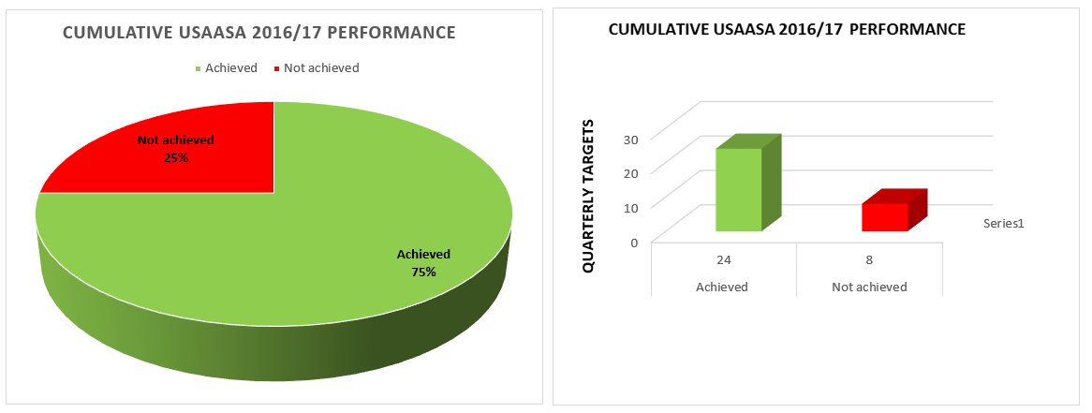
Cumulative USAASA 2016/17 Performance
USAASA Cumulative Performance Outcomes:
24 of the 32 planned targets were achieved, being 75% of the total planned targets
8 of the 32 planned targets were not achieved, being 25% of the total planned targets

Slide 10
USAASA Labour Environment as at the end of Q3 2016/17
USAASA had 56 permanent employees and 4 interns as at the end of the quarter
Appointments
None
Terminations
Two resignations, one at executive management level and one at senior management level
One retirement at skilled level
Consequence Management
Non performance – three written warnings at executive management level
Insubordination – one suspension at senior management level
Breach of internal controls – one suspension/resignation at executive management level and one suspension at qualified professional level

Slide 11
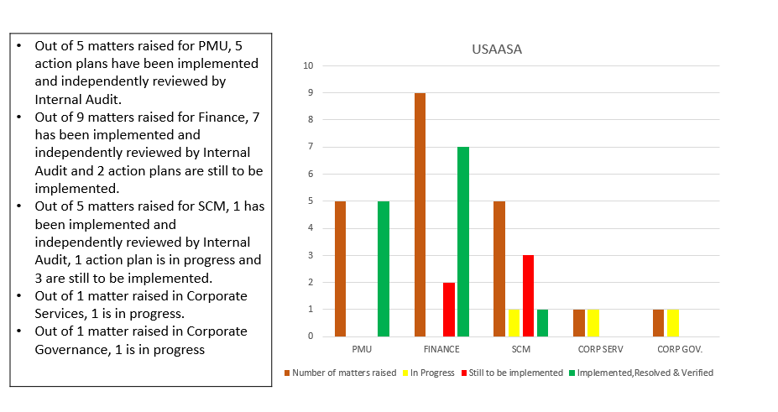
AUDITOR GENERAL implementation action plan

Slide 12
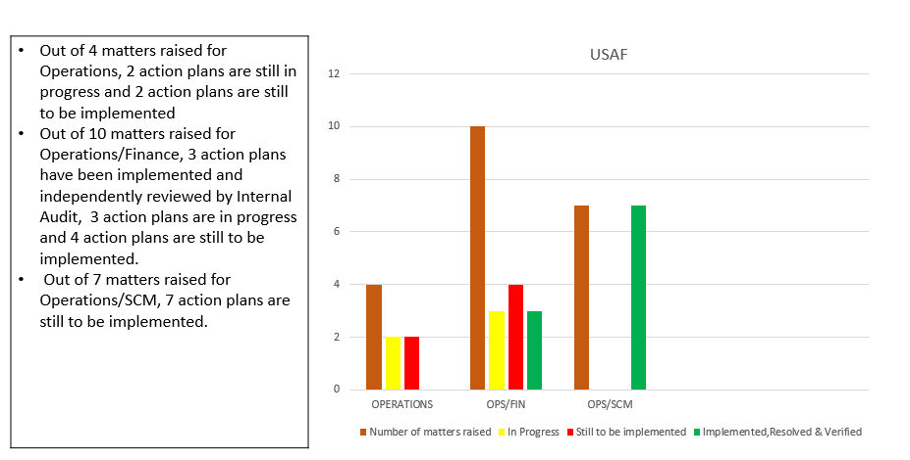
AUDITOR GENERAL implementation action plan

Slide 13
USAASA 2016/17 Quarter 3 Budget Performance - Revenue
Description | Annual Budget Income (R’000) | Budget Q3 Income (R’000) | Q3 Income (R‘000)
Revenue
Other Income -Interest, levies & tenders | - | - | 2 530
Transfers
USAASA Operations | 69 045 | 17 261 | 17 261
Total revenue | 69 045 | 17 261 | 19 791
USAASA 2016/17 Quarter 3 Budget Performance - Expenditure
Description | Annual Budget (R’000) | Q3 Budget (R’000) | Q3 Actual Spending (R‘000) | Quarter Variances (R‘000) | Quarter % Spent
Expenditure
Compensation of employees | 43 713 | 10 928 | 10 487 | 441 | 96%
Goods and services | 24 218 | 6 333 | 6 141 | 192 | 97%
Depreciation | 0 | 0 | 773 | -773
Other Capex | 1 114 | 0 | 0 | 0 | 0%
Total | 69 045 | 17 261 | 17 401 | -140 | 101%
USAASA Approved Retention of 2015/16 Unspent funds
Description | Total Budget (R’000) | Q3 Actual Spending (R‘000) | Annual Spent to date | Available Budget | Annual % Spent
BDM Distribution & Logistics | 131 189 | 19 989 | 48 230 | 82 959 | 37%
Enterprise Resource Planning (ERP) | 25 063 | 2 975 | 2 975 | 22 088 | 12%
Total | 156 252 | 22 964 | 51 205 | 105 047 | 33%

Slide 14
USAASA 2016/17 Quarter 3 Budget Performance - Expenditure

Slide 16
USAF Performance against Corporate Plan KPIs
Strategic Objectives | KPI | Annual Target | Q3 Target | Actual Performance | Outcomes | Variance Explanation
To provide access to ICT services in 6 identified under-serviced areas by 2021 as part of implementing the South Africa Connect digital development strategic pillar in support of the National Development Plan | Accessible broadband network coverage in identified underserviced areas | 02 under-serviced local municipality broadband projects initiated & completed in the OR Tambo District Municipality in the Eastern Cape | Last mile connection for Mhlontlo and King Sabata Dalindyebo local municipalities in the OR Tambo District | Equipment for base stations has been procured and delivered. However connectivity has not been provided | Not achieved | Connectivity was not in place as yet as base stations were yet to be installed
To facilitate the broadband connectivity of educational institutions, primary health care facilities and government institutions by 2021 | Number of existing broadband network connections maintained in educational institutions, primary health care facilities and traditional ICT centres | Maintain broadband network connectivity in 127 schools, 93 clinics and 38 traditional ICT centres in compliance with Section 88 of the Electronic Communications Act,2005 | Broadband network connectivity maintained in 127 schools, 93 clinics and 38 traditional ICT centres | Only Usage at 32 sites was remotely monitored and the remaining sites were physically checked on an ad hoc basis | Not achieved | Usage reports were only provided for the 32 sites. The contracts for some sites have since come to an end during the third quarter

Slide 17
USAF Performance against Corporate Plan KPIs
Strategic Objectives | KPI | Annual Target | Q3 Target | Actual Performance | Outcomes | Variance Explanation
To fund digital television access equipment for qualifying TV-owning needy households by 2021 | Number of set-top boxes & antennas procured and installed for qualifying needy TV-owning households | 58 460 Set-Top Boxes & antennas procured and installed for qualifying needy TV-owning households | 14 615 Set-Top Boxes & antennas procured and installed for qualifying needy TV-owning households | 8 477 set top boxes & antennas installed for qualifying needy TV-owning households during the quarter under review | Not achieved | 8 477 out of the targeted 14 615 STBs and antennae installed, which equates to 58% of the quarterly target. The focus has been in the SKA area. A total of 50 282 registrations have taken place nationally. To date 27 196 installations have been allocated to the installers with 25 165 installations completed. The installation completion percentage is 92.53%

Slide 18
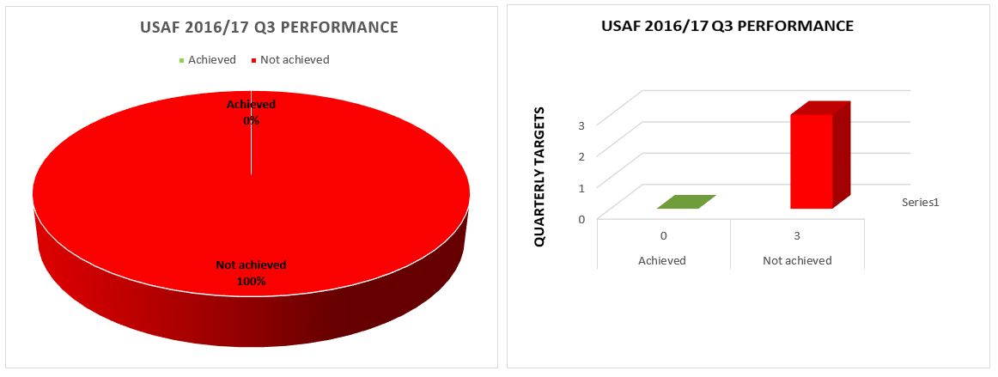
Summary of USAF 2016/2017 Performance
USAF Operations Q3 Performance Outcomes:
0 of the 3 planned Q3 targets were achieved, being 0% of the total planned targets
3 of the 3 planned Q3 targets were not achieved, being 100% of the total planned targets

Slide 19
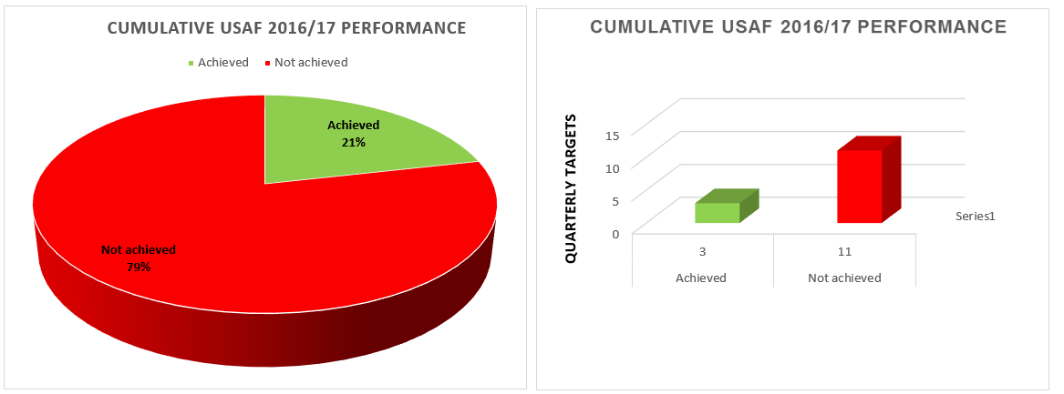
Cumulative USAF 2016/2017 Performance
USAF Operations Cumulative Performance Outcomes:
3 of the 14 planned targets were achieved, being 21% of the total planned targets
11 of the 14 planned targets were not achieved, being 79% of the total planned targets

Slide 20
USAF 2016/17 Quarter 3 Budget Performance – Revenue
Description | Annual Budget Income (R’000) | Quarter 3 Budget Income (R’000) | Income (R‘000)
Revenue
Other Income (Interest) | - | - | 27 485
Transfers | 644 540 | 162 577 | 162 577
Total revenue | 644 540 | 162 577 | 190 062
USAF 2016/17 Quarter 3 Budget Performance - Expenditure
Description | Annual Budget | Quarter 3 Budget (R’000) | Actual Q3 Spending (R‘000) | Quarter 3 Variances (R‘000) | Quarter 3 - % Spent
Broadband Infrastructure | 32 634 | 9 600 | 4 435 | 5 165 | 46%
STB Subsidies for BDM | 589 384 | 147 346 | 28 201 | 119 145 | 19%
Rapid Deployment & Connectivity | 18 776 | 4 694 | 2 371 | 2 323 | 51%
Bank Charges & Audit Fees | 996 | 249 | 52 | 197 | 21%
Project Costs | 2 750 | 688 | 1 102 | -414 | 160%
Total | 644 540 | 162 577 | 36 161 | 126 416 | 22%

Slide 21
USAF 2016/17 Quarter 3 Budget Performance - Expenditure

Slide 22
THANK YOU ☺

